Slide 1
ROLE-BASED ACCESS CONTROL (RBAC)
REDESIGN FOR
LEAST PRIVILEGE
ROLE-BASED ACCESS CONTROL (RBAC) REDESIGN FOR LEAST PRIVILEGE
2400090241 - K. GANESH SAI VENKAT
2400090233- V. PAVAN MANIDHAR
2400090237- CH. SRI PAVANI SRUTHI
2400090243- G. SAI RITHIKA

Slide 2
Four Objectives
Implement least-privilege access
Reduce unauthorized access
Give users only the access they need to complete their work.
Prevent users from reaching systems or data outside their responsibilities.
Define roles and permissions clearly
Improve security and access management
Match each role with clear responsibilities and approved permissions.
Make access easier to control, review, update, and audit.

Slide 3
Access Request Flow
Start
Submit access request
Authenticate user
Identify role
Permission required for role?
YES
NO
Grant minimum necessary access
Deny request
Access resource
Notify requester
Record audit log
Stop

Slide 4
Redesign Process
1
Identify Users and Resources
Identify users, their roles, and the resources they need to access.
2
Define Required Roles
Create roles based on users’ responsibilities and job requirements.
3
Assign Minimum Necessary Permissions
Give each role only the permissions required to perform its tasks.
4
Monitor and Review Permissions Regularly
Regularly review, update, and remove unnecessary permissions.
5
Verify Access Requests
Check and approve access requests according to the user’s role and requirements.

Slide 5
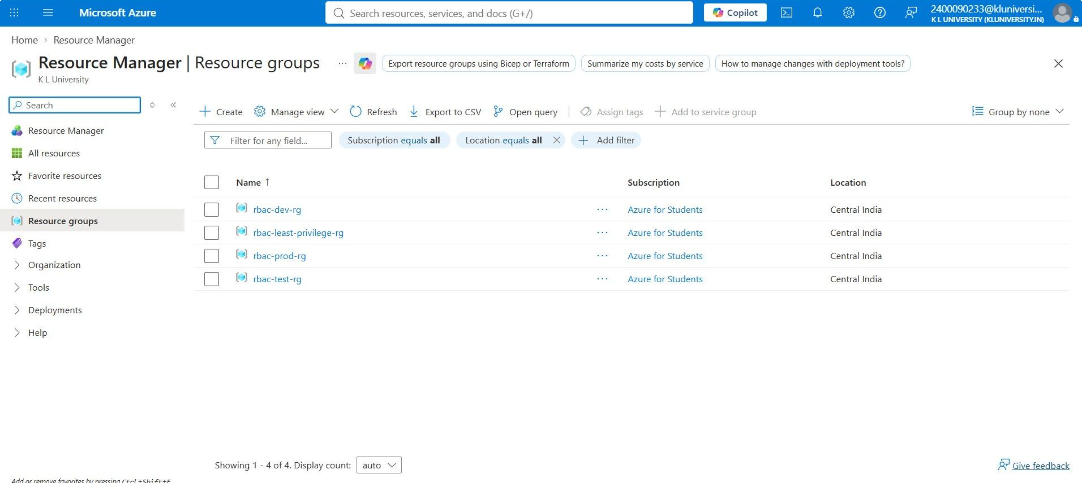

Slide 6
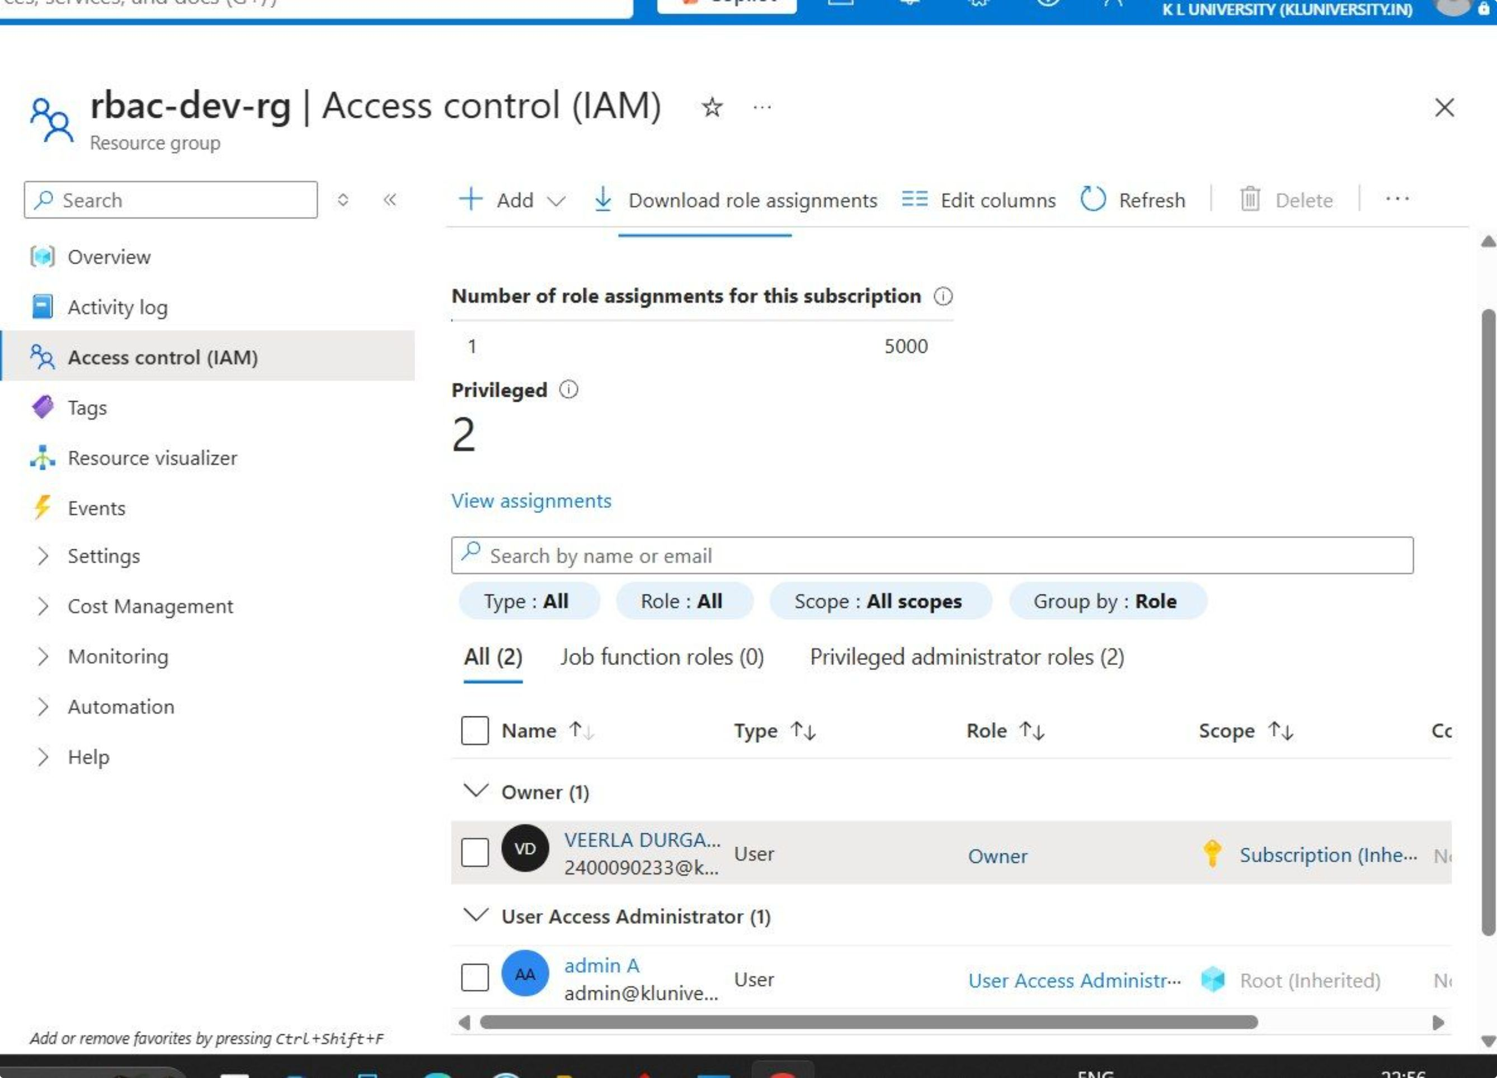

Slide 7
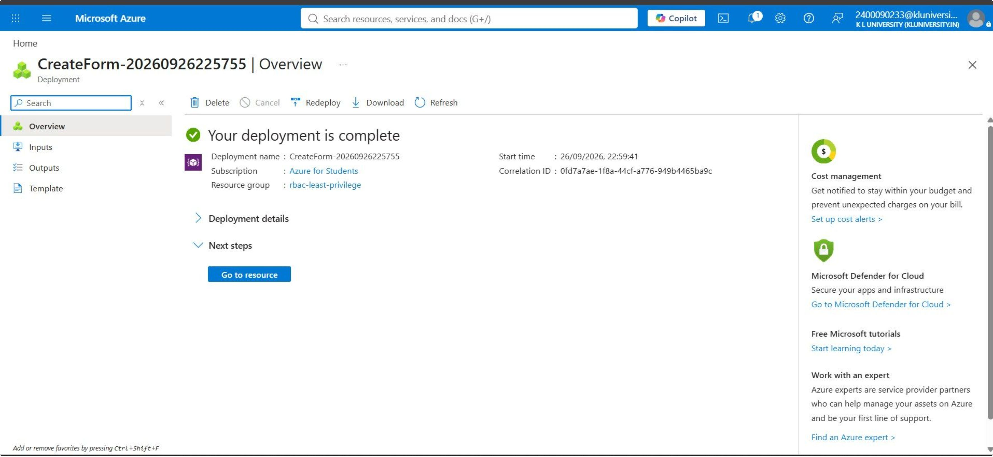

Slide 8
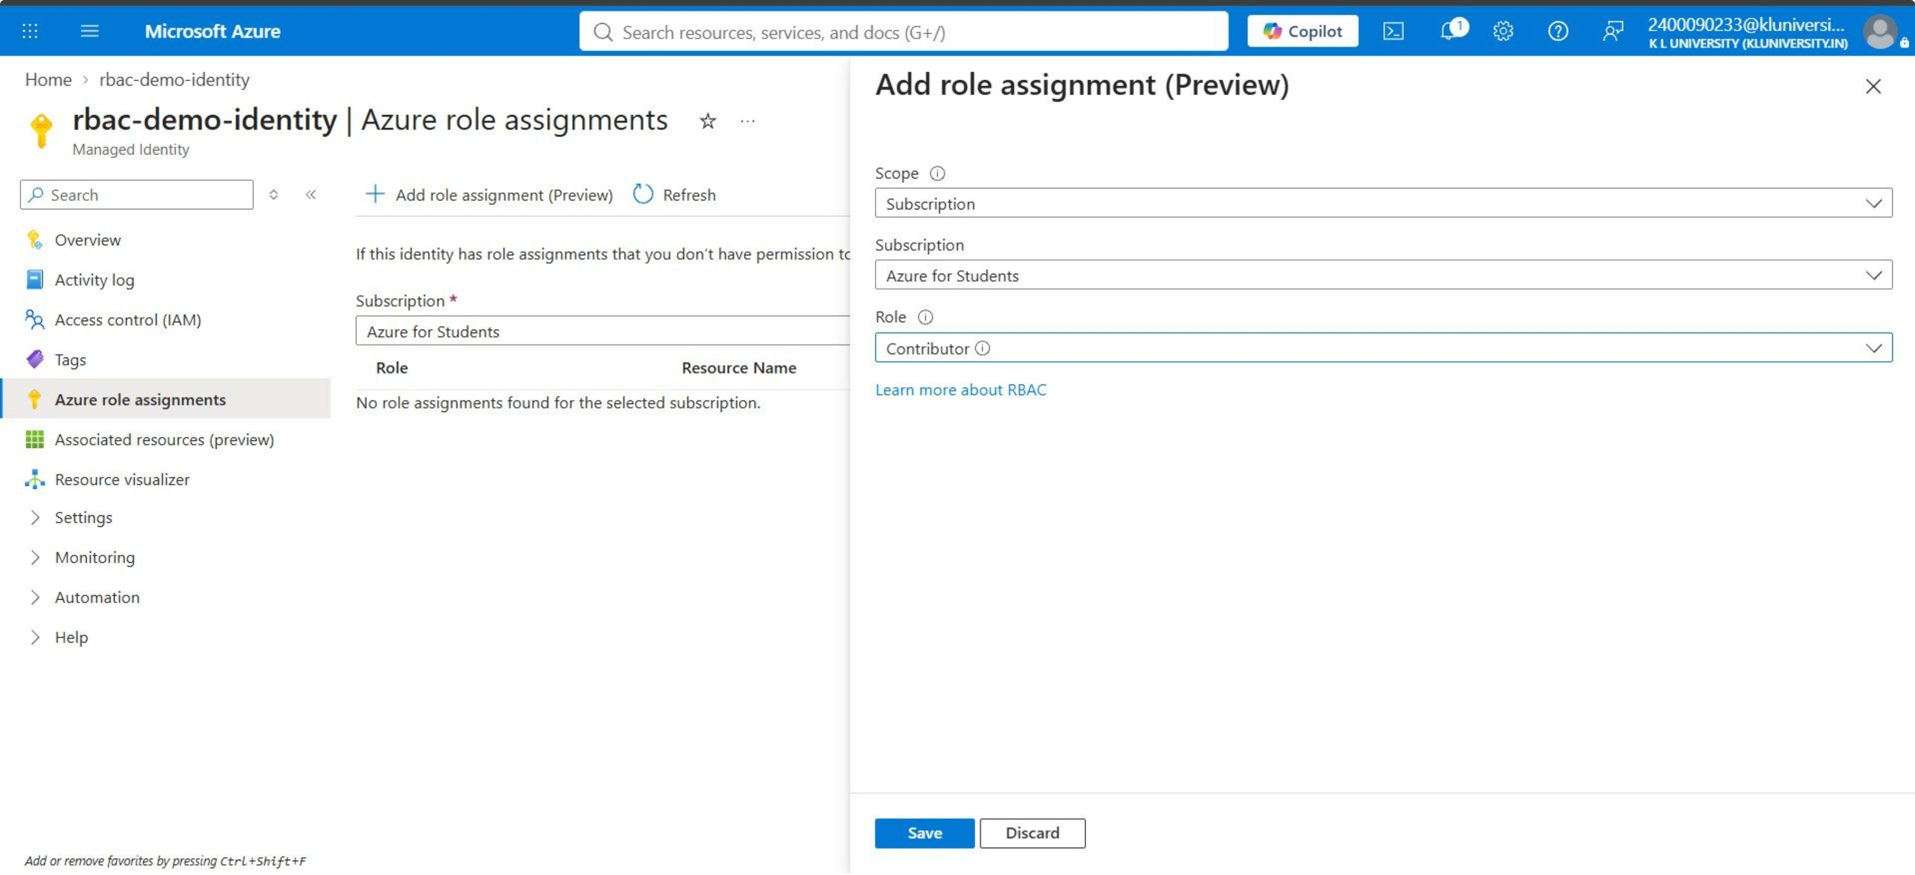

Slide 9
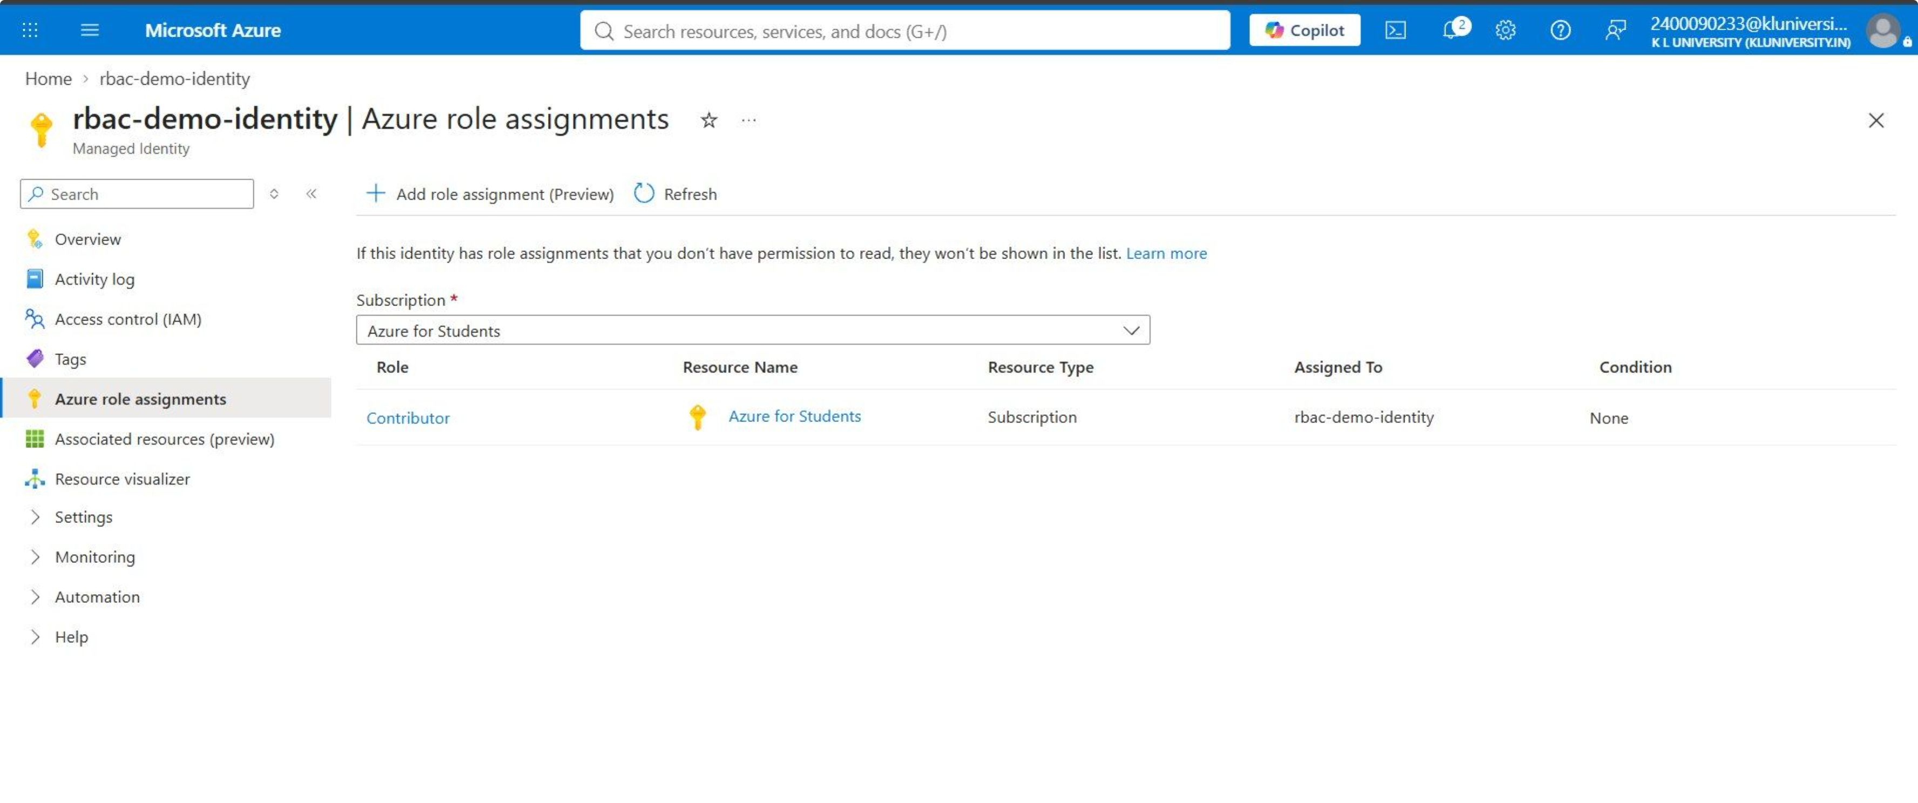

Slide 11
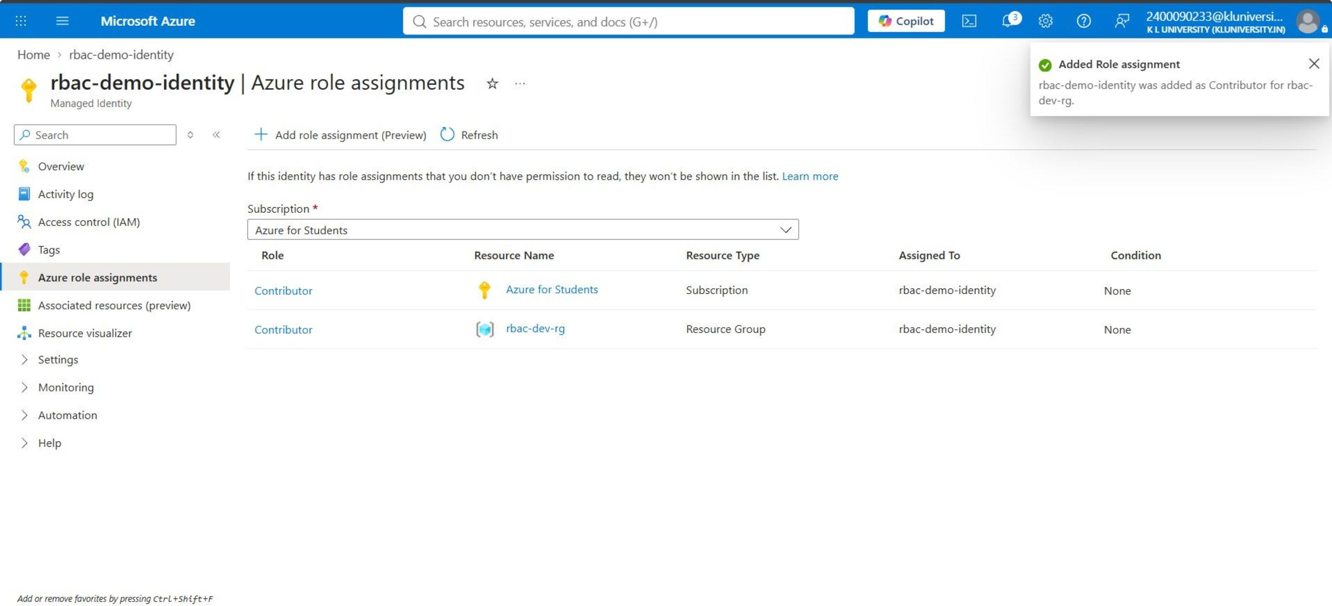

Slide 12
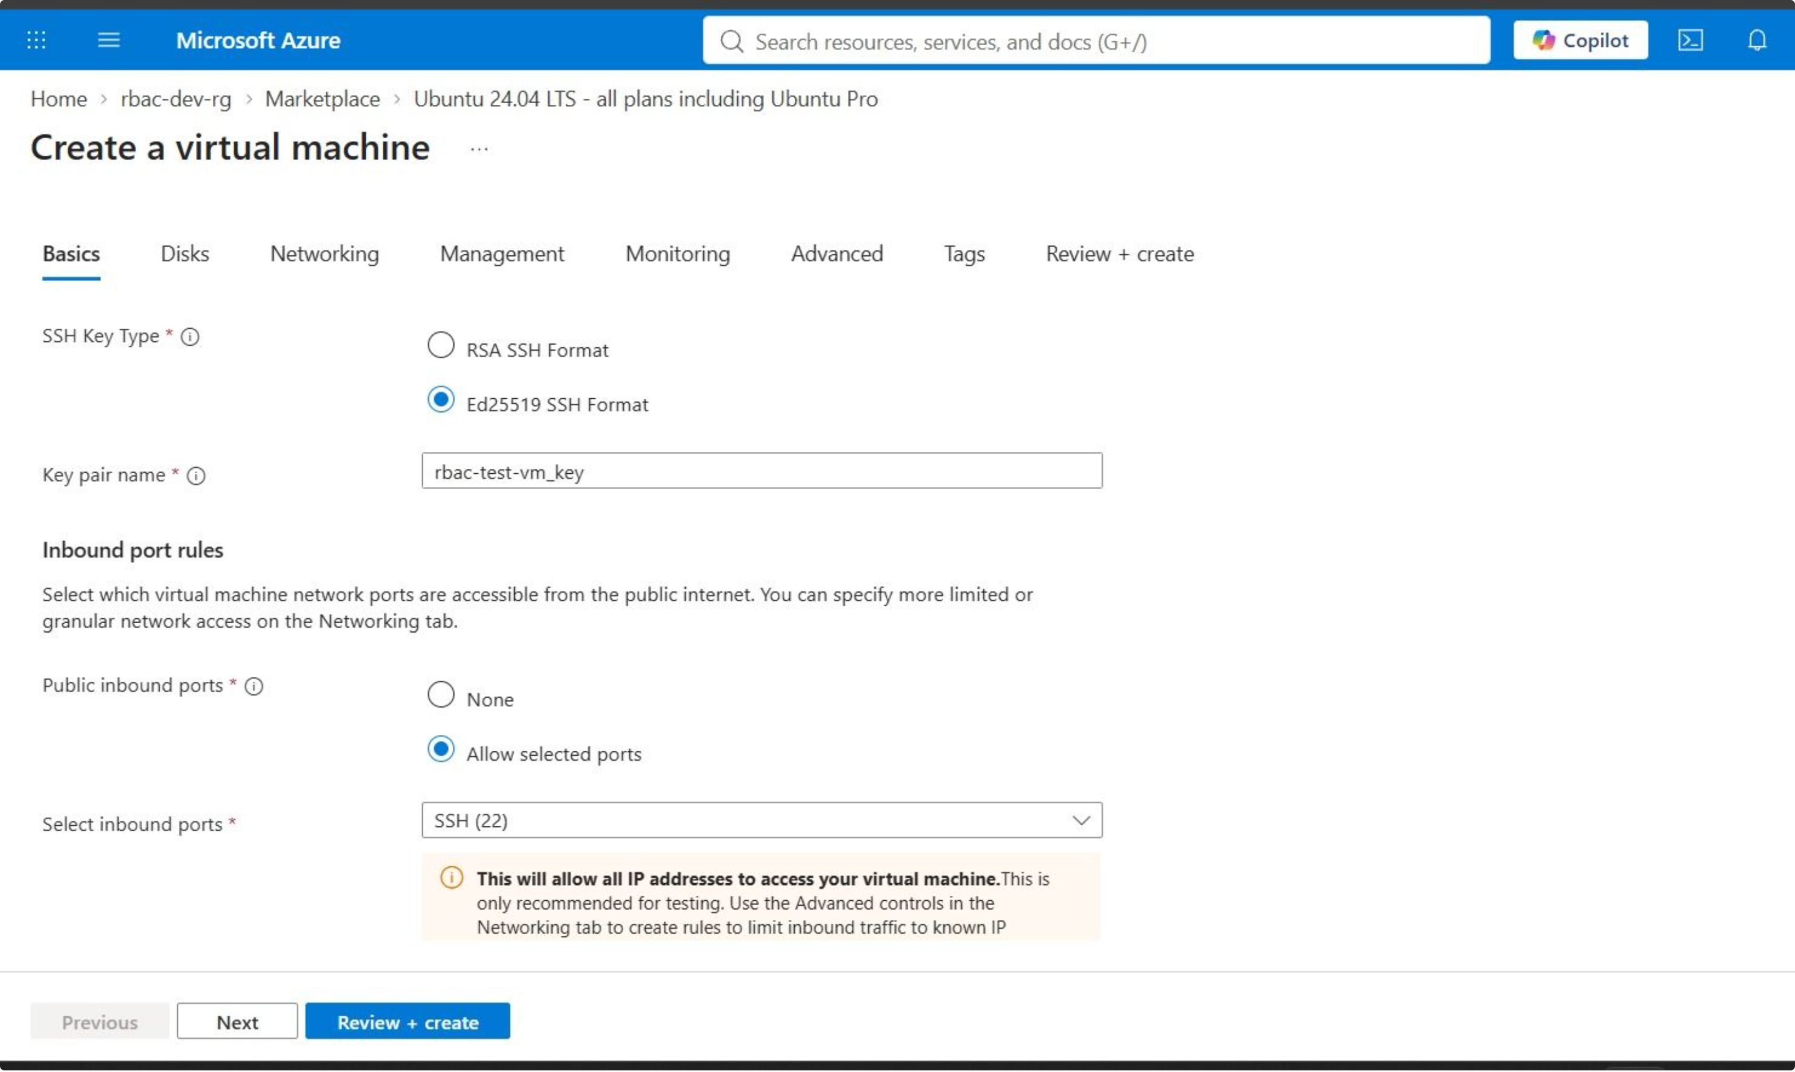

Slide 13
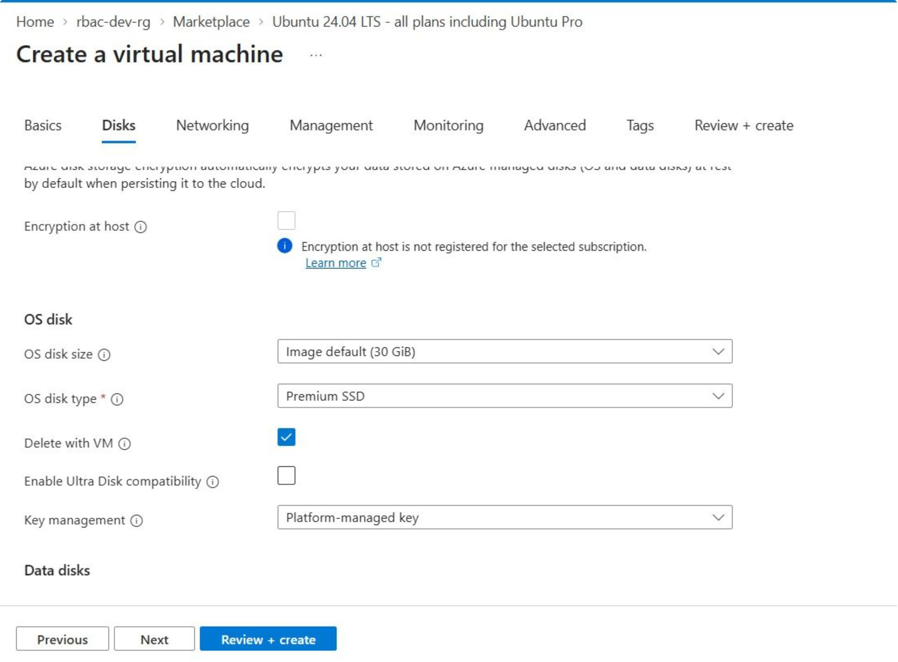

Slide 14
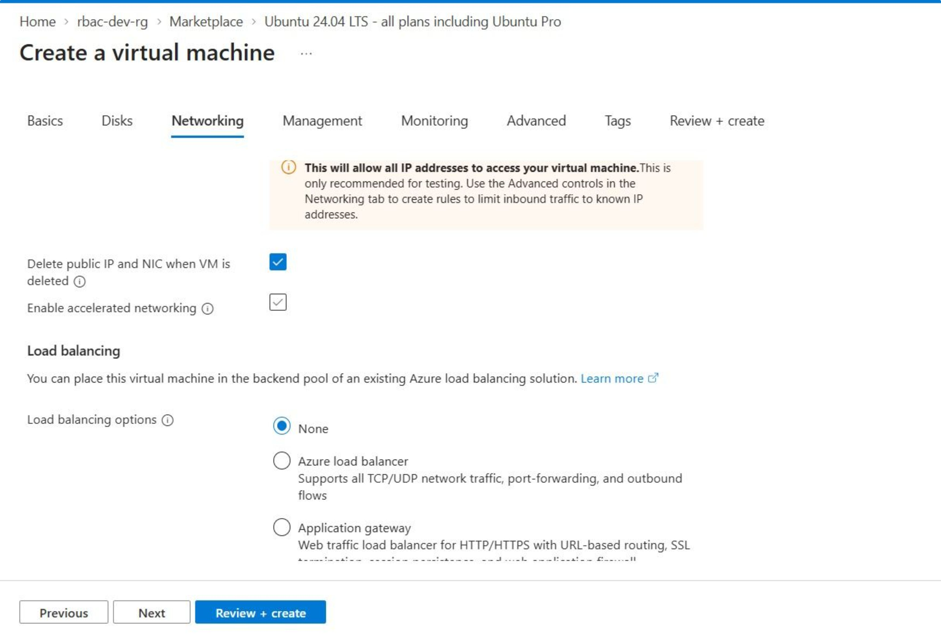

Slide 15
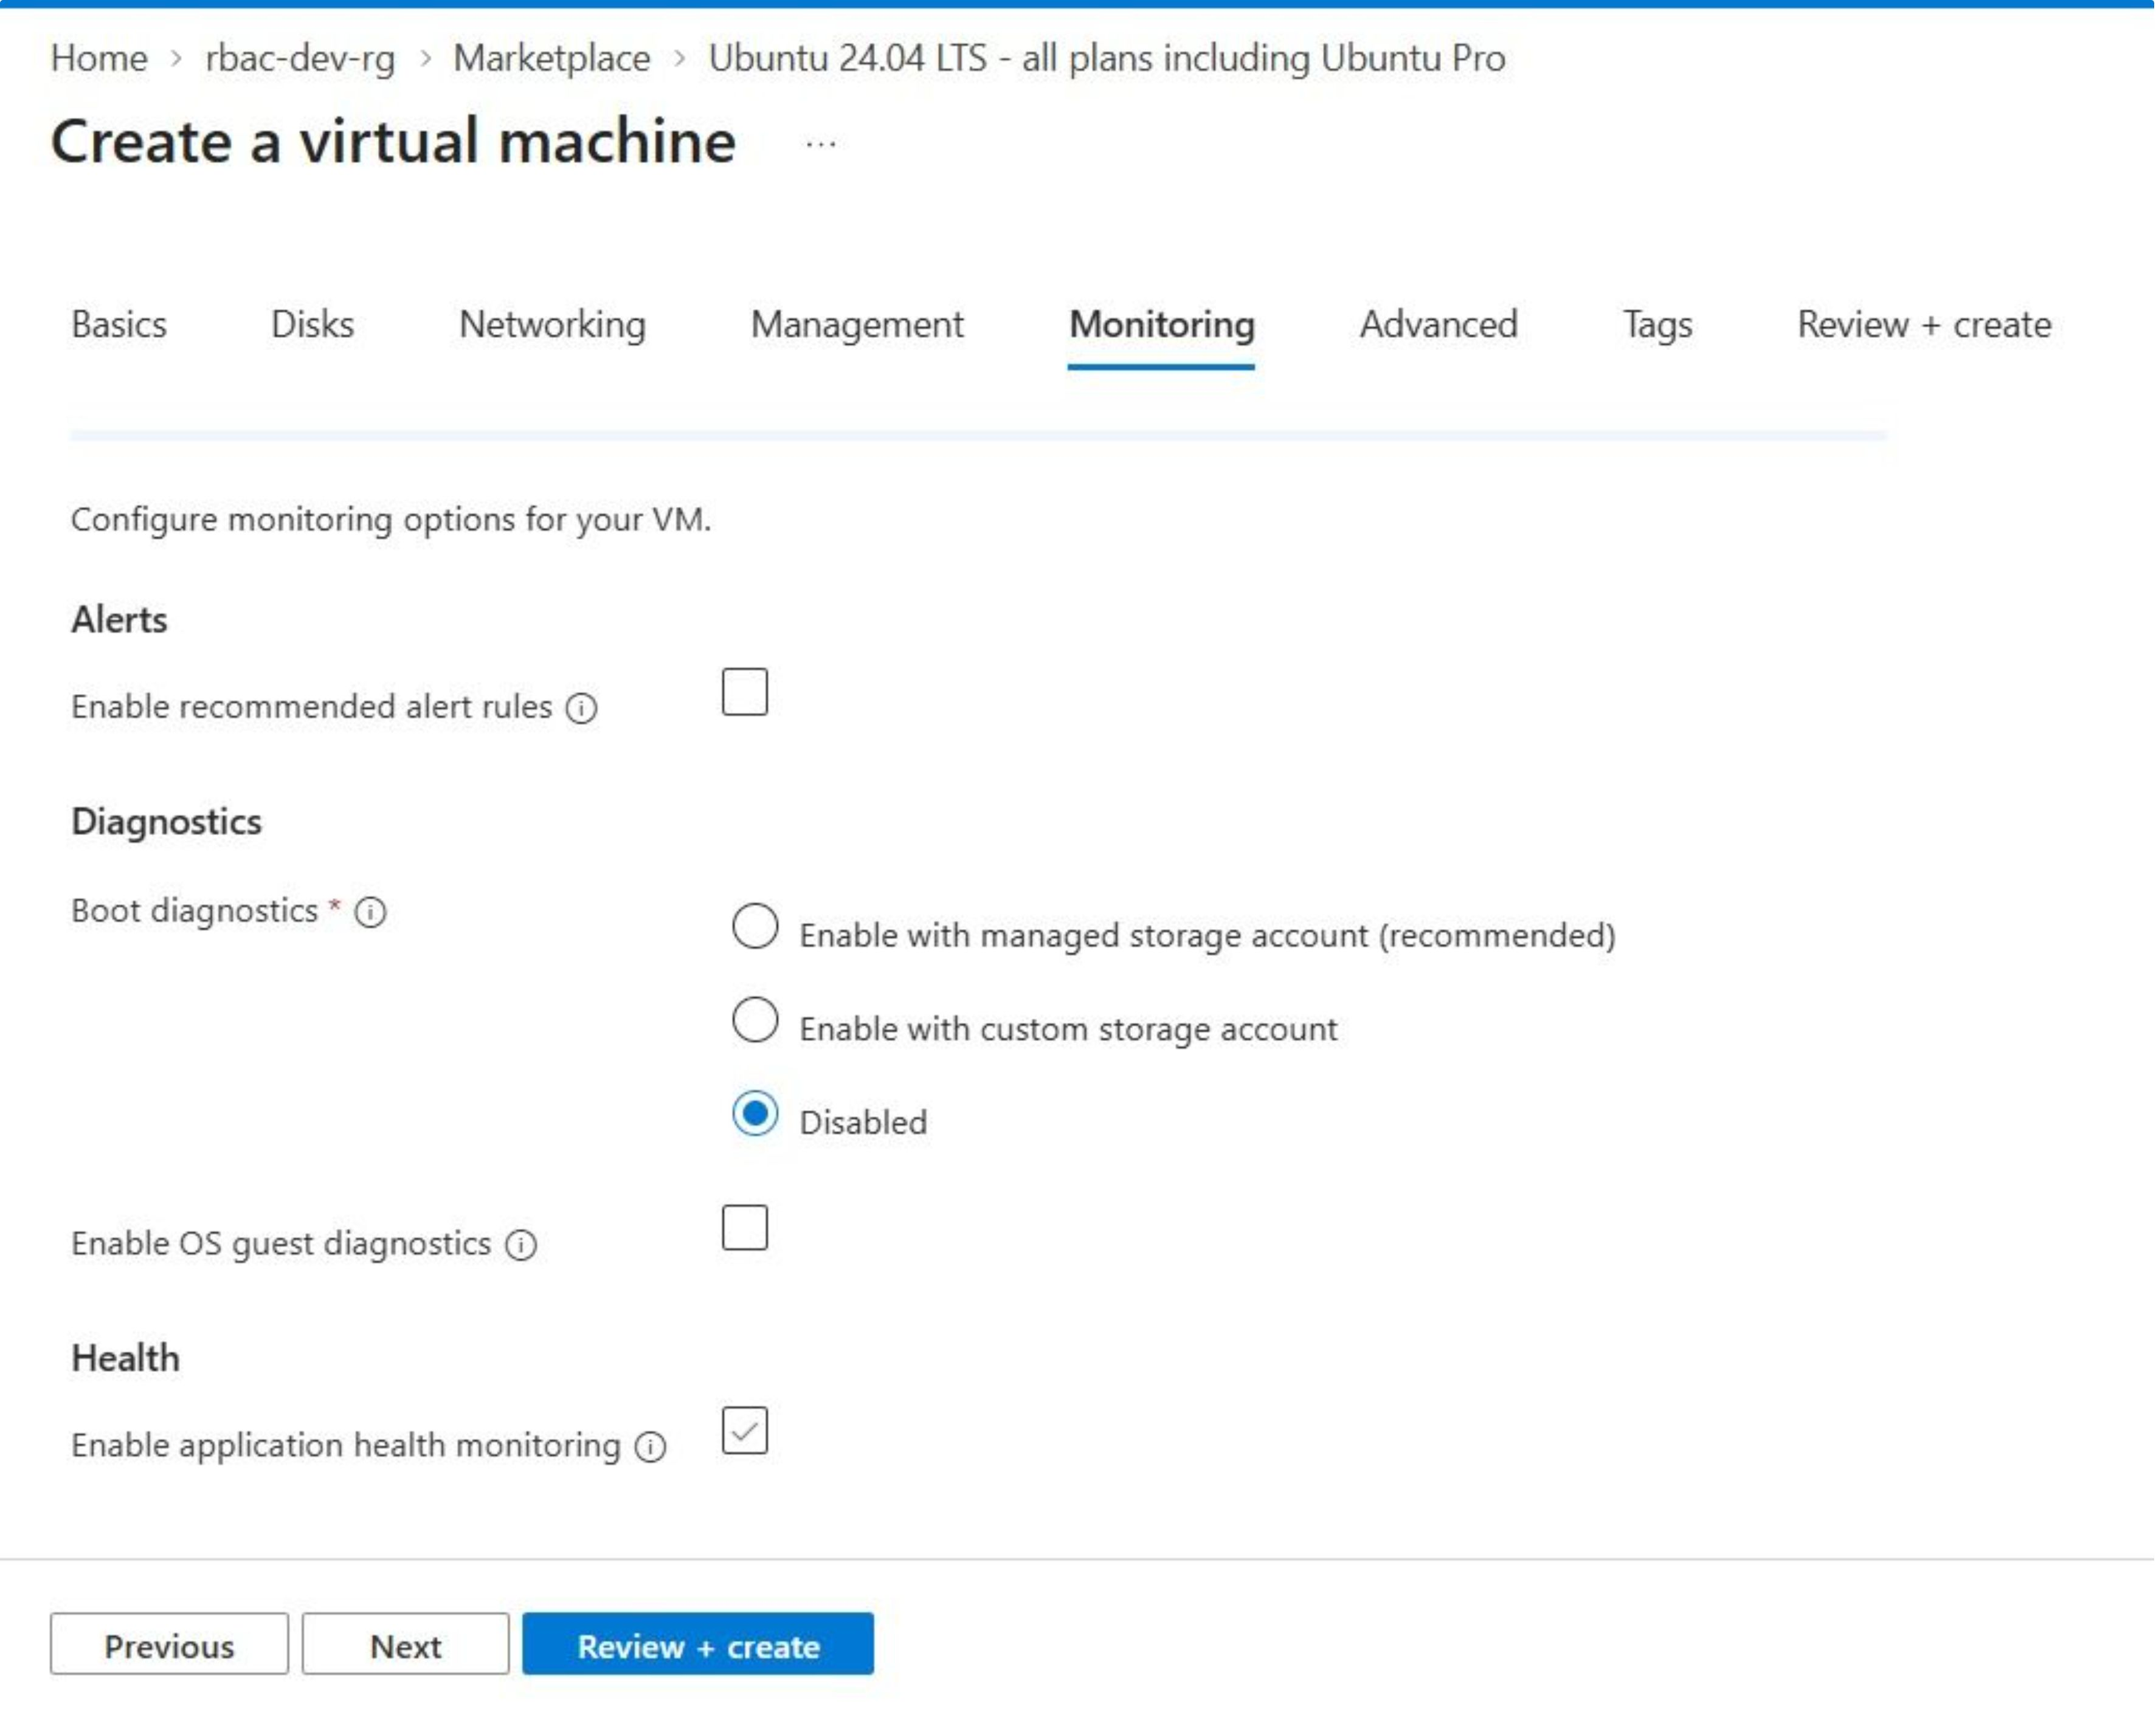

Slide 16
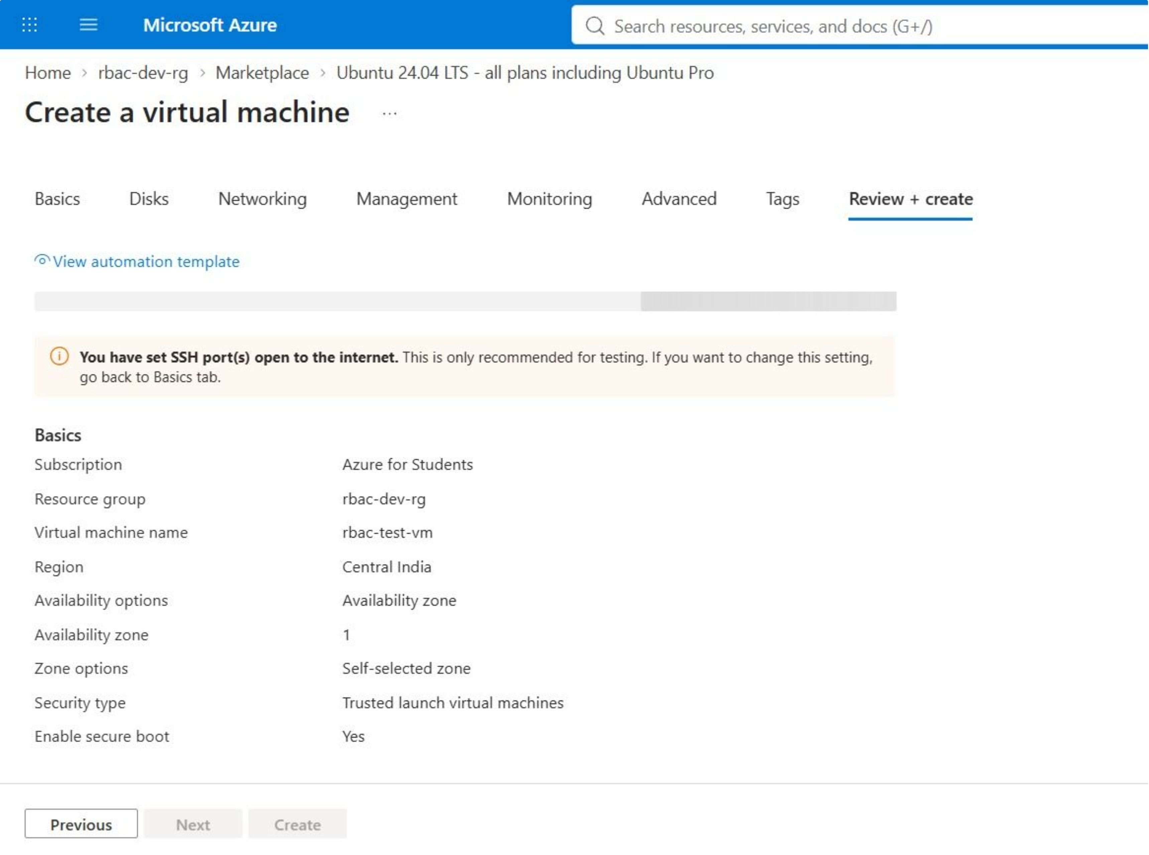

Slide 17
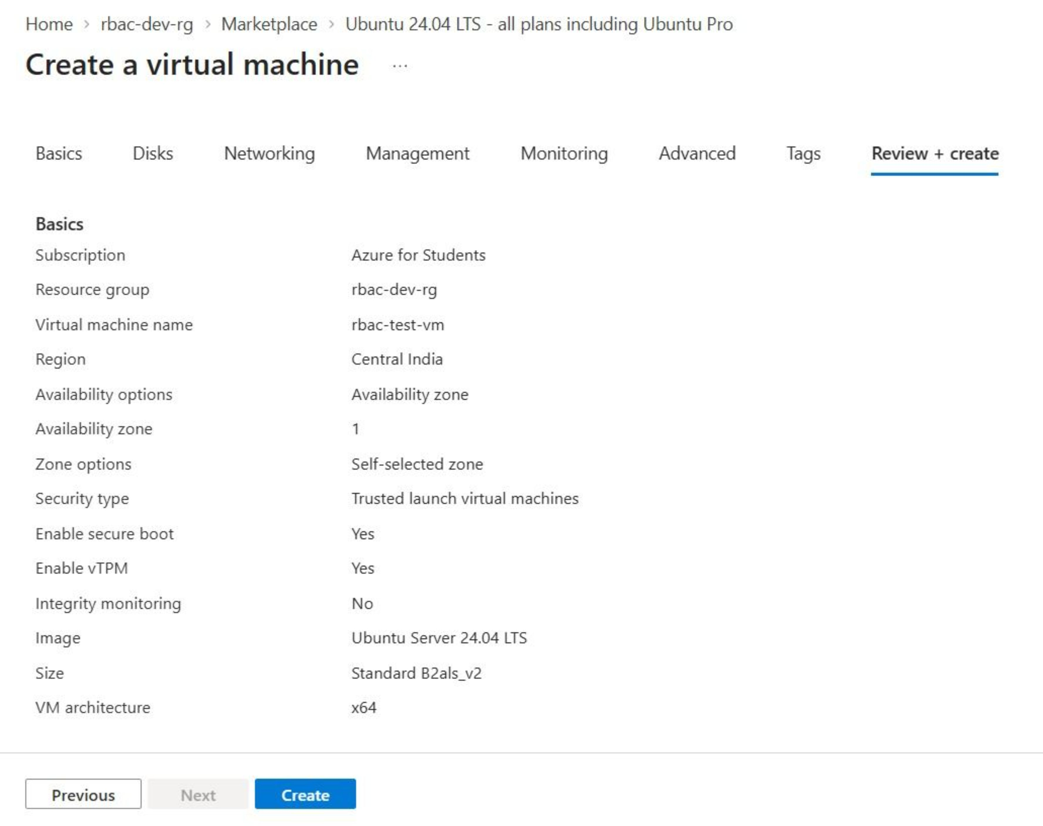

Slide 18
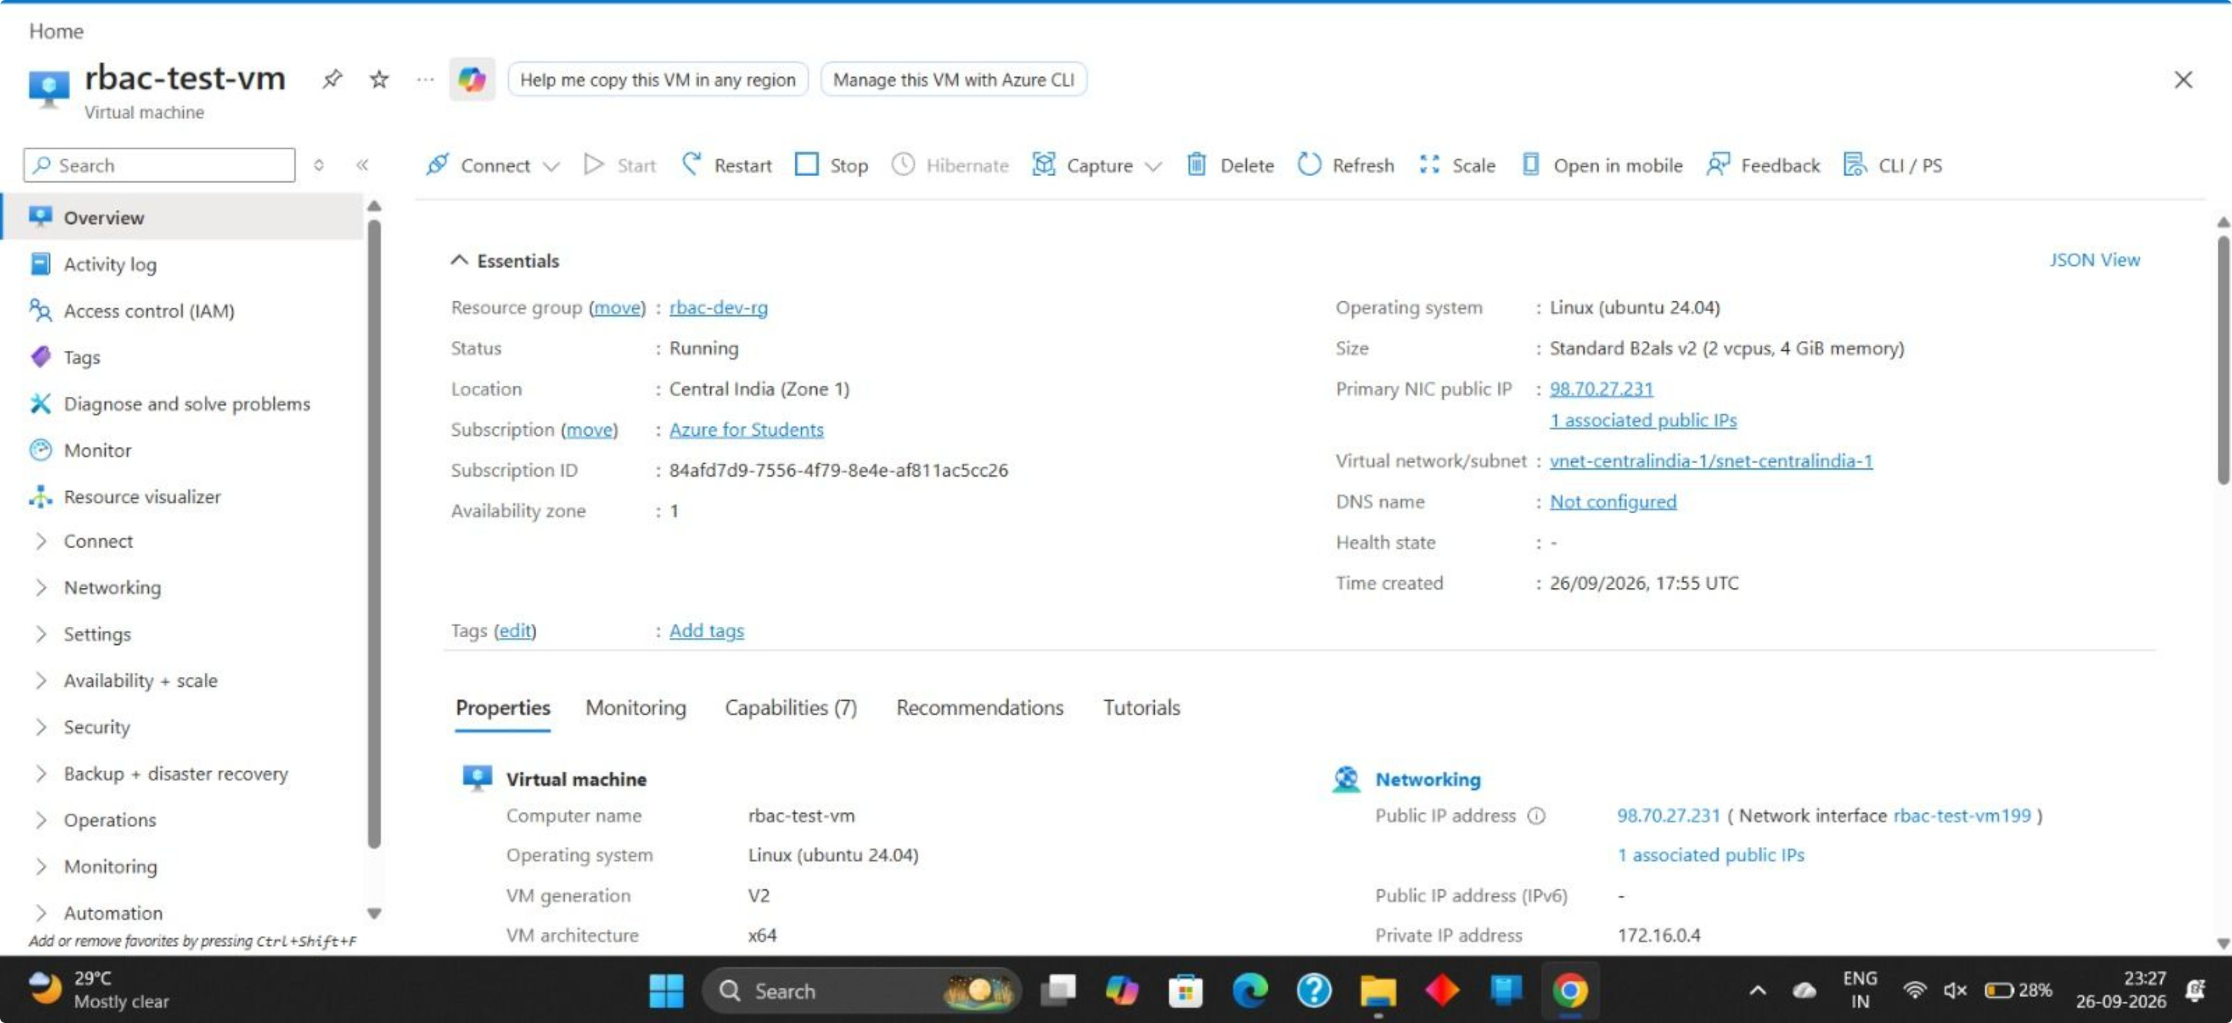

Slide 19
Conclusion
RBAC simplifies access management.
Least privilege reduces unnecessary permissions.
Regular access reviews help maintain security.
The redesigned system provides controlled and auditable access.

