Slide 1

Department of CSE, School of CS&AI, SR University
Course Code | Course Title | L | R | P | Cr
23CA201SE402 | EXPLAINABLE AI | 2 | 0 | 2 | 3
Specialization Elective - I
Dr. S. VAIRACHILAI
Mail Id: vairachilai@sru.edu.in

Slide 2
Unit 2 - Model-Agnostic Explainability Techniques
Permutation Importance: Understanding Feature Contributions by Randomization
2. Partial Dependence Plots -PDPs and Individual Conditional Expectation -ICE Plots: Visualizing Feature Effects
3. Global Surrogate Models: Approximating Black-Box Models with Interpretable Ones
4. Local Interpretable Model-Agnostic Explanations -LIME: Individual Predictions with Local Approximations
SHapley Additive exPlanations-SHAP: A Unified Framework for Feature Importance Based on Game Theory Counterfactual Explanations: Understanding What Changes Lead to Different Outcomes Influence Functions: Tracing Predictions Back to Training Data Points
Contrastive Explanations: Differences Between Similar Instances with Different Predictions

Slide 3
Perturbation-Based methods
Slide Title
Perturbation-based methods are model-agnostic techniques used to explain black-box model by slightly modifying (perturbing) the input features and observing how the model's predictions change.
These methods aim to understand how each feature influences the output.
These methods help identify feature importance or generate local explanations by analyzing the model's sensitivity to small input changes.
Method | Summary
LIME (Local Interpretable Model-Agnostic Explanations) | Perturbs inputs around one instance, fits a simple surrogate model to explain the local behavior.
SHAP (Kernel SHAP) | Perturbs features in all possible combinations to estimate Shapley values.
Partial Dependence Plots (PDP) | Shows the average effect of one or two features on the predicted outcome by varying them.
Sensitivity Analysis | Measures how much output changes with respect to changes in inputs.

Slide 4
LIME
Slide Title
LIME - Local Interpretable Model‑Agnostic Explanations
Post‑hoc XAI technique that helps explain individual predictions made by complex "black-box" models.
Local: Explains one instance at a time, focusing on the neighborhood around that instance
Interpretable: Uses simple models Surrogate Models like linear regression or shallow decision trees for human-understandable explanations
Model‑agnostic: Works with any type of supervised model

Slide 5
LIME - Surrogate Models
Slide Title
In Explainable AI (XAI), surrogate models are simplified, interpretable models that mimic the behavior of more complex, often opaque, black-box models.
Linear Surrogate Models
Linear Regression — for continuous outputs (regression tasks).
Logistic Regression — for binary classification probabilities.
Ridge / Lasso Regression — for regularized linear fits.
Tree-Based Surrogate Models
Decision Trees — simple if-then rules; both classification and regression.
Rule Lists / Rule Sets — interpretable sets of decision rules.
Gradient Boosted Trees (with depth restriction) — interpretable small ensembles.

Slide 6
LIME -Surrogate Models
Slide Title
Probabilistic Surrogate Models
Naïve Bayes — interpretable probability-based classification.
Generalized Additive Models (GAMs) — additive effects of features.
k-Nearest Neighbors (kNN) with small k (as a local proxy).
Sparse Linear Models — only a few features with non-zero weights.
Monotonic Regression Models — constrain effects to be only increasing/decreasing
In LIME, the surrogate is usually a weighted linear regression (or weighted logistic regression) because:
Simple and fast to fit locally.
Coefficients are easy to interpret as local feature importance.

Slide 7
Activation Function

Slide 8
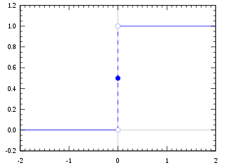
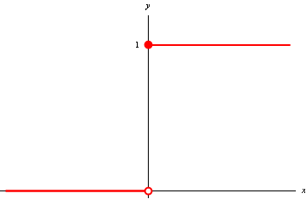
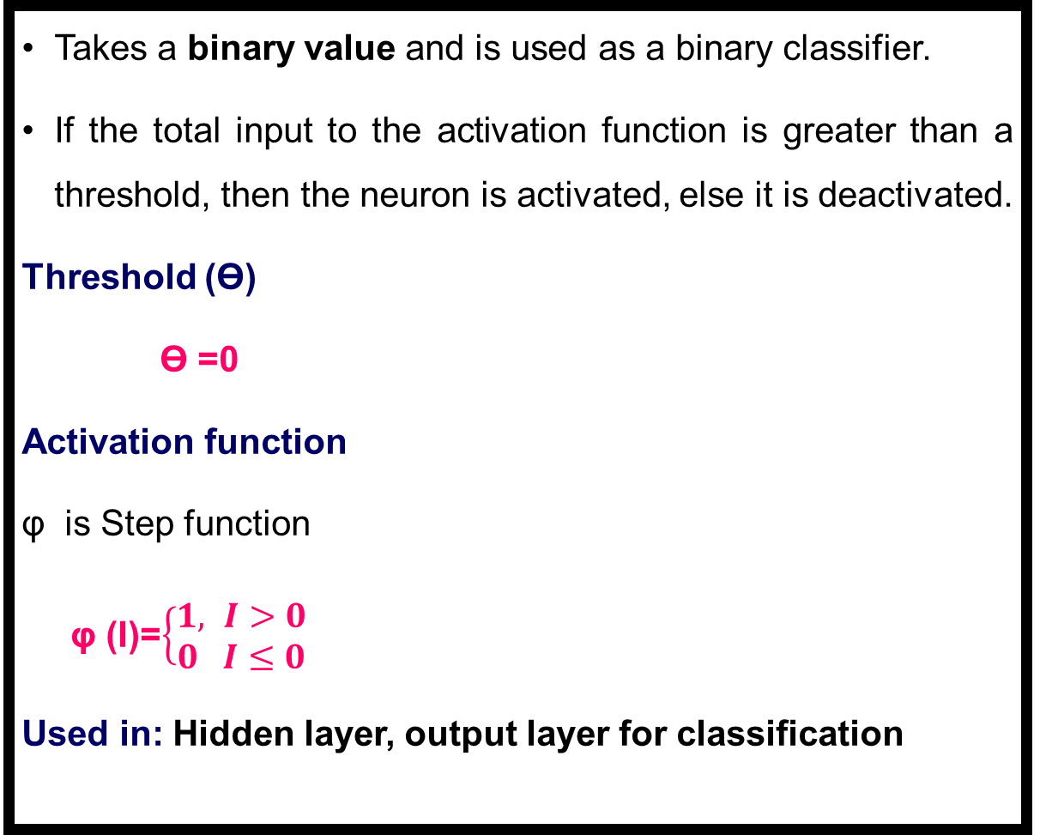

Step Function /Heaviside Function/ Binary Step Function
Takes a binary value and is used as a binary classifier.
If the total input to the activation function is greater than a threshold, then the neuron is activated, else it is deactivated.
Threshold (Ɵ)
Ɵ =0
Activation function
φ is Step function
φ (I)=$\left\{\begin{aligned}1, I>0 \\ 0 I≤0\end{aligned}\right.$
Used in: Hidden layer, output layer for classification
Weights Sum: (Total input)
I=$W.X^{T }$
$$\text{I}\text{=}\sum{w_{0}x_{0}+w_{1}}x_{1} + w_{2}x_{2} + . . . +w_{m}x_{m}$$
Example
Perceptron

Slide 9
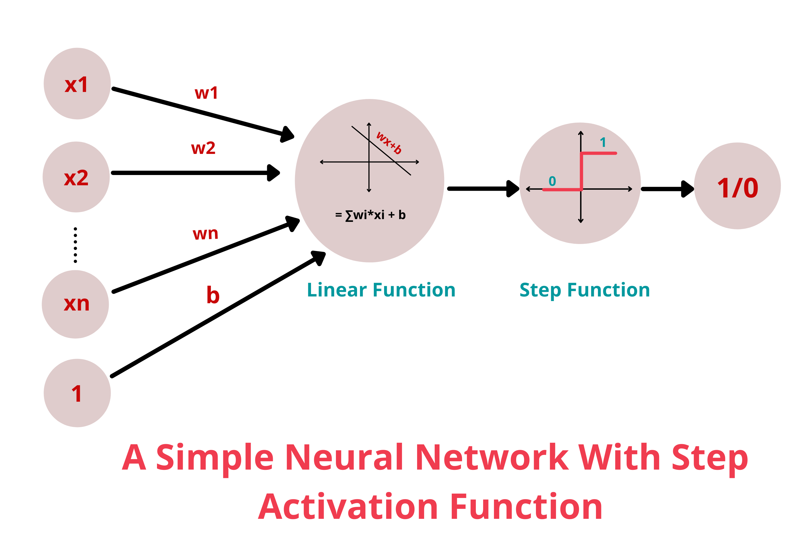
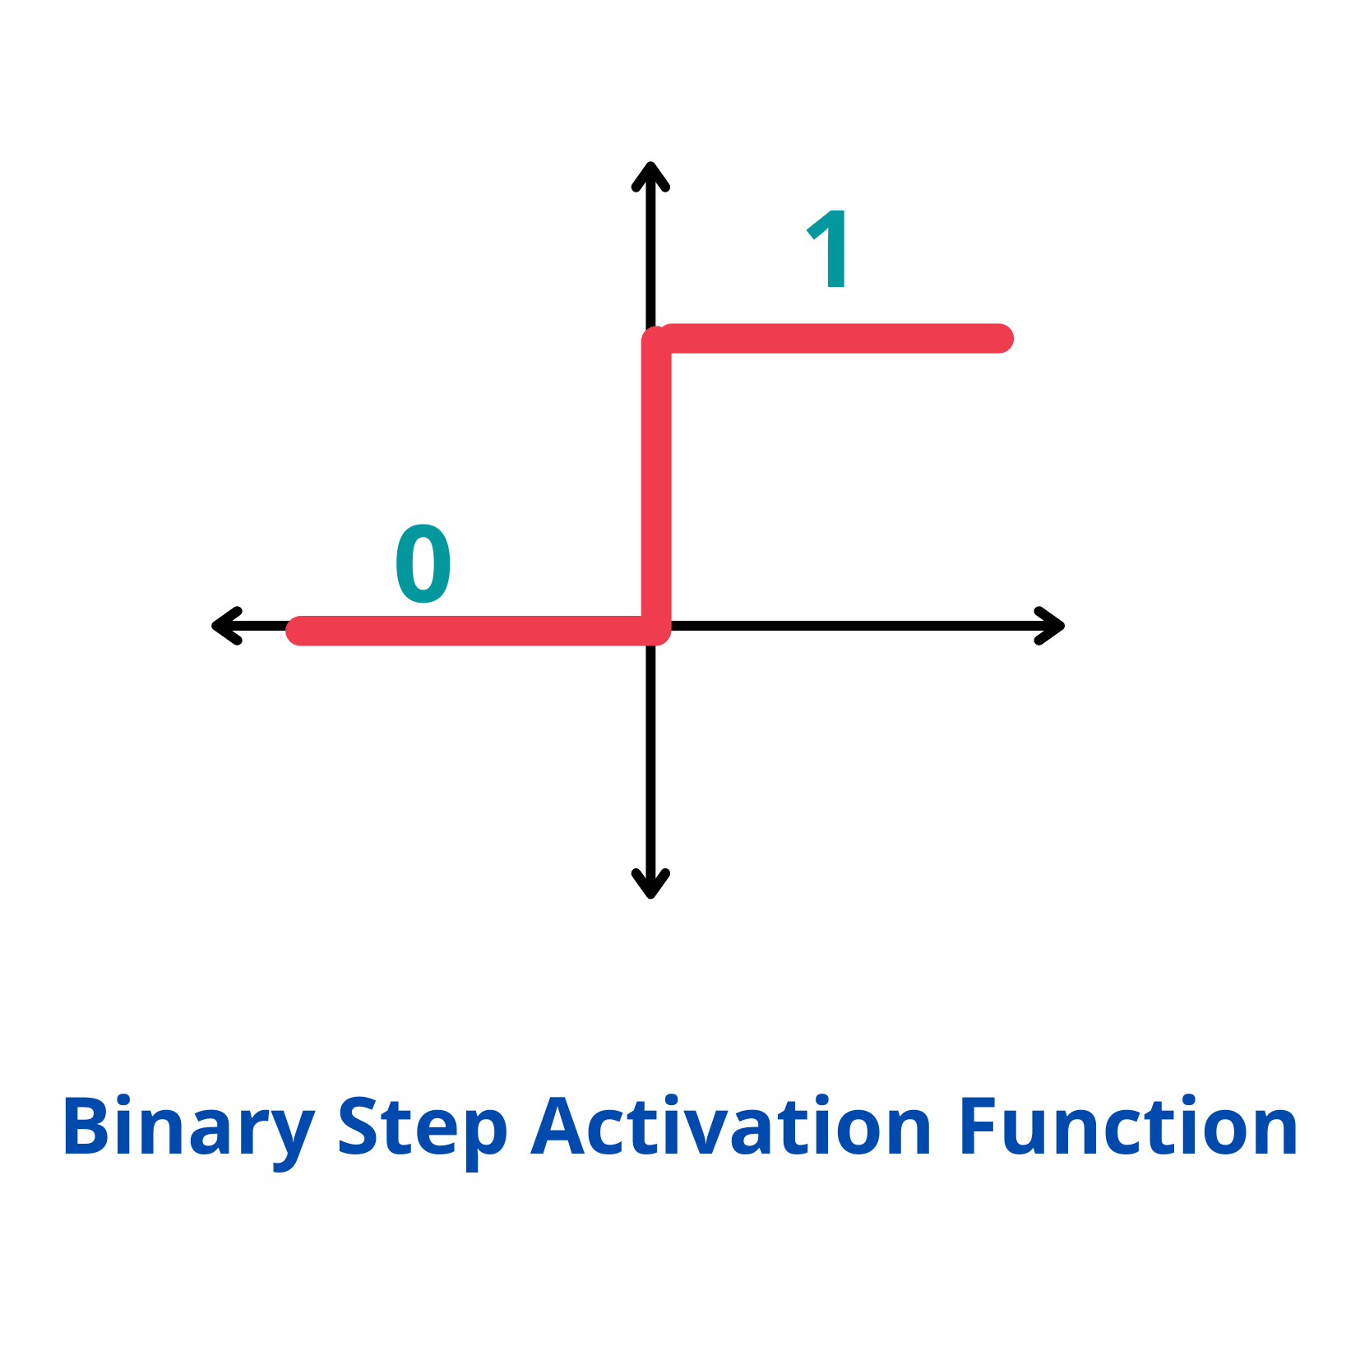

Step Function /Heaviside Function/ Binary Step Function
Output assumes value 0 for negative argument and 1 for positive argument
Step activation functions are useful for binary schemes
To classify an input model in one of two groups
Range ( 0 , 1 )
Examples:
φ(2) = 1
φ(0) = 0
Φ(1) = 1
φ(-4) = 0
φ (I)=$\left\{\begin{aligned}1, I>0 \\ 0 I≤0\end{aligned}\right.$
Example
Perceptron

Slide 10
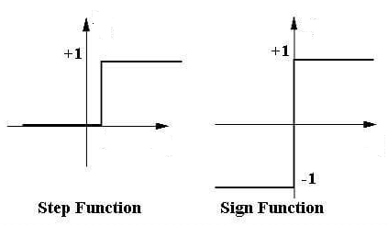
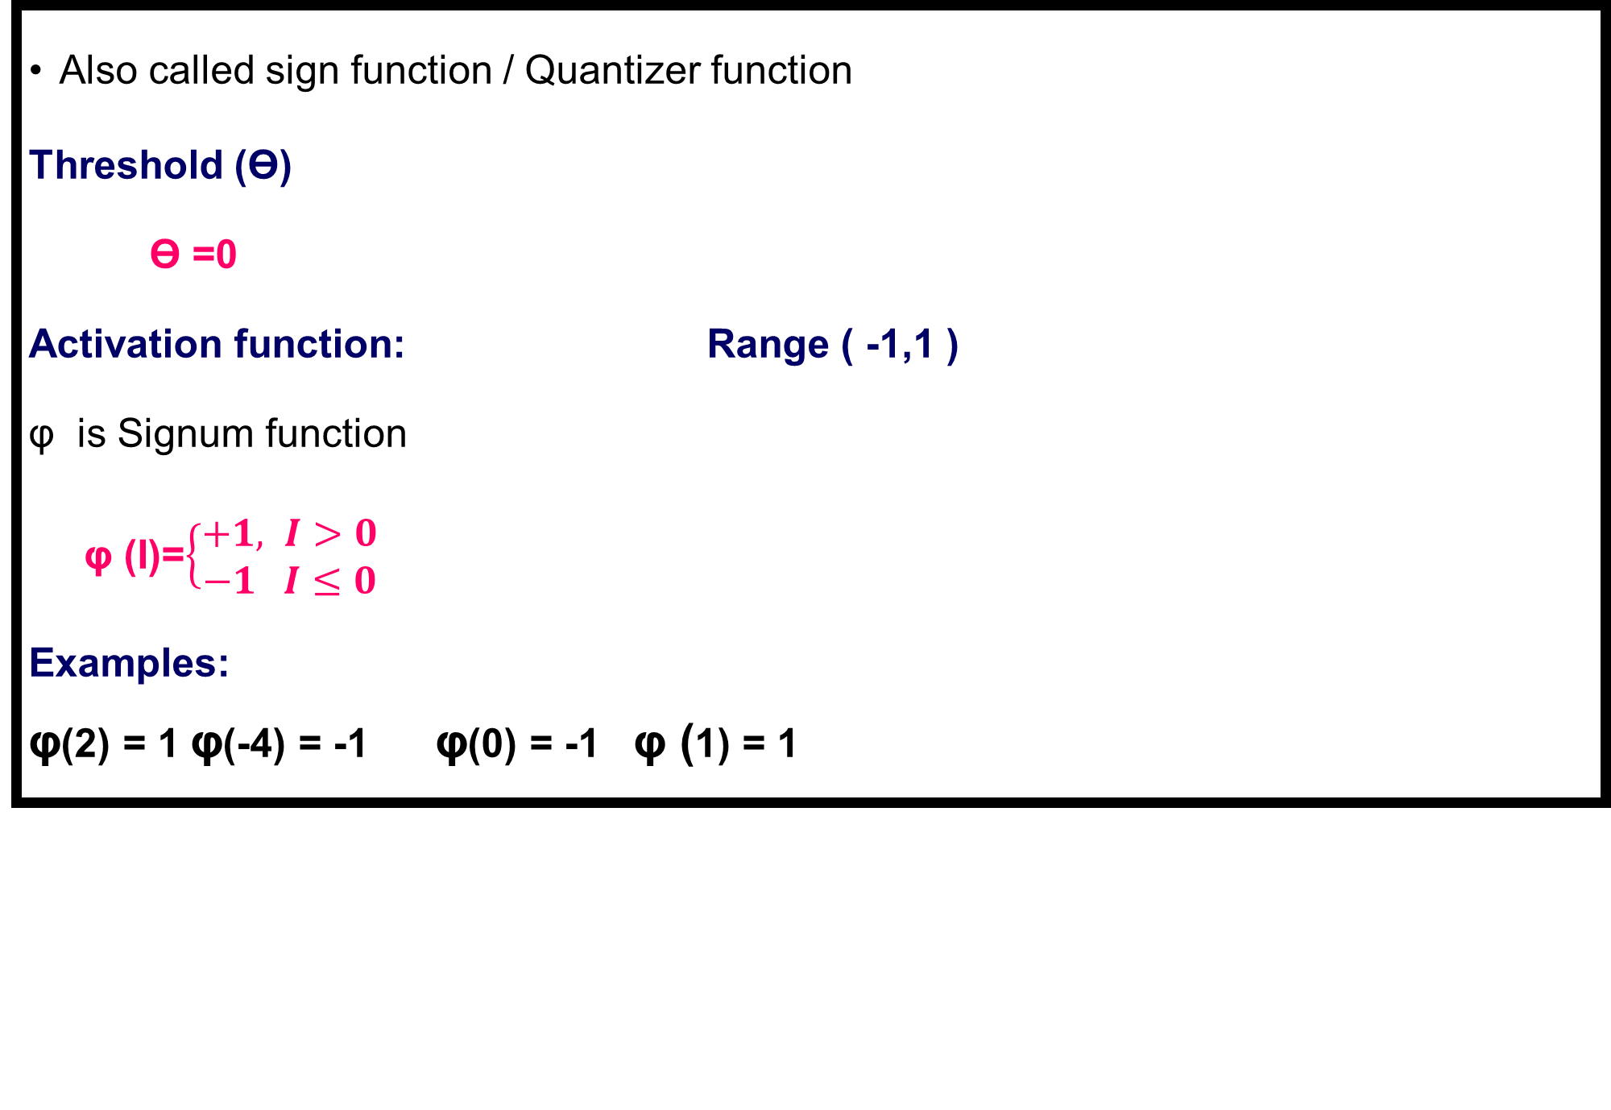
Signum Activation Function
Also called sign function / Quantizer function
Threshold (Ɵ)
Ɵ =0
Activation function: Range ( -1,1 )
φ is Signum function
φ (I)=$\left\{\begin{aligned}+1, I>0 \\ −1 I≤0\end{aligned}\right.$
Examples:
φ(2) = 1 φ(-4) = -1 φ(0) = -1 φ (1) = 1
Example
Perceptron

Slide 11
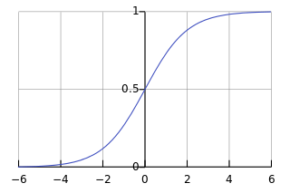
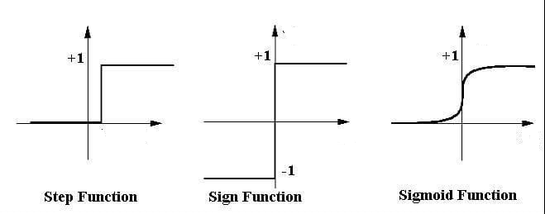
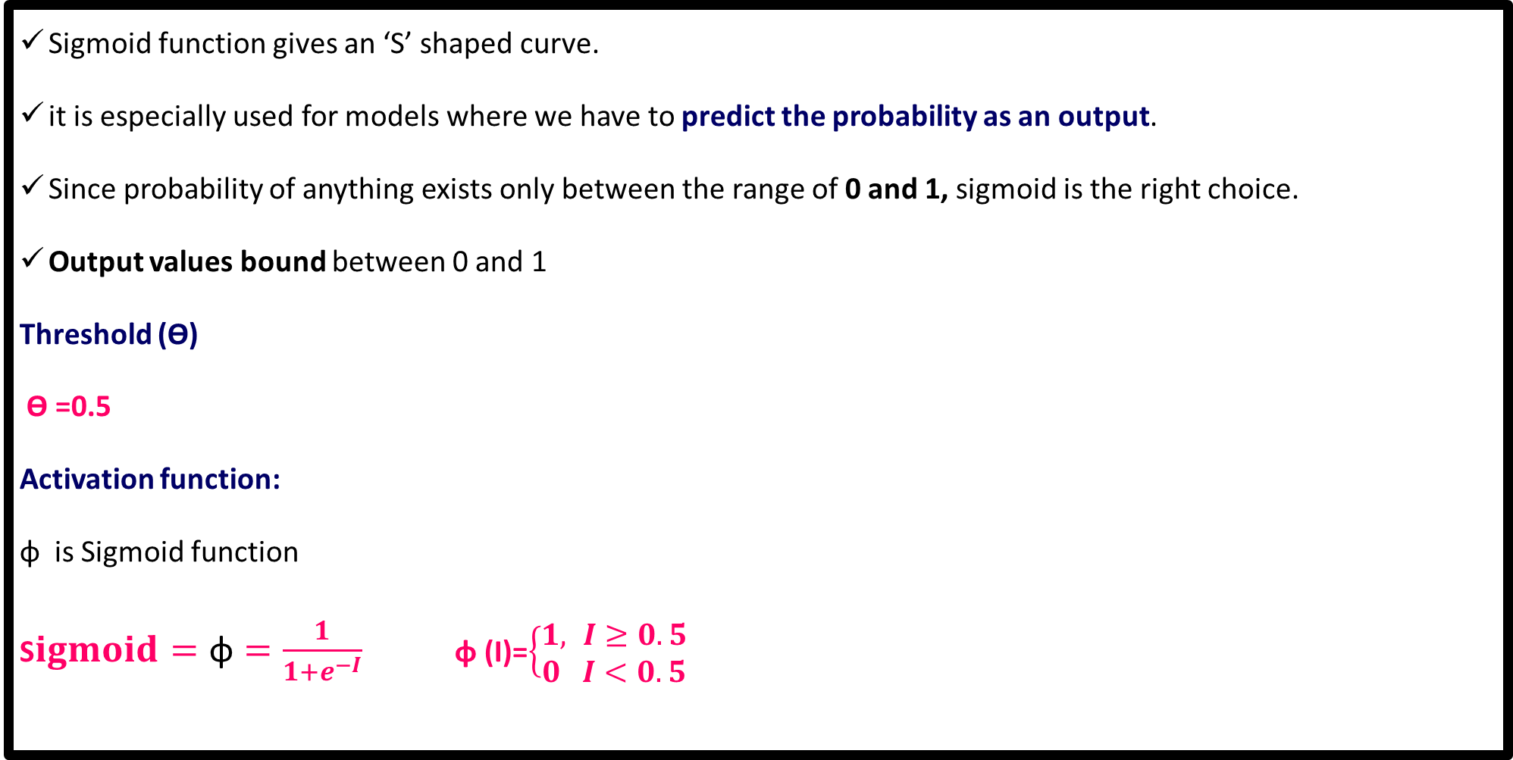
Sigmoid / Logistic Function/Soft Step
Sigmoid function gives an ‘S’ shaped curve.
it is especially used for models where we have to predict the probability as an output.
Since probability of anything exists only between the range of 0 and 1, sigmoid is the right choice.
Output values bound between 0 and 1
Threshold (Ɵ)
Ɵ =0.5
Activation function:
φ is Sigmoid function
S$igmoid=\text{φ}=\frac{1}{1+e^{−I}}$ φ (I)=$\left\{\begin{aligned}1, I≥0.5 \\ 0 I<0.5\end{aligned}\right.$
Example
Logistic Regression
Multilayer NN

Slide 12
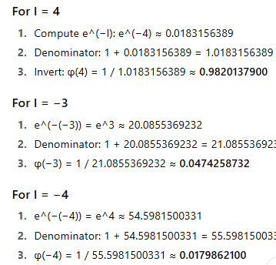
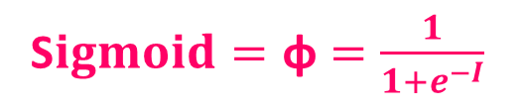

Sigmoid / Logistic Function
Range ( 0,1 )
Examples:
φ(4) = 0.982, φ(-3) = 0.0474, φ(-4) = 0.01798
φ (I)=$\left\{\begin{aligned}1, I≥0.5 \\ 0 I<0.5\end{aligned}\right.$
Used in: Hidden layer
Output layer for classification
S$igmoid=\text{φ}=\frac{1}{1+e^{−I}}$

Slide 13
Early Neural Network Architectures
Rosenblatt’s Perceptron
Perceptron is the basic building block for any neural network .
Perceptron algorithm was invented by Frank Rosenblatt in the late 1950
Perceptron is a neural network unit (an artificial neuron) that does certain computations to detect features or business intelligence in the input data.
Single Layer Perceptron
One input layer of neurons feed forward to one output layer of neurons

Slide 14
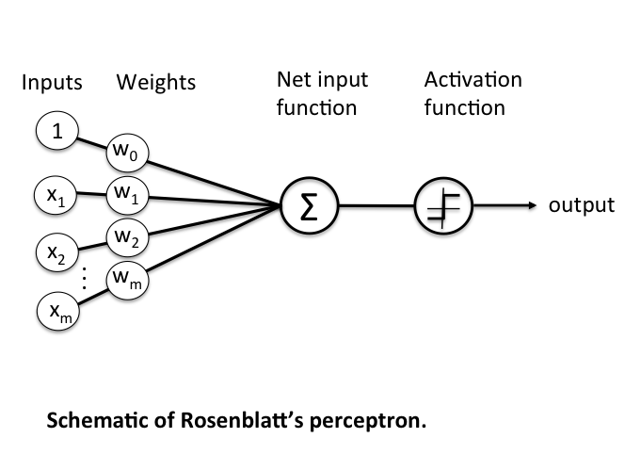
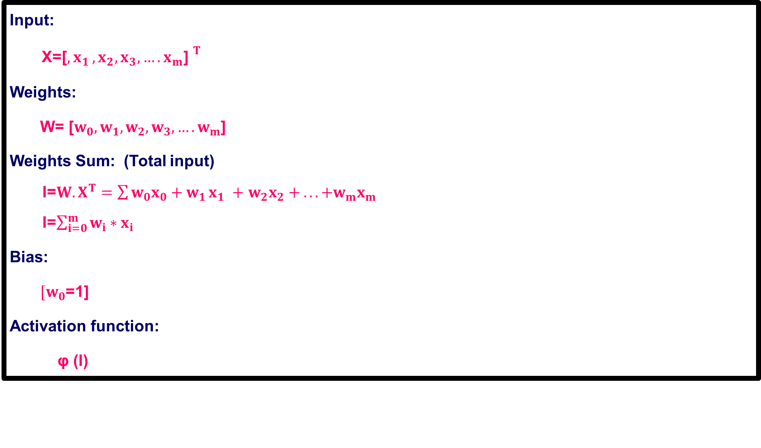
Single Layer Perceptron
Input:
X=${\text{[}{,x}_{1},x_{2},x_{3},….x_{m}\text{] }}^{T}$
Weights:
W= [${w_{0},w}_{1},w_{2},w_{3},….w_{m}$]
Weights Sum: (Total input)
I=$W.X^{T}=\sum{w_{0}x_{0}+w_{1}}x_{1} +$ $w_{2}x_{2} + . . . +w_{m}x_{m}$
I=$\sum_{i=0}^{m}{w_{i}∗x_{i}}$
Bias:
$[w_{0}$=1]
Activation function:
φ (I)

Slide 15
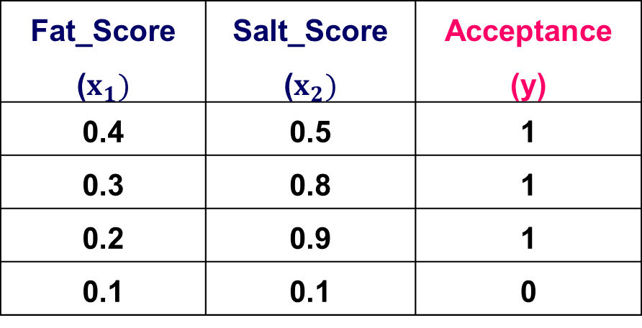
Single Layer Perceptron
Consider the following dataset given in a table that includes the information on a tasting score for a certain processed cheese.
Two predictors are score for fat & salt indicating the relative presence of fat and salt in the particular cheese sample.
Output variable is the cheese sample’s consumer taste acceptance, where “1” indicates that a taste test panel likes the cheese and “0” that it does not like it.
Fat_Score ($x_{1})$ | Salt_Score ($x_{2})$ | Acceptance (y)
0.4 | 0.5 | 1
0.3 | 0.8 | 1
0.2 | 0.9 | 1
0.1 | 0.1 | 0

Slide 16
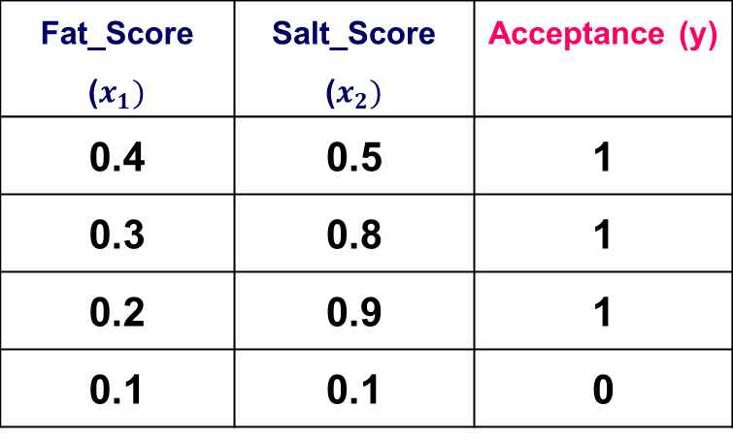
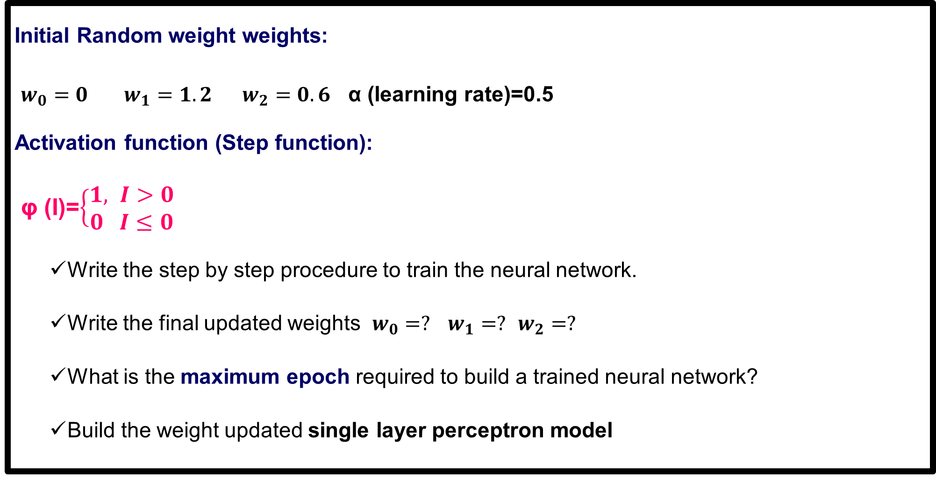
Single Layer Perceptron
Initial Random weight weights:
$w_{0}=0$ $w_{1}=1.2$ $w_{2}=0.6$ α (learning rate)=0.5
Activation function (Step function):
φ (I)=$\left\{\begin{aligned}1, I>0 \\ 0 I≤0\end{aligned}\right.$
Write the step by step procedure to train the neural network.
Write the final updated weights $w_{0}=?$ $w_{1}=?$ $w_{2}=?$
What is the maximum epoch required to build a trained neural network?
Build the weight updated single layer perceptron model
Fat_Score ($x_{1})$ | Salt_Score ($x_{2})$ | Acceptance (y)
0.4 | 0.5 | 1
0.3 | 0.8 | 1
0.2 | 0.9 | 1
0.1 | 0.1 | 0

Slide 17

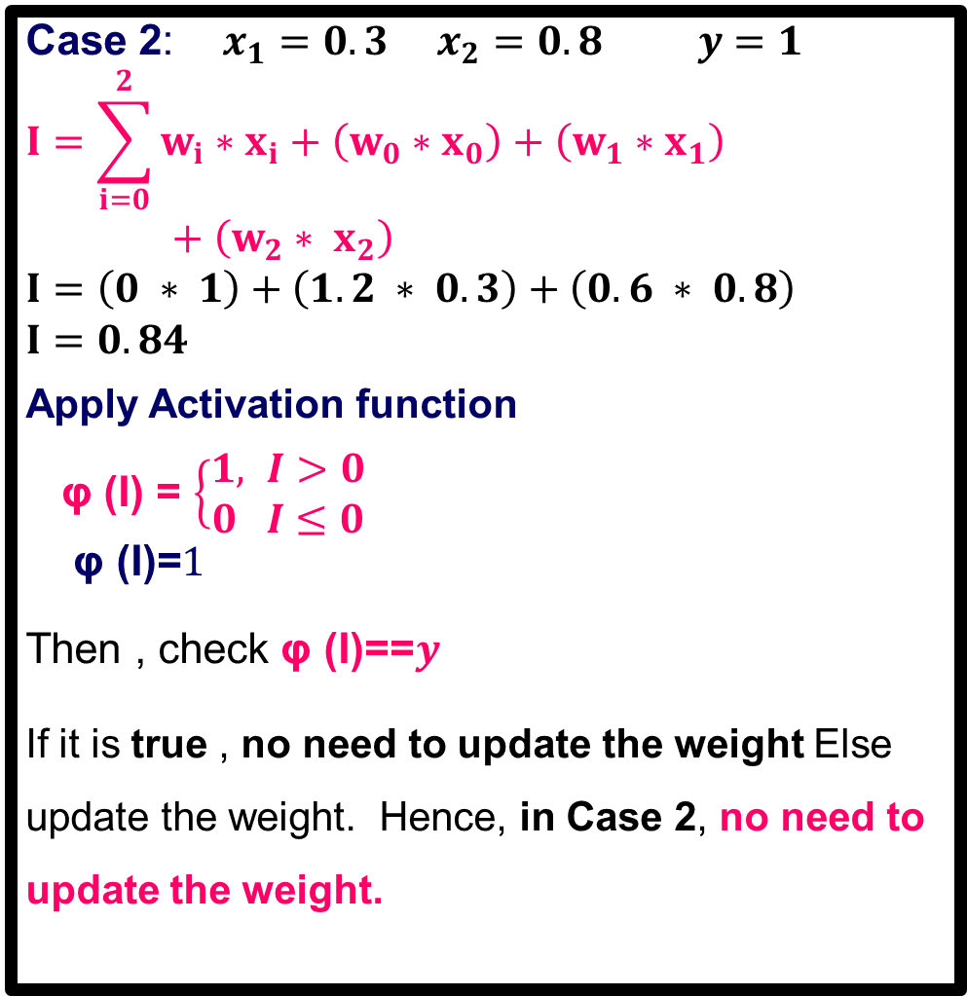

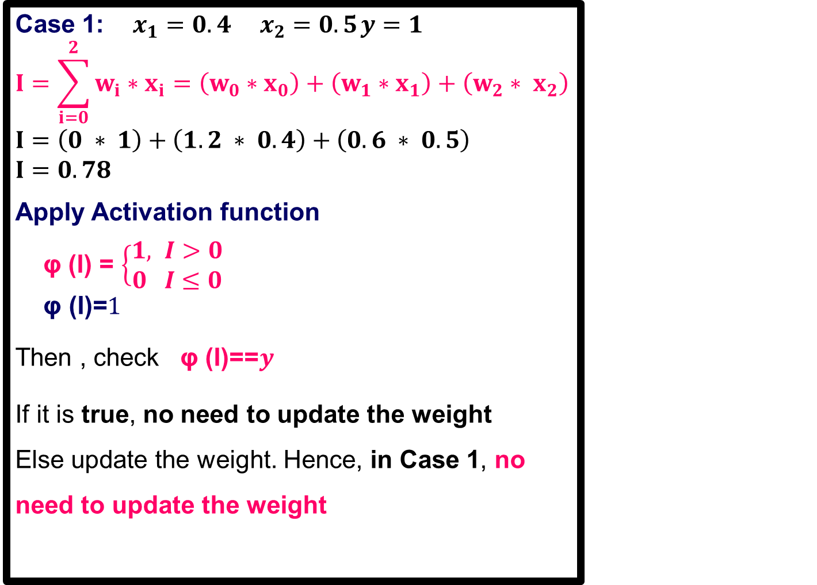

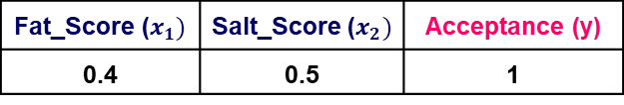
Single Layer Perceptron
Case 1: $x_{1}=0.4 x_{2}=0.5$ $y=1$
$$I=\sum_{i=0}^{2}{w_{i}∗x_{i}}=\left(w_{0}∗x_{0}\right)+\left(w_{1}∗x_{1}\right)+\left(w_{2}∗ x_{2}\right)$$
$$I=\left(0 ∗ 1\right)+\left(1.2 ∗ 0.4\right)+\left(0.6 ∗ 0.5\right)$$
$$I=0.78$$
Apply Activation function
φ (I) = $\left\{\begin{aligned}1, I>0 \\ 0 I≤0\end{aligned}\right.$
$$\text{φ}\text{ (}\text{I}\text{)=}1$$
Then , check φ (I)==$y$
If it is true, no need to update the weight Else update the weight. Hence, in Case 1, no need to update the weight
Case 2: $x_{1}=0.3 x_{2}=0.8 y=1$
$$I=\sum_{i=0}^{2}{w_{i}∗x_{i}}+\left(w_{0}∗x_{0}\right)+\left(w_{1}∗x_{1}\right)+\left(w_{2}∗ x_{2}\right)$$
$$I=\left(0 ∗ 1\right)+\left(1.2 ∗ 0.3\right)+\left(0.6 ∗ 0.8\right)$$
$$I=0.84$$
Apply Activation function
φ (I) = $\left\{\begin{aligned}1, I>0 \\ 0 I≤0\end{aligned}\right.$
$$\text{φ}\text{ (}\text{I}\text{)=}1$$
Then , check φ (I)==$y$
If it is true , no need to update the weight Else update the weight. Hence, in Case 2, no need to update the weight.
$$I=W.X^{T}$$
$$I=W.X^{T}$$
Threshold (Ɵ)=0
Threshold (Ɵ)=0
Fat_Score ($x_{1})$ | Salt_Score ($x_{2})$ | Acceptance (y)
0.4 | 0.5 | 1
Fat_Score ($x_{1})$ | Salt_Score ($x_{2})$ | Acceptance (y)
0.3 | 0.8 | 1

Slide 18
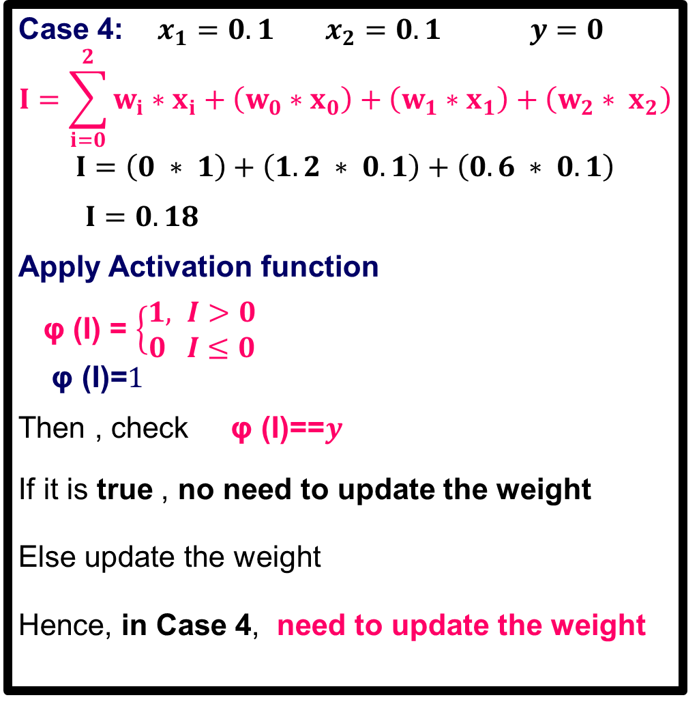
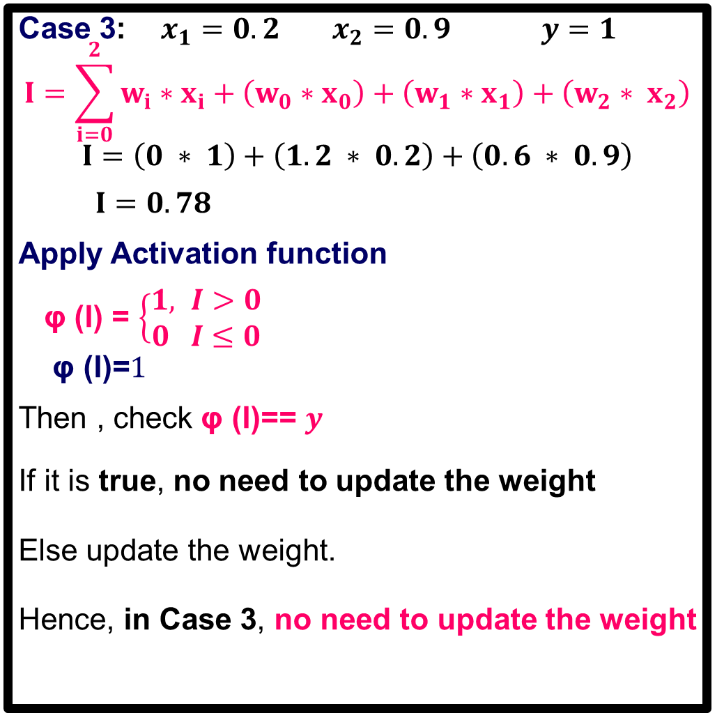


Single Layer Perceptron
Case 3: $x_{1}=0.2$ $x_{2}=0.9$ $y=1$
$$I=\sum_{i=0}^{2}{w_{i}∗x_{i}}+\left(w_{0}∗x_{0}\right)+\left(w_{1}∗x_{1}\right)+\left(w_{2}∗ x_{2}\right)$$
$$I=\left(0 ∗ 1\right)+\left(1.2 ∗ 0.2\right)+\left(0.6 ∗ 0.9\right)$$
$I=0.78$
Apply Activation function
φ (I) = $\left\{\begin{aligned}1, I>0 \\ 0 I≤0\end{aligned}\right.$
$$\text{φ}\text{ (}\text{I}\text{)=}1$$
Then , check φ (I)== $y$
If it is true, no need to update the weight
Else update the weight.
Hence, in Case 3, no need to update the weight
Case 4: $x_{1}=0.1$ $x_{2}=0.1$ $y=0$
$$I=\sum_{i=0}^{2}{w_{i}∗x_{i}}+\left(w_{0}∗x_{0}\right)+\left(w_{1}∗x_{1}\right)+\left(w_{2}∗ x_{2}\right)$$
$$I=\left(0 ∗ 1\right)+\left(1.2 ∗ 0.1\right)+\left(0.6 ∗ 0.1\right)$$
$I=0.18$
Apply Activation function
φ (I) = $\left\{\begin{aligned}1, I>0 \\ 0 I≤0\end{aligned}\right.$
$$\text{φ}\text{ (}\text{I}\text{)=}1$$
Then , check φ (I)==$y$
If it is true , no need to update the weight
Else update the weight
Hence, in Case 4, need to update the weight
$$I=W.X^{T}$$
$$I=W.X^{T}$$
Threshold (Ɵ)=0
Threshold (Ɵ)=0
0 th epoch completed

Slide 19

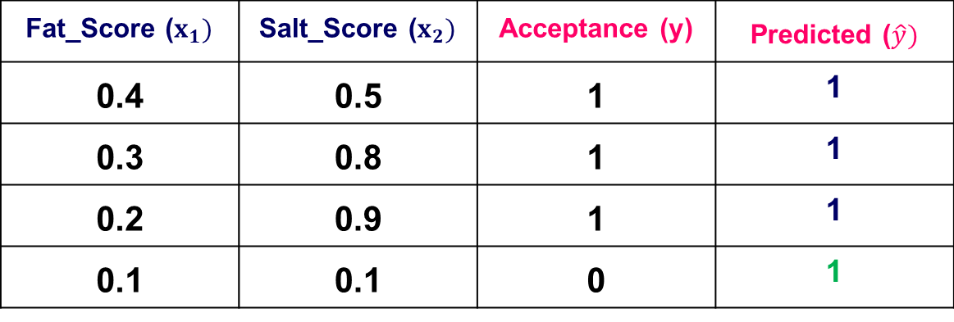




Weight Updation Single Layer Perceptron
$$w_{i}(new)=w_{i}(old)+Δw_{i}$$
$Δw_{i}=α \left(y−\hat{y}\right)x_{i}$
$$w_{i}(new)=w_{i}(old)+α ( y−\hat{y})x_{i}$$
Fat_Score ($x_{1})$ | Salt_Score ($x_{2})$ | Acceptance (y) | Predicted ($\hat{y})$
0.4 | 0.5 | 1 | 1
0.3 | 0.8 | 1 | 1
0.2 | 0.9 | 1 | 1
0.1 | 0.1 | 0 | 1
$$w_{0}(new)=w_{0}(old)+α ( y−\hat{y})x_{0}$$
$$w_{0}\left(new\right)=0+0.5 \left(0−1\right)∗1$$
$$w_{0}\left(new\right)=−0.5$$
$$w_{1}(new)=w_{1}(old)+α ( y−\hat{y})x_{1}$$
$$w_{1}\left(new\right)=1.2+0.5 \left(0−1\right)∗0.1$$
$$w_{1}\left(new\right)=1.15$$
$$w_{2}(new)=w_{2}(old)+α ( y−\hat{y})x_{2}$$
$$w_{2}\left(new\right)=0.6+0.5 \left(0−1\right)∗0.1$$
$$w_{2}\left(new\right)=0.55$$
Initial Random weight weights:
$w_{0}=0$ $w_{1}=1.2$ $w_{2}=0.6$
α (learning rate)=0.5
1 th epoch started

Slide 20
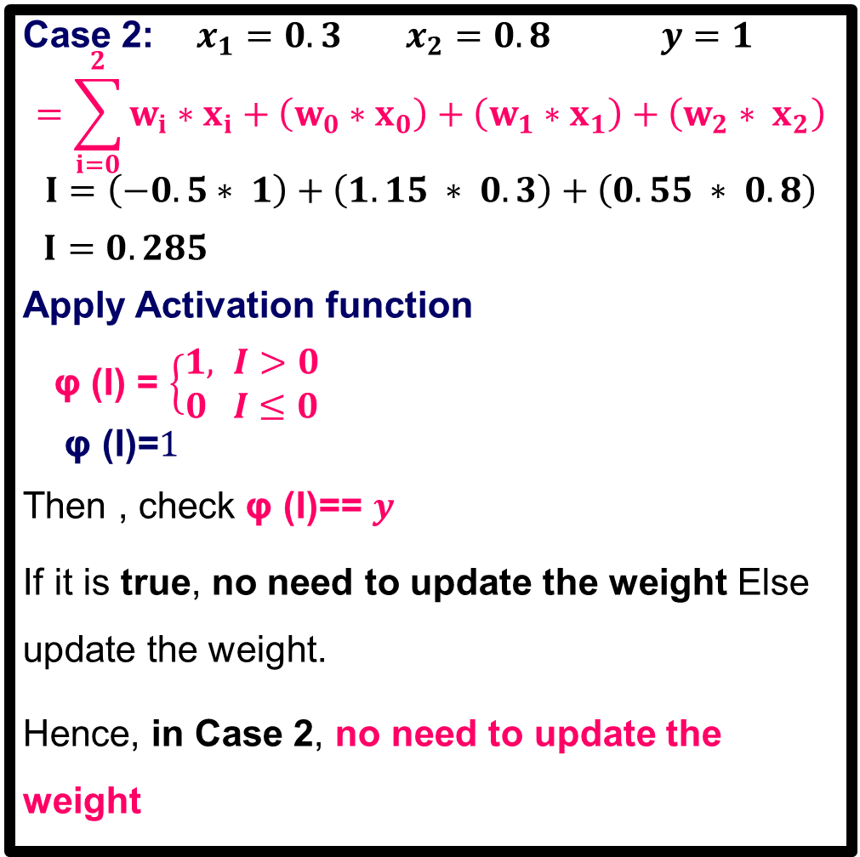
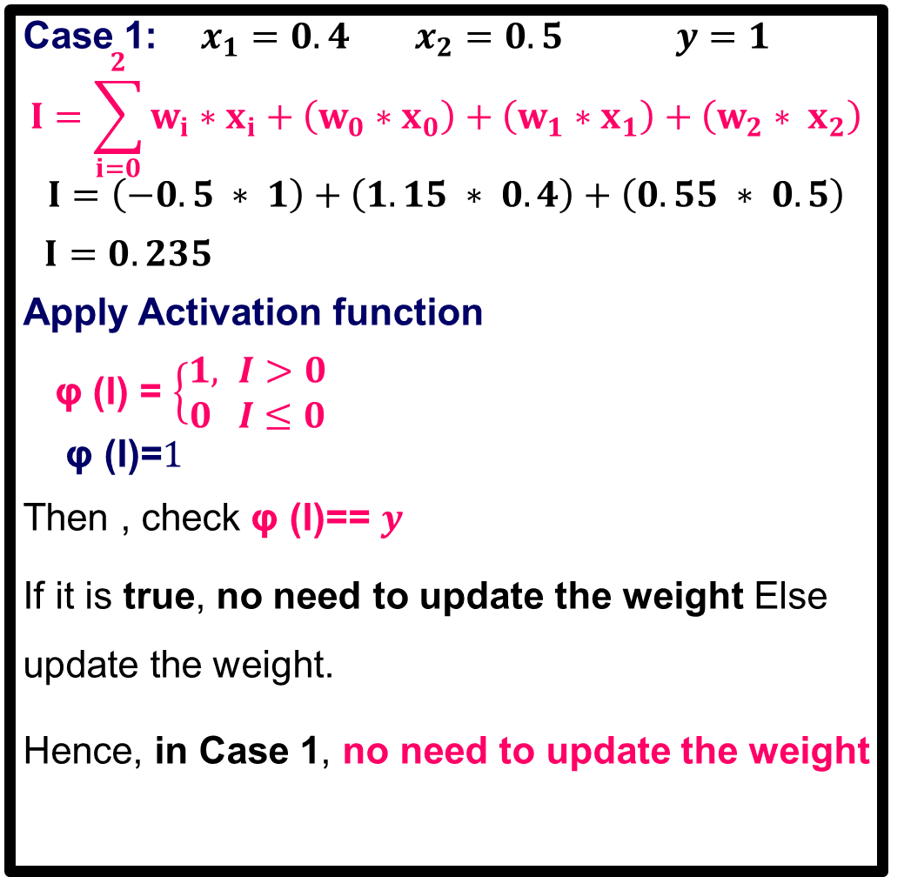
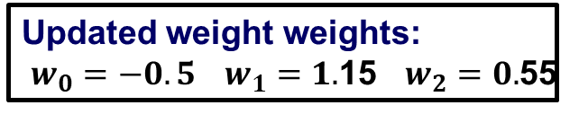
Single Layer Perceptron
Case 1: $x_{1}=0.4$ $x_{2}=0.5$ $y=1$
$$I=\sum_{i=0}^{2}{w_{i}∗x_{i}}+\left(w_{0}∗x_{0}\right)+\left(w_{1}∗x_{1}\right)+\left(w_{2}∗ x_{2}\right)$$
$$I=\left(−0.5 ∗ 1\right)+\left(1.15 ∗ 0.4\right)+\left(0.55 ∗ 0.5\right)$$
$I=0.235$
Apply Activation function
φ (I) = $\left\{\begin{aligned}1, I>0 \\ 0 I≤0\end{aligned}\right.$
$$\text{φ}\text{ (}\text{I}\text{)=}1$$
Then , check φ (I)== $y$
If it is true, no need to update the weight Else update the weight.
Hence, in Case 1, no need to update the weight
Case 2: $x_{1}=0.3$ $x_{2}=0.8$ $y=1$
$$=\sum_{i=0}^{2}{w_{i}∗x_{i}}+\left(w_{0}∗x_{0}\right)+\left(w_{1}∗x_{1}\right)+\left(w_{2}∗ x_{2}\right)$$
$$I=\left(−0.5∗ 1\right)+\left(1.15 ∗ 0.3\right)+\left(0.55 ∗ 0.8\right)$$
$I=0.285$
Apply Activation function
φ (I) = $\left\{\begin{aligned}1, I>0 \\ 0 I≤0\end{aligned}\right.$
$$\text{φ}\text{ (}\text{I}\text{)=}1$$
Then , check φ (I)== $y$
If it is true, no need to update the weight Else update the weight.
Hence, in Case 2, no need to update the weight
Updated weight weights:
$w_{0}=−0.5$ $w_{1}=1.$15 $w_{2}=0.$55

Slide 21
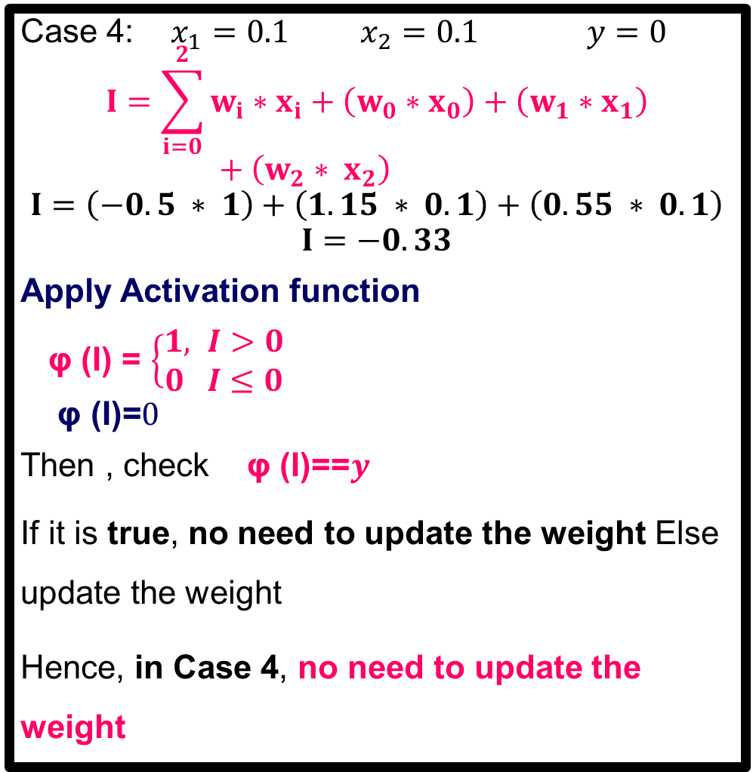
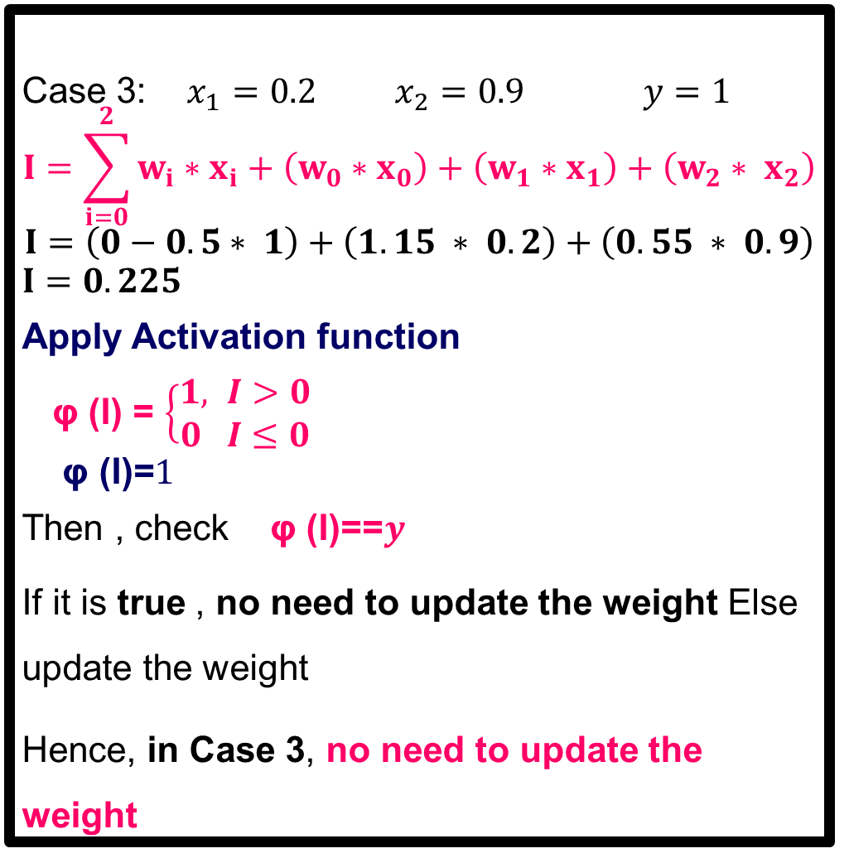
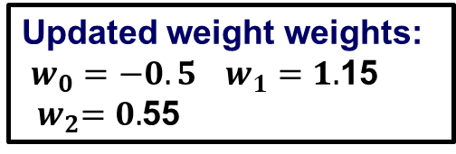
Single Layer Perceptron
Case 3: $x_{1}=0.2$ $x_{2}=0.9$ $y=1$
$$I=\sum_{i=0}^{2}{w_{i}∗x_{i}}+\left(w_{0}∗x_{0}\right)+\left(w_{1}∗x_{1}\right)+\left(w_{2}∗ x_{2}\right)$$
$$I=\left(0−0.5∗ 1\right)+\left(1.15 ∗ 0.2\right)+\left(0.55 ∗ 0.9\right)$$
$$I=0.225$$
Apply Activation function
φ (I) = $\left\{\begin{aligned}1, I>0 \\ 0 I≤0\end{aligned}\right.$
$$\text{φ}\text{ (}\text{I}\text{)=}1$$
Then , check φ (I)==$y$
If it is true , no need to update the weight Else update the weight
Hence, in Case 3, no need to update the weight
Case 4: $x_{1}=0.1$ $x_{2}=0.1$ $y=0$
$$I=\sum_{i=0}^{2}{w_{i}∗x_{i}}+\left(w_{0}∗x_{0}\right)+\left(w_{1}∗x_{1}\right)+\left(w_{2}∗ x_{2}\right)$$
$$I=\left(−0.5 ∗ 1\right)+\left(1.15 ∗ 0.1\right)+\left(0.55 ∗ 0.1\right)$$
$$I=−0.33$$
Apply Activation function
φ (I) = $\left\{\begin{aligned}1, I>0 \\ 0 I≤0\end{aligned}\right.$
$$\text{φ}\text{ (}\text{I}\text{)=}0$$
Then , check φ (I)==$y$
If it is true, no need to update the weight Else update the weight
Hence, in Case 4, no need to update the weight
Updated weight weights:
$w_{0}=−0.5$ $w_{1}=1.$15 ${ w}_{2}=0.$55
1 st epoch completed.
All nodes are trained.

Slide 22
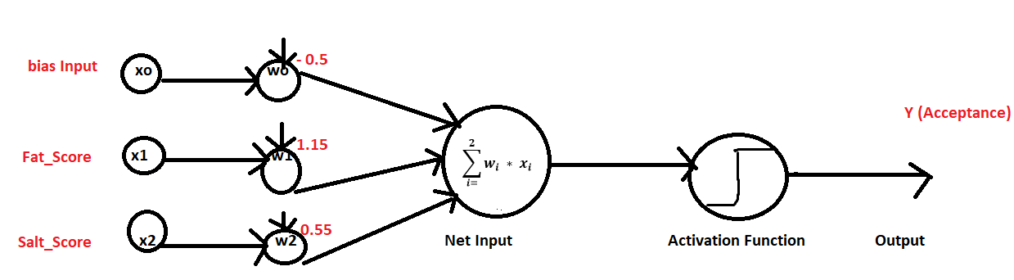
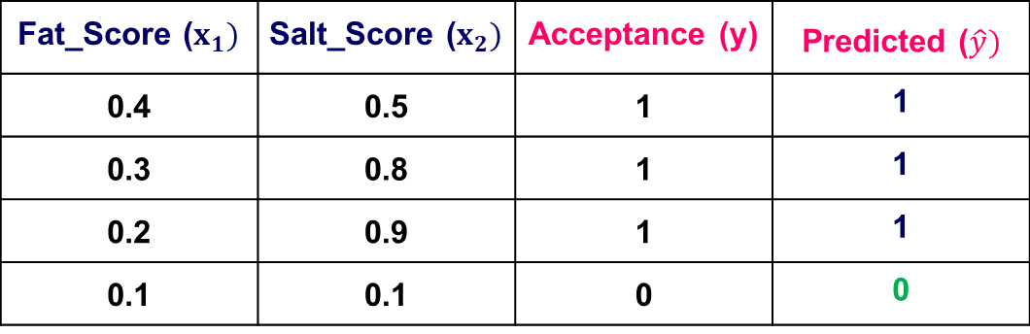
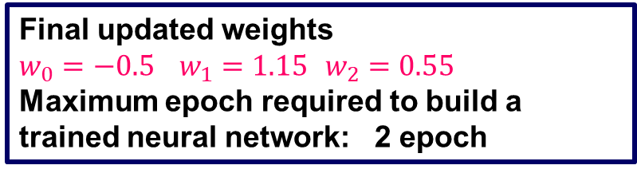
Single Layer Perceptron
Fat_Score ($x_{1})$ | Salt_Score ($x_{2})$ | Acceptance (y) | Predicted ($\hat{y})$
0.4 | 0.5 | 1 | 1
0.3 | 0.8 | 1 | 1
0.2 | 0.9 | 1 | 1
0.1 | 0.1 | 0 | 0
Final updated weights
$w_{0}=−0.5$ $w_{1}=1.15$ $w_{2}=0.55$
Maximum epoch required to build a trained neural network: 2 epoch

Slide 23
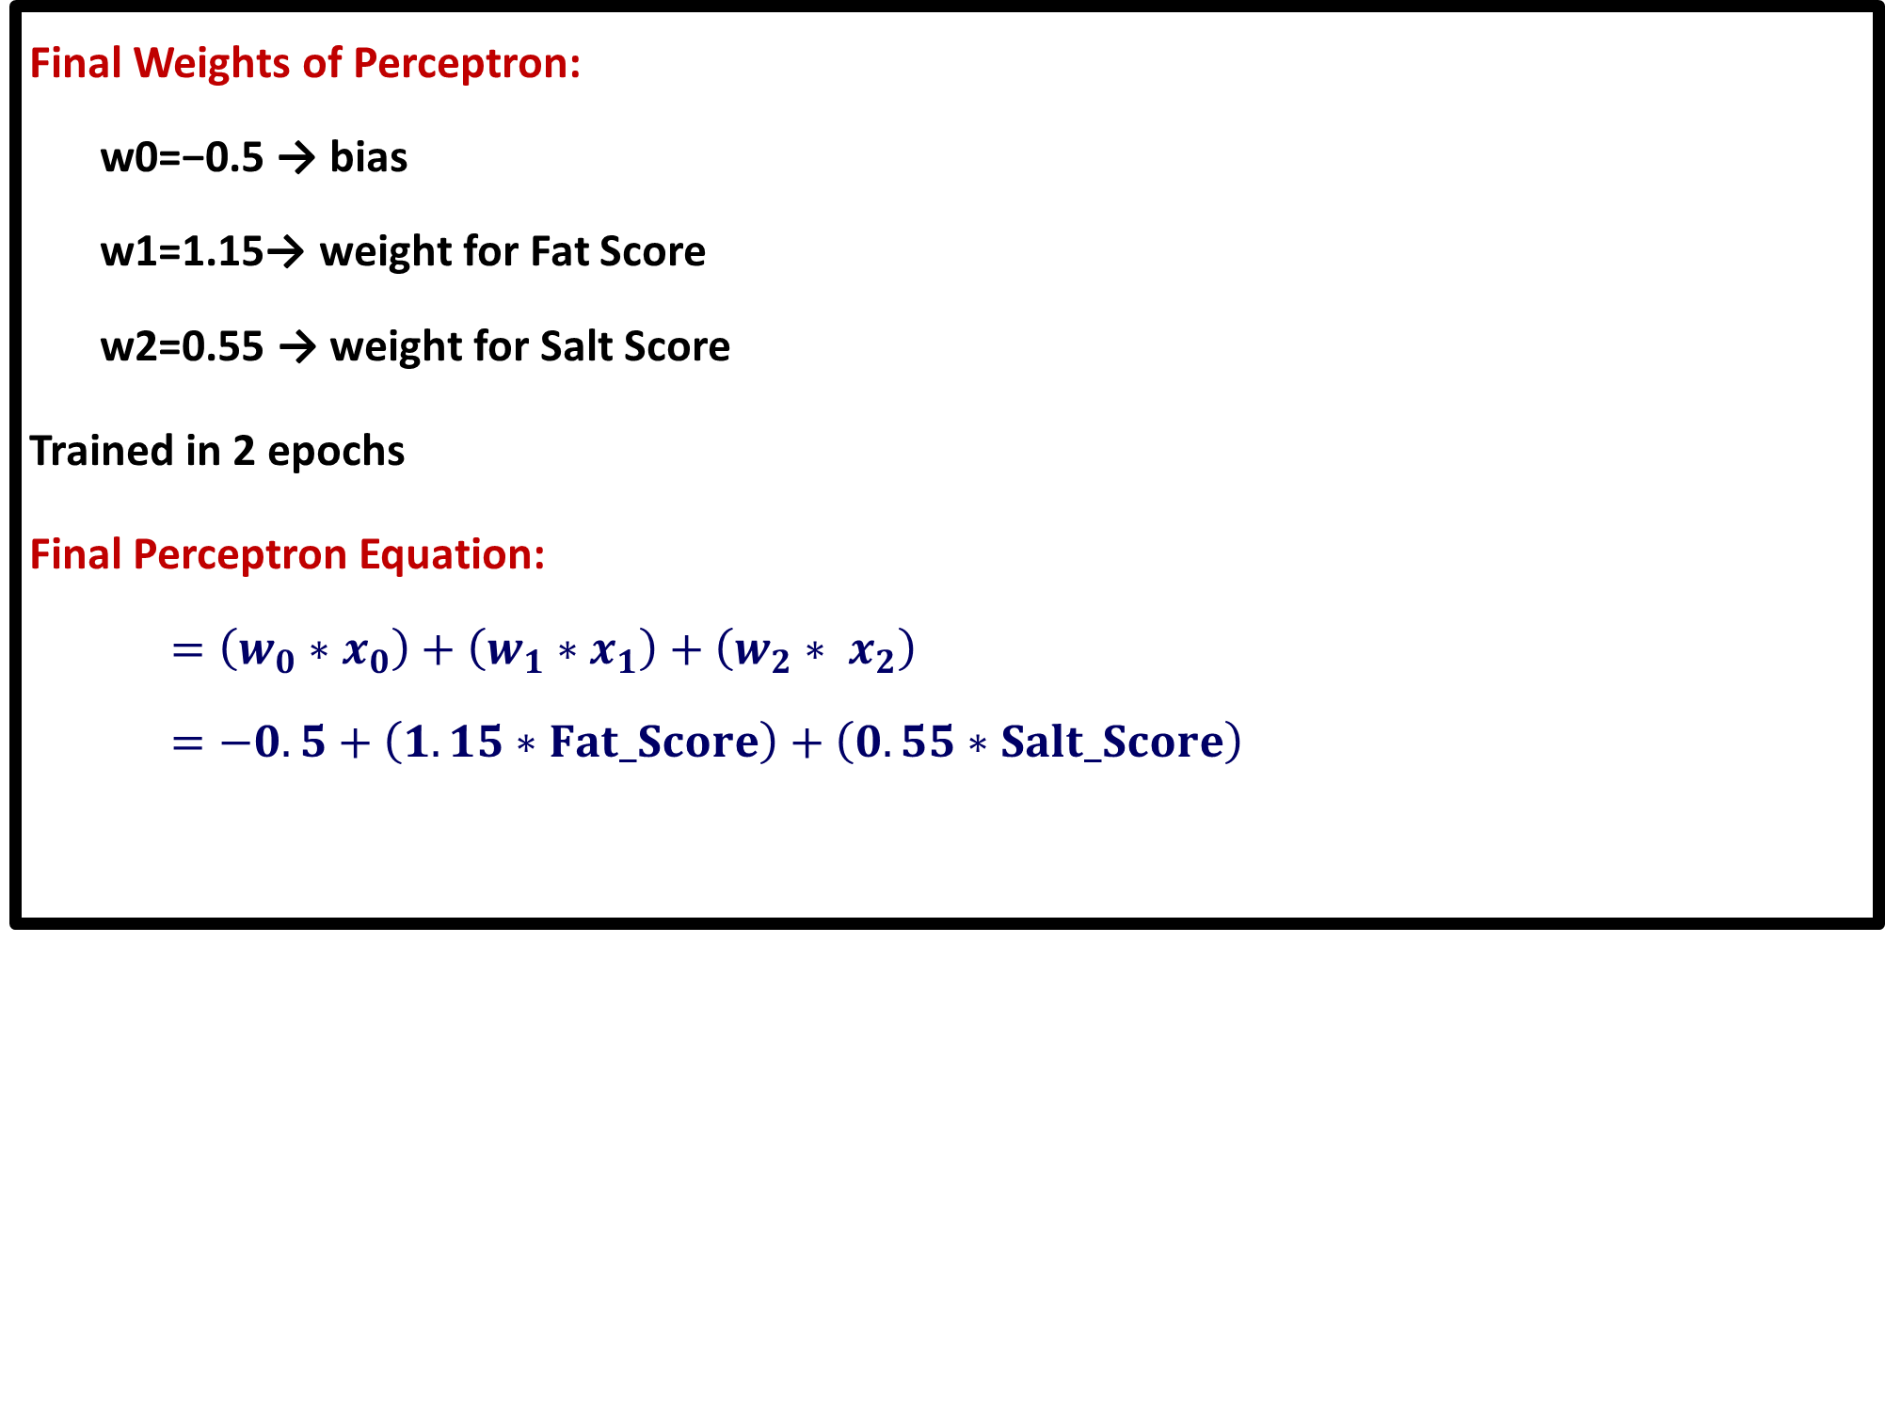
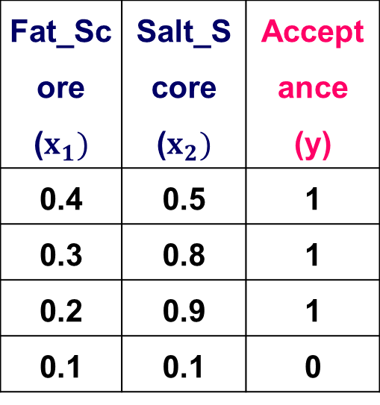

Single Layer Perceptron
Slide Title
Final Weights of Perceptron:
w0=−0.5 → bias
w1=1.15→ weight for Fat Score
w2=0.55 → weight for Salt Score
Trained in 2 epochs
Final Perceptron Equation:
$=\left(w_{0}∗x_{0}\right)+\left(w_{1}∗x_{1}\right)+\left(w_{2}∗ x_{2}\right)$
$=−0.5+\left(1.15∗Fat_Score\right)+\left(0.55∗Salt_Score\right)$
Activation Function
φ (I) = $\left\{\begin{aligned}1, I>0 \\ 0 I≤0\end{aligned}\right.$
Fat_Score ($x_{1})$ | Salt_Score ($x_{2})$ | Acceptance (y)
0.4 | 0.5 | 1
0.3 | 0.8 | 1
0.2 | 0.9 | 1
0.1 | 0.1 | 0

Slide 24
LIME Algorithm
Slide Title
Step 1: Choose instance to explain
Select the instance (Data Point) of interest for which we want to have an explanation of its black box prediction.
Step 2:Perturb the Instance
Generate multiple perturbed versions of this instance by slightly modifying its features.
For tabular data, this might involve adding random noise; for image data, it could involve turning off or segmenting superpixels (contiguous patches of similar pixels).
Step 3: Obtain Predictions from the Black-Box Model
Feed these perturbed instances into the original, complex machine learning model and obtain its predictions for each.

Slide 25
LIME Algorithm
Slide Title
Step 4: Calculate the distance
Calculate the distance between the query-instance and all the Perturb the Instances
Step 5: Compute Kernel Weights (using an RBF kernel (σ=0.1)).
Step 6 : Fit a weighted, interpretable surrogate (local linear regression)

Slide 26
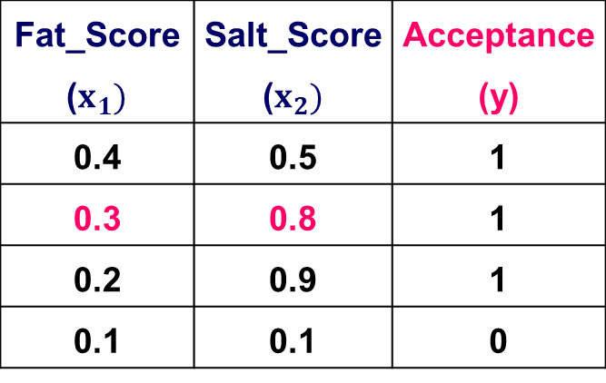
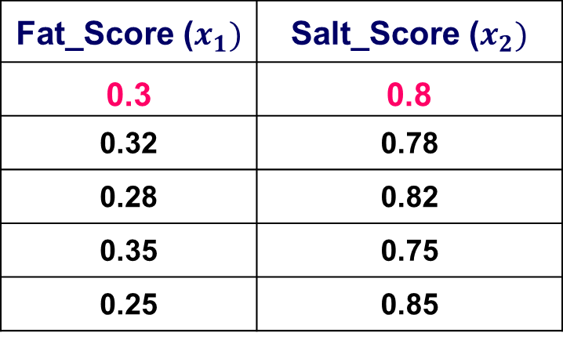
LIME
Slide Title
Step 1: Choose instance to explain
Select the instance (Data Point) of interest for which
we want to have an explanation of its black box prediction.
x₁ = 0.3, x₂ = 0.8
Step 2:Perturb the Instance
Fat_Score ($x_{1})$ | Salt_Score ($x_{2})$ | Acceptance (y)
0.4 | 0.5 | 1
0.3 | 0.8 | 1
0.2 | 0.9 | 1
0.1 | 0.1 | 0
Fat_Score ($x_{1})$ | Salt_Score ($x_{2})$
0.3 | 0.8
0.32 | 0.78
0.28 | 0.82
0.35 | 0.75
0.25 | 0.85

Slide 27
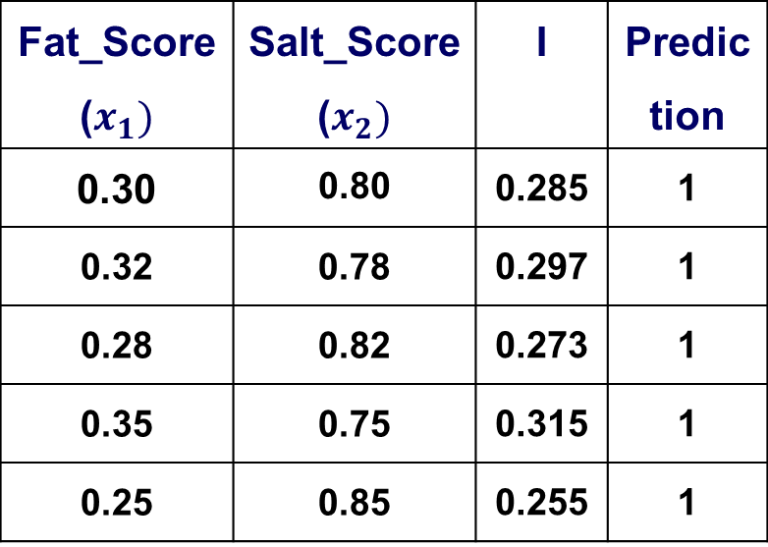
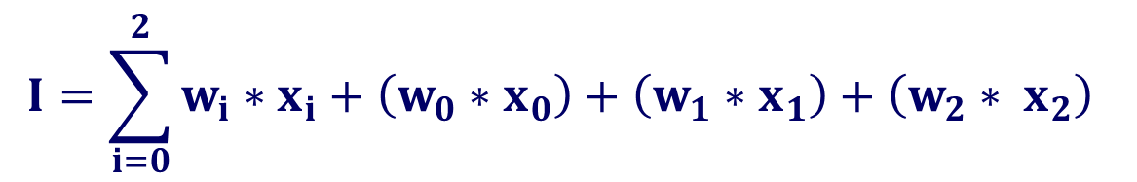
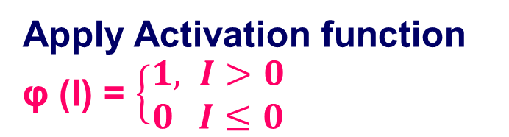

LIME
Slide Title
Step 3: Obtain Predictions from the Black-Box Model
Fat_Score ($x_{1})$ | Salt_Score ($x_{2})$ | I | Prediction
0.30 | 0.80 | 0.285 | 1
0.32 | 0.78 | 0.297 | 1
0.28 | 0.82 | 0.273 | 1
0.35 | 0.75 | 0.315 | 1
0.25 | 0.85 | 0.255 | 1
$I=−0.5+\left(1.15∗Fat_Score\right)+\left(0.55∗Salt_Score\right)$
Case 1: $x_{1}=0.3$ $x_{2}=0.8$
$$I=\left(−0.5∗ 1\right)+\left(1.15 ∗ 0.3\right)+\left(0.55 ∗ 0.8\right)=0.285$$
Case 2: $x_{1}=0.3$2 $x_{2}=0.78$
$$I=\left(−0.5∗ 1\right)+\left(1.15 ∗ 0.32\right)+\left(0.55 ∗ 0.78\right)=0.297$$
Case 3: $x_{1}=0.$28 $x_{2}=0.82$
$$I=\left(−0.5∗ 1\right)+\left(1.15 ∗ 0.28\right)+\left(0.55 ∗ 0.82\right)=0.273$$
Case 4: $x_{1}=0.3$5 $x_{2}=0.75$
$$I=\left(−0.5∗ 1\right)+\left(1.15 ∗ 0.35\right)+\left(0.55 ∗ 0.75\right)=0.315$$
Case 5: $x_{1}=0.$25 $x_{2}=0.85$
$$I=\left(−0.5∗ 1\right)+\left(1.15 ∗ 0.25\right)+\left(0.55 ∗ 0.85\right)=0.255$$
Apply Activation function
φ (I) = $\left\{\begin{aligned}1, I>0 \\ 0 I≤0\end{aligned}\right.$
$$I=\sum_{i=0}^{2}{w_{i}∗x_{i}}+\left(w_{0}∗x_{0}\right)+\left(w_{1}∗x_{1}\right)+\left(w_{2}∗ x_{2}\right)$$

Slide 28
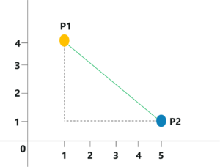


Euclidean Distance
n is the number of dimensions
x is the data point from dataset
y is the new data point (to be predicted)
$$d\left(x,y\right)=\sqrt{\sum_{i=1}^{n}{{(x_{i} −y_{i})}^{2}}}$$
Point P1=(1,4)
Point p2= (5,1)
Euclidean Distance =$\sqrt{{(5−1)}^{2}+{(4−1)}^{2}}$
=$\sqrt{16+9}$
= 5

Slide 29


LIME
Slide Title
Step 4: Calculate the distance between the
query-instance and all the Perturb the Instances
query-instance = [0.3, 0.8]
Fat_Score ($x_{1})$ | Salt_Score ($x_{2})$ | ED
0.3 | 0.8 | 0.000
0.32 | 0.78 | 0.028
0.28 | 0.82 | 0.028
0.35 | 0.75 | 0.071
0.25 | 0.85 | 0.071
$d=\sqrt{{(0.3−0.3)}^{2}\text{+}{(0.8−0.8)}^{2 }}=$0
$d=\sqrt{{(0.32−0.3)}^{2}\text{+}{(0.78−0.8)}^{2}}=$0.028
$d=\sqrt{{(0.28−0.3)}^{2}\text{+}{(0.82−0.8)}^{2 }}=$0.028
$d=\sqrt{{(0.35−0.3)}^{2} \text{+}{(0.75−0.8)}^{2}}=$0.071
$d=\sqrt{{(0.25−0.3)}^{2} \text{+}{(0.85−0.8)}^{2}}=$0.071
Euclidean Distance =$\sqrt{{(x_{1}−0.3)}^{2}+{(x_{2}−0.8)}^{2}}$
Euclidean distance is small, the perturbed sample is very similar to the query instance and should have high influence on the local surrogate model.
Euclidean distance is large, the perturbed sample is less similar to the query instance and should have low influence in the explanation.

Slide 30


LIME
Slide Title
Step 5: Compute Kernel Weights (using an RBF kernel (σ=0.1)).
Weight=$exp\left(−\frac{d^{2}}{σ^{2}}\right)$ 𝞼=0.1
Fat_Score ($x_{1})$ | Salt_Score ($x_{2})$ | ED | Weight
0.3 | 0.8 | 0.00 | 1.000
0.32 | 0.78 | 0.028 | 0.925
0.28 | 0.82 | 0.028 | 0.925
0.35 | 0.75 | 0.071 | 0.604
0.25 | 0.85 | 0.071 | 0.604
Higher kernel weights mean the perturbed sample is closer to the query instance and has greater influence on the local surrogate model.
Lower kernel weights mean the sample is farther from the query instance and has less influence in the explanation.

Slide 31
LIME -Step 6: Fit Local Linear Regression
Slide Title
import numpy as np
from sklearn.linear_model import LinearRegression
X_perturbed = np.array([ [0.3, 0.8],
[0.32, 0.78],
[0.28, 0.82],
# Inputs [0.35, 0.75],
[0.25, 0.85]
])
# Outputs from Perceptron (I values)
I_outputs = np.array([0.285, 0.308, 0.262, 0.338, 0.238])
Similarity weights
weights = np.array([1.0, 0.923, 0.923, 0.602, 0.602])
# Fit linear regression (surrogate)
lr = LinearRegression()
lr.fit(X_perturbed, I_outputs, sample_weight=weights)
print("Intercept (β₀):", lr.intercept_)
print("Fat_Score weight (β₁):", lr.coef_[0])
print("Salt_Score weight (β₂):", lr.coef_[1])
Output:
Intercept (β₀): 0.543279
Fat_Score weight (β₁): 0.51477
Salt_Score weight (β₂): -0.51477

Slide 32
LIME
Slide Title
Interpret the results of local surrogate linear model (which is explaining the perceptron's behavior around the instance [0.3, 0.8]) using the LIME explanation:
Term | Value | Meaning
Intercept (β₀) | 0.543 | Baseline model output when both inputs are 0
Fat_Score weight (β₁) | +0.515 | Effect of fat score on perceptron output
Salt_Score weight (β₂) | −0.515 | Effect of salt score on perceptron output

Slide 33
LIME -Final Inference
Slide Title
Surrogate Model: Weighted Regression Result
Intercept (0.5433): This is the predicted perceptron raw score when both features are 0 — not meaningful globally, but part of the local fit.
Fat_Score coefficient (+0.5148): Local effect: Increasing Fat_Score by 0.1 (while keeping Salt_Score constant) is predicted to increase I by about 0.05148 This means more fat increases acceptance likelihood in this local neighborhood.
Salt_Score coefficient (−0.5148) : Local effect: Increasing Salt_Score by 0.1 is predicted to decrease I by about 0.0515 .This means more salt decreases acceptance likelihood locally.
Equal magnitudes, opposite signs : Local importance of Fat and Salt is the same in size but opposite in direction — the model balances fat and salt inversely.

Slide 34
LIME -Final Inference
Slide Title
Overall Local Insight
For cheese samples similar to (0.30, 0.80)
Increasing Fat_Score will make the perceptron more likely to predict “like” (y=1).
Increasing Salt_Score will make it less likely.
These effects are local — they hold for cheeses near our test sample in the feature space, but may not hold far away.
LIME explanation tells you how the model behaves near your cheese (0.30, 0.80). If you move far away in fat/salt levels, recompute a new local explanation; the effects can change.

Slide 35
References
Slide Title
https://www.geeksforgeeks.org/artificial-intelligence/introduction-to-explainable-aixai-using-lime/
https://christophm.github.io/interpretable-ml-book/lime.html?utm_source=chatgpt.com
https://c3.ai/glossary/data-science/lime-local-interpretable-model-agnostic-explanations/?utm_source=chatgpt.com

