Slide 1
Problem Statement 114 – ARM is Great!
DAA Capstone Project​
NAME: SHESHANK
ROLL NO: CH.SC.U4CSE24125

Slide 2
Problem Statement:
Setup:
You are the Lead Architect at ARM designing the scheduling logic for the Core Conqueror 9000 processor.
The processor contains M identical cores operating under a Single Global Clock Tree.
Key idea:
All cores must run at the same frequency f at any moment.
The processor must execute N incoming tasks efficiently.
Each task requires a certain number of Compute Units to complete.
Your job is to determine:
How tasks should be assigned to cores.
What frequency the processor should run.
so that the system is efficient.

Slide 3
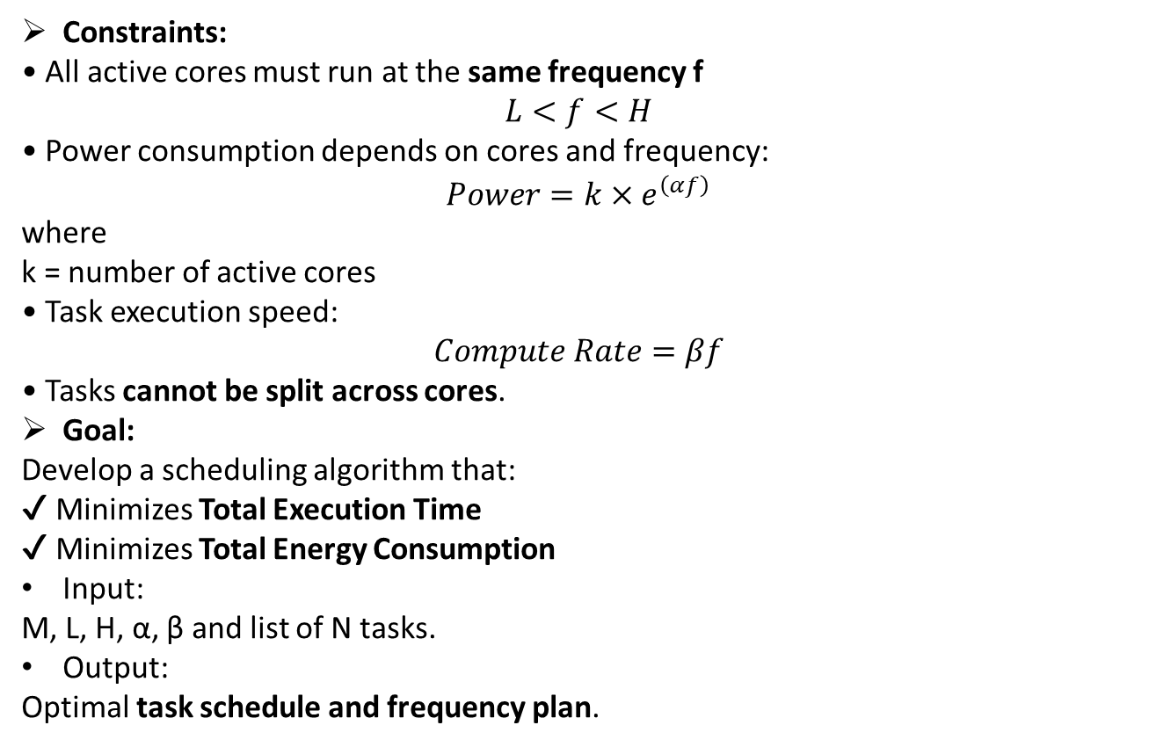
Constraints & Goal:
Constraints:
• All active cores must run at the same frequency f
$$L<f<H$$
• Power consumption depends on cores and frequency:
$$Power=k×e^{\left(αf\right)}$$
where k = number of active cores
• Task execution speed:
$$Compute Rate=βf$$
• Tasks cannot be split across cores.
Goal:
Develop a scheduling algorithm that:
✔ Minimizes Total Execution Time ✔ Minimizes Total Energy Consumption
Input:
M, L, H, α, β and list of N tasks.
Output:
Optimal task schedule and frequency plan.
M = Number of processor cores
L = Minimum processor frequency
H = Maximum processor frequency
α (alpha) = Constant that affects power consumption
β (beta) = Constant that affects computation speed

Slide 4
Algorithmic Approach & Design:
Algorithm Used: Longest Processing Time (LPT Greedy)
Explanation:
We sort tasks in descending order of compute units and assign each task to the least loaded core.
This balances workloads across cores and reduces total completion time.
Steps:
Sort tasks by largest compute units
Select the least loaded core
Assign the task to that core
Update the core load
Repeat until all tasks are assigned

Slide 5
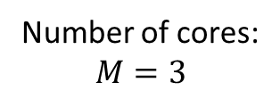
Worked Example:
Number of cores:
$$M=3$$
Tasks:
Task | Compute Units
T1 | 500
T2 | 200
T3 | 450
T4 | 300
T5 | 250
T6 | 150
Order | Task | Compute Units
1 | T1 | 500
2 | T3 | 450
3 | T4 | 300
4 | T5 | 250
5 | T2 | 200
6 | T6 | 150
Step 1 — Sort Tasks (Longest First)
LPT requires sorting tasks in descending order.

Slide 6

Step 2 — Initialize Core Loads
Core | Load
C1 | 0
C2 | 0
C3 | 0
Total Execution Time
Finish times:
Core1 → 650
Core2 → 650
Core3 → 550
Step 3 — Assign Tasks Using LPT
Core | Tasks | Load
C1 | T1, T6 | 650
C2 | T3, T2 | 650
C3 | T4, T5 | 550
Total Execution Time=650
Final Task Allocation
Assume:
$L=5$
$H=15$
$α=0.1$
Then:
$$f^{∗}=\frac{1}{α}=\frac{1}{0.1}=10$$
Since $10$ lies between $5$ and $15$, the selected frequency is:
$$f=10$$
Core | Tasks
Core 1 | T1 → T6
Core 2 | T3 → T2
Core 3 | T4 → T5
Execution Timeline
Time | Core 1 | Core 2 | Core 3
0–450 | T1 | T3 | T4
450–500 | T1 | T2 | T4
500–550 | T6 | T2 | T5
550–650 | T6 | T2 | Idle

Slide 7
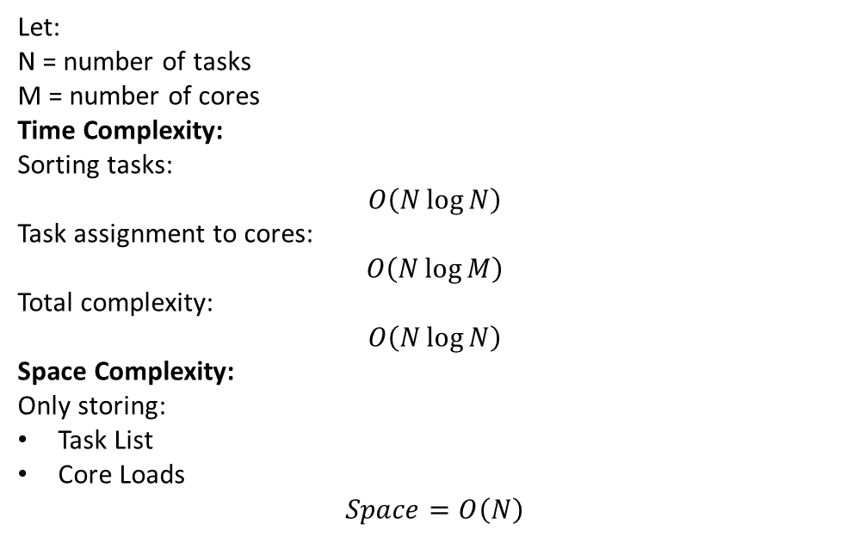
Asymptotic Analysis:
Let:
N = number of tasks M = number of cores
Time Complexity:
Sorting tasks:
$$O\left(N\log{N}\right)$$
Task assignment to cores:
$$O\left(N\log{M}\right)$$
Total complexity:
$$O\left(N\log{N}\right)$$
Space Complexity:
Only storing:
Task List
Core Loads
$$Space=O\left(N\right)$$
Conclusion
• Efficiently schedules N tasks across M cores using the LPT greedy algorithm. • Ensures balanced workload distribution and reduced total execution time. • Selects an appropriate processor frequency to minimize energy consumption while maintaining performance.

Slide 8
Thank You

