Slide 1


Analysis on Price of Laptops Based on Features Available In Flipkart

Slide 2
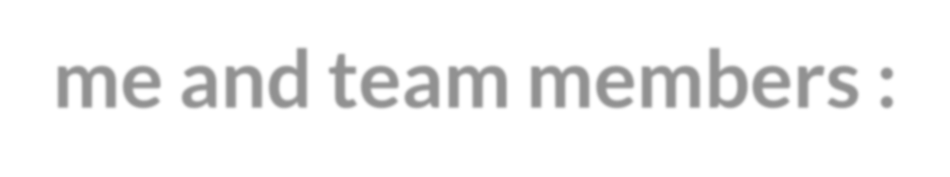

About me and team members :
Name: B.Sai Rohit
Graduation: B.Tech (CSE)
I want to learn data science to know about how data is useful for
business .
Name: Kasam Sai Ram
Graduation: B Tech(CSE)
I want to learn more about data science skills like sql, python.
Name: Nallavelli Dinesh
Graduation: Degree(BSC)
I am eager to enhance my data science skills, focusing on SQL, Python, and related technologies.

Slide 3
Problem Statement
To find what are the features that are influencing the Prices of Laptops.

Slide 4
Objective Of The Project
The objective of this project is to analyze how various features of laptops influence their prices on e-commerce platform like Flipkart.

Slide 5

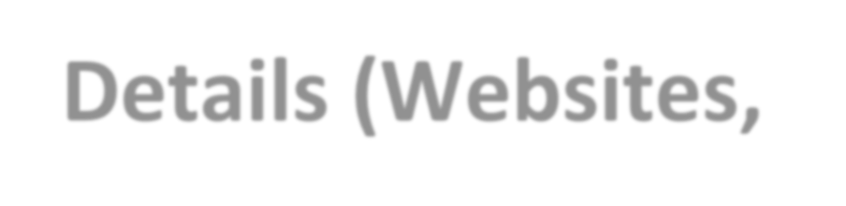
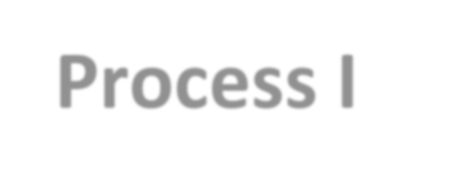

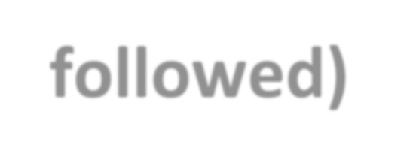
Web Scraping – Details (Websites, Process I followed)
The process of using bots to extract content and data from a website was flipkart.
We scrap the data of following catgory of Laptops present in flipkart.
We have collected 1 - 60 pages from the website
We have gone through out every parameter category from the web site to extaract sufficient data for analysis
we inspect website and mapped every tags and class which we need from the website.
we match the container and make sure the data witch we need is present in the container.

Slide 6
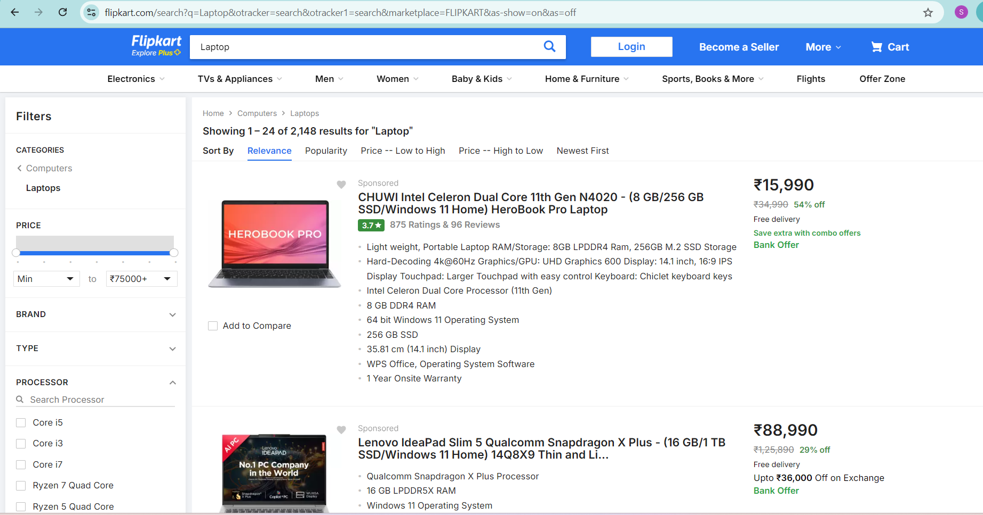

Slide 7
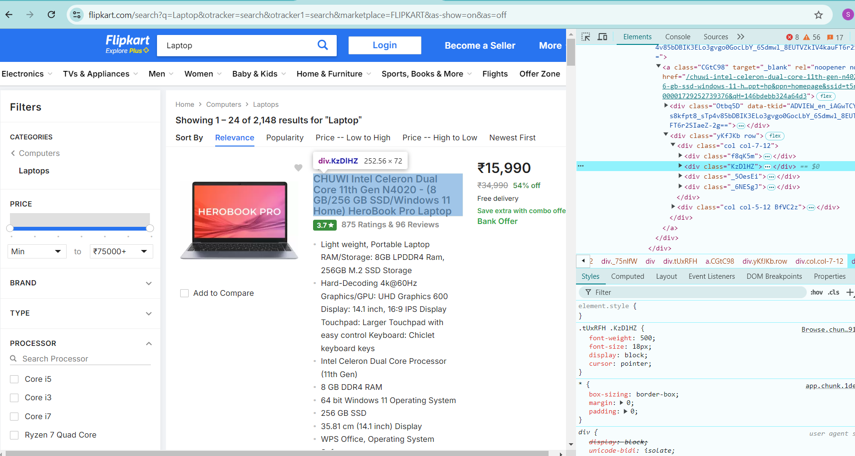

Slide 8
Exploratory Data Analysis Of Data Cleaning
DATA CLEANING:
we under go process of fixing or removing incorrect, corrupted, incorrectly formatted, duplicate, or incomplete data within a dataset.
2. we Looked at the proportion of missing data.
3. Checked the data type of each column.
4. We checked for trailing whitespaces.
5. Deal with Missing Values (NaN Values).
6. Checked the unique values of columns.

Slide 9
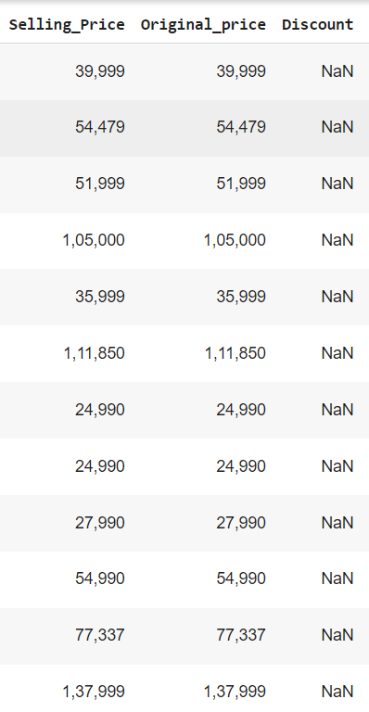
Filling Null Values In Discount Column
We got to fill the null values in Discount column.
Because Both Selling_price and Orginal_price having same values.
we are filling the Discount values with 0% off.

Slide 10
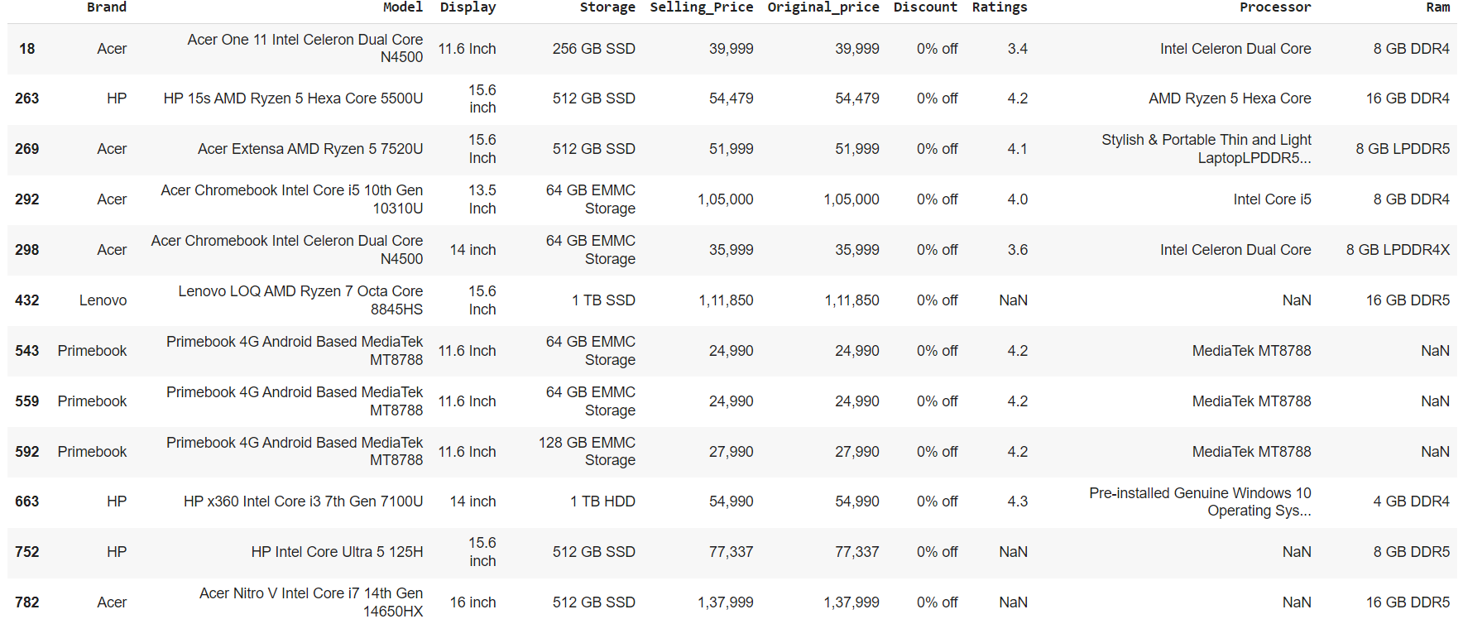

Slide 11
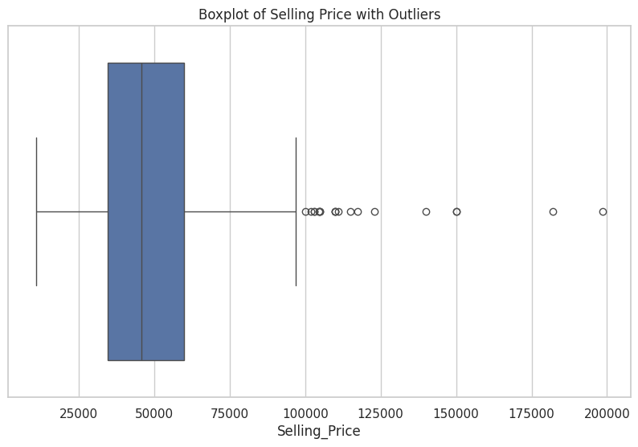
Outlier Detection

Slide 12
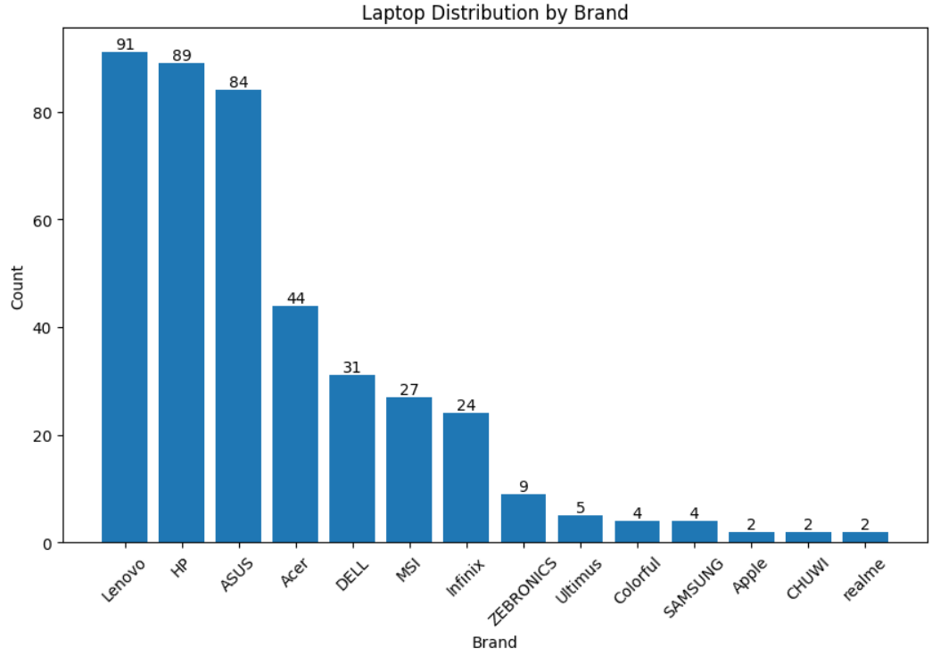
Univariant Analysis
To Know Which Laptop Brands Are More By Using Countplot.

Slide 13
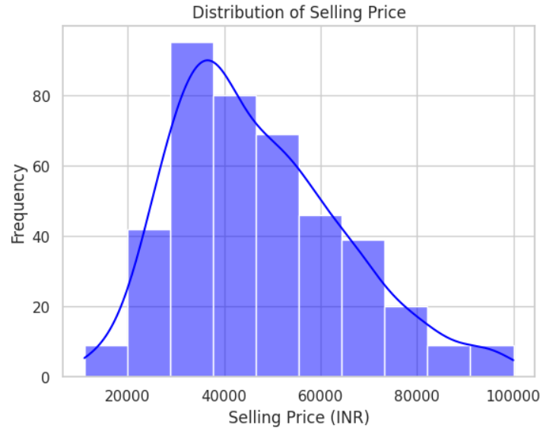
Distribution Of Selling Price
In Univariant Analysis we have checked for Distribution Of Selling Price using Histogram Plot.
We got to know that the Selling Price Range between 30K-40k is more.

Slide 14
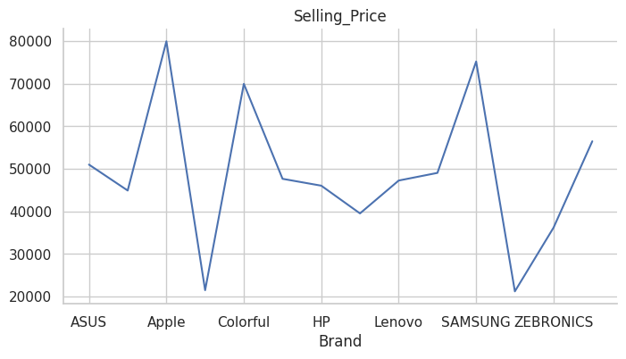
Bivariate Analysis
We performed bivariate analysis on Selling_Price and Brand Column.
We found that Apple and Samsung have higher selling prices compared to other brands.

Slide 15
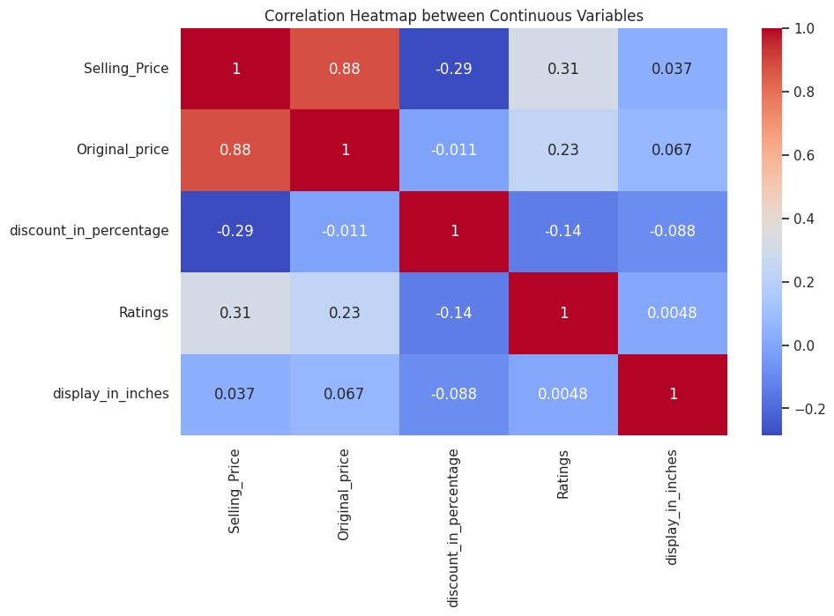
Multivariate Analysis
We performed Multivariate Analysis on all Numeric columns.
We checked correlation of all numeric columns

Slide 16
Key Business Questions :
"A key business question that could be explored using Flipkart Laptop data is:
'What are the Features that are Influencing Laptop price on Flipkart?’
This question can be analyzed into various aspects of features such as Ratings, Processor, Brand Name, Storage, Ram.
Analyzing this factors may provide valuable insights for increasing the laptop price on flipkart.

Slide 17
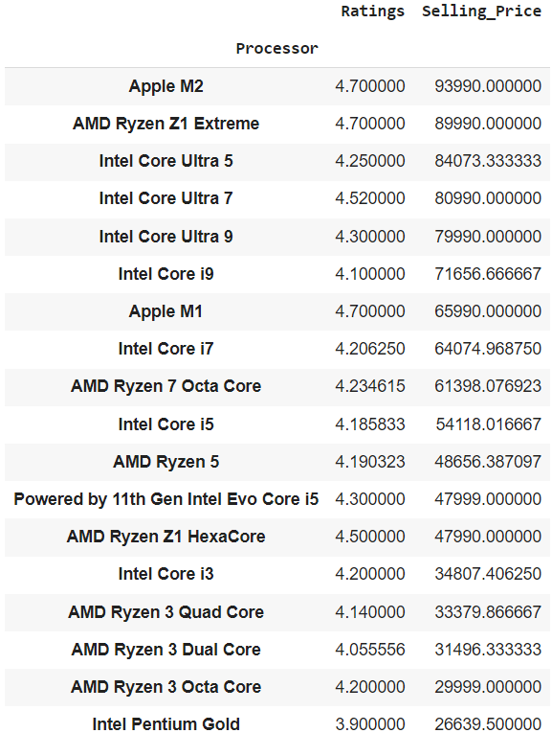
Conclusion
The main features that are effecting the increase in selling_price are from the above given plots.

Slide 18
Your Experience/Challenges working on Web Scraping – Data Analysis Project.
Well this was our first project it was great exploring through out the project starting from the web site selection to visualization.
We got a new challenges through passing the process of scraping and also a major task of cleaning section we got to know things how it could work actually .
Finally we took it into final compleation hope we could learn much more about new things of exploring when we go more deeper from data analysis to data science.

Slide 19



THANK YOU

