Slide 1
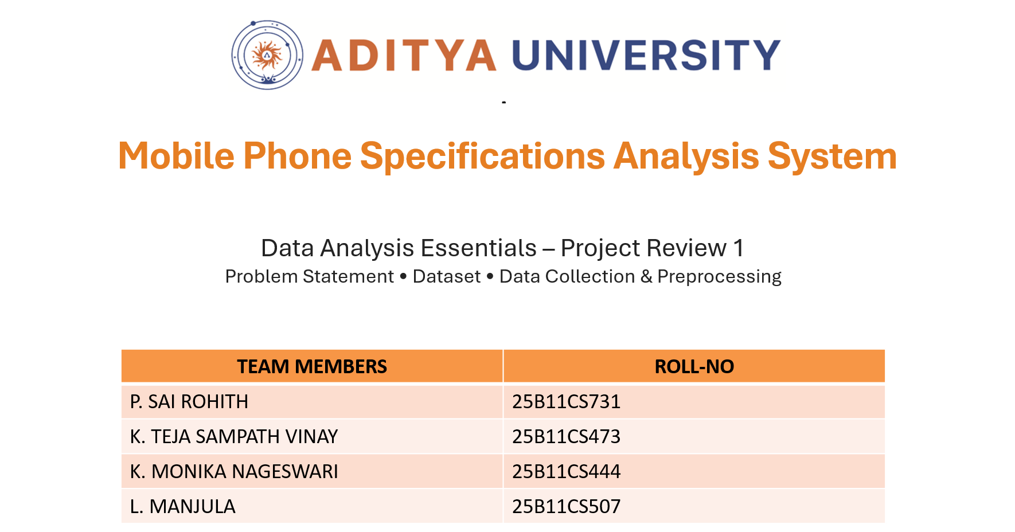

Slide 2


DOMAIN & PROJECT OVERVIEW
Smartphone Market & Data Analytics
.
.
Smartphones differ in brands, specifications, features and prices.
Important attributes include RAM, ROM, battery, camera, ratings and price.
.
.
Data analytics can be used to compare smartphones and identify useful patterns.
Our project analyzes smartphone data to support data-driven comparison and decision-making.

Slide 3

PROBLEM STATEMENT
Consumers face difficulty in comparing smartphones because different models have different specifications, features, ratings and prices. Manual comparison of multiple attributes is time-consuming and may not provide a clear data-driven view of which phones offer better value.
Our project addresses this by:
  Organizing smartphone specification data.
  Cleaning and preparing the data.
  Comparing important smartphone attributes.
  Analyzing relationships between specifications and price.
  Identifying better-value options based on selected criteria.

Slide 4
OBJECTIVES
  Analyze
Analysing smartphone specifications and prices.
  Compare
Comparing Smartphones based on important attributes.
  Perform
Brand-wise and price-range analysis.
  Study
Relationships between specifications and price.
  Visualise
Identify smartphones offering better value based on selected criteria.
Present findings using meaningful data visualizations.

Slide 5
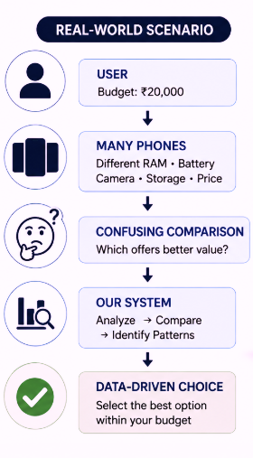

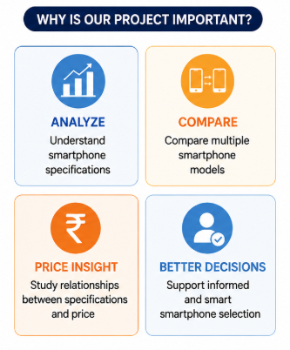
REAL WORLD EXAMPLE AND IMPORTANCE

Slide 6
Dataset Selection & Source
Selected Dataset
Mobile price prediction Dataset
from
Kaggle
in the format of
CSV
Why did we select this dataset?
  Directly related to our project domain.
  Contains smartphone specifications and price information.
  Contains numerical and categorical attributes.
  Suitable for data cleaning and preprocessing.
  Suitable for comparison and visualization.

Slide 7
📊 DATASET UNDERSTANDING
DATASET SIZE
836 Records | 10 Columns
Attribute | Description
Brand | Smartphone manufacturer/brand
Ratings | User/customer rating
RAM | Memory capacity
ROM | Internal storage capacity
Mobile Size | Size of the mobile device
Primary Camera | Main camera specification
Selfie Camera | Front camera specification
Battery Power | Battery capacity
Price | Smartphone price
Unnamed: 0 | Index/identifier column

Slide 8

DATASET FEATURES
📱 DEVICE
Brand
⚙️ MEMORY
RAM • ROM
🔋 HARDWARE
Mobile Size • Battery Power
📷 CAMERA
Primary Camera • Selfie Camera
⭐ EVALUATION
Rating
💰 ANALYSIS
Price

Slide 9

DATA COLLECTION PROCESS
Dataset Source → CSV File → Python → Pandas DataFrame
DATA IMPORT
import pandas as pd
data = pd.read_csv("mobile_phone_dataset.csv")
Initial Check
df.head()
df.shape
df.info()

Slide 10

DATA CLEANING & PREPROCESSING
Preparing smartphone data for reliable analysis
01
02
03
04
MISSING VALUES
DUPLICATE VALUES
OUTLIERS
TRANSFORMATION
data.isnull().sum()
data.duplicated().sum()
Numerical columns
Data preparation
Identified
Identify → Remove if found
Detect → Analyze → Handle
Types → Formats → Transform
Total missing cells: 313
Rating : 31 , RAM :7 , ROM:4
Mobile_size: 2, selfie_Cam : 269
PREPROCESSING FLOW
Encoding & Scaling
Only when required
RAW DATA
CHECK
CLEAN
TRANSFORM
READY

Slide 11
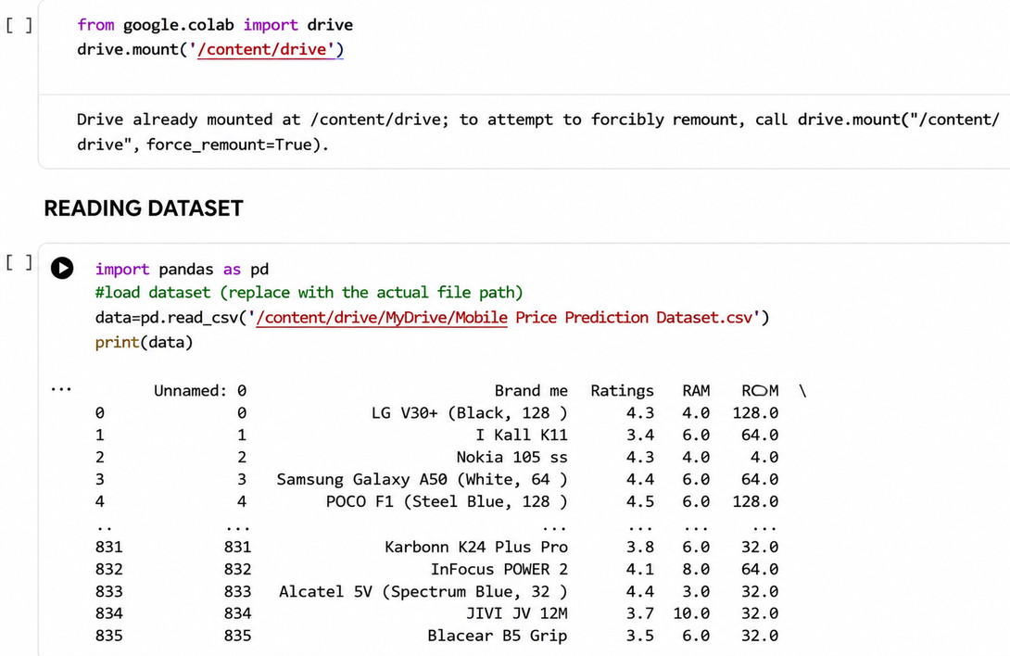
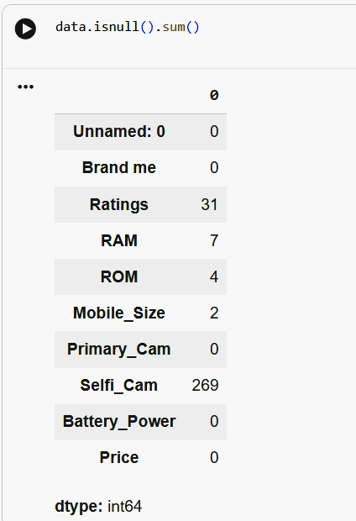
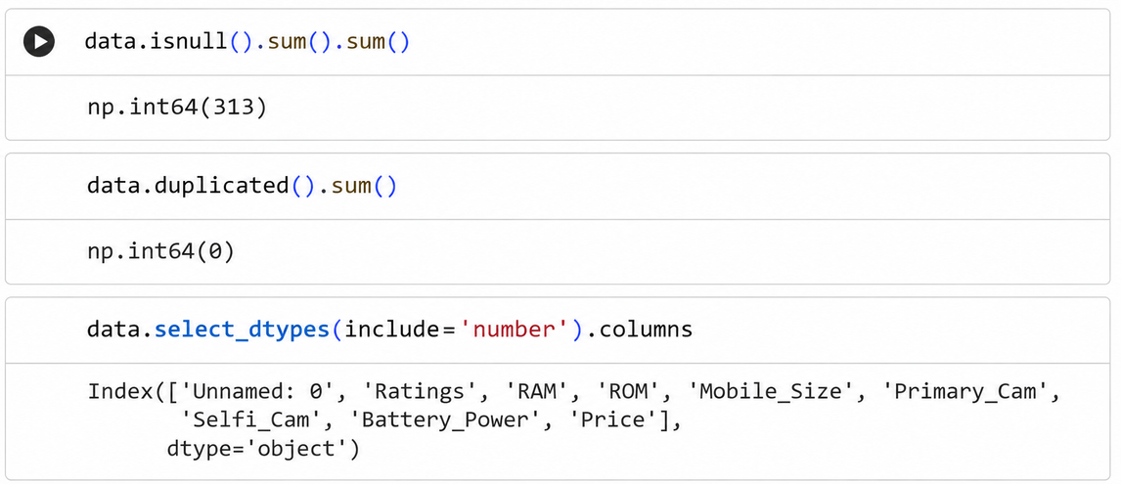
INITIAL DATA OUTPUT
MISSING VALUES

Slide 12
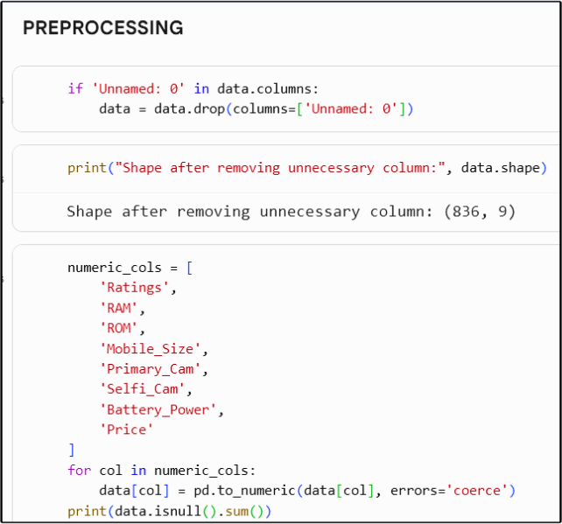
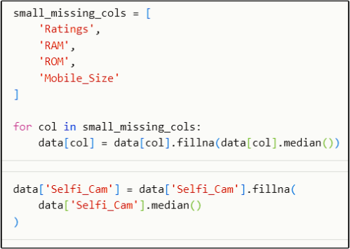
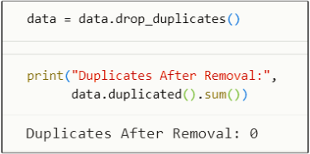
REPLACING MISSING VALUES
DELETING DUPLICATES

Slide 13
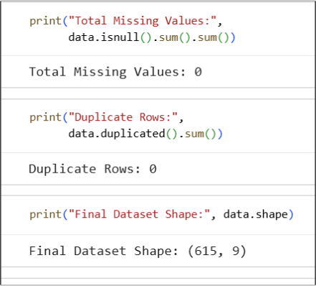
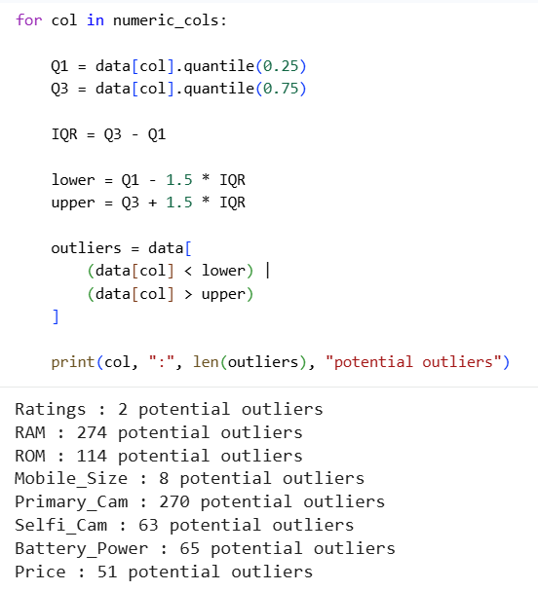
CLEANED DATA
OUTLIER DETECTION

Slide 14
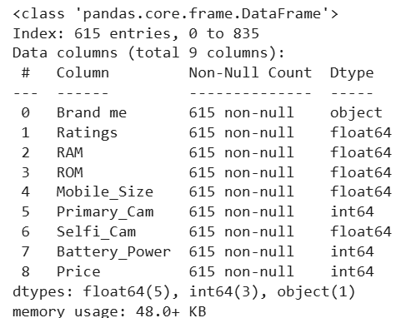
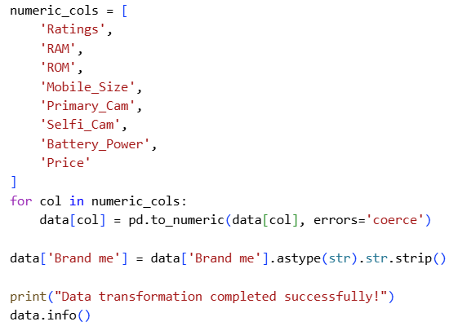
DATA TRANSFORMATION

Slide 15
WHAT WE WILL DO NEXT
OUR NEXT JOURNEY
01
PREPARE
ANALYZE
VISUALIZE
INSIGHT
Final Goal: Meaningful smartphone comparison based on data

Slide 16
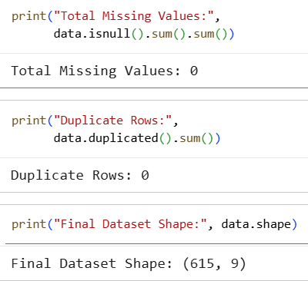
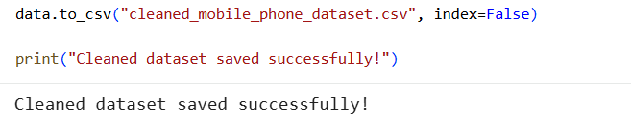
FINAL DATA VERIFICATION
DATASET SAVING

Slide 17

DATA ANALYSIS
After data preparation, the dataset is analyzed using Pandas.
Analysis Performed
  Analyze smartphone specifications
  Calculate summary statistics
  Compare important attributes
  Perform brand-wise analysis
  Categorize smartphones by price
  Study relationships between specifications and price
Main Attributes
RAM • ROM • Battery • Ratings • Price

Slide 18
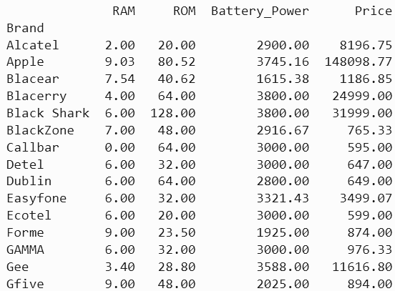
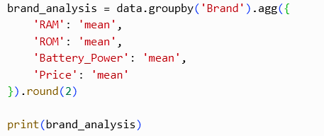
BRAND-WISE ANALYSIS
Operations Performed
OUTPUT :
  Identify different smartphone brands
  Count smartphones for each brand
  Calculate average price by brand
  Compare brand-wise pricing

Slide 19

PRICE RANGE ANALYSIS
Smartphones are grouped into different price categories:
  Below ₹10K
  ₹10K – ₹20K
  ₹20K – ₹30K
  ₹30K – ₹50K
  Above ₹50K
Purpose
To understand how smartphones are distributed
across different pricesegments

Slide 20
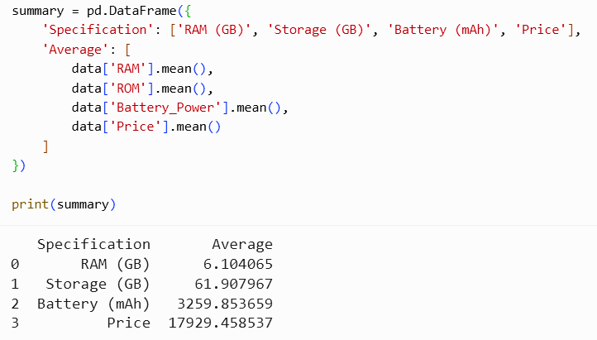
SPECIFICATION ANALYSIS
Attributes Analyzed
  RAM
  ROM
  Battery Power
  Ratings
  Price
Analysis
  Average values
  Minimum values
  Maximum values
  Distribution of values

Slide 21
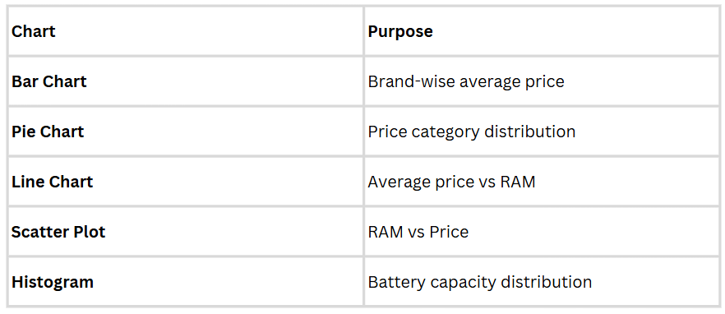
DATA VISUALIZATION
The analyzed data is represented using Matplotlib.
Visualizations Used

Slide 22
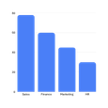
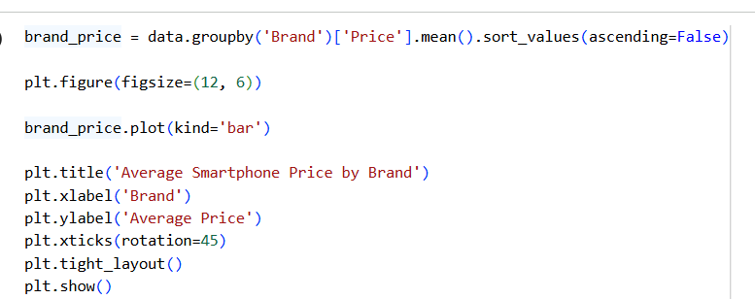
BRAND-WISE AVERAGE PRICE
Bar Chart
  Compares average smartphone price across brands
  Makes brand-wise price comparison easier
  Shows differences in average pricing
The chart helps identify how average smartphone prices vary between brands.

Slide 23
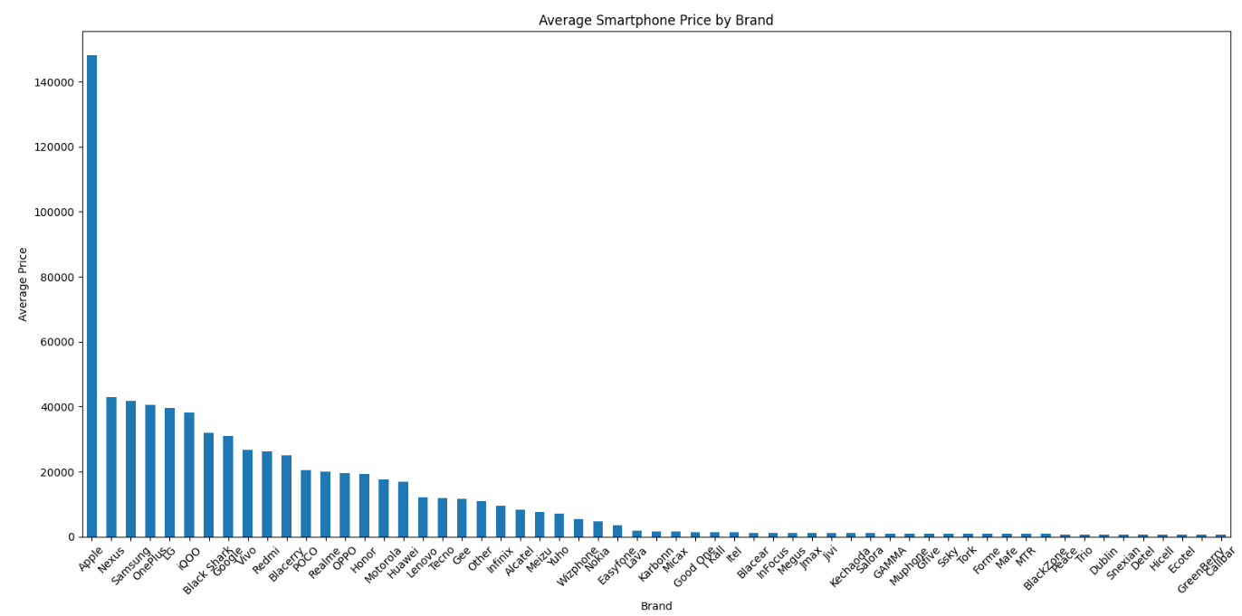
BAR CHART

Slide 24
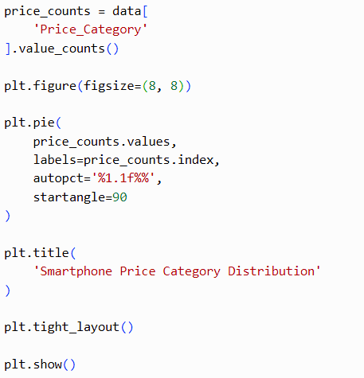
PRICE CATEGORY DISTRIBUTION
Pie Chart
  Represents smartphones across different price categories
  Shows the proportion of each price segment
  Helps identify the distribution of smartphones by price range

Slide 25
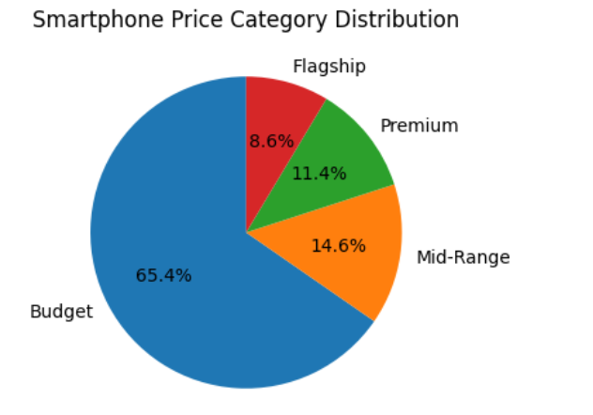

Slide 26
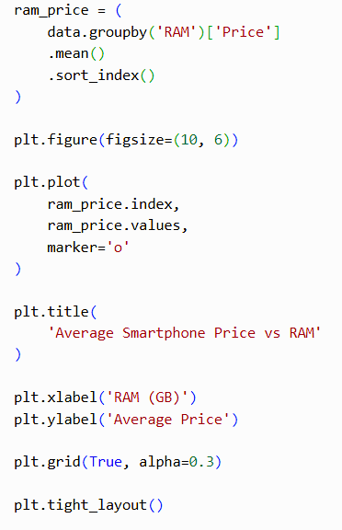
AVERAGE PRICE VS RAM
Line Chart
  Compares average price for different RAM values
  Shows how average price changes with RAM
  Helps identify pricing patterns across RAM levels

Slide 27
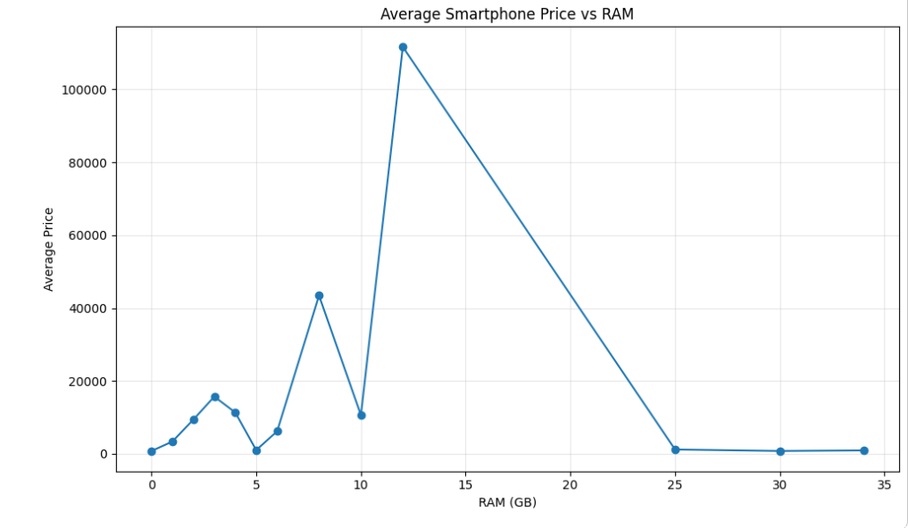

Slide 28
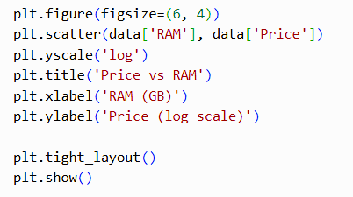
RAM VS PRICE
Scatter Plot
  Compares RAM with smartphone price
  Each point represents a smartphone
  Shows variation in prices for different RAM values
  Helps observe the relationship between RAM and price

Slide 29
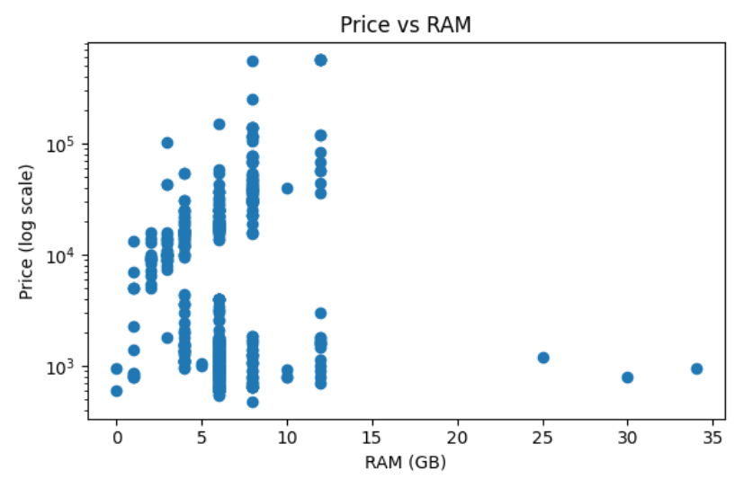

Slide 30
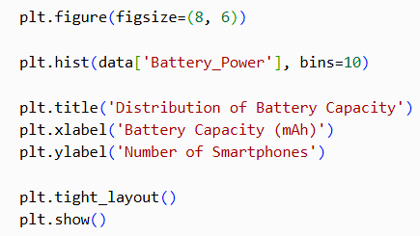
BATTERY CAPACITY DISTRIBUTION
Histogram
  Shows the distribution of battery capacities
  Groups battery values into intervals
  Helps identify commonly occurring battery ranges
  Shows how battery capacities are spread
across the dataset

Slide 31
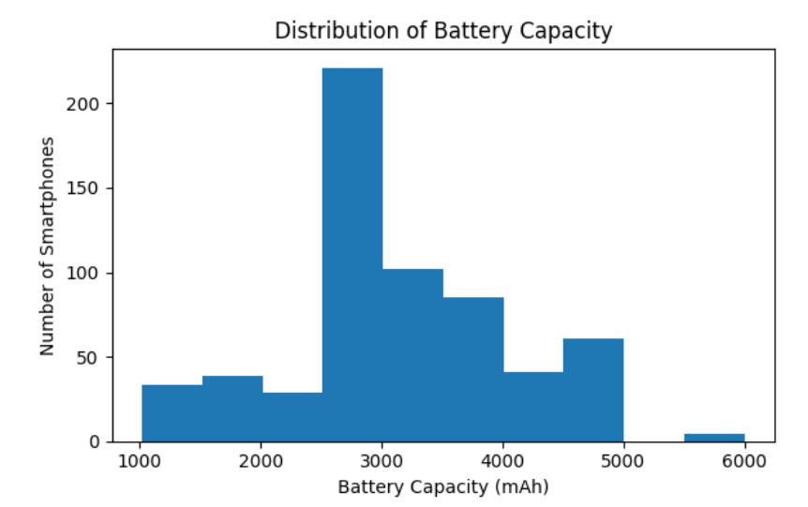

Slide 32
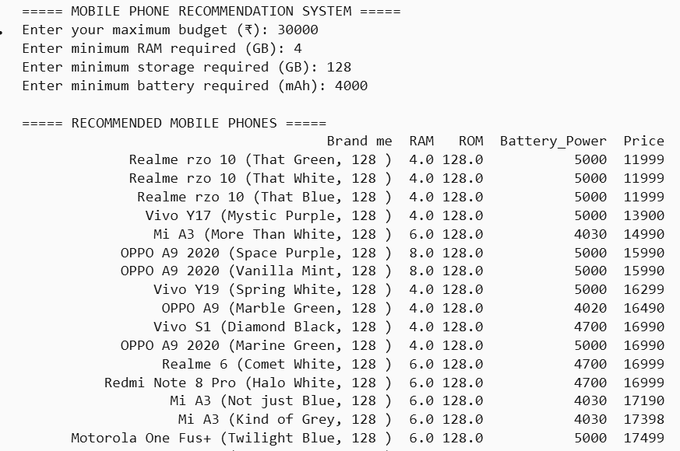
SMARTPHONE RECOMMENDATION
User Requirements
  Budget
  Minimum RAM
  Minimum Storage
  Minimum Battery
Process
User Requirements
↓
Filter Dataset
↓
Find Matching Smartphones
↓
Display Recommendations

Slide 33
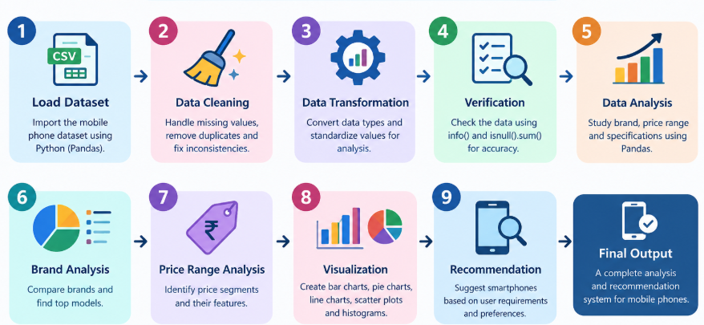
PROJECT WORKFLOW

Slide 34
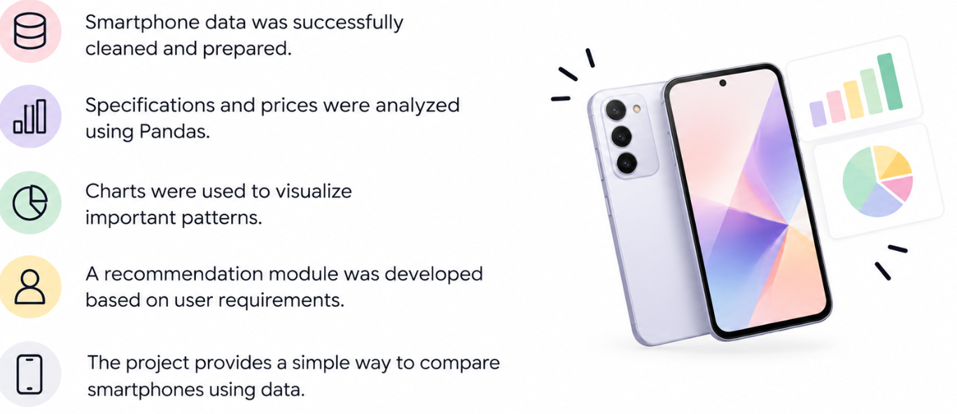
CONCLUSION

Slide 35







FUTURE ENHANCEMENTS
Richer Dataset: larger, up-to-date data with more attributes such as processor, display, 5G and release year.
Live Data: collect prices and ratings from e-commerce sites to track price changes over time.
Price Prediction: apply machine learning models to predict smartphone price from specifications.
Value Score & Clustering: rank phones by value and group them into budget, mid-range and flagship.
Review Sentiment Analysis: use customer reviews to make recommendations more reliable.
Smarter Recommendations: add more filters and side-by-side comparison of selected phones.
Interactive Dashboard: build a web app or dashboard (Streamlit / Power BI) for non-technical users.

Slide 36
THANK YOU

