Slide 1
WEEK 3
CYBERSECURITY ASSESSMENT
Nmap • Wireshark • Vulnerability Assessment • Security Hardening
Presented by
Sairohith H
Intern Id
DG/SEPTEMBER/CYBER/131

Slide 2
2. Project Objective
• Assess an authorized small internal lab network using practical security tools.
• Discover hosts and exposed services with Nmap.
• Capture and understand network traffic with Wireshark.
• Identify security findings and explain their risk.
• Apply basic firewall hardening and verify the change with a follow-up scan.
Week 3 Cybersecurity Assessment | 2

Slide 3
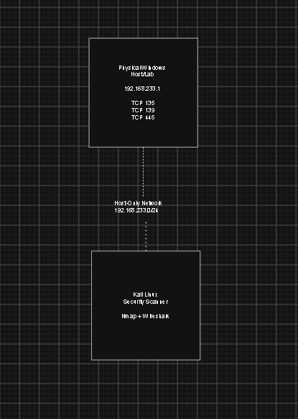
3. Lab Architecture
The lab traffic was kept inside the authorized VirtualBox Host-Only network, which provided an isolated environment for carrying out the security testing without directly exposing the practical activity to external networks.
The main target used in the scans was 192.168.233.1, which was the Windows system selected for the assessment.
Kali Linux was used as the assessment machine. Nmap was run from Kali to discover the target, identify open ports, and examine the services running on the Windows system.
Wireshark was used to capture and analyze the traffic between the assessment machine and the target. This helped in understanding how different protocols and connection attempts appeared at packet level.
The Host-Only network used the 192.168.233.0/24 subnet, allowing the lab systems to communicate with each other within the controlled environment.
Week 3 Cybersecurity Assessment | 3

Slide 4
4. Tools Used
Nmap
Host discovery, port scanning, service/version detection, OS detection, SYN, UDP and NSE scans.
Wireshark
Packet capture, filtering and protocol-level traffic analysis.
Kali Linux
Assessment environment used to run the security tools.
VirtualBox
Created the isolated lab VMs and Host-Only network.
Windows Firewall
Used to restrict inbound access during hardening.
Windows 11
An another OS as a Base Machine
Week 3 Cybersecurity Assessment | 4

Slide 5
5. Nmap Assessment
Main commands
nmap -sn 192.168.233.1/24
nmap 192.168.233.1
nmap -sV 192.168.233.1
nmap -O 192.168.233.1
nmap -sS 192.168.233.1
nmap -sU --top-ports 20 192.168.233.1
nmap --script vuln 192.168.233.1
Host discovery
The lab network was scanned to identify active hosts.
Service detection
Nmap identified the services behind the open ports.
Advanced scans
SYN, UDP, OS and vulnerability-script scans added more detail.
Week 3 Cybersecurity Assessment | 5

Slide 6
6. Nmap Results
Port | Protocol | Service | Result
135 | TCP | MSRPC | Open
139 | TCP | NetBIOS-SSN | Open
445 | TCP | Microsoft-DS / SMB | Open
Baseline
997 other TCP ports were reported as filtered in the basic scan.
Service detection
135 was identified as Microsoft Windows RPC; 139 as Windows NetBIOS-SSN; 445 as Microsoft-DS.
Week 3 Cybersecurity Assessment | 6

Slide 7
7. Wireshark Analysis
• Traffic was captured on the authorized lab interface.
• Protocols observed included TCP, UDP, DNS, ICMP and ARP.
• Useful filters included: arp, icmp, tcp, udp, dns.
• TCP SYN and RST filters were used to focus on connection attempts.
• Packet details were checked for time, source, destination, ports, flags and protocol information.
Key point
Wireshark provided packet-level evidence behind the Nmap results.
Week 3 Cybersecurity Assessment | 7

Slide 8
8. Security Findings
Finding | Evidence | Risk
SMB exposure | TCP/445 open | High
Multiple Windows services exposed | 135, 139 and 445 open | High
NetBIOS exposure | TCP/139 open | Medium
RPC exposure | TCP/135 open | Medium
Additional reachable high ports | Packet investigation showed 61728, 44505 and 52325 | Medium
Risk ratings describe exposure and potential impact; they do not prove that a service is exploitable.
Week 3 Cybersecurity Assessment | 8

Slide 9
9. Vulnerability / Risk Assessment
High
SMB exposure and combined Windows-service exposure need tighter access control.
Medium
RPC and NetBIOS exposure should be limited to systems that need them.
No confirmed critical issue
The Nmap NSE output did not establish a confirmed critical software vulnerability.
• TCP/445: security-sensitive SMB exposure.
• TCP/139: legacy NetBIOS exposure.
• TCP/135: Windows RPC exposure.
• Additional high-numbered ports were observed, but their applications were not identified.
• Failed SMB negotiation in two NSE checks was treated as inconclusive, not as a confirmed vulnerability.
Week 3 Cybersecurity Assessment | 9

Slide 10
10. Hardening Performed
TCP/135
Inbound RPC access restricted with a Windows Firewall block rule.
TCP/139
Inbound NetBIOS access restricted with a Windows Firewall block rule.
TCP/445
Inbound SMB access restricted with a Windows Firewall block rule.
• The changes were made on the authorized Windows target.
• The goal was to reduce unnecessary network exposure.
• The correct verification method is a Kali-to-Windows Nmap scan after the firewall change.
Week 3 Cybersecurity Assessment | 10

Slide 11
11. Before vs After
Service | Before | Action | After
TCP/135 | Open | Inbound firewall block | Use actual post-hardening Nmap result
TCP/139 | Open | Inbound firewall block | Use actual post-hardening Nmap result
TCP/445 | Open | Inbound firewall block | Use actual post-hardening Nmap result
Evidence rule
The final After column must match the actual Nmap result. No result should be changed or assumed.
Week 3 Cybersecurity Assessment | 11

Slide 12
12. Recommendations
• Keep Windows and installed software patched and up to date.
• Allow TCP/135, TCP/139 and TCP/445 only from systems that require them.
• Disable NetBIOS and other legacy services when they are not needed.
• Review SMB shares and remove unnecessary sharing.
• Use a least-privilege inbound firewall policy.
• Identify and review any unexpected high-numbered listening ports.
• Repeat Nmap scans after configuration changes to confirm the result.
Week 3 Cybersecurity Assessment | 12

Slide 13
Conclusion
• This week connected network scanning with packet-level analysis.
• Nmap showed the main exposed Windows services: 135, 139 and 445.
• Wireshark helped explain TCP connection attempts and other network traffic.
• The assessment focused on reducing unnecessary service exposure.
• Firewall hardening was applied and the final Nmap result should be used to confirm the change.
Thank you

