Slide 1
Generative AI Art Creation
Theme : recent trends and developments in computer science engineering

Slide 2
Introduction to Generative Art
What is Generative Art?
Generative art refers to the creation of artwork through the use of algorithms, computer code, and automated processes. It is a form of art that is created by a system or set of rules, rather than by the direct hand of the artist. Generative art is often characterized by its dynamic, evolving, and unpredictable nature.
Significance in the Art World
Generative art has gained significant attention and recognition in the art world due to its unique and innovative approach. It challenges traditional notions of authorship and creativity, blurring the lines between human and machine collaboration. Generative art has opened up new possibilities for artistic expression, pushing the boundaries of what is considered art.

Slide 3
Team Members :
S.NO. | Name
1. | SINGAM VARUN KUMAR REDDY
2. | MEDA SAAI KARTHIK
3. | Y.V.PRANEETH REDDY
4. | M.SRAVAN SRINIVAS RAJ

Slide 4
Types of Generative Art
Fractal Art
Fractal art is created using mathematical equations and algorithms.
It often exhibits self-similarity and intricate patterns.
Fractal art can be generated through iterations and zooming into specific areas of the fractal equation.
Algorithmic Art
Algorithmic art is generated using predefined rules and algorithms.
Artists create algorithms that determine the visual output.
The process can involve randomness and iteration to create unique and unpredictable results.

Slide 5
Continues :
Procedural Art
Procedural art is created through a sequence of steps or procedures.
Artists define rules and parameters that generate the artwork.
The process can involve randomness and variation, allowing for endless possibilities and exploration.

Slide 6
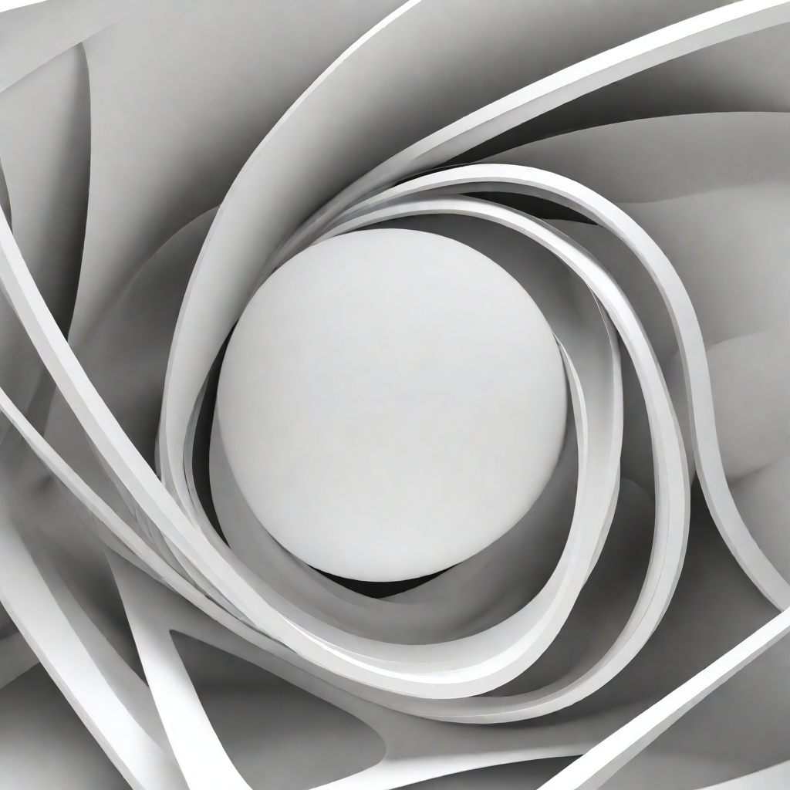
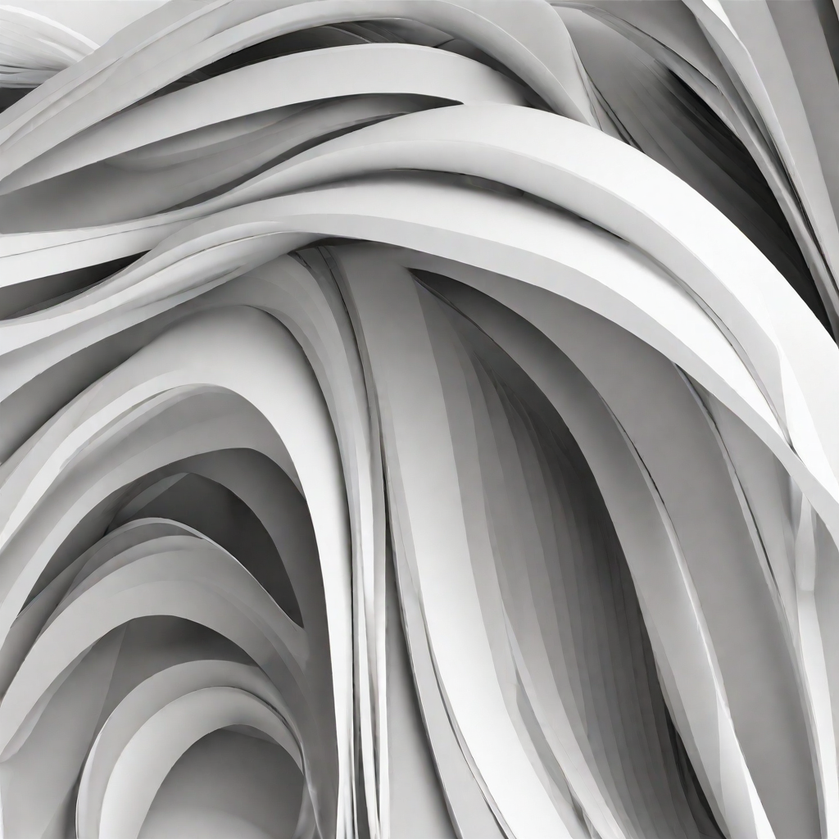
Tools and Software for Generative Art
Specialized Software
Generative Design: A software package that enables designers to create complex patterns and forms using generative algorithms.
NodeBox: A node-based visual programming environment for creating generative art and design.
Programming Languages
Processing: A flexible software sketchbook and a language for learning how to code within the context of the visual arts.
p5.js: A JavaScript library that makes coding accessible for artists, designers, educators, and beginners.

Slide 7
Conclusion :
Embracing Generative Art
Generative art is revolutionizing the art world by combining technology and creativity.
Artists are embracing algorithms and code to create unique and dynamic artworks.
This new form of art challenges traditional notions and pushes the boundaries of creativity.
Democratizing Art
Generative art opens up new opportunities for artists and art enthusiasts.
It allows for greater accessibility and inclusivity in the art world.
Anyone with a computer and coding skills can create their own generative artworks.

Slide 8
Impact on the Art World
Generative art challenges traditional notions of authorship and originality.
It blurs the lines between artist and machine, raising questions about the role of technology in art.
The art world is embracing generative art as a new and exciting form of expression.

