Slide 1
HOUSING PRICES PREDICTION
SAIRAM
BY RUCHI

Slide 2
BIO
BACHELOR OF ENGINEERING COMPUTER SCIENCE
CERTIFIED AI FOR KIDS TRAINER
TRAINED IN PYTHON BY NUS

Slide 3
AGENDA
Business Problem Definition
DATA Process Design
Values delivery
Next steps and Summary

Slide 4
AGENDA
Business Problem Definition
DATA Process Design
Values delivery
Next steps and Summary

Slide 5

Ask a home buyer to describe their dream house, and they probably won't begin with the height of the basement ceiling or the proximity to an east-west railroad. But this playground competition's dataset proves that much more influences price negotiations than the number of bedrooms or a white-picket fence.

Slide 6
BUSINESS QUESTION: How to predict the price of the house?
DATA QUESTION:
What model could be used to predict HOUSE PREDICTION and what is the accuracy ??? ”

Slide 7
Process workflow
BUSINESS QUESTION
EDA
MODELLING
DATA QUESTIONS
FEATURE
ENGINEERING
VALIDATION
TESTING

Slide 8
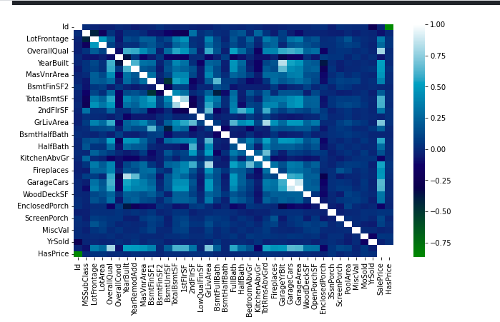
Plotting a heatmap to see if there is any correlation between the columns

Slide 9
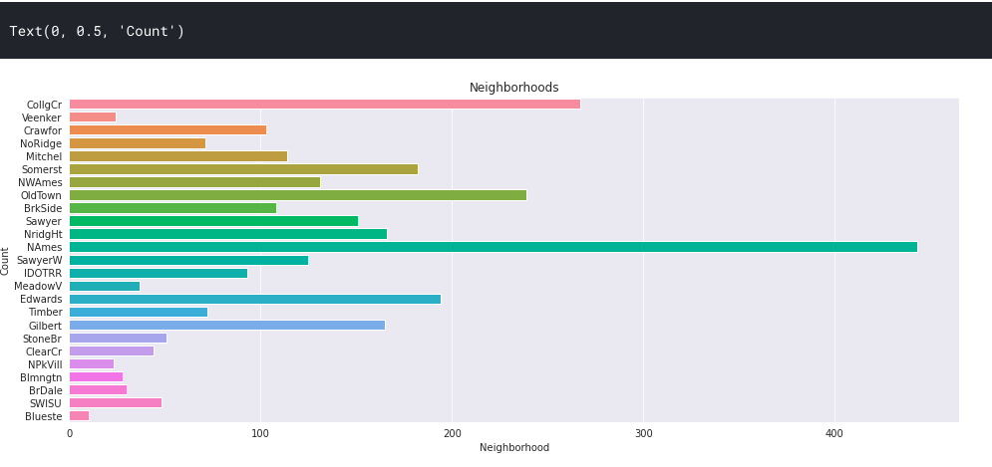
BARPLOT DEPICTING THE PRICE NEIGHBOURHOOD WISE

Slide 10
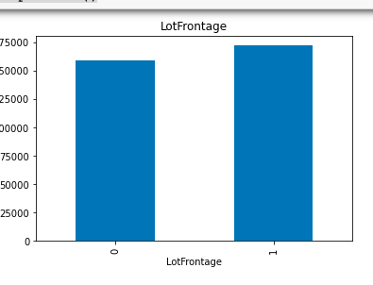
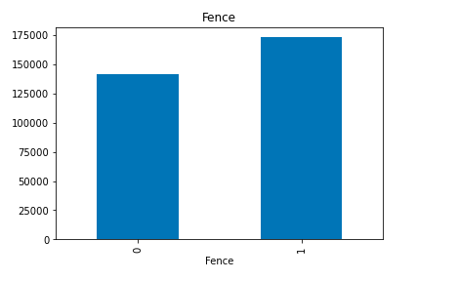
Potential features explored from EDA

Slide 11
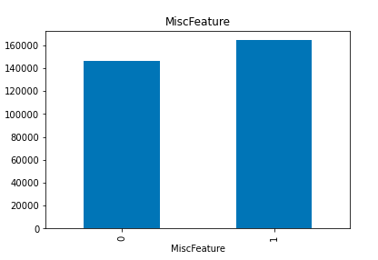
Potential features explored from EDA
Price depicted as per miscellaneous features

Slide 12
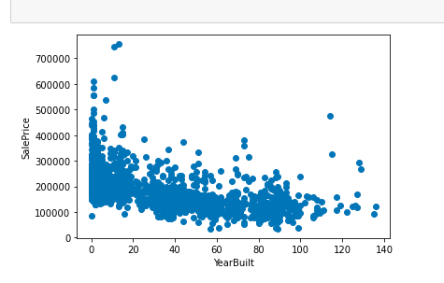
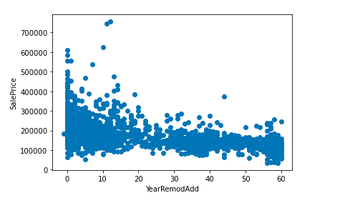
Potential features explored from EDA

Slide 13
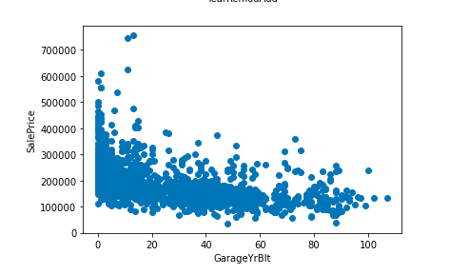
Potential features explored from EDA

Slide 14
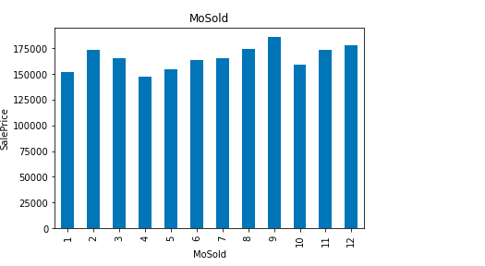
Potential features explored from EDA

Slide 15
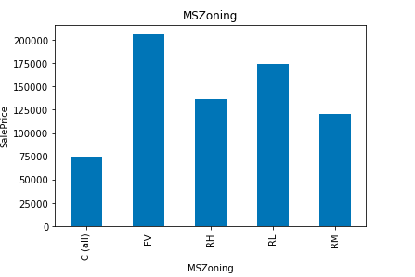
Potential features explored from EDA

Slide 16
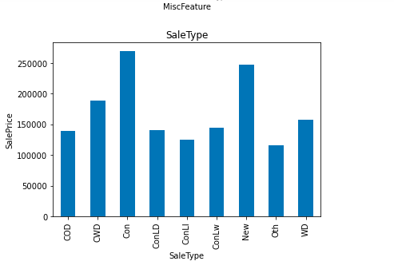
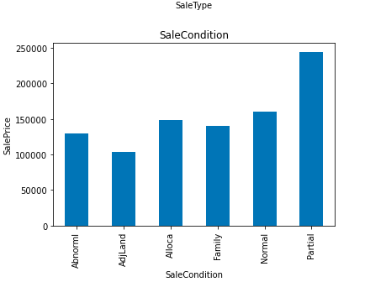
Potential features explored from EDA

Slide 17
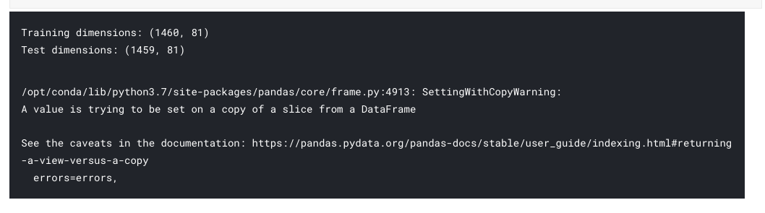
modelling

Slide 18
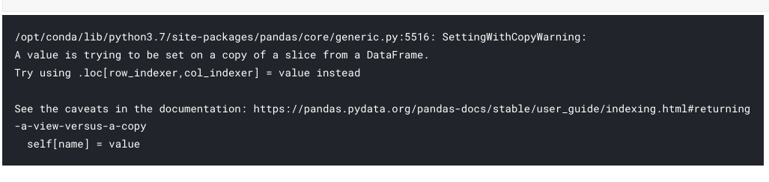
Data modelling contd

Slide 19
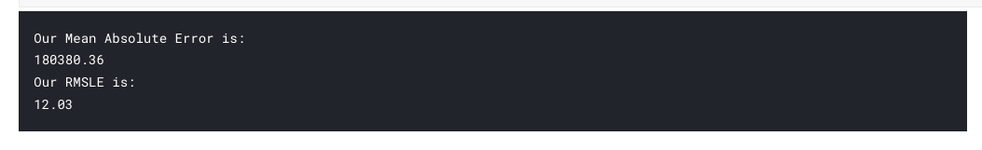
Mean absolute error

Slide 20
Future work:
Data Preprocess:
Feature Engineering
Deep learning:
AutoEncoder
Conventional layer (feature extraction)
Machine Learning:
Cat-boost
Method:
Blending
Stacking

Slide 21

Target companies

