Slide 1
Excel Reassessment
By:
Sairus Mishra
EmpID: 4301

Slide 2
Q1
Insights:
Total number of orders returned are 800 which makes up 8% of total orders.
Returned? | Number of Orders | Percentage of Orders
No | 9194 | 92%
Yes | 800 | 8%
Grand Total | 9994 | 100%
Returned? | Total Profit | Total Sales | Loss(S-P)
No | 263164.6602 | 2116696.582 | 1853532
Yes | 23232.3615 | 180504.2779 | 157271.9
Formula Used:
1st we join the data return and order using vlookup, and then used pivot table to find the above table and %. Total loss of returned which is sales – profit is 157271.9, we used pivot table to extract this information.

Slide 3
Q2
Insights:
Standard Class has highest shipping time i.e. 5 days and least time it takes in same day ship mode.
Formula Used:
1st we calculated shipping time by simply subtracting Order date and Ship Date and then used pivot table to get the data and chart above.

Slide 4
Q3
Insights:
Table 1 shows the group of sale which gives the highest profit which is 0-100 category and table 2 shows list of customers who ordered most.
Sale | Number of Customers | Total Profit
0-100 | 6226 | 33.3K
100-200 | 1189 | 26.1K
200-300 | 675 | 17.9K
400-500 | 293 | 12.0K
800-900 | 119 | 11.7K
300-400 | 449 | 10.1K
500-600 | 218 | 10.0K
600-700 | 175 | 9.1K
1200-1300 | 45 | 8.9K
Customer ID | Number of Orders
WB-21850 | 37
PP-18955 | 34
MA-17560 | 34
JL-15835 | 34
SV-20365 | 32
JD-15895 | 32
CK-12205 | 32
EH-13765 | 32
AP-10915 | 31
ZC-21910 | 31
EP-13915 | 31
Table 1
Table 2
Formula Used:
For Tab 1, we used pivot table then grouped the sales column and we also added profit to it and in terms of tab 2, we used order id vs customer id and got the list of customer who orders the most by sorting them.

Slide 5
Q4
Category | Sub-Category | Total Sales | Average Profit
Technology | Phones | 330K | 50.07
Technology | Machines | 189K | 29.43
Technology | Accessories | 167K | 54.11
Technology | Copiers | 150K | 817.91
Furniture | Chairs | 328K | 43.10
Furniture | Tables | 207K | -55.57
Furniture | Bookcases | 115K | -15.23
Furniture | Furnishings | 92K | 13.65
Office Supplies | Storage | 224K | 25.15
Office Supplies | Binders | 203K | 19.84
Office Supplies | Appliances | 108K | 38.92
Office Supplies | Paper | 78K | 24.86
Office Supplies | Supplies | 47K | -6.26
Office Supplies | Art | 27K | 8.20
Office Supplies | Envelopes | 16K | 27.42
Office Supplies | Labels | 12K | 15.24
Office Supplies | Fasteners | 3K | 4.38
Sub-Category | Total Sales | Average Profit
Phones | 330K | 50.07
Chairs | 328K | 43.10
Storage | 224K | 25.15
Tables | 207K | -55.57
Binders | 203K | 19.84
Machines | 189K | 29.43
Accessories | 167K | 54.11
Copiers | 150K | 817.91
Bookcases | 115K | -15.23
Appliances | 108K | 38.92
Furnishings | 92K | 13.65
Paper | 78K | 24.86
Supplies | 47K | -6.26
Art | 27K | 8.20
Envelopes | 16K | 27.42
Labels | 12K | 15.24
Fasteners | 3K | 4.38
Table 3
Table 1
Category | Total Sales | Average Profit
Technology | 836K | 78.75
Furniture | 742K | 8.70
Office Supplies | 719K | 20.33
Table 2
Insights:
Table 1,2,3 shows that Phone in Technology has the highest sales combined and individually too.
Formula Used:
We used pivot to group them by category and subcategory and found sales and average profit of each combination.

Slide 6
Q5
Insights:
Central regions has very less sales as well as profits compared to other regions.
For order of profitability, West>East>South>Central.
Formula Used:
We used pivot to group them by regions and found the sum of sales and average profit and plotted in combo chart.

Slide 7
Q6
Insights:
Both of them are somehow correlated inversely,
However, DR is almost inversely proportional to Profit Margin.
Discount Rate Vs Quantity Sold | -50.53%
Discount Rate Vs Profit Margin | -63.12%
Profit | Sum of Quantity
0 | 18267
0.1 | 373
0.15 | 198
0.2 | 13660
0.3 | 849
0.32 | 105
0.4 | 786
0.45 | 45
0.5 | 241
0.6 | 501
0.7 | 1660
0.8 | 1188
Profit | Sum of Profit
0 | 320987.6
0.1 | 9029.177
0.15 | 1418.992
0.2 | 90337.31
0.3 | -10369.3
0.32 | -2391.14
0.4 | -23057.1
0.45 | -2493.11
0.5 | -20506.4
0.6 | -5944.66
0.7 | -40075.4
0.8 | -30539
Formula Used:
=CORREL(G5:G16,H5:H16) and
=CORREL(J5:J16,K5:K16)

Slide 8
Q7
Insights:
So, we can clearly see that average shipping time is more in central region, and moreover we are making loss for the returned products in central region. So we should focus on central region to increase the sales and profit.
Region | Returned | Average of Shipping Time | Sum of Sales | Sum of Profit
Central | No | 4.08 | 487K | 43K
Central | Yes | 3.61 | 14K | -4K
Central Total |  | 4.06 | 501K | 40K
East | No | 3.90 | 637K | 87K
East | Yes | 3.98 | 42K | 5K
East Total |  | 3.91 | 679K | 92K
South | No | 3.92 | 374K | 45K
South | Yes | 4.72 | 17K | 2K
South Total |  | 3.96 | 392K | 47K
West | No | 3.97 | 618K | 89K
West | Yes | 3.71 | 107K | 20K
West Total |  | 3.93 | 725K | 108K
Formula Used:
We used simple pivot to analyse the data.

Slide 9
Q8
Customer ID | Distinct Count of Order ID
BH-11710 | 8
EH-13945 | 8
LC-16930 | 8
KM-16720 | 8
PS-18970 | 8
PN-18775 | 8
LC-16870 | 8
AD-10180 | 8
HA-14920 | 8
FH-14365 | 8
HK-14890 | 8
DL-13315 | 8
CB-12535 | 8
AG-10495 | 8
KL-16555 | 8
DJ-13510 | 8
AB-10060 | 8
MK-17905 | 8
SS-20140 | 8
RF-19840 | 8
CJ-12010 | 8
PB-19150 | 8
RB-19795 | 8
MC-17605 | 8
RL-19615 | 8
FP-14320 | 8
MO-17800 | 8
ME-17725 | 8
JD-16150 | 8
AR-10825 | 8
SR-20740 | 8
Insights:
These are the customers who order very frequently.
TH-21235 | 8
AB-10165 | 8
JK-15370 | 8
RS-19765 | 8
RD-19810 | 8
CP-12340 | 8
BF-11020 | 8
DL-12865 | 8
LT-17110 | 8
HW-14935 | 8
BW-11110 | 8
DP-13105 | 8
JA-15970 | 8
CY-12745 | 8
DL-13495 | 8
AP-10720 | 8
MC-17575 | 8
CP-12085 | 8
YS-21880 | 8
KM-16375 | 8
DB-13270 | 8
SG-20470 | 8
RD-19480 | 8
MC-17275 | 8
MM-18055 | 8
ED-13885 | 8
RP-19855 | 8
JF-15565 | 8
KH-16330 | 8
CB-12415 | 8
AM-10705 | 8
CT-11995 | 8
RF-19345 | 8
RB-19435 | 8
DK-13375 | 8
PJ-18835 | 8
SV-20935 | 8
EM-13825 | 8
KN-16705 | 8
SC-20260 | 8
TM-21010 | 8
DB-12910 | 8
TT-21220 | 8
TC-21295 | 8
GA-14515 | 8
DR-12940 | 8
DM-13345 | 8
LB-16795 | 8
MH-17455 | 8
KE-16420 | 8
BG-11035 | 8
Formula Used:
We used pivot to count the number of orders of customers and sort them largest to smallest.

Slide 10
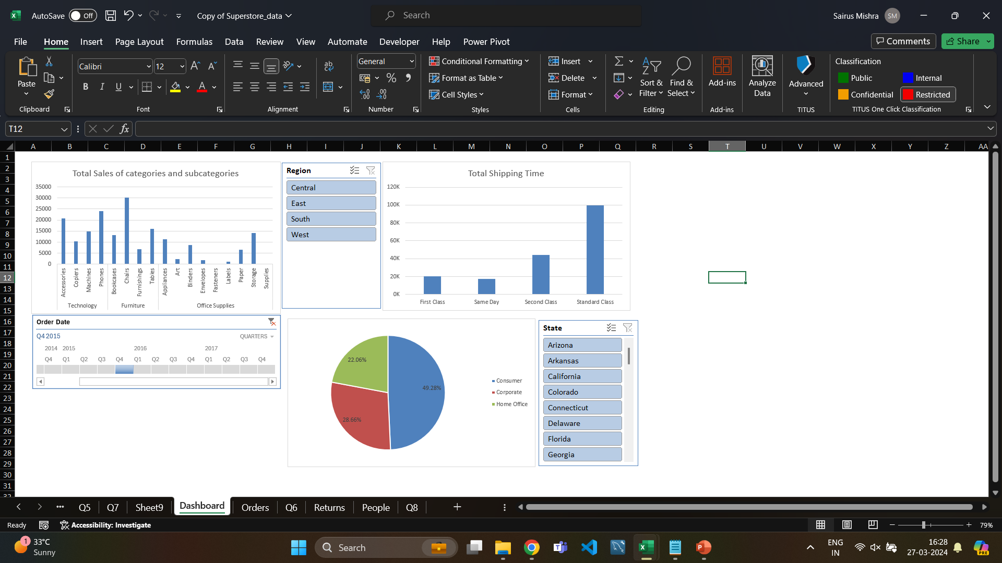
Q9
Insights:
We have made a dashboard to analyse total sales in categories subcategories and percentage of segment ordered.
Formula Used:
Pivot table used to make graphs and later slicers and timelines are added.

