Slide 1

Customer Segmentation

Slide 2

Agenda
Introduction
Problem Statement
Data Collection
Data Pre-Processing
Sentiment Analysis
Insights from Analysis
Data Modelling
Future Scope
Conclusion

Slide 3
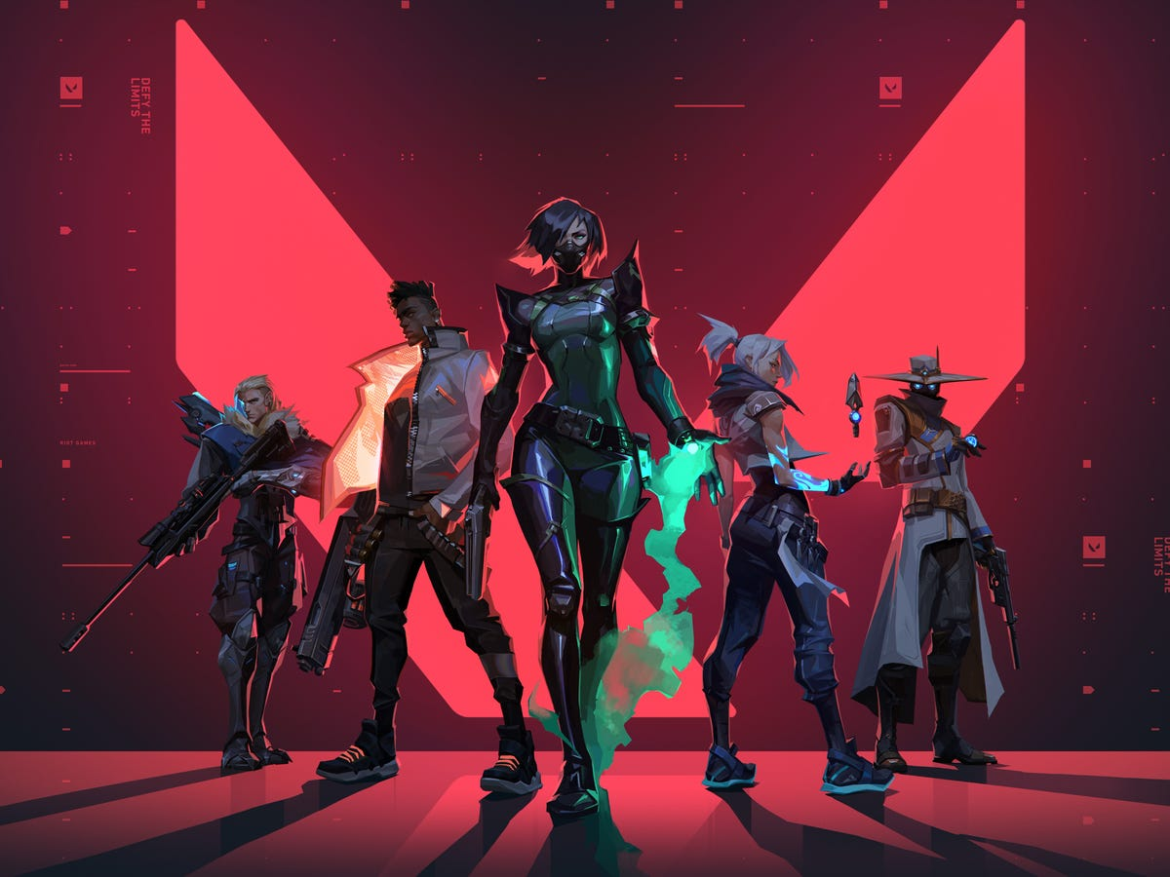
Introduction
Valorant, a free-to-play first-person tactical hero shooter developed and published by Riot Games
Released on June 2, 2020
Estimated 19M total players as of 2024 with a daily average of nearly 5M players
Players play as one of a set of Agents, characters based on several countries and cultures around the world

Slide 4

Problem Statement
The 25th agent, Clove debuted in the game alongside patch 8.05 on 26th March 2024
What are people's reactions to the new agent before and after its release?
We conducted sentiment analysis on people's discussions on Reddit

Slide 5
Data Collection
Collected the Reddit's comments using PRAW from Reddit's below five subreddit
Subreddit | Subscribed Users | # of posts per day | Collected count
r/Valorant | 2 million | ~9 | 7489
r/ValorantCompetitive | 222k | ~1 | 3380
r/ValorantPBE | 40k | ~1 | 600
r/ValorantClips | 22k | ~2 | 432
r/Eggwick | 25k | ~3 | 826
To optimize storage and retrieval efficiency, we implemented storing data from CSV to MySQL database due to the large volume of data from these subreddits.

Slide 6
Data Pre-Processing/Challenges
Pre-processing the collected data involved removing filler and stop-words to enhance its relevance for further analysis.
Challenges
The character name "clove" inconsistently appeared as "cleave," potentially causing confusion in preprocessing.
Some gamer verbal expressions were accidentally removed, risking loss of valuable context.
Solution
Developed logic to handle "clove" variations, maintaining accuracy.
Refined preprocessing to retain crucial gamer expressions for comprehensive data processing.

Slide 7
Sentiment Analysis
Implemented sentiment analysis on pre & post-release dataset
Google Bert:
Training Data Set - IMDB Data set
Challenges – Longer execution time to train model, incorrect sentiment predictions due to context mismatch in IMDB and reddit comments
Llama 2:
Ollama - used to run Llama 2 LLM locally
LangChain - used to interact with Ollama Llama 2
Challenges - prompted to download models from paid sources and pay for collab pro due to extensive CPU utilization, giving csv files as input

Slide 8
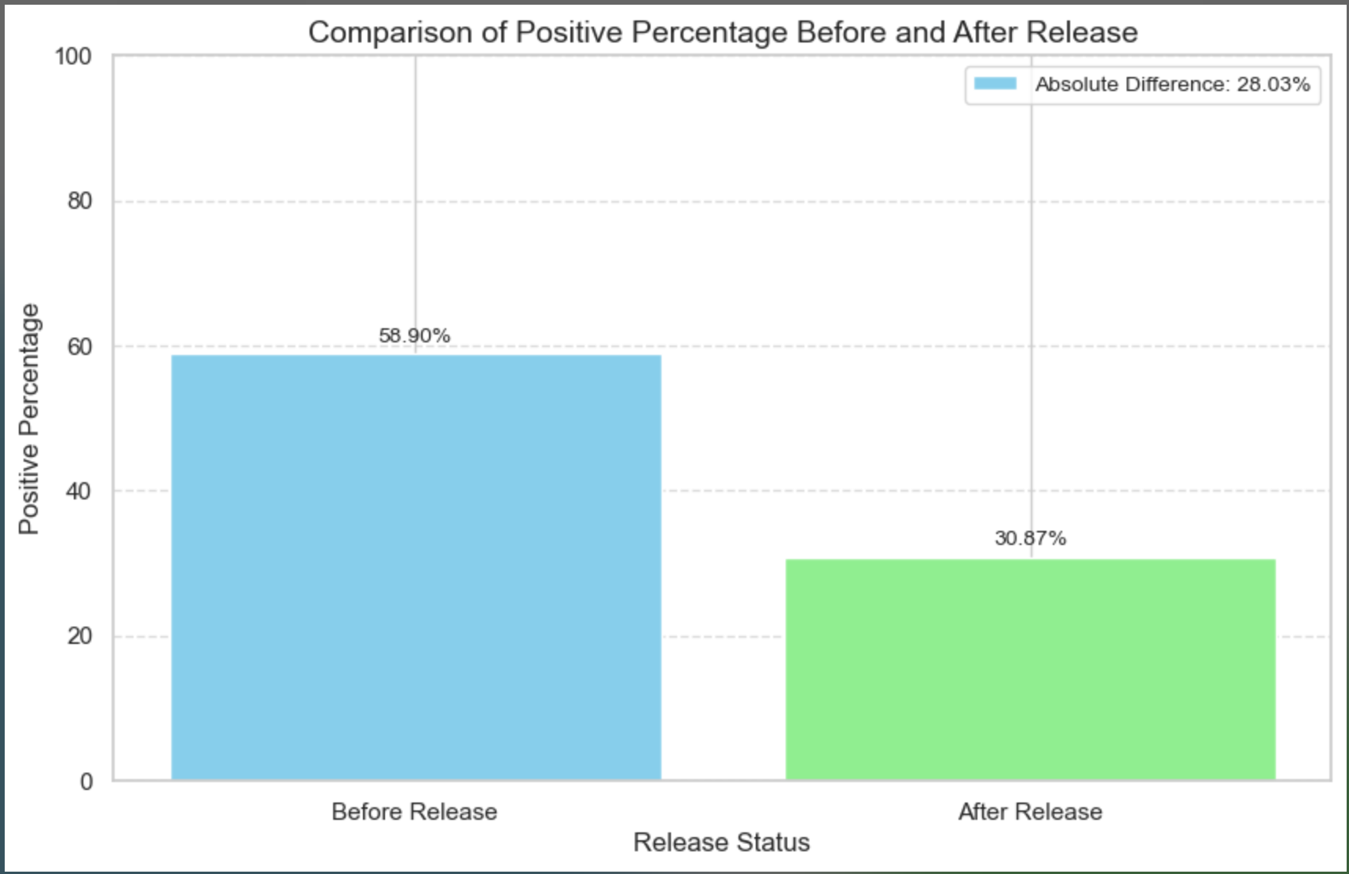
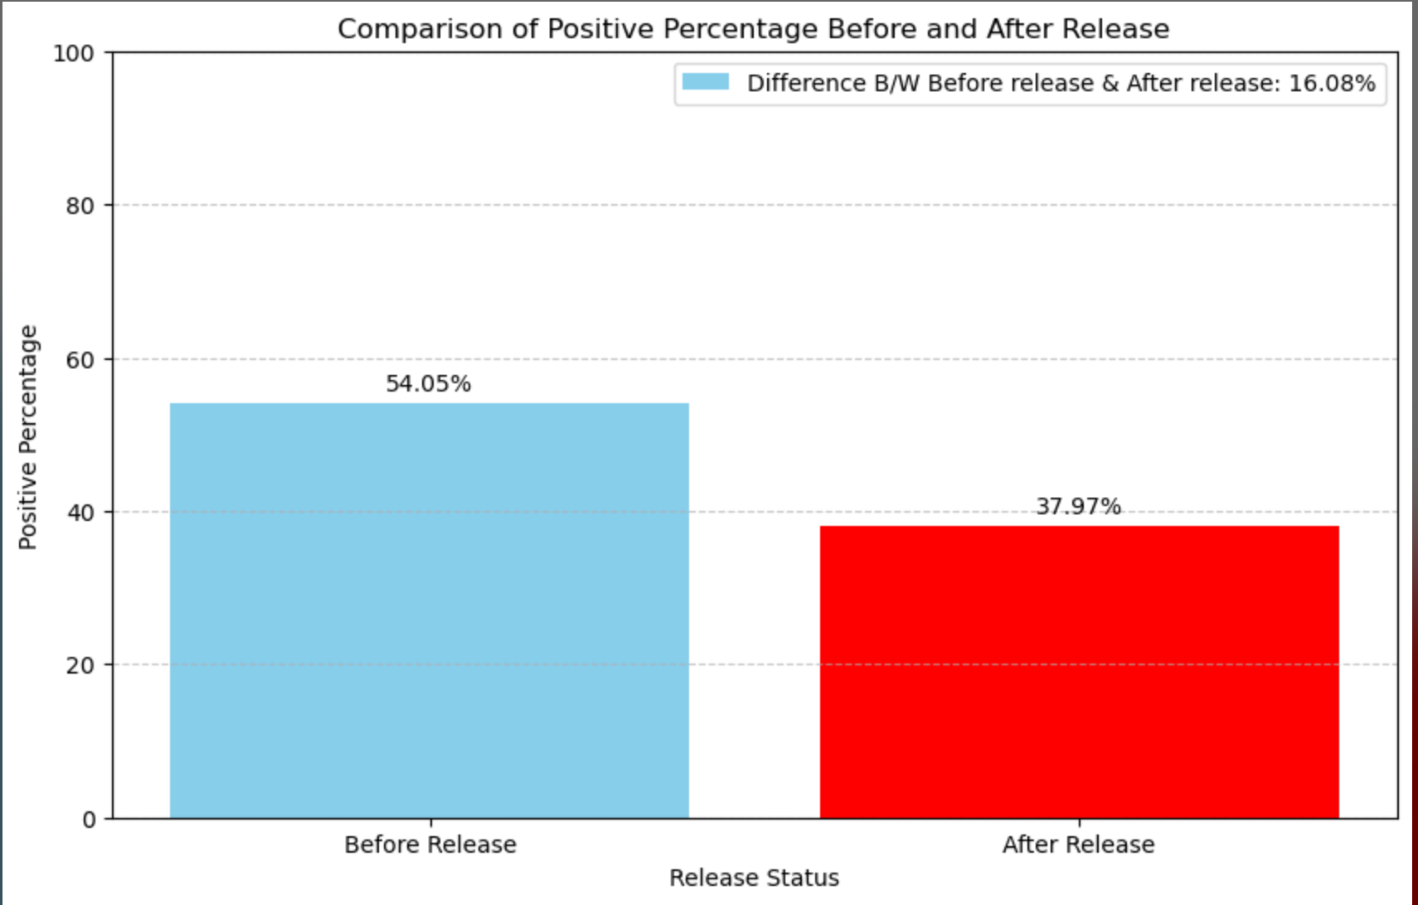
Insights from Analysis (BERT)
BERT's Sentiment Analysis for Raw Data
BERT's Sentiment Analysis for Filtered Data

Slide 9
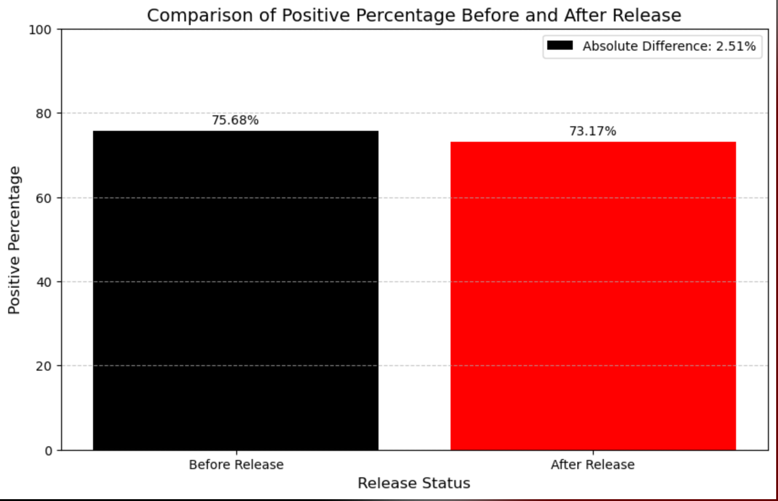
Insights from Analysis (Llama)
Llama 2's Sentiment Analysis for Filtered Data

Slide 10
Data Modelling
Data modelling is crucial for extracting meaningful insights from data.
LDA (Latent Dirichlet Allocation): Probabilistic topic modeling technique used to discover hidden topics within a collection of documents or texts.
Topic modelling done on 4 distinct groups of data formed by sentiment analysis:
- Before Release Positive Comments
- Before Release Negative Comments
- After Release Positive Comments
- After Release Negative Comments

Slide 11
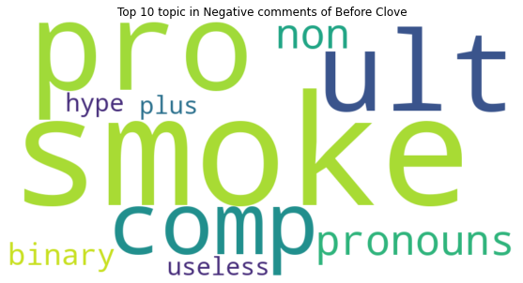
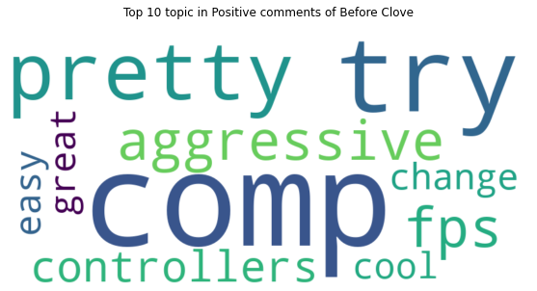
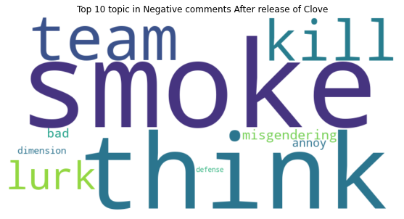
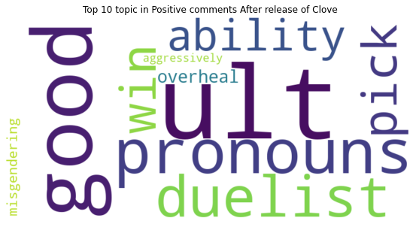
Data Modelling (WordCloud)

Slide 12




Future Scope
Enhanced Data Collection
- Collecting additional pre-release data for improved sentiment analysis
- Exploring data from other social media platforms
Advanced Data Processing:
- Refining keyword filtering for precise analysis
- Implementing advanced algorithms for optimized insights
Optimized Data Management:
- Considering NoSQL for scalability with unstructured data
Automated Data Retrieval:
- Deploying API Wrappers on remote VMs for continuous data retrieval

Slide 13
Valorant Community's Reception of Agent Clove
Consistent Themes:
- "Smoke" remains a critical point of discussion pre and post-release
- Persistent mention of "pronouns" signals ongoing gender identity conversations
Evolving Discussions:
- Transition from speculative "hype" to actual gameplay focus on "ability" and "ult."
- Pre-release concerns about competitive fit lessen post-launch
Sentiment Improvements:
- Positive reception of Clove's "abilities" post-launch suggests exceeded expectations
- Clove is embraced as an "aggressive controller," fitting the desired playstyle
Areas for Attention:
- Recurrent misgendering highlights the need for community education
- Negative comments on "team" and "lurk" suggest potential issues with team dynamics

Slide 14
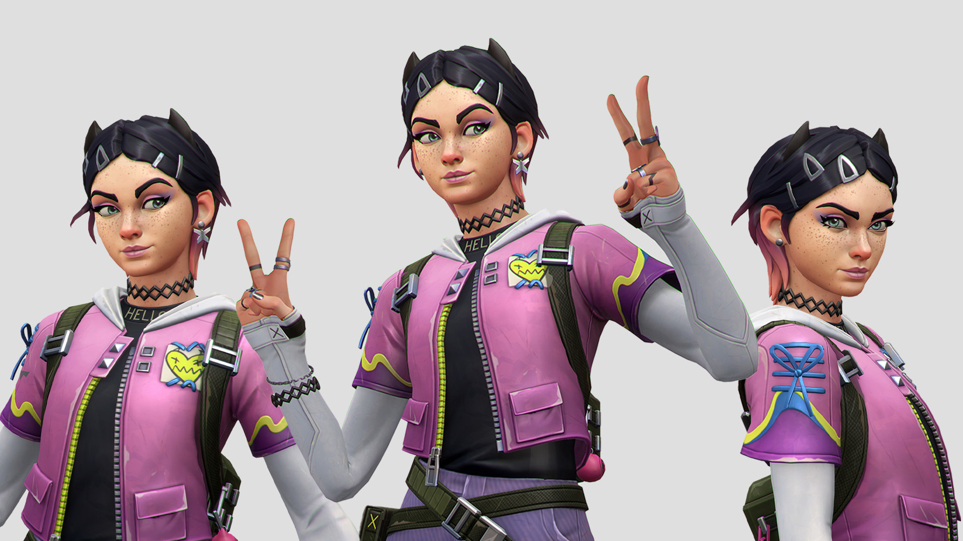
Thank you
Thank You!

