Slide 1
Song Mood Recognition
Sai Samarth Taluri, Sanjana Mahesh,Renita Kurian

Slide 2
Introduction
In recent years, automatic playlist generation has been introduced to cope with the problem of the tedious and time consuming manual playlist selection.
Furthermore, browsing the entire music library manually to select songs for the playlist is felt to be difficult by most music listeners. This becomes especially difficult if music collections become prohibitively large, as the user will not know or remember all songs in it.

Slide 3
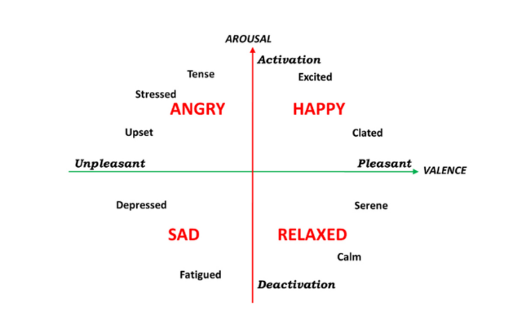
Russell’s Model
Russell used a statistical technique to group the emotion ratings based on positive correlations – which gave rise to 4 major emotions that are “Happy”, “Angry” , “Sad” and “Relaxed”.
Russell’s emotion model is a 2D valence-arousal model. Valence can be positive or negative while arousal is a measure of how strongly an emotion is felt.

Slide 4
Literature Review
Paper 1:
Mood Classification Using Listening Data

Slide 5
Authors:
Filip Korzeniowski, Oriol Nieto, Matthew C. McCallum, Minz Won, Sergio
Oramas, Erik M. Schmidt
Abstract :
The mood of a song is a highly relevant feature for exploration and recommendation in
large collections of music. These collections tend to require automatic methods for
predicting such moods. In this work, The authors showed that listening-based features
outperform content-based ones when classifying moods: embeddings obtained through
matrix factorization of listening data appear to be more informative of a track mood than embeddings based on its audio content. Mood tagging is a multi-label classification
problem, and can be considered a subset of the broader audio tagging task where only
those tags that represent moods are considered.

Slide 6
Methodology :
To demonstrate this, they compiled a subset of the Million Song Dataset, totaling 67k
tracks, with expert annotations of 188 different moods collected from AllMusic.The
mood information that they used in this work has been human-annotated by experts
from AllMusic. For a given input embedding of a certain type, how well the predicted
moods resemble the true moods associated with a track is the goal of their model
and to quantify this they used a macro-averaged average precision as the main
evaluation metric, as is commonly used in multi-label classification. They first computed
AP for each mood tag, and then averaged them to calculate the final result. They used
Audio-based models like Musicnn and Short-Chunk CNN, Listening-based Models such
as Taste-Profile Factorization and Proprietary Factorization, and Transfer Learning
method.
Conclusion :
They have shown how listening data surpass audio-based embeddings when classifying
moods in the proposed dataset. The notable differences in performance between
listening- and audio-based models suggest that either i) current state-of-the-art audio
models are not capable of successfully extracting certain mood information about a
given track; and/or ii) such mood information is not necessarily present in the audio
content, and thus the usage of other signals such as listening information may be
required to obtain more accurate results.

Slide 7
Paper 2:
Transfer Learning For Music Classification And Regression Tasks

Slide 8
Authors: Keunwoo Choi, Gy ̈orgy Fazekas, Mark Sandler, Kyunghyun Cho
October, 2017
Abstract:
A transfer learning approach for music classification and regression tasks has been
presented in this paper. They propose to use a pre-trained convnet feature, a
concatenated feature vector using the activations of feature maps of multiple layers in a trained convolutional network. They show how this convnet feature can serve as
general-purpose music representation. In the experiments, a convnet is trained for
music tagging and then transferred to other music-related classification and regression tasks. The convnet feature outperforms the baseline MFCC feature in all the considered tasks and several previous approaches that are aggregating MFCCs as well as low- and high-level music features.

Slide 9
Results And Discussion:
The pre-trained convnet was first trained to predict music tags and then aggregated
features from the layers were transferred to solve genre classification, vocal/non-vocal
classification, emotion prediction, speech/music classification, and acoustic event
classification problems. Unlike the common approach in transfer learning, they
proposed to use the features from every convolutional layer after applying an
average-pooling to reduce their feature map sizes. In the experiments, the pre-trained
convnet feature showed good performance overall. It outperformed the baseline MFCC
feature for all the six tasks.It also outperformed the random-weights convnet
features for all the six tasks, demonstrating the improvement by pre-training on a source
task. For all the five music tasks, concatenating MFCC feature onto convnet features
did not improve the performance, indicating the music information in MFCC feature is
already included in the convnet feature. Hence, it is seen that transfer learning can
alleviate the data sparsity problem in MIR and can be used for a large number of
different tasks.

Slide 10
Paper 3:
Mood classification from Song Lyric using Machine Learning

Slide 11
Authors: Kornkanya Siriket, Vera Sa-ing, Subhorn Khonthapagdee;2021
Abstract:
Abstract— Nowadays, many people change the way they listen to music by listening to the mood of the songs in the tracks. This research is interested in analyzing song extraction using natural language processing to acquire mood information. Lyrics are valuable for
categorizing music. First, removing special characters and using Term-frequency/inverse-document frequency (TFIDF) and then Latent Dirichlet Allocation (LDA) are used to connect words to mood classes. We perform a lyric- based mood classification on local machine learning classifiers such as Random forest, Decision
tree, Naïve Bayes, Logistic Regression, AdaBoost and XGBoost. Using grid search for tuning the best parameter yield the results XGBoost shows the highest accuracy. It can prove that boosting algorithms have better performance than local machine learning in this research.
Conclusion:
Finally an accuracy of 89% was obtained using XGBoost.

Slide 12
Summary of Evaluated Models:
- Based on the novelty curve resulting from Foote's method, it was found that
standardized euclidean distance gave the best results.
- Convex NMF uses a convex variant of NMF in order to divide the audio features
into meaningful clusters.
- The best results with Lu et al. method for mood tracking were obtained using a
window of 4 seconds to compute the divergence shape measure.
- The Structural Features (SF) method is both homogeneity and repetition based.
It uses a variant of the lag matrix to obtain structural features.

Slide 13
Implementation
Our model aims to take an audio input , extract MFCC features and pass it to a Convolutional Neural Network (CNN).
The output is a text which has value Happy,Angry,Sad or Relaxed

Slide 14
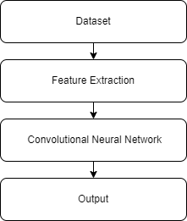
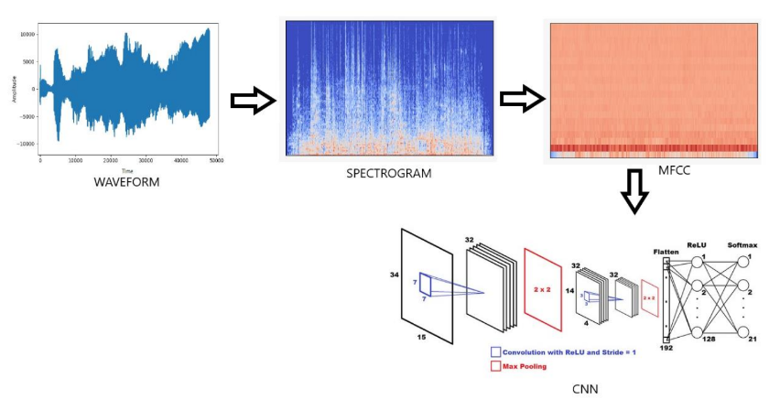

Slide 15
Dataset Source
Audio dataset : 4Q Audio Emotion Dataset (Russell) – Kaggle
-> 1000 songs audio (250 per quadrant)
The dataset also includes a csv file containing the top 100 features of the given audio files.

Slide 16
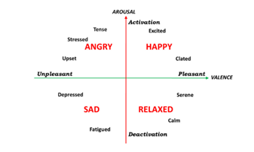
Feature Extraction
Feature extraction is a part of the dimensionality reduction process, in which, an initial set of the raw data is divided and reduced to more manageable groups. So when you want to process it will be easier. The most important characteristic of these large data sets is that they have a large number of variables. These variables require a lot of computing resources to process. So Feature extraction helps to get the best feature from those big data sets by selecting and combining variables into features, thus, effectively reducing the amount of data. These features are easy to process, but still able to describe the actual data set with accuracy and originality.

Slide 17
Feature extraction can be done using various methods such as Zero cross rating, MFCC, MEL spectrogram etc.
Here in our model we have used Mfcc as it provided us with the best results.
MFCC (Mel-frequency cepstrum)
MFCCs are commonly derived as follows:
Take the Fourier transform of (a windowed excerpt of) a signal.
Map the powers of the spectrum obtained above onto the mel scale, using triangular overlapping windows or alternatively, cosine overlapping windows.
Take the logs of the powers at each of the mel frequencies.
Take the discrete cosine transform of the list of mel log powers, as if it were a signal.
The MFCCs are the amplitudes of the resulting spectrum.

Slide 18
Convolutional Neural Network
CNNs are used on audio and text data since we can also represent the sound and texts as a time series data
We use Dense, Activation and Dropout functions
The Dense layer is a normal fully connected layer in a neuronal network.
A dropout layer ignores a set of neurons (randomly) . This is usually done to avoid overfitting.
The Activation function activates the neurons. The activation functions we have used are RELU and Softmax
While compiling the model, the loss is categorical cross entropy and Adam is used as the optimizer.

Slide 19
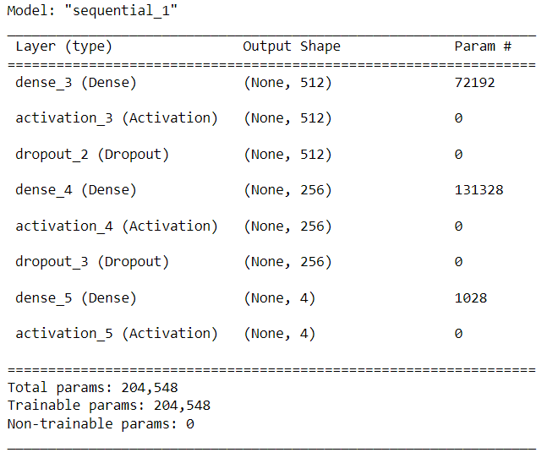

Slide 20
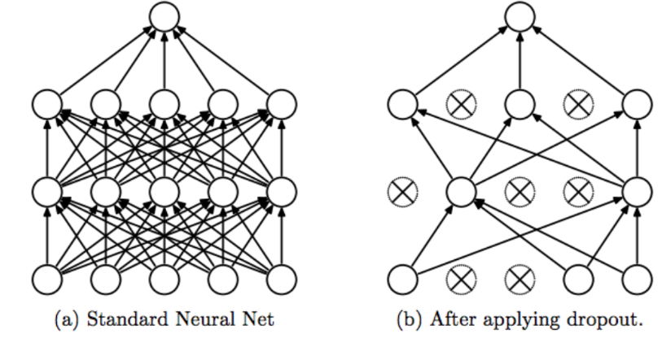

Slide 21
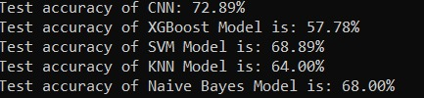
Results

Slide 22
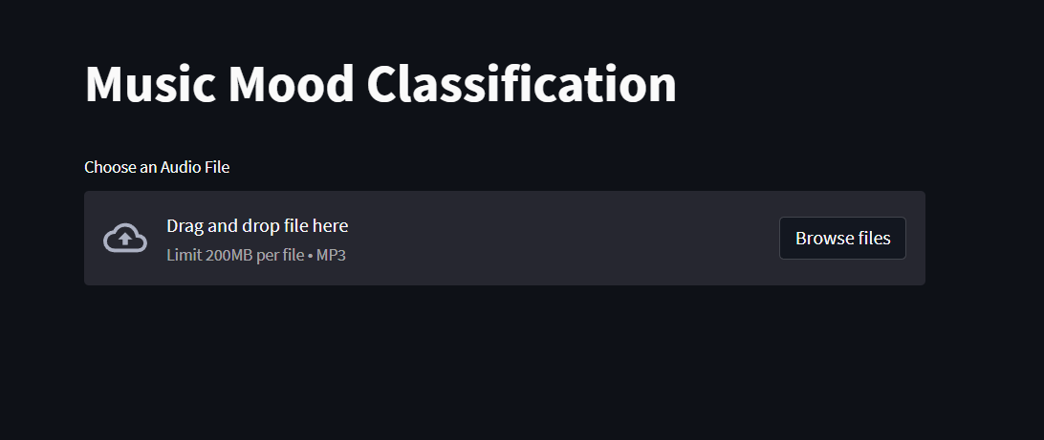
Sample screenshot for UI

Slide 23
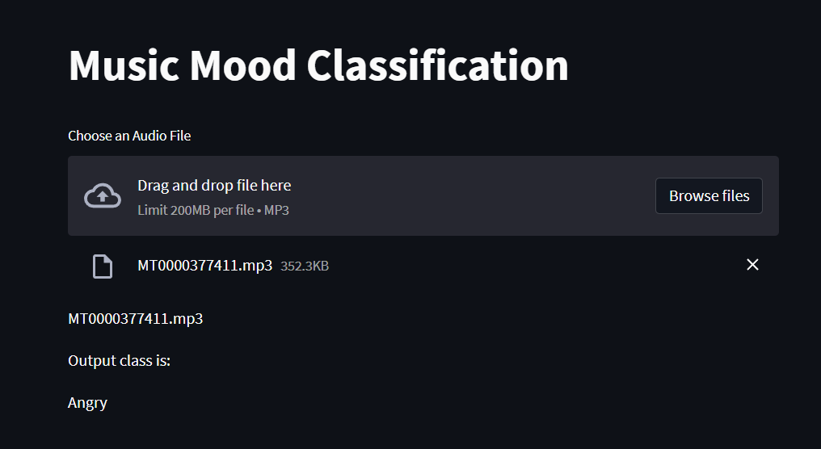

Slide 24
Conclusion
Inside the scope:
We will be using Mel-frequency cepstral coefficients (MFCCs) extracted from Mel spectrograms as attributes for training our classification model.
Outside the scope:
-> Unsupervised learning on bigger dataset for better accuracy.
-> Model which can simultaneously process both audio and lyrical data and provide mood classification.
-> We can build a recommender system which will suggest songs for a user depending on his mood as well as his playlist history.

Slide 25
THANK YOU

