Slide 1
Database Design Project CS 6360.002 Indoor Playground
Sai Sandeep Vaddi – SXV160830
Sandeep Avula – SXA165930

Slide 2
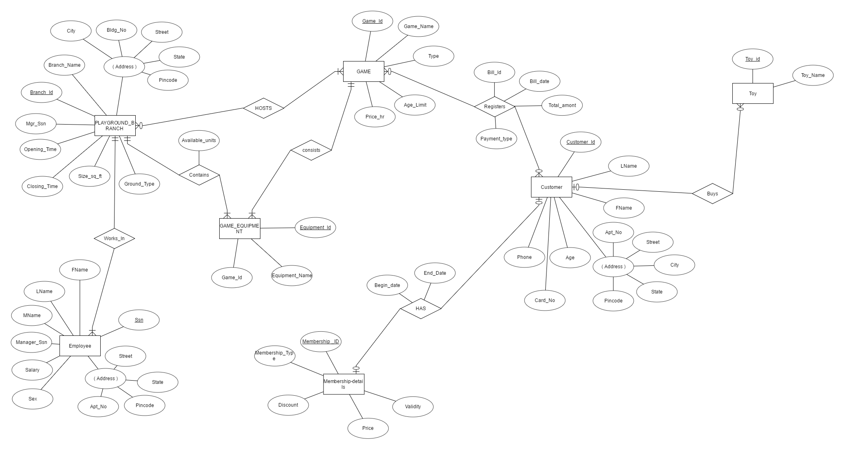
ER Diagram

Slide 3
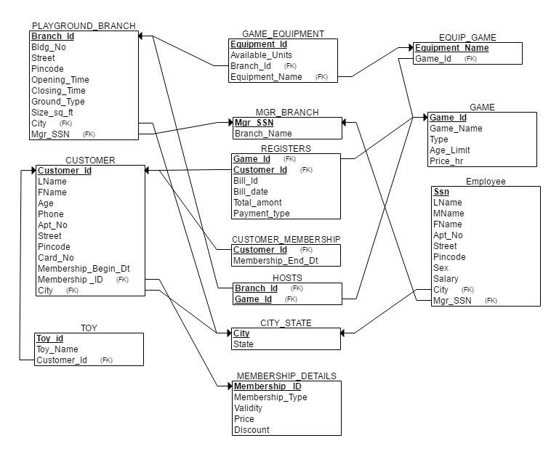
Final Relational Schema

Slide 4
Stored Procedures

Slide 5
Stored Procedures

Slide 6
Triggers

Slide 7
Triggers

Slide 8
Thank You

