Slide 1


Water Quality Classification using Machine Learning

Slide 2

Learning Objectives
Understand how AI/ML can classify water potability.
Explore the dataset and its key features.
Learn how to select the best machine learning model for classification.
Implement Random Forest for predicting potable water.
Evaluate the model using accuracy and confusion matrix visuals.
GOAL
Source :
www.freepik.com/

Slide 3
Tools and Technology used
Programming Language: Python
Libraries: Pandas, NumPy, Matplotlib, Seaborn, Scikit-learn
Model Used: Random Forest Classifier
Platform: Jupyter Notebook / Anaconda
Dataset Source: Kaggle (Water Potability Dataset)

Slide 4
Methodology
Data Preprocessing – Handle missing values, normalize.
Feature Selection – Choose water parameters as inputs.
Model Building – Random Forest, Logistic Regression,Descision tree.
Model Evaluation – Compare models and choose the best.
Visualization – Accuracy bar chart & confusion matrix heatmap.
Final Model – Random Forest with ~72–76% accuracy.

Slide 5
Problem Statement:
Access to safe and potable water is a global challenge. Manual testing of water quality is time-consuming and costly.We need an automated, intelligent system to classify whether water is safe (potable) or unsafe (not potable) based on chemical and physical properties.

Slide 6
Solution:
Collected and pre-processed the water portability dataset.
Handled missing values with median imputation.
Split data into training (80%) and testing (20%) sets.
Evaluated multiple ML models and identified the best performing model.
Selected Random Forest Classifier as it gave the highest accuracy.
Built visualizations (bar charts, confusion matrix) for easy interpretation.

Slide 7
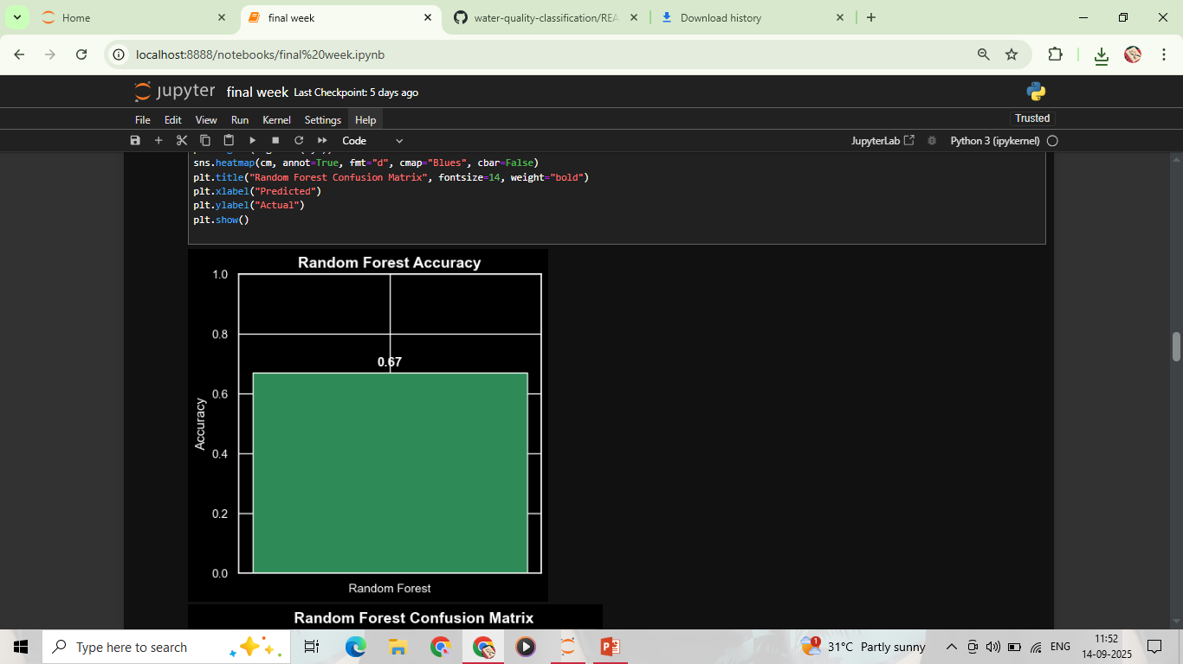
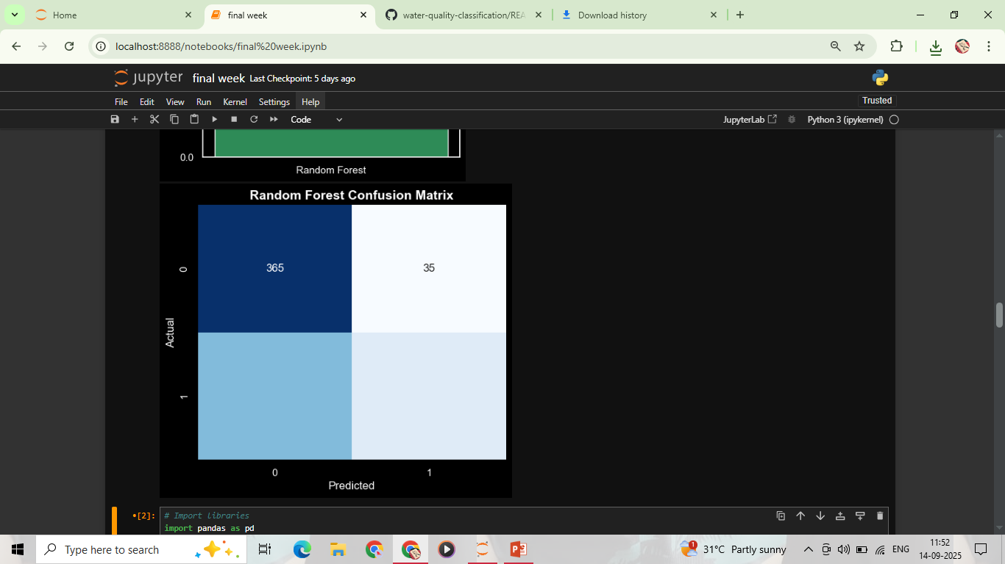
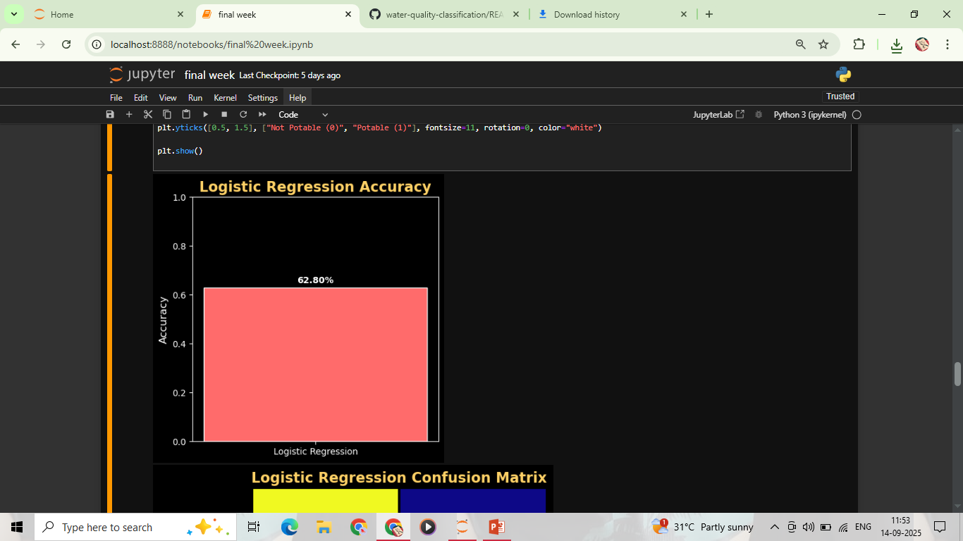
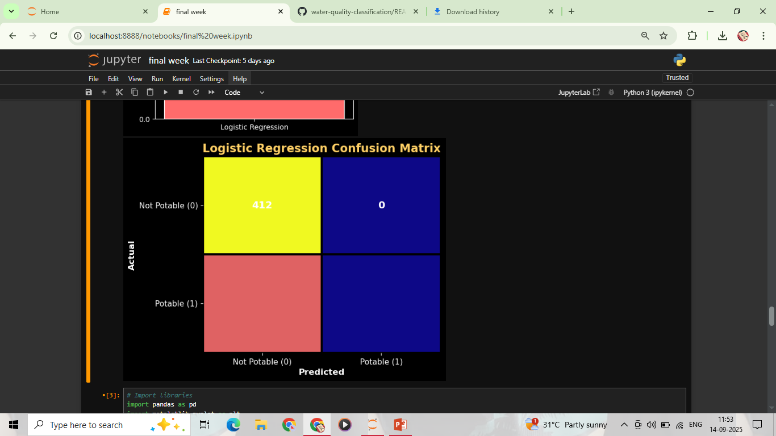
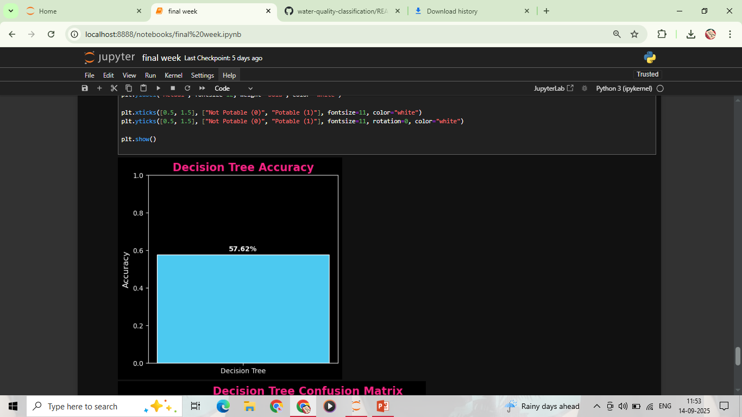
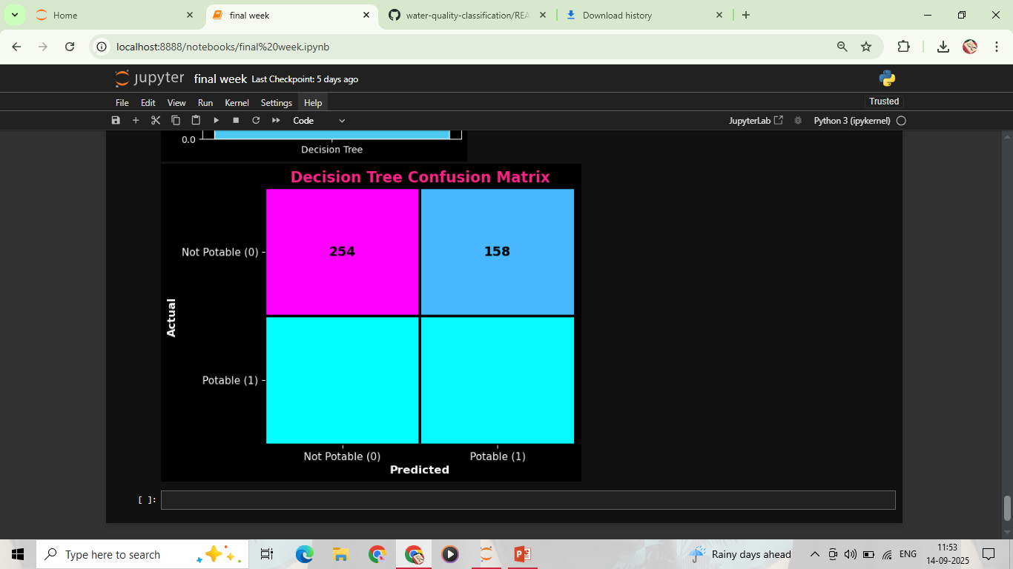
Screenshot of Output:

Slide 8
Conclusion:
The project successfully classifies water quality into potable or not potable.
Random Forest Classifier gave the best performance with ~72–76% accuracy.
The model is more effective in detecting unsafe water, which is critical for real-world use.
Can be further improved with feature engineering, hyperparameter tuning, and dataset balancing.
Demonstrates how AI/ML can support public health by ensuring water safety.

