Slide 1

SPELL CHECKER IN INFORMATION RETRIEVAL
INDIAN INSTITUTE OF INFORMATION TECHNOLOGY,SRICITY
BY
E.P.S.Santhosh
UG-3
S20180010053

Slide 2
The big.txt is used as a vocabulary .
This spell checker have a accuracy of above 80%.
In the given test cases we got all the correct words .
The peternorvigs is used as reference for writing code .

Slide 3
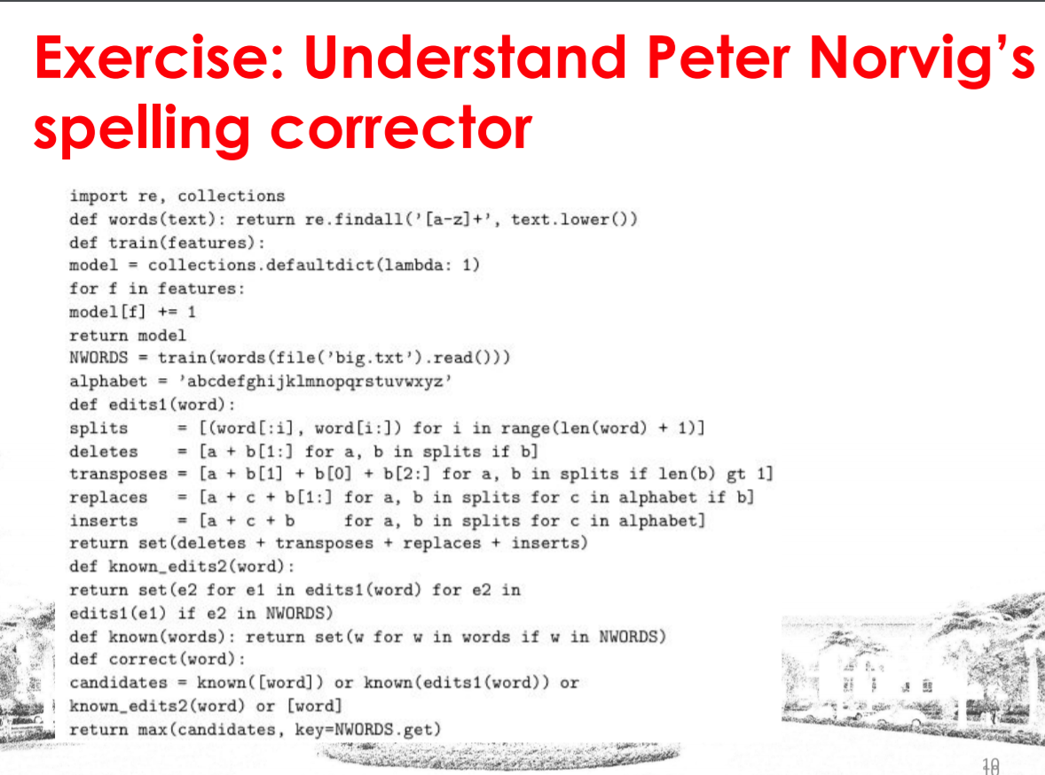
PSEUDO CODE OF PETER NORVIGS SPELL CHECKER

Slide 4
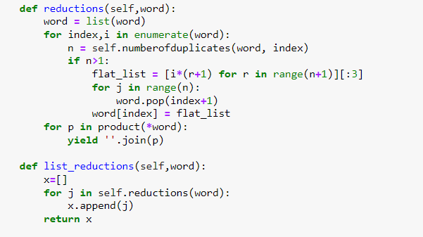
EXTENSIONS
Reductions .
if we have the word “Jjoobbbb” then it will convert it to job(which is the correct word) .

Slide 5
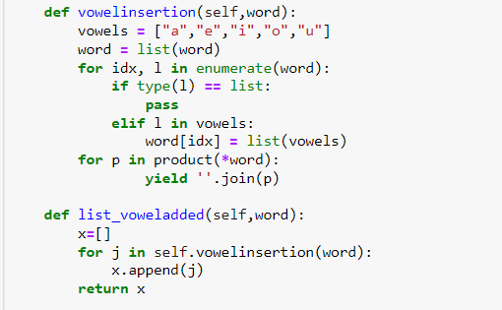
EXTENSIONS
1) Vowel insertions .
if we have the word “weke” then it will convert it to wake(which is the correct word) .

Slide 6
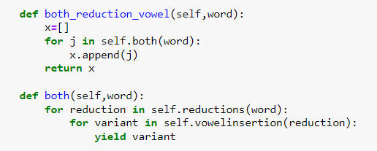
EXTENSIONS
1)Both reduction and vowel .
if we have the word “cunspirrancy” then it will convert it to conspirancy(which is the correct word) .

Slide 7
REFERENCES
1) Download the data set from here
https://norvig.com/big.txt
2) https://norvig.com/spell-correct.html
3) https://amunategui.github.io/peter_norvig_magic_spell_checker/index.html

