Slide 1

Princeton Institute of Engineering and Technology for Women
Department Of Computer Science And Engineering(Artificial Intelligence& Machine Leaning)
E-PILOTS A SYSTEM TO PREDICT HARD LANDING DURING THE APPROACH PHASE OF COMMERCIAL FLIGHTS
Under the Guidance of
Mr. T.KANAKAIAH,Assistant Professor
Submitted by
B.SAISANTHOSHI 216M5A6602
CH.RAMYA 206M1A6618
K.POOJITHA 206M1A6619
B.NITHEESHA 206M1A6620

Slide 2
Introduction
Abstract
Problem Statement
Objective
ExistingSystem & Disadvantages
ProposedSystem & Advantages
System Requirements
Algorithms
Modules
Output
Future Scope
References
List of Contents

Slide 3
INTRODUCTION
Between 2008 and 2017, almost 49% of the deadly accidents involved in commercial jets happened when they were landing this percentage has stayed the same for many years.
The companies that makes planes, said that only 3% of landings in commercial flights. were not done properly Surprisingly, 97% of these bad landings continued instead of trying again.
Many of these accidents are caused by planes going off the runway. Not landing properly, hard landing on the runway, and other things can lead to this.
However, if pilots decided to try landing again more often, it could reduce the number of accidents in the aviation industry.

Slide 4
ABSTRACT
This project aims to develop a system called E-Pilots that uses machine learning algorithms to predict hard landings during the approach phase of commercial flights.
The system will analyze flight data to precede hard landings by temporal dependencies of aircraft variables as input to a network.
We describe a cockpit-deployable machine learning system to support flight crew go-around decision-making based on the prediction of a hard landing event.
The findings of this project are expected to contribute to the improvement of aviation safety and reduce the occurrence of hard landings. The implications of this research may also extend to other areas of aviation safety and flight automation.

Slide 5

PROBLEM STATEMENT
The objective is to develop an E-PILOTS (Enhanced Predictive Integrated Landing Optimization and Tracking System) that utilizes advanced technology and data analysis techniques to predict the probability of a hard landing during the approach phase of commercial flights.
The system should aim to assist pilots in making informed decisions and taking corrective actions to prevent hard landings.

Slide 6
OBJECTIVE
Develop a system that uses machine learning algorithms to predict hard landings during the approach phase of commercial flights.
Collect and analyze flight data to identify patterns that precede hard landings. Integrate the E-Pilots system with existing flight systems to provide pilots with real-time warnings and guidance to prevent hard landings.
Evaluate the performance of the E-Pilots system in detecting and preventing hard landings using a dataset of historical flight data. Compare the performance of the E-Pilots system with existing hard landing prediction systems and assess its potential for improving aviation safety.

Slide 7
EXISTING SYSTEM & DISADVANTAGES
One existing system for hard landing prediction during the approach phase of commercial flights is the Smart Land system developed by Honeywell Aerospace.
The Smart Land system uses multiple sensors on the aircraft to provide pilots with real-time information about the aircraft's position, velocity, and trajectory during the approach phase.
The system then uses algorithms to analyze this data and detect any signs of a hard landing, such as excessive rate, high vertical acceleration, or touchdown beyond the designated touchdown zone.
DISADVANTAGES ARE Limited Data Analysis, Insufficient Integration, High Maintenance Costs.

Slide 8
PROPOSED SYSTEM & ADVANTAGES
In this project we are introducing Hybrid LSTM algorithm to predict Hard or Not Hard Landing. Timely prediction of Hard Landing can avoid accident and save passenger lives.
In propose system we are applying machine learning model for cockpit which will read data from flight such as Tire elevation, speed and other values and then predict type of landing, if hard landing predicted then it instructs pilot to avoid landing or divert landing route. In propose system author has trained LSTM with different features such as Pilot, Actuator and Physical. 3 different LSTM algorithms trained on above 3 different features and then merge all algorithms to form a hybrid model.
ADVANTAGES ARE Enhanced safety, Accurate Predictions, Cost Savings, Continuous Improvement.

Slide 9
SYSTEM REQUIREMENTS
1. HARDWARE REQUIREMENTS 2. SOFTWARE REQUIREMENTS
* Processor : Pentium –1V * Operating system : Windows 7 Ultimate
* Ram : 4GB(minimum) * Coding Language :Python
* Hard disk : 20GB *Front-End :Tkinter
* Mouse : Two or Three Button mouse * Back-End : Django-ORM
* Monitor : SVGA * Designing : Html, CSS, JavaScript.
*Key board : standard windows keyboard *Data base : MySQL(WAMP server)

Slide 10
ALGORITHMS
SVM
Logistic regression
LSTM algorithm

Slide 11
MODULES
1.Data Collection and Processing
2.Machine Learning Model Development
3.Real –Time Monitoring Module

Slide 12
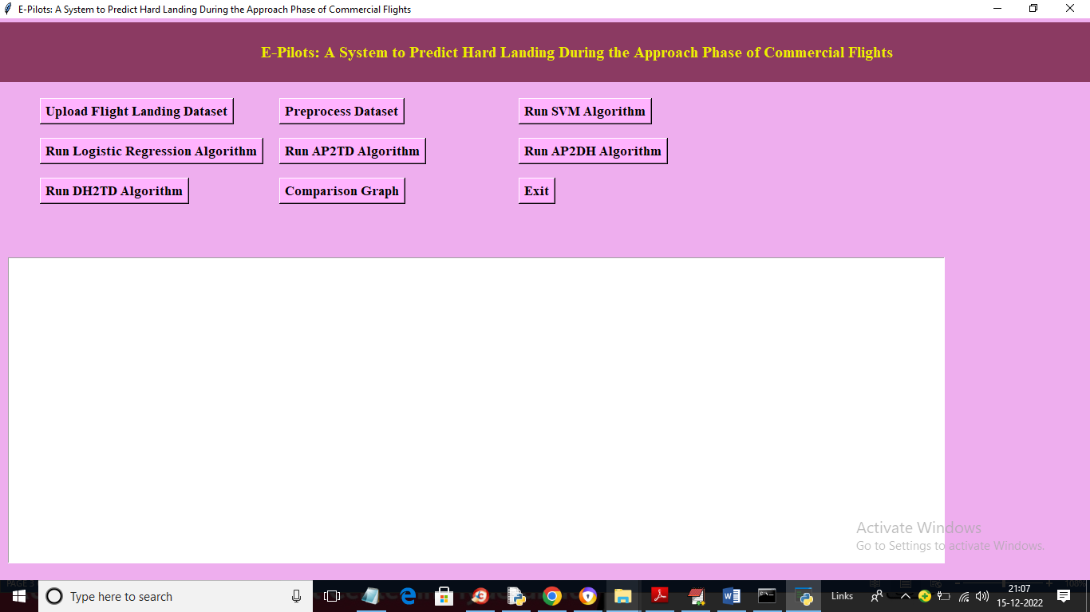
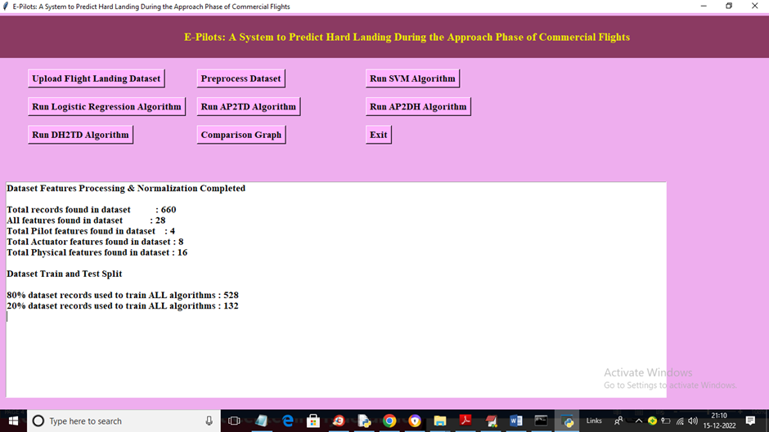
OUTPUT

Slide 13
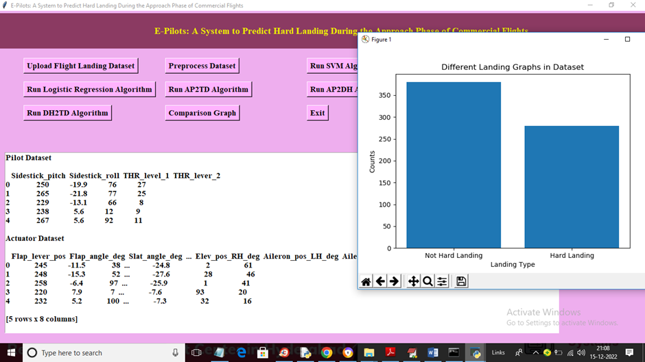
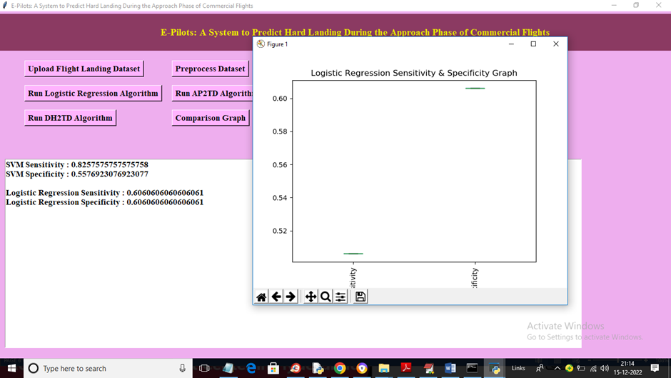

Slide 14
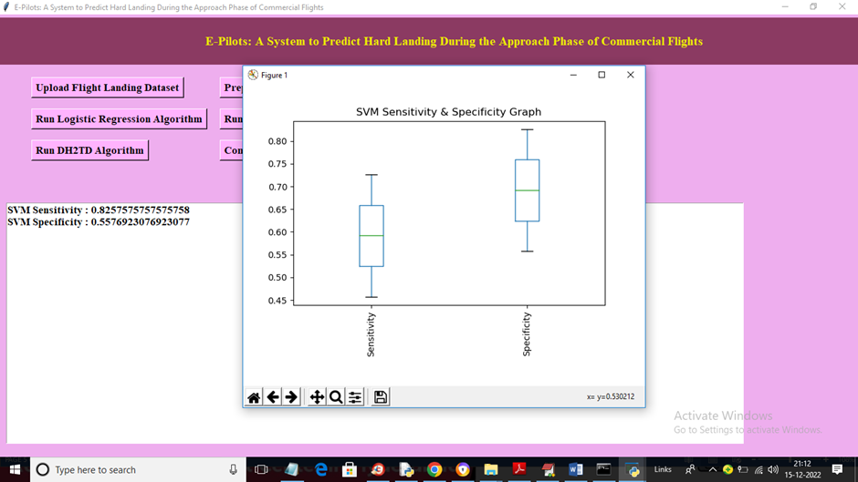
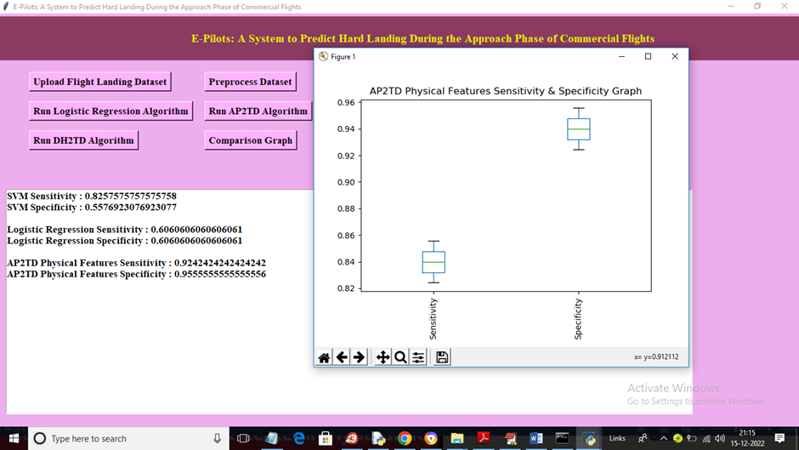

Slide 15
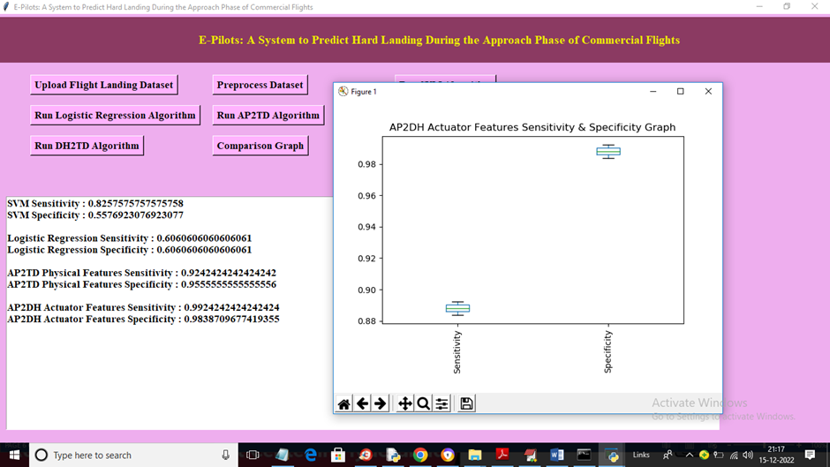
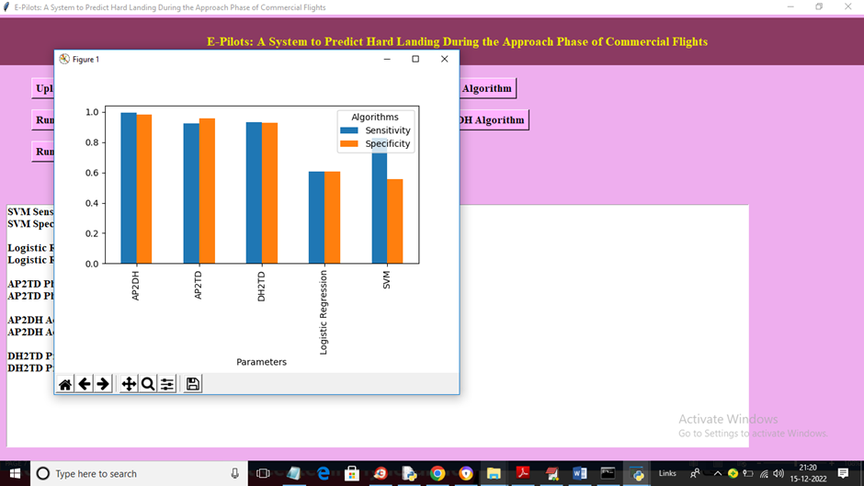

Slide 16
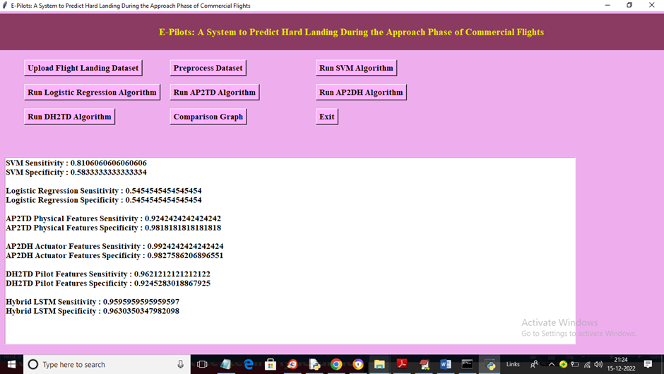

Slide 17

FUTURE SCOPE
✔ future scopes aim to enhance the system's capabilities, improve flight safety, and provide more comprehensive support to pilots, air traffic controller, and other stakeholders involved in the landing phase of commercial flights.

Slide 18
REFERENCES
[1]Statistical Summary of Commercial Jet Airplane Accidents–Worldwide Operations| 1959–2017, Boeing Commercial Airplanes, Aviation Saff., Seattle, WA, USA, 2018.
[2]‘‘Developing standardized FDM-based indicators,’’ Eur. Aviation Saff. Plan 20122015, Cologne, Germany, 2016.
[3]‘‘Advisory circular ac no: 91-79a mitigating the risks of a runway overrun upon landing,’’ Federal Aviation Admin., Washington, DC, USA, 2016.
[4]M. Coker and L. S. Pilot, ‘‘Why and when to perform a go-around maneuver,’’ Boeing Edge, vol. 2014, pp. 5–11, 2014. M. Coker and L. S. Pilot, ‘‘Why and when to perform a go-around maneuver,’’ Boeing Edge, vol. 2014, pp. 5–11, 2014.
[5]T. Baldev and W. Curtis, ‘‘Go-around decision making and execution project: Final report to flight safety foundation,’’ Flight Saff. Found., Alexandria, VA, USA, Mar. 2017.
[6]‘‘European action plan for the prevention of runway excursions,’’ Euro control, Brussels, Belgium, 2013.

