Slide 1
EE352and EE312 Lab5:Bandpass Operational Amplifier
Haoru Xie and SAISAO KHAM

Slide 2
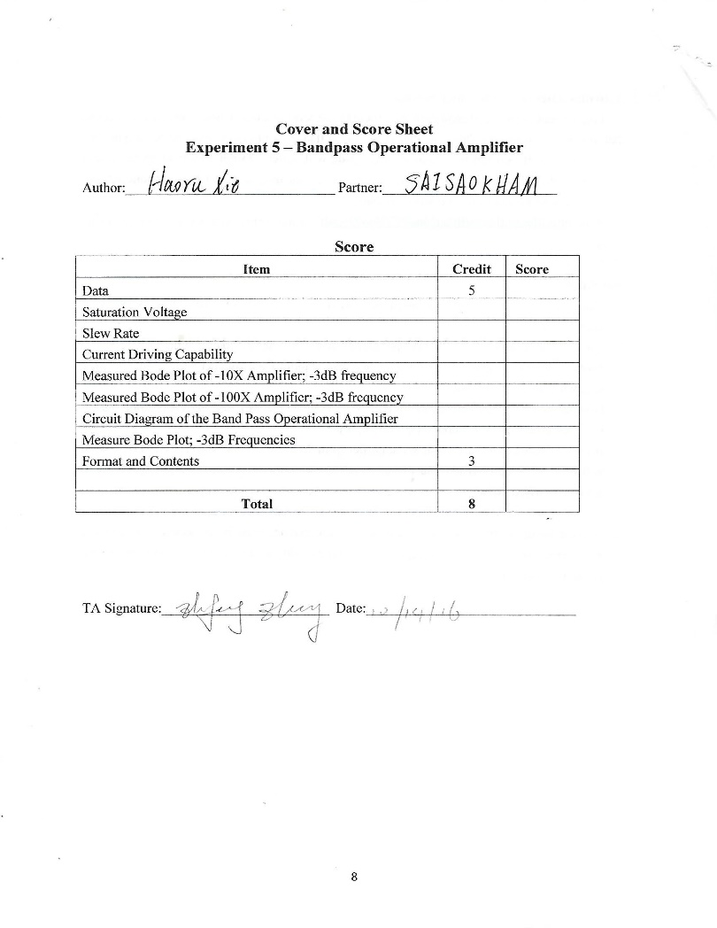
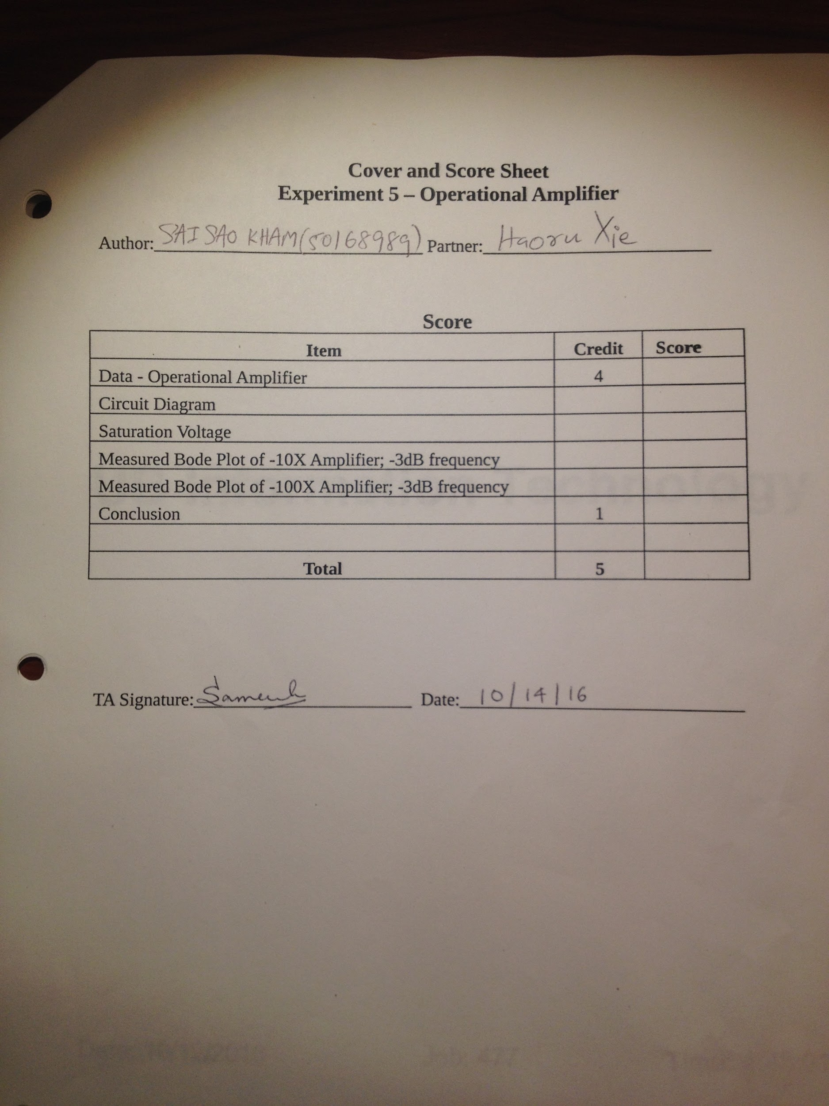
Cover and Score Sheet

Slide 3
Authors information
This report is prepared by HAORU XIE, who is the first author and prepared the original draft of the report, and Saisao Kham, who is the second author and revised the report.

Slide 4
Part 1. Construct an open-loop operational amplifier (Saturation Voltage)
In this configuration, the operational amplifier functions as a comparator
When the voltage applied to the inverting input is more positive that the voltage applied to the non-inverting input, the output is at the negative saturation voltage.
When the voltage applied to non-inverting input is more positive, the output is at the positive saturation voltage.

Slide 5
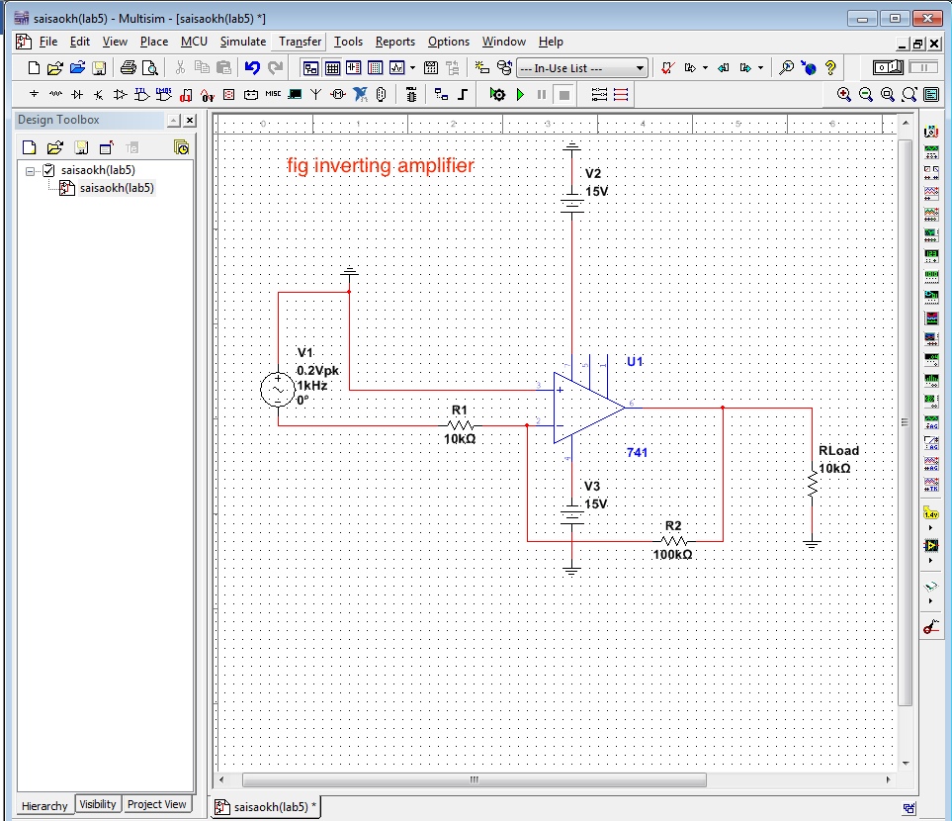
Inverting op-amp

Slide 6
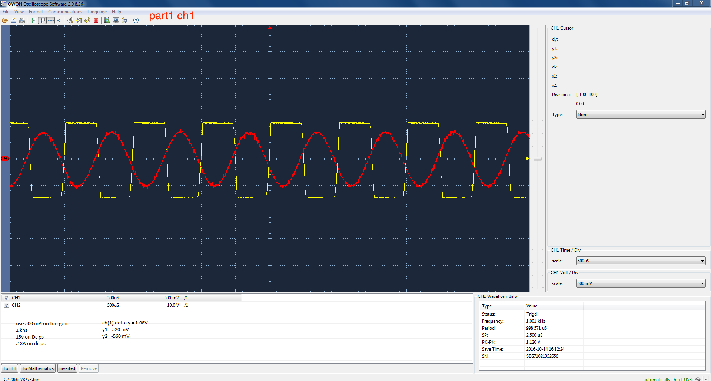

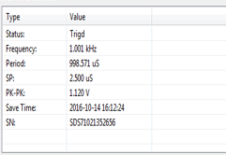
Open-loop operational amplifier: the input waveform

Slide 7
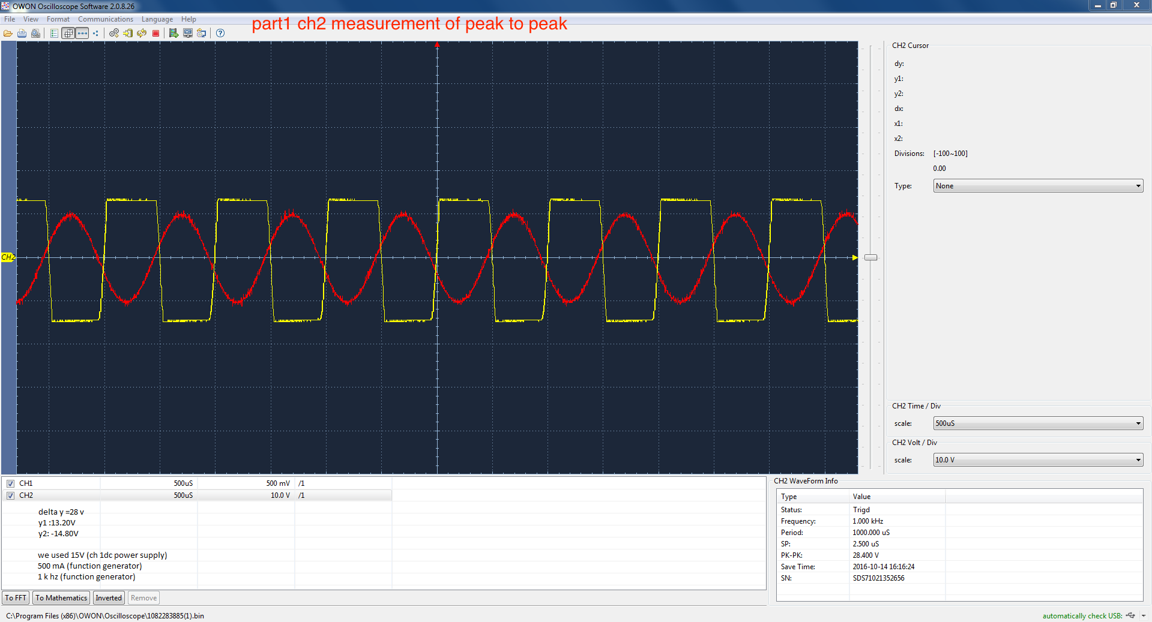

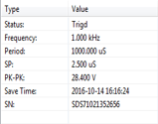
Open-loop operational amplifier: the output waveform

Slide 8
The Yellow lane: output
The Red lane: input
We noticed that for the output we get the V-pp is 28V
The positive output saturation voltages is 13.20V
The negative output saturation voltage is -14.80V
We using the power supply voltage: +/-15V
So the positive output saturation voltages has 12% off
The negative output saturation voltage has 1.33% off

Slide 9
Part 2. Determine the slew rate both up and down
Apply a 1K Hz square wave.
V-pp is 2V.
Connect both positive and negative power supply voltages.
The output waveform evolves from square wave to trapezoidal wave and eventually to triangular wave, if the frequency of the function generator is high enough, e.g.,>100K Hz.
The Yellow lane: output
The Red lane: input

Slide 10
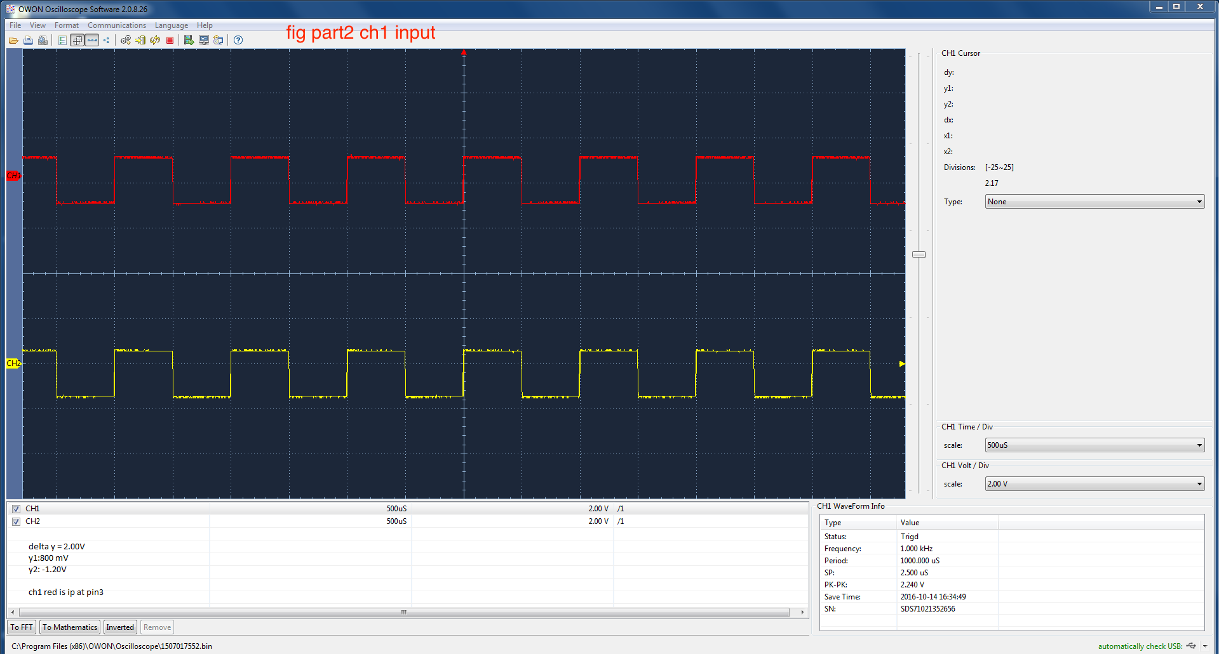

the input waveform and the output waveform

Slide 11
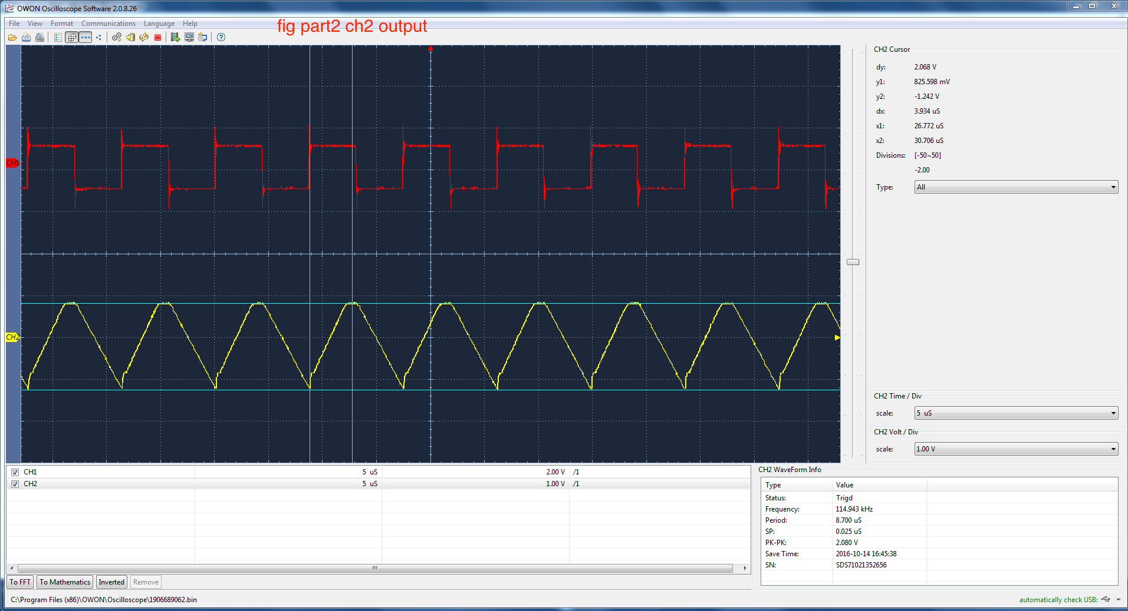
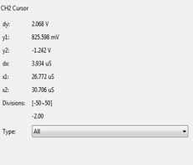
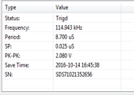
Using the F=115K Hz

Slide 12

Calculations for the Slew rate both up and down
F=115K Hz
For the input.
We get the y1=800mv y2=-1.20v
So we get the $∆$y= y1-y2=2V
For the output
Wen get the y1=880mV y2=-1.20V
So we get the $∆$y= y1-y2=2.08V
The time for up=4.2uS=$4.2×{10}^{−6} s$
The slew rate for the up =$\frac{∆y}{t_{up}}$=$\frac{2.08 V}{4.2×{10}^{−6} s}$=495238 V/S
The time for down=4.7us
The slew rate for the up =$\frac{∆y}{t_{up}}$=$\frac{2.08 V}{4.7×{10}^{−6} s}$=442553 V/S

Slide 13
Current driving capability
Use the same circuit
Apply a 1K Hz, sine wave with large amplitude, e.g., 10V V-pp, as input
Connect a 1K ohm load resistor between the output pin of the operational amplifier and ground. Gradually reduce the load resistance until the waveform becomes clipped. The load resistance can be quite low, e.g.,100 ohm.
Using 1K ohm potentiometer
The current driving capability must be taken into account in designing operational amplifier circuits with a heavy load otherwise the output waveform will become distorted because of the current limit.

Slide 14
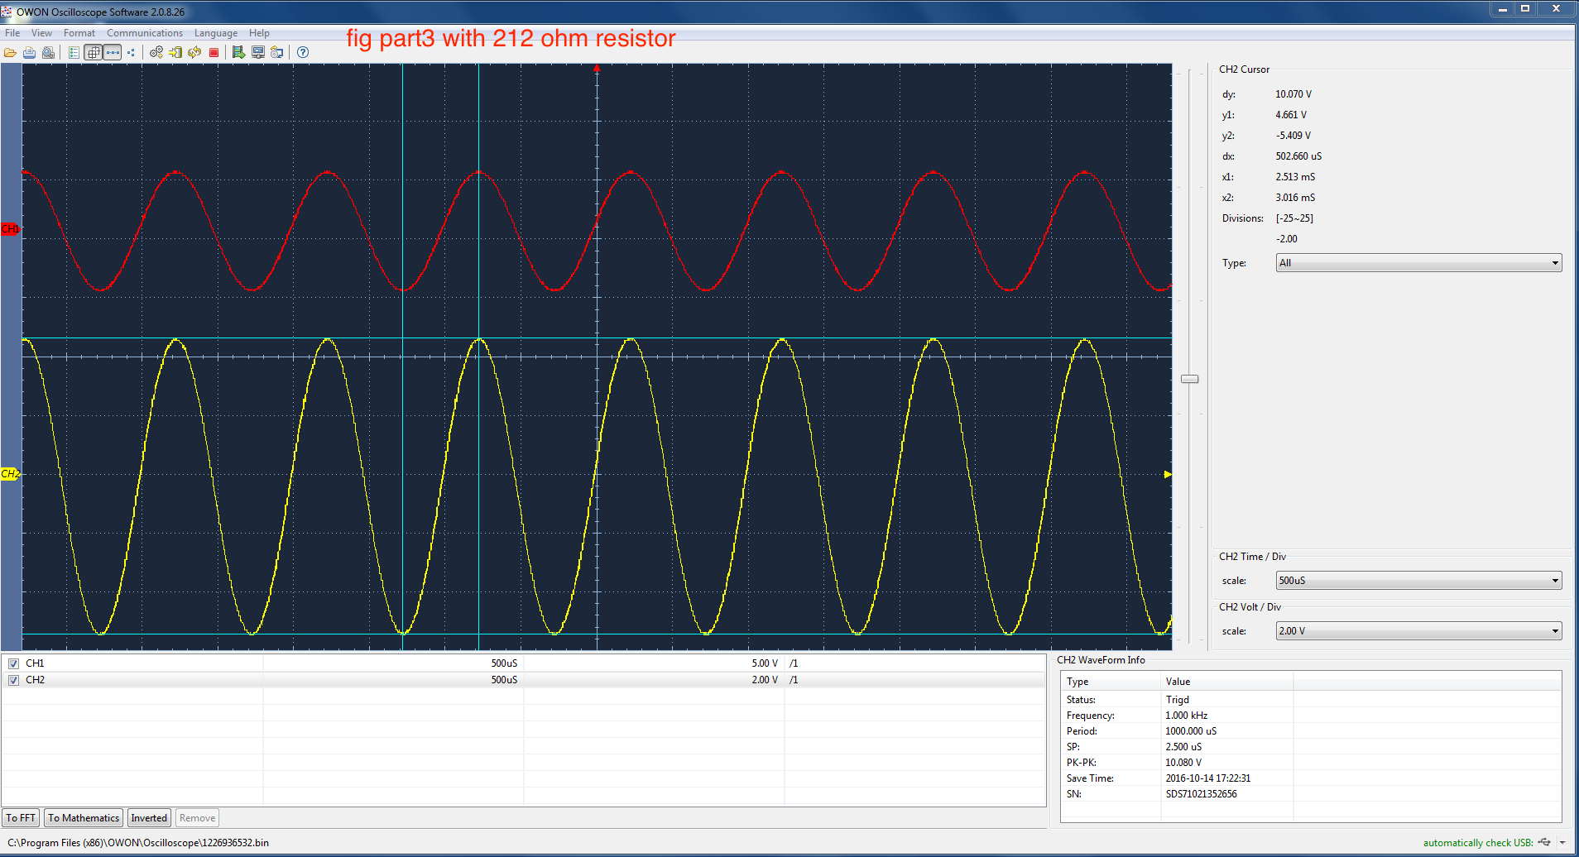
With 212 ohm resistor

Slide 15


Input at pin3 and out put at pin 6

Slide 16

Calculations for Current Driving Capability
For the input
y1=4.6V y2=-5.8V
So we get the $∆$y= y1-y2=10.40V
For the output
We get the y1=4.56v y2=-5.4v
So we get the $∆$y= y1-y2=10V
R=212ohm
Current=10V/212ohm =0.04717 A

Slide 17
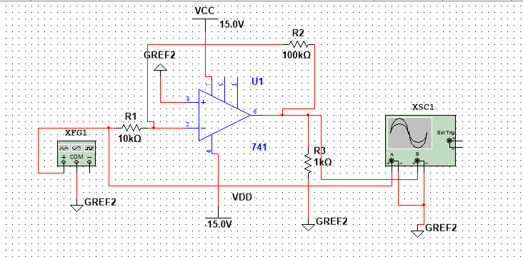
Part4. Measured Bode Plot of -10X Amplifier; -3dB frequency

Slide 18
Design and construct an inverting amplifier with a gain of -10, and find the -3db frequency
For the 741 operational amplifier, pin 7 connected to 15V; pin 4 to -15V
R2/R1=10
R3 is the load resistor
Resistors used should be in the range of a few K ohm to few hundred K ohm.
Operate the circuit and characterize the gain at 1 KHz.
The input voltage of the sine wave is flexible, e.g., 50 mV to 200 mV V-pp.

Slide 19
The goal is to keep the operational amplifier in the linear regime, i.e., the output is not clipped or saturated. The measured gain is the ratio of the output voltage and the input voltage.
Compare measured gain to the theoretical gain.
Using a function generator, it is straight forward to extend the measurement and find the high frequency at which the voltage gain is reduced to 70.7% from the gain at 1 K Hz. This is the high frequency -3db point.
Operational amplifier with dual voltage power supply can function at dc. There is no low frequency cut-off. Keep the operational amplifier in the linear regime, i.e., without waveform clipping or distortion, while performing the frequency analysis.

Slide 20
Data table Using 10K ohm as R1, 10K ohm as R2
f | vin | vout | Vout/Vin (measured)
10 | 0.208 | 2.07 | 9.951923077
30 | 0.208 | 2.07 | 9.951923077
50 | 0.208 | 2.07 | 9.951923077
200 | 0.208 | 2.07 | 9.951923077
500 | 0.208 | 2.07 | 9.951923077
1000 | 0.208 | 2.07 | 9.951923077
3000 | 0.208 | 2.07 | 9.951923077
5000 | 0.208 | 2.07 | 9.951923077
8000 | 0.208 | 2.07 | 9.951923077
10000 | 0.208 | 2.07 | 9.951923077
15000 | 0.208 | 2.07 | 9.951923077
18000 | 0.208 | 2.07 | 9.951923077
20000 | 0.208 | 2 | 9.615384615
25000 | 0.208 | 2 | 9.615384615
30000 | 0.208 | 1.92 | 9.230769231
35000 | 0.208 | 1.88 | 9.038461538
50000 | 0.208 | 1.68 | 8.076923077
60000 | 0.208 | 1.6 | 7.692307692
70000 | 0.208 | 1.44 | 6.923076923
110000 | 0.208 | 1.04 | 5
210000 | 0.208 | 0.64 | 3.076923077

Slide 21
Vout/Vin Vs. Frequency(Hz)

Slide 22
Compare measured gain to the theoretical gain.

Slide 23

Calculations for gain of -10, and find the -3db frequency
When the frequency is 70K Hz the $\frac{Vout}{Vin}$=6.923077
It is very close to 7.07
The -3db frequency is 70K Hz

Slide 24
Part5. Measured Bode Plot of -100X Amplifier; -3dB frequency
Construct an inverting amplifier with a gain of -100 by changing resistor(s)
Using R1=1K ohm, R2=100K ohm
At such a high gain, a 50-mV input signal is amplified to 5V.
Using a voltage divider to attenuate the output of the function generator by approximately a factor of 20.
Using two resistors, 1K ohm and 47 ohm, to form the divider as discussed in Exp.1.
Compare the -3db point to that of the -10 amplifier.

Slide 25
Data table. Using R1=1K ohm, R2=100K ohm
frequency | Vin | Vout | Vout/Vin
1 | 0.0045 | 0.44 | 97.77778
100 | 0.0045 | 0.44 | 97.77778
200 | 0.0045 | 0.44 | 97.77778
300 | 0.0045 | 0.44 | 97.77778
400 | 0.0045 | 0.44 | 97.77778
1000 | 0.0045 | 0.44 | 97.77778
2000 | 0.0045 | 0.432 | 96
3000 | 0.0045 | 0.424 | 94.22222
5000 | 0.0045 | 0.384 | 85.33333
8000 | 0.0045 | 0.32 | 71.11111
9000 | 0.0045 | 0.296 | 65.77778
13000 | 0.0045 | 0.248 | 55.11111
20000 | 0.0045 | 0.176 | 39.11111
40000 | 0.0045 | 0.104 | 23.11111
80000 | 0.0045 | 0.056 | 12.44444

Slide 26
Measured Bode Plot of -100X Amplifier, -3dB frequency

Slide 27
Compare measured gain to the theoretical gain.

Slide 28

Calculations for gain of -100, and find the -3db frequency
When the frequency is 8K Hz the $\frac{Vout}{Vin}$=7.11111
It is very close to 7.07
The -3db frequency is 8K Hz

Slide 29
Part 5. Circuit Diagram of the Band Pass Operational Amplifier circuit diagram
The design goals
Amplifier gain: -10
Low frequency -3db: around 20 Hz
High frequency -3db: around 20K Hz
Design a low pass filter using R2 and C2.
The -3db frequency is 20K Hz with the following constraint, R2=10xR1.
This constraint is needed so that the gain of the operational amplifier, -R2/R1=10.
R should be in the 1K ohm to 100K ohm range.

Slide 30
Identify values of R1,C1,R2,and C2
R1=8K ohm
C1=1uF
R2=80K ohm
C2=100pF

Slide 31
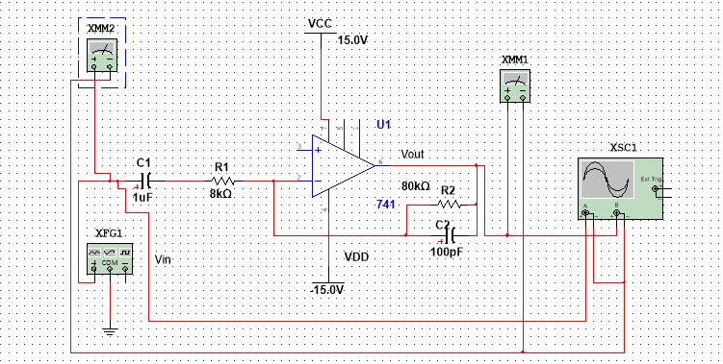
Circuit Diagram of the Band Pass Operational Amplifier

Slide 32
Data table
frequency | vout | Vin | Vout/Vin (Measured) | Theoretical
1 | 0.1 | 0.084 | 1.19047619 | 10
5 | 0.18 | 0.087 | 2.068965517 | 10
10 | 0.291 | 0.09 | 3.233333333 | 10
15 | 0.53 | 0.094 | 5.638297872 | 10
17 | 0.59 | 0.097 | 6.082474227 | 10
18 | 0.64 | 0.0984 | 6.504065041 | 10
19 | 0.654 | 0.0984 | 6.646341463 | 10
20 | 0.69 | 0.0983 | 7.019328586 | 10
21 | 0.692 | 0.104 | 6.653846154 | 10
30 | 0.801 | 0.104 | 7.701923077 | 10
80 | 1.012 | 0.104 | 9.730769231 | 10
300 | 1.064 | 0.104 | 10.23076923 | 10
1000 | 1.08 | 0.104 | 10.38461538 | 10
3000 | 1.08 | 0.104 | 10.38461538 | 10
5000 | 1.08 | 0.104 | 10.38461538 | 10
8000 | 0.94 | 0.104 | 9.038461538 | 10
10000 | 0.883 | 0.104 | 8.490384615 | 10
16000 | 0.78 | 0.104 | 7.5 | 10
19000 | 0.741 | 0.104 | 7.125 | 10
20000 | 0.728 | 0.104 | 7 | 10
40000 | 0.421 | 0.104 | 4.048076923 | 10
80000 | 0.218 | 0.104 | 2.096153846 | 10
100000 | 0.174 | 0.104 | 1.673076923 | 10

Slide 33
Band Pass plot

Slide 34
Conclusion
The gain of an operational amplifier or op-amp circuit depends upon a variety of factors including the circuit configuration as well as the components around the operational amplifier chip itself. This page gives a summary or overview of the gain of the different operational amplifier circuits available. Most op amp chips have very high gain levels, typically of the order of 10 000 to 100 000 at very low frequencies.Although this gain is not directly used, as it would mean that even very small input signals would send the chip into limiting, by using negative feedback high performance circuits can be generated. For the inverting op-amp gain, the circuit for the inverting op-amp has the output 180 degrees out of phase with the input and also provides a virtual earth input.For the non-inverting op-amp gain, the circuit for the non-inverting op-amp offers a higher input impedance than the inverting op amp circuit.We learn that these two circuits provide examples of where the op amp gain is controlled not by the internal gain of the chip itself, but by the external components in the negative feedback loop.
Operational amplifier bandwidth, frequency response and gain bandwidth product are key parameters for many circuit.Operational amplifier are used for comparatively low frequency circuits, but with the performance of these chips is improving all the time, much higher bandwidth operational amplifier and operational amplifier circuits are available.The bandwidth of the op-amp has a bearing on the design of the op amp circuit and the frequency response or bandwidth available for the circuit.

