Slide 1
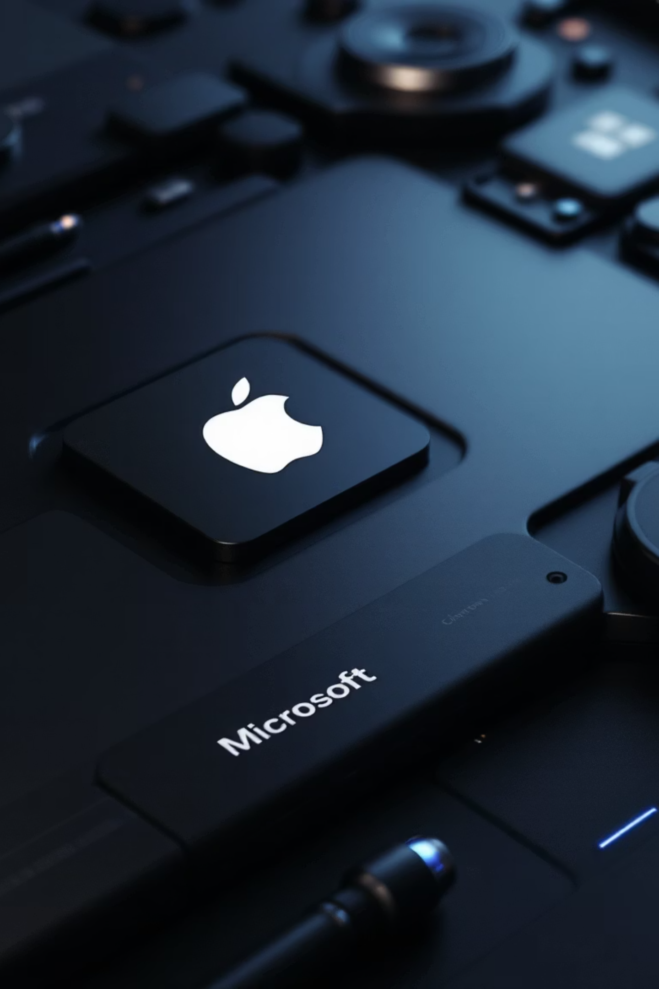
Apple & Microsoft: A Comparative Financial Performance Analysis (2010-2024)
A Power BI & Python Driven Deep Dive into Performance, Efficiency, and Future Outlook
Sai Saran Ravi

Slide 2

Project Goal & Scope
Objective
Tools & Data
To conduct a comprehensive analysis comparing the financial performance, operational efficiency, and future outlook of Apple and Microsoft over the 15-year period (2010-2024). The key goal was to go beyond simply reporting numbers and explain the "why" and "how" behind their performance, highlighting their different business models.
Data Source: Publicly available annual income statement data obtained via the Alpha Vantage API.
Tools: Python (in Google Colab) for initial API data extraction and comparative forecast; Power BI Desktop for data cleaning (Power Query), data modeling, DAX calculations, and building the final interactive dashboard.

Slide 3
Building the Analytical Engine
Raw data is almost never ready for analysis. This phase ensures data quality, consistency, and relevance, forming a reliable foundation for the entire dashboard.
01
02
03
Data Prep (Power Query)
Data Modeling
DAX Measures
Extracted and loaded annual/quarterly data via Python/API into Power BI. Filtered for annual reports only to ensure fair year-over-year comparisons. Standardized time period to 2010-2024 for both companies to analyze the "modern era" post-iPhone 4/iPad launch and Microsoft's cloud pivot.
Created a separate Date Table (Dim_Date) covering 2010-2024—a crucial Power BI best practice enabling powerful time intelligence DAX functions like YoY, CAGR, and Rolling Averages.
Developed Core KPIs: Total Revenue ($B), Net Income ($B), Operating Income ($B) to measure absolute size and profitability.
Calculated Profitability Ratios: Gross Margin %, Operating Margin %, Net Margin % to measure efficiency at different stages regardless of company size—crucial for comparing different business models.
Established a Many-to-One (*:1) relationship between Financials[fiscalDateEnding] and Dim_Date[Date], linking financial events to the calendar. Set Cross-filter direction to Single (Date → Financials) to protect the integrity of the Dim_Date table.
Selected essential financial columns for a lean, efficient data model. Created a Company column, extracted Fiscal Year as Whole Number, and normalized financials to Billions ($B) for easier reading and correct data types.
Calculated Growth Metrics: Revenue YoY Growth %, Operating Income YoY Growth %, Revenue CAGR % to measure short-term momentum and long-term stability.
Calculated Efficiency & Cost Ratios: Cost of Revenue %, R&D %, SG&A %, Operating Expenses ($B), Cost Efficiency Ratio—essential for the "Why" analysis, breaking down costs and measuring profit generated per dollar spent.

Slide 4

Executive Summary: Performance At a Glance
61%
46%
70%
Apple Revenue Share
Apple Gross Margin
Microsoft Gross Margin
Apple's current dominance in overall revenue size within this two-company comparison (FY 2024)
Lower due to hardware manufacturing costs
Higher due to low-cost software/cloud reproduction
Key Insights
Apple leads significantly in both revenue and net income scale, demonstrating its massive market presence. However, Microsoft maintains consistently superior operational efficiency with higher Operating Margins throughout most of the 15-year period.
Microsoft's YoY growth is generally steadier, closer to its CAGR line, while Apple's YoY growth shows higher peaks but also more significant dips, indicating more volatility despite a strong long-term CAGR.

Slide 5
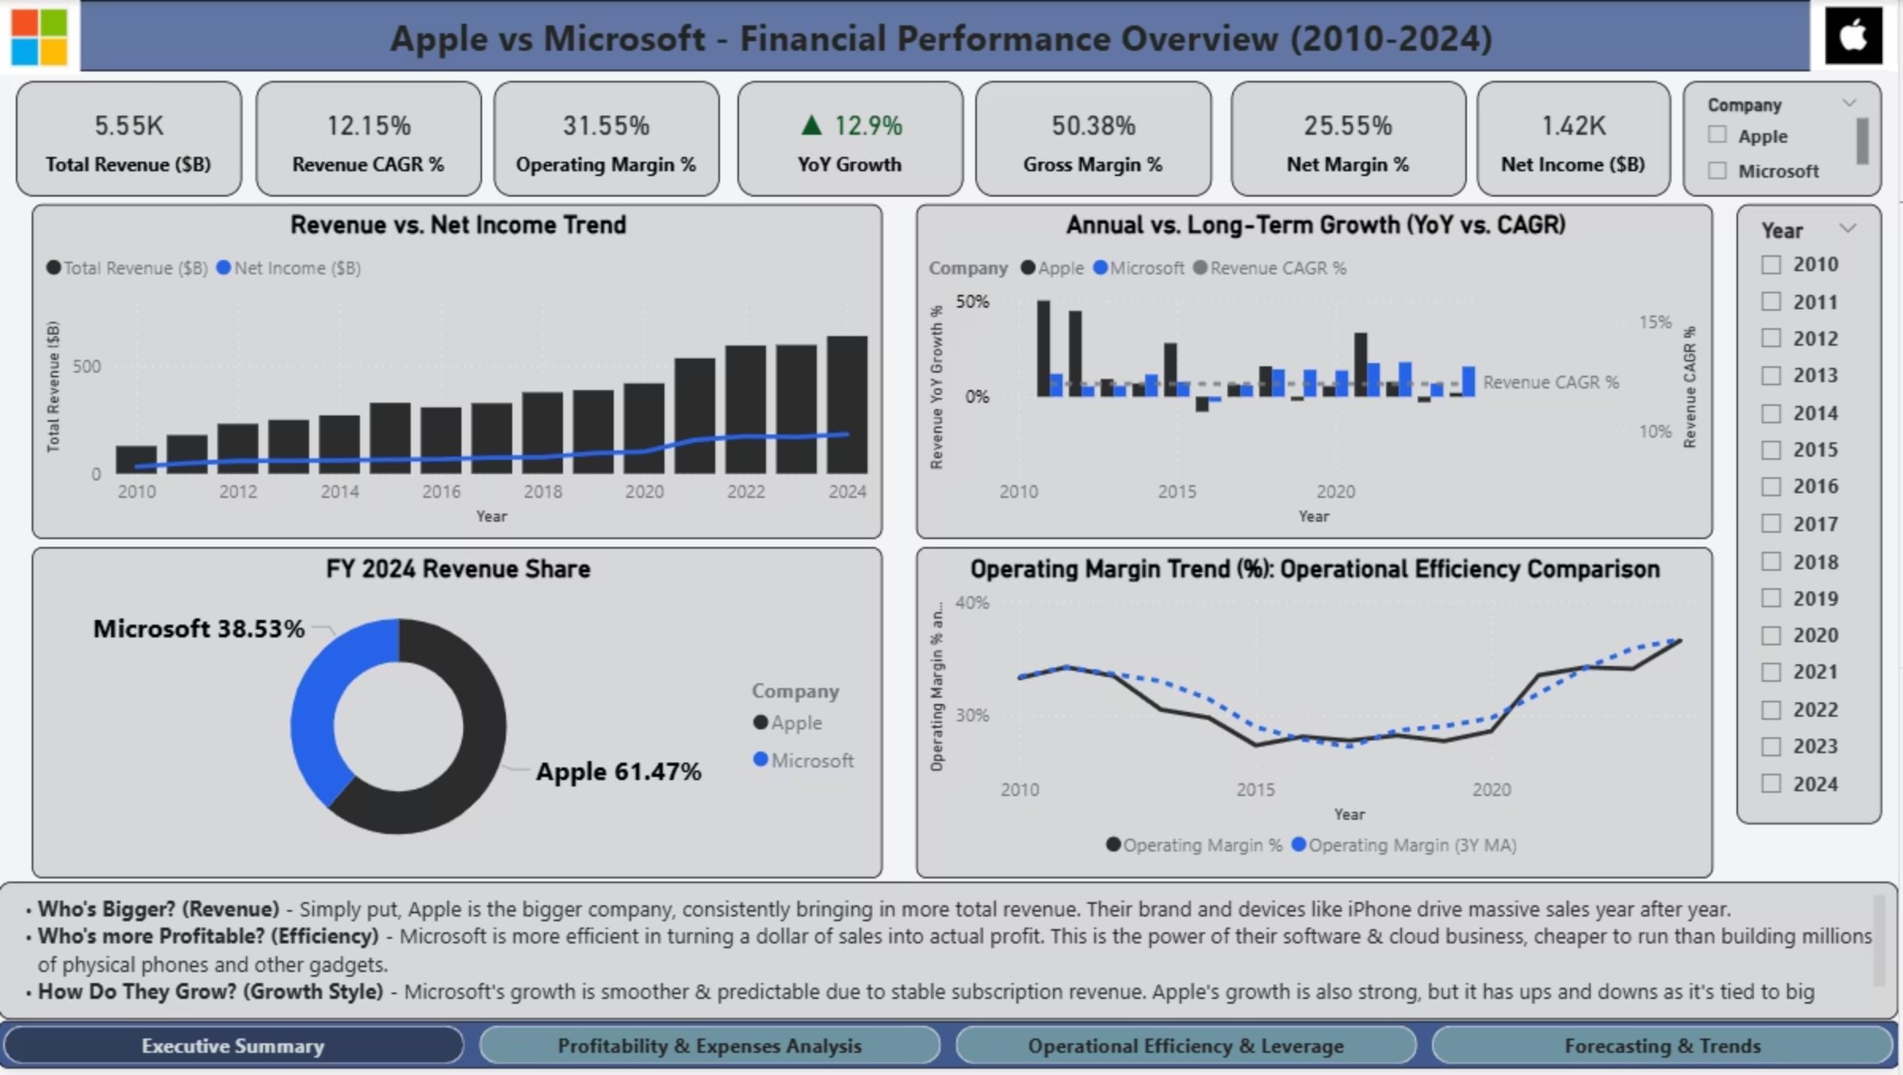
Executive Summary

Slide 6






Profitability Deep Dive: Understanding the "How" & "Why"
Margin Trends
Cost Structure
Scale vs. Margin
Microsoft enjoys a much higher Gross Margin (70%) due to low-cost software/cloud reproduction, while Apple's is lower (46%) due to hardware manufacturing costs. However, Net Margins are more competitive, showing different paths to profitability.
Apple's cost structure is dominated by Cost of Revenue (~54%), while Microsoft has a low Cost of Revenue (~30%) but invests a larger percentage in R&D (~12%) and SG&A, showcasing their different business models.
As revenue grew massively, Net Margin % remained relatively flat or even slightly compressed. This indicates that maintaining growth requires huge ongoing operational investments (R&D, marketing, logistics) that prevent the profit rate from continuously increasing.
The fundamental difference in profit models is clear: Microsoft's software-centric approach allows for higher initial profitability, while Apple's hardware-centric model requires higher upfront costs but generates massive absolute profits through scale and premium pricing.

Slide 7
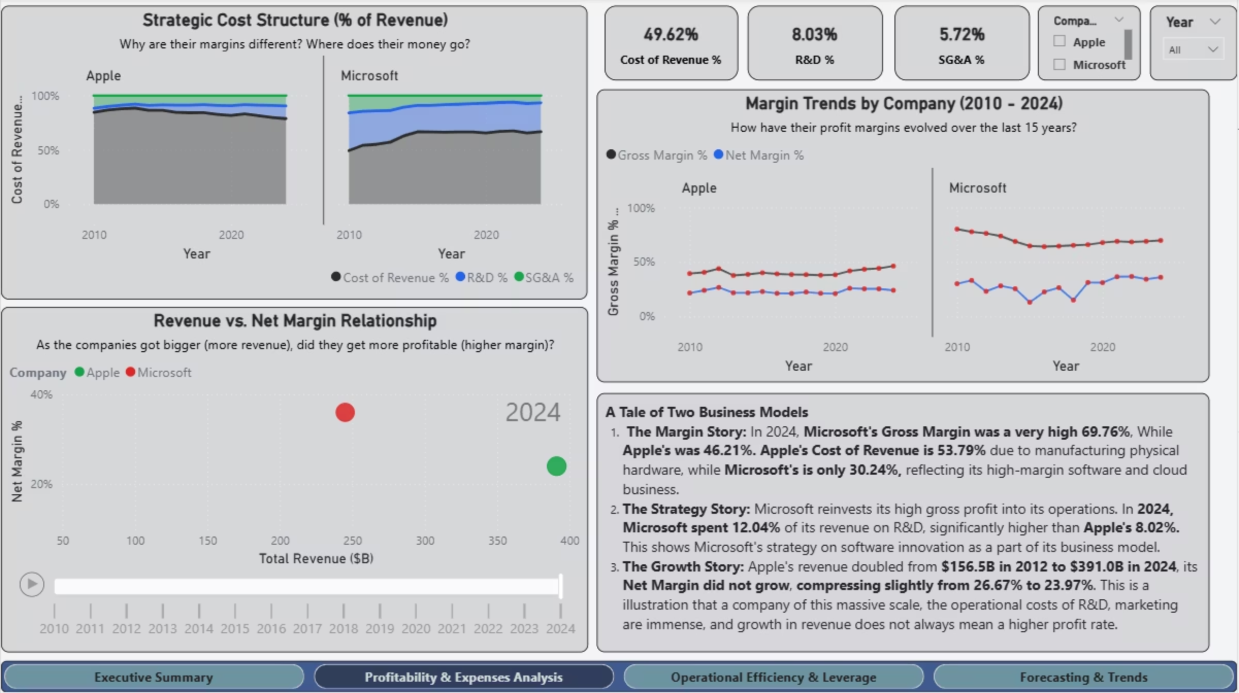
Profitability and Expense Analysis
Analyze how profitability differs and why?

Slide 8


Operational Efficiency & Leverage
23.6%
15.7%
Microsoft Profit Growth
Microsoft Revenue Growth
Operating profit growth in 2024
Revenue growth in 2024, showing positive operating leverage
Cost Efficiency Advantage
Strategic SG&A Investment
Microsoft generates significantly more profit per dollar spent (~$0.98 vs. Apple's ~$0.46 in 2024). Microsoft's efficiency trend has been generally increasing since 2017, reinforcing their operational strength.
Apple historically spent a higher percentage on SG&A (~6-7%) but still achieved strong Operating Margins (~31.5% in 2024). This suggests Apple's SG&A is an effective strategic investment in retail and marketing supporting its premium model, not just overhead.
When the profit growth line is above the revenue growth bar (like Microsoft in 2024), it signals positive operating leverage—the company is becoming more efficient as it scales.

Slide 9
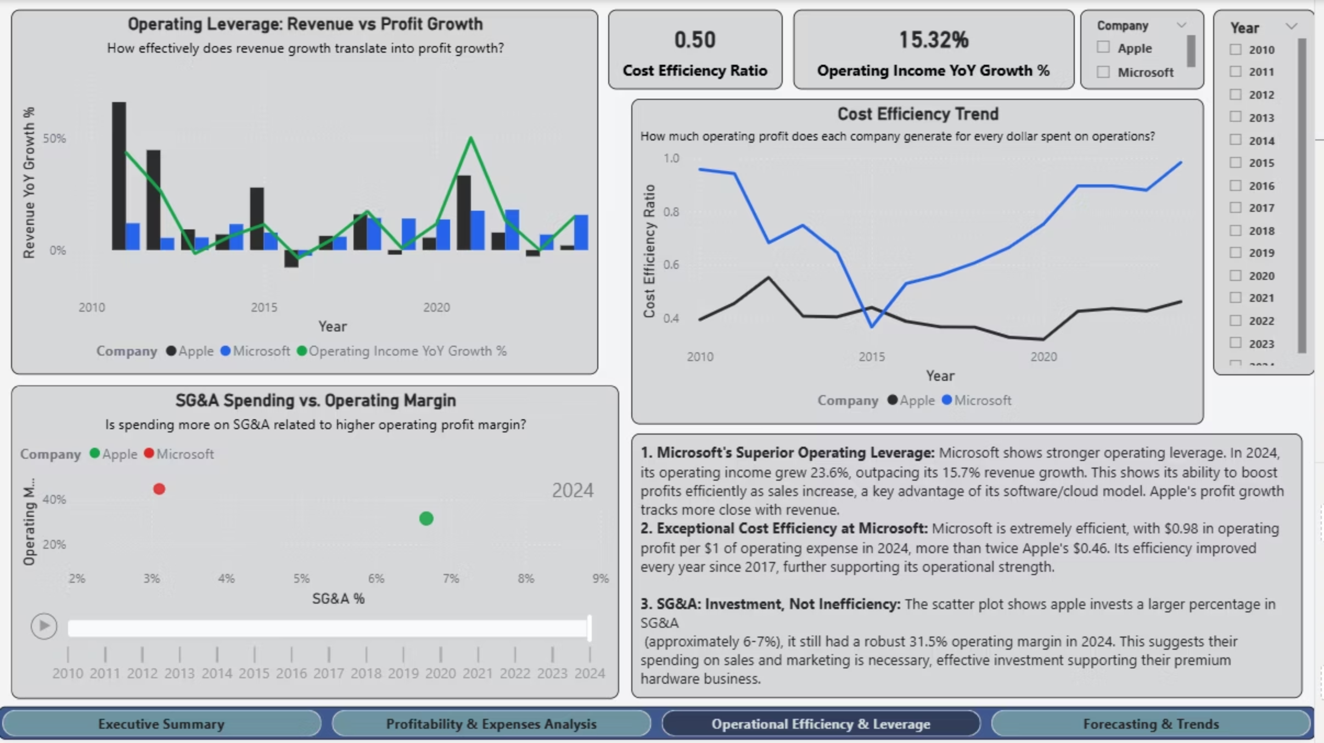
Operational Efficiency Analysis
(Analyze how efficiently each company converts growth into profit and manages operational spending)

Slide 10




Forecasting & Outlook: What's Next
Future outlook based on historical trends, comparing Power BI's exponential smoothing model with simple Python linear regression, highlighting forecast uncertainty and model sensitivity.
Revenue Forecast (2028)
Net Income Forecast (2028)
Model Comparison
Microsoft: ~$362B (stronger projected growth momentum)
Microsoft: ~$118B
Python's simple linear regression forecast is similar for Apple (~$493B) but noticeably more pessimistic for Microsoft (~$255B) compared to Power BI's forecast. This highlights how different models interpret trends and emphasizes model sensitivity.
Apple: ~$119B
Apple: ~$494B (maintains lead in absolute size)
Microsoft is forecast to nearly close the absolute profit gap, indicating its efficiency gains are expected to continue strongly impacting the bottom line.
The confidence interval (shaded area) in forecasts visually represents uncertainty. Both companies' futures will be heavily influenced by strategic execution in areas like AI, market expansion, and continued innovation.

Slide 11
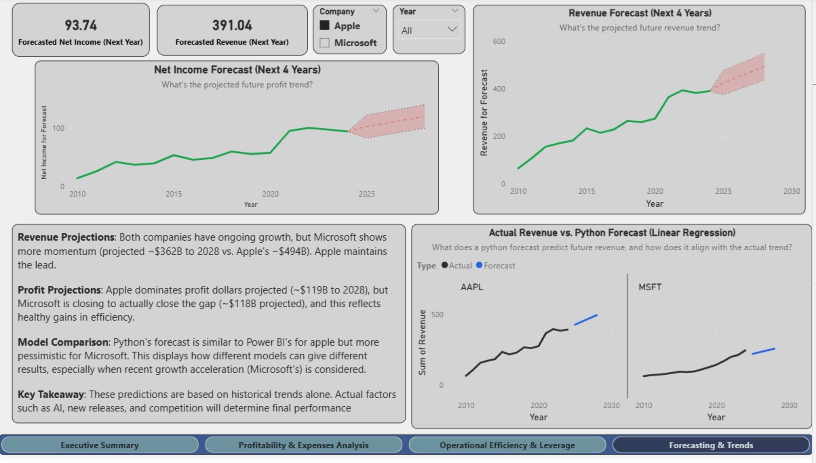
Forecasting Analysis

Slide 12
Conclusions: Two Paths to Tech Dominance
Apple: Dominance Through Scale & Ecosystem
Microsoft: Dominance Through Efficiency & Recurring Revenue
Success Driver: Apple's financial strength stems primarily from its massive scale, premium brand power, and tightly integrated hardware/software ecosystem.
Success Driver: Microsoft excels through exceptionally high margins, superior operational efficiency, and stable, recurring revenue streams.
Model: Fundamentally hardware-centric, reflected in higher absolute revenues but lower gross margins compared to Microsoft due to manufacturing costs.
Model: Primarily software and cloud-centric, allowing for lower cost of revenue and strong reinvestment in R&D and enterprise sales.
Strength: Remarkable ability to scale profits faster than revenue (operating leverage) and maintain consistent, high profitability.
Strength: Unmatched ability to generate huge absolute profits and command premium pricing.
Current State
Future Momentum
Recommendation
Both companies are incredibly strong financially, representing resilient and dominant business models. Apple leads significantly in size; Microsoft leads significantly in operational efficiency.
Based on recent trends and forecasts, Microsoft shows stronger efficiency momentum and is projected to close the absolute net income gap. However, both companies' futures will be heavily influenced by strategic execution in areas like AI, market expansion, and continued innovation.
This Power BI dashboard provides a robust framework for ongoing comparative analysis of these tech giants. It effectively highlights their differing strategies and performance drivers, enabling data-driven insights into their competitive positioning.

