Slide 1

Strategic and optimized plan for stock management at Gala Groceries
Objective:
Predict and manage stock levels more effectively using sales and sensor data.
Key Insights:
Important Factors: Unit price, temperature, and hour of the day.
Less Important Factor: Product category.
Results:
Accurate Predictions: The model can accurately forecast stock levels based on key influencing factors.
Improved Storage: Advanced temperature control and real-time inventory tracking enhance product quality and reduce waste.
Efficient Procurement: Better demand forecasting helps in timely and precise restocking.
Strategic Plan:
Data Aggregation: Combine sales and sensor data by timestamp and product_id.
Feature Engineering: Create temporal features (e.g., hour of the day, day of the week).
Predictive Modeling: Use machine learning to predict stock levels.
Storage Optimization: Allocate storage based on product durability and perishability.
Supplier Coordination: Improve communication for timely restocking.
Conclusion:
The model provides a robust solution for optimizing stock levels, ensuring freshness, reducing waste, and meeting customer demand efficiently.

Slide 2
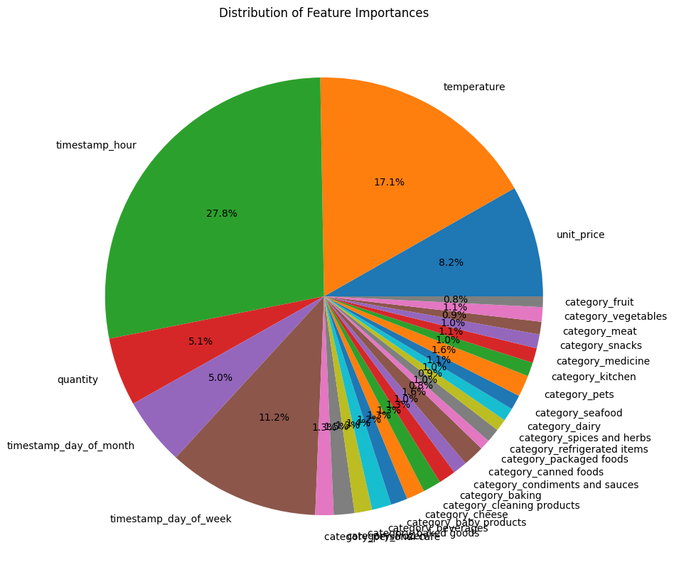

Slide 3

THANKS

