Slide 1

Title :Integrated Blood Bank Management Platform
Student Name: Sai Saranya
Student ID: 2520030258
Cluster:4
Section: 14
Under the Guidance
of
Supervisor Name: Dr. Jayaram Boga
Assistant Professor
Department of CSE

Slide 2
OUTLINE
Abstract
Existing System
Proposed System
System Architecture
Project Modules
Objectives
Co’s Attainments - FWD
Co1
Co2 …….. 5. Co5
Co’s Attainments - DSA
Co1
Co2 …….. 5. Co5
Screen Shots for FWD & DSA
Conclusion
Geo-Tagged Photos

Slide 3
Abstract
The Integrated Blood Bank Management Platform is a comprehensive computerized system designed to manage and coordinate all blood bank operations efficiently. The platform maintains detailed records of blood donors, blood groups, blood collection, testing, storage, and distribution in a centralized database. It reduces manual paperwork, minimizes errors, and improves overall operational accuracy.
The system enables administrators to easily register donors, update donor information, and track donation history. It also monitors blood stock levels in real time, helping staff quickly identify available blood groups during emergencies. This ensures faster response and timely availability of blood for patients and hospitals.

Slide 4
In addition, the platform generates reports related to blood stock, donor activities, and blood requests, assisting management in proper planning and decision-making. Security features such as authentication and access control protect sensitive donor and patient information.
By integrating all blood bank functions into a single digital platform, the system enhances efficiency, transparency, communication, and reliability. Overall, the Integrated Blood Bank Management Platform plays a vital role in supporting life-saving services through effective blood collection, storage, and distribution management.

Slide 5
Existing System
Blood donation coordination mostly happens manually.
Hospitals rely on phone calls and personal contacts.
Difficult to track available donors quickly.
No centralized digital record of donors.
Emergency blood requirements may be delayed.

Slide 6
Proposed System
Develop a web-based blood donation platform.
Allow donors to register their blood group and contact details.
Allow patients to request blood units online.
Display donor and request history dynamically.
Provide search and filter features for blood types.
Improve response time during emergencies.

Slide 7
System Architecture
User Interface Layer – HTML and CSS based web interface.
Application Logic Layer – JavaScript handles validation and events.
Data Storage Layer – Browser local Storage stores donor/request data.
User Interaction – Forms collect donor and requester details.
Display Layer – Dynamic rendering using DOM manipulation.

Slide 8
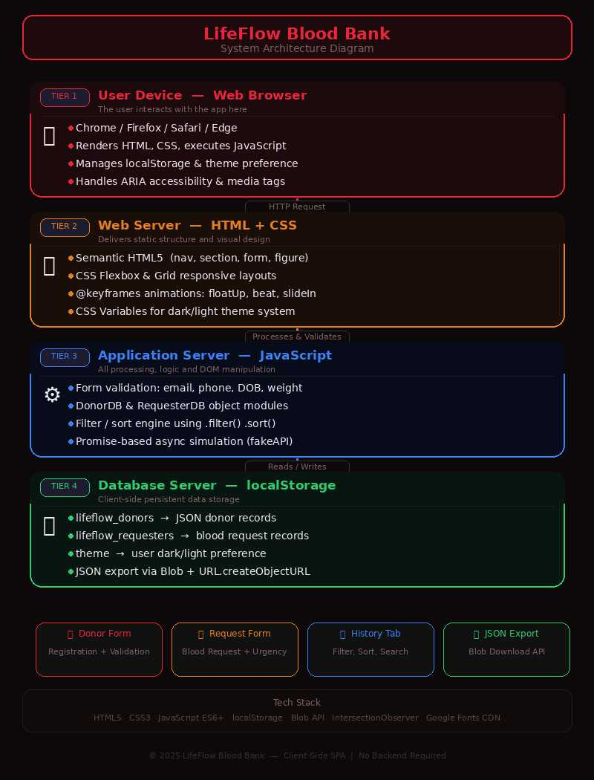
System Architecture

Slide 9
Project Modules
Donor Registration Module
Allows users to register as blood donors.
Blood Request Module
Allows patients to request blood units.
History Management Module
Maintains donor and requester records.
Search and Filter Module
Theme Management Module
User Interface Module

Slide 10
Objectives
Create a digital platform for blood donation.
Help patients find blood donors quickly.
Reduce delay during medical emergencies.
Maintain digital donor records.
Provide user‑friendly interface for registrations.
Encourage community participation in blood donation.

Slide 11
Co’s Attainments - FWD
CO1: Understanding HTML structure and CSS styling.
CO2: Designing responsive layouts using CSS.
CO3: Implementing JavaScript logic and functions.
CO4: Using DOM manipulation for dynamic content.
CO5: Building complete interactive web applications.

Slide 12
Co’s Attainments - DSA
CO Attainments – DSA
CO1 A full Big-O Summary Table (best/average/worst + space complexity notes) is printed at runtime. CO1 is fully attained.
CO2 Doubly Linked List (DonorLinkedList): Insert at head/tail O(1), delete by ID O(n), forward/backward traversal, in-place reversal, array conversion for sorting.
CO3 Priority Queue / Max-Heap (EmergencyDonorPQ): Java PriorityQueue with custom comparator (max-heap by unitsDonated), used for emergency donor dispatch.
CO4 Java HashMap (CityDonorMap): HashMap<String, List<DonorNode>> used for city-wise grouping, demonstrates computeIfAbsent, getOrDefault, and Map.Entry iteration.
CO5 Develop a real-world application using data structures.

Slide 13
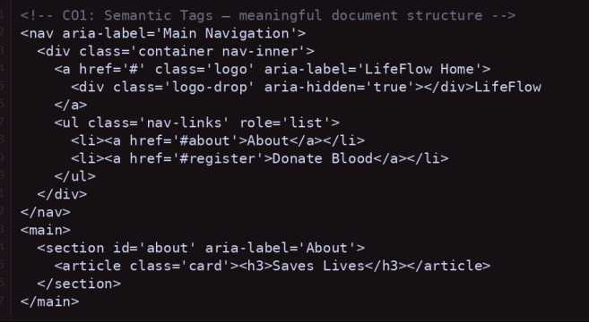
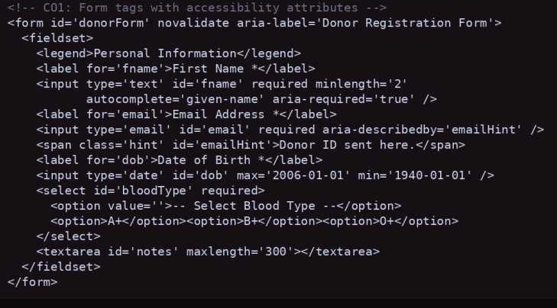
Screenshots for FWD
CO1 – HTML Structure & Basic CSS

Slide 14
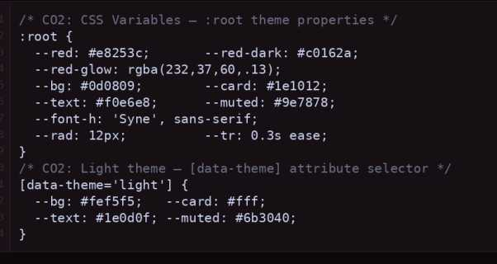
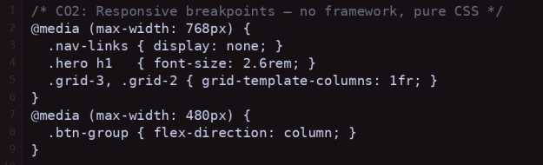
CO-2 – HTML Forms & Input Handling

Slide 15
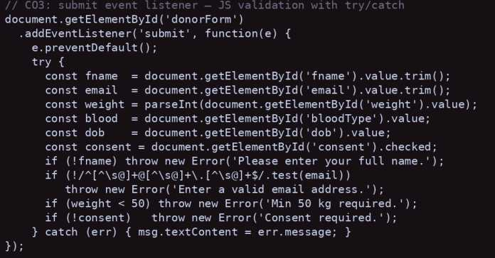
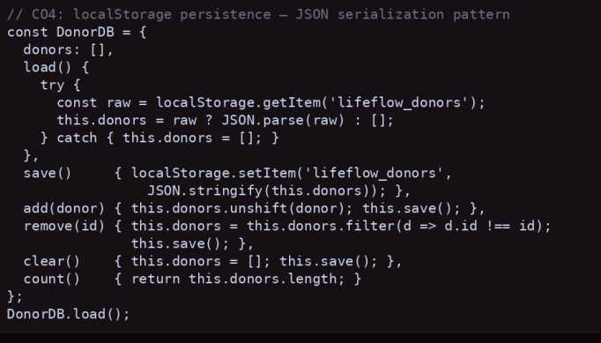
Screenshots for FWD
CO3 – JavaScript Programming Concepts
CO4 – JavaScript DOM Manipulation

Slide 16
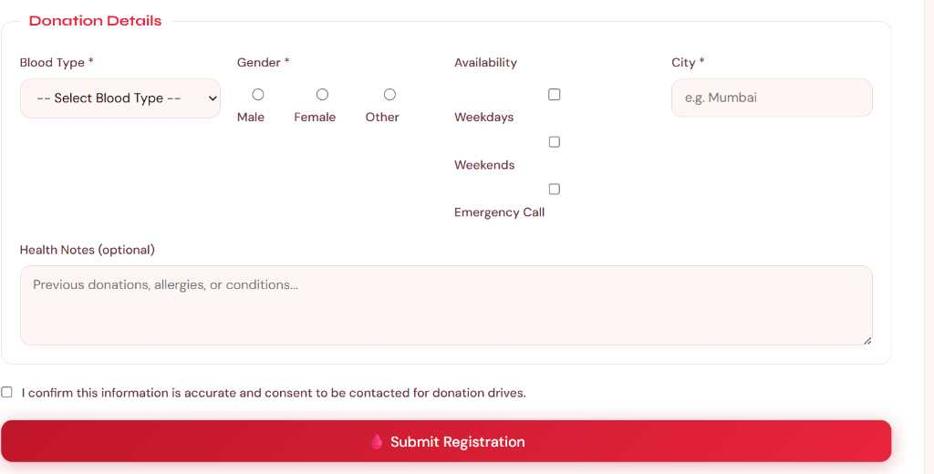
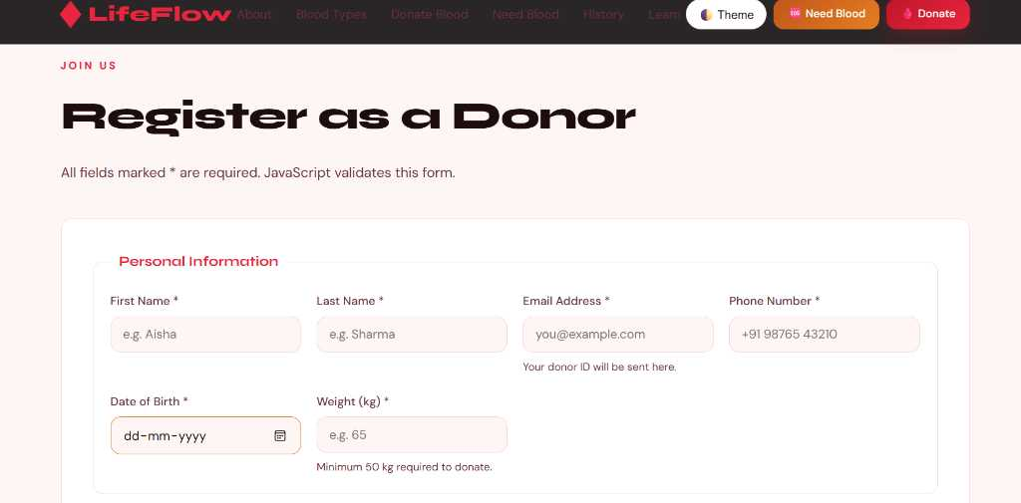
CO5 – Advanced Web Application Features

Slide 17
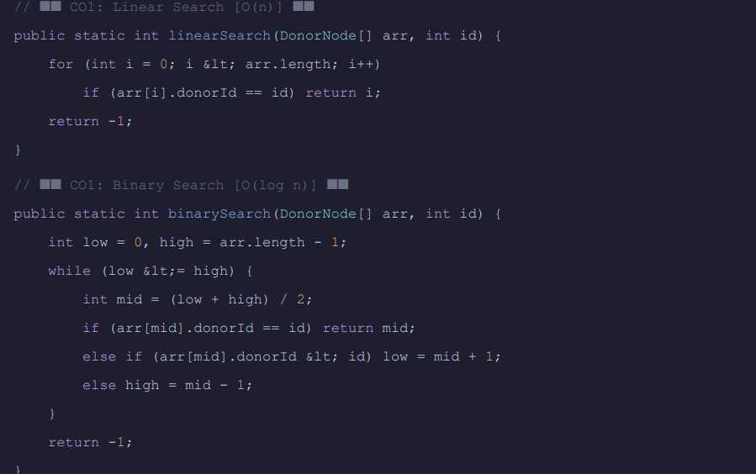
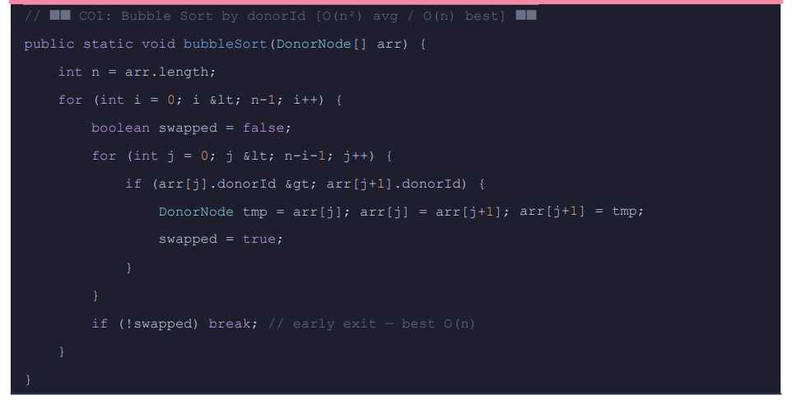
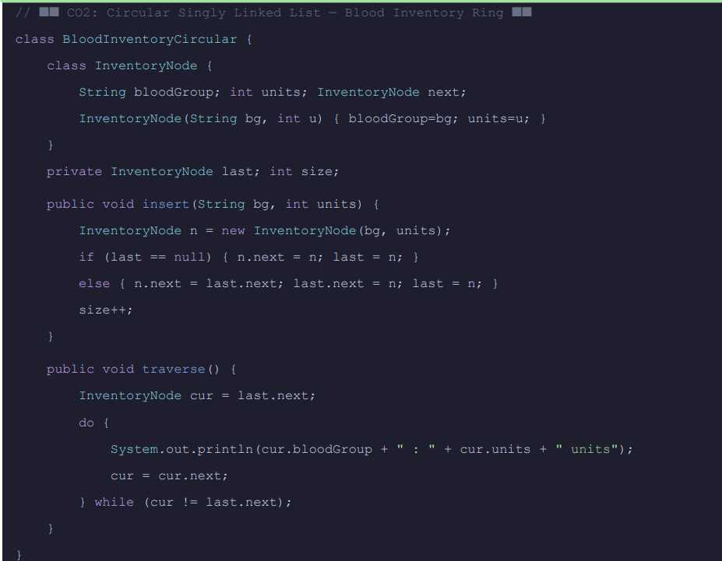
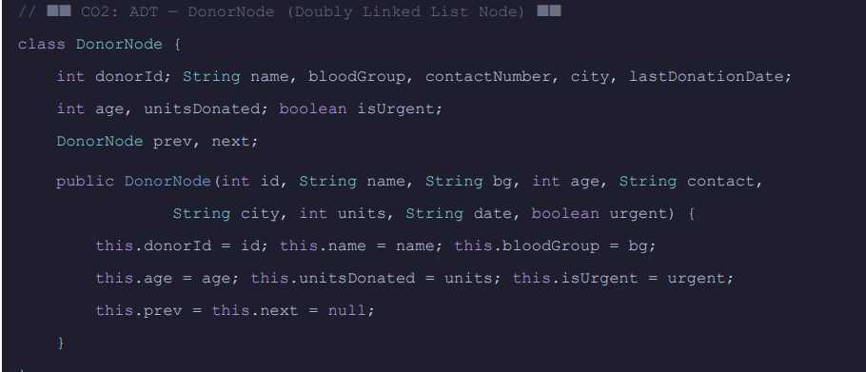
Screenshots for DSA
CO1 – Algorithm Implementation (Searching / Efficiency Concept)
CO2 – ADT using ArrayList

Slide 18
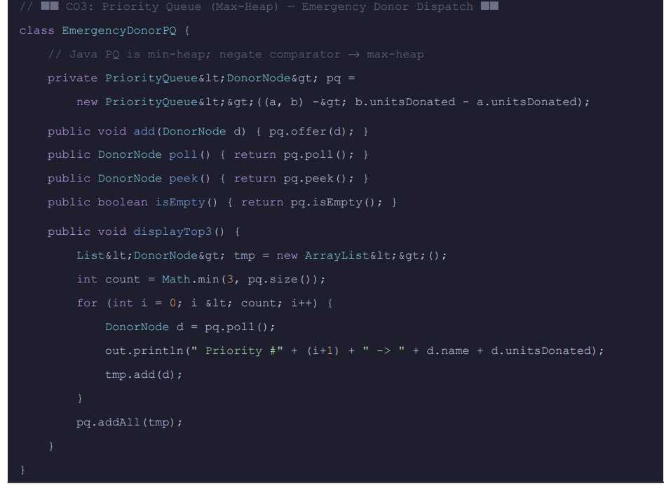
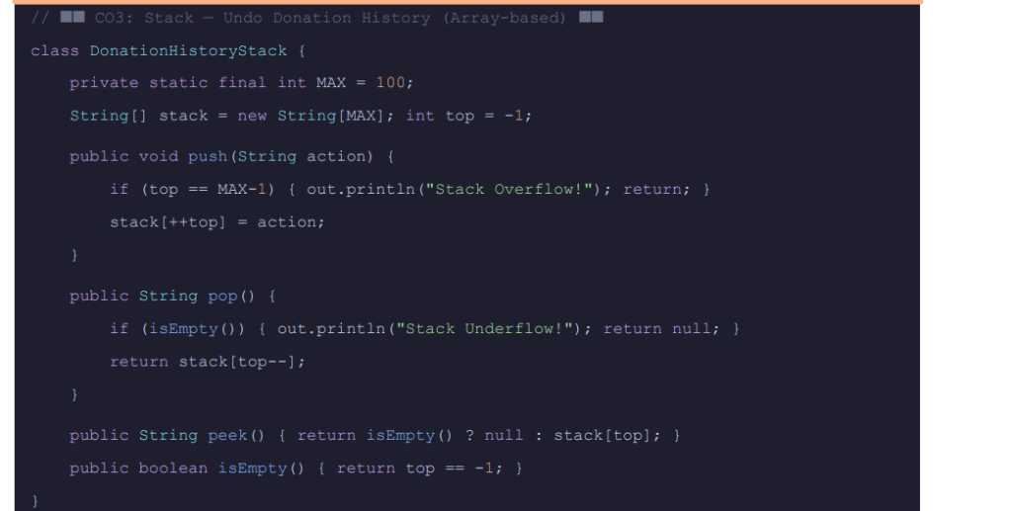
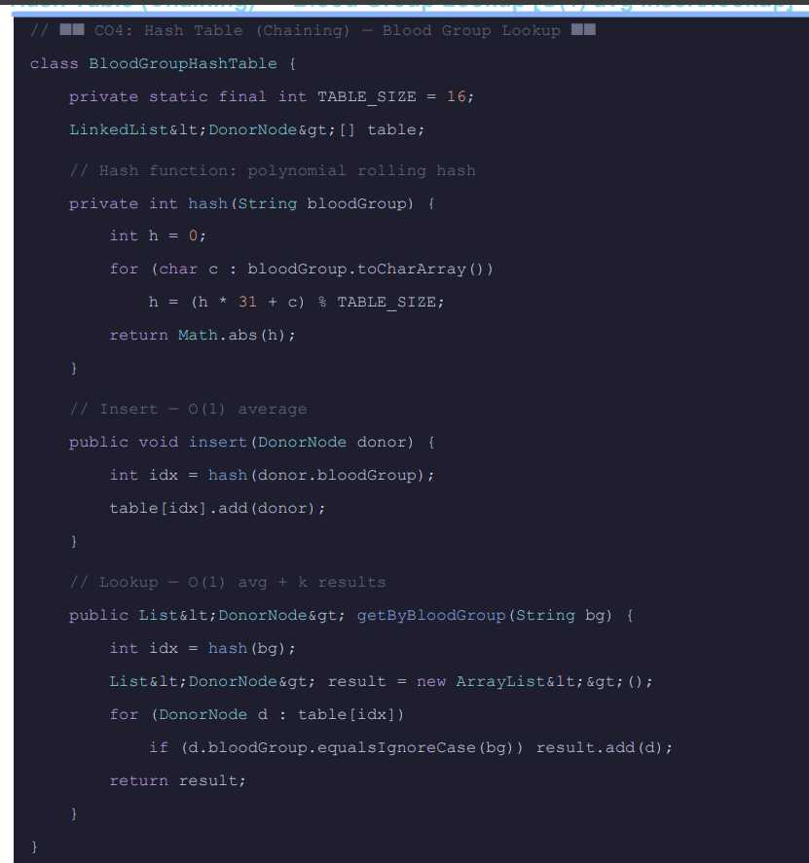
Screenshots for DSA
CO3 – Linear Data Structure Operations
CO4 – Hash-Based Data Structures

Slide 19
Conclusion
The Blood Bank Donor Information System demonstrates how data structures and algorithms can be effectively used to manage donor information and blood requests in a structured and efficient way. The system stores and organizes donor records using data structures such as Doubly Linked Lists, Stack, Circular Queue, Priority Queue, Hash Tables, and HashMap. These structures help in performing operations like insertion, deletion, searching, and sorting of donor data. By implementing different sorting and searching algorithms, the system ensures that donor information can be accessed quickly and managed efficiently.
Overall, this project highlights the practical application of Data Structures and Algorithms (DSA) in solving real-world healthcare problems. Features such as emergency donor prioritization, request processing, and quick blood group lookup improve the efficiency of blood bank management. The system also demonstrates how Java programming concepts and algorithmic techniques can be integrated to build reliable and scalable applications that support faster decision-making and better organization of donor records.

Slide 20
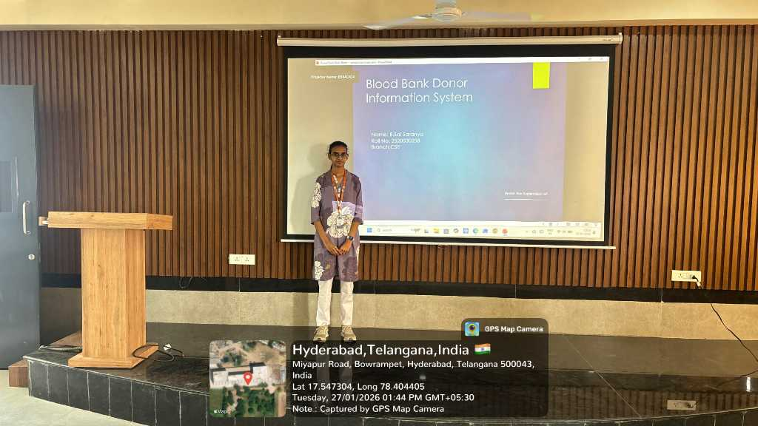
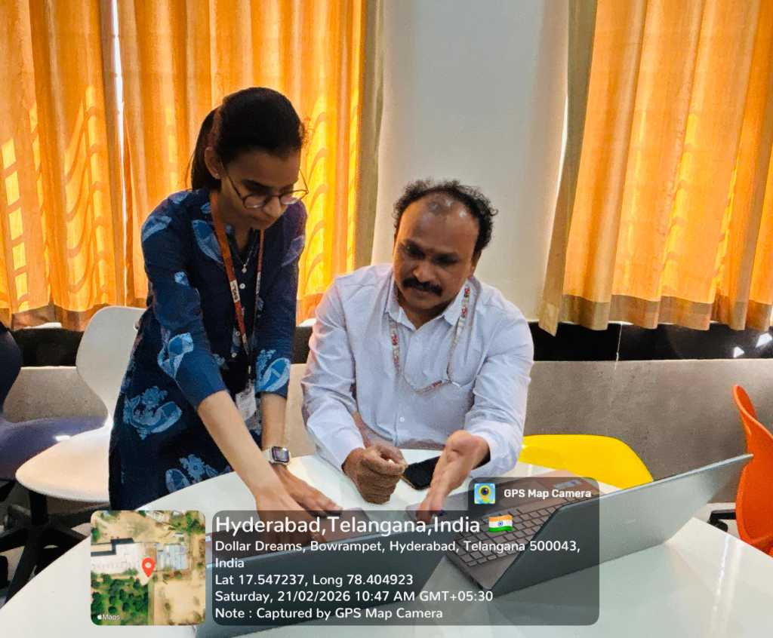
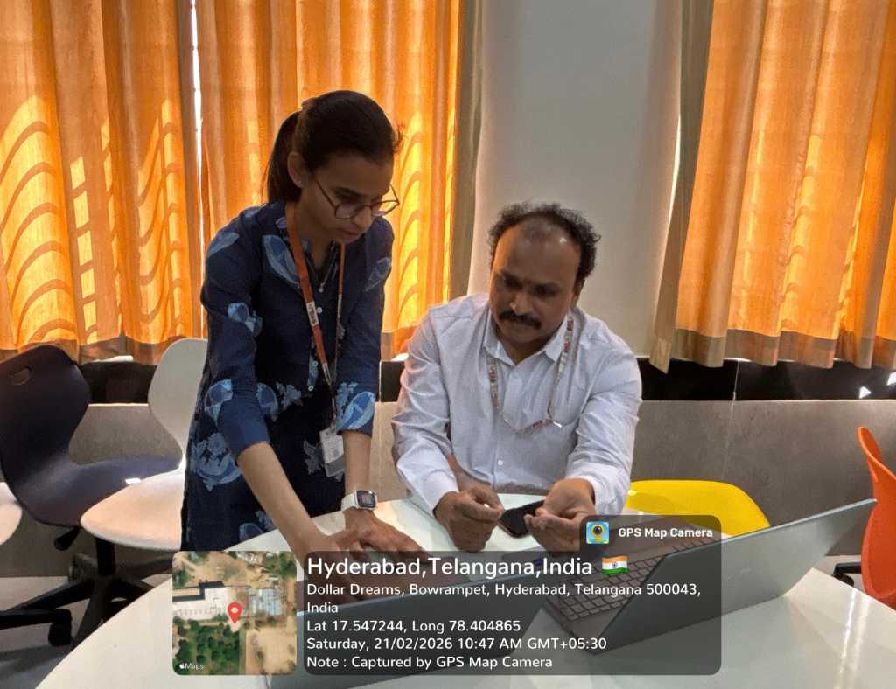
Geo- Tag Photos

Slide 21
THANK YOU

