Slide 1
Machine Learning (25SC2107E)
Insider Threat Detection Using Elastic Net Regularized Logistic Regression
Team Members
2520030436 – G. Eesha Yuktha
2520030258 – B. Sai Saranya

Slide 2
Contents
Abstract
Introduction
Literature Survey
Problem Statement and Objectives
Workflow / Flow Chart
Exploratory Data Analysis
Model Evaluation Results
System Implementation & Monitoring
Hardware and Software Requirements
Conclusion
Future Scope

Slide 3
Abstract
Problem: Insider threats occur when authorized users misuse their legitimate access to steal sensitive information or damage organizational systems.
Approach: An Insider Threat Detection System is proposed using Elastic Net Regularized Logistic Regression to classify user activity as normal or potentially malicious.
Features used: Behavioral and security-related signals are analyzed — login patterns, file access, access frequency, and unusual user behavior.
Why Elastic Net: Elastic Net combines L1 and L2 penalties, enabling automatic feature selection while reducing overfitting on correlated behavioral data.
Evaluation: The model is trained and evaluated using accuracy, precision, recall, F1-score, and ROC-AUC.
Impact: Demonstrates how ML can help cybersecurity teams flag suspicious behavior early and reduce the risk of insider attacks.
Project Snapshot
1500 event records, 23 features
250 unique users, 7 departments
Model: Elastic Net Logistic Regression
Metrics: Accuracy, Precision, Recall, F1, ROC-AUC

Slide 4
Introduction
Insiders are employees, contractors, or partners who already hold legitimate access — they don't need to break in, they can simply misuse the access they have.
Perimeter defenses such as firewalls and intrusion-detection systems are built to catch outside attackers, so they largely miss valid credentials being used for malicious purposes.
Behavioral analytics offers a way forward: monitoring login times, file access volume, downloads, and device usage can reveal patterns that don't fit a user's normal routine.
This project applies Elastic Net regularized Logistic Regression to structured behavioral log data — 1500 events across 23 login, file-access, and device-usage features.
Goal: build an interpretable, regularized classifier that flags suspicious activity early, even when the underlying features are highly correlated with one another.
23
Behavioral features tracked
250
Unique users monitored
7
Departments covered

Slide 5
Literature Survey
Rule-based / SIEM systems: Rule-based & SIEM systems apply static thresholds and known-misuse signatures; effective for known patterns but blind to novel behavior and prone to high false-positive rates.
Unsupervised anomaly detection: Clustering, PCA and isolation-forest methods flag outlier sessions without needing labeled attacks, but struggle to separate genuine anomalies from true insider threats.
Supervised ML classifiers: Logistic regression, random forest and SVM trained on labeled behavioral logs perform well, but plain (unregularized) models can overfit or mis-weight correlated features.
Deep learning / sequence models: LSTMs and autoencoders capture temporal user behavior and are powerful, but need large labeled datasets and are harder to interpret for security audits.
This project's direction — regularized linear models: Elastic Net logistic regression balances feature selection (L1) with stability under correlated inputs (L2) — a strong, interpretable fit given the highly correlated behavioral features observed in this dataset (e.g. file_access_count and unique_files_accessed, r ≈ 0.90).

Slide 6
Problem Statement and Objectives
Problem Statement
Malicious insiders act using valid credentials, so their activity blends into normal traffic and manual log review doesn't scale. Unregularized models further struggle with the many correlated behavioral features (e.g. file access and download volume) and the roughly 4:1 imbalance between normal and threat events.
Objectives
Perform structural EDA and data-quality checks on the 1500-record insider-threat log dataset.
Engineer and encode behavioral and categorical features (department, role, device type) for modeling.
Handle the 80:20 class imbalance via class-weighting or resampling.
Train an Elastic Net regularized Logistic Regression classifier that selects relevant features and controls multicollinearity.
Evaluate the model using accuracy, precision, recall, F1-score, and ROC-AUC.
Deliver an interpretable, deployable screening tool for security analysts.

Slide 7
Flow Chart
1. Data Collection (raw behavioral logs)
↓
2. Data Quality Checks (missing values & duplicates)
↓
3. Exploratory Data Analysis (EDA)
↓
4. Feature Engineering & Encoding
↓
5. Train / Test Split + Class-Imbalance Handling
↓
6. Elastic Net Logistic Regression Training
↓
7. Evaluation → Prediction API → Dashboard & Monitoring

Slide 8
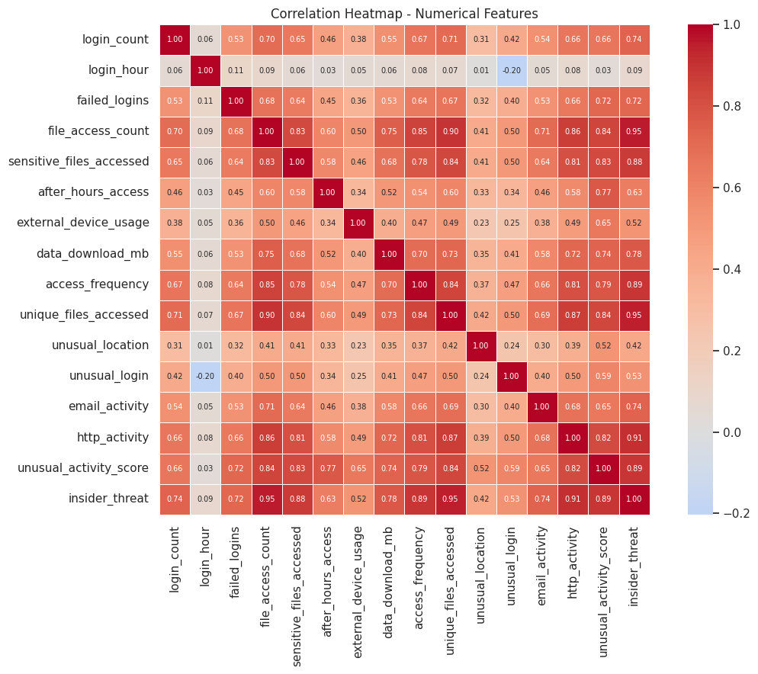
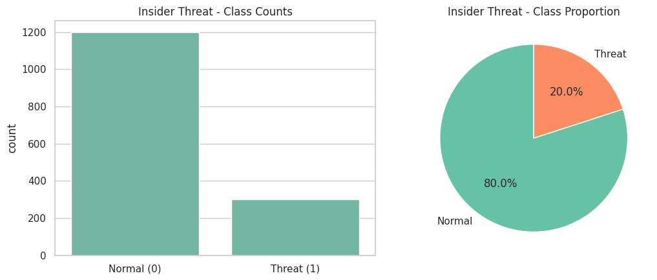
Results
Exploratory Data Analysis — dataset quality and behavior patterns
1500
Event records
23
Features
0
Missing / duplicate values
80:20
Normal : Threat ratio
Correlation heatmap — numerical features
Class distribution — Normal vs Threat (80% / 20%)
Key findings: file-access and HTTP activity strongly correlate with the threat label. The 80:20 class split motivates class weighting. Correlated features support using Elastic Net regularization.

Slide 9
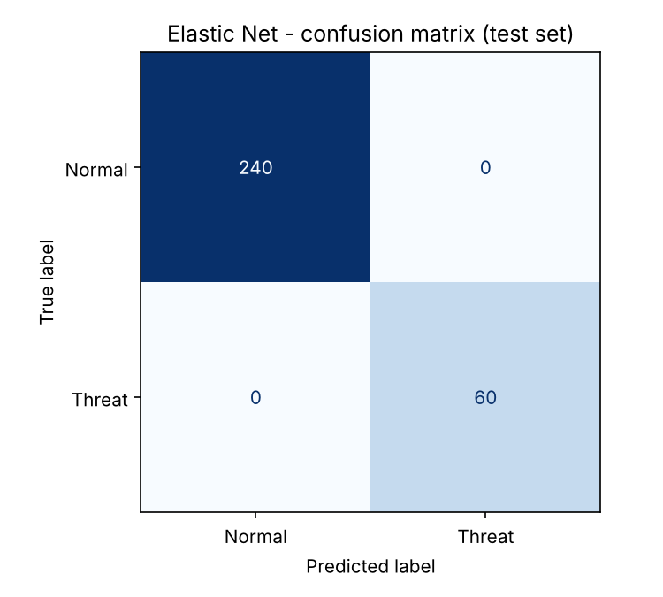
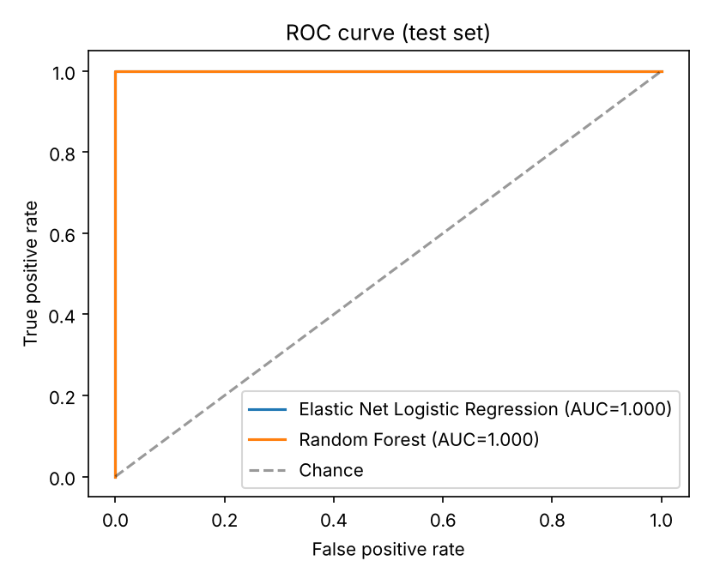
Model Evaluation Results
Held-out test set: 300 records (240 normal, 60 threat); threshold = 0.50
Model | Accuracy | Precision | Recall | F1-score | ROC-AUC
Elastic Net Logistic Regression | 100% | 100% | 100% | 100% | 1.000
Random Forest | 100% | 100% | 100% | 100% | 1.000
Isolation Forest | 92% | 100% | 60% | 75% | 0.997*
Confusion matrix and ROC curve
Elastic Net confusion matrix
Feature selection
TN 240 | FP 0
FN 0 | TP 60
L1 regularization set 23 of 33 encoded coefficients to zero. Strong signals included file access, unique files, sensitive-file access, HTTP activity and access frequency.
Important limitation: the dataset source is unknown and appears synthetic. Perfect supervised scores indicate easy separation in this dataset—not proven performance on real company logs. Isolation Forest is unsupervised and missed 24 of 60 threats.

Slide 10
System Implementation & Monitoring
Implemented locally; public cloud deployment is planned, not completed.
1. User Interface
2. API Layer
3. Prediction
4. Logs
5. Monitoring
Streamlit form
Local model or API mode
FastAPI + Pydantic
POST /predict, /health
Saved Elastic Net pipeline
Impute • scale • encode
Prediction + score + UTC time
No user IDs logged
Threat rate, missing values
range checks + KS drift
Model training
Comparison models
Monitoring caveat
Stratified 80/20 split • 5-fold CV
GridSearchCV tunes C and l1_ratio
Class weighting handles 20% threat class
Random Forest benchmark
Isolation Forest detects anomalies
Saved pipelines use Joblib
Drift means input distributions changed.
Without true labels, performance decline cannot be confirmed.
Local run: uvicorn app.main:app --reload | streamlit run app/streamlit_app.py | pytest -v

Slide 11
Hardware and Software requirements
Hardware Requirements
Software Requirements
Processor: Intel i5 / AMD Ryzen 5 or equivalent
RAM: 8 GB minimum (16 GB recommended)
Storage: 5 GB free space
GPU: Not required
Internet: Needed for package installation / hosted services
Python 3.10+
FastAPI + Uvicorn (REST API)
Streamlit (interactive dashboard)
scikit-learn, pandas, NumPy, SciPy
matplotlib, joblib, Pydantic, requests
pytest + httpx (automated tests)
OS: Windows, Linux, or macOS

Slide 12
Conclusion
The project now implements an end-to-end insider-threat screening workflow using 1,500 records and 23 original dataset columns. Data checks found no missing values or duplicate rows; 20% of records are labelled as threats.
On the held-out 300-record test set, Elastic Net Logistic Regression achieved 100% accuracy, precision, recall, F1-score and ROC-AUC. Random Forest tied on this dataset; Isolation Forest achieved 92% accuracy and 60% recall.
The pipeline includes preprocessing, feature selection, a FastAPI prediction service, a Streamlit interface, request logging and input-drift monitoring. The perfect supervised scores must be treated cautiously because the dataset origin is unknown and appears synthetic; these results do not establish real-world performance.

Slide 13
Future Scope
Validate on real, labelled organizational or benchmark data (for example, CERT) before making security claims.
Tune thresholds for high threat recall and calibrate predicted probabilities.
Monitor drift over time and evaluate performance when ground-truth labels become available.
Improve temporal/session-level features and test against additional baselines such as XGBoost and SVM.
Deploy the API and dashboard to a hosted environment; online deployment is not yet completed.
Add explainability reports (e.g., SHAP) and role-based access controls for analyst use.

Slide 14
Thank you

