Slide 1
MACHINE LEARNING PROJECT
Traffic Flow Pattern
Clustering
Using K-Means and DBSCAN for Smart Urban Traffic Congestion Analysis
TEAM
N. Yeswanth Kumar • 2520030183
B. Sai Sashank • 2520030454
Under Mr. Shaik Asif
CSE • KLEF • A.Y. 2026–27

Slide 2
INTRODUCTION
02
Understanding urban traffic flow
Traffic conditions change continuously and can be described using measurable road conditions.
THE TRAFFIC PATTERN
PROJECT IDEA
A traffic observation is not defined by a single number.
Instead of manually defining every traffic pattern, use unsupervised learning to discover groups in the measurements.
• Vehicle count indicates the amount of traffic present.
• Average speed reflects how freely vehicles are moving.
• Traffic density represents how many vehicles occupy a unit road length.
• Road occupancy describes how much of the road is occupied.
Traffic measurements
→
Clustering
→
K-Means + DBSCAN
Traffic patterns

Slide 3
PROBLEM STATEMENT
03
What are we trying to solve?
The project treats traffic-pattern discovery as an unsupervised machine-learning problem.
PROBLEM STATEMENT
WHY CLUSTERING?
Given traffic observations containing vehicle count, speed, density and occupancy, identify meaningful groups of observations that represent different traffic-flow conditions.
NO
predefined target label required
4
The important point:
• We are not training a classifier with a target output.
• We are discovering structure already present in the numerical measurements.
• Different clustering algorithms can reveal different views of the same traffic data.
core traffic measurements
2
clustering approaches

Slide 4
OBJECTIVES
04
Project objectives
The workflow moves from understanding the data to evaluating two clustering methods.
01
Explore the dataset
Understand structure, distributions, relationships and data quality.
02
Prepare the features
Handle missing values and standardize the four clustering features.
03
Apply K-Means
Find broad traffic patterns and determine a suitable number of clusters.
04
Apply DBSCAN
Discover density-based structure and identify noise observations.
05
Evaluate & compare
Use Silhouette Score and Davies-Bouldin Index to describe the clustering results.

Slide 5
LITERATURE SURVEY
05
What previous research has explored
Selected traffic-clustering studies that directly connect to our problem.
Study
Method
Traffic data / focus
Key contribution
Scope / limitation relevant to us
Kianfar & Edara
(2013)
Hierarchical +
K-Means + GMM
Freeway sensor data;
speed, occupancy, flow
Clusters traffic into
free-flow and congested
regimes.
Focused on freeway
bottlenecks and
fundamental diagrams.
Almeida et al.
(2023)
K-Means +
DBSCAN
Urban bus mobility
data; congestion levels
Uses K-Means for
congestion levels and
DBSCAN for road patterns.
Uses bus-mobility probe
data; our project uses a
compact feature table.
Lahijanian et al.
(2025)
K-Means + DBSCAN
+ Affinity Propagation
11 months of motorway
time-series data
Shows clustering can
separate day/traffic
patterns and anomalies.
Uses longitudinal motorway
data; our scope is a simpler
student-scale pipeline.
Sources: Kianfar & Edara (2013); Almeida et al. (2023); Lahijanian et al. (2025).

Slide 6
RESEARCH GAP
06
What is different about our project?
The goal is not to claim previous work is weak; our project chooses a different, simpler scope.
PREVIOUS STUDIES
OUR PROJECT SCOPE
• The selected studies use freeway sensor, bus-mobility or longitudinal traffic data.
• Uses four directly interpretable traffic measurements: vehicle count, speed, density and occupancy.
• Their scopes include congestion regimes, road-level congestion or day/traffic patterns.
• Applies both K-Means and DBSCAN to the same standardized feature space.
• These richer spatial/temporal datasets are outside the scope of our compact student-scale pipeline.
• Evaluates the resulting structures using Silhouette Score and Davies-Bouldin Index.
• Algorithm choice and DBSCAN parameter selection remain important modelling decisions.
• Keeps the pipeline compact and explainable for urban traffic-pattern analysis.
KEY GAP
A simple, reproducible comparison of centroid-based and density-based clustering on common traffic-flow features.

Slide 7
PROPOSED APPROACH
07
Our project: from measurements to traffic patterns
A compact pipeline that keeps the algorithms, features and interpretation connected.
01
02
03
04
05
Traffic data
Preprocess
Cluster
Evaluate
Interpret
Vehicle count
Speed
Density
Occupancy
Quality check
Standardize
Feature matrix
K-Means
DBSCAN
Silhouette
Davies-Bouldin
Traffic profiles
Noise observations
WHY THIS COMBINATION?
K-Means gives broad centroid-based groups, while DBSCAN adds a density-based view and explicit noise detection. Comparing both helps us understand how different clustering assumptions organize the same traffic observations.

Slide 8
REFERENCES
08
Selected research papers
Use these papers in the literature-survey discussion and keep the full citations in the project report.
1
A Data Mining Approach to Creating Fundamental Traffic Flow Diagram
Clustering traffic data into free-flow and congested regimes using traffic-flow variables.
Kianfar, J., & Edara, P. (2013) • Procedia - Social and Behavioral Sciences, 104, 430–439 • DOI: 10.1016/j.sbspro.2013.11.136
2
Exploring bus tracking data to characterize urban traffic congestion
Uses K-Means and DBSCAN for urban congestion characterization from bus mobility data.
Almeida, A., Brás, S., Sargento, S., & Oliveira, I. (2023) • Journal of Urban Mobility, 4, 100065 • DOI: 10.1016/j.urbmob.2023.100065
3
Empirical analysis of traffic patterns: Leveraging machine learning techniques for in-Depth insights
Compares K-Means, DBSCAN and Affinity Propagation on motorway traffic patterns.
Lahijanian, Z., Isaenko, N., Fusco, G., & Colombaroni, C. (2025) • Transportation Research Procedia, 90, 250–257 • DOI: 10.1016/j.trpro.2025.06.065
Full citation details are included in the project report.

Slide 9
DATASET
09
Dataset structure
The current dataset contains 588 traffic records and 8 columns.
588
8
DATASET OVERVIEW
records
columns
The dataset contains traffic measurements together with time-related fields and a Traffic_Condition field.
COLUMNS USED FOR CLUSTERING
OTHER DATA FIELDS
• Vehicle_Count — number of vehicles
• Average_Speed_kmph — average traffic speed
• Traffic_Density_veh_per_km — vehicles per kilometre
• Road_Occupancy_percent — percentage of road occupied
• Record_ID
• Hour
• Day_of_Week
• Traffic_Condition — Low / Moderate / High
The four numerical traffic features are the inputs used for clustering.

Slide 10
DATA PREPARATION
10
Data quality and preprocessing
Clustering is sensitive to missing values and feature scale, so preparation is performed before ML.
DATA QUALITY
FINAL PREPROCESSING PIPELINE
0
1
Select features
Use four numerical traffic features.
duplicate rows
2
Quality check
Missing values
3
StandardScaler
Put features onto a comparable standardized scale.
0 missing values across all clustering features.
4
Clustering
Use the cleaned/scaled matrix for K-Means and DBSCAN.
Why scale?
Distance-based clustering should not be dominated by a feature simply because it has a larger numerical range.

Slide 11
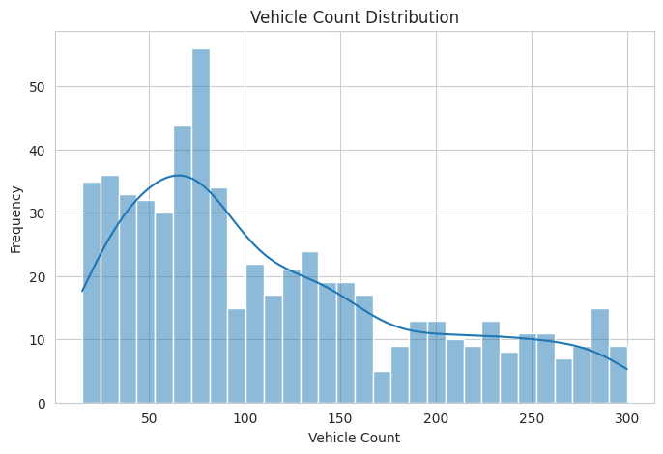
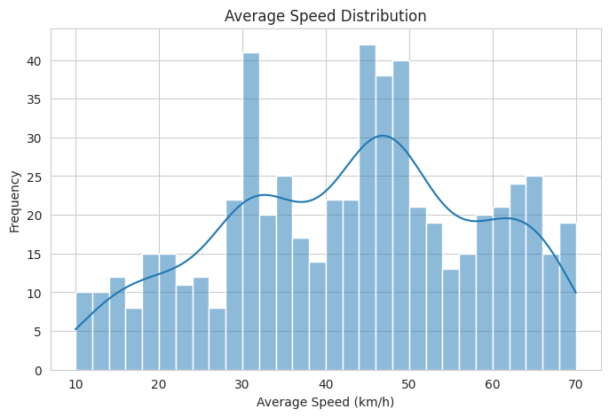
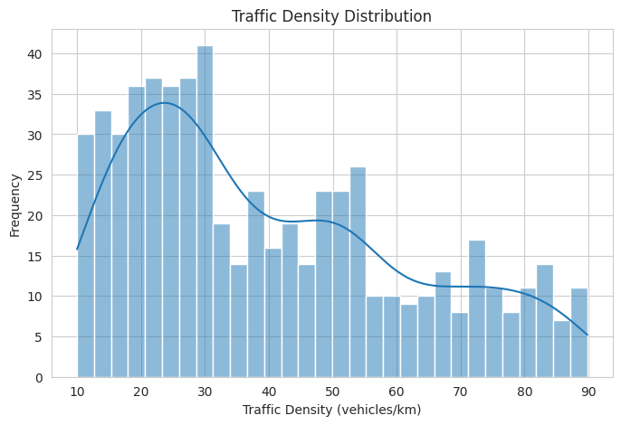
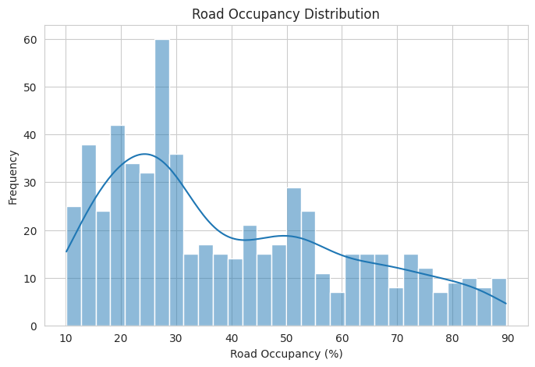
EXPLORATORY DATA ANALYSIS
11
EDA: distributions of traffic features
The notebook examines the individual distributions before clustering.
Vehicle Count Distribution
Average Speed Distribution
Traffic Density Distribution
Road Occupancy Distribution
These distributions help us understand the range and spread of each numerical feature before applying clustering.

Slide 12
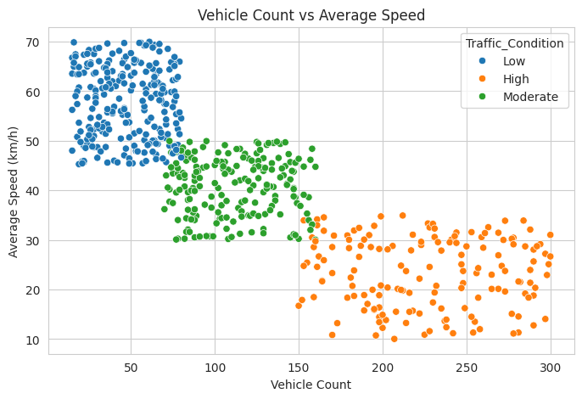
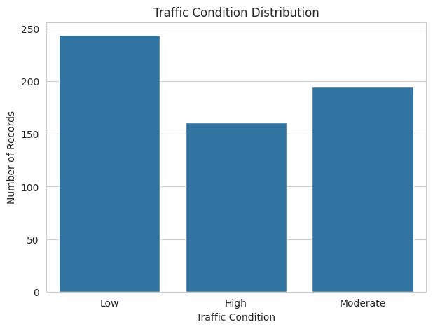
EXPLORATORY DATA ANALYSIS
12
EDA: traffic conditions and feature relationships
The scatter plots reveal how traffic variables change together.
Traffic Condition Distribution
Vehicle Count vs Average Speed
Key observation: higher vehicle counts are associated with lower average speeds in the observed data.

Slide 13
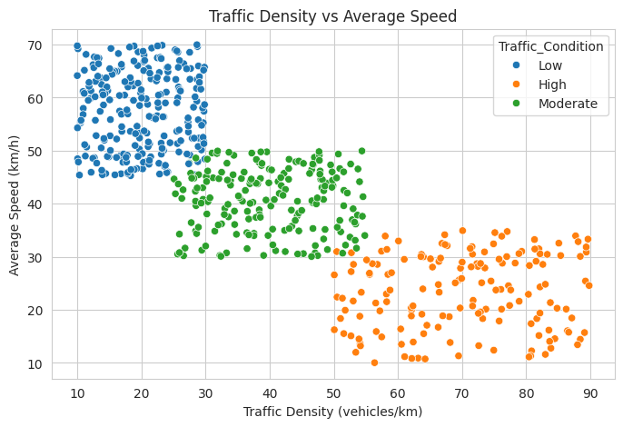
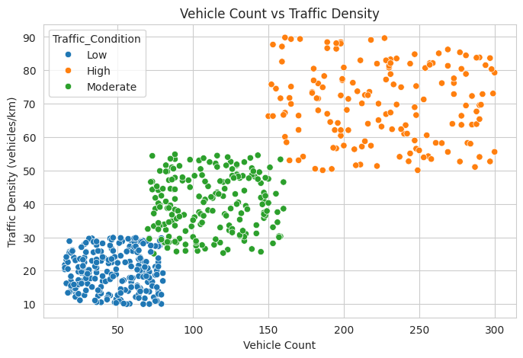
EXPLORATORY DATA ANALYSIS
13
EDA: density and occupancy relationships
Traffic density, speed and vehicle count show strong structure in the observations.
Traffic Density vs Average Speed
Vehicle Count vs Traffic Density
The visible separation between traffic regions supports the idea that clustering can discover meaningful flow patterns.

Slide 14
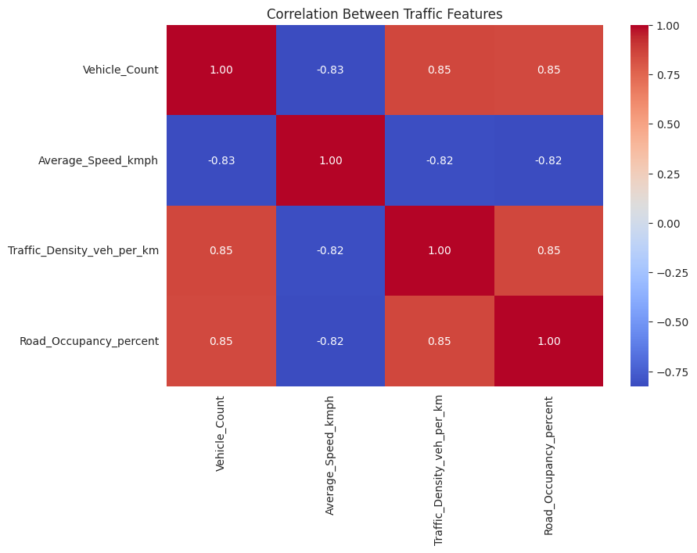
FEATURE ANALYSIS
14
Correlation analysis
Correlation helps us understand which traffic measurements move together.
Correlation Heatmap — actual notebook output
WHAT THE VALUES MEAN
Vehicle count ↔ speed
−0.826
Strong negative relationship
Vehicle count ↔ density
+0.851
Strong positive relationship
Speed ↔ density
−0.816
Strong negative relationship
Speed ↔ occupancy
−0.820
Strong negative relationship
These relationships show that the selected variables contain strong traffic-flow structure.

Slide 15
FEATURE SELECTION
15
Why these four features?
The clustering input is deliberately focused on measurable traffic-flow characteristics.
FEATURE SELECTION
IMPORTANT: PCA IS ONLY FOR VISUALIZATION
• Vehicle count captures traffic volume.
• Average speed captures traffic movement.
• Traffic density captures concentration of vehicles.
• Road occupancy captures how much of the road is occupied.
Clustering uses all four standardized features.
PCA then reduces the four-dimensional data to two principal components so that the clusters can be plotted on a 2D graph.
Together, these features describe both the amount of traffic and how freely it is moving.
4D scaled data
→
PCA
→
2D plot

Slide 16
K-MEANS
16
K-Means: how the algorithm works
K-Means is a centroid-based unsupervised clustering method.
CORE IDEA
WORKFLOW
K-Means divides observations into K groups so that observations within a cluster are relatively similar to each other.
Choose K
Assign points
Update centroids
Repeat
Final clusters
Each cluster is represented by a centroid — the mean position of the observations assigned to that cluster.
The algorithm repeatedly assigns points to the nearest centroid and recalculates the centroids until the assignments stabilize.
For our project, K must be selected before the final K-Means model is fitted.

Slide 17
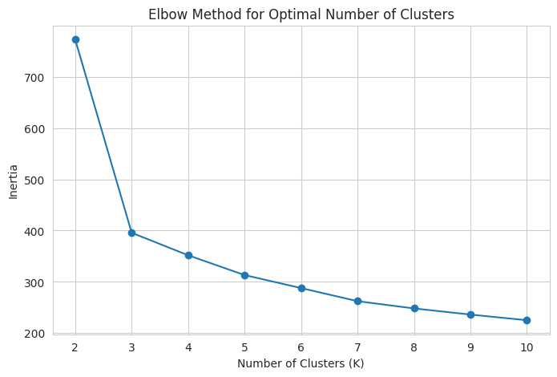
K-MEANS
17
Selecting the number of clusters with the Elbow Method
The notebook tests K values from 2 through 10 and records the inertia.
Elbow Method — actual notebook output
HOW TO READ IT
• Inertia measures within-cluster variation.
• Increasing K generally reduces inertia.
• We look for a point where additional clusters provide smaller improvements.
• K = 3 was selected for the final K-Means model.
K = 3
selected for K-Means

Slide 18
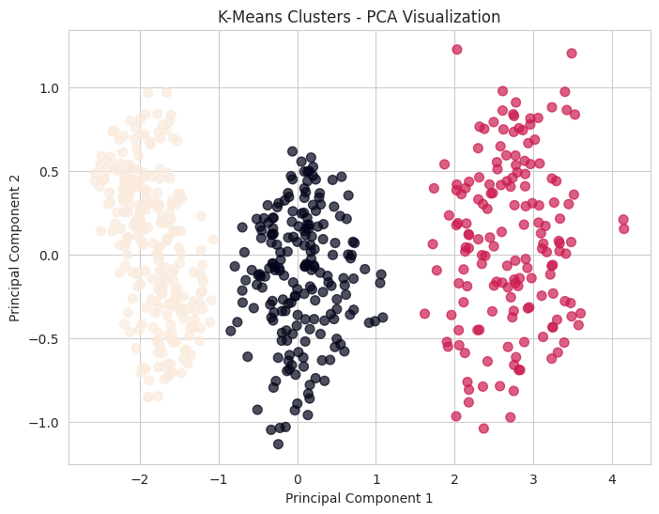
K-MEANS RESULTS
18
K-Means result: three broad traffic patterns
The final model uses K = 3 and the four standardized traffic features.
K-Means PCA Visualization — actual notebook output
CLUSTER INTERPRETATION
3
clusters
Cluster 2
Low-congestion pattern
Cluster 0
Moderate-traffic pattern
Cluster 1
High-congestion pattern
The labels are interpreted from the cluster profiles: high vehicle count, lower speed and higher density/occupancy correspond to the high-congestion pattern.

Slide 19
K-MEANS EVALUATION
19
How do we evaluate the K-Means clusters?
Two internal clustering metrics are used in the notebook.
SILHOUETTE SCORE
DAVIES-BOULDIN INDEX
0.5214
0.7045
K-Means silhouette
K-Means Davies-Bouldin
Concept
Concept
Measures how similar an observation is to its own cluster compared with other clusters. Higher values generally indicate better separation.
Measures similarity between clusters using within-cluster scatter and between-cluster separation. Lower values indicate less cluster overlap.
These metrics describe the structure found by the clustering algorithm; they do not represent a traffic prediction accuracy.

Slide 20
DBSCAN
20
DBSCAN: density-based clustering
DBSCAN groups observations based on dense neighborhoods and can identify noise.
CORE IDEA
PARAMETERS USED IN OUR IMPLEMENTATION
DBSCAN does not require us to specify the number of clusters in advance.
0.5
5
eps — neighborhood radius
min_samples — minimum neighbors
• Dense regions form clusters.
• Sparse observations may be labelled as noise.
• This makes DBSCAN useful when unusual observations are important.
In our notebook, DBSCAN was run with eps = 0.5 and min_samples = 5 on the standardized traffic features.
Points that do not satisfy the density requirement can receive the label −1, which we interpret as noise.

Slide 21
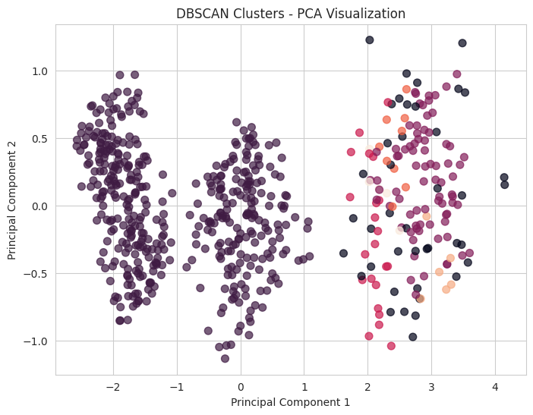
DBSCAN RESULTS
21
DBSCAN result: six clusters + noise detection
The implementation identifies six clusters and 41 noise observations.
DBSCAN PCA Visualization — actual notebook output
RESULTS
6
41
clusters
noise points
0.3897
1.17
Silhouette
Davies-Bouldin
Evaluation note
The notebook excludes noise points when calculating the DBSCAN Silhouette and Davies-Bouldin metrics.

Slide 22
COMPARISON
22
K-Means vs DBSCAN
Both methods use the same standardized traffic features but organize the observations differently.
Aspect
K-Means
DBSCAN
HOW TO INTERPRET THE DIFFERENCE
• K-Means produces three broad, interpretable traffic patterns.
• DBSCAN identifies six density-based groups.
• DBSCAN additionally identifies 41 observations as noise.
• The two algorithms therefore provide complementary views of the same data.
Approach
Centroid-based
Density-based
Clusters
3
6
Noise points
0
41
Silhouette
0.5214
0.3897
Davies-Bouldin
0.7045
1.17
The metrics are reported from this dataset and this implementation; they should be interpreted in that context.

Slide 23
CONCLUSION
23
Final findings and future scope
The project demonstrates a complete unsupervised-learning workflow for traffic-flow pattern analysis.
WHAT WE ACHIEVED
FUTURE SCOPE
• Analyzed 588 traffic records using four core traffic measurements.
• Performed EDA to understand distributions and relationships.
• Verified data quality and standardized the clustering features.
• K-Means identified three broad traffic patterns.
• DBSCAN identified six density-based clusters and 41 noise observations.
• Used Silhouette Score and Davies-Bouldin Index to evaluate the resulting cluster structures.
• Systematically tune DBSCAN parameters.
• Test additional clustering algorithms.
• Add richer road-level and temporal data.
• Explore real-time traffic monitoring applications.
Traffic data → patterns → analysis

Slide 24
PRESENTATION / DEMO
24
Implementation walkthrough
Use the Colab notebook to show that the presentation results come directly from the implementation.
1. DATA + EDA
2. PREPROCESSING
3. ML RESULTS
• Check shape / columns
• Missing values + duplicates
• Show EDA graphs
• Select 4 features
• Quality check
• StandardScaler
• Create X_scaled
• Elbow → K=3
• K-Means metrics
• DBSCAN + noise
• Final comparison
Final notebook: open the project Colab notebook used for the results.

