Slide 1
MACHINE LEARNING PROJECT
Traffic Flow Pattern
Clustering
Using K-Means and DBSCAN for Smart Urban Traffic Congestion Analysis
N. Yeswanth Kumar • 2520030183
B. Sai Sashank • 2520030454
Under the guidance of Mr. Shaik Asif
Department of CSE | A.Y. 2026–27
Koneru Lakshmaiah Education Foundation
BACHELOR OF TECHNOLOGY

Slide 2
1. Problem Statement
Why analyze traffic flow patterns?
Project response
• Rapid urbanization and increasing vehicle ownership create severe congestion.
• Congestion causes delays, fuel wastage, environmental pollution, and reduced productivity.
• Traditional traffic monitoring can struggle with large volumes of traffic data.
• Unsupervised machine learning can reveal hidden traffic patterns without predefined labels.
Cluster traffic observations using vehicle count, average speed, traffic density, and road occupancy to identify regular patterns and unusual congestion regions.
Source: project abstract & introduction (PDF, pp. 2–3).
Traffic Flow Pattern Clustering • Machine Learning • 2026–27
2

Slide 3
2. Objectives
01 Understand traffic behavior
02 Discover traffic patterns
Analyze vehicle count, speed, density and occupancy.
Use K-Means to group similar traffic observations.
03 Detect abnormal congestion
04 Support decisions
Use DBSCAN to identify dense regions and noise/outliers.
Provide insights for signals, alternate routes and infrastructure planning.
The project aims to contribute to intelligent transportation and smart-city traffic management.
Traffic Flow Pattern Clustering • Machine Learning • 2026–27
3

Slide 4
3. Dataset & Traffic Features
Values below are taken from the supplied Jupyter notebook output.
588
8
0
0
records
columns
missing values
duplicate rows
Feature | Meaning | Observed range / type
Vehicle_Count | Number of vehicles | 15 – 300
Average_Speed_kmph | Average traffic speed | 10.03 – 69.96 km/h
Traffic_Density_veh_per_km | Vehicles per kilometre | 10.00 – 89.82
Road_Occupancy_percent | Road occupancy | 10.12 – 89.70 %
Traffic conditions: Low = 237, Moderate = 194, High = 157 records.
Traffic Flow Pattern Clustering • Machine Learning • 2026–27
4

Slide 5
4. Proposed Methodology / Workflow
1
2
3
4
5
6
Collect
Preprocess
Explore
Cluster
Evaluate
Apply
Traffic sensor / dataset records
Missing values, duplicates, normalization
Distributions, correlations, outliers
K-Means + DBSCAN
Silhouette, Davies–Bouldin, visual inspection
Congestion hotspots & traffic management
Notebook status: the supplied notebook demonstrates data loading, quality checks, exploratory analysis, correlation analysis, condition summaries and hourly traffic analysis; the K-Means/DBSCAN modeling stage is described in the project abstract but is not yet implemented in the supplied notebook.
Traffic Flow Pattern Clustering • Machine Learning • 2026–27
5

Slide 6
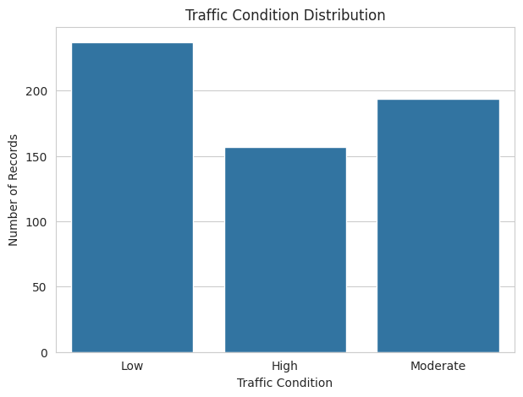
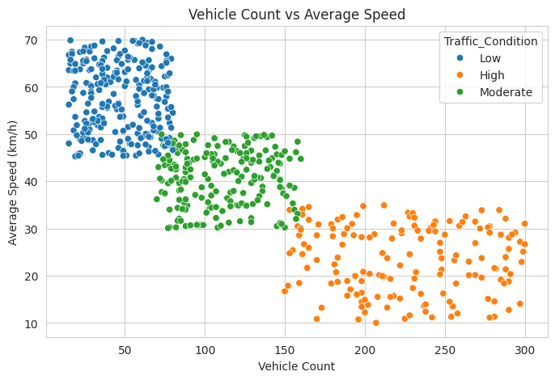
5. Exploratory Data Analysis
Charts reproduced from the supplied notebook outputs.
Traffic condition distribution
Vehicle count vs average speed
Traffic Flow Pattern Clustering • Machine Learning • 2026–27
6

Slide 7
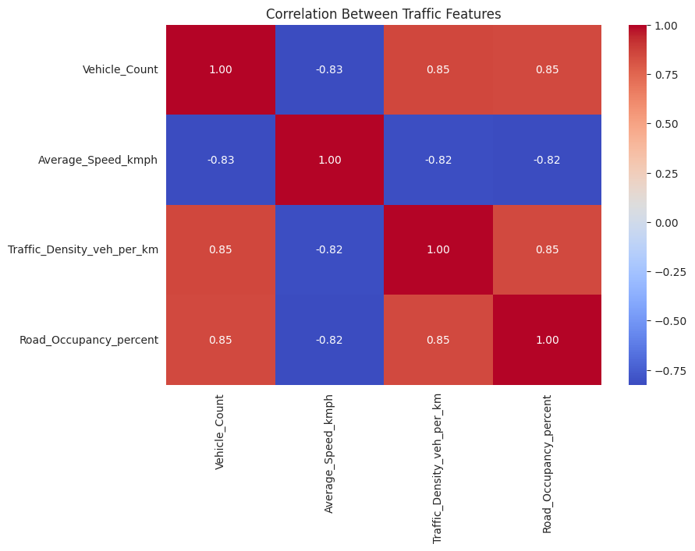
6. Feature Relationship Analysis
Correlation matrix from the supplied notebook.
Strong positive relationships
Vehicle count correlates strongly with traffic density (0.851) and road occupancy (0.846).
Speed moves in the opposite direction
Average speed has strong negative correlation with vehicle count (−0.826), density (−0.816) and occupancy (−0.820).
Implication
These features provide useful signals for separating traffic-flow states.
Traffic Flow Pattern Clustering • Machine Learning • 2026–27
7

Slide 8
7. Traffic Condition Profiles
Average values by the dataset's existing Traffic_Condition label.
Condition | Vehicle Count | Avg Speed (km/h) | Density (veh/km) | Occupancy (%)
High | 225.87 | 23.37 | 70.02 | 69.22
Moderate | 111.52 | 40.72 | 40.09 | 39.88
Low | 47.82 | 57.52 | 20.10 | 20.40
Low traffic
Moderate traffic
High traffic
Lower vehicle count, density and occupancy with higher average speed.
Intermediate values across all four traffic-flow features.
Highest vehicle count, density and occupancy, with much lower speed.
Traffic Flow Pattern Clustering • Machine Learning • 2026–27
8

Slide 9
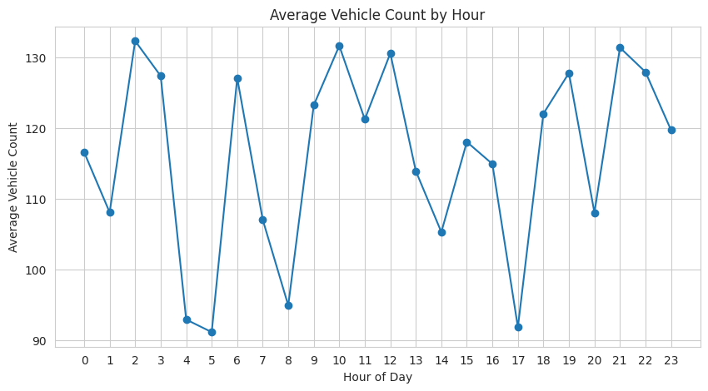
8. Hourly Traffic Pattern
Average vehicle count by hour from the supplied notebook.
Observed variation
Average vehicle count varies across the 24-hour period rather than remaining constant.
Why it matters
Time-of-day patterns can help traffic managers anticipate changing road demand.
Highest observed hourly average in the notebook: 132.29 vehicles at hour 2.
Traffic Flow Pattern Clustering • Machine Learning • 2026–27
9

Slide 10
9. K-Means vs DBSCAN
Algorithm roles specified in the project abstract.
K-Means
DBSCAN
• Partition observations into a predefined number of clusters.
• Groups records according to similarity in traffic features.
• Useful for identifying regular traffic-flow patterns such as low, moderate and high states.
• Requires the number of clusters to be selected before training.
• Density-based clustering method.
• Finds naturally occurring dense regions without fixing the number of clusters beforehand.
• Can identify noise/outliers and unusual congestion events.
• Useful for locating irregular congestion caused by accidents, roadblocks or special events.
Project evaluation plan: compare cluster quality using Silhouette Score, Davies–Bouldin Index and visual cluster representations.
Traffic Flow Pattern Clustering • Machine Learning • 2026–27
10

Slide 11
10. Expected Applications & Benefits
Traffic signal optimization
Alternate route planning
Use recurring traffic patterns to support better signal timing decisions.
Identify congestion-prone conditions and support route recommendations.
Road infrastructure planning
Congestion hotspot detection
Use traffic-flow evidence to prioritize capacity and improvement needs.
DBSCAN can help surface dense and unusual traffic regions.
Overall goal: contribute to data-driven traffic management and intelligent transportation systems for smart cities.
Traffic Flow Pattern Clustering • Machine Learning • 2026–27
11

Slide 12
11. Software & Hardware Requirements
Requirements listed on page 3 of the supplied project document.
Component | Requirement
Operating System | Windows 10/11 or Ubuntu Linux
Programming | Python 3.10 or above
IDE | Jupyter Notebook / Visual Studio Code / PyCharm
ML Library | Scikit-learn
Data Analysis | Pandas, NumPy
Visualization | Matplotlib, Seaborn
Dataset Source | Kaggle / UCI ML Repository / Traffic Sensor Data
Database (Optional) | MySQL
Version Control | Git & GitHub
Hardware | Intel Core i3/i5 or above, 8 GB RAM, 10 GB free storage
Traffic Flow Pattern Clustering • Machine Learning • 2026–27
12

Slide 13
12. Conclusion
The project combines traffic-data exploration with unsupervised learning to understand congestion patterns.
• The supplied dataset contains 588 traffic observations with four key numerical traffic features.
• Data-quality checks show no missing values and no duplicate rows in the notebook output.
• Exploratory analysis shows strong relationships between traffic volume, density, occupancy and speed.
• K-Means is intended to group regular traffic states, while DBSCAN is intended to reveal dense/irregular congestion regions.
• The final clustering stage can support smarter traffic signals, routing and infrastructure decisions.
Thank You
Questions & Discussion
KLU • CSE • Machine Learning • 2026–27

