Slide 1
Kalpavriksh APP
By Sai Sashreek D
Date / Version: July 19, 2022 / 0.0.1

Slide 2
APP Technologies & Versions
MERN Stack will be used for whole project development & AWS will be used for Application deployment.
MERN - M for MongoDB, E for ExpressJS, R for ReactJS, N for NodeJS
AWS – Amazon Web Services for deploying MERN App on server.
For MERN Application development NodeJS is important and NodeJS version should be 16 LTS (Long Time Support)
ReactJS Version 16 and above is required but not below 16.
MongoDB Atlas database will be used for this project.

Slide 3
Front-End Development
ReactJS is UI library which is mainly used for developing single page applications.
It makes it painless to create interactive UI’s. It will efficiently update and render just the right components when your data changes.
Declarative views make your code more predictable and easier to debug.
ReactJS is completely component based that manage their own state, then compose them to make complex UI’s.
ReactJS Installation Steps
Step 1 – NodeJS need to be downloaded and installed
Step 2 – create-react-app CLI tool need to be installed via CMD line
Step 3 – Create react app using npx create-react-app <app-name>
Step 4 – Run react app using cd <app-name>; npm start
Step 5 – Build react app using npm build

Slide 4
Backend Development
NodeJS is an opensource server environment.
It allows you to run JavaScript on server.
It runs on various platforms (Windows, Linux, Unix, Mac OS X, etc.)
NodeJS uses asynchronous programming.
It runs single-threaded, non-blocking, which is very memory efficient.
What NodeJS can Do?
NodeJS can generate dynamic page content.
It can create, open, read, write, delete, and close files on the server.
It can collect form data.
It can add, delete, modify data in your database.

Slide 5
Database Development
MongoDB is an open-source document database and leading NoSQL database.
It is written in C++.
It is a cross-platform, document-oriented database that provides, high performance, high availability, and easy scalability.
It works on concept of collection and document.

Slide 6
Project Highlights
Kaplavriksh Application consists of 5 modules.
Each module is divided into different sections
Module One is writing / creating UI Components using front-end library i.e., ReactJS
Module Two is writing business logics in backend using NodeJS
Module Three is connecting NodeJS with database using MongoDB
Module Four is connecting API with ReactJS Application
Module Five is deploying Healthvriksh Application in AWS
Project Development Lifecycle
Application Development Lifecycle
Agile / SCRUM Methodology

Slide 7
Project Development Lifecycle
Version Control:
Effective use of version control software such as GitHub, GitLab, GitGuardian, svn.
Establish a working flow that the whole team agrees with such as working on new branches or clone copy
Effectively review pull request
Automation Testing:
Use appropriate testing framework
Implement testing at early stage
Test whenever there is new change
Project Management:
Effectively use project management tool such as asana,
Trello or slack Apply agile/scrum methodology
Deployment:
Deploy project at early stage
Deploy the project to appropriate platform such as AWS
Coding:
Keep code dry
Write useful commit messages
Commenting code

Slide 8
Application Life Cycle
MERN Stack Development
HTML / CSS / SASS(SCSS) / JS / ReactJS
NodeJS web server
React JS
Express
Web Framework
MongoDB
Mongoose
Front-End Development
Back-End Development
Database Management

Slide 9
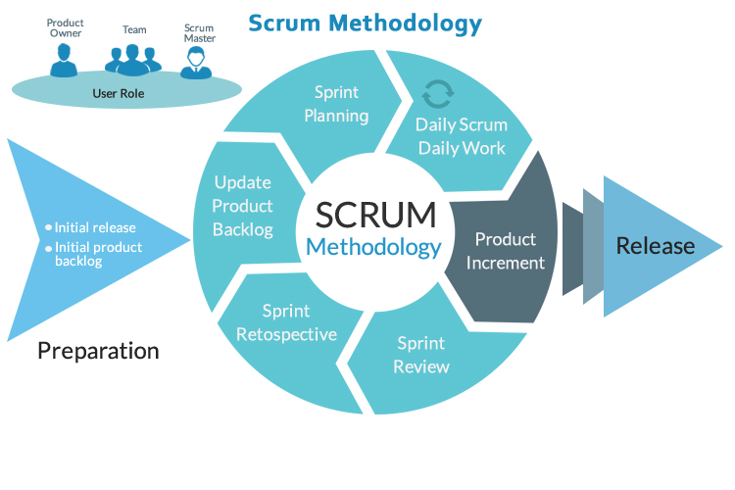
Agile / SCRUM Methodology

Slide 10
Project Features
Anonymous Users
Patients
Authenticated Users
Doctors
Dietician
Nurses
Admin
Add / Create User accounts
Edit User accounts
Delete User accounts
Block / Unblock User accounts

Slide 11
UI Components / Reusable Component
Login
Register
Dashboard
Reset / Forgot Password
Authentication

Slide 12
API Logic & Models
Login
Register
Dashboard
Reset / Forgot Password
Authentication

Slide 13
Connecting API to Database
Login
Register
Reset / Forgot Password
Authentication

Slide 14
Connecting API to React APP
Login
Register
Dashboard
Reset / Forgot Password
Authentication

Slide 15
Application Deployment
Awaiting UI Screens from Client

Slide 16
Testing Application AWS
Awaiting UI Screens from Client

