Slide 1

PROJECT UDYAM DIGITAL
A simpler path from SMB need to activation
CodeRunners · ABVIIITM
Notes:
Airtel SYNC 2026 Digital Track. Team: CodeRunners. Campus: ABVIIITM. The case brief describes the fictional Accel Business operator and the Project Udyam Digital challenge.

Slide 2

THE ACTIVATION GAP
The drop-off concentrates at quote and KYC
5,000 synthetic leads · Apr–Jun 2026
5,000
7.4%
3,406
of leads activate
1,974
17.6 days
861
588
mean lead → activation
368
3 follow-ups
Lead
Contacted
Needs
assessed
Quote
accepted
KYC
complete
Activated
56%
of assessed leads do not accept a quote
32%
of accepted quotes stop before KYC is complete
Notes:
Source: supplied Airtel_SYNC_Case.pdf, Appendix A1, and synthetic smb_leads.csv. Funnel: 5,000 → 3,406 → 1,974 → 861 → 588 → 368. 7.36% activation rounds to 7.4%. 56.4% of assessed leads do not accept a quote; 31.7% of accepted quotes do not reach KYC completion. Mean lead-to-activation time is 17.6 days; customers made three status chases on average.

Slide 3
SEGMENT OPPORTUNITY
Prioritise offices and multi-site businesses
Observed segment rates; sample comparisons are not causal
Professional offices
11.1%
40%
138 / 1,247 activated
Small multi-site
11.0%
of observed leads are offices or multi-site
83 / 755 activated
Small manufacturers
12.8%
221 activations
37 / 289 activated
from 2,002 leads · ~11.0% observed
Micro retail & services
4.1%
110 / 2,709 activated
Keep a low-cost route for micro firms
55% of the indicative SMB base · 4.1% observed activation · highest price sensitivity
Notes:
Source: supplied smb_leads.csv and Airtel_SYNC_Case.pdf Appendix A2. Rates = activated / leads by segment: professional offices 138/1,247 = 11.1%; small multi-site 83/755 = 11.0%; manufacturers 37/289 = 12.8%; micro retail/services 110/2,709 = 4.1%. Office + multi-site accounts for 2,002/5,000 leads and 221 activations. Segment sizes in the case are indicative. Small manufacturers have the highest sample rate, but fewer leads and higher installation complexity; no causal claim.

Slide 4
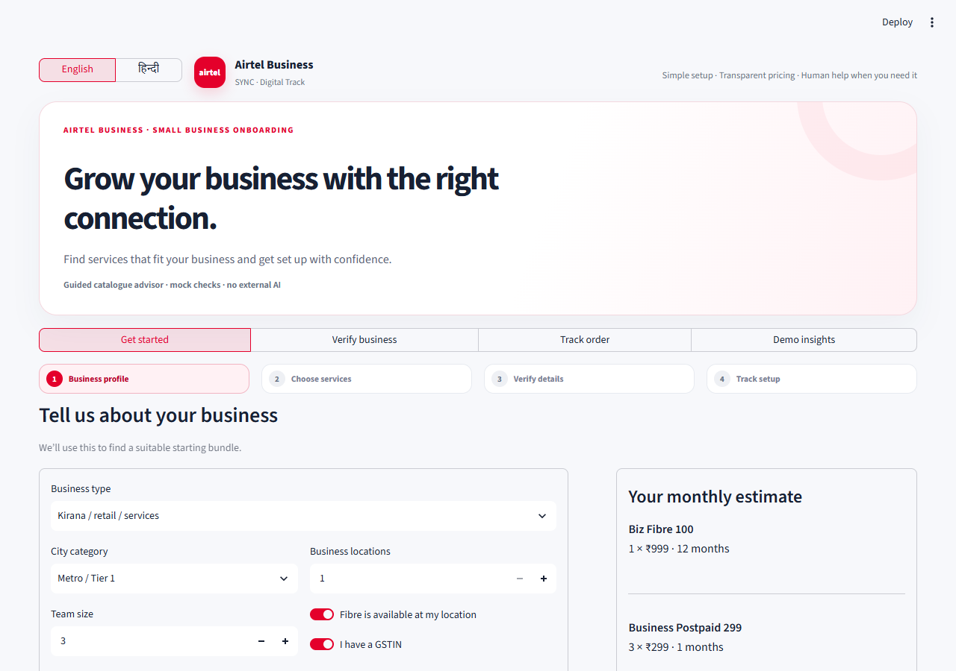
THE CUSTOMER JOURNEY
One advisor, three offers, clear prices
Example catalogue minimums · before tax, discounts and coverage checks
MICRO RETAIL
₹1,797 / mo
1 site · 1 SIM · POS
₹2,500 setup
PROFESSIONAL OFFICE
₹3,171 / mo
Clinic · 1 site · 3 users
₹2,000 setup
MULTI-SITE
₹13,494 / mo
3 sites · 10 employees
₹19,500 setup
The profile drives the recommendation; add-ons update the quote.
DISCOVER → COMPARE → VERIFY → TRACK
Notes:
Source: supplied product_catalogue.csv. Starting monthly prices use the catalogue minima and listed example quantities: micro P04 ₹899 + P07 ₹299 + P19 ₹599 = ₹1,797; setup ₹2,500. Professional P02 ₹1,499 + P12 ₹1,000 + P16×3 ₹375 + P20×3 ₹297 = ₹3,171; setup ₹2,000. Three-site multi P02×3 ₹4,497 + P09×3 ₹1,497 + P10×3 ₹7,500 = ₹13,494; setup ₹19,500. Confirm city/size/GSTIN eligibility, tax, coverage and site feasibility before sale. Screenshot is from the local working prototype.

Slide 5
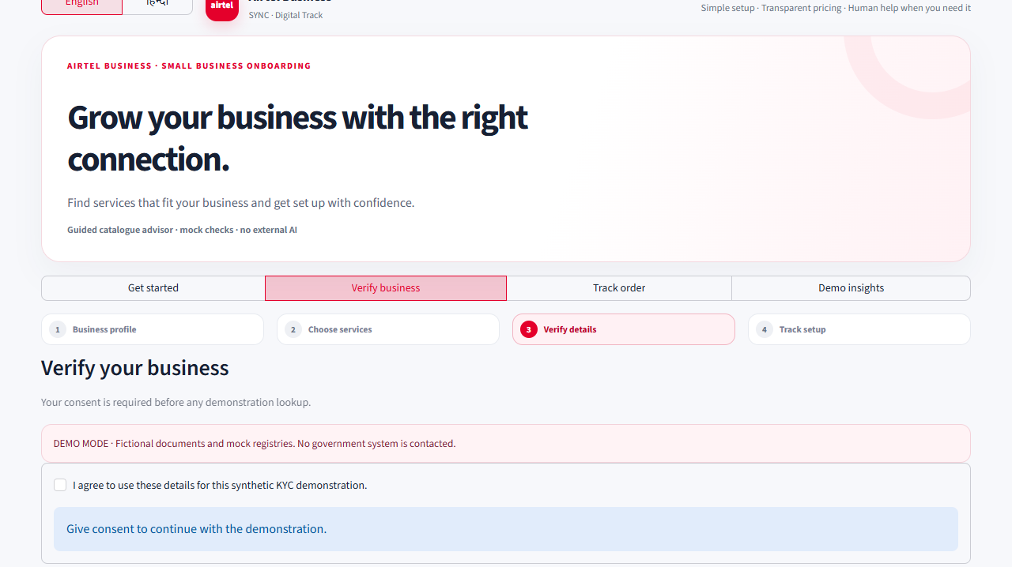
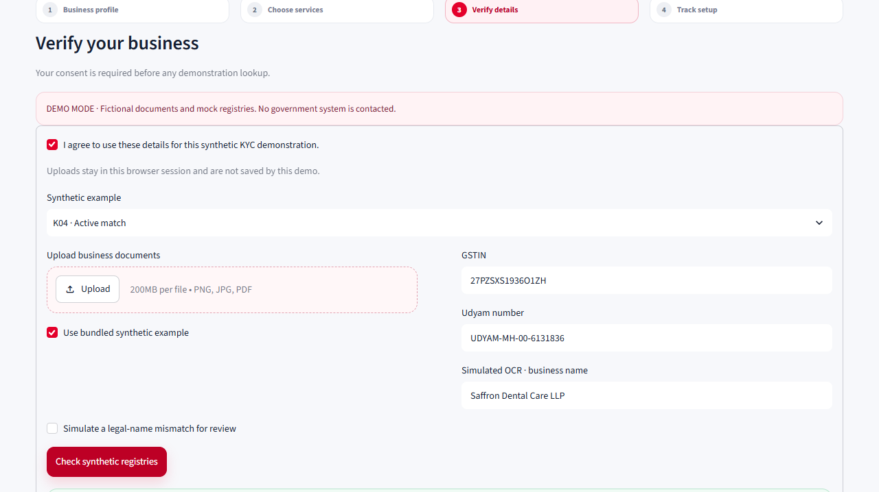
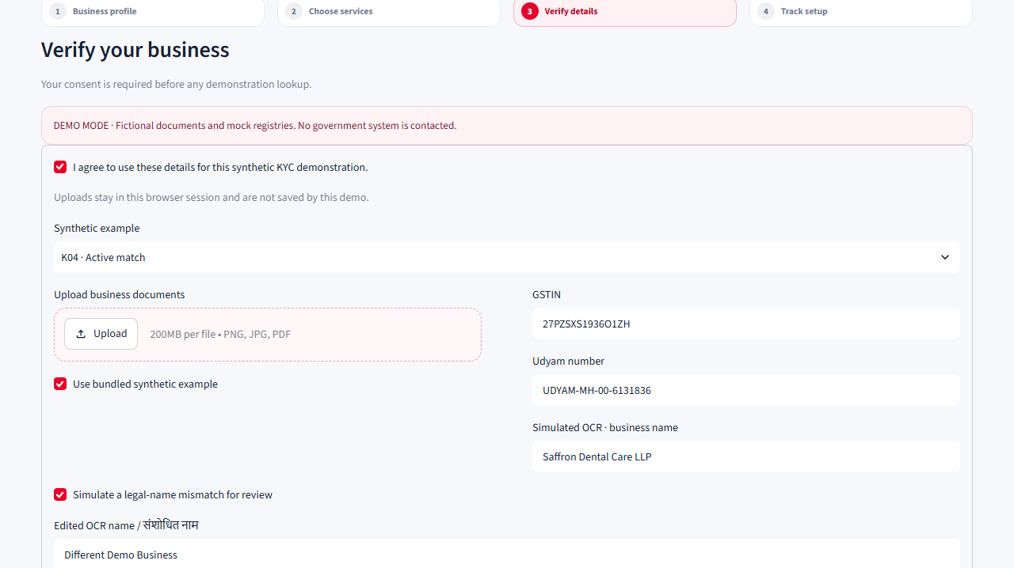
TRUSTED ONBOARDING
Consent, verification and assisted handoff
Consent before checks · local fixtures only · exceptions go to people
CONSENT
MATCH
MANUAL REVIEW
Explain purpose before a lookup
Mock GSTIN / Udyam match
Mismatch or missing proof
CONSENT → MOCK LOOKUP → FIXTURE OCR → REVIEW IF UNCERTAIN
No government calls or automated approval in this demo. Local partner/sales follow-up handles exceptions.
Notes:
All screenshots and checks are local to the prototype and use fictional challenge fixtures. Consent is shown before mocked GSTIN/Udyam checks. OCR is a scenario-backed simulation, not document recognition. A match is a demo result, not government verification. Missing, cancelled or mismatched records route to human review; no automated approval. A production design would use authorised services, explicit consent, purpose limitation, minimisation, retention controls, security and audit.

Slide 6
MARKET LANDSCAPE
SMBs need one guided path across products
Official product pages show overlapping offers; this is a capability map, not a price ranking.
JIOBUSINESS
TATA TELE BUSINESS
AIRTEL BUSINESS
SMB BUNDLES
Internet + voice + work tools
Broadband + voice + security
Internet + mobile + cloud calls
DIGITAL TOOLS
Plans, bills and service requests
DIY security, reporting, plan filters
Business portal / service manager
SUPPORT & FIT
Self-care + assisted care
Managed support; plan selectors
Account support; site feasibility
Our test: make fit → full quote → consented review → trackable handoff feel like one journey.
Notes:
Official product sources checked 6 Nov 2026. JioBusiness: https://www.jio.com/jcms/business/enterprise-bundle-plans/ and https://www.jio.com/business/services/connectivity/high-speed-internet/ . Tata Tele Business: https://www.tatatelebusiness.com/data-services/business-broadband/ and https://www.tatatelebusiness.com/data-services/smart-internet/ . Airtel Business: https://www.airtel.in/b2b/contact-us/ and https://www.airtel.in/b2b/dedicated-internet . The map summarises disclosed capabilities; it is not a price, quality or customer-outcome ranking. Do not claim competitors lack digital tools. Differentiation tested here is a single, dataset-grounded guided SMB acquisition journey.

Slide 7
PILOT & IMPACT
Measure the funnel in a 90-day pilot
7.4%
43.6%
68.3%
17.6d
ILLUSTRATIVE CASE
BASELINE
QUOTE
KYC
CYCLE
+132
Lead → activation
Assessed → accepted
Accepted → complete
Mean activation time
activations at 10% on 5,000 leads
10% pilot target
55% target
80% target
≤12 days
₹2.37–4.19L gross MRR*
90-DAY PILOT
WKS 0–2
WKS 3–6
WKS 7–12
Instrument funnel + recruit partner clusters
Launch in selected Tier 1/2 locations
Review conversion, activation and support
Targets are hypotheses; churn is missing. Reconcile case CAC ₹15,000 vs CSV mean ₹5,385 before ROI claims. *Gross list-price sensitivity, before discounts, taxes and costs.
WATCH LIVE APP · 00:51
OPEN THE PROJECT REPOSITORY ↗
Notes:
Baselines from synthetic smb_leads.csv and supplied challenge PDF: quote acceptance = 861/1,974 = 43.6%; KYC completion = 588/861 = 68.3%. Targets are proposed pilot hypotheses, not guarantees. 10% activation on 5,000 leads implies 500 wins vs. 368 observed, or +132. If every incremental customer chose a ₹1,797 micro or ₹3,171 clinic bundle, list-price gross MRR would be ₹237,204–₹418,572. Sensitivity only, not a forecast, margin, profit or ROI; excludes mix, taxes, discounts, churn, costs and timing. Churn column is empty. PDF CAC is ₹15,000; mean acquisition_cost_inr among activated CSV rows is ~₹5,385; reconcile before CAC/ROI claims. Links point to the public project repository and the narrated demo video.

