Slide 1
PREDICTIVE ANALYSIS OF WINE QUALITY
AND PREFERENCES USING MACHINE LEARNING TECHNIQUES
MINI HACKATHON 1 • 24–29 AUGUST 2026
G Sai Sathwik — 2520030328
Guide: Dr. Shaik Asif
KL UNIVERSITY • MINI HACKATHON 1 • 2026

Slide 2
1. Problem Statement
Why automate wine-quality assessment?
Human sensory evaluation is valuable but subjective and difficult to scale.
Physicochemical laboratory measurements are objective, repeatable and available before final certification.
Goal: learn the mapping between chemical properties and sensory quality.
Primary output: Poor / Average / Excellent quality category.
Secondary output: predicted numeric quality score for future extension.
KL UNIVERSITY • MINI HACKATHON 1 • 2026

Slide 3
2. Objectives
What the project delivers
Identify and structure the Wine Quality dataset.
Perform systematic EDA: distributions, imbalance, correlations and feature relationships.
Compare Logistic Regression, SVM, Random Forest and Gradient Boosting.
Use macro-F1 in addition to accuracy because rare quality classes matter.
Build a lightweight prediction prototype.
KL UNIVERSITY • MINI HACKATHON 1 • 2026

Slide 4
3. Dataset
UCI Wine Quality schema
Source: UCI Wine Quality dataset — red and white Vinho Verde samples.
Official dataset: 4,898 white + 1,599 red samples; 11 physicochemical inputs + quality score.
Inputs: acidity, volatile acidity, citric acid, sugar, chlorides, SO₂, density, pH, sulphates and alcohol.
Target: sensory quality score on an ordered scale.
Project addition: wine_type + derived quality_class.
DATA INTEGRITY NOTE: bundled offline CSV = reproducible synthetic demonstration aligned to UCI structure; use official UCI CSVs for final empirical claims.
KL UNIVERSITY • MINI HACKATHON 1 • 2026

Slide 5
4. Data Dictionary
The 11 physicochemical predictors
Group | Variables | Role
Acidity | fixed acidity • volatile acidity • citric acid | Chemical inputs
Composition | residual sugar • chlorides | Chemical inputs
Sulfur dioxide | free SO₂ • total SO₂ | Preservation/chemistry
Physical | density • pH | Physical/chemical inputs
Flavor/strength | sulphates • alcohol | Chemical inputs
Outcome | quality | Sensory target
KL UNIVERSITY • MINI HACKATHON 1 • 2026

Slide 6
5. Methodology
End-to-end ML workflow
Data acquisition
Cleaning & validation
EDA
Feature engineering
Train/test split
Model comparison
Interpretation
Prototype
KL UNIVERSITY • MINI HACKATHON 1 • 2026

Slide 7
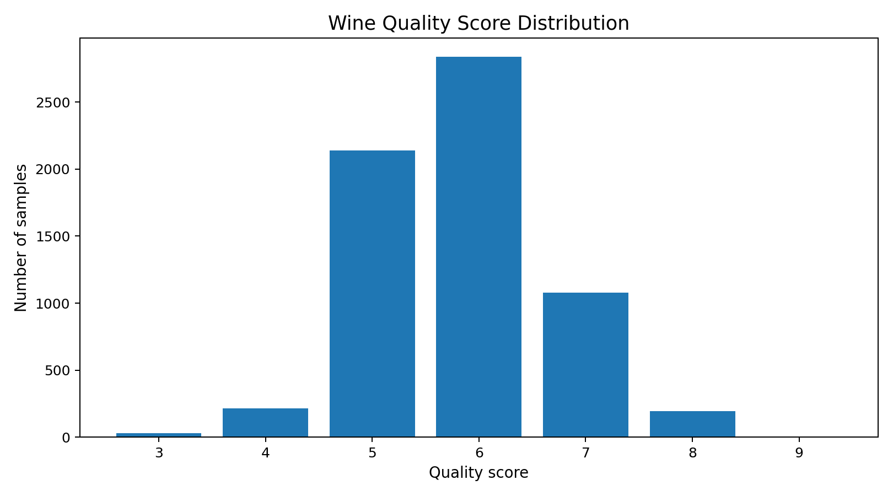
6. EDA — Target Distribution
Quality is highly concentrated in the middle
Most observations belong to quality 5–6.
Very low and very high quality scores are rare.
Class imbalance makes accuracy alone insufficient.
Macro-F1 is therefore included in model selection.
KL UNIVERSITY • MINI HACKATHON 1 • 2026

Slide 8
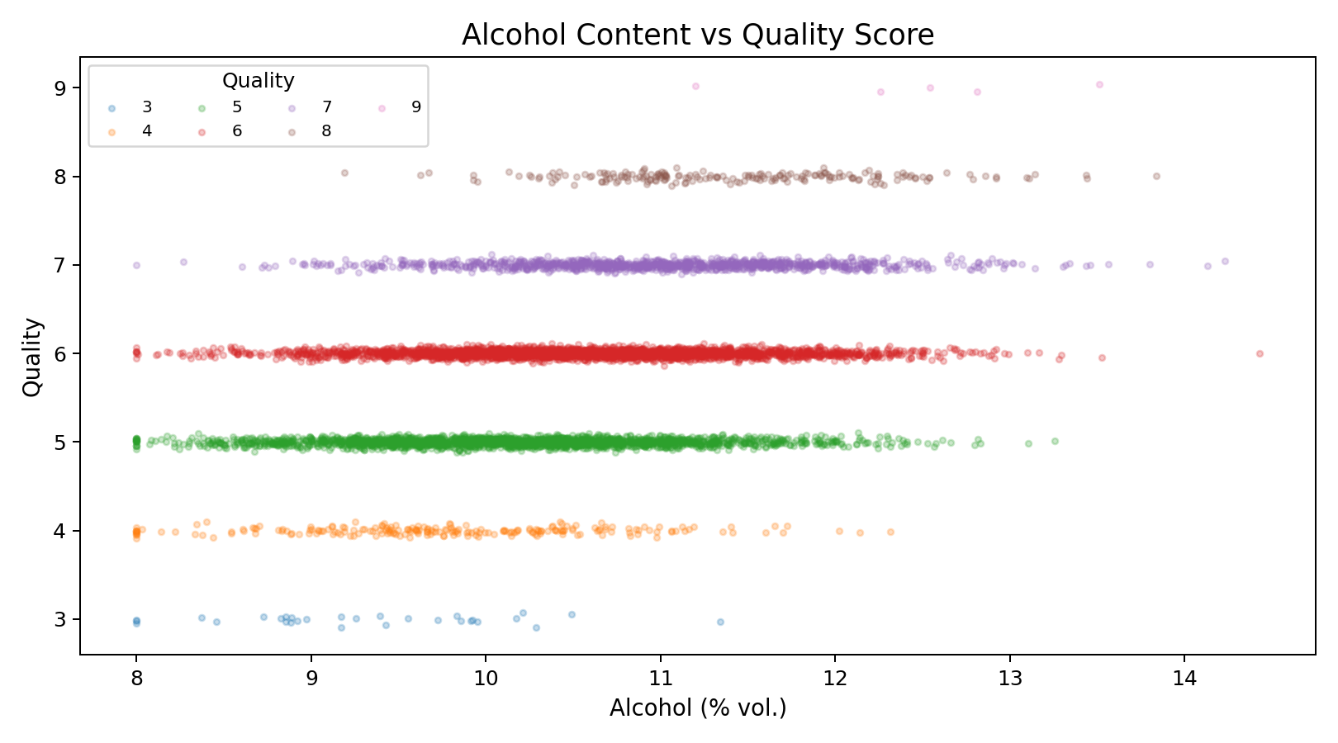
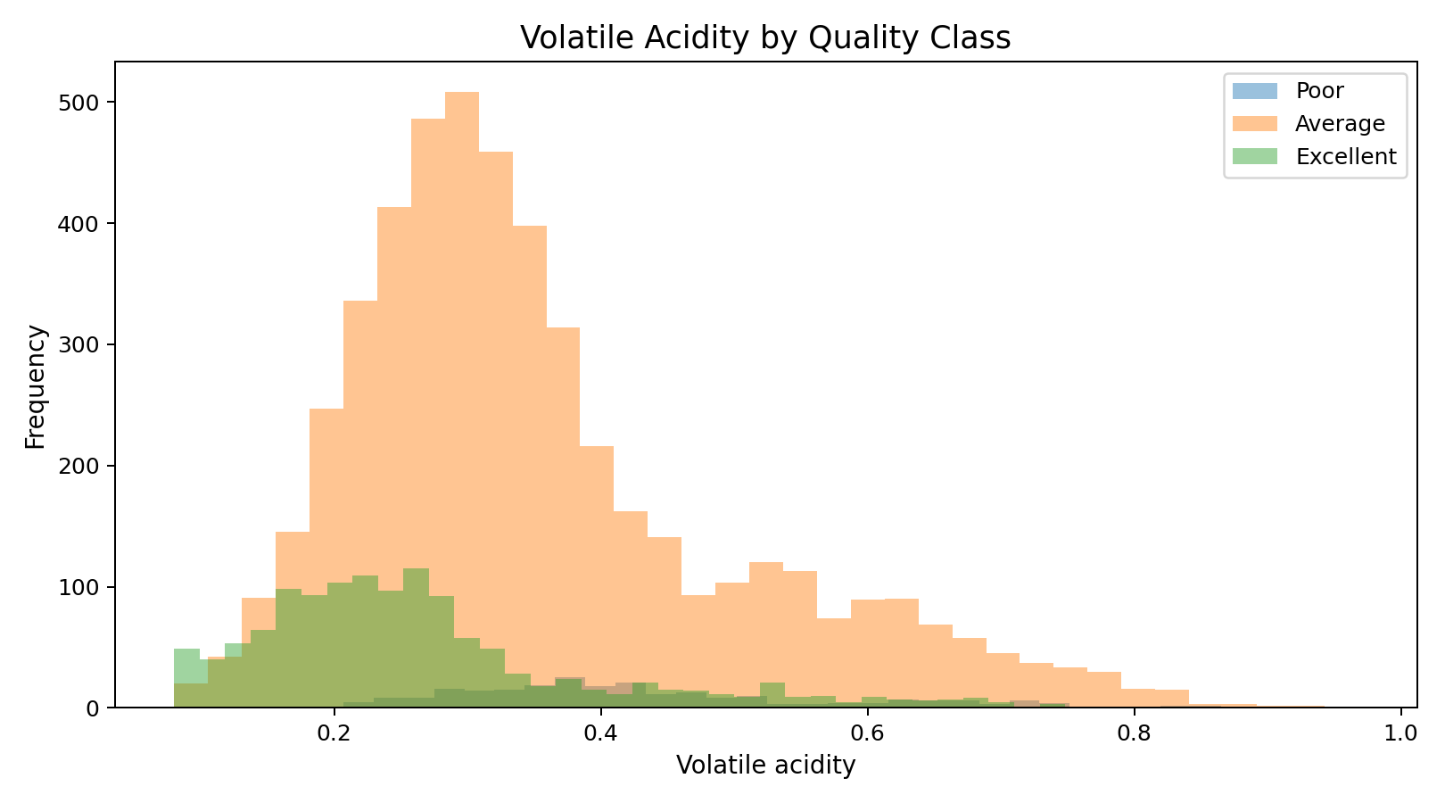
7. EDA — Key Relationships
Which measurements move with quality?
KL UNIVERSITY • MINI HACKATHON 1 • 2026

Slide 9
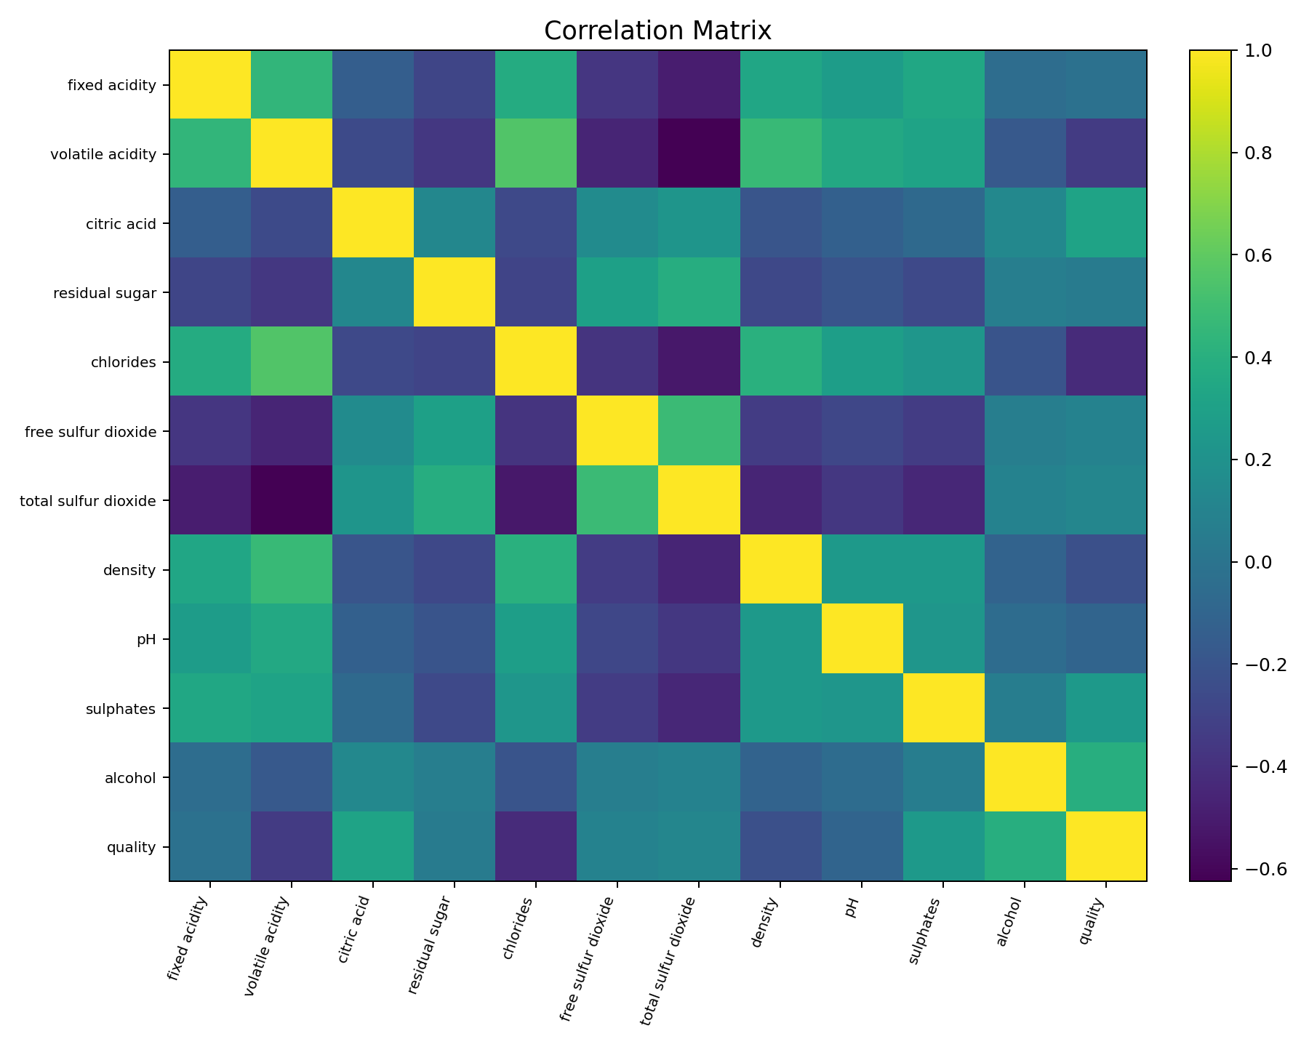
8. EDA — Correlation Analysis
Relationships among physicochemical variables
Strongest positive signal in the demonstration: alcohol (corr ≈ 0.40).
Strongest negative signal: chlorides (corr ≈ -0.42).
Correlations are useful for screening, but they do not prove causation.
Nonlinear models can capture interactions missed by linear correlation.
KL UNIVERSITY • MINI HACKATHON 1 • 2026

Slide 10
9. Algorithms
Why compare four model families?
Logistic Regression — transparent linear baseline.
SVM (RBF) — nonlinear boundaries; directly connected to the 2009 wine-preference study.
Random Forest — nonlinear ensemble + feature importance.
Gradient Boosting — sequential ensemble model for complex patterns.
Final selection should consider both overall performance and minority-class behavior.
KL UNIVERSITY • MINI HACKATHON 1 • 2026

Slide 11
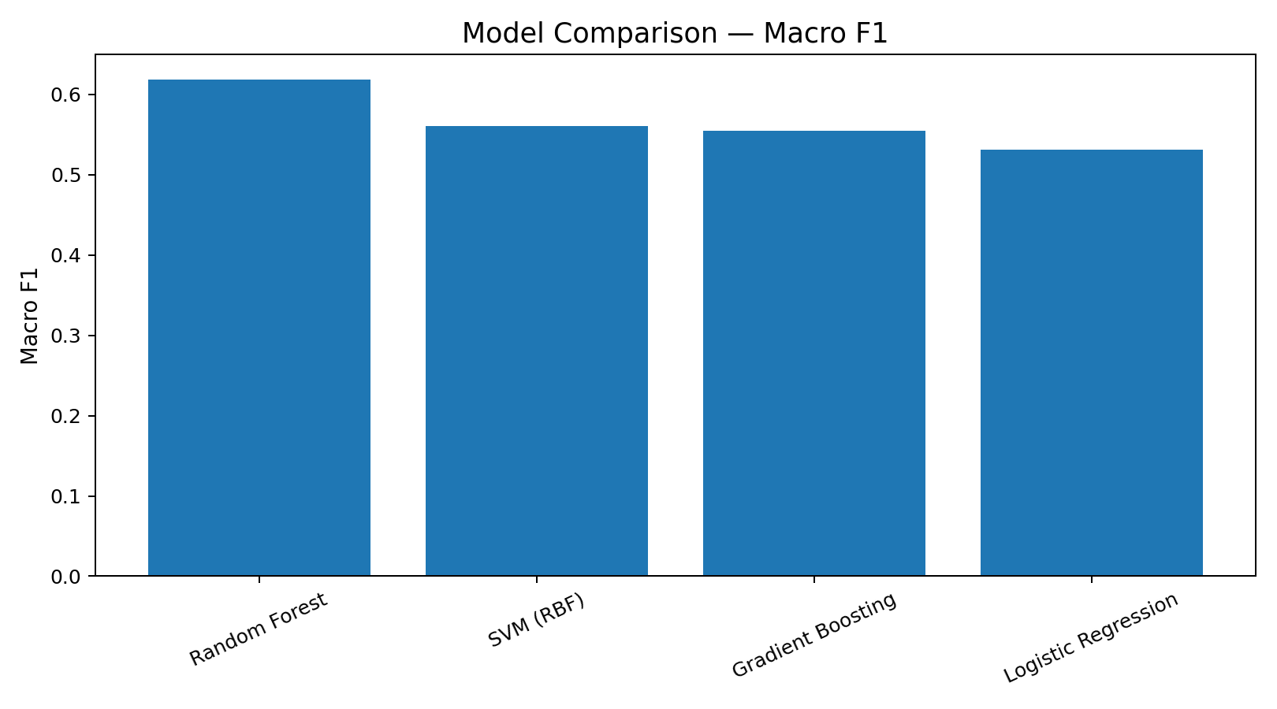
10. Model Results
Demonstration split — 80/20 stratified
Model | Accuracy | Macro F1 | Rank
Random Forest | 0.804 | 0.619 | 1
SVM (RBF) | 0.685 | 0.560 | 2
Gradient Boosting | 0.814 | 0.555 | 3
Logistic Regression | 0.632 | 0.531 | 4
Best by macro-F1: Random Forest (0.619)
KL UNIVERSITY • MINI HACKATHON 1 • 2026

Slide 12
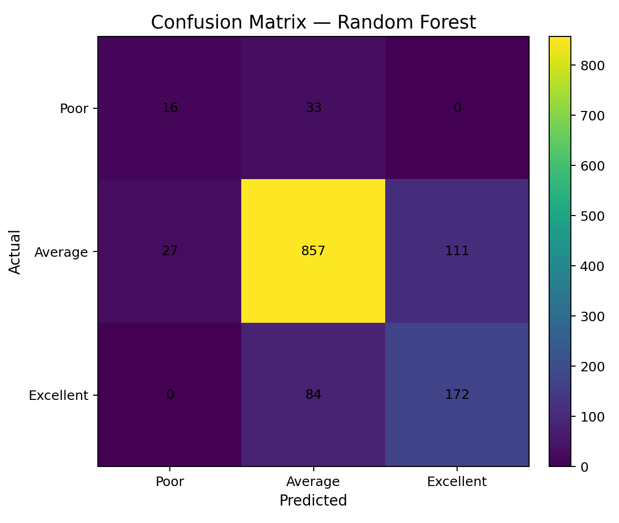
11. Error Analysis
Confusion matrix of the selected classifier
Most errors occur between neighboring quality categories.
Rare Poor and Excellent cases are harder to classify reliably.
Macro-F1 exposes this weakness better than raw accuracy.
External validation is required before any production use.
KL UNIVERSITY • MINI HACKATHON 1 • 2026

Slide 13
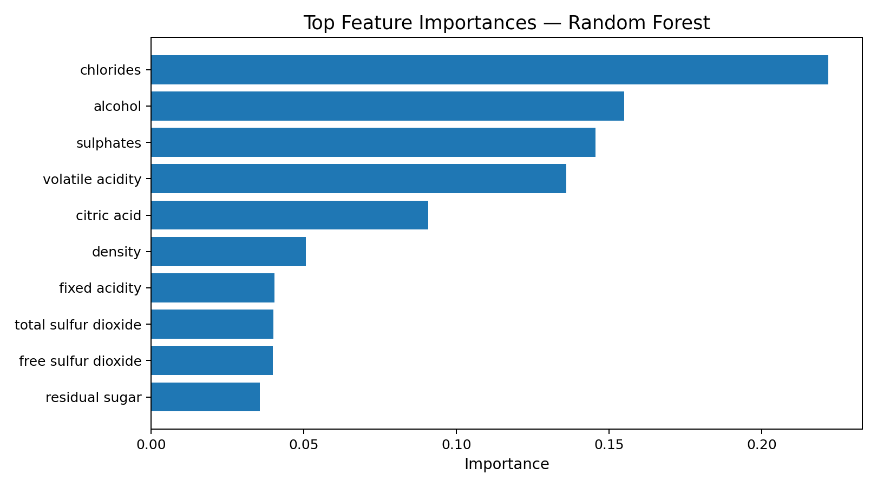
12. Explainability
Top Random Forest feature importances
Top features are ranked by Random Forest impurity-based importance.
Feature importance indicates predictive usefulness, not causal influence.
Future version: SHAP explanations for individual predictions.
KL UNIVERSITY • MINI HACKATHON 1 • 2026

Slide 14
13. Research Foundation
Papers that justify the algorithm choices
Cortez et al. (2009), Decision Support Systems — modeled human wine taste preferences from physicochemical tests and reported promising SVM performance.
Bhardwaj et al. (2022), Machine Learning with Applications — used synthetic-data-assisted wine-quality prediction, feature selection and ensemble methods.
Research takeaway: combine objective chemistry features, careful model selection and interpretable evaluation.
KL UNIVERSITY • MINI HACKATHON 1 • 2026

Slide 15
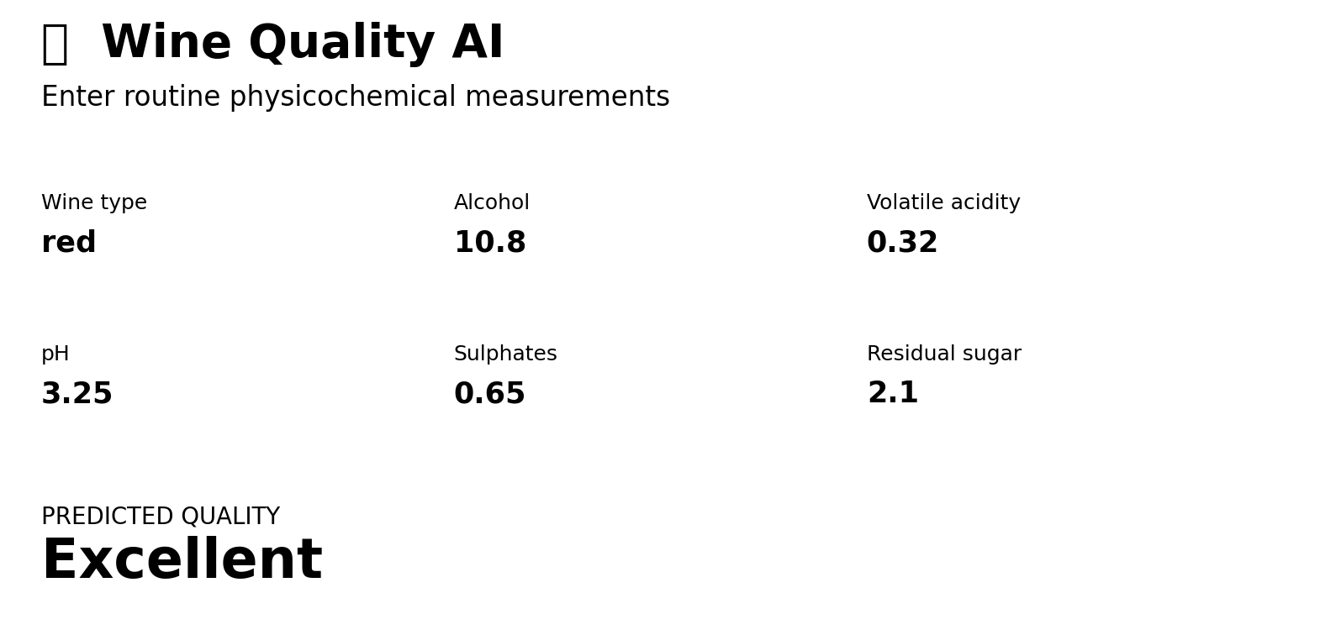
14. Prototype
Wine Quality AI — Streamlit decision-support interface
Input → model → quality class
Probability display when available
Designed for demonstration, not certification
KL UNIVERSITY • MINI HACKATHON 1 • 2026

Slide 16
15. Conclusion & Future Scope
From hackathon prototype to deployable decision support
End-to-end workflow completed: problem → dataset → EDA → algorithms → evaluation → prototype.
Key challenge: imbalanced, overlapping quality classes.
Best demonstration model selected using macro-F1 rather than accuracy alone.
Future: official UCI rerun, SHAP, calibration, ordinal models, external validation and real consumer-preference data.
KL UNIVERSITY • MINI HACKATHON 1 • 2026

Slide 17
16. References
Primary sources
UCI Machine Learning Repository — Wine Quality dataset, DOI 10.24432/C56S3T.
Cortez, P., Cerdeira, A., Almeida, F., Matos, T., & Reis, J. (2009). Modeling wine preferences by data mining from physicochemical properties. Decision Support Systems, 47(4), 547–553.
Bhardwaj, P., Tiwari, P., Olejar, K., Parr, W., & Kulasiri, D. (2022). A machine learning application in wine quality prediction. Machine Learning with Applications, 8, 100261.
KL UNIVERSITY • MINI HACKATHON 1 • 2026

