Slide 1
Healthcare Analytics CRITICALITY INDEX PREDICTION USING MACHINE LEARNING

Slide 2

Group 6: Power mode on
Nikhil Reddy Konatham (0774384)
Mounika Peddayerramreddygari (0795661)
Sai Satwik Bolisetti (0793105)
Naga Vijaya Lakshmi Petchetti (0795708)

Slide 3

Agenda
Introduction
Analysis
Data Cleaning
Data Modelling
Data Visualization
Building a model
Conclusion

Slide 4
Introduction
Our primary goal is to use machine learning modules to forecast a patient's criticality (Criticality Index).
The probability of ICU care is termed the Criticality Index
This model supports the doctors with the best decision-making in any given situation.
we are using the data from the Mimic Clinical dataset

Slide 5

Analysis :
We have used Big Query and GCP to download and load the data for analysis & performed numerous analytics on the MIMIC III database to understand the relations, dependencies, correlations, and measurements.
There is no specific column for Criticality Index in the MIMIC dataset, So, we have built a Criticality Index variable using the most specific and important factors which can predict the criticality most accurately
We have many limitations to using Big Query without a Billing account, so we used only Select commands and Temporary Tables to acquire data.

Slide 6
A step-by-step procedure used to obtain the necessary data.
Table 1 - Standardized Vitals Table (Converted all the Temperatures in Fahrenheit to Celsius)
Table 2 - Joining the Step1 Temp, Admissions & callout tables
Table 3 - Created an age & Length of stay table
Table 4 - Joining the above 2 tables
Table 5 - Joining Step3 with Lab events (we have limited the results to 39000000 due to limitations in BigQuery.)

Slide 7
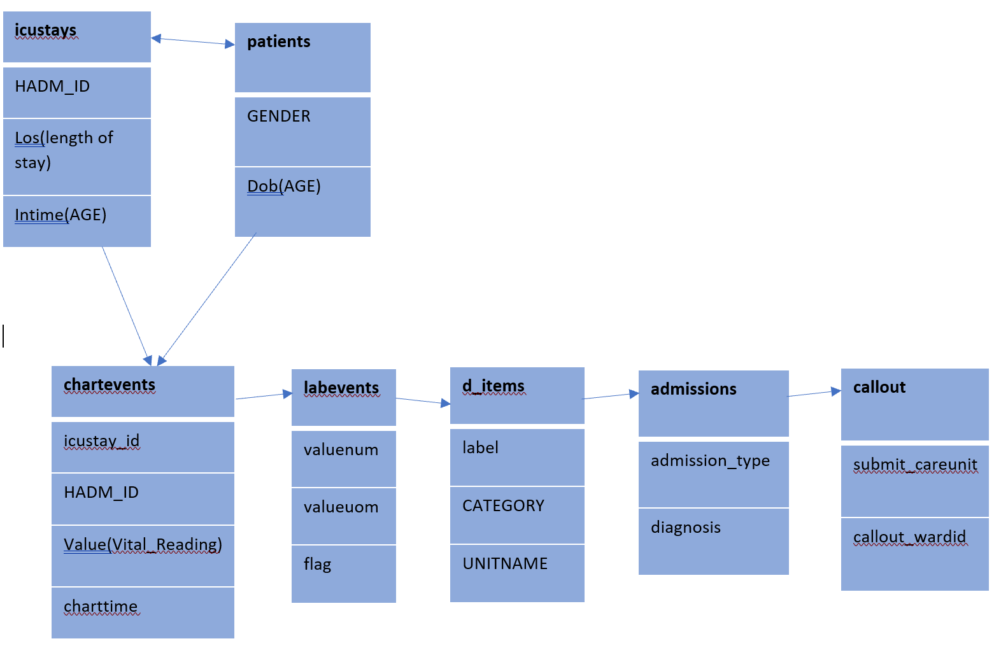
SCHEMA

Slide 8

Data Cleaning:
Standardization of Vitals
Arterial O2 Saturation, O2 saturation pulseoxymetry, SpO2,SaO2 is in %. Converted all percentage values into decimal values
Temperatures are in a combination of Fahrenheit and Celsius. Converted all the values to Celsius
Dropped all the rows which has patient age >100
Combined all the various vital names into a single vital item.
Tools Used - Big Query and Python

Slide 9

Top 6 vitals which play a crucial role in assessing a patient’s health in this project
“Systolic BP”
All the below Vital Readings are renamed to “Systolic BP”.
“Diastolic BP”
All the below Vital Readings are renamed to “Diastolic BP”.
“Respiratory Rate”
All the below Vital Readings are renamed to “Respiratory Rate”.
“Temperature C“
All the below Vital Readings are renamed to “Temperature C”.
“Oxygen Saturation”
All the below Vital Readings are renamed to “Oxygen Saturation”
'Arterial Blood Pressure diastolic', 'ART BP Diastolic', 'ABP [Diastolic]', 'Arterial BP [Diastolic]', 'Arterial BP #2 [Diastolic]', 'Manual Blood Pressure Diastolic Right', 'Manual Blood Pressure Diastolic Left', 'Manual BP [Diastolic]'
'Resp Rate (Total)', 'Respiratory Rate', 'Respiratory Rate (Total)', ‘Spont RR’, ‘Breath Rate’
'Arterial BP [Systolic]', 'Arterial BP #2 [Systolic]', 'Arterial Blood Pressure systolic', 'ART BP Systolic', 'Manual BP [Systolic]', 'Manual Blood Pressure Systolic Left', 'Manual Blood Pressure Systolic Right'
'Temperature Celsius', 'Temperature Fahrenheit', 'Temperature F', 'Temperature C’, ‘Temperature C (calc)', 'Temperature F (calc)'
“Heart Rate”
Vital Readings which are PULSE & Heart Rate are renamed to “Heart Rate”
'Oxygen Saturation', 'SpO2', 'SaO2', 'Arterial O2 Saturation','O2 saturation pulseoxymetry'

Slide 10

Data modeling

Slide 11
def xyz(proj2_rand_samp) : if (proj2_rand_samp["Systolic_BP"] >= 120) & (proj2_rand_samp["Systolic_BP"]<= 129): return "1" elif (proj2_rand_samp["Systolic_BP"] >= 130) & (proj2_rand_samp["Systolic_BP"]<= 139): return "2" elif (proj2_rand_samp["Systolic_BP"] >= 140) & (proj2_rand_samp["Systolic_BP"]<= 179): return "3" elif (proj2_rand_samp["Systolic_BP"] >= 180): return "4" elif (proj2_rand_samp["Systolic_BP"] < 105): return "3" else : return "0" proj2_rand_samp["Systolic_BP_range"] = proj2_rand_samp.apply(lambda proj2_rand_samp:xyz(proj2_rand_samp), axis = 1)
Created 6 vital items range columns and assigned the criticality weight between 0-4 based on the values found on the web (Click Here for References)

Slide 12
proj2_rand_samp['Criticality_Range'] = proj2_rand_samp.loc[:, 'Systolic_BP_range':'Temperature_C_range'].sum(1)
Created an index, criticality_range which is populated based on the six vital ranges.

Slide 13
def xyz(df) : if (df["admission_type"] == 'EMERGENCY') | (df["diagnosis"] == diagnosis) & (df["Criticality_Range"] >3): return "5" elif (df["icustay_id"] != 'NULL') & (df["Criticality_Range"] >3): return "4" elif (df["admission_type"] == 'EMERGENCY') & (df["Criticality_Range"]<=3 ) & (df["Criticality_Range"] > 1): return "2" elif (df["Criticality_Range"] == 1): return "1" else: return "0" df["Avg_Criticality"] = df.apply(lambda df:xyz(df), axis = 1)
Populated Avg_Criticality column based on the independent variables Admission_Type, Diagnosis, Age, Criticality_Range.

Slide 14
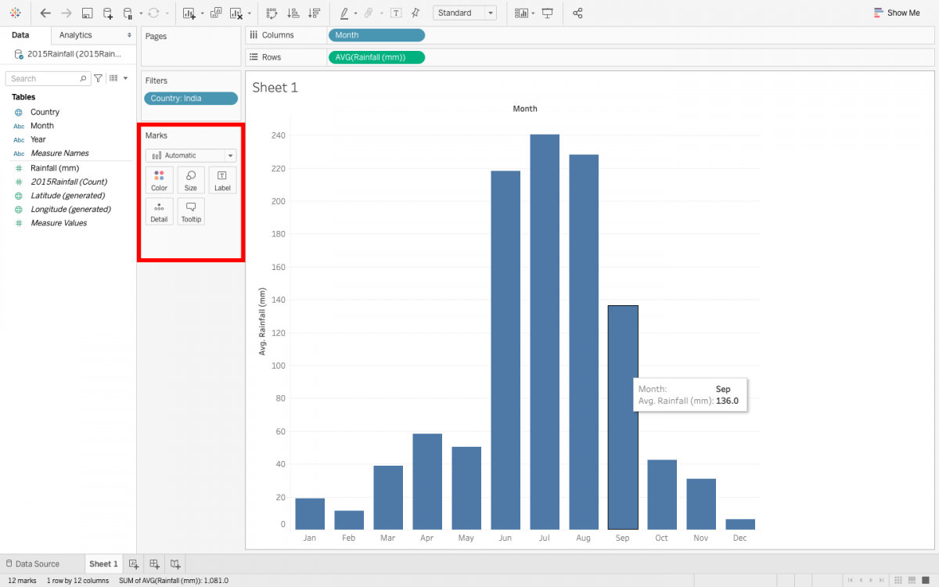
Data Visualization

Slide 15
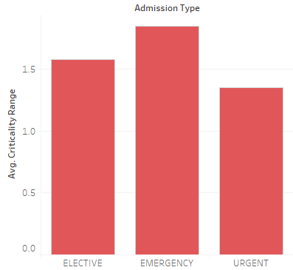
Average of Criticality Range for each Admission Average of Criticality Range for each Admission Type. Details are shown for Admission Type. Details are shown for Admission Type.

Slide 16
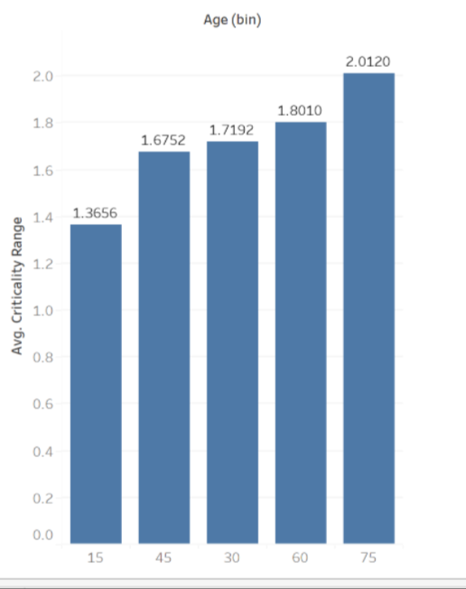
AGE VS AVG of Criticality range

Slide 17
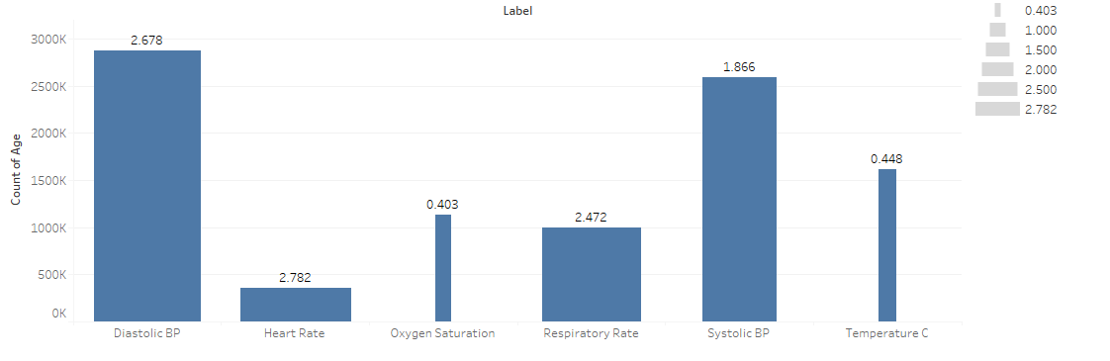
Count of Age for each Label. Size shows average of the Criticality Range. The marks are labeled by average of Criticality Range.

Slide 18
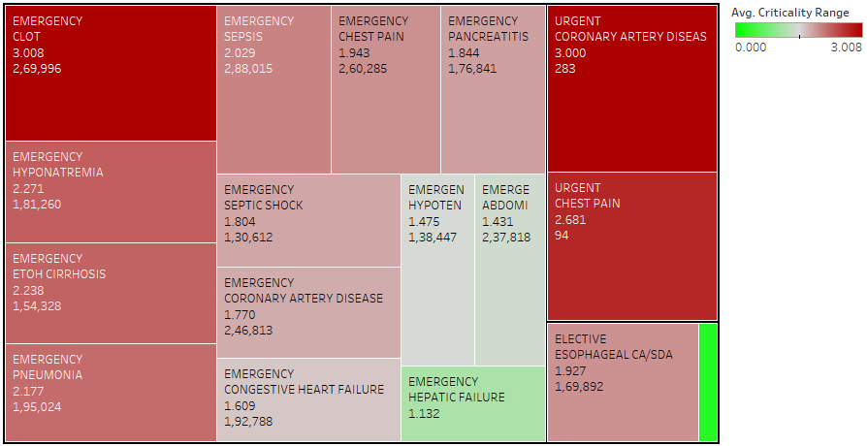
Admission Type, Diagnosis, average of Criticality Range and count of Criticality Range. Color shows average of Criticality Range. Size shows average of Criticality Range.

Slide 19

Building a model

Slide 20
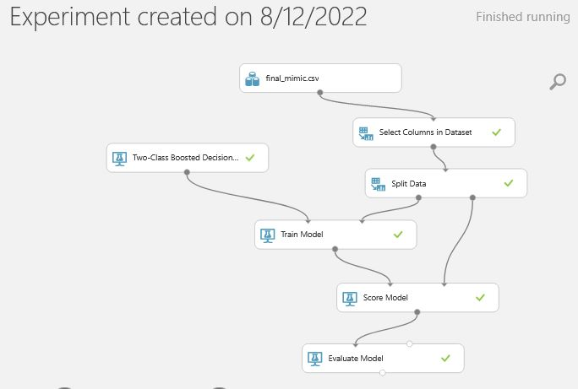
Two-Class Boosted Decision Tree:

Slide 21
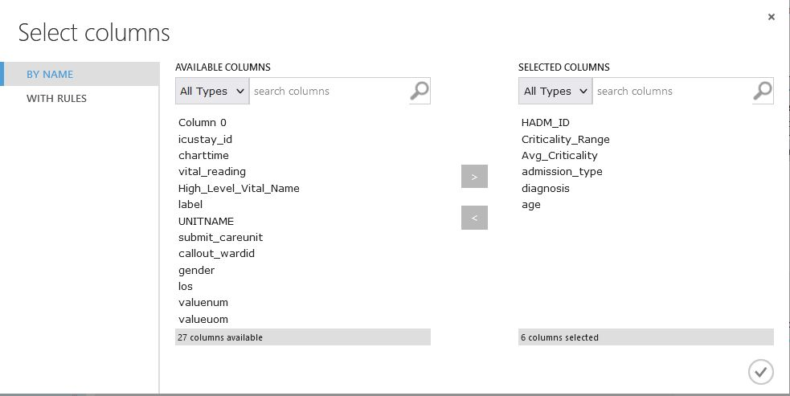
Columns Selected

Slide 22
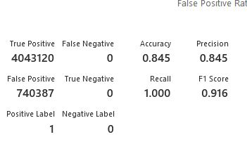
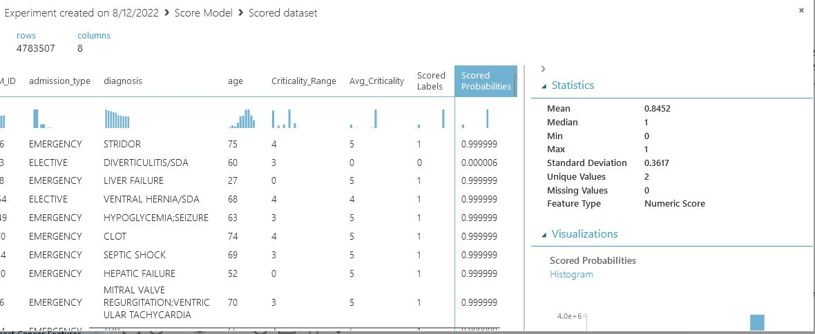
Score Model & Evaluate Results

Slide 23

CONCLUSION
From our Model, we conclude that the model’s prediction accuracy is 84.5%
We would like to explore more to find underlying variables and useful insights to build the model to predict the Diagnosis/ ICD9 code used by doctors.
Also, we will need to build more different models to evaluate which model fits better.

Slide 24
References
All the entity relationships and database details in this project are taken from the Mimic-iii schema and Entity Relationship on the below page. https://mit-lcp.github.io/mimic-schema-spy/index.html
The dataset can be found using the below U : https://physionet.org/content/mimiciii/1.4/
https://www.health.state.mn.us/diseases/coronavirus/pulseoximeter.html
https://www.medicalnewstoday.com/articles/323819
https://www.researchgate.net/figure/The-Group-age-range-of-age-and-the-normal-Respiratory-rate-table-type-styles-4_tbl1_342236322
https://emoha.com/blogs/health/what-is-normal-bp-range-for-women-and-men

Slide 25
Thank you

