Slide 1
Sanitation Prediction System Prototype
A Machine Learning Based Approach
CHINNALA KUMARA SATYA SAI

Slide 2
Introduction
This prototype analyzes school sanitation data and predicts whether a school requires sanitation improvements based on various factors like school toilets and individual household latrines.

Slide 3
Problem Statement
Lack of proper sanitation in schools leads to health hazards and absenteeism among students. There is a need for a system that can predict sanitation needs based on available data.

Slide 4
Objective
To develop a machine learning-based system that predicts whether a school requires additional sanitation facilities by analyzing sanitation data from CSV files.

Slide 5
Data Used
The data consists of sanitation progress from the Eleventh Plan (2007-2012) with columns like:
- Total IHHL
- School Toilets
- Sanitary Complexes
- Anganwadi Toilets.

Slide 6
Workflow
1. Upload the CSV file.
2. Preprocess the data.
3. Apply machine learning models.
4. Generate predictions.
5. Display results (Sanitation Needed or Not).

Slide 7
Machine Learning Model
The model uses a decision tree classifier based on the available sanitation data. It predicts if sanitation facilities are needed based on the number of school toilets and other related factors.

Slide 8
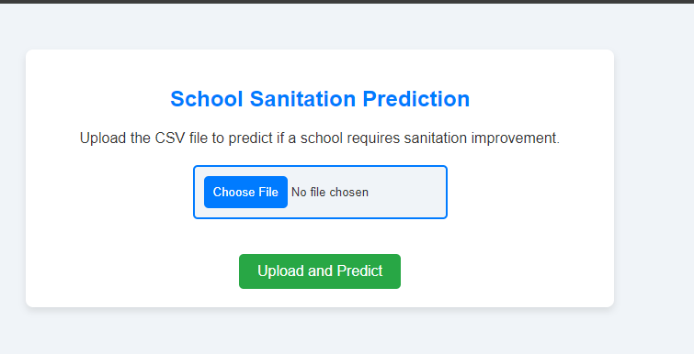

Slide 9
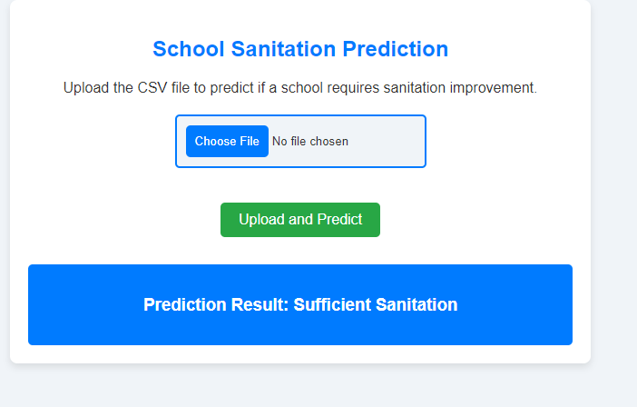

Slide 10
Output
The system outputs a classification:
- 'Sanitation Needed': If the school lacks adequate sanitation facilities.
- 'Sanitation Not Needed': If the school has sufficient sanitation facilities.

Slide 11
Key Benefits
1. Helps authorities prioritize schools requiring sanitation improvements.
2. Provides data-driven insights.
3. Easy to use interface with CSV upload feature.

Slide 12
Conclusion
The sanitation prediction prototype is a valuable tool for assessing school sanitation needs using machine learning. It helps improve the hygiene environment in schools, ensuring the well-being of students.

Slide 13
THANK YOU

