Slide 1

RELAY · IPC CHAT SYSTEM
Inter-Process Chat Application Using IPC
Real-time communication between independent processes
TEAM
MEMBERS
Espadas_OSSP
2520030088 – SATYAN
2520030084 – VISHNU
2520030523 - SANDEEP
Notes:
Relay is a local chat system built from OS-level IPC. It gives independent processes a shared conversation layer without turning them into one application.
We will follow the path from socket boundary to message frame, terminal interface, reliability controls, and live demo.

Slide 2
THE PROBLEM
Independent processes need a shared conversation layer
Separate memory
Safe exchange
One operating system
Separate processes have isolated memory spaces.
Local clients still need a safe, structured way to exchange messages.
Relay provides a reliable IPC-based path for multi-process chat on one operating system.
02
Notes:
Separate processes cannot share memory directly, but they still need to exchange meaningful messages. The key requirement is a controlled local path with structure and safety built in.
Relay addresses that gap while keeping each client independent.

Slide 3




Relay turns OS-level IPC into a usable chat system
Two-way messaging
Broker server
Between independent client processes.
Manages routing for multiple clients.
Chat state
Terminal interface
Rooms, private messages, presence, and acknowledgements.
03
Notes:
The objective is more than moving bytes between processes. Relay combines two-way messaging, broker routing, chat state, and a terminal interface into one usable system.
Those capabilities give the IPC mechanism a clear user-facing shape.

Slide 4
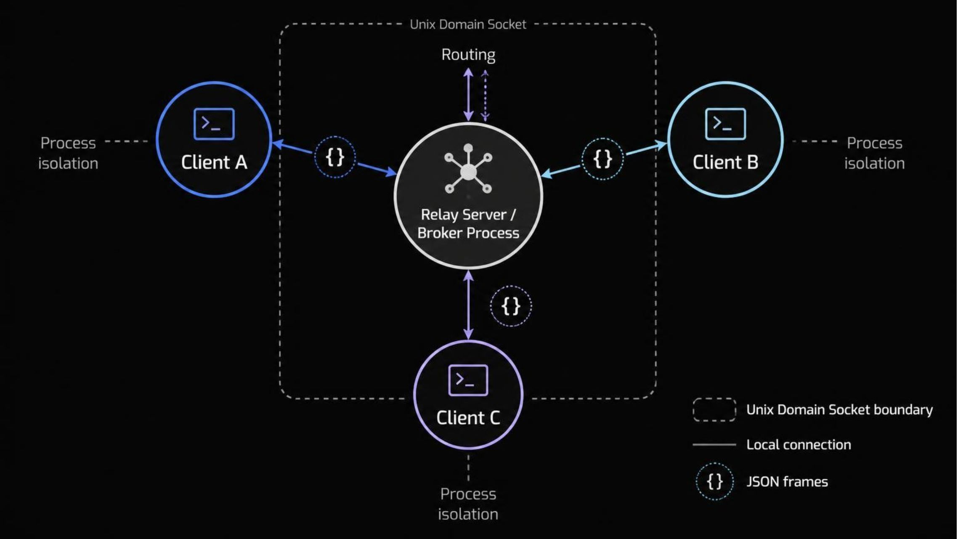
One broker routes messages between independent processes
04
Notes:
Read the architecture from left to right. Client A, Client B, and Client C run as separate OS processes, while the Relay Server / Broker Process owns connections and message routing.
The Unix domain stream socket carries local traffic, and structured JSON frames make the protocol explicit.

Slide 5
TRANSPORT CHOICE
Unix domain sockets fit local process-to-process chat
SELECTED
ALTERNATIVE
AF_UNIX
TCP
Address processes through the local operating system.
Network-oriented communication.
SOCK_STREAM
Useful when communication must cross a network boundary, but broader than this local IPC use case.
The system stays local by design.
Reliable byte-stream communication.
AF_UNIX · SOCK_STREAM
Low overhead · no network exposure · local-only communication
05
Notes:
AF_UNIX addresses processes through the local operating system, and SOCK_STREAM provides reliable byte-stream communication.
TCP is the network-oriented alternative. Relay selects Unix domain sockets for low overhead, no network exposure, and local-only communication.

Slide 6
A small JSON frame keeps every message explicit
EXAMPLE MESSAGE
SOCKET BOUNDARY
Messages are length-delimited or newline-delimited.
Validation covers size and format.
The server handles fragmented and combined socket writes, then returns responses and acknowledgements.
{
"type": "send",
"room": "general",
"text": "Hello from another process"
}
06
Notes:
The JSON frame makes each message explicit: type, room, and text are visible and inspectable. The transport still delivers a byte stream, so Relay handles delimiters, fragmentation, and combined writes.
After validation, the server returns responses and acknowledgements so the client can see the result.

Slide 7




Features that make Relay feel like a real chat tool
Messaging
Presence
Multiple independent clients and public rooms. Private messages, acknowledgements, and recent room history.
Presence and /who.
Interface
Resilience
Unicode and multi-language text. Commands and a scrollable terminal UI.
Graceful disconnects.
07
Notes:
Relay’s feature set is grouped into four areas: messaging, presence, interface, and resilience.
The result is a chat tool with rooms, private messages, connected-user visibility, commands, Unicode support, acknowledgements, history, and graceful disconnects.

Slide 8
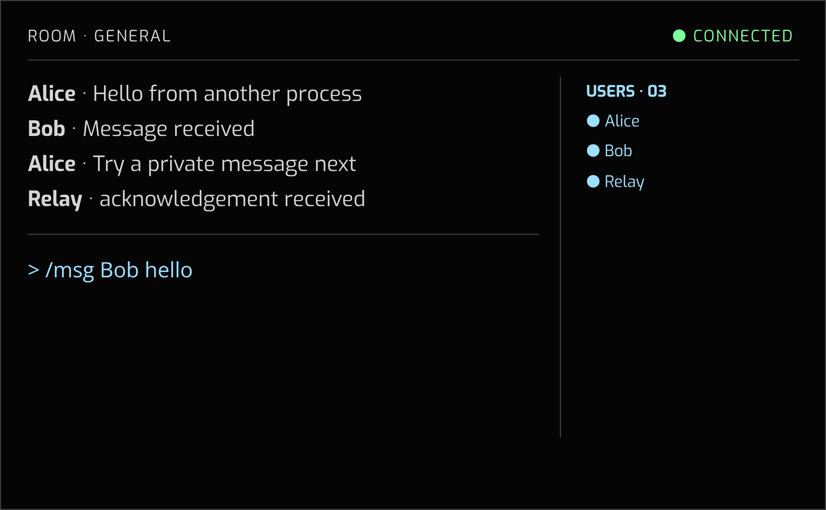
OPERATOR VIEW
The terminal UI keeps the state visible
Room name, connected users, message history, input, and connection status stay in view.
COMMANDS
/join room · /msg user message · /who · /stats · /help · /clear · /quit
08
Notes:
The terminal makes the system state visible while it is running. The room, connected users, history, input area, and connection status all remain available for the next action.
The command vocabulary covers joining rooms, private messages, presence, statistics, help, clearing the view, and quitting.

Slide 9
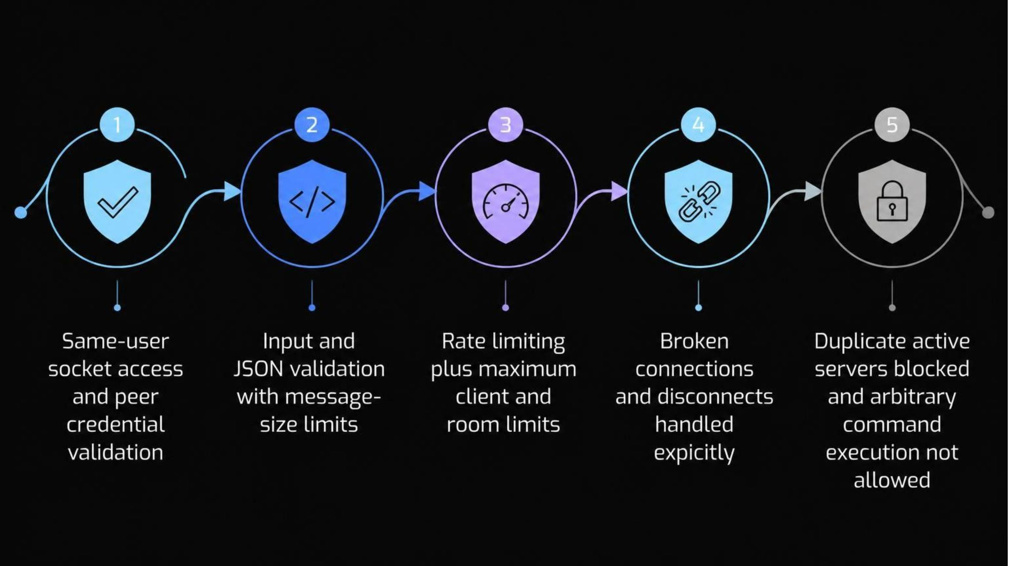
RELIABILITY POSTURE
Start where
the bytes enter.
Concrete controls protect the local boundary.
09
Notes:
Reliability starts at the local socket boundary. Relay checks same-user access and peer credentials, validates input and JSON, and applies message-size limits.
Resource limits, explicit disconnect handling, duplicate-server blocking, and the prohibition on arbitrary command execution complete the concrete posture without overstating it.

Slide 10
The demo makes the IPC loop visible
01
02
03
04
Start Relay
Launch Alice
Launch Bob
Join and chat
Start the Relay server.
Launch Client Alice in one terminal.
Launch Client Bob in another.
Join the same room and exchange messages.
05
06
07
Private path
Observe state
Disconnect handling
Send a private message and display connected users.
Show acknowledgements and room history.
Close one client and demonstrate disconnect handling.
10
Notes:
The demo follows the IPC loop in order: start the broker, launch Alice and Bob in separate terminals, join a room, and exchange messages.
Then we show a private message, connected users, acknowledgements, and room history before closing one client to demonstrate disconnect handling.

