Slide 1
Following tools have been used with the ReAct agent.
All are custom tools created with the help of LangChain’s tool decorator.
Crawl4AI is an open-source web crawling and scrapping framework designed to automate the collection of data from websites
SEARCH_TOOL
CRAWL_URLS
SUMMARIZE_MARKDOWN
Uses LLM to output source links based on pre-defined prompt.
Uses Crawl4AI to crawl the source links.
Uses PruningContentFilter to filter out only the text/content.
Uses LLM to summarize the markdown based on pre-defined prompt.

Slide 2
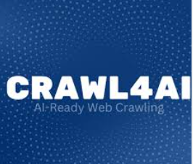

User Query
Search_tool
LLM returns source links
Web Research Agent
Crawl4AI crawls the source links and generate markdown
Crawl_urls_tool
Summarize_markdown_tool
LLM summarizes the markdown

