Slide 1

Restaurant Recommendation Engine
Using Collaborative Filtering Technique

Slide 2
Business Problem
Suppose a company like Foursquare is providing location services to its users.
AIM: To increase number of users
Targeted USERS:
Location providers : Restaurants
People looking for Restaurants
PROBLEMS faced by:
Restaurants: for a new restaurant, It takes time to get popular among people. Spends lot of investment in advertising to show their existence
People: Because of so many choices, they get always confused to choose restaurants.

Slide 3
Solution: Recommendation Systems
Recommendations to users will be beneficial to both service providers and users
HANDLING:
Restaurants will be benefited because we are making them popular by recommending them to people
People will benefited because they will get recommendations based on their taste and past ratings

Slide 4
Recommendation Systems
There are two basic approaches to recommending:
Collaborative Filtering (Implemented)
Content-based

Slide 5
Collaborative Filtering
Weight all users with respect to similarity with the active user.
Select a subset of the users (neighbors) to use as predictors.
Normalize ratings and compute a prediction from a weighted combination of the selected neighbors’ ratings.
Present items with highest predicted ratings as recommendations.

Slide 6
Problems with Collaborative Filtering
Cold Start: There needs to be enough other users already in the system to find a match.
Sparsity: If there are many items to be recommended, even if there are many users, the user/ratings matrix is sparse, and it is hard to find users that have rated the same items.
First Rater: Cannot recommend an item that has not been previously rated.
New items
Esoteric items
Popularity Bias: Cannot recommend items to someone with unique tastes.
Tends to recommend popular items.

Slide 7
Content-based recommendations
Recommendations are based on information on the content of items rather than on other users’ opinions.
Uses a machine learning algorithm to induce a profile of the users preferences from examples based on a feature description of content.
Some previous applications:
Newsreader (Lang, 1995)
Syskill and Webert (Pazzani et al., 1996)

Slide 8




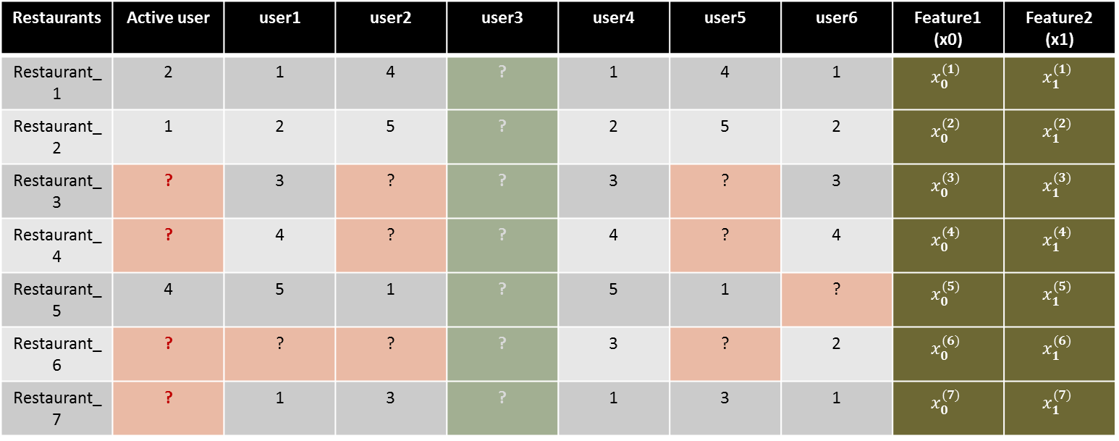





Matrix Factorization:
$Q^{T} × P = M′$
$$θ_{0}^{(j)}$$ | $$θ_{1}^{(j)}$$
X
$$x_{0}^{(1)}$$
$$x_{0}^{(2)}$$
=
$$r(i,j)$$
 | $$θ_{0}^{(1)}$$ | $$θ_{0}^{(2)}$$ | $$θ_{0}^{(3)}$$ | $$θ_{0}^{(4)}$$ | $$θ_{0}^{(5)}$$ | $$θ_{0}^{(6)}$$ | $$θ_{0}^{(7)}$$
Values to estimate
 | $$θ_{1}^{(1)}$$ | $$θ_{1}^{(2)}$$ | $$θ_{1}^{(3)}$$ | $$θ_{1}^{(4)}$$ | $$θ_{1}^{(5)}$$ | $$θ_{1}^{(6)}$$ | $$θ_{1}^{(7)}$$
Feature vector
Restaurants | Active user | user1 | user2 | user3 | user4 | user5 | user6 | Feature1 (x0) | Feature2 (x1)
Restaurant_1 | 2 | 1 | 4 | ? | 1 | 4 | 1 | $$x_{0}^{(1)}$$ | $$x_{1}^{(1)}$$
Restaurant_2 | 1 | 2 | 5 | ? | 2 | 5 | 2 | $$x_{0}^{(2)}$$ | $$x_{1}^{(2)}$$
Restaurant_3 | ? | 3 | ? | ? | 3 | ? | 3 | $$x_{0}^{(3)}$$ | $$x_{1}^{(3)}$$
Restaurant_4 | ? | 4 | ? | ? | 4 | ? | 4 | $$x_{0}^{(4)}$$ | $$x_{1}^{(4)}$$
Restaurant_5 | 4 | 5 | 1 | ? | 5 | 1 | ? | $$x_{0}^{(5)}$$ | $$x_{1}^{(5)}$$
Restaurant_6 | ? | ? | ? | ? | 3 | ? | 2 | $$x_{0}^{(6)}$$ | $$x_{1}^{(6)}$$
Restaurant_7 | ? | 1 | 3 | ? | 1 | 3 | 1 | $$x_{0}^{(7)}$$ | $$x_{1}^{(7)}$$
$$x_{0}^{(i)}$$ | $$x_{1}^{(i)}$$
$$P$$
User vector
$$θ_{0}^{(j)}$$ | $$θ_{1}^{(j)}$$
$$Q$$
Value to predict
Rating
$$r(i,j)$$

Slide 9
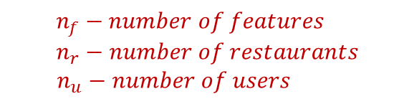
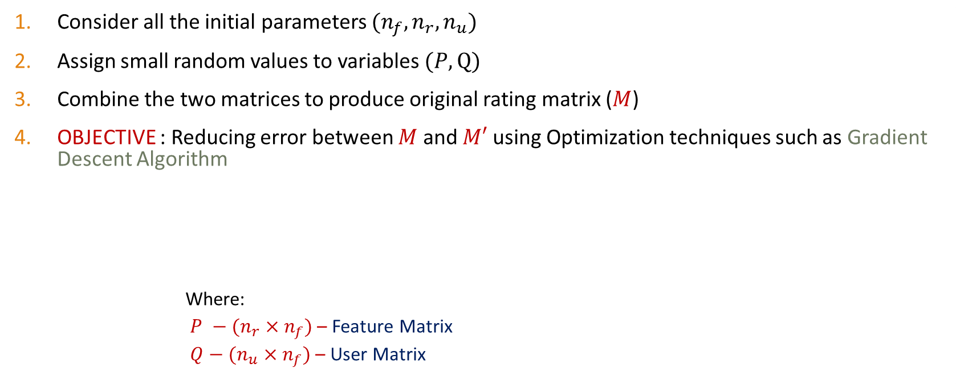
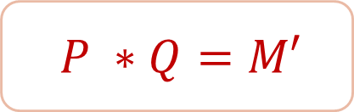
Approach: Step-1
Consider all the initial parameters $(n_{f},n_{r},n_{u})$
Assign small random values to variables $(P,Q)$
Combine the two matrices to produce original rating matrix ($M$)
OBJECTIVE : Reducing error between $M$ and $M′$ using Optimization techniques such as Gradient Descent Algorithm
Where:
$P −(n_{r}×n_{f})$ – Feature Matrix
$Q−(n_{u}×n_{f})$ – User Matrix
$$P ∗Q=M′$$
$$n_{f}−number of features$$
$$n_{r}−number of restaurants$$
$$n_{u}−number of users$$

Slide 10
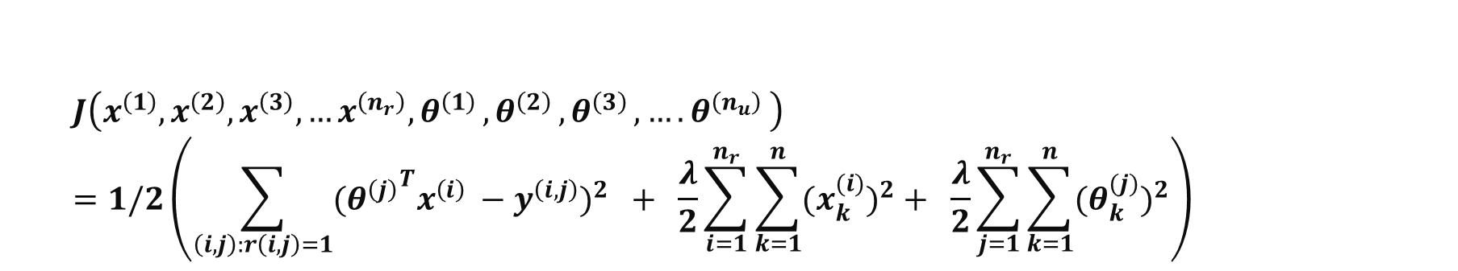
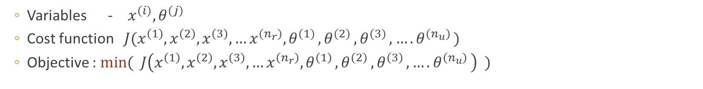

Step-2: Defining the cost function
Variables - $x^{(i)},θ^{(j)}$
Cost function $J(x^{\left(1\right)},x^{\left(2\right)},x^{\left(3\right)},…x^{(n_{r})}{,θ}^{(1)}{,θ}^{(2)}{,θ}^{(3)}{,….θ}^{(n_{u})})$
Objective : $min( J\left(x^{\left(1\right)},x^{\left(2\right)},x^{\left(3\right)},…x^{\left(n_{r}\right)}{,θ}^{\left(1\right)}{,θ}^{\left(2\right)}{,θ}^{\left(3\right)}{,….θ}^{\left(n_{u}\right)}\right) )$
$$J\left(x^{\left(1\right)},x^{\left(2\right)},x^{\left(3\right)},…x^{\left(n_{r}\right)}{,θ}^{\left(1\right)}{,θ}^{\left(2\right)}{,θ}^{\left(3\right)}{,….θ}^{\left(n_{u}\right)}\right)=1/2\left(\sum_{\left(i,j\right):r\left(i,j\right)=1}{{{{(θ}^{\left(j\right)}}^{T}x^{\left(i\right)} −y^{\left(i,j\right)})}^{2}} + \frac{λ}{2}\sum_{i=1}^{n_{r}}{\sum_{k=1}^{n}{{{(x}_{k}^{(i)})}^{2}}}+ \frac{λ}{2}\sum_{j=1}^{n_{r}}{\sum_{k=1}^{n}{{{(θ}_{k}^{(j)})}^{2}}}\right)$$
$λ$- regularization parameter

Slide 11
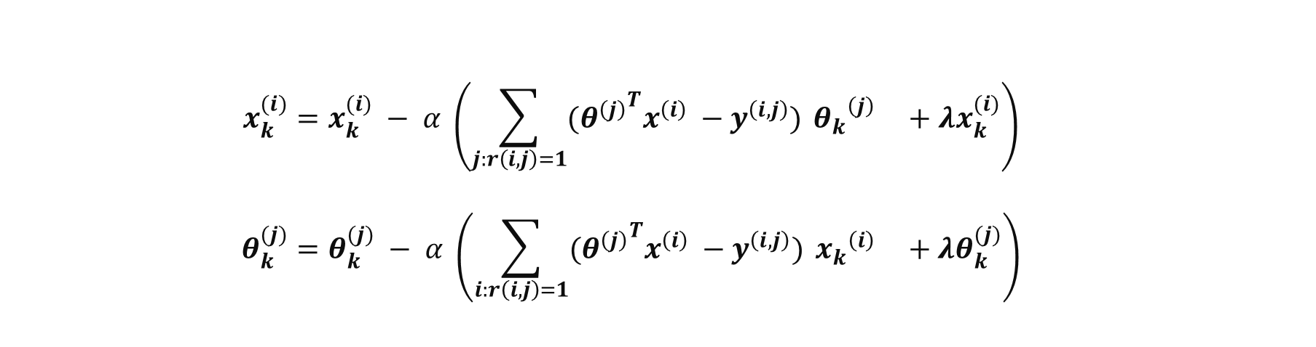
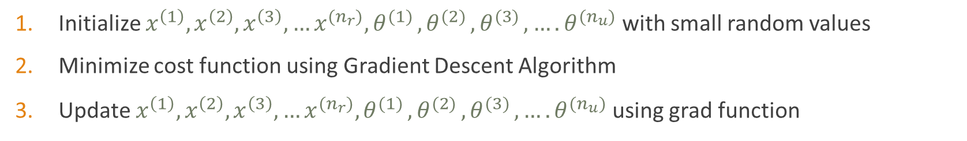

Step-3: Defining Gradient Function
Initialize $x^{\left(1\right)},x^{\left(2\right)},x^{\left(3\right)},…x^{(n_{r})}{,θ}^{(1)}{,θ}^{(2)}{,θ}^{(3)}{,….θ}^{(n_{u})}$ with small random values
Minimize cost function using Gradient Descent Algorithm
Update $x^{\left(1\right)},x^{\left(2\right)},x^{\left(3\right)},…x^{(n_{r})}{,θ}^{(1)}{,θ}^{(2)}{,θ}^{(3)}{,….θ}^{(n_{u})}$ using grad function
$$x_{k}^{(i)}=x_{k}^{(i)} − α \left(\sum_{j:r\left(i,j\right)=1}{{{(θ}^{\left(j\right)}}^{T}x^{\left(i\right)} −y^{\left(i,j\right)}) }{θ_{k}}^{\left(j\right)} +λx_{k}^{(i)}\right)$$
$$θ_{k}^{(j)}=θ_{k}^{(j)} − α \left(\sum_{i:r\left(i,j\right)=1}{{{(θ}^{\left(j\right)}}^{T}x^{\left(i\right)} −y^{\left(i,j\right)}) }{x_{k}}^{\left(i\right)} +λθ_{k}^{(j)}\right)$$
$α$- learning rate

Slide 12
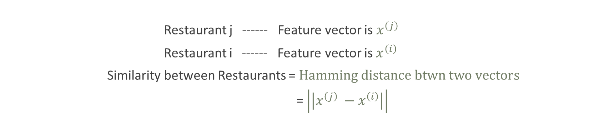
Finding Related Restaurants:
Restaurant j ------ Feature vector is $x^{\left(j\right)}$
Restaurant i ------ Feature vector is $x^{\left(i\right)}$
Similarity between Restaurants = $Hamming distance btwn two vectors$
= $\left|\left|x^{\left(j\right)} −x^{\left(i\right)}\right|\right|$

Slide 13
Problem : New Users
For the Users who have not visited any Restaurant, This system will not recommend any Restaurants.
SOLUTION: Mean-Normalization Technique

Slide 14
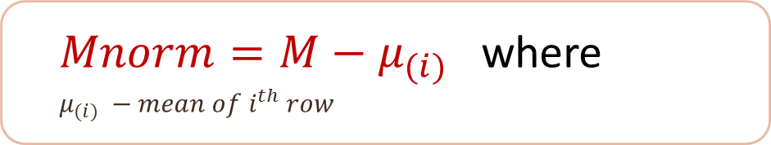

Mean-Normalization Technique
In the above example, User3 have not rated any restaurant. So to help him
Change the Normalize the rating matrix
For $user\left(j\right)$predicted rating will be $r\left(i,j\right)= {{(θ}^{\left(j\right)}}^{T}x^{\left(i\right)})+μ_{(i)}$
$Mnorm=M−μ_{(i)}$ where
$μ_{(i)} −mean of i^{th} row$

Slide 15
Implementation:
Dataset Preparation
Normalizing the ratings
Defining the cost and gradient functions
Setting Initial parameters
Apply Gradient Descent Algorithm
Reconstructing the Rating Matrix
Recommendation of TOP 5 Restaurants

Slide 16
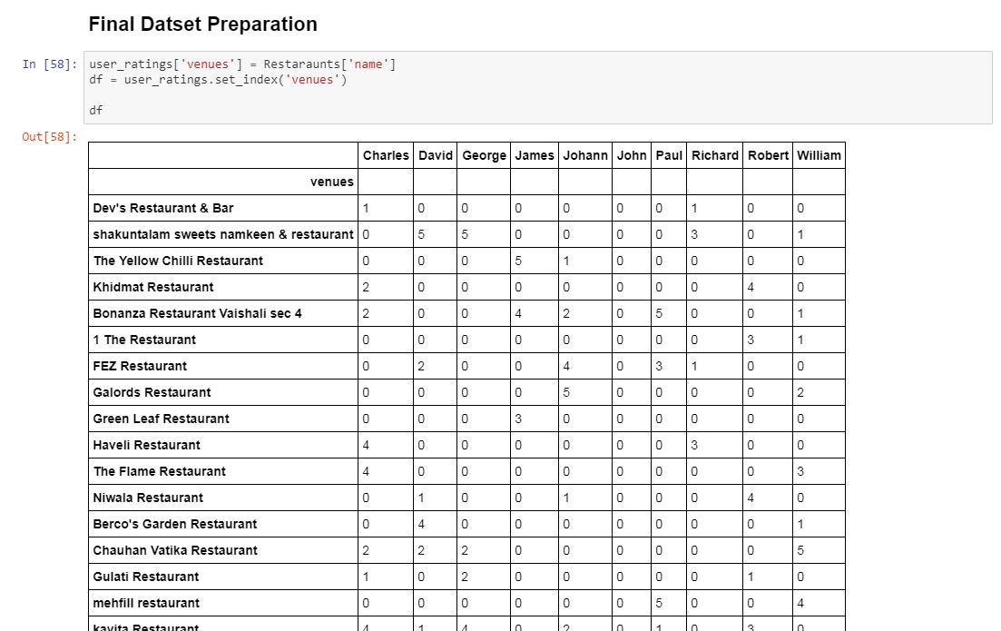
Dataset

Slide 17
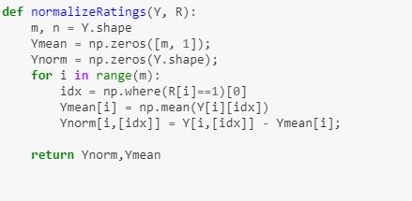
Normalizing the ratings

Slide 18
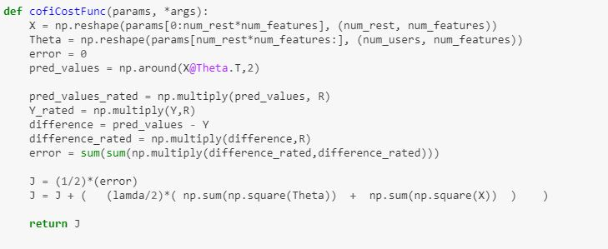
Cost function

Slide 19
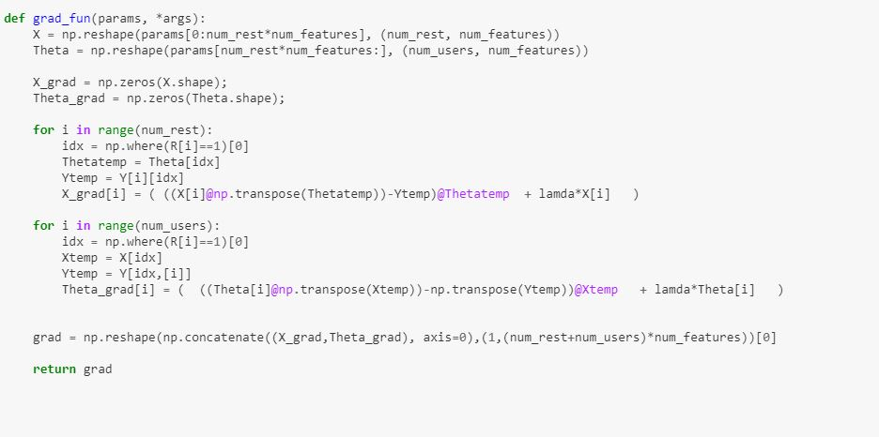
Gradient function

Slide 20
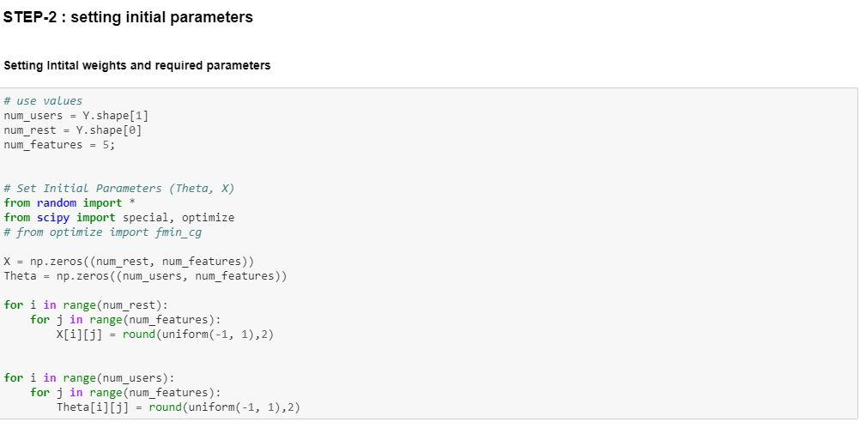
Setting Initial parameters

Slide 21
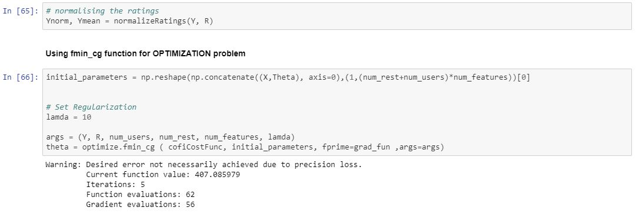
Apply GradiantDescent Algorithm

Slide 22
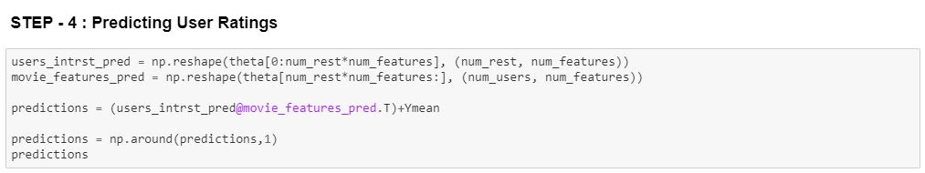
Reconstructing the Rating Matrix

Slide 23
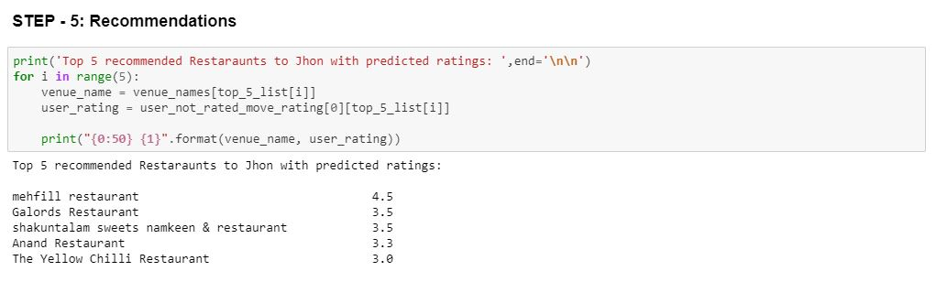
Recommendation of TOP 5 Restaurants

Slide 24
CONCLUSION:
Recommendation System is Implemented using Collaborative Filtering Technique.
Because for every restaurant, Every feature estimation is time consuming and may not be available at all some times, So, Collaborative filtering is used here which do not require any prior knowledge on Features.

Slide 25
Thank you

