Slide 1
Understanding Kubernetes Pod lifecycle management/config management

Slide 2
Agenda
Pod Life Cycle
Overview
Pod life cycle phases
Container life cycle phases
Container restart policy
Pod termination
Garbage collection of failed containers
Container Probes
Overview
Types
Commands and Arguments
Init Containers
POD configuration
Configure Environment Variables in Applications
Configuring ConfigMaps in Applications
Configure Secrets in Applications

Slide 3
Kubernetes Pod Life Cycle

Slide 4
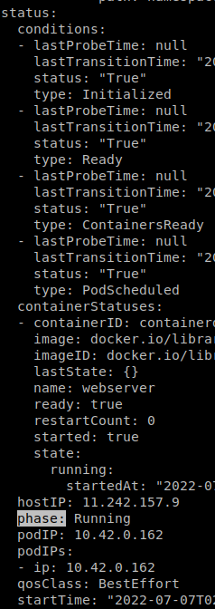
Pod lifecycle - Overview
Quick Recap:
Pods obj have both a specification and an actual status. The status for a Pod object consists of a set of Pod conditions.
Reconciliation loops: Whilst a Pod is running, the kubelet is able to restart containers to handle faults(app crash, deadlock etc) to match current state to desired state
POD has Phase (Pending, Running etc.) & Status (Scheduled, ContainerReady etc.). Also Container has States (Waiting, Running etc.)
Notes:
You can also inject custom readiness information into the condition data for a Pod, if that is useful to your application.

Slide 5
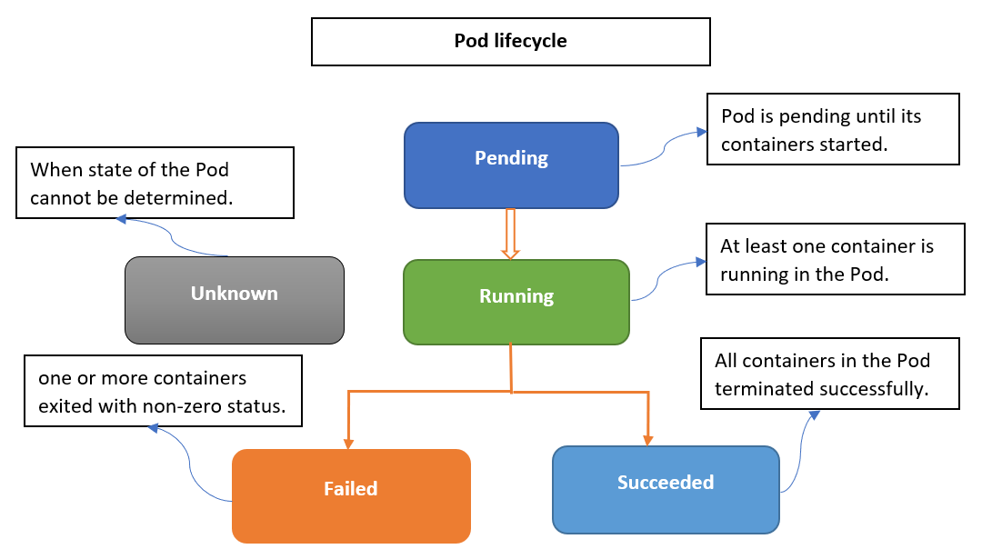
POD Phases
A Pod's status field is a PodStatus object, which has a phase field.
The phase of a Pod is a high-level summary of where the Pod is in its lifecycle.
Pending: The Pod has been accepted by the Kubernetes cluster, but one or more of the containers has not been set up and made ready to run. This includes time a Pod spends waiting to be scheduled as well as the time spent downloading container images over the network.
Running: The Pod has been bound to a node, and all of the containers have been created. At least one container is still running, or is in the process of starting or restarting.
Succeeded: All containers in the Pod have terminated in success, and will not be restarted.
Failed: All containers in the Pod have terminated, and at least one container has terminated in failure. That is, the container either exited with non-zero status or was terminated by the system.
Unknown: For some reason the state of the Pod could not be obtained. This phase typically occurs due to an error in communicating with the node where the Pod should be running.
Note:
If a node dies or is disconnected from the rest of the cluster, Kubernetes applies a policy for setting the phase of all Pods on the lost node to Unknown.

Slide 6
Container States
As well as the phase of the Pod overall, Kubernetes tracks the state of each container inside a Pod.
Once the scheduler assigns a Pod to a Node, the kubelet starts creating containers for that Pod using a container runtime. There are three possible container states: Waiting, Running, and Terminated.
Waiting
Kubelet working on instantiation process includes image pull, init containers etc.
Running
The Running state indicates that a container is executing without issues.
If there was a postStart hook configured, it has already executed and finished.
Terminated
A container can ran to completion or failed for some reason. When use kubectl to query a Pod with a container that is Terminated, you see a reason, an exit code, and the start and finish time for that container's period of execution.
If a container has a preStop hook configured, this hook runs before the container enters the Terminated state.

Slide 7
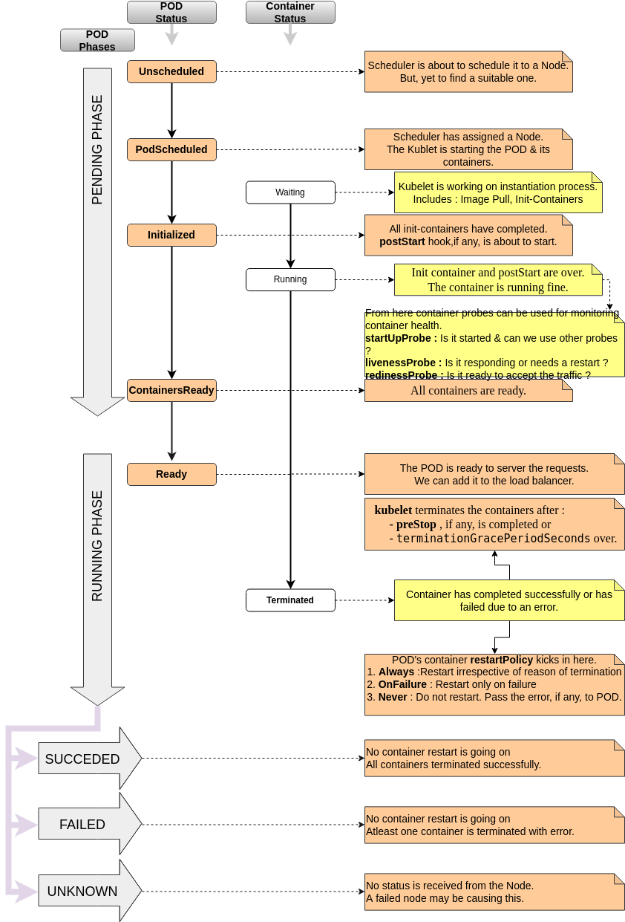
Pod Lifecycle at a Glance

Slide 8
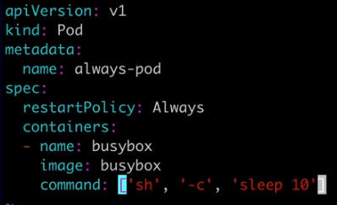
Container restart policy
The spec of a Pod has a restartPolicy field with possible values Always, OnFailure, and Never. The default value is Always.
Always: restart successed or failed container
OnFailure: restart failed container
Never: never restart container
The restartPolicy applies to all containers in the Pod.
restartPolicy only refers to restarts of the containers by the kubelet on the same node.
After containers in a Pod exit, the kubelet restarts them with an exponential back-off delay (10s, 20s, 40s, …), that is capped at five minutes. Once a container has executed for 10 minutes without any problems, the kubelet resets the restart backoff timer for that container.

Slide 9
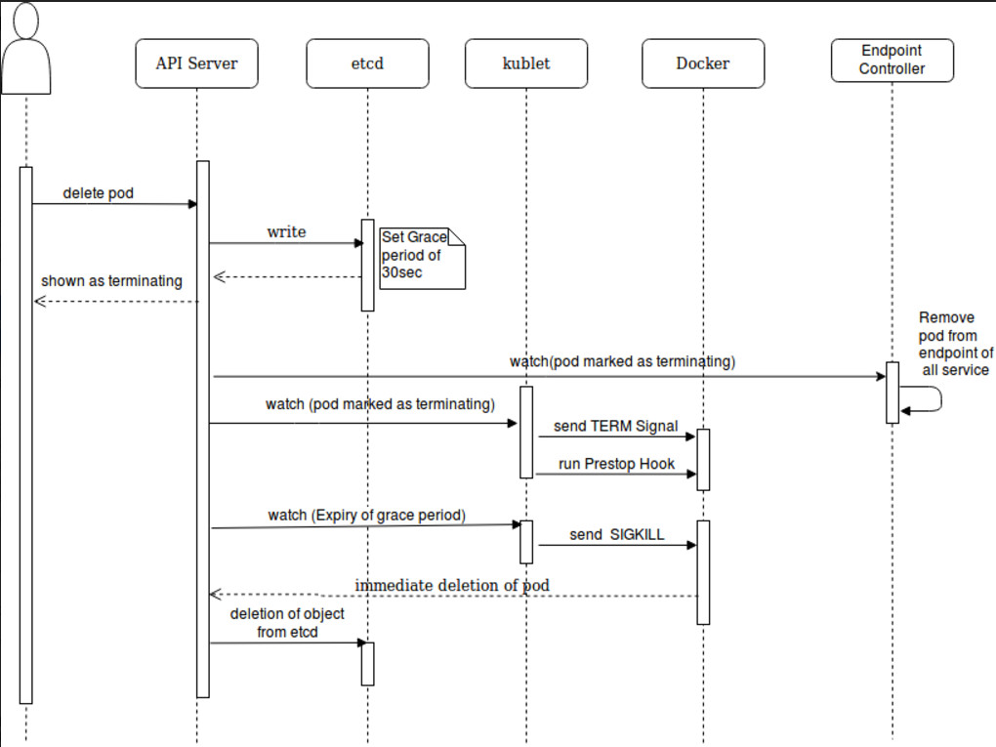
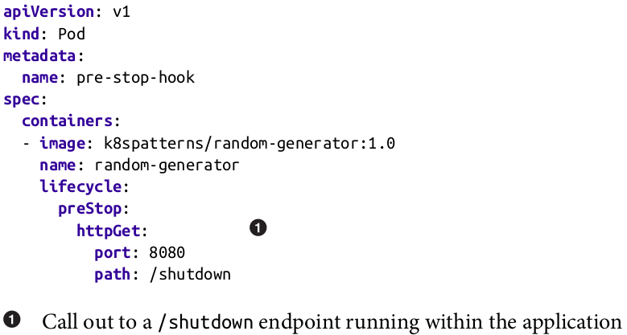
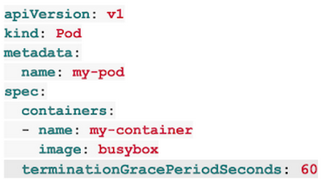
POD Termination flow

Slide 10
POD Termination flow (user driven)
You use the kubectl tool to manually delete a specific Pod, with the default grace period (30 seconds).
The Pod in the API server is updated with the time beyond which the Pod is considered "dead" along with the grace period. If you use kubectl describe to check on the Pod you're deleting, that Pod shows up as "Terminating". On the node where the Pod is running: as soon as the kubelet sees that a Pod has been marked as terminating (a graceful shutdown duration has been set), the kubelet begins the local Pod shutdown process.
If one of the Pod's containers has defined a preStop hook, the kubelet runs that hook inside of the container. If the preStop hook is still running after the grace period expires, the kubelet requests a small, one-off grace period extension of 2 seconds.
The kubelet triggers the container runtime to send a TERM signal to process 1 inside each container.
At the same time as the kubelet is starting graceful shutdown, the control plane removes that shutting-down Pod from Endpoints. ReplicaSets and other workload resources no longer treat the shutting-down Pod as a valid, in-service replica. Pods that shut down slowly cannot continue to serve traffic as load balancers (like the service proxy) remove the Pod from the list of endpoints as soon as the termination grace period begins.
When the grace period expires, the kubelet triggers forcible shutdown. The container runtime sends SIGKILL to any processes still running in any container in the Pod. The kubelet also cleans up a hidden pause container if that container runtime uses one.
The kubelet triggers forcible removal of Pod object from the API server, by setting grace period to 0 (immediate deletion).
The API server deletes the Pod's API object, which is then no longer visible from any client.

Slide 11
Node failure scenario:
This section details what happens during a node failure and what is expected during the recovery.
Post node failure, in about 1 minute, kubectl get nodes will report NotReady state.
In about 5 minutes, the states of all the pods running on the NotReady node will change to either Unknown.This is based on pod eviction timeout settings, the default duration is five minutes.
Irrespective of deployments (StatefulSet or Deployment), Kubernetes will automatically evict the pod on the failed node and then try to recreate a new one with old volumes.
If the node is back online within 5 minutes of the failure, Kubernetes will restart pods, unmount, and re-mount volumes.
Notes:
https://www.upnxtblog.com/index.php/2021/06/22/what-happens-when-one-of-your-kubernetes-nodes-fails/

Slide 12
Garbage collection of failed Pods
Garbage collection is a collective term for the various mechanisms Kubernetes uses to clean up cluster resources. This allows the clean up of resources like the following:
Failed pods
Completed Jobs
Objects without owner references
Unused containers and container images
Dynamically provisioned PersistentVolumes with a StorageClass reclaim policy of Delete
Stale or expired CertificateSigningRequests (CSRs)
Nodes deleted in the following scenarios:
On a cloud when the cluster uses a cloud controller manager
On-premises when the cluster uses an addon similar to a cloud controller manager
Node Lease objects
For failed Pods, the API objects remain in the cluster's API until a human or controller process explicitly removes them.
The control plane cleans up terminated Pods (with a phase of Succeeded or Failed), when the number of Pods exceeds the configured threshold (determined by terminated-pod-gc-threshold in the kube-controller-manager).
This avoids a resource leak as Pods are created and terminated over time.
Notes:
https://kubernetes.io/docs/concepts/architecture/garbage-collection/

Slide 13
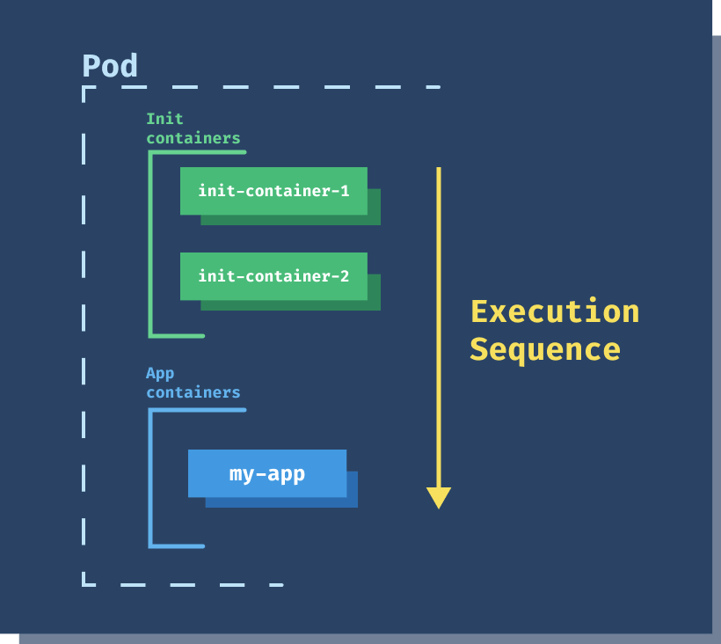
Init containers
apiVersion: v1
kind: Pod
metadata:
name: myapp-pod
labels:
app: myapp
spec:
containers:
- name: myapp-container
image: busybox
command: ['sh', '-c', 'echo The app is running! && sleep 3600']
initContainers:
- name: init-myservice
image: busybox
command: ['sh', '-c', 'until nslookup myservice; do echo waiting for myservice; sleep 2; done;']
- name: init-mydb
image: busybox
command: ['sh', '-c', 'until nslookup mydb; do echo waiting for mydb; sleep 2; done;']
An init container is a container in a pod that is started before the pod app containers are started.
It's meant to perform initialization logic for the main application hosted on the Pod. For example, create the necessary user accounts, perform database migrations, create database schemas and so on.
Init container started in order as in yaml file.
Each init container must exit successfully before the next is invoked.
If an init container fails to start (due to the runtime) or exits with failure, it is retried according to the pod restart policy.
A pod cannot be ready until all init containers have succeeded.
Notes:
https://kubernetes.io/docs/concepts/workloads/pods/init-containers/#examples

Slide 14
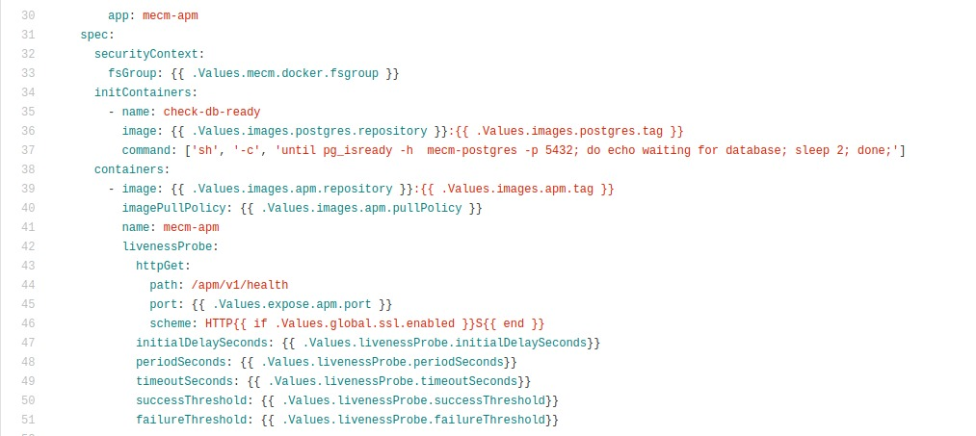
Init containers - EdgeGallery Example
pg_isready is a utility for checking the connection status of a PostgreSQL database server. The exit status specifies the result of the connection check.

Slide 15
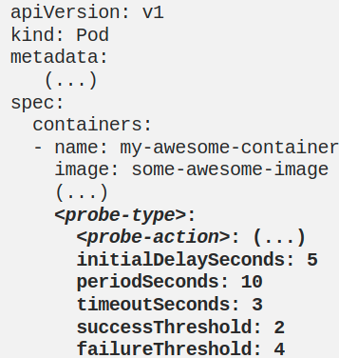
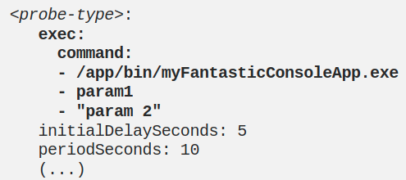
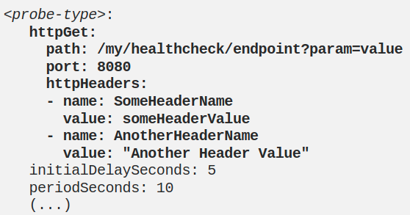
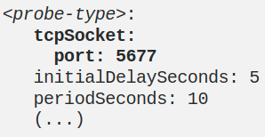
Container probes - Overview
A probe is a diagnostic performed periodically by the kubelet on a container.
Check mechanisms:
There are four different ways to check a container using a probe. Each probe must define exactly one of these four mechanisms:
exec
Executes a specified command inside the container. The diagnostic is considered successful if the command exits with a status code of 0.
grpc
Performs a remote procedure call using gRPC. The target should implement gRPC health checks. The diagnostic is considered successful if the status of the response is SERVING.
httpGet
Performs an HTTP GET request against the Pod's IP address on a specified port and path. The diagnostic is considered successful if the response has a status code greater than or equal to 200 and less than 400.
tcpSocket
Performs a TCP check against the Pod's IP address on a specified port. The diagnostic is considered successful if the port is open. If the remote system (the container) closes the connection immediately after it opens, this counts as healthy.
Notes:
https://medium.com/swlh/fantastic-probes-and-how-to-configure-them-fef7e030bd2f

Slide 16
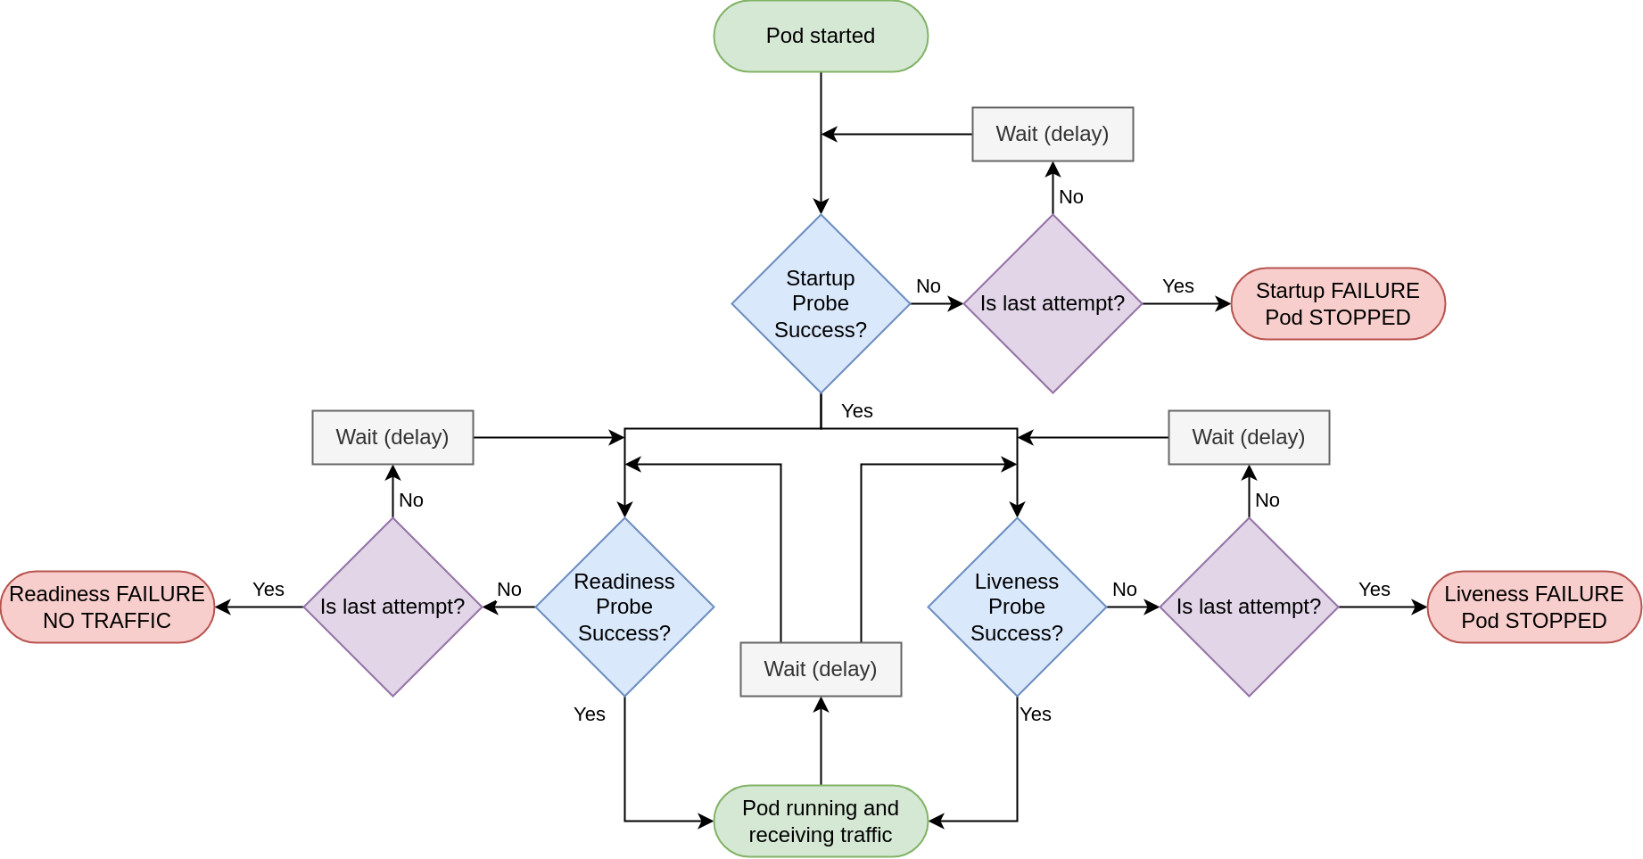
Container Probes - Types
The kubelet can optionally perform and react to three kinds of probes on running containers:
livenessProbe
Indicates whether the container is running. If the liveness probe fails, the kubelet kills the container, and the container is subjected to its restart policy.
readinessProbe
Indicates whether the container is ready to respond to requests. If the readiness probe fails, the endpoints controller removes the Pod's IP address from the endpoints of all Services that match the Pod. The default state of readiness before the initial delay is Failure.
startupProbe
Indicates whether the application within the container is started. All other probes are disabled if a startup probe is provided, until it succeeds. If the startup probe fails, the kubelet kills the container, and the container is subjected to its restart policy.
Kubernetes liveness and readiness probes are mechanisms to improve service reliability and availability.
Notes:
https://medium.com/swlh/fantastic-probes-and-how-to-configure-them-fef7e030bd2f

Slide 17
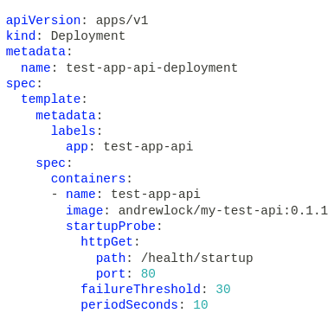
https://andrewlock.net/deploying-asp-net-core-applications-to-kubernetes-part-6-adding-health-checks-with-liveness-readiness-and-startup-probes/
Container Probes - Startup probes
The first probe to run is the Startup probe. When your app starts up, it might need to do a some initial setup work.
It might need to fetch data from remote services, load dlls from plugins etc.
During that process, your app should either not respond to requests, or if it does, it should return a status code of 400 or higher.
Once the startup process has finished, you can switch to returning a success result (200) for the startup probe.
As soon as the startup probe succeeds once it never runs again for the lifetime of that container. If the startup probe never succeeds, Kubernetes will eventually kill the container, and restart the pod.
Once the startup probe succeeds, Kubernetes starts the liveness and readiness probes.

Slide 18
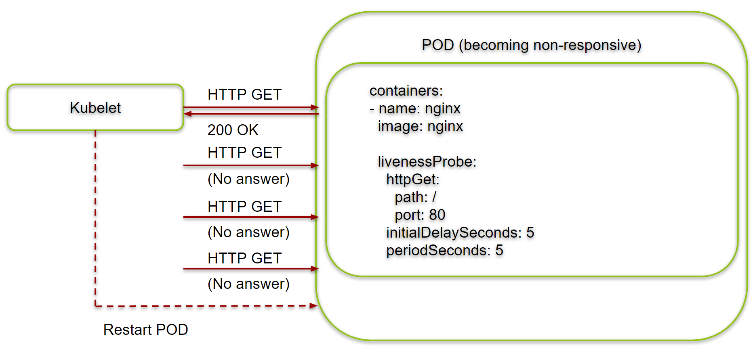
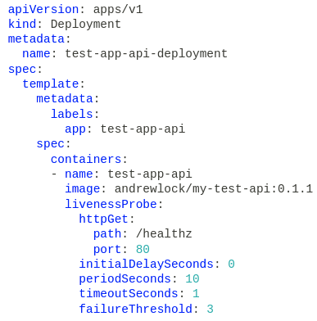
Container Probes - Liveness probes
It indicates whether the container is alive or not.
If a container fails its liveness probe, Kubernetes will kill the pod and restart another.
If you have multiple containers in a pod, then if any of the containers fail their liveness probes then the whole pod is killed and restarted.
it will take approximately 30s (periodSeconds × failureThreshold) before Kubernetes restarts the pod.

Slide 19
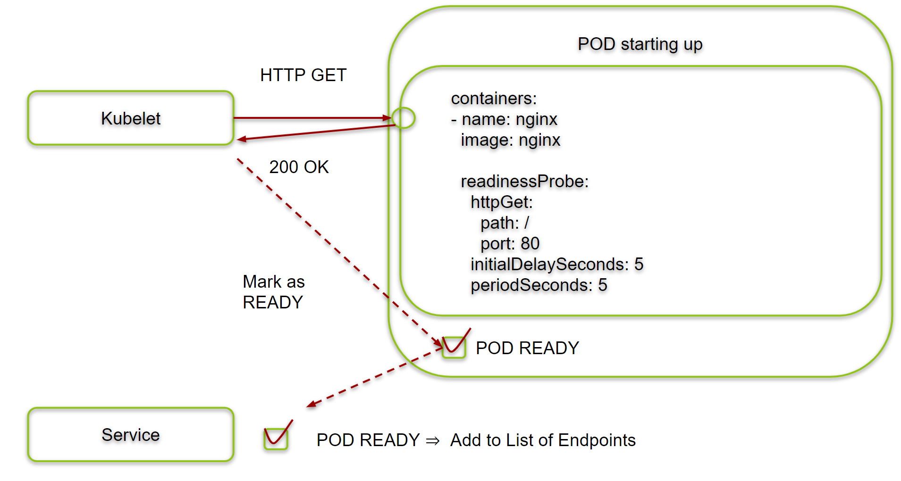
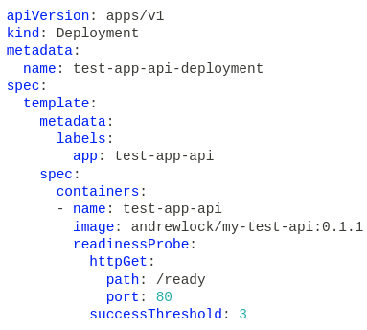
Container Probes - Readiness probes
Readiness probes indicate whether your application is ready to handle requests.
It could be that your application is alive, but that it just can't handle HTTP traffic.
In that case, Kubernetes won't kill the container, but it will stop sending it requests.
In practical terms, that means the pod is removed from an associated service's "pool" of pods that are handling requests, by marking the pod as "Unready".

Slide 20
Probe Example - EdgeGallery Example

Slide 21
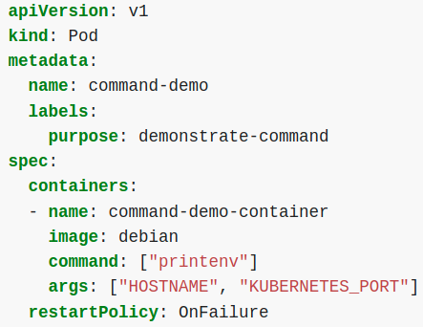
Commands and Arguments
When you create a Pod, you can define a command and arguments for the containers that run in the Pod.
To define a command, include the command field in the configuration file.
To define arguments for the command, include the args field in the configuration file.
The command and arguments that you define in the configuration file override the default command and arguments provided by the container image.
If you define args, but do not define a command, the default command is used with your new arguments.
Notes:
https://kubernetes.io/docs/tasks/inject-data-application/define-command-argument-container/#:~:text=When%20you%20create%20a%20Pod%2C%20you%20can%20define%20a%20command,field%20in%20the%20configuration%20file.

Slide 22
Configurations

Slide 23
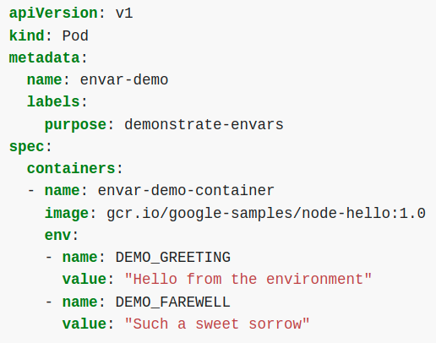
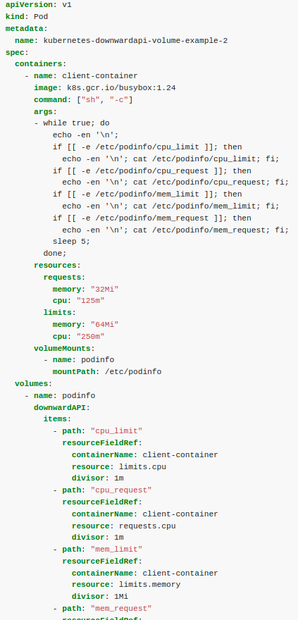
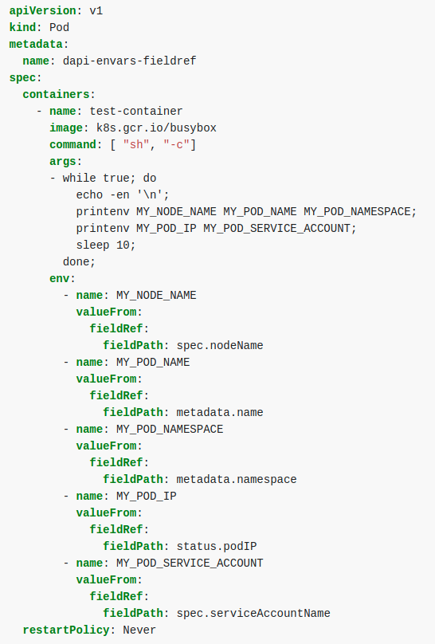
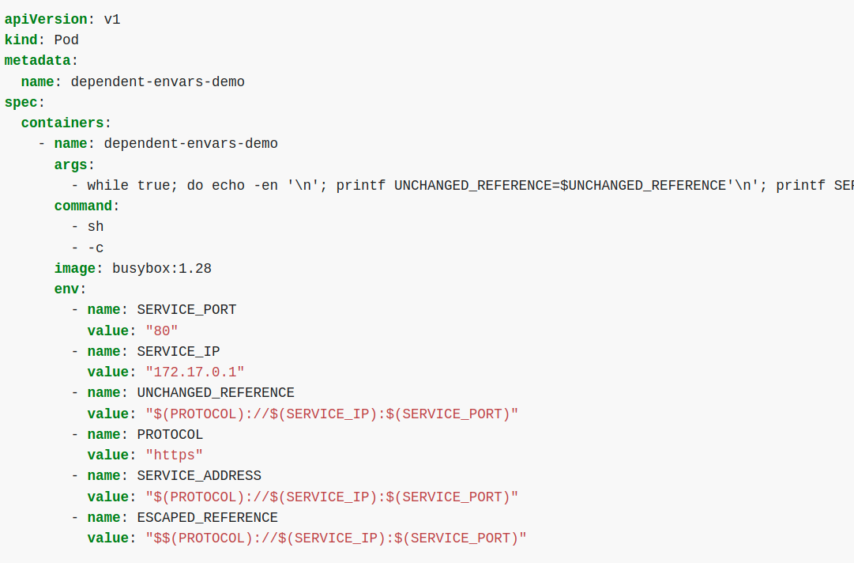
Configure Environment Variables in Applications
It enables you to inject environment variables at runtime.
You can set environment variables for containers running in a pod. When you create a Pod, you can set environment variables for the containers that run in the Pod. To set environment variables, include the env or envFrom field in the configuration file.
Different way of Env variables:
Key - value
Dependent env
Environment-variable-expose-pod-information
environment-variable-expose-container-information
Key-value Envs
environment-variable-expose-pod-information
environment-variable-expose-container-information
Dependent Env: env define and used in config file
Notes:
https://kubernetes.io/docs/tasks/inject-data-application/define-interdependent-environment-variables/

Slide 24
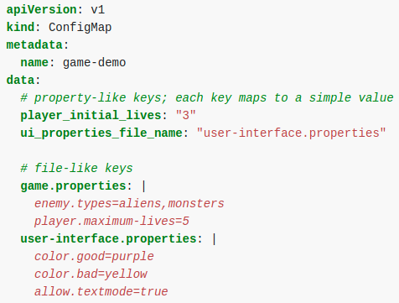
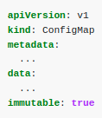
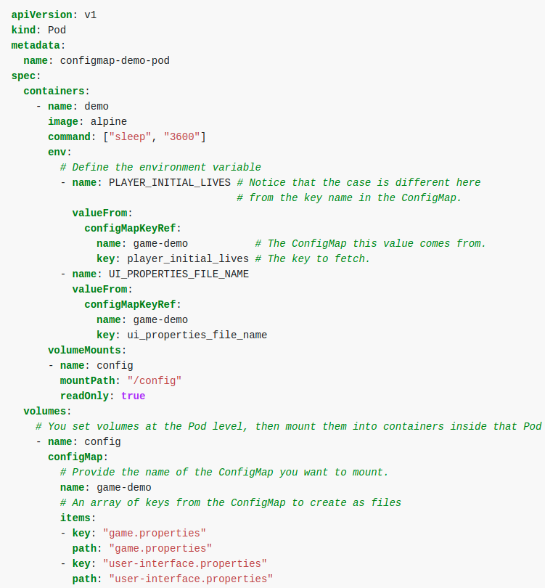
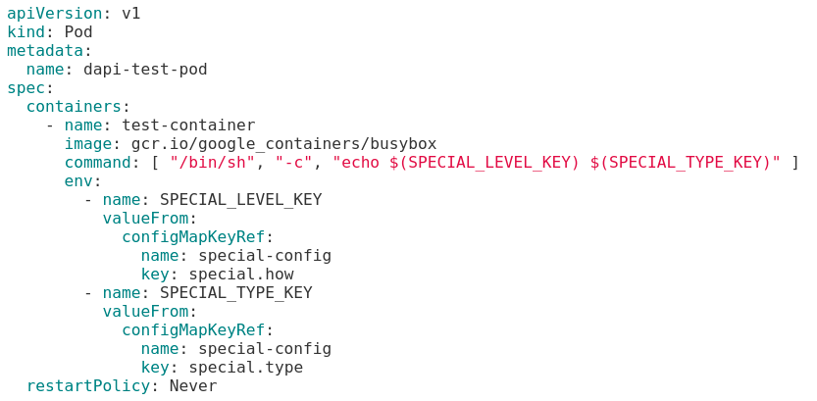
Configure Config maps in Applications
A ConfigMap is an API object used to store non-confidential data in key-value pairs. A ConfigMap allows you to decouple environment-specific configuration from your container images, so that your applications are easily portable.
Pods can consume ConfigMaps as environment variables, command-line arguments, or as configuration files in a volume.
A ConfigMap has data and binaryData fields. These fields accept key-value pairs as their values. The data field is designed to contain UTF-8 strings while the binaryData field is designed to contain binary data as base64-encoded strings.
There are four different ways that you can use a ConfigMap to configure a container inside a Pod:
Inside a container command and args
Environment variables for a container
Add a file in read-only volume, for the application to read
Write code to run inside the Pod that uses the Kubernetes API to read a ConfigMap
Immutable configmaps:
Once a ConfigMap is marked as immutable, it is not possible to revert this change
You can only delete and recreate the ConfigMap.
sample cm with key value and files type data
Immutable cm
Config consumed as volume, is synced with configmap updates in pod by kubelet.
ConfigMaps consumed as environment variables are not updated automatically and require a pod restart.
CM consumed bia env.
CM as env. and mount vol.
Notes:
https://kubernetes.io/docs/concepts/configuration/configmap/

Slide 25
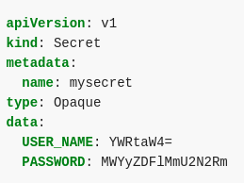
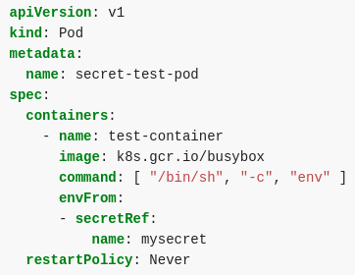
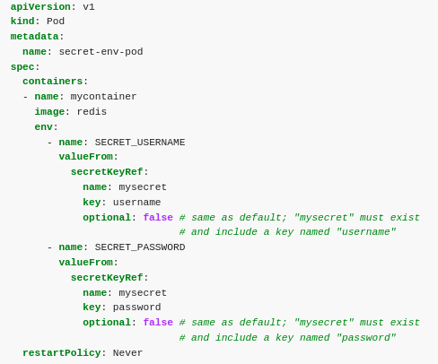
Configure Secrets in Applications
It works in a similar manner as configMaps.
However, they’re more suited to sensitive data like passwords, API keys, etc.
A Secret is an object that contains a small amount of sensitive data such as a password, a token, or a key. Such information might otherwise be put in a Pod specification or in a container image. Using a Secret means that you don't need to include confidential data in your application code.
There are three main ways for a Pod to use a Secret:
As files in a volume mounted on one or more of its containers.
As container environment variable.
By the kubelet when pulling images for the Pod.
Individual secrets are limited to 1MiB in size.
You can specify the data and/or the stringData field when creating a configuration file for a Secret.
The values for all keys in the data field have to be base64-encoded strings.
If the conversion to base64 string is not desirable, you can choose to specify the stringData field instead, which accepts arbitrary strings as values.
Use envFrom to define all of the Secret's data as container environment variables. The key from the Secret becomes the environment variable name in the Pod.
Notes:
https://kubernetes.io/docs/concepts/configuration/secret/

