Slide 1
CNI

Slide 2
Agenda
CNI
What is CNI?
How CNI fits in?
How a CNI Plugin is being used in k8s?
CNI Specifications details
CNI Reference Plugins
Pod networking
Simple CNI implementation
Calico

Slide 3
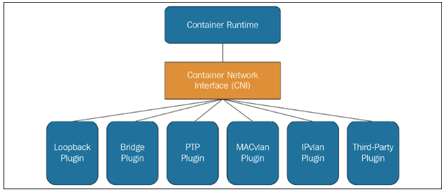
Container Network Interface(CNI)
CNCF project to standardize container networking plugins.
CNI defines specifications/API for writing container networking plugins
An interface between container runtime(ex: kubernetes) and the network implementation
CNI plugins conﬁgures the network interfaces and routes
CNI concerns itself only with network connectivity of containers and removing allocated resources when the container is deleted
CNI consists of three components
CNI specification : defines an API between runtimes and network plugins for container network setup
Library : provide a Go implementation of the CNI specification that runtimes can use to more easily consume CNI
Plugin : provide network setup for a variety of use-cases and serve as reference examples of plugins conforming to the CNI specification

Slide 4
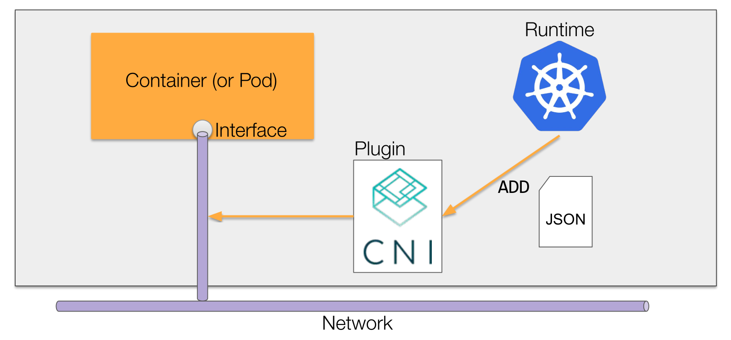
How CNI fits in

Slide 5
How a CNI plugin is being used in K8S
Host Network namespace
API Server
Kubelet
Schedule a Pod
br

Slide 6
How a CNI plugin is being used in K8S
API Server
Kubelet
CRI
Host Network namespace
Create pod network ns
Pod Network Namespace
br
lo

Slide 7
How a CNI plugin is being used in K8S
API Server
Kubelet
CNI
CNI_COMMAND:ADD
CRI
Host Network namespace
Pod Network Namespace
br
lo

Slide 8
How a CNI plugin is being used in K8S
API Server
Kubelet
CNI
CRI
Host Network namespace
Create eth0
Allocate IP
Define routes
Pod Network Namespace
eth0
br
lo

Slide 9
How a CNI plugin is executed?
Container info
env vars
CNI
CNI config
stdin

Slide 10
How a CNI plugin is executed?
CNI_COMMAND=ADD
CNI_CONTAINERID=b784318..
CNI_NETNS=/proc/12345/ns/net
CNI_IFNAME=eth0
Container info
env vars
CNI
CNI config
{
"cniVersion" : "0.3.1" ,
"name" : "my-cni-demo" ,
"type" : "my-cni-demo" ,
"podcidr" : "10.240.0.0/24"
}
stdin
Configuration fed to plugin on stdin for each operation

Slide 11
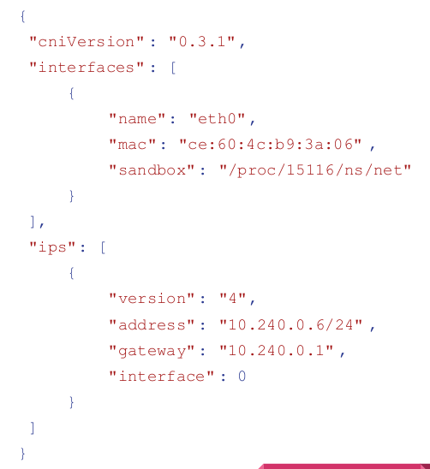
How a CNI plugin is executed?
Container info
env vars
CNI
CNI config
stdin

Slide 12
CNI
Runtime
Container Runtime must create network namespace.
Identify network the container must attach to
Container Runtime to invoke Network plugin (bridge) when container added.
Container Runtime to invoke Network plugin (bridge) when container Deleted.
Json format of the network configuration.
CNI commands and network config
Config
CNI plugin
Must support command line arguments of ADD/DEL/GET
Must support parameters such as container id, network ns etc,
Must manage ip address assignment to pods.
Must return results in a specific format
Configures/manage network

Slide 13
CNI Specifications - Summary
A format for administrators to define network configuration.
A protocol for container runtimes to make requests to network plugins.
A procedure for executing plugins based on a supplied configuration.
A procedure for plugins to delegate functionality to other plugins.
Data types for plugins to return their results to the runtime.

Slide 14
Network configuration format
{
"cniVersion": "1.0.0",
"name": "dbnet",
"plugins": [
{
"type": "bridge",
// plugin specific parameters
"bridge": "cni0",
"keyA": ["some more", "plugin specific", "configuration"],
"ipam": {
"type": "host-local",
// ipam specific
"subnet": "10.1.0.0/16",
"gateway": "10.1.0.1",
"routes": [
{"dst": "0.0.0.0/0"}
]
},
"dns": {
"nameservers": [ "10.1.0.1" ]
}
},
{
"type": "tuning",
"capabilities": {
"mac": true
},
"sysctl": {
"net.core.somaxconn": "500"
}
},
{
"type": "portmap",
"capabilities": {"portMappings": true}
}
]
}
CNI defines a network configuration format for administrators. It contains directives for both the container runtime as well as the plugins to consume. At plugin execution time, this configuration format is interpreted by the runtime and transformed in to a form to be passed to the plugins.
A network configuration consists of a JSON object with the following keys:
cniVersion (string): Semantic Version 2.0 of CNI specification to which this configuration list and all the individual configurations conform. Currently “1.0.0”
name (string): Network name. This should be unique across all network configurations on a host (or other administrative domain). Must start with an alphanumeric character, optionally followed by any combination of one or more alphanumeric characters, underscore, dot (.) or hyphen (-).
disableCheck (boolean): Either true or false. If disableCheck is true, runtimes must not call CHECK for this network configuration list. This allows an administrator to prevent CHECKing where a combination of plugins is known to return spurious errors.
plugins (list): A list of CNI plugins and their configuration, which is a list of plugin configuration objects.
Required Keys
type (string): Matches the name of the CNI plugin binary on disk. Must not contain characters disallowed in file paths for the system (e.g. / or \).
Optional keys, well-known: Plugins that consume any of these configuration keys should respect their intended semantics.
ipMasq (boolean): If supported by the plugin, sets up an IP masquerade on the host for this network. This is necessary if the host will act as a gateway to subnets that are not able to route to the IP assigned to the container.
ipam (dictionary): Dictionary with IPAM (IP Address Management) specific values:
type (string): Refers to the filename of the IPAM plugin executable. Must not contain characters disallowed in file paths for the system (e.g. / or \).
dns (dictionary, optional): Dictionary with DNS specific values:
nameservers (list of strings, optional): list of a priority-ordered list of DNS nameservers that this network is aware of. Each entry in the list is a string containing either an IPv4 or an IPv6 address.
domain (string, optional): the local domain used for short hostname lookups.
search (list of strings, optional): list of priority ordered search domains for short hostname lookups. Will be preferred over domain by most resolvers.
options (list of strings, optional): list of options that can be passed to the resolver

Slide 15
2. Execution Protocol
The CNI protocol is based on execution of binaries invoked by the container runtime. CNI defines the protocol between the plugin binary and the runtime. The runtime passes parameters to the plugin via environment variables and configuration. It supplies configuration via stdin.
Protocol parameters are passed to the plugins via OS environment variables.
CNI_COMMAND: indicates the desired operation; ADD, DEL, CHECK, or VERSION.
CNI_CONTAINERID: Container ID. A unique plaintext identifier for a container, allocated by the runtime. Must not be empty. Must start with an alphanumeric character, optionally followed by any combination of one or more alphanumeric characters, underscore (), dot (.) or hyphen (-).
CNI_NETNS: A reference to the container’s “isolation domain”. If using network namespaces, then a path to the network namespace (e.g. /run/netns/[nsname])
CNI_IFNAME: Name of the interface to create inside the container; if the plugin is unable to use this interface name it must return an error.
CNI_ARGS: Extra arguments passed in by the user at invocation time. Alphanumeric key-value pairs separated by semicolons; for example, “FOO=BAR;ABC=123”
CNI_PATH: List of paths to search for CNI plugin executables. Paths are separated by an OS-specific list separator; for example ‘:’ on Linux and ‘;’ on Windows

Slide 16
2. Execution Protocol
CNI operations:
CNI defines 4 operations: ADD, DEL, CHECK, and VERSION. These are passed to the plugin via the CNI_COMMAND environment variable.
ADD: Add container to network, or apply modifications
A CNI plugin, upon receiving an ADD command, should either
create the interface defined by CNI_IFNAME inside the container at CNI_NETNS, or
adjust the configuration of the interface defined by CNI_IFNAME inside the container at CNI_NETNS.
DEL: Remove container from network, or un-apply modifications
A CNI plugin, upon receiving a DEL command, should either
delete the interface defined by CNI_IFNAME inside the container at CNI_NETNS, or
undo any modifications applied in the plugin’s ADD functionality
CHECK: Check container’s networking is as expected
CHECK is a way for a runtime to probe the status of an existing container.
VERSION: probe plugin version support

Slide 17
3. Execution of network configurations
Lifecycle & Ordering
The container runtime must create a new network namespace for the container before invoking any plugins.
The container runtime must not invoke parallel operations for the same container, but is allowed to invoke parallel operations for different containers. This includes across multiple attachments.
Plugins must handle being executed concurrently across different containers. If necessary, they must implement locking on shared resources (e.g. IPAM databases).
The container runtime must ensure that add is eventually followed by a corresponding delete. The only exception is in the event of catastrophic failure, such as node loss. A delete must still be executed even if the add fails.
delete may be followed by additional deletes.
The network configuration should not change between add and delete.
The network configuration should not change between attachments.

Slide 18
3a. Adding an attachment
The operation of a network configuration on a container is called an attachment.
For every configuration defined in the plugins key of the network configuration,
Look up the executable specified in the type field. If this does not exist, then this is an error.
Derive request configuration from the plugin configuration, with the following parameters:
If this is the first plugin in the list, no previous result is provided,
For all additional plugins, the previous result is the result of the previous plugins.
Execute the plugin binary, with CNI_COMMAND=ADD. Provide parameters defined above as environment variables. Supply the derived configuration via standard in.
If the plugin returns an error, halt execution and return the error to the caller.

Slide 19
3b.Deleting an attachment
Deleting a network attachment is much the same as adding, with a few key differences:
The list of plugins is executed in reverse order
The previous result provided is always the final result of the add operation.
For every plugin defined in the plugins key of the network configuration, in reverse order,
Look up the executable specified in the type field. If this does not exist, then this is an error.
Derive request configuration from the plugin configuration, with the previous result from the initial add operation.
Execute the plugin binary, with CNI_COMMAND=DEL. Provide parameters defined above as environment variables. Supply the derived configuration via standard in.
If the plugin returns an error, halt execution and return the error to the caller.

Slide 20
4. Plugin Delegation
CNI plugin may wish to delegate some functionality to another plugin. One common example of this is IP address management.
Delegated Plugin protocol
Like CNI plugins, delegated plugins are invoked by running an executable. The executable is searched for in a predefined list of paths, indicated to the CNI plugin via CNI_PATH. The delegated plugin must receive all the same environment variables that were passed in to the CNI plugin. Just like the CNI plugin, delegated plugins receive the network configuration via stdin and output results via stdout.
Delegated plugin execution procedure
When a plugin executes a delegated plugin, it should:
Look up the plugin binary by searching the directories provided in CNI_PATH environment variable.
Execute that plugin with the same environment and configuration that it received.
Ensure that the delegated plugin’s stderr is output to the calling plugin’s stderr.

Slide 21
5. Result Types
Plugins can return one of three result types:
Success (or Abbreviated Success)
Error
_Version
Success:
Plugins provided a prevResult key as part of their request configuration must output it as their result, with any possible modifications made by that plugin included. If a plugin makes no changes that would be reflected in the Success result type, then it must output a result equivalent to the provided prevResult.
Plugins must output a JSON object with the following keys upon a successful ADD operation:
cniVersion: The same version supplied on input - the string “1.0.0”
interfaces: An array of all interfaces created by the attachment, including any host-level interfaces:
name: The name of the interface.
mac: The hardware address of the interface (if applicable).
sandbox: The isolation domain reference (e.g. path to network namespace) for the interface, or empty if on the host. For interfaces created inside the container, this should be the value passed via CNI_NETNS.
ips: IPs assigned by this attachment.
address (string): an IP address in CIDR notation (eg “192.168.1.3/24”).
gateway (string): the default gateway for this subnet, if one exists.
interface (uint): the index into the interfaces list for a CNI Plugin Result indicating which interface this IP configuration should be applied to.
routes: Routes created by this attachment:
dst: The destination of the route, in CIDR notation
gw: The next hop address. If unset, a value in gateway in the ips array may be used.
dns: a dictionary consisting of DNS configuration information
nameservers (list of strings): list of a priority-ordered list of DNS nameservers that this network is aware of. Each entry in the list is a string containing either an IPv4 or an IPv6 address.
domain (string): the local domain used for short hostname lookups.
search (list of strings): list of priority ordered search domains for short hostname lookups. Will be preferred over domain by most resolvers.
options (list of strings): list of options that can be passed to the resolver.
Error
Plugins should output a JSON object with the following keys if they encounter an error:
cniVersion: The same value as provided by the configuration
code: A numeric error code, see below for reserved codes.
msg: A short message characterizing the error.
details: A longer message describing the error
Version
Plugins must output a JSON object with the following keys upon a VERSION operation:
cniVersion: The value of cniVersion specified on input
supportedVersions: A list of supported specification versions

Slide 22
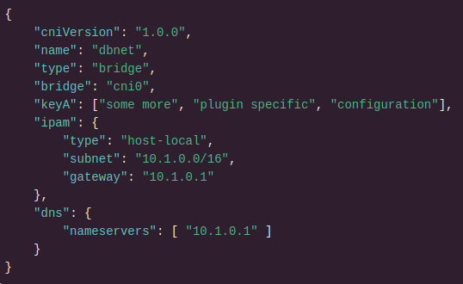
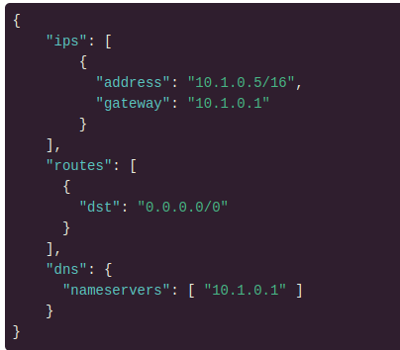
Add example
The container runtime would perform the following steps for the add operation.
1. Call the bridge plugin with the following JSON, CNI_COMMAND=ADD:
2. The host-local plugin returns the following result:
The bridge plugin, as it delegates IPAM to the host-local plugin, would execute the host-local binary with the exact same input, CNI_COMMAND=ADD.

Slide 23
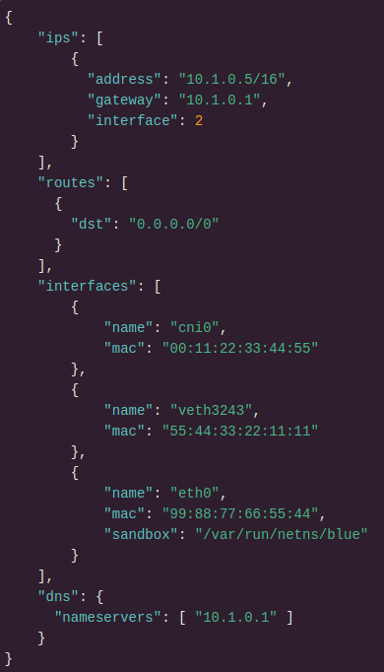
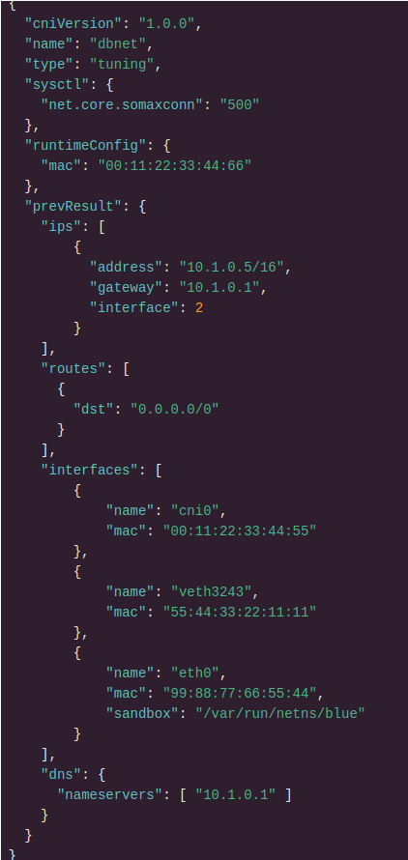
3. The bridge plugin returns the following result, configuring the interface according to the delegated IPAM configuration:
4. Next, call the tuning plugin, with CNI_COMMAND=ADD. Note that prevResult is supplied, along with the mac capability argument. The request configuration passed is:

Slide 24
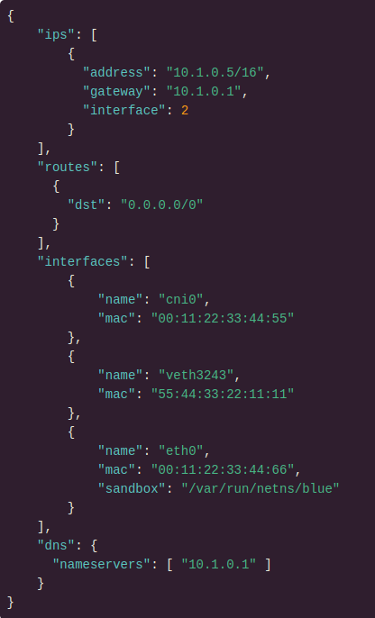
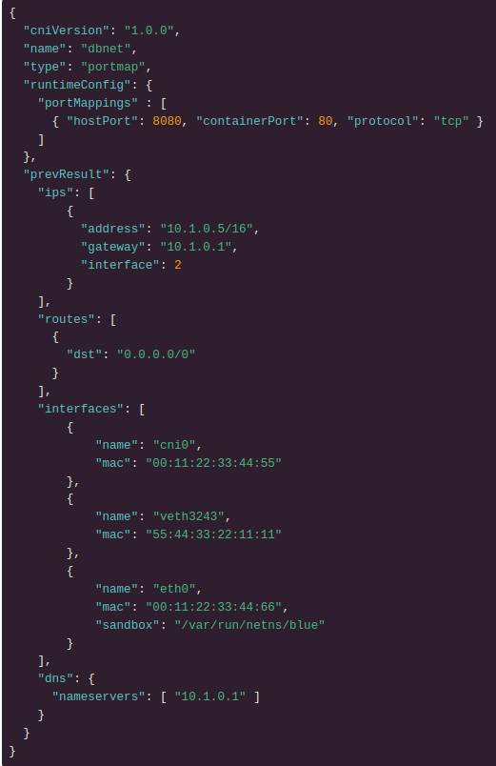
5. The plugin returns the following result. Note that the mac has changed.
6. Finally, call the portmap plugin, with CNI_COMMAND=ADD. Note that prevResult matches that returned by tuning:
The portmap plugin outputs the exact same result as that returned by bridge, as the plugin has not modified anything that would change the result (i.e. it only created iptables rules).

Slide 25
CNI Reference Plugins
Main: interface-creating
bridge : Creates a bridge, adds the host and the container to it
ipvlan : Adds an ipvlan interface in the container
macvlan : Creates a new MAC address, forwards all traffic to that to the container
ptp : Creates a veth pair
host-device : Moves an already-existing device into a container
vlan : Creates a vlan interface off a master
Windows: windows specific
win-bridge : Creates a bridge, adds the host and the container to it
win-overlay : Creates an overlay interface to the container
IPAM: IP address allocation
dhcp : Runs a daemon on the host to make DHCP requests on behalf of a container
host-local : Maintains a local database of allocated IPs
static : Allocates static IPv4/IPv6 addresses to containers
Meta: other plugins
tuning : Changes sysctl parameters of an existing interface
portmap : An iptables-based portmapping plugin. Maps ports from the host’s address space to the container
bandwidth : Allows bandwidth-limiting through use of traffic control tbf (ingress/egress)
sbr : A plugin that configures source based routing for an interface (from which it is chained)
firewall : A firewall plugin which uses iptables or firewalld to add rules to allow traffic to/from the container

Slide 26
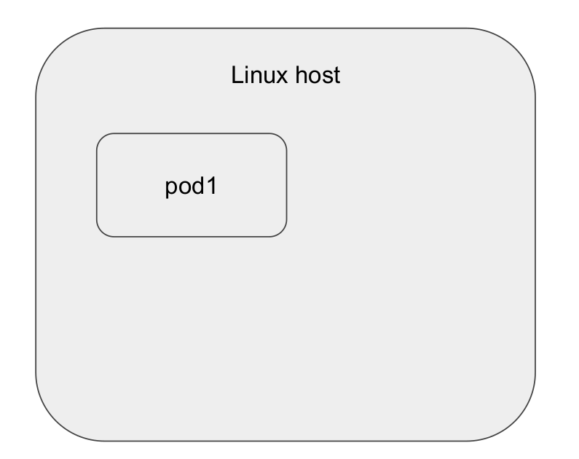
Anatomy of pod networking

Slide 27
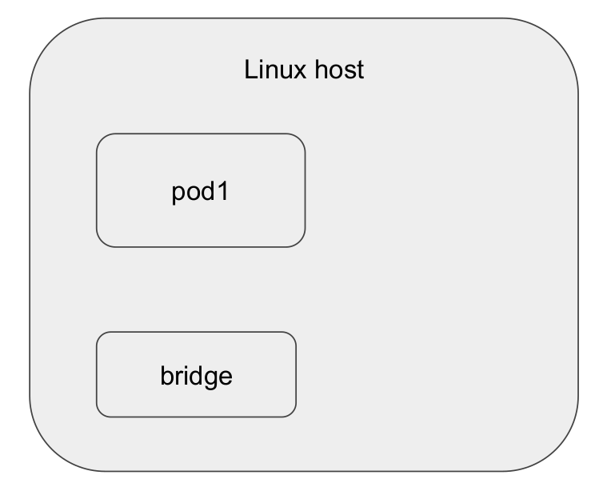
Anatomy of pod networking

Slide 28
Anatomy of pod networking

Slide 29
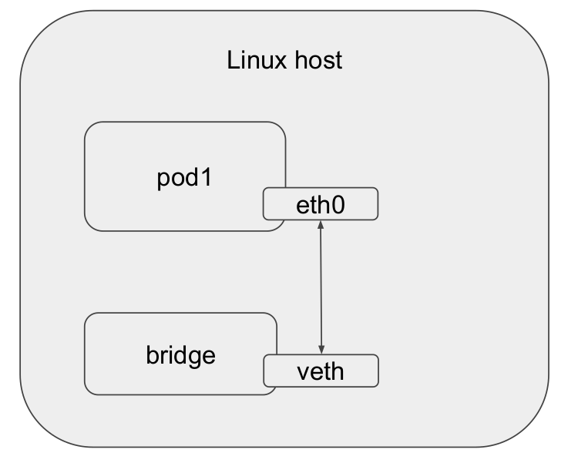
Anatomy of pod networking

Slide 30
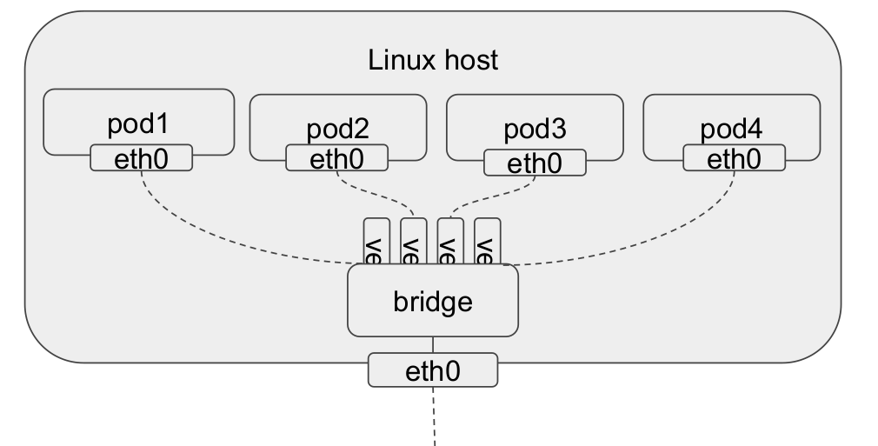
Anatomy of pod networking

Slide 31
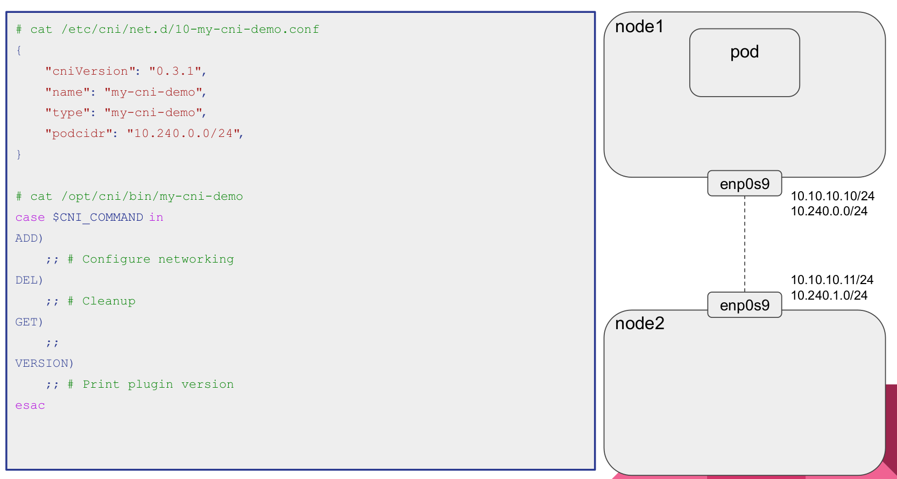

Slide 32
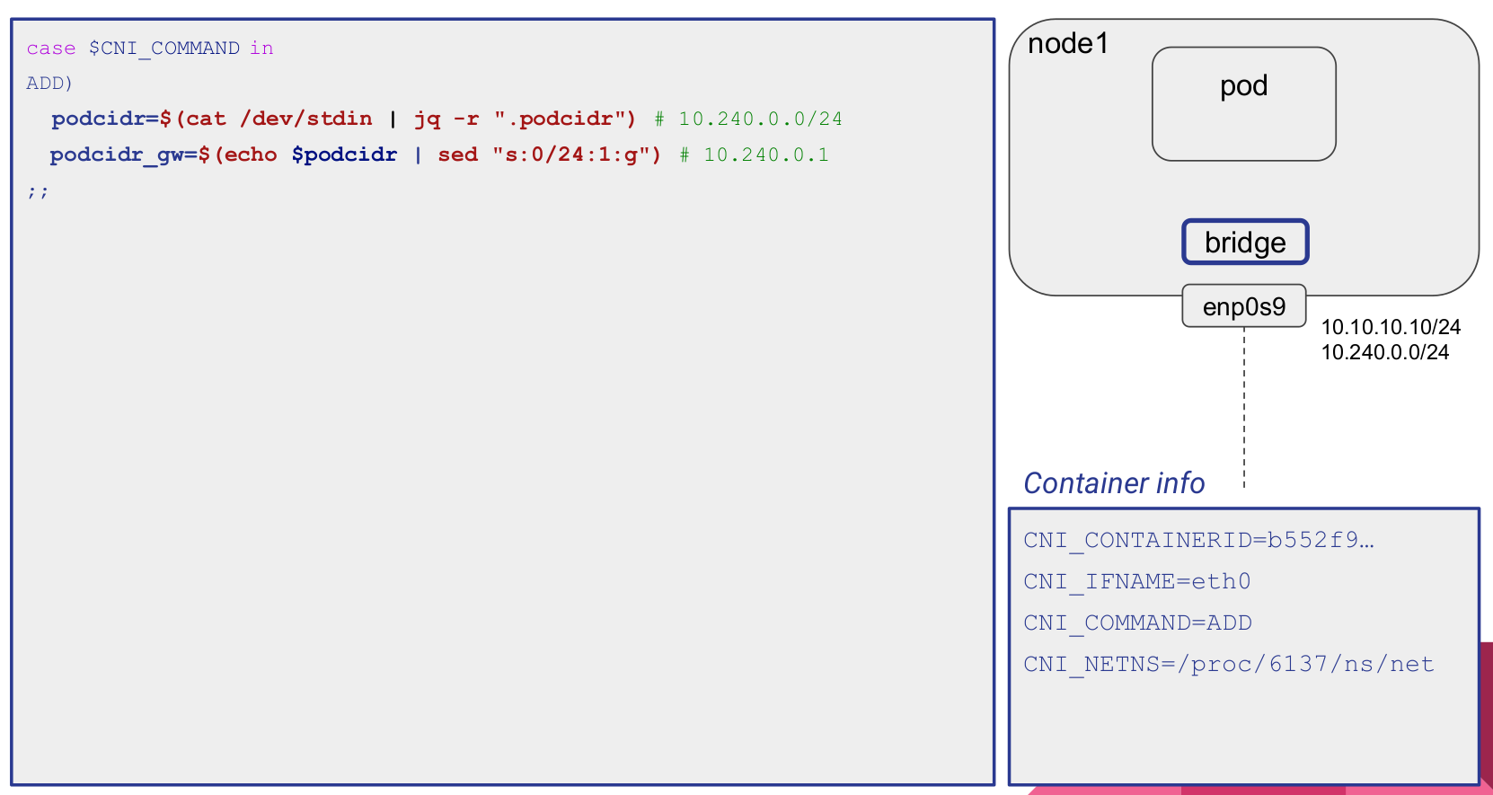

Slide 33
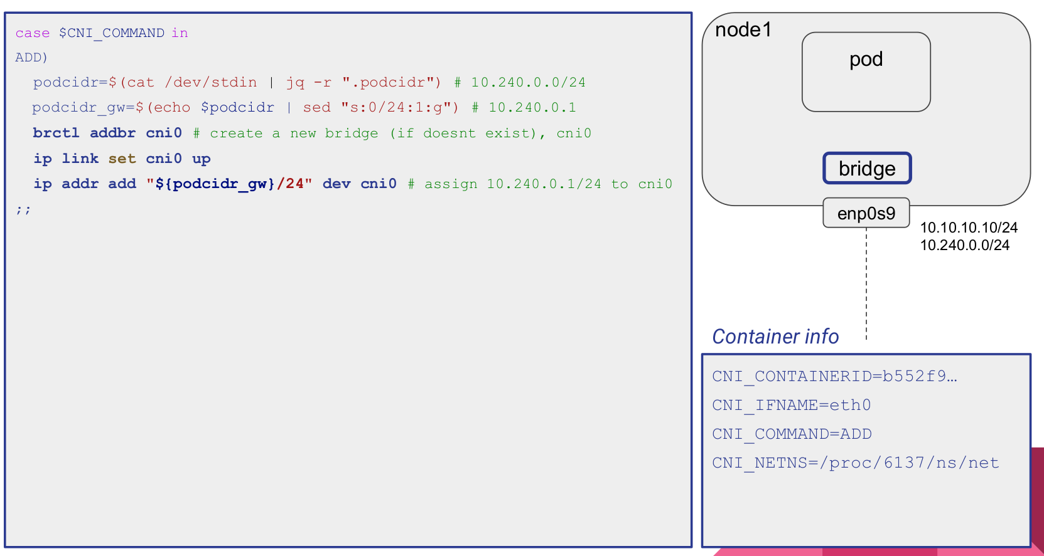

Slide 34
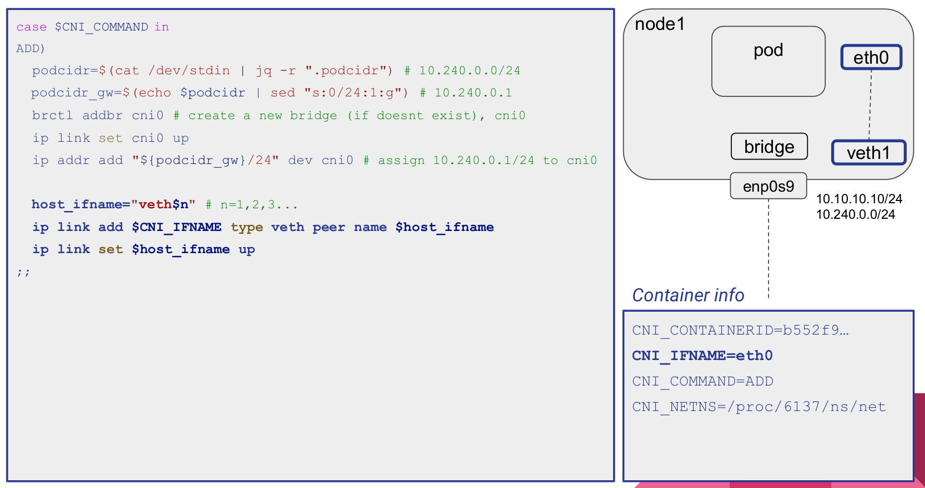

Slide 35
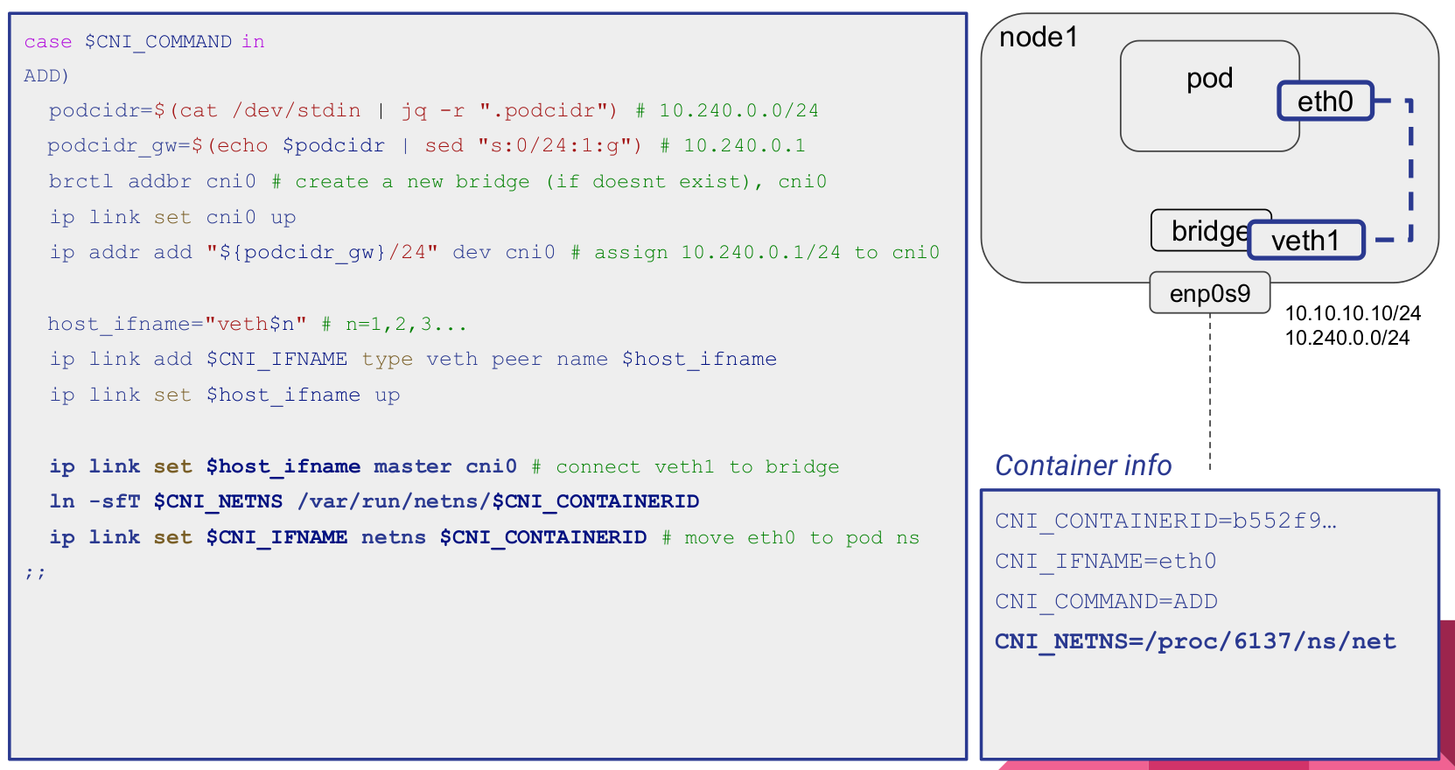

Slide 36
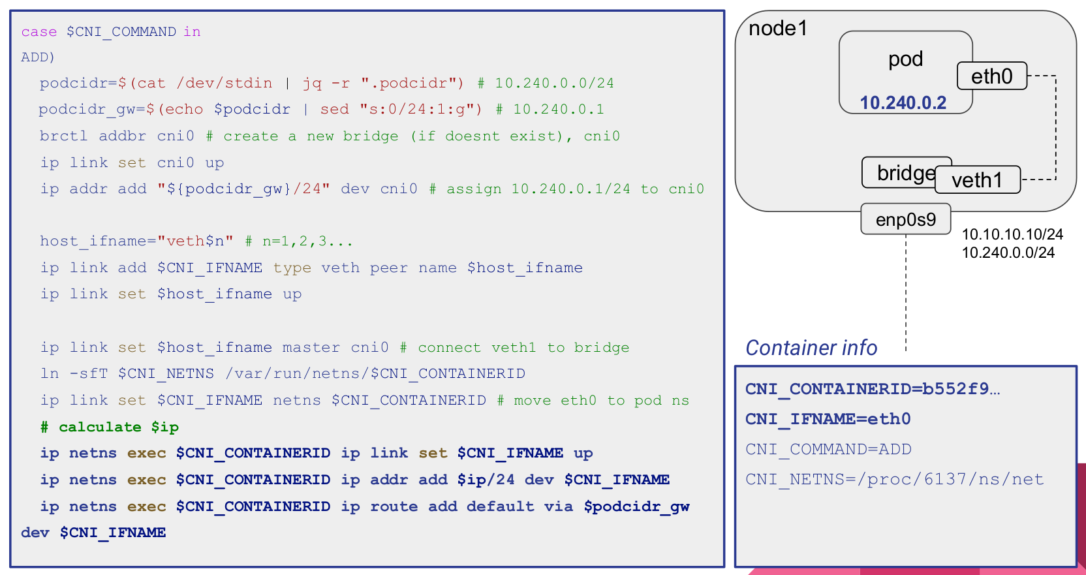

Slide 37
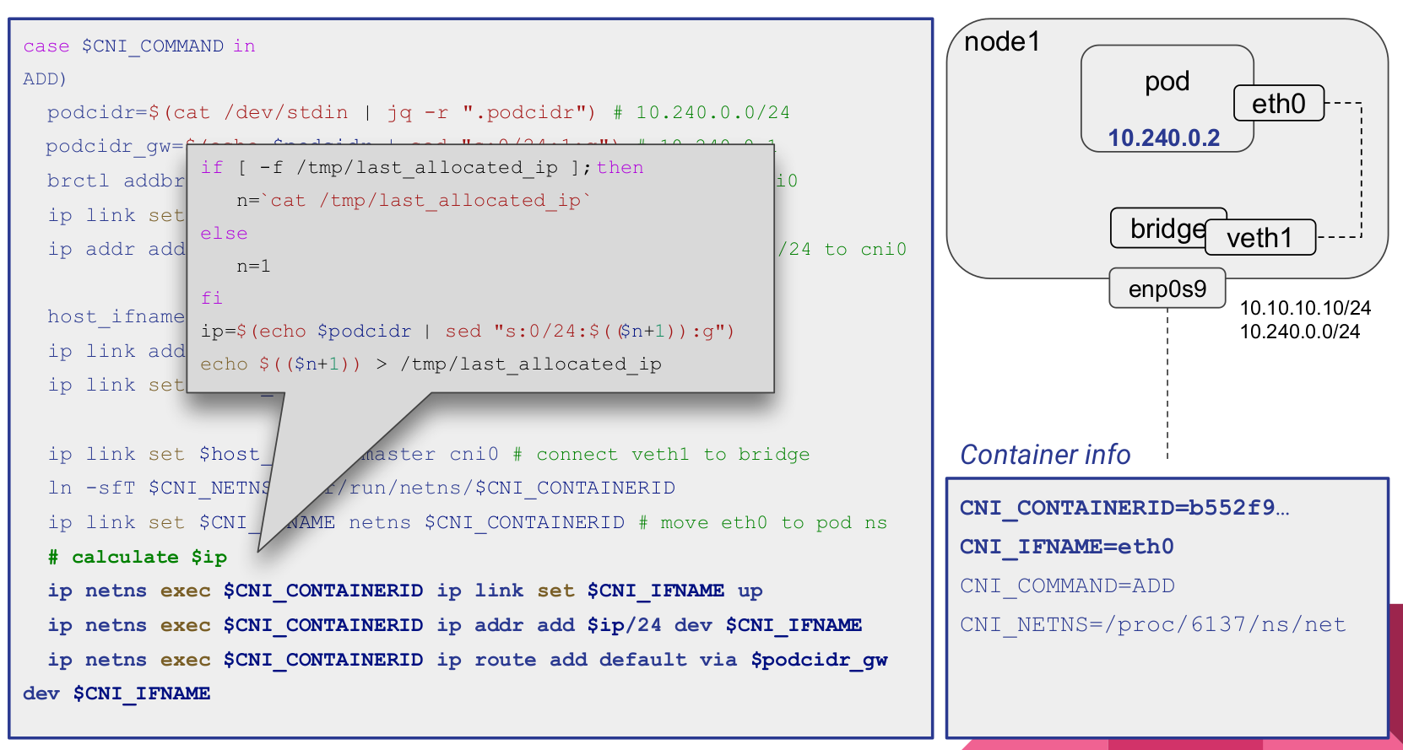

Slide 38
CNI plugin: Calico
To install Calico after installing the initial Kubernetes cluster, run this command:
“kubectl apply -f https://docs.projectcalico.org/manifests/calico.yaml”
The Calico CNI IPAM plugin allocates IP addresses for pods out of one or more configurable IP address ranges, dynamically allocating small blocks of IPs per node as required.
The default encapsulation for Calico is IP-in-IP protocol, which involves wrapping a Layer 3 IP packet inside an extra IP header.
Uses “Border Gateway Protocol” (BGP) to share and exchange routes info between nodes to facilitate POD network communication.
CRC Checksum
Destination MAC Addr
Source MAC Addr
Source IP
Destination IP
MAC Header
Source IP
Destination IP
Ethernet Frame

Slide 39
kube-node1-cal
kube-master-cal
eth0: 172.16.94.5
eth0: 172.16.94.6
eth0: 172.16.61.206
eth0: 172.16.61.207
Calic7d01d52dfb
Calic91e3ae7866
Califb43d1590f7
Cali33b17198513
tunnel0: 172.16.94.0
tunnel0: 172.16.61.192
IP-in-IP
transformation
eth0:192.168.0.41
eth0:192.168.0.40

Slide 40
Border Gateway Protocol: BGP
BGP is a standardized exterior gateway protocol designed to exchange routing and reachability information among autonomous systems(AS) on the Internet. It makes routing decisions based on paths, network policies, or rule-sets configured by a network administrator. It has two major functions:
Who on the internet I can send packet to.
Make a decision which route should a packet take. Routers in participating BGP peers periodically exchange route information about what autonomous systems they have direct connections to.
A:0
B:1
C:1
D:B:2
D:C:2
A:0
B:1
C:1
B:0
A:1
D:1
C:A:2
Network A
Network B
C:0
A:1
D:1
B:A:2
B:D:2
Network C
Network D
D:0
C:1
B:1
A:B:2
A:C:2

Slide 41
How Calico Leverages BGP
By default Calico creates a full-mesh of internal BGP(iBGP) connections where each node peers with each other. This allows Calico to operate over any L2 network, whether public cloud or private cloud, or, if IPIP is configured, to operate as an overlay over any network that does not block IPIP traffic. Calico does not use BGP for VXLAN overlays.
Route reflectors: To build large clusters of internal BGP(iBGP), BGP route reflectors can be used to reduce the number of BGP peerings used on each node. In this model, some nodes act as route reflectors and are configured to establish a full mesh amongst themselves. Other nodes are then configured to peer with a subset of those route reflectors, reducing the total numbers BGP peering connections compared to full-mesh.
Top of Rack(TOR): In on-premises deployments, you can configure Calico to peer directly with your physical network infrastructure. Typically, this involves disabling Calico’s default full-mesh behavior, and instead peer Calico with your L3 ToR routers.
Kubernetes Cluster
Node A
Node B
Virtual Router
Virtual Router
Node C
Node D
Virtual Router
Virtual Router

Slide 42
K8S API Server
1
kubelet
Bird(BGP Agent)
Bird(BGP)
Felix
8
9
2
Felix
Host Network Namespace
Host Network Namespace
4
7
CRI
Adds Route to Container
CNI plugin
Route Table
Route Table
3
Destination Gateway Genmask Iface
172.16.94.5 0.0.0.0 255.255.255.255 calicX
Destination Gateway Genmask Iface
172.16.94.0 kube-node1-cal 255.255.255.192 tunl0
6
5
POD Network Namespace
Adds veth pair
Moves host side veth to host
tunnel0: 172.16.61.192
Sets Default Route
eth0
172.16.94.5
calicX
eth0: 192.168.0.41
eth0: 192.168.0.40

Slide 43
Calico On-Prem Networking Options
Non-overlay network. This is the most performant option as there is no encapsulation involved .
BGP to peer with TOR(Top of Rack). This method uses BGP to peer with the physical network(TOR) to make pod IPs routable outside of the cluster.
Single L2 non-routable. If peering BGP to the physical network is not an option, we can also run non-overlay mode if the cluster is within a single L2 network, with Calico just peering BGP between the nodes in the cluster. Even though this is not strictly an overlay network, the pod Ips are not routable outside of the cluster, because the broader network does not have routes for the pod IPs.
Cross-subnet overlay. If nodes are on multiple subnets, we can run Calico in either VXLAN or IP-in-IP overlay mode, with cross-subnet overlay mode to optimize performance within each L2 subnet.
Overlay network. If none of the above options can be leveraged, we can run Calico in full overlay mode. Options are “IP-in-IP” or “VXLAN”.

Slide 44
Kubernetes Network Policy
The main features of Kubernetes policies are:
Policies are namespace scoped (i.e. you create them within the context of a specific namespace just like, for example, pods)
Policies are applied to pods using label selectors
Policy rules can specify the traffic that is allowed to/from other pods, namespaces, or CIDRs
Policy rules can specify protocols(TCP, UDP, SCTP), named ports or port numbers
Kubernetes itself does not enforce network policies, and instead delegates their enforcement to network plugins. Most network plugins implement the mainline elements of kubernetes network policies, though not all implement every feature of the specification.

Slide 45
Calico Network Policy
Policies can be applied to any kind of endpoint: pods/containers/VMs/host interfaces
Policy rules support
Actions: Allow, Deny, Log
Source and destination match criteria
Ports: numbered ports in a range and kubernetes named ports
Protocols: TCP, UDP, ICMP, SCTP, UDPLite, ICMPv6, Protocol numbers (1-255)
HTTP attributes (if using istio service mesh)
ICMP attributes
IP or CIDR

Slide 46
Calico network policy concepts
Endpoints: Calico network policies apply to endpoints. In kubernetes, each pod is a calico endpoint. However, Calico can support other kinds of endpoints. There are two types of calico endpoints: workload endpoints(such as kubernetes pod or openstack VM) and host endpoints(an interface or group of interfaces on a host).
Namespaced and global network policies:
Calico network policy is a namespaced resource that applies to pods/containers/VMs in that namespace:
apiVersion: projectcalico.org/v3
kind:NetworkPolicy
metadata:
name: cal-allow-ingress-from-svc
namespace: products-prod
Calico global network policy is a non namespaced resource and can be applied to any kind of endpoints(pods, VMs, host interfaces) Independent of namespace:
apiversion: projectcalico.org/v3
kind: GlobalNetworkPolicy
metadata:
name: allow-nodeport-30007

Slide 47
Calico Host Endpoints
A HostEndpoint resource represents one or more real or virtual interfaces that are attached to a host running Calico. It enforces Calico network policy on the traffic entering or leaving the Host’s default network namespace through those interfaces.
A host endpoint with interfaceName: * represents all of a host’s real or virtual interfaces
A host endpoint for one specific real interface is configured by interfaceName: <name of the interface> ex: interfaceName: eth0. Or by leaving the interface name empty and including one of the interfaces ips in expected ips.

Slide 48
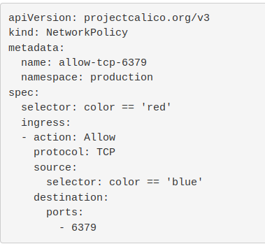
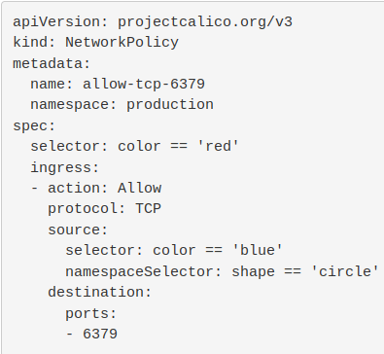
Control traffic to/from endpoints in a namespace
In the following example, ingress traffic to endpoints in the namespace: production with label color: red is allowed, only if it comes from a pod in the same namespace with color: blue, on port 6379.
To allow ingress traffic from endpoints in other namespaces, use a namespaceSelector in the policy rule. A namespaceSelector matches namespaces based on the labels that are applied in the namespace. In the following example, ingress traffic is also allowed from endpoints in namespaces that match shape == circle.

Slide 49
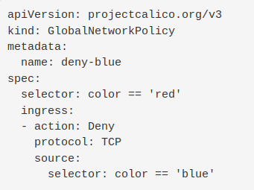
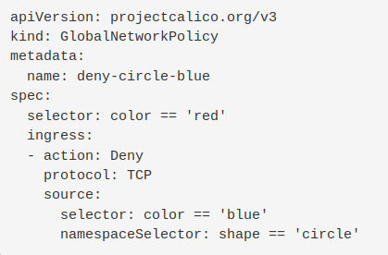
Control traffic to/from endpoints independent of namespace
The following Calico network policy is similar to the previous example, but uses kind: GlobalNetworkPolicy so it applies to all endpoints, regardless of namespace.
In the following example, incoming TCP traffic to any pods with label color: red is denied if it comes from a pod with color: blue.
As with kind: NetworkPolicy, you can allow or deny ingress traffic from endpoints in specific namespaces using a namespaceSelector in the policy rule:

Slide 50
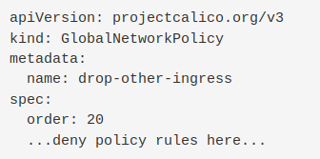
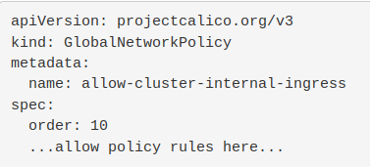
Apply network policies in specific order
To control the order/sequence of applying network policies, you can use the order field (with precedence from the lowest value to highest). Defining policy order is important when you include both action: allow and action: deny rules that may apply to the same endpoint.
In the following example, the policy allow-cluster-internal-ingress (order: 10) will be applied before the policy drop-other-ingress (order: 20).

Slide 51
Generate logs for specific traffic
In the following example, incoming TCP traffic to an application is denied, and each connection attempt is logged to syslog.
apiVersion: projectcalico.org/v3
kind: NetworkPolicy
Metadata:
name: allow-tcp-6379
namespace: production
Spec:
selector: role == 'database'
types:
- Ingress
- Egress
ingress:
- action: Log
protocol: TCP
source:
selector: role == 'frontend'
- action: Deny
protocol: TCP
source:
selector: role == 'frontend'

Slide 52
References
https://www.youtube.com/watch?v=YjjrQiJOyME
https://www.youtube.com/watch?v=U35C0EPSwoY
https://www.youtube.com/watch?v=zmYxdtFzK6s

