Slide 1
JAVA Introduction

Slide 2
Introduction
What is Java?
  Java is a general-purpose, class-based, object-oriented programming language designed for having lesser implementation dependencies. It is a computing platform for application development.
  Java is fast, secure, and reliable, therefore. It is widely used for developing Java applications in data centers, game consoles, scientific supercomputers, cell phones, etc.
  Java was developed by Sun Microsystems (which is now the subsidiary of Oracle) in the year 1995. James Gosling is known as the father of Java
What is Java Platform?
  Java Platform is a collection of programs that help programmers to develop and run Java programming applications efficiently. It includes an execution engine, a compiler, and a set of libraries in it.
What is Java used for?
  It is used for developing Android Apps
  Helps to create Enterprise Software
  Wide range of Mobile java Applications
  Scientific Computing Applications
  Used for Big Data Analytics
  Smart Card
  Robotics

Slide 3
Java Features
Java Features
  Simple: Java is very easy to learn, and its syntax is simple, clean and easy to understand.
  Object oriented: Everything in Java is an object. Object-oriented means we organize our software as a combination of different types of objects that incorporate both data and behavior.
  Platform Independent: Java is platform independent because it is different from other languages like C, C++, etc. which are compiled into platform specific machines while Java is a write once, run anywhere language
  Secured: Java is best known for its security. With Java, we can develop virus-free systems. Java is secured because: No explicit pointer and Java Programs run inside a virtual machine sandbox
  Robust: It uses strong memory management and there is a lack of pointers that avoids security problems.
  High performance: Java is faster than other traditional interpreted programming languages because Java bytecode is "close" to native code. It is still a little bit slower than a compiled language (e.g., C++)
  MultiThreaded: A thread is like a separate program, executing concurrently. We can write Java programs that deal with many tasks at once by defining multiple threads.
  Potable: Because it facilitates you to carry the Java bytecode to any platform. It doesn't require any implementation.
Components Of Java Programming Language
  A Java Programmer writes a program in a human-readable language called Source Code. Therefore, the CPU never understand the source code written in any programming language.
  These computers understand only one thing, which is called machine language. These machine codes run at the CPU level.
  However, no need to worry about the machine code, as programming is all about the source code. The machine understands this source code and translates them into machine understandable code, which is an executable code.
  All these functionalities happen inside the following Java platform components

Slide 4
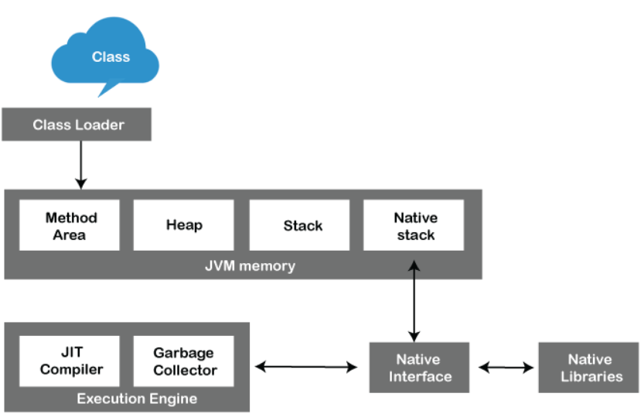
Components of Java Architecture
The Java architecture includes the three main components:
  Java Virtual Machine (JVM)
  Java Runtime Environment (JRE)
  Java Development Kit (JDK)
Java Virtual Machine
  The main feature of Java is WORA. WORA stands for Write Once Run Anywhere. The feature states that we can write our code once and use it anywhere or on any operating system.
JVM Architecture:
  JVM is an abstract machine that
  provides the environment in which Java
  bytecode is executed. The falling figure
  represents the architecture of the JVM.
  ClassLoader: ClassLoader is a subsystem
  used to load class files. ClassLoader first
  loads the Java code whenever we run it.
  Class Method Area: In the memory, there is an area where the class data is stored during the code's execution. Class method area holds the information of static variables, static methods, static blocks, and instance methods.

Slide 5
Components of Java Architecture
Heap: The heap area is a part of the JVM memory and is created when the JVM starts up. Its size cannot be static because it increase or decrease during the application runs.
Stack: It is also referred to as thread stack. It is created for a single execution thread. The thread uses this area to store the elements like the local variable, data used for calling method and returns etc.
Native Stack: It contains the information of all the native methods used in the application.
Execution Engine: It is the central part of the JVM. Its main task is to execute the byte code and execute the Java classes.
  Interpreter: It converts the byte code into native code and executes. It sequentially executes the code. The interpreter interprets continuously and even the same method multiple times. This reduces the performance of the system, and to solve this, the JIT compiler is introduced.
  JIT Compiler: JIT compiler is introduced to remove the drawback of the interpreter. It increases the speed of execution and improves performance.
  Garbage Collector: The garbage collector is used to manage the memory, and it is a program written in Java.
Java Native Interface: Java Native Interface works as a mediator between Java method calls and native libraries.

Slide 6
Java Development kit (JDK)
JDK is a software development environment used for making Java applications.
Java developers can use it on Windows, macOS, and Linux. JDK helps them to code and run Java programs. It is possible to install more than one JDK version on the same computer.
Why use JDK?
  JDK contains tools required to write Java programs and JRE to execute them.
  It includes a compiler, Java application launcher, etc.
  Compiler converts code written in Java into byte code.
  Java application launcher opens a JRE, loads the necessary class, and executes its main method.
Java Virtual Machine (JVM):
  Java Virtual Machine (JVM) is an engine that provides a runtime environment to drive the Java Code or applications. In other programming languages, the compiler produces machine code for a particular system. However, the Java compiler produces code for a Virtual Machine known as Java Virtual Machine.

Slide 7
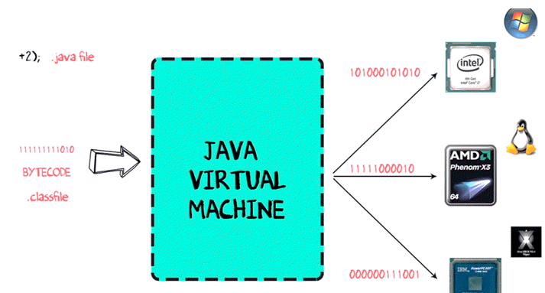
Java Virtual Machine
Why JVM
  JVM provides a platform-independent way of executing Java source code.
  It has numerous libraries, tools, and frameworks.
  Once you write a Java program, you can run on any platform and save lots of time.
Java Runtime Environment (JRE)
  JRE is a piece of software that is designed to run the software. It contains the class libraries, loader class, and JVM. In simple terms, if you want to run a Java program, you need JRE. If you are not a programmer, you don’t need to install JDK, but just JRE to run Java programs.
How Java Virtual Machine works?
  The code to display the addition of two numbers is System.out.println(1+2), and saved as a .java file.
  Using the java compiler the code is converted into an intermediate code called the bytecode. The output is a .class file.
  This code is not understood by any platform, but only a virtual platform called the Java Virtual Machine.
  This Virtual Machine resides in the RAM of your operating
  system. When the Virtual Machine is fed with this bytecode,
  it identifies the platform it is working on and converts the
  bytecode into the native machine code.
  While working on PC or browsing the web, whenever
  you see either of these icons, be assured the java virtual
  machine is loaded into your RAM. But what makes Java
  lucrative is that code, once compiled, can run not only on all
  PC platforms but also on mobiles or other electronic gadgets
  supporting Java.

Slide 8
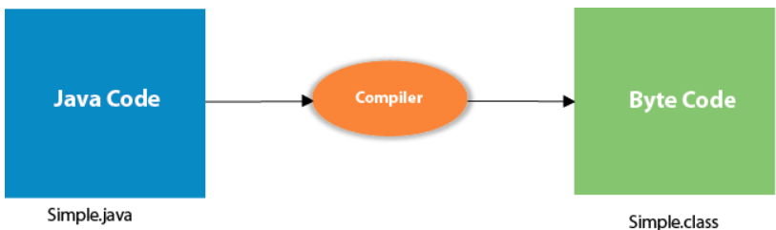
Create HelloWorld Example
class Simple{
public static void main(String args[]){
System.out.println("Hello Java");
  }
}
Save the above file as Simple.java.
To compile:
  javac Simple.java
To execute:
  java Simple
Output:
  Hello Java
Compilation Flow:
When we compile Java program using javac tool, the Java compiler converts the source code into byte code.
Parameters used in First Java Program
  class keyword is used to declare a class in Java.
  public keyword is an access modifier that represents visibility. It means it is visible to all.
  static is a keyword. If we declare any method as static, it is known as the static method. The core advantage of the static method is that there is no need to create an object to invoke the static method. The main() method is executed by the JVM, so it doesn't require creating an object to invoke the main() method. So, it saves memory.
  void is the return type of the method. It means it doesn't return any value.
  main represents the starting point of the program.
  String[] args or String args[] is used for command line argument. We will discuss it in coming section.
  System.out.println() is used to print statement. Here, System is a class, out is an object of the PrintStream class, println() is a method of the PrintStream class.

Slide 9
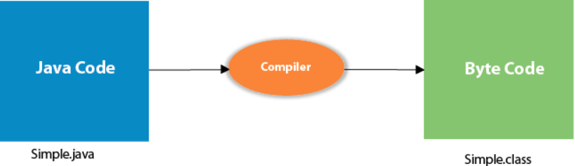
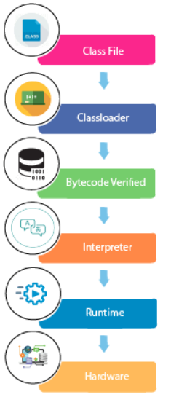
Internal Details of Hello Java Program
We have created Java Hello World program and learn how to compile and run a Java program.
What happens at compile time?
  At compile time, the Java file is compiled by Java Compiler (It does not interact with OS) and converts the Java code into bytecode.
What happens at runtime?
At runtime, the following steps are performed:
Classloader: It is the subsystem of JVM that is
used to load class files.
Bytecode Verifier: Checks the code fragments for illegal code
that can violate access rights to objects.
Interpreter: Read bytecode stream then execute the instructions.

Slide 10
Thank You

