Slide 1
Java variables, datatypes, packages and class

Slide 2
Contents
Variable Declaration and initialization
Java Naming Convention
Types of variables
Scope of variables
Datatypes in Java
Memory Allocation of Primitive, Non-primitive Data Types
Java Packages
Class in Java
Lifecycle of an object
Anonymous object in Java

Slide 3
Variable Declaration and initialization
Variables are used to represent values that may be changed in the program. In Java, all variables must be declared before they can be used. The basic form of a variable declaration is shown here:
  type identifier [ = value];
The type is one of Java’s primitive types or the name of a class or interface.
The identifier is the name of the variable. can initialize the variable by specifying an equal sign and a value.
To declare more than one variable of the specified type, use a comma-separated list.
// A Java program to demonstrate int data type
  class IntExample1 {
    public static void main(String args[])
    {
    int age; // Declaration of variable age
    age = 20; // initialization of the variable age
    System.out.println(age);
    }
  }

Slide 4
Java Naming Convention
Java naming convention is a rule to follow as you decide what to name your identifiers such as class, package, variable, constant, method, etc.
But, it is not forced to follow. So, it is known as convention not rule. These conventions are suggested by several Java communities such as Sun Microsystems
Advantage of Naming Conventions in Java
  By using standard Java naming conventions, you make your code easier to read for yourself and other programmers. Readability of Java program is very important
Naming Conventions of the Different Identifiers
  Class:
    It should start with the uppercase letter.
    It should be a noun such as Color, Button, System, Thread, etc.
  Interface
    It should start with the uppercase letter.
    It should be an adjective such as Runnable, Remote, ActionListener.
  Method
    It should start with lowercase letter.
    It should be a verb such as main(), print(), println().
    If the name contains multiple words, start it with a lowercase letter followed by an uppercase letter such as actionPerformed().
  Variable
    It should start with a lowercase letter such as id, name.
    It should not start with the special characters like &, $, and _.
  Package
    It should be a lowercase letter such as java, lang.
    If the name contains multiple words, it should be separated by dots (.) such as java.util, java.lang.
  Constant
    It should be in uppercase letters such as RED, YELLOW.
    If the name contains multiple words, it should be separated by an underscore(_) such as MAX_PRIORITY.

Slide 5
Types of variables
There are three types of variables in Java
  local variable
  instance variable
  static variable
Local Variable
  A variable declared inside the body of the method is called local variable. You can use this variable only within that method and the other methods in the class aren't even aware that the variable exists.
Instance Variable
  A variable declared inside the class but outside the body of the method, is called an instance variable. It is not declared as static
  It is called an instance variable because its value is instance-specific and is not shared among instances.
Static variable
  A variable that is declared as static is called a static variable. It cannot be local. You can create a single copy of the static variable and share it among all the instances of the class. Memory allocation for static variables happens only once when the class is loaded in the memory.

Slide 6
Types of variables
Example java program to understand the types of variables in java
  public class Student
  {
  int age = 22; //instance variable
  String name = “john” // instance variable
  static String collegeName =”xyz”; //static variable
  public void method()
  {
  int n = 90; //local variable
  }
  public static void main(String args[])
  {
  int data=50; //local variable
  }
  }//end of class

Slide 7
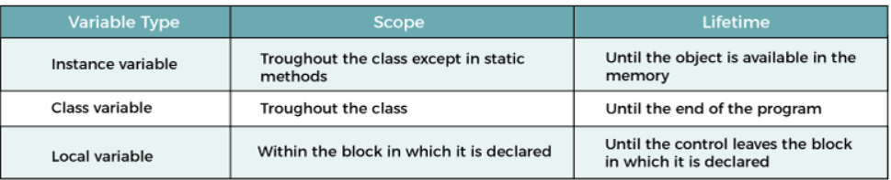
Scope of variables
In programming, scope of variable defines how a specific variable is accessible within the program.
Scope of Variable:
  In programming, a variable can be declared and defined inside a class, method, or block. Variable declared inside a block or method are not visible to outside. If we try to do so, we will get a compilation error.
  A variable can be a parameter of a method or constructor.
  A variable can be defined and declared inside the body of a method and constructor.
  It can also be defined inside blocks and loops.
  Variable declared inside main() function cannot be accessed outside the main() function

Slide 8
Datatypes
Data types specify the different sizes and values that can be stored in the variable. There are two types of data types in Java:
  Primitive data types: The primitive data types include boolean, char, byte, short, int, long, float and double.
  Non-primitive data types: The non-primitive data types include Classes, Interfaces, and Arrays.
Java Primitive Data Types
  In Java language, primitive data types are the building blocks of data manipulation. These are the basic data types available in Java language
  Java is a statically-typed programming language. It means, all variables must be declared before its use.
There are 8 types of primitive data types:
  boolean: The Boolean data type is used to store only two possible values: true and false.
  byte: The byte data type is an example of primitive data type. It is an 8-bit signed integer. Its value-range lies between -128 to 127. Its default value is 0.
  char: The char data type is a single 16-bit Unicode character. Its value-range lies between '\u0000' (or 0) to '\uffff'.The char data type is used to store characters.
  short: The short data type is a 16-bit signed integer. Its value-range lies between -32,768 to 32,767. Its default value is 0.
  int: The int data type is a 32-bit signed integer. Its value-range lies between - 2,147,483,648 to 2,147,483,647 . Its default value is 0.
  long: The long data type is a 64-bit integer. Its value-range lies between -9,223,372,036,854,775,808 to 9,223,372,036,854,775,807. Its default value is 0.
  float: The float data type is a single-precision 32-bit floating point. It is recommended to use a float (instead of double) if you need to save memory. Its default value is 0.0F.
  double: The double data type is a double-precision 64-bit floating point. Its default value is 0.0d.

Slide 9
Non-primitive data types in Java
Non-primitive data types
  Unlike primitive data types, these are not predefined. These are user-defined data types created by programmers.
  Whenever a non-primitive data type is defined, it refers a memory location where the data is stored in heap memory.
  An object reference variable lives on the stack memory and the object to which it points always lives on the heap memory. The stack holds a pointer to the object on the heap.
  In Java programming, all non-primitive data types are simply called objects that are created by instantiating a class.
Key points:
  The default value of any reference variable is null.
  Whenever we are passing a non-primitive data type to a method, we are passing the address of that object where the data is stored.

Slide 10
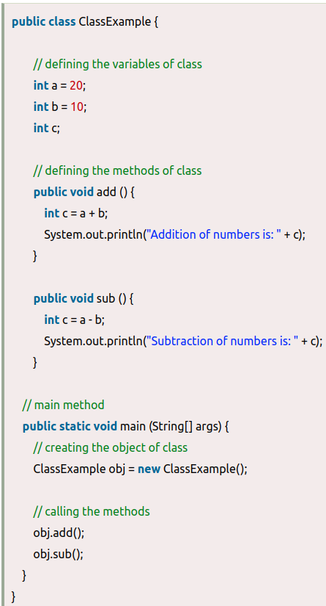
Types of Non-primitive data types
There are five types of non-primitive data types in Java. They are as follows:
  Class
  Object
  Interface
  String
  Array
Class and objects:
  Class: A class in Java is a user defined
  data type i.e. it is created by the user.
  It acts a template to the data which
  consists of member variables and methods.
  Object: An object is the instance of the
  class, which can access the elements of
  class i.e. methods and variables.
  In the following example, we are creating a class containing the variables and methods ( add() and sub() ). Here, we are accessing the methods using the object of the Class obj.

Slide 11
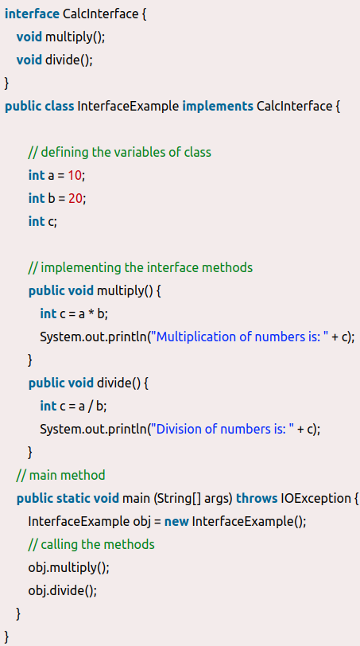
Types of Non-primitive data types
Interface: An interface is similar to a class
however the only difference is that its methods
are abstract by default i.e. they do not have body.
An interface has only the final variables and method
declarations. It is also called a fully abstract class.
Note: If the class implements an interface, it must
implement all the methods of that interface. If not,
we must declare the class as abstract.
In the following example, we are creating the interface
CalcInterface with two abstract methods ( multiply()
and divide() ). Here, the class InterfaceExample
implements the interface and further defines the
methods of that interface. Then, the object of class
is used to access those methods.

Slide 12
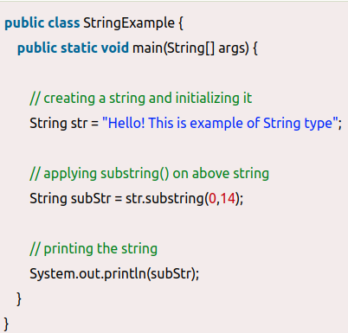
Types of Non-primitive data types
String: A string represents a sequence of characters for
example "Hello world", etc. String is the class of Java.
One of the ways to create a string and store
a value in it is shown below:
  String str = "You're the best";
Here, String type variable str has the value
"You're the best"
In the following example, we are creating a string with
a value. Here, we are using one of the String class
methods, substring() which prints the specified
indexed part of the string.
Array: An array is a data type which can store multiple homogenous variables i.e., variables of same type in a sequence. They are stored in an indexed manner starting with index 0. The variables can be either primitive or non-primitive data types.
Following example shows how to declare array of primitive data type int:
  int [ ]marks;
Following example shows how to declare array of non-primitive data type:
  Student [ ] students;
  where, Student is the class name and [ ] creates an array of object students.

Slide 13
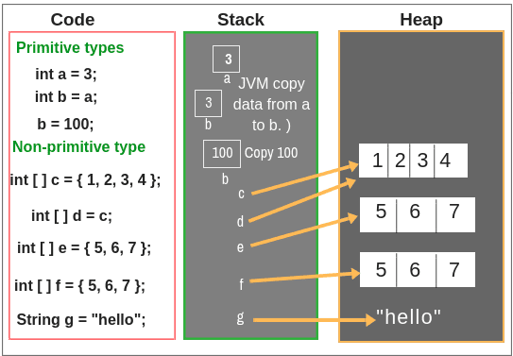
Memory Allocation of Primitive, Non-primitive Data Types
In Java, all data type for primitive type variables is stored on the stack.
For reference data types, the stack holds a pointer to the object on the heap. When setting a reference type variable equal to another reference type variable, a copy of only the pointer is made.
Let’s understand all these points by taking one simple example as shown in the below figure.
In the first line, we declared a primitive
type variable int a = 3;. Since ‘a’ is a primitive type
variable whose data type is int. So, all data will be
allocated on the stack memory.
In the second line, we declared a variable
type int b = a;. Since ‘b’ is a primitive type variable
and ‘a’ is also a primitive type. Therefore, JVM just
copies the data from a to b.
In the third line, we just modified the value of variable b
equal to 100. In this case, JVM will store the entry 100 on the stack.
Let’s take some reference type variable i.e. Non-primitive type. In line 4, ‘c’ is a reference type variable that is declared as an integer array.
An integer array is an object. So, JVM will set c on the stack and point the pointer to an object on the heap.
In the fifth line, a variable d is also declared as integer array type and set equal to c. So in this case, JVM will copy the address of c’s data to d in the stack memory. So, c and d both will point to the same object on the heap.

Slide 14
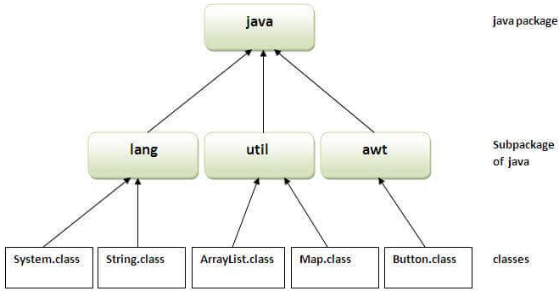
Java Package
A java package is a group of similar types of classes, interfaces and sub-packages.
Package in java can be categorized in two form, built-in package and user-defined package.
There are many built-in packages such as java, lang, awt, javax, swing, net, io, util, sql etc.
Advantage of Java Package
  Java package is used to categorize the
  classes and interfaces so that they can
  be easily maintained
  Java package removes naming collision.
The package keyword is used to create a
package in java.
How to access package from another package?
There are three ways to access the package from outside the package.
  import package.*;
  import package.classname;
  fully qualified name.

Slide 15
Java Package
Using packagename.*:
  Use package.* then all the classes and interfaces of this package will be accessible.
  The import keyword is used to make the classes and interface of another package accessible to the current package.
Using packagename.classname:
  If you import package.classname then only declared class of this package will be accessible.
Using fully qualified name:
  If you use fully qualified name then only declared class of this package will be accessible. Now there is no need to import. But you need to use fully qualified name every time when you are accessing the class or interface.
  It is generally used when two packages have same class name e.g. java.util and java.sql packages contain Date class.
Subpackage in java:
  Package inside the package is called the subpackage. It should be created to categorize the package further.
The standard of defining package is domain.company.package e.g. com.huawei.bean

Slide 16
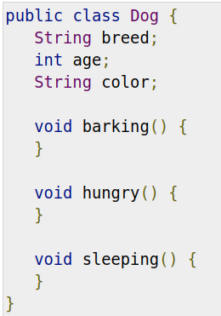
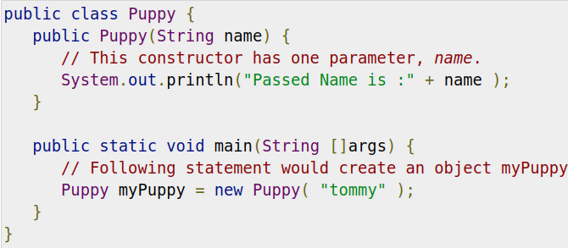
Classes in Java
A class is a blueprint from which individual objects are created.
Creating an Object
  As mentioned previously, a class provides the blueprints
  for objects. So basically, an object is created from a class.
  In Java, the new keyword is used to create new objects.
There are three steps when creating an object from a class
  Declaration − A variable declaration with a variable name
  with an object type.
  Instantiation − The 'new' keyword is used to create the
  object.
  Initialization − The 'new' keyword is followed by a call to
  a constructor. This call initializes the new object.

Slide 17
Life cycle of an object
Creation of .class file on disk
  Java programs run on the Java virtual machine (JVM). When we compile the Java class, it is transformed into byte code. The compiled classes are stored as a .class file on a disk.
Loading .class file into memory:
  After that, the Java runtime finds out that class on the disk that is in the form of a .class file. Java classloader loads that class into memory.
Looking for initialized static members of class:
  Now Java looks for all initialized static members of the class such as static method, static field, and static block. It belongs to the class itself and is shared by all the objects created from the class.
Ways to initialize class in java:
  A class can be initialized in two ways in Java. First, when you access a static field or static method of the class. The second way is when object or instance of the class is created using the new keyword, the class is initialized.
Allocation of memory for object and reference variable:
  Java allocates the memory on the heap for the object and memory on the stack for object reference variable.
Calling of the constructor of class:
  After allocating the memory, JVM calls the constructor of the class but it is called only once when the object is created.
Removing of object and reference variable from memory:
  When the accessing of field and methods are completed, the object and its reference are removed from the memory by the JVM.
  User don’t have to destroy objects yourself. Actually, when the object is no longer in use, Java runtime calls the garbage collector to destroy all the objects.

Slide 18
Anonymous object in Java
An object which has no reference variable is called anonymous object in Java.
Anonymous means nameless. If you want to create only one object in a class then the anonymous object is a good approach.
Declaration of Anonymous object
The syntax to create an anonymous object in Java is given below.
  new Class_name();
For example:
  new Student();
We can pass the parameter to the constructor like this:
  new Student(“Shubh”);
For exmple: To call a method through the anonymous object then we can write code like this:
  new Student().display();

Slide 19
Thank You

