Slide 1
Constructors

Slide 2
Contents
what is a method in Java.
Types of methods.
Method declaration
Constructor
Access Modifiers
Static keyword
Final Keyword

Slide 3
Method in Java
A method is a way to perform some task. It's a block of code or collection of statements or a set of code grouped together to perform a certain task or operation.
It is used to achieve the reusability of code, we write a method once and use it many times.
The method is executed only when we call or invoke it.
The most important method in Java is the main() method.

Slide 4
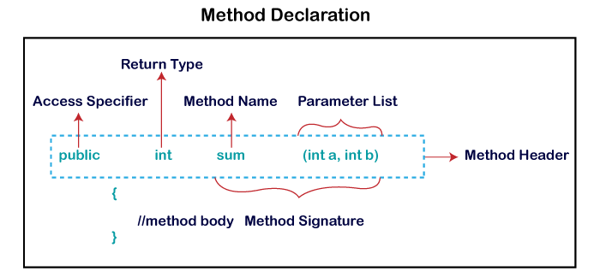
Method Declaration
Method declaration provides information about method attributes, such as visibility, return-type, name, and arguments.
It has six components that are known as method header
Method Signature: Every method has a method signature. It is a part of the method declaration. It includes the method name and parameter list.
Access Specifier: Access specifier or modifier is the access type of the method. It specifies the visibility of the method. Java provides four types of access specifier:
Return Type: Return type is a data type that the method returns. It may have a primitive data type, object, collection, void, etc. If the method does not return anything, we use void keyword.
Method Name: It is a unique name that is used to define the name of a method. It must be corresponding to the functionality of the method. Suppose, if we are creating a method for subtraction of two numbers, the method name must be subtraction(). A method is invoked by its name.
Parameter List: It is the list of parameters separated by a comma and enclosed in the pair of parentheses. It contains the data type and variable name. If the method has no parameter, left the parentheses blank.
Method Body: It is a part of the method declaration. It contains all the actions to be performed. It is enclosed within the pair of curly braces.

Slide 5
Naming a Method
While defining a method,
Remember that the method name must be a verb and start with a lowercase letter.
If the method name has more than two words, the first name must be a verb followed by adjective or noun.
In the multi-word method name, the first letter of each word must be in uppercase except the first word. For example:
Single-word method name: sum(), area()
Multi-word method name: areaOfCircle(), stringComparision()
It is also possible that a method has the same name as another method name in the same class, it is known as method overloading.
Types of Method
There are two types of methods in Java:
Predefined Method
User-defined Method

Slide 6
Predefined Method
Methods that is already defined in the Java class libraries is known as predefined methods, also known as the standard library method or built-in method.
We can directly use these methods just by calling them in the program at any point. Ex. length(), equals(), compareTo(), sqrt(), etc.
When we call any of the predefined methods in our program, a series of codes related to the corresponding method runs in the background that is already stored in the library.
Each and every predefined method is defined inside a class. Such as print() method is defined in the java.io.PrintStream class. It prints the statement that we write inside the method. For example, print("Java"), it prints Java on the console.
public class Demo
{
public static void main(String[] args)
{
// using the max() method of Math class
System.out.print("The maximum number is: " + Math.max(9,7));
}
}

Slide 7
User-defined Method
The method written by the user or programmer is known as a user-defined method. These methods are modified according to the requirement.
public class Addition
{
public static void main(String[] args)
{
int a = 19;
int b = 5;
//method calling
int c = add(a, b); //a and b are actual parameters
System.out.println("The sum of a and b is= " + c);
}
//user defined method
public static int add(int n1, int n2) //n1 and n2 are formal parameters
{
int s;
s=n1+n2;
return s; //returning the sum
}
}

Slide 8
Static Method
Method with static keyword is known as static method.
Method with static keyword belongs to a class rather than an instance of a class.
Static methods can be called without creating an object.
It can access static data members and also change the value of it.
public class Display
{
public static void main(String[] args)
{
show();
}
static void show()
{
System.out.println("It is an example of static method.");
}
}

Slide 9
Instance Method
The method of the class is known as an instance method.
It is a non-static method defined in the class. Before calling or invoking the instance method, it is necessary to create an object of its class.
public class InstanceMethodExample
{
public static void main(String [] args)
{
//Creating an object of the class
InstanceMethodExample obj = new InstanceMethodExample();
//invoking instance method
System.out.println("The sum is: "+obj.add(12, 13));
}
int s;
//user-defined method because we have not used static keyword
public int add(int a, int b)
{
s = a+b;
//returning the sum
return s;
}
}
There are two types of instance method:
Accessor Method
Mutator Method
public int getId()
{
return Id;
}
Accessor Method: The method(s) that reads the instance variable(s) is known as the accessor method.
Mutator Method: The method(s) read the instance variable(s) and also modify the values.
public void setRoll(int roll)
{
this.roll = roll;
}

Slide 10
Abstract Method
The method that does not has method body is known as abstract method
It always declares in the abstract class. It means the class itself must be abstract if it has abstract method.
To create an abstract method, we use the keyword abstract.
abstract void method_name();
abstract class Demo //abstract class
{
//abstract method declaration
abstract void display();
}
public class MyClass extends Demo
{
//method impelmentation
void display()
{
System.out.println("Abstract method?");
}
}
public static void main(String args[])
{
//creating object of abstract class
Demo obj = new MyClass();
//invoking abstract method
obj.display();
}

Slide 11
Constructors in Java
A constructor is a block of codes similar to the method.
It is called when an instance of the class is created. At the time of calling constructor, memory for the object is allocated in the memory.
It is a special type of method which is used to initialize the object.
Every time an object is created using the new() keyword, at least one constructor is called.
It calls a default constructor if there is no constructor available in the class.
There are two types of constructors in Java: no-arg constructor, and parameterized constructor.
Note: It is called constructor because it constructs the values at the time of object creation. It is not necessary to write a constructor for a class. java compiler creates a default constructor.

Slide 12
Rules for creating Java constructor
Java Default Constructor
A constructor is called "Default Constructor" when it doesn't have any parameter.
Syntax of default constructor:
<class_name>(){}
There are two rules defined for the constructor.
Constructor name must be the same as its class name
A Constructor must have no explicit return type
A Java constructor cannot be abstract, static, final, and synchronized
Types of Java constructors
There are two types of constructors in Java:
Default constructor (no-arg constructor)
Parameterized constructor
//Java Program to create and call a default constructor
class Bike1{
//creating a default constructor
Bike1(){System.out.println("Bike is created");}
//main method
public static void main(String args[]){
//calling a default constructor
Bike1 b=new Bike1();
}
}
purpose of a default constructor?
to provide the default values to the object like 0, null, etc., depending on the type.

Slide 13
Java Parameterized Constructor
//Java Program to demonstrate the use of the parameterized constructor.
class Student4{
int id;
String name;
//creating a parameterized constructor
Student4(int i, String n) {
id = i;
name = n;
}
//method to display the values
void display(){System.out.println(id+" "+name);}
public static void main(String args[]) {
//creating objects and passing values
Student4 s1 = new Student4(111,"Karan");
Student4 s2 = new Student4(222,"Aryan");
//calling method to display the values of object
s1.display();
s2.display();
}
}
A constructor which has a specific number of parameters is called a parameterized constructor.
Constructor Overloading in Java
Constructor overloading in Java is a technique of having more than one constructor with different parameter lists.
Constructors are differentiated by the compiler by the number of parameters in the list and their types.

Slide 14
Difference between constructor and method in Java
Java Constructor | Java Method
A constructor is used to initialize the state of an object. | A method is used to expose the behavior of an object.
A constructor must not have a return type. | A method must have a return type.
The constructor is invoked implicitly. | The method is invoked explicitly.
The Java compiler provides a default constructor if you don't have any constructor in a class. | The method is not provided by the compiler in any case.
The constructor name must be same as the class name. | The method name may or may not be same as the class name.

Slide 15
Can constructor perform other tasks instead of initialization?
Yes, like object creation, starting a thread, calling a method, etc. You can perform any operation in the constructor as you perform in the method.

Slide 16
Modifiers
Access modifiers : limits the visibility of classes, fields, constructors, or methods in the Java program.
Non-access modifiers : modifiers do not change the accessibility of variable or method, but they provide special properties to them

Slide 17
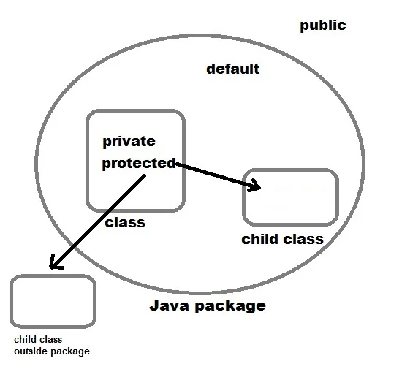
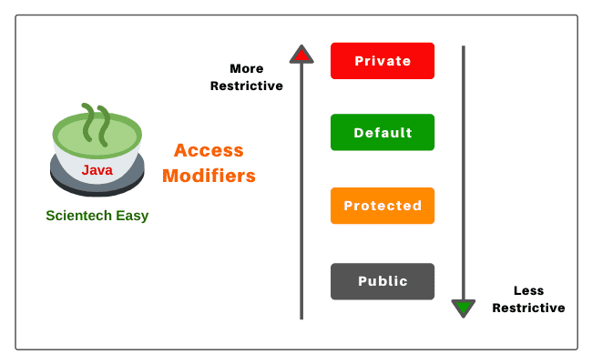
Access modifier
Access modifier limits the visibility of classes, fields, constructors, or methods in the Java program.
Public: The method is accessible by all classes when we use public specifier in our application.
Private: When we use a private access specifier, the method is accessible only in the classes in which it is defined.
Protected: When we use protected access specifier, the method is accessible within the same package or subclasses in a different package.
Default: When we do not use any access specifier in the method declaration, Java uses default access specifier by default. It is visible only from the same package only.

Slide 18
Private Access Modifier
1. Private access modifier in java can apply to a variable, method, constructor, inner class but not the outer class that is class itself.
2. The instance variable can be private but a local variable cannot be private.
3. Private members of a class cannot be accessed from outside the class. They are accessible only within the class.
4. Private members of a superclass cannot be inherited to the subclass. Therefore, they are not accessible in subclasses.
5. If we make any constructor as private, we cannot create an object of that class from another class and also cannot create the subclass of that class.
6. A class cannot be private except for inner classes. Inner classes are members of the outer class. So, members of the class can be private.
7. If we declare a method as private, we cannot call the private method from outside the class.
The only modifiers are applicable to a top-level class. They are public, default, final, abstract.

Slide 19
Default Access Modifier
1. When access modifier is not specified to members of a class or a class itself, it is called default access modifier.
2. The default can apply to the instance variable, local variable, constructor, methods, inner class, or outer class.
3. Default members of a class are visible inside of the class and everywhere within classes in the same package only. Therefore, they can be accessed from outside the classes in the same package but can not be accessed outside the package.
4. Default members can be inherited to the subclass within the same package only. It cannot be inherited from outside the package.

Slide 20
Protected Access Modifier
1. Protected access modifier can be applied to instance variables, local variables, constructors, methods, inner classes but not the outer class.
2. Protected members are accessible inside the class and everywhere within classes in the same package and outside the package but through inheritance only.
3. Protected members can be inherited to the subclass.
4. If we make constructor as protected then we can create the subclass of that class within the same package but not outside the package

Slide 21
Public Access Modifier
1. Public access modifier can apply to instance variables, constructors, inner classes, outer class, methods but not with local variables.
2. Public members of a class can be used anywhere.
3. Public members of a class can be inherited to any subclass.

Slide 22
Private Protected Access
A variable or field can be declared with two keywords as private and protected together like this:
private protected int age;
It provides the visibility level in between the “protected access” and “private access”. This modifier makes the variable visible in all the subclasses regardless of what package they are in but the field cannot be accessed by other classes in the same package.

Slide 23
Non Access Modifier
Non access modifiers are used to set special properties to the variable or method.
Non-access modifiers do not change the accessibility of variable or method, but they provide special properties to them. Java provides following non-access modifiers.
Final
Static
Transient
Synchronized
Volatile
Final Modifier
Final modifier can be used with variable, method and class. if variable is declared final then we cannot change its value. If method is declared final then it can not be overridden and if a class is declared final then we can not inherit it.
Static modifier
static modifier is used to make field static. We can use it to declare static variable, method, class etc. static can be use to declare class level variable. If a method is declared static then we don’t need to have object to access that. We can use static to create nested class.

Slide 24
Non Access Modifier
Transient modifier
When an instance variable is declared as transient, then its value doesn't persist when an object is serialized
Synchronized modifier
When a method is synchronized it can be accessed by only one thread at a time.
Volatile modifier
Volatile modifier tells to the compiler that the volatile variable can be changed by other parts of a program. Volatile variables are used in case of multi-threading program. volatile keyword cannot be used with a method or a class. It can be only used with a variable.
Every read of a volatile variable will be read from the computer's main memory, and not from the CPU cache, and that every write to a volatile variable will be written to main memory, and not just to the CPU cache.
Static and volatile are introduced for special purposes in java. Volatile keyword mainly used in multi threading environment.
Declaring a variable as volatile (be it static or not) states that the variable will be accessed frequently by multiple threads. In Java, this boils down to instructing threads that they can not cache the variable's value, but will have to write back immediately after mutating so that other threads see the change. (Threads in Java are free to cache variables by default).
public class SharedObject {
public volatile int counter = 0;
}

Slide 25
Applicable Modifiers with Classes, Methods, Variables, Interfaces
Outer Class (Top-level Class):
1. The only modifiers are applicable to the outer class. They are public, default, final and abstract.
2. Final and abstract both cannot be applied simultaneously with a class. It is an illegal combination.
3. If a class is declared as public, private or protected cannot be applied simultaneously with public class. It is also an illegal combination.
Methods:
1. The only two modifiers that are not applicable for methods are transient and volatile.
2. If a method is declared as public, we cannot declare simultaneously private or protected with a public method.
3. If a method is defined as abstract, we cannot apply final, static, synchronized and private.
Variables:
1. The modifiers applicable for variables are public, protected, private, default, final, static, transient, and volatile.
2. The non-access modifiers such as abstract, synchronized, native, and strictfp are not applicable for variables.
3. The only applicable modifier with local variable is final. If a variable is declared as final, we cannot declare as volatile.
Inner Class:
1. The applicable modifiers for the inner class are public, private, protected, default, final, abstract and static.
2. The non-applicable modifiers for inner class are synchronized, transient and volatile.
3. The modifiers which are not applicable for inner classes but not applicable for outer classes are private, protected, and static.

Slide 26
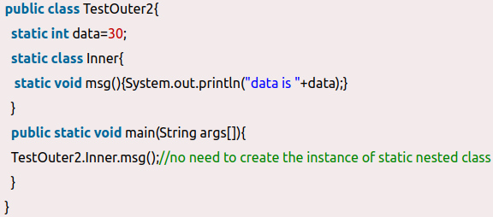
Applicable Modifiers with Classes, Methods, Variables, Interfaces
Constructors:
1. For a constructor, only access modifiers are applicable. The access modifiers like public, protected, default, and private can be applied with constructors.
2. Non-access modifiers cannot be applied with constructors. By mistake, if you apply any other modifiers with constructor except these four access modifiers, you will get a compile-time error.
Outer Enum:
1. The only modifiers like public, default are applicable for outer enum.
2. The modifiers which are applicable for classes but not applicable for enum are final and abstract.
Inner Enum:
1. For enum, we can apply all four access modifiers and a non-access modifiers like static.
Outer Interface:
1. Public, default, abstract are modifiers that are applicable for outer interface. Except for these modifiers, we cannot apply other modifiers with outer or top-level interface.
2. The non-access modifier that is applicable for classes but not applicable for an interface, is final.
Inner Interface:
1. For inner interface, we can apply modifiers like private, default, protected, public, abstract, static.
2. The non-access modifiers such as final, synchronized, native, transient, and volatile are not applicable for inner interface.

Slide 27
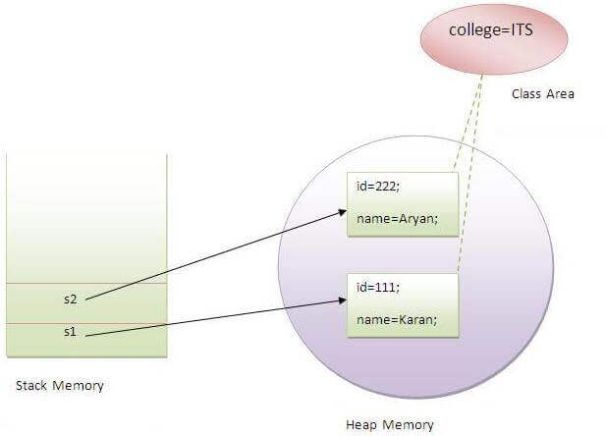
Java static keyword
static keyword - used mainly for memory management, It makes program memory efficient (i.e., it saves memory).
One can apply static keyword with variables, methods, blocks and nested classes. The static keyword belongs to the class than an instance of the class.
The static can be:
Variable (also known as a class variable)
Method (also known as a class method)
Block
Nested class
Understanding the problem without static variable
class Student{
int id;
String name;
String college = "ITS";
}
all instance data members will get memory each time when the object is created.
Java static property is shared to all objects.

Slide 28
Java static method
class Calculate{
static int cube(int x){
return x*x*x;
}
public static void main(String args[]){
int result=Calculate.cube(5);
System.out.println(result);
}
}
Static keyword with any method, it is known as static method.
A static method belongs to the class rather than the object of a class.
A static method can be invoked without the need for creating an instance of a class.
A static method can access static data member and can change the value of it.
Restrictions for the static method
class A{
int a=40;//non static
public static void main(String args[]){
System.out.println(a);
}
}
The static method can not use non static data member or call non-static method directly.
this and super cannot be used in static context.

Slide 29
Java static block
When a block is declared with the static keyword, it is called static block in Java.
It is a normal block of code that is enclosed in braces ({ }) and is preceded by a keyword “static”.
Is used to initialize the static data member.
It is executed before the main method at the time of classloading.
The static block gets executed only once by JVM when the class is loaded into the memory by Java ClassLoader.
Advantages of static initialization block:
1. Static initialization blocks are used to write logic that you want to execute during the class loading.
2. They are used to initialize the static variables.
class A2{
static{System.out.println("static block is invoked");}
public static void main(String args[]){
System.out.println("Hello main");
}
}
Output:static block is invoked
Hello main

Slide 30
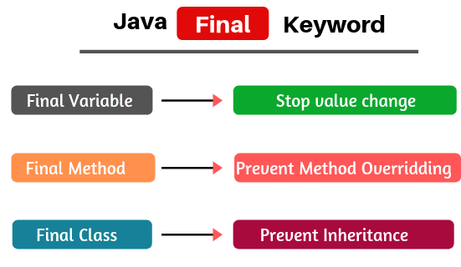
Final Keyword
Final keyword declared with variable, method, and class indicates that “This cannot be modified”.
A final variable can be used where we want to remain constant the value of a variable throughout the execution of a program.
A final keyword can be applied to local variables, instance variables, and static variables.
A variable that is declared as final and not initialized at a time of declaration is known as a blank final variable. A blank final variable must be initialized in the constructor of the class or initialize in the static block otherwise it results in compilation error.
A final method can be inherited in the subclass but we cannot override it
Abstract method Vs final method: abstract method must be overridden in the subclass but final method cannot be overridden in the subclass.
If we declare any parameter as final, the value of parameter cannot be changed after initialization.
package finalPrograms;
public class FinalVariableEx
{
// Declare a final instance variable.
final int a = 20;
// Declare an instance method.
void change()
{
// Change the value of the final instance variable.
a = 40; // compile time error. A final variable's value cannot be changed.
System.out.println(a);
// Declare a final local variable inside the method.
final int i = 0;
for(i=0; i< 5; i++) // compile time error.
{
class Test
{
// Declaration of final instance variable.
final int x;
Test(){
// Initialization of final variable in the constructor.
x = 20;
}
}
void msg(final String name)
{
name = "Lava"; // Compile time error because the final local variable cannot be changed.
}
static
{
a = 20;
System.out.println("Value of a: " +a);
}

Slide 31
Reference Final Variable: A final variable that is declared as a reference to an object is known as reference final variable. There is nothing like a final object in Java.
If a final reference variable refers to an object then it does not mean that the object is final. It simply means that the reference variable cannot refer to another object.
For example, a final List reference variable looks like this:
final List list; // Here, list is variable of type List.
Here, the list is final. It does not mean that elements cannot be added or removed from the list. The final list means the reference variable cannot refer to any new ArrayList. Any attempt to do so will get a compile-time error.

Slide 32
Use of Final class in Java
Three important uses of a final class in Java.
1. The first use is to prevent inheritance, as the final classes cannot be extended.
2. The second use is to create an immutable class like the predefined String class. We cannot make a class immutable without making it final.
3. A final class is very useful when we want high security in any application because the final class cannot be extended.
Key Points:
1. A constructor cannot be final.
2. A block cannot be final.
3. A local final variable must be initialized at the time of declaration.
4. We cannot change the value of a final variable after initialization.
5. A final method cannot be overridden.
6. A final class cannot be extended(inherited).
7. We can create the object for a final class but cannot extend it.
8. If the method parameters are declared as final, the value of these parameters cannot be changed.
// An immutable class
final class Student {
// Member attributes of final class
private final String name;
private final int regNo;
private final Map<String, String> metadata;
// Constructor of immutable class
// Parameterized constructor
public Student(String name, int regNo,
Map<String, String> metadata)
{

Slide 33
Thank you…

Slide 38
Methods in Java
The building block of a Java application.
A method is a set of code used to write the logic of the applications which perform some specific tasks or operations.
A method is executed when it is called from another method.
The main() method is the first method that is executed by JVM (Java Virtual Machine) in java program.
When a method is called, it returns a value to the calling method. It can also perform a task without returning any value to the calling method.

Slide 39
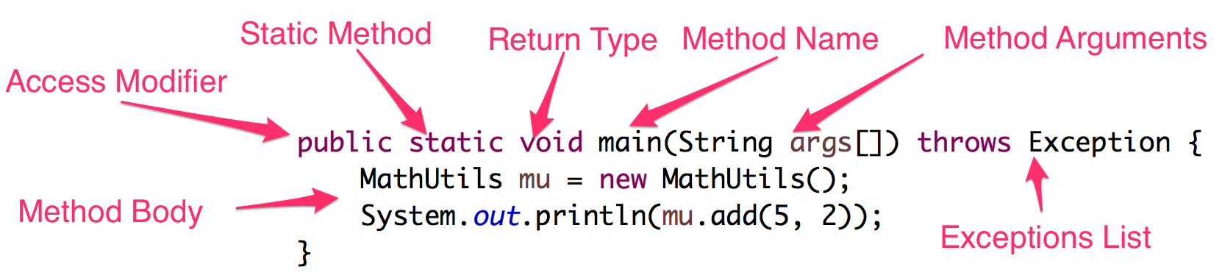
Java Method Components
A method has six fundamental parts such as modifiers, method name, return type, parameter list, exception list, and body.
Basic syntax to declare a method is as follows
The method name with parameter list (number of parameters, type of parameters, and order of parameters ) is called method signature in java.
Syntax:
method_modifier return_type method_name(Parameter_list) throws Exceptions
{
// Method body
}

Slide 40
Java Method Components
A method must be declared inside the class. In general, a method has six fundamental parts such as modifiers, method name, return type, parameter list, exception list, and body.
Access Modifiers: Java Method access modifiers defines the access type of a method but it is optional to use. It is used to restrict the scope of the method. There are four access modifiers in java – private, protected, public and default. Apart from access modifiers, we can also specify a method to be static, in that case, we don’t need to create an object to call the method. We can directly call a static method through class. Static methods are useful for creating utility methods.
The public is the least restrictive access modifier and the private is the most.
It may be declared as final, synchronized, abstract (If the method is abstract, the implementation is omitted and the method body is
replaced with a single semicolon).
Return Type: Java Methods must specify the return type. They can be any primitive type or an object. If the method is not returning anything, then we must use void as return type.
Method Name: Every method in Java must have a name. It’s used to identify the method. We should provide descriptive names for our method to give some idea about the task performed by the method. If you have written any Java program, I am sure you would have seen java main method.
Method Parameters: We can pass parameters to a method, they are defined in the parenthesis after the method name. Usually, method statements work on these parameters to achieve their tasks.
Exceptions List: Sometimes a java method can throw exceptions. We can define them using throws keyword. If there are multiple exceptions that can be thrown, then we can separate them using comma.
Method Body: This is where all the method operations take place. Method body contains statements to be executed by the method and they are inside the curly brackets.

Slide 41
Why do we use methods in Java?
The purpose of using methods in the Java program is to write the logic of the applications.
class Addition
{
// Declare two instance variables.
int a = 10;
int b = 20;
System.out.println(a + b); // It is invalid syntax because inside the class, we cannot write directly the business logic of the application. Therefore, we declare the method inside the class and write the logic inside the methods.
// Declaration of an instance method.
void add()
{
// Write logic of adding two number and print it on the console.
System.out.println(a+b);
}
public static void main(String[] args)
{
Addition a = new Addition(); // Object creation.
a.add(); // Calling method.
}
}

Slide 42
Java Method
https://www.scientecheasy.com/2020/06/java-methods.html/
Methods in Java are the building block of a Java application
Java Method is a collection of statements to process some specific task and return the response to the caller.
Methods allow us to write reusable code and dividing our program into several small units of work.

Slide 43
Java Method Signature
Java Method Signature consists of its name and parameter types in the declared order.
In a class, there can be multiple methods but each of them should have a different signature otherwise it won’t compile.
Java Method signature is used by JRE to identify the exact method to be called when invoked in our program.
public void print(String s) {}
private static int print(String s) {}
public void print(String s, int i) {}
private static void print(int i, String s) {}
It won’t compile because both the methods have same signature.
Above methods are different because the parameters order are not the same.

Slide 44
Calling a Java Method
Create a main method and call some other method
package com.journaldev.util;
public class MathUtils {
public int add (int x, int y) {
return x + y;
}
public static void main(String args[]) throws Exception {
MathUtils mu = new MathUtils();
System.out.println(mu.add(5, 2));
MathUtils.print("Static Method");
}
public static void print(String s) {}
}

Slide 46
Methods in Java
Void Method
Value returning Method
The return key work
Calling methods.

Slide 47
Void Method: A method that does not return a value , The return type is void.
public static void sayHi() {
System.out.println(“Hi”);
}

Slide 48
https://www.skylit.com/javamethods/ppt/index.html
https://www.scientecheasy.com/2020/06/java-methods.html/
https://www.slidesfinder.com/programmingsguru/collections-in-java-powerpoint-presentation/4548.aspx

