Slide 1
JAVA Exception Handling

Slide 2
Agenda
Exception Handling
Hierarchy of Java Exception classes
Java Exception Keywords
Common Scenarios of Java Exceptions
Java try-catch block
Java try multiple catch Exceptions
Java Nested try block
Java finally block
Java throw exception
Throwing User-defined Exception
Java Exception Propagation
Java throws keyword
Difference between throw and throws in Java
Difference between final, finally and finalize

Slide 3
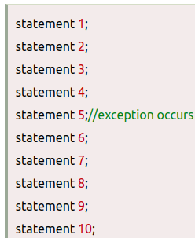
Exception Handling
Exception Handling in Java is one of the powerful mechanism to handle the runtime errors so that the normal flow of the application can be maintained.
In Java, an exception is an event that disrupts the normal flow of the program. It is an object which is thrown at runtime.
What is Exception Handling?
  Exception Handling is a mechanism to handle
  runtime errors such as ClassNotFoundException,
  IOException, FileNotFoundException etc.
Advantage of Exception Handling:
  The core advantage of exception handling is to maintain
  the normal flow of the application. An exception normally
  disrupts the normal flow of the application; that is why we
  need to handle exceptions. Let's consider a scenario:
  Suppose there are 10 statements in a Java program and an exception
  occurs at statement 5; the rest of the code will not be executed, i.e.,
  statements 6 to 10 will not be executed. However, when we perform
  exception handling, the rest of the statements will be executed. That is
  why we use exception handling in Java.

Slide 4
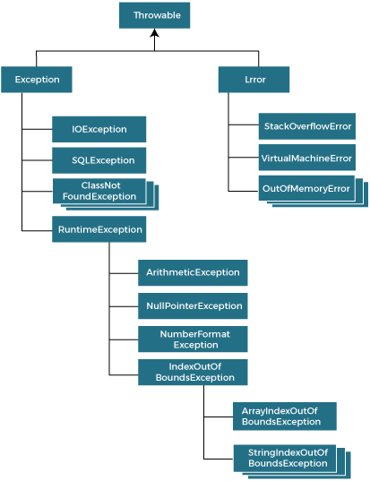
Hierarchy of Java Exception classes
The java.lang.Throwable class is the root class of Java Exception hierarchy inherited by two subclasses: Exception and Error.
Types of Java Exceptions:
There are mainly two types of exceptions:
  Checked and Unchecked. An error is considered as the unchecked
  exception. However, according to Oracle, there are three types of
  exceptions namely:
    Checked Exception
    Unchecked Exception
    Error
Checked Exception
  The classes that directly inherit the Throwable class except
  RuntimeException and Error are known as checked exceptions.
  For example, IOException, SQLException, etc. Checked exceptions
  are checked at compile-time.
Unchecked Exception
  The classes that inherit the RuntimeException are known as unchecked
  exceptions. For example, ArithmeticException, NullPointerException,
  ArrayIndexOutOfBoundsException, etc. Unchecked exceptions are
  not checked at compile-time, but they are checked at runtime.
Error
  Error is irrecoverable. Some example of errors are OutOfMemoryError,
  VirtualMachineError, AssertionError etc.

Slide 5
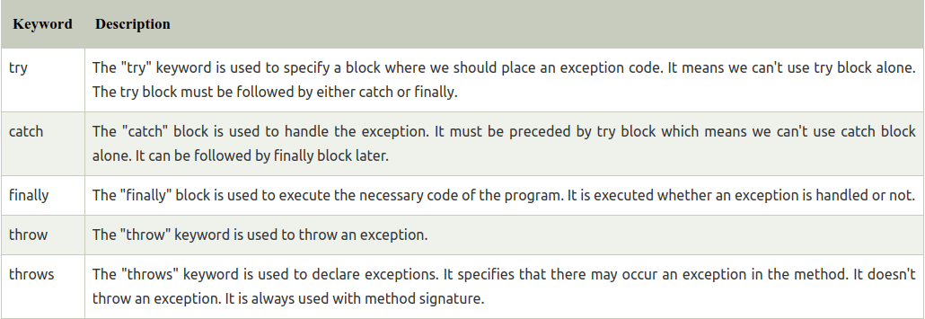
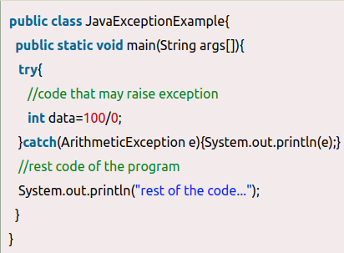
Java Exception Keywords
Java provides five keywords that are used to handle the exception. The following table describes each.
Java Exception Handling Example
  Let’s see an example of Java Exception
  Handling in which we are using a try-catch
  statement to handle the exception.
  In these example, 100/0 raises an
  ArithmeticException which is handled by a
  try-catch block.

Slide 6
Common Scenarios of Java Exceptions
There are given some scenarios where unchecked exceptions may occur. They are as follows:
A scenario where ArithmeticException occurs:
  If we divide any number by zero, there occurs an ArithmeticException.
    int a=50/0; //ArithmeticException
A scenario where NullPointerException occurs
  If we have a null value in any variable, performing any operation on the variable throws a NullPointerException.
    String s=null;
    System.out.println(s.length());//NullPointerException
A scenario where ArrayIndexOutOfBoundsException occurs
  When an array exceeds to it's size, the ArrayIndexOutOfBoundsException occurs. Consider the following statements.
    int a[]=new int[5];
    a[10]=50; //ArrayIndexOutOfBoundsException

Slide 7
Java try-catch block
Java try block
  Java try block is used to enclose the code that might throw an exception. It must be used within the method.
  If an exception occurs at the particular statement in the try block, the rest of the block code will not execute
Java try block must be followed by either catch or finally block.
  try{
    //code that may throw an exception
  }catch(Exception_class_Name ref){
    // Expected case
  }
Syntax of try-finally block
  try{
    //code that may throw an exception
  }finally{
    // expected case
  }
Java catch block
  Java catch block is used to handle the Exception by declaring the type of exception within the parameter. The declared exception must be the parent class exception ( i.e., Exception) or the generated exception type. However, the good approach is to declare the generated type of exception.
  The catch block must be used after the try block only. We can use multiple catch block with a single try block.

Slide 8
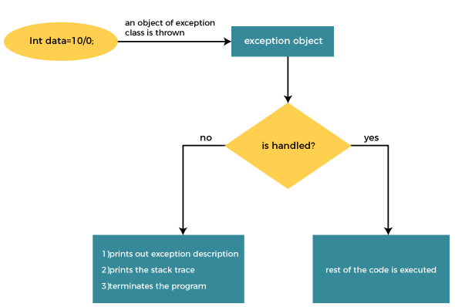
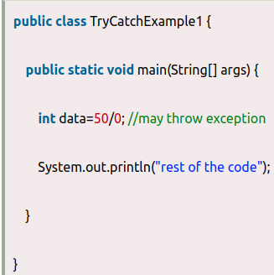
Internal Working of Java try-catch block
The JVM firstly checks whether the exception
is handled or not. If exception is not handled,
JVM provides a default exception handler that
performs the following tasks:
  Prints out exception description.
  Prints the stack trace (Hierarchy of
  methods where the exception occurred).
  Causes the program to terminate.
But if the application programmer handles the
exception, the normal flow of the application is
maintained, i.e., rest of the code is executed.
Problem without exception handling
  Let's try to understand the problem if we
  don't use a try-catch block.
As displayed in the above example, the rest of the code is not executed
(in such case, the rest of the code statement is not printed).
There might be 100 lines of code after the exception. If the exception is
not handled, all the code below the exception won't be executed.

Slide 9
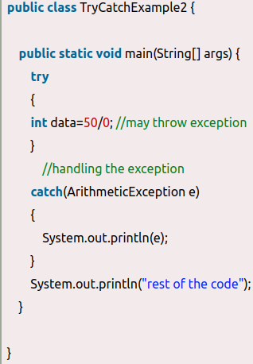
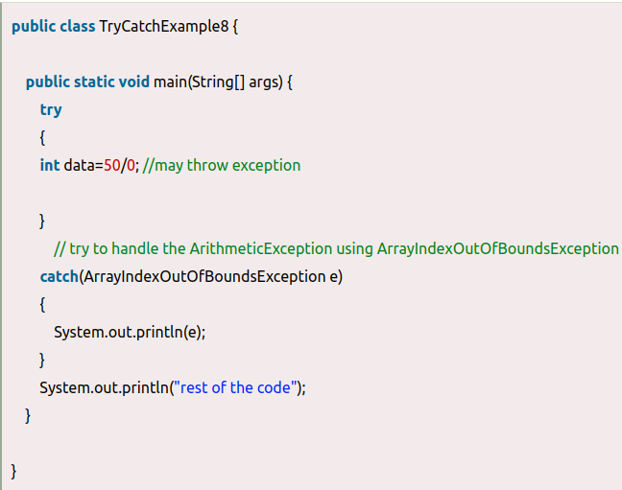
Solution by exception handling
Let's see the solution of the above problem by a java try-catch block.
Example1:
  As displayed in the above example, the rest of the code
  is executed, i.e., the rest of the code statement is
  printed.
Example2:
  We handle the generated exception
  (Arithmetic Exception) with a different type of exception
  class (ArrayIndexOutOfBoundsException).
Output:
Exception in thread "main" java.lang.ArithmeticException: / by zero
Output:
java.lang.ArithmeticException: / by zero
rest of the code

Slide 10
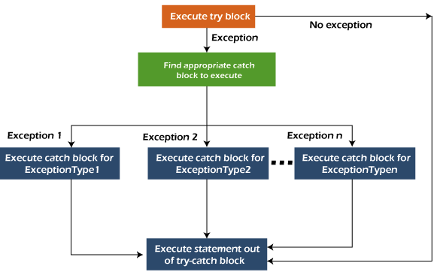
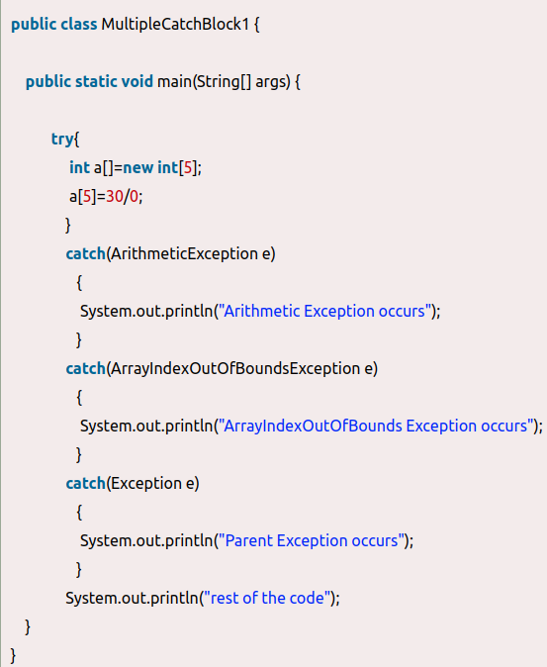
Java Multi Catch Exceptions
Java Multi-catch block
  A try block can be followed by one or more
  catch blocks. Each catch block must contain
  a different exception handler. So, if you have
  to perform different tasks at the occurrence of
  different exceptions, use java multi-catch block.
Points to remember
  At a time only one exception occurs and at
  a time only one catch block is executed.
  All catch blocks must be ordered from most
  specific to most general, i.e. catch for
  ArithmeticException must come before catch
  for Exception.
Let's see a simple example of java multi-catch block.
Fig: Flowchart of Multi-catch Block:
Output:
Arithmetic Exception occurs
rest of the code

Slide 11
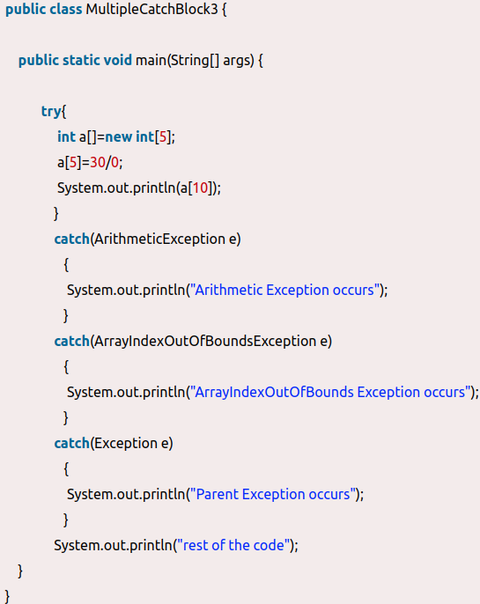
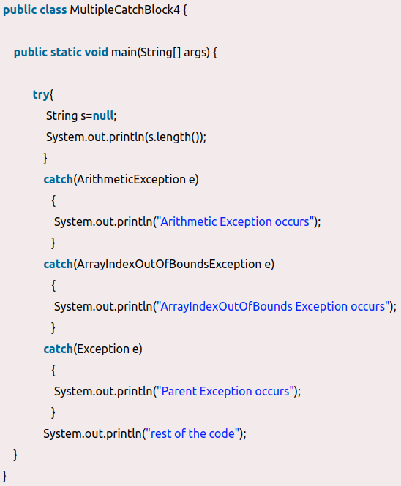
Java Multiple Catch Exceptions
Example3
Example2:
In this example, try block contains two exceptions. But at a time only one exception occurs and its corresponding catch block is executed.
In this example, we generate NullPointerException, but didn't provide the corresponding exception type. In such case, the catch block containing the parent exception class Exception will invoked.
Output:
Parent Exception occurs
rest of the code
Output:
Arithmetic Exception occurs
rest of the code

Slide 12
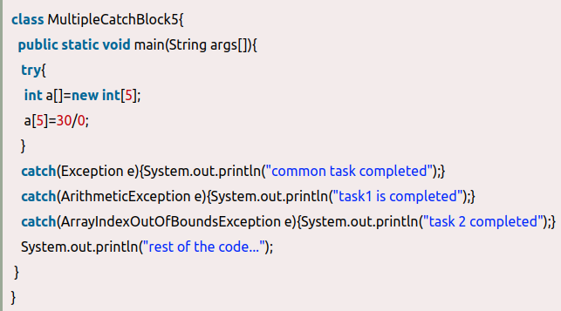
Java Multiple Catch Exceptions
Example4:
  Let's see an example, to handle the exception without maintaining the order of exceptions (i.e. from most specific to most general).
Output:
Compile-time error

Slide 13
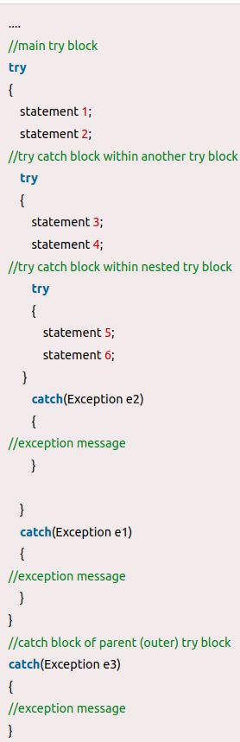
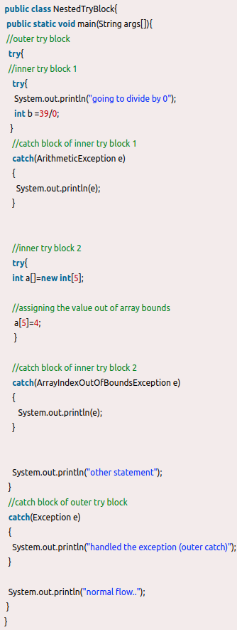
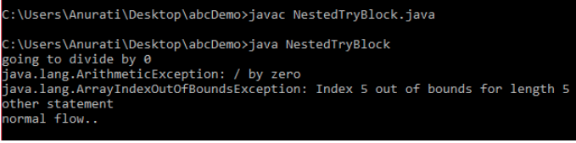
Java Nested try block
In Java, using a try block inside another try block is permitted. It’s called as nested try block.
For example, the inner try block can be used to handle ArrayIndexOutOfBoundsException while the outer try block can handle the ArithemeticException (division by zero).
Why use nested try block
  Sometimes a situation may arise where a part
  of a block may cause one error and the entire
  block itself may cause another error. In such
  cases, exception handlers have to be nested.
Java Nested try example:
  Let's see an example where we place a try
  block within another try block for two different
  exceptions.
Output of fig2 ex:
Fig1: Syntax
Fig2: Example1

Slide 14
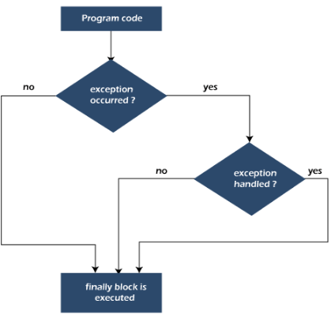
Java finally block
Java finally block is a block used to execute important code such as closing the connection, etc.
Java finally block is always executed whether an exception is handled or not. Therefore, it contains all the necessary statements that need to be printed regardless of the exception occurs or not.
The finally block follows the try-catch block.
Flowchart of finally block
Note: If you don't handle the exception, before
terminating the program, JVM executes finally
block (if any).
Why use Java finally block?
  finally block in Java can be used to put
  "cleanup" code such as closing a file,
  closing connection, etc.
  The important statements to be printed can
  be placed in the finally block.

Slide 15
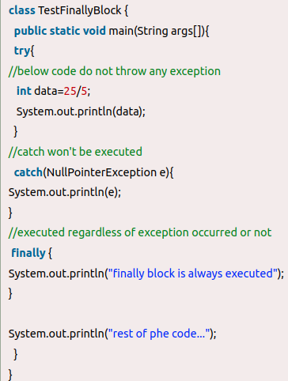
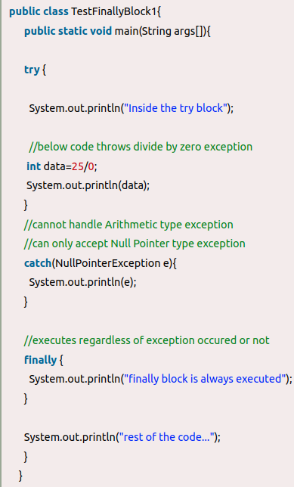

Java finally block
Example1:
  When an exception does not occur
  Let's see the below example where the Java
  program does not throw any exception, and
  the finally block is executed after the try block.
Example2:
  When an exception occurr but not handled
  by the catch block
  Let's see the the fillowing example. Here, the
  code throws an exception however the catch
  block cannot handle it. Despite this, the finally
  block is executed after the try block and then
  the program terminates abnormally.
Output:
5
Finally block is always executed
Rest of phe code
Fig1: Example1
Output of fig2 ex
Fig2: Example2

Slide 16
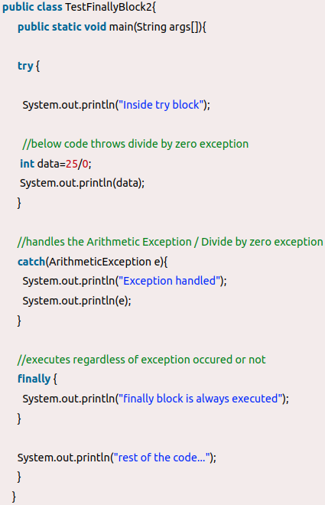

Java finally block
Example3:
  Let's see the following example where the Java code throws an exception and the catch block handles the exception. Later the finally block is executed after the try-catch block. Further, the rest of the code is also executed normally.
  Rule: For each try block there can be zero or more
  catch blocks, but only one finally block.
  Note: The finally block will not be executed if the
  program exits (either by calling System.exit() or by
  causing a fatal error that causes the process to abort).
Output:

Slide 17
Java throw exception
Java throw keyword
  The Java throw keyword is used to throw an exception explicitly.
  We specify the exception object which is to be thrown. The Exception has some message with it that provides the error description. These exceptions may be related to user inputs
  We can throw either checked or unchecked exceptions in Java by using throw keyword. It is mainly used to throw a custom exception.
The syntax of the Java throw keyword is given below.
  throw new exception_class("error message");
Example of throw IOException.
  throw new IOException("sorry device error");
Where the Instance must be of type Throwable or subclass of Throwable. For example, Exception is the sub class of Throwable and the user-defined exceptions usually extend the Exception class.

Slide 18
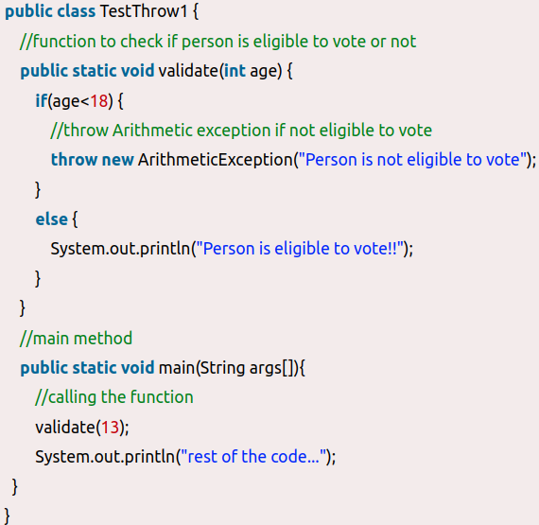
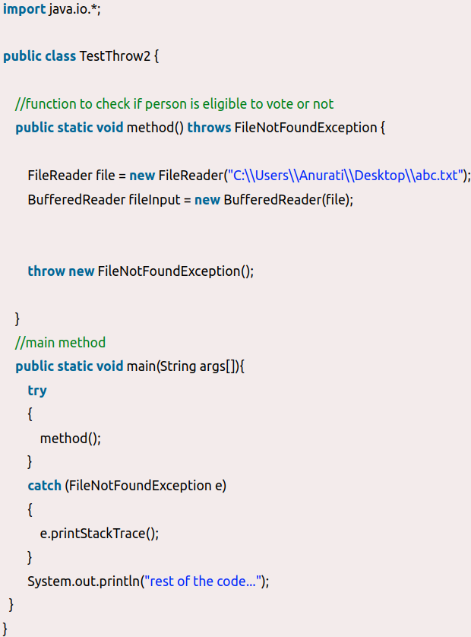

Java throw keyword example
Throwing Unchecked Exception
  we have created the validate
  method that takes integer value as a
  parameter. If the age is less than 18, we are
  throwing the ArithmeticException otherwise
  print a message welcome to vote.
Note: Every subclass of Error and
RuntimeException is an unchecked exception
in Java. A checked exception is everything else
under the Throwable class.
Throwing checked Exception
  If we throw a checked exception using throw
  keyword, it is must to handle the exception using
  catch block or the method must declare it using
  throws declaration.
Fig1: Throwing UnChecked Exception
Output of fig1:
Output of fig2:
Fig2: Throwing Checked Exception

Slide 19
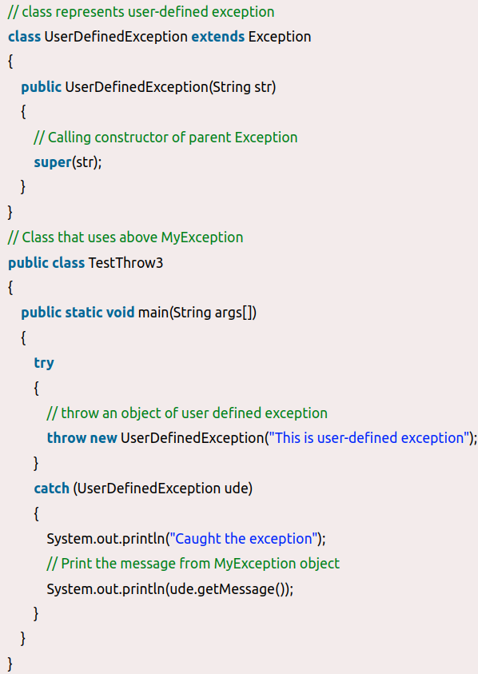
Throwing User-defined Exception
Example:
Output:
Caught the exception
This is user-defined exception

Slide 20
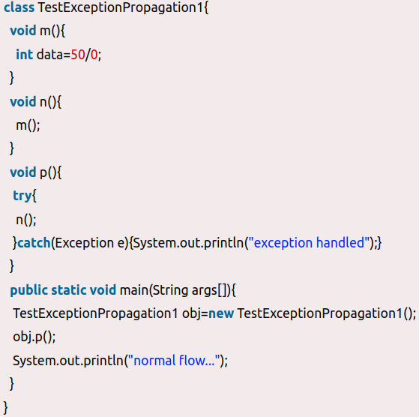
Java Exception Propagation
An exception is first thrown from the top of the stack and if it is not caught, it drops down the call stack to the previous method. If not caught there, the exception again drops down to the previous method, and so on until they are caught or until they reach the very bottom of the call stack. This is called exception propagation.
Exception Propagation Example:
  In these example exception occurs in the
  m() method where it is not handled, so it is
  propagated to the previous n() method where
  it is not handled, again it is propagated to the
  p() method where exception is handled.
  Exception can be handled in any method in call
  stack either in the main() method, p() method,
  n() method or m() method.
Output:
exception handled
normal flow...

Slide 21
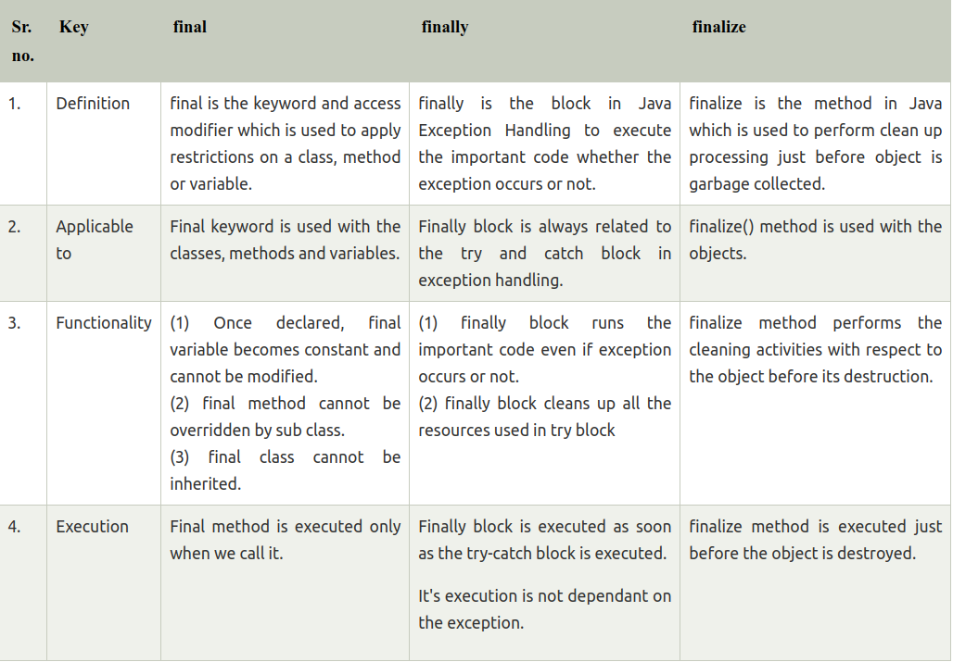
Difference between final, finally and finalize
The difference between final, finally and finalize is that the final is an access modifier, finally is the block in Exception Handling and finalize is the method of object class.

Slide 22
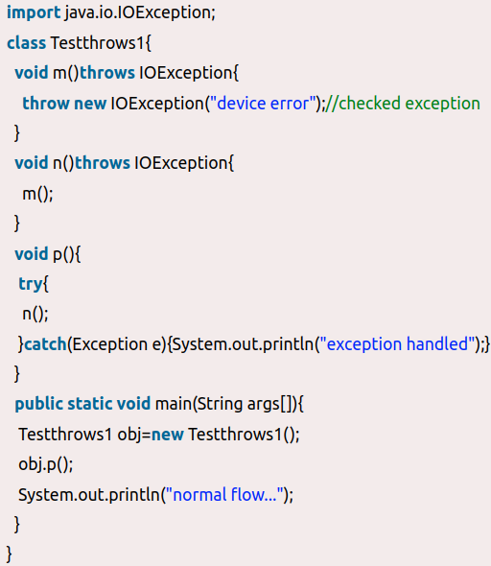
Java throws keyword
throws is a keyword in Java which is used in the signature of method to indicate that this method might throw one of the listed type exceptions. The caller to these methods has to handle the exception using a try-catch block.
Syntax:
  return_type method_name() throws exception_class_name{
  //method code
  }
Java throws Example:
  Let's see the example of Java throws
  clause which describes that exceptions
  can be propagated by throws keyword.
Rule: If we are calling a method that
declares an exception, we must either
caught or declare the exception.
Output:
exception handled
normal flow...

Slide 23
Difference between throw and throws in Java
There are many differences between throw and throws keywords. A list of differences between throw and throws are given below:
Sr.No | Key | throw | throws
1 | Definition | Java throw keyword is used throw an exception explicitly in the code, inside the method or the block of code. | Java throws keyword is used in the method signature to declare an exception which might be thrown by the method while the execution of the code.
2 | Syntax | throw is followed by an instance of exception to be thrown. | throws is followed by class names of Exceptions to be thrown.
3 | Declaration | throw is used within the method. | throws is used with the method signature.
4 | Internal implementation | We are allowed to throw only one exception at a time i.e. we cannot throw multiple exceptions. | We can declare multiple exceptions using throws keyword that can be thrown by the method. For example, main() throws IOException, FileNotFoundException.

Slide 24
Difference between final, finally and finalize
The difference between final, finally and finalize is that the final is an access modifier, finally is the block in Exception Handling and finalize is the method of object class.

Slide 25
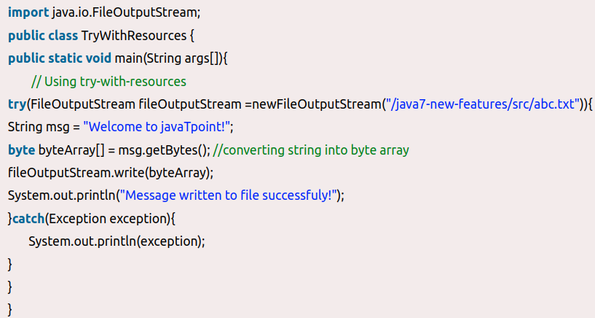
The try-with-resources statement
In Java, the try-with-resources statement is a try statement that declares one or more resources. The resource is as an object that must be closed after finishing the program. The try-with-resources statement ensures that each resource is closed at the end of the statement execution.
We can pass any object that implements java.lang.AutoCloseable, which includes all objects which implement java.io.Closeable
The following example writes a string into a file.
It uses an instance of FileOutputStream to write
data into the file. FileOutputStream is a resource
that must be closed after the program is finished
with it. So, in this example, closing of resource is
done by itself try.

Slide 26
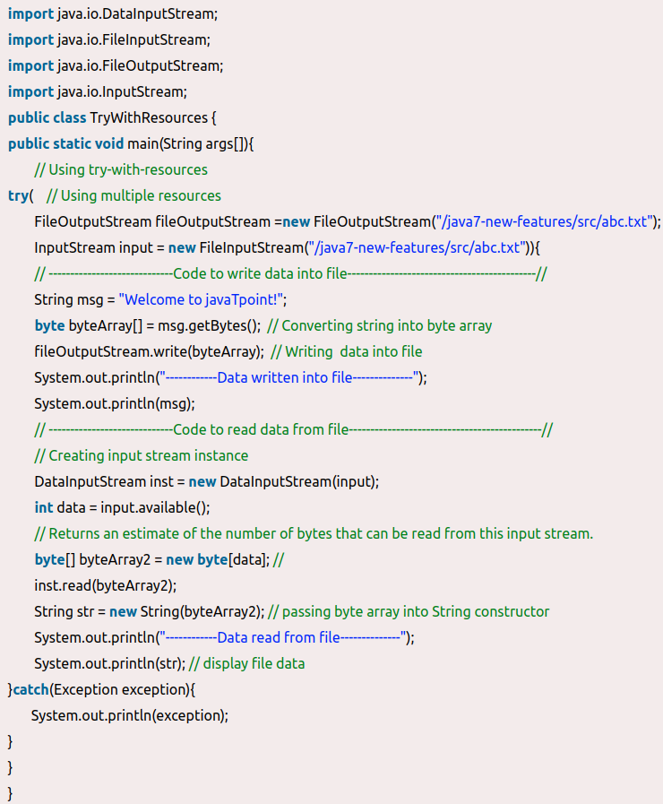
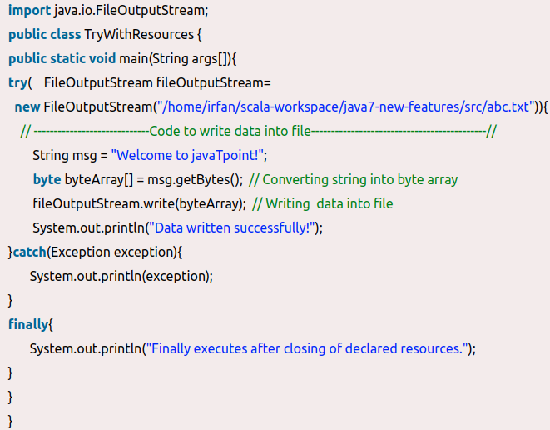
The try-with-resources statement
Try-with-resources Example : Using Multiple
Resources
You can use catch and finally blocks with
try-with-resources statement just like an
ordinary try statement.
Note - In a try-with-resources statement,
catch or finally block executes after closing
of the declared resources.
Try-with-resources Example: using finally block

Slide 27
Thank You

