Slide 1
File I/O

Slide 2
Agenda
Java I/O Streams
Types of I/O Streams
Important Classes of IO Streams
Files

Slide 3
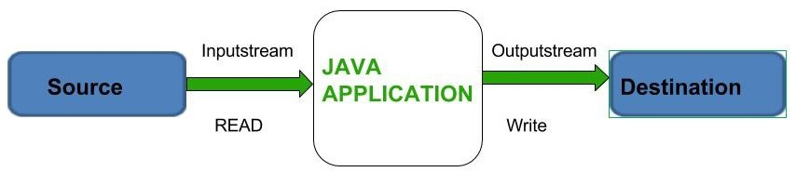
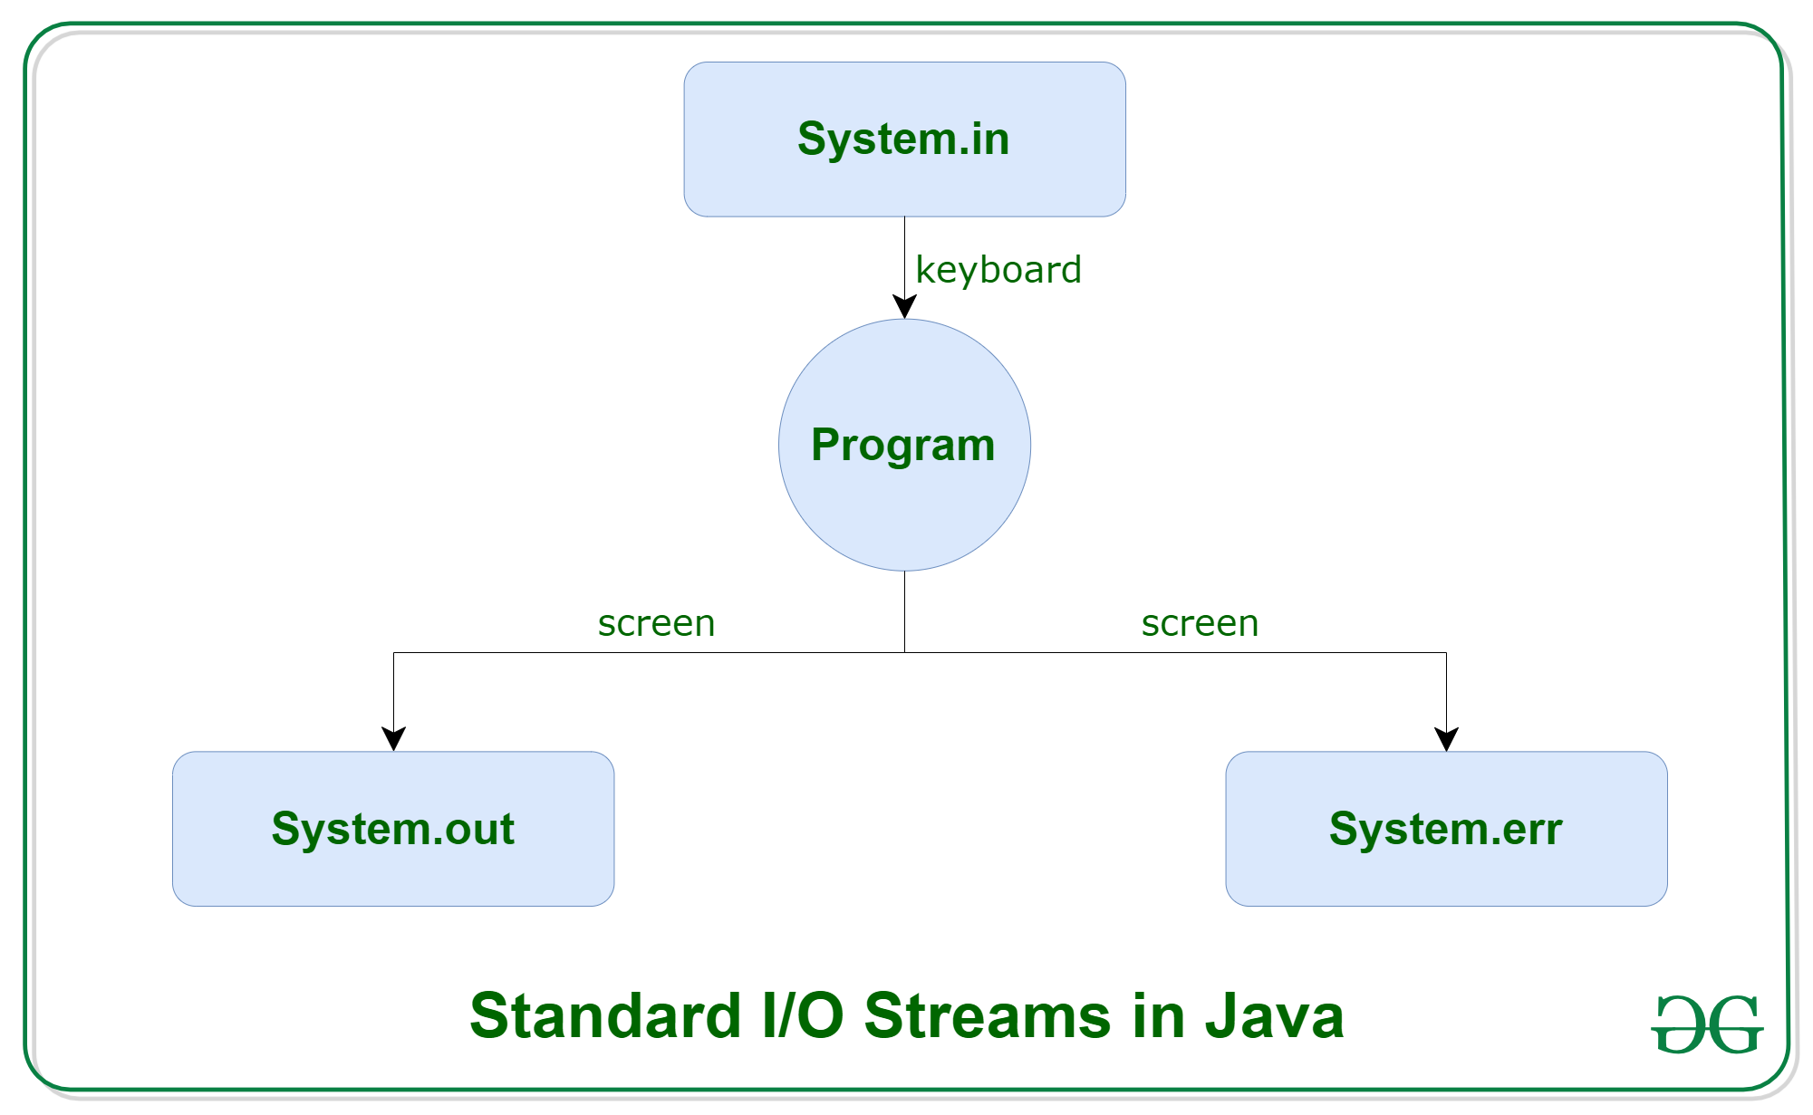
Introduction
System.in: This is the standard input stream that is used to read characters from the keyboard or any other standard input device.
System.out: This is the standard output stream that is used to produce the result of a program on an output device like the computer screen.
print()
println()
printf()
System.err: This is the standard error stream that is used to output all the error data that a program might throw, on a computer screen or any standard output device.

Slide 4
// A Java program to demonstrate working of printf() in Java
class JavaFormatter {
public static void main(String args[])
{
int x = 100;
System.out.printf("Printing simple integer: x = %d\n", x);
// this will print it upto 2 decimal places
System.out.printf("Formatted with precision: PI = %.2f\n", Math.PI);
float n = 5.2f;
// automatically appends zero to the rightmost part of decimal
System.out.printf("Formatted to specific width: n = %.4f\n", n);
n = 2324435.3f;
// here number is formatted from right margin and occupies a width of 20 char
System.out.printf("Formatted to right margin: n = %20.4f\n", n);
}
}

Slide 5
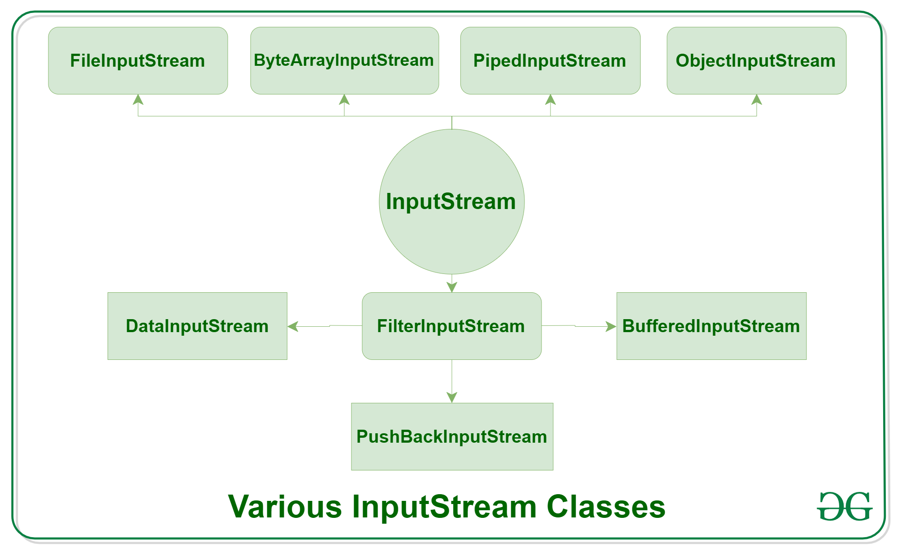
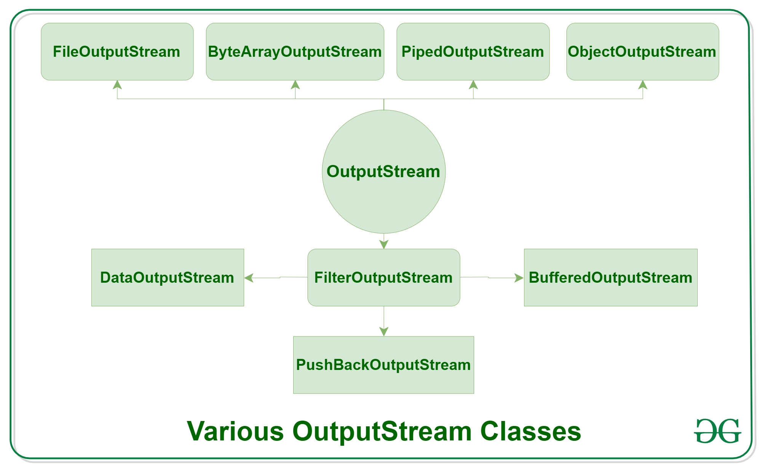
Types of Streams
Depending on the type of operations, streams can be divided into two primary classes
Input Stream: These streams are used to read data that must be taken as an input from a source array or file or any peripheral device. For eg., FileInputStream, BufferedInputStream, ByteArrayInputStream etc.
Output Stream: These streams are used to write data as outputs into an array or file or any output peripheral device. For eg., FileOutputStream, BufferedOutputStream, ByteArrayOutputStream etc.

Slide 6
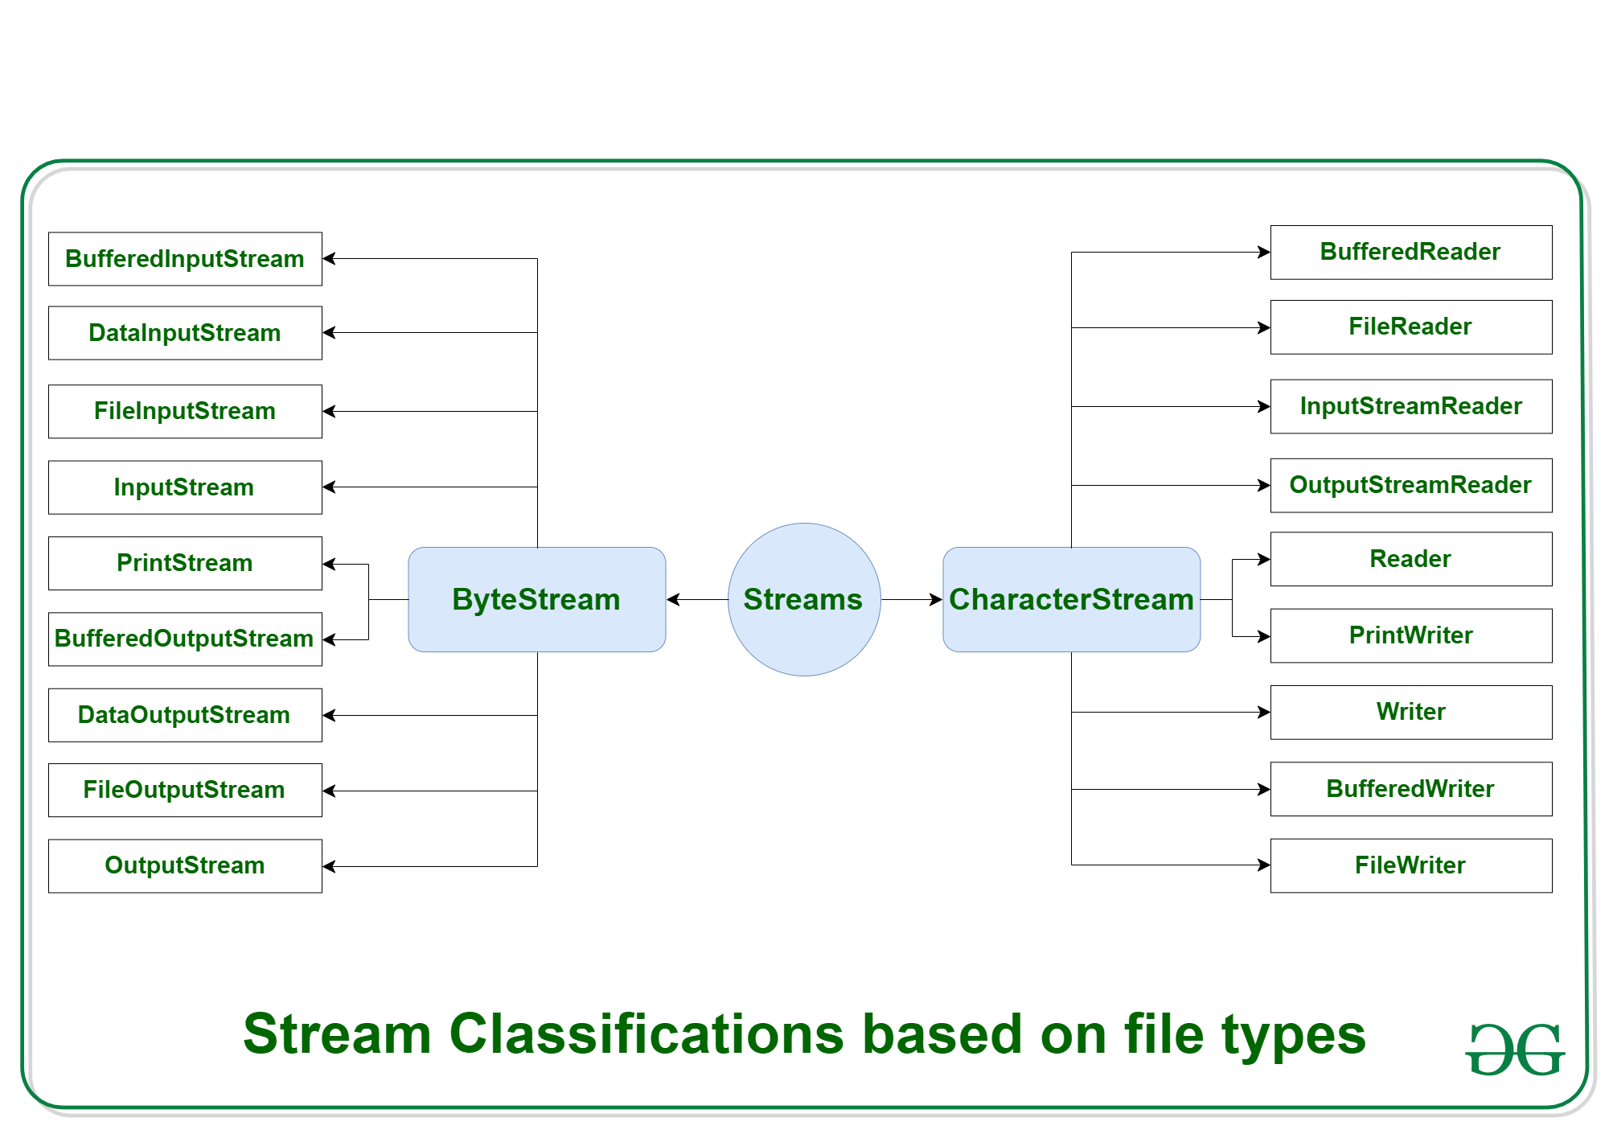
Depending on the types of file, Streams can be divided into two primary classes which can be further divided into other classes as can be seen through the diagram below
ByteStream:
This is used to process data byte by byte (8 bits).
Though it has many classes, the FileInputStream and the FileOutputStream are the most popular ones.
The FileInputStream is used to read from the source and FileOutputStream is used to write to the destination.
CharacterStream:
In Java, characters are stored using Unicode conventions. Character stream automatically allows us to read/write data character by character.
Though it has many classes, the FileReader and the FileWriter are the most popular ones.
FileReader and FileWriter are character streams used to read from the source and write to the destination respectively.

Slide 7
FileInputStream
FileInputStream class is useful to read data from a file in the form of sequence of bytes. FileInputStream is meant for reading streams of raw bytes such as image data. For reading streams of characters, consider using FileReader.
Methods
int available(); It attempts to read next character from the file and return its Unicode value. If the next character is not available then we will get -1.
int i=fr.read();
System.out.println((char)i); As this method returns uni code value , while printing we have to perform type casting.
int read(byte[] b);
It attempts to read enough characters from the file into char[] array and returns the no of characters copied from the file into char[] array.
read(byte[] b, int off, int len)
skip()
void close();
Constructors
FileInputStream(String name)
FileInputStream(File file):
FileInputStream(FileDescriptor fdobj)

Slide 8
Example
import java.io.*;
class GFG {
public static void main(String args[]) throws IOException
{
FileInputStream fin = new FileInputStream("file1.txt");
System.out.println(fin.getChannel());
System.out.println(fin.getFD());
System.out.println("Number of remaining bytes:" + fin.available());
fin.skip(4);
System.out.println("FileContents :");
int ch;
while ((ch = fin.read()) != -1)
System.out.print((char)ch);
fin.close();
}
}

Slide 9
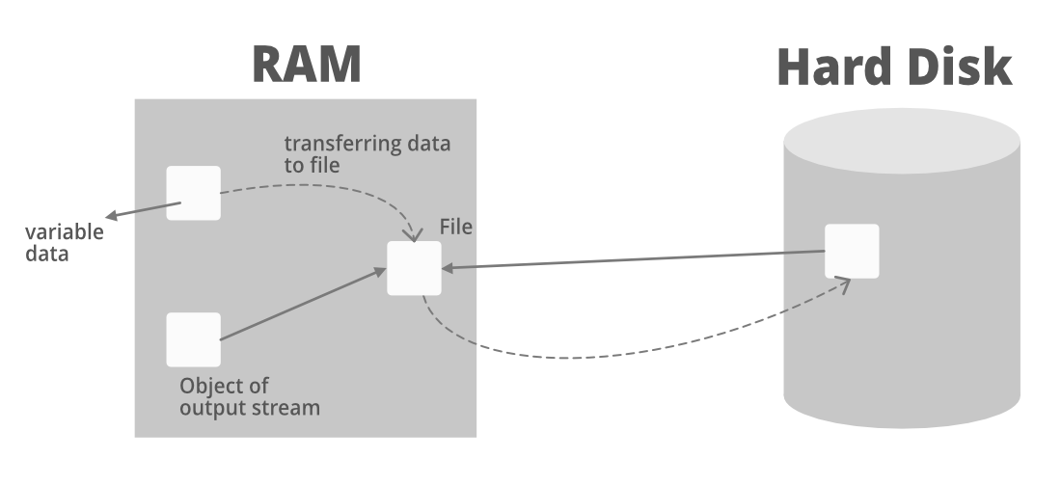
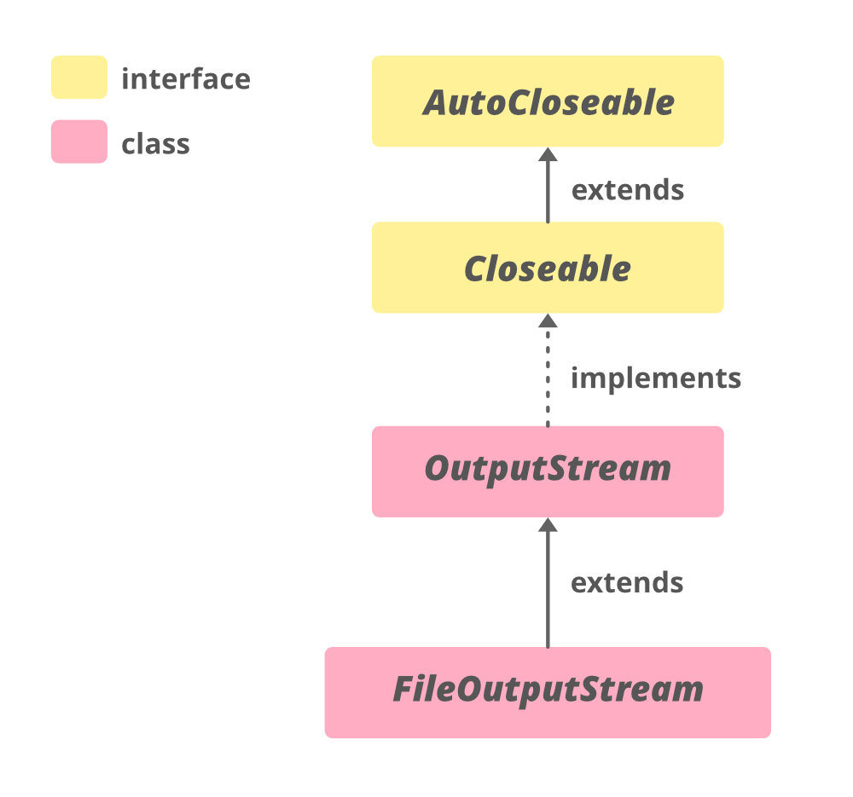
FileOutputStream
FileOutputStream is an outputstream for writing data/streams of raw bytes to file or storing data to file. FileOutputStream is a subclass of OutputStream.
To write primitive values into a file, we use FileOutputStream class.
For writing byte-oriented and character-oriented data, we can use FileOutputStream but for writing character-oriented data, FileWriter is more preferred.
Constructors
FileOutputStream( String name):
FileOutputStream(File file):
FileOutputStream(FileDescripter fdobj): FileOutputStream( String name, boolean append):
FileOutputStream( File file, boolean append):

Slide 10
FileOutputStream Methods & Example
write(): this writes the single byte to the file output stream.
write(byte[] array): this writes the specified array’s bytes to the output stream.
write(byte[] array, int start, int length): this writes the number of bytes equal to length to the output stream from an array starting from the position start.
flush(): For clearing the OutputStream, we use the flush() method. This method forces all the data to get stored to its destination.
import java.io.FileOutputStream;
import java.util.*;
public class Main {
public static void main(String[] args)
{
String data = "Welcome to GfG";
try {
FileOutputStream output
= new FileOutputStream("output.txt");
// The getBytes() method used
// converts a string into bytes array.
byte[] array = data.getBytes();
output.write(array);
output.close();
}
catch (Exception e) {
e.getStackTrace();
}
}
}

Slide 11
BufferedInputStream
A BufferedInputStream adds functionality to another input stream-namely, the ability to buffer the input and to support the mark and reset methods.
When the BufferedInputStream is created, an internal buffer array is created. As bytes from the stream are read or skipped, the internal buffer is refilled as necessary from the contained input stream, many bytes at a time.
Constructors
BufferedInputStream(InputStream in) : Creates a BufferedInputStream and saves its argument, the input stream in, for later use.
BufferedInputStream(InputStream in, int size) : Creates a BufferedInputStream with the specified buffer size, and saves its argument, the input stream in, for later use.

Slide 12
BufferedInputStream Methods
import java.io.BufferedInputStream;
import java.io.FileInputStream;
import java.io.IOException;
class BufferedInputStreamDemo
{
public static void main(String args[]) throws IOException
{
FileInputStream fin = new FileInputStream("file1.txt");
BufferedInputStream bin = new BufferedInputStream(fin);
System.out.println("Number of remaining bytes:" +
bin.available());
boolean b=bin.markSupported();
if (b)
bin.mark(bin.available());
bin.skip(4);
System.out.println("FileContents :");
int ch;
while ((ch=bin.read()) != -1)
System.out.print((char)ch);
bin.reset();
while ((ch=bin.read()) != -1)
System.out.print((char)ch);
fin.close();
}
}
int available()
void mark(int readlimit)
boolean markSupported()
int read()
int read(byte[] b, int off, int len)
void reset()
long skip(long n)
void close()

Slide 13
BufferedOutputStream
Constructors
BufferedOutputStream(OutputStream out) : Creates a new buffered output stream to write data to the specified underlying output stream.
BufferedOutputStream(OutputStream out, int size) : Creates a new buffered output stream to write data to the specified underlying output stream with the specified buffer size.
Java.io.BufferedOutputStream class implements a buffered output stream.
By setting up such an output stream, an application can write bytes to the underlying output stream without necessarily causing a call to the underlying system for each byte written.

Slide 14
BufferedOutputStream Methods
import java.io.*;
class BufferedOutputStreamDemo
{
public static void main(String args[])throws Exception
{
FileOutputStream fout = new FileOutputStream("f1.txt");
//creating bufferdOutputStream obj
BufferedOutputStream bout = new BufferedOutputStream(fout);
//illustrating write() method
for(int i = 65; i < 75; i++)
{
bout.write(i);
}
byte b[] = { 75, 76, 77, 78, 79, 80 };
bout.write(b);
//illustrating flush() method
bout.flush();
//illustrating close() method
bout.close();
fout.close();
}
}
void write(int b) : Writes the specified byte to this buffered output stream.
void write(byte[] b, int off, int len) : Writes len bytes from the specified byte array starting at offset off to this buffered output stream.
void flush() : Flushes this buffered output stream.

Slide 15
DataInputStream & DataOutputStream
import java.io.*;
class DataInputStreamDemo {
public static void main(String args[]) throws IOException {
try ( DataOutputStream dout =
new DataOutputStream(new FileOutputStream("file.dat")) ) {
dout.writeDouble(1.1);
dout.writeInt(55);
dout.writeBoolean(true);
dout.writeChar('4');
}
catch (FileNotFoundException ex) {
FileNotFoundException occurs
System.out.println("Cannot Open the Output File");
return;
}
try ( DataInputStream din =
new DataInputStream(new FileInputStream("file.dat")) ) {
// Illustrating readDouble() method
double a = din.readDouble();
// Illustrating readInt() method
int b = din.readInt();
// Illustrating readBoolean() method
boolean c = din.readBoolean();
// Illustrating readChar() method
char d = din.readChar();
// Print the values
System.out.println("Values: " + a + " " + b + " " + c + " " + d);
}
// Catch block to handle the exceptions
catch (FileNotFoundException e) {
// Display message when FileNotFoundException occurs
System.out.println("Cannot Open the Input File");
return;
}
}
}
A data input stream enables an application to read primitive Java data types from an underlying input stream in a machine-independent way(instead of raw bytes). That is why it is called DataInputStream – because it reads data (numbers) instead of just bytes.
A data output stream lets an application write primitive Java data types to an output stream in a portable way. An application can then use a data input stream to read the data back in. Let us do discuss the constructor of this class prior to moving ahead to the methods of this class.

Slide 16
PrintStream Class
import java.io.FileNotFoundException;
import java.io.FileOutputStream;
import java.io.PrintStream;
import java.util.Locale;
//Java program to demonstrate PrintStream methods
class Printstream
{
public static void main(String args[]) throws FileNotFoundException
{
FileOutputStream fout=new FileOutputStream("file.txt");
//creating Printstream obj
PrintStream out=new PrintStream(fout);
String s="First";
//writing to file.txt
char c[]={'G','E','E','K'};
//illustrating print(boolean b) method
out.print(true);
//illustrating print(int i) method
out.print(1);
//illustrating print(float f) method
out.print(4.533f);
//illustrating print(String s) method
out.print("GeeksforGeeks");
out.println();
//illustrating print(Object Obj) method
out.print(fout);
out.println();
//illustrating append(CharSequence csq) method
out.append("Geek");
out.println();
//illustrating checkError() method
out.println(out.checkError());
//illustrating format() method
out.format(Locale.UK, "Welcome to my %s program", s);
//illustrating flush method
out.flush();
//illustrating close method
out.close();
}
}
A PrintStream adds functionality to another output stream, namely the ability to print representations of various data values conveniently.
Unlike other output streams, a PrintStream never throws an IOException; instead, exceptional situations merely set an internal flag that can be tested via the checkError method.
Optionally, a PrintStream can be created so as to flush automatically.
All characters printed by a PrintStream are converted into bytes using the platform’s default character encoding.
The PrintWriter class should be used in situations that require writing characters rather than bytes.

Slide 17
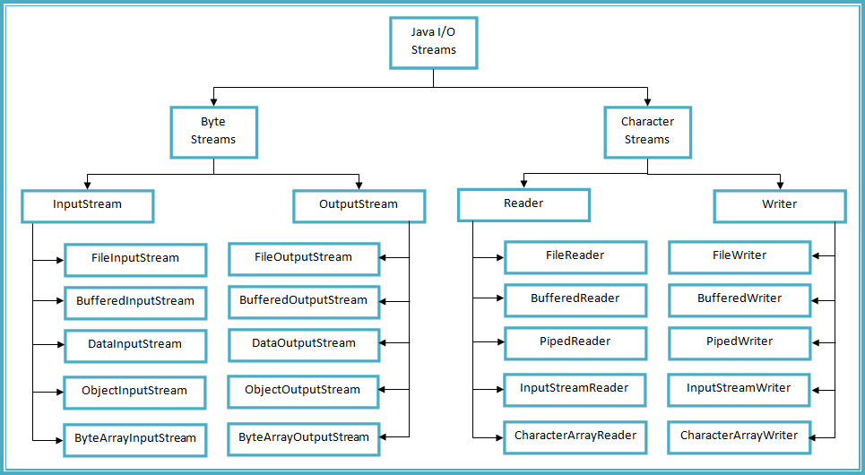
Classes

Slide 18
File
File f=new File("abc.txt");
This line 1st checks whether abc.txt file is already available (or) not if it is already available then "f" simply refers that file.
If it is not already available then it won't create any physical file just creates a java File
object represents name of the file.
Example:
import java.io.*;
class FileDemo
{
public static void main(String[] args)throws IOException
{
File f=new File("cricket.txt");
System.out.println(f.exists());//false
f.createNewFile();
System.out.println(f.exists());//true
}
}

Slide 19
File
A java File object can represent a directory also.
Example:
import java.io.*;
class FileDemo
{
public static void main(String[] args)throws IOException
{
File f=new File("cricket123");
System.out.println(f.exists());//false
f.mkdir();
System.out.println(f.exists());//true
}
}

Slide 20
Constructor of File Class
File f=new File(String name);
Creates a java File object that represents name of the file or directory in current working directory.
File f=new File(String subdirname,String name);
Creates a File object that represents name of the file or directory present in specified sub directory.
File f=new File(File subdir,String name);
File(URI uri);
import java.io.*;
class FileDemo
{
public static void main(String[] args)throws IOException
{
File f1=new File("file123");
f1.mkdir();
File f2=new File("file123","abc.txt");
f2.createNewFile();
}
}
import java.io.*;
class FileDemo
{
public static void main(String[] args)throws IOException
{
File f=new File("c:\\file123","demo.txt");
f.createNewFile();
}
}

Slide 21
Important Methods of File
boolean exists();
Returns true if the physical file or directory available.
boolean createNewFile();
This method 1st checks whether the physical file is already available or not if it is already available then this method simply returns false without creating any physical file.
If this file is not already available then it will create a new file and returns true
boolean mkdir();
This method 1st checks whether the directory is already available or not if it is already available then this method simply returns false without creating any directory.
If this directory is not already available then it will create a new directory and returns true
boolean isFile();
Returns true if the File object represents a physical file.
boolean isDirectory();
Returns true if the File object represents a directory.
String[] list();
It returns the names of all files and subdirectories present in the specified directory.
long length();
Returns the no of characters present in the file.
boolean delete();
To delete a file or directory.

Slide 22
FileWriter
By using FileWriter object we can write character data to the file.
Methods
write(int ch);
To write a single character to the file.
write(char[] ch);
To write an array of characters to the file.
write(String s);
To write a String to the file.
flush(); To give the guarantee the total data include last character also written to the file.
close(); To close the stream.
Constructors
FileWriter fw = new FileWriter(String name);
FileWriter fw = new FileWriter(File f);
The above 2 constructors meant for overriding.
Instead of overriding if we want append operation then we should go for the following 2 constructors.
FileWriter fw = new FileWriter(String name,boolean append);
FileWriter fw = new FileWriter(File f,boolean append);
If the specified physical file is not already available then these constructors will create that file.

Slide 23
Examples
import java.io.*;
class FileWriterDemo
{
public static void main(String[] args)throws IOException
{
FileWriter fw=new FileWriter("cricket.txt",true);
fw.write(99); //adding a single character
fw.write("file\nwriter example");
fw.write("\n");
char[] ch={'a','b','c'};
fw.write(ch);
fw.write("\n");
fw.flush();
fw.close();
}
}
Output:
cfile
writer example
abc
The main problem with FileWriter is we have to insert line separator manually, which is difficult to the programmer. ('\n')
And even line separator varying from system to system.

Slide 24
FileReader
By using FileReader object we can read character data from the file.
Methods
int read(); It attempts to read next character from the file and return its Unicode value. If the next character is not available then we will get -1.
int i=fr.read();
System.out.println((char)i); As this method returns uni code value , while printing we have to perform type casting.
int read(char[] ch);
It attempts to read enough characters from the file into char[] array and returns the no of characters copied from the file into char[] array.
File f=new File("abc.txt");
Char[] ch=new Char[(int)f.length()];
void close();
Constructors
FileReader fr = new FileReader(String name);
FileReader fr = new FileReader (File f)

Slide 25
Examples
class FileReaderDemo
{
public static void main(String[] args)throws IOException
{
FileReaderfr=new FileReader("cricket.txt");
int i=fr.read();
//more amount of data
while(i!=-1)
{
System.out.print((char)i);
i=fr.read();
}
}
}
Output:
Charan
Software solutions
ABC
import java.io.*;
classFileReaderDemo
{
public static void main(String[] args)throws IOException
{
File f = new File("cricket.txt");
FileReader fr = new FileReader(f);
char[] ch=new char[(int)f.length()]; //small
//amount of data
fr.read(ch);
for(char ch1:ch)
{
System.out.print(ch1);
}
}
}
Output:
XYZ
Software solutions.
Usage of FileWriter and FileReader is not recommended because :
While writing data by FileWriter compulsory we should insert line separator(\n) manually which is a bigger headache to the programmer.
While reading data by FileReader we have to read character by character instead of line by line which is not convenient to the programmer.
To overcome these limitations we should go for BufferedWriter and BufferedReader concepts.

Slide 26
BufferedWriter
By using BufferedWriter object we can write character data to the file.
Methods
write(intch);
write(char[] ch);
write(String s);
flush();
close();
newline();
Inserting a new line character to the file.
Constructors
BufferedWriter bw = new BufferedWriter(writer w);
BufferedWriter bw = new BufferedWriter(writer w, int buffersize);
BufferedWriter never communicates directly with the file it should communicates via some writer object.
BufferedWriter bw = new BufferedWriter("cricket.txt"); (invalid)
BufferedWriter bw = new BufferedWriter (new File("cricket.txt")); (invalid)
BufferedWriter bw = new BufferedWriter (new FileWriter("cricket.txt")); (valid)

Slide 27
Advantage over FileWriter
When compared with FileWriter which of the following capability(facility) is available as method in BufferedWriter.
Writing data to the file.
Closing the writer.
Flush the writer.
Inserting new line character.
Example:
import java.io.*;
class BufferedWriterDemo
{
public static void main(String[] args)throws IOException
{
FileWriter fw= new FileWriter("cricket.txt");
BufferedWriter bw = new BufferedWriter(fw);
bw.write(100);
bw.newLine();
char[] ch={'a','b','c','d'};
bw.write(ch);
bw.newLine();
bw.write("Buffered");
bw.newLine();
bw.write("writer example");
bw.flush();
bw.close();
}
}
Output:
d
abcd
Buffered
writer example

Slide 28
BufferedReader
This is the most enhanced(better) Reader to read character data from the file.
Methods
int read();
int read(char[] ch);
String readLine();
It attempts to read next line and return it , from the File. if the next line is not available then this method returns null.
void close();
Constructors
BufferedReader br=new BufferedReader(Reader r);
BufferedReader br=new BufferedReader(Reader r, int buffersize);
BufferedReader can not communicate directly with the File it should communicate via some Reader object.
The main advantage of BufferedReader over FileReader is we can read data line by line instead of character by character.

Slide 29
Example
import java.io.*;
class BufferedReaderDemo
{
public static void main(String[] args)throws IOException
{
FileReader fr = new FileReader("cricket.txt");
BufferedReader br = new BufferedReader(fr);
String line = br.readLine();
while(line!=null)
{
System.out.println(line);
line=br.readLine();
}
br.close();
}
}
Whenever we are closing BufferedReader automatically underlying FileReader will be closed it is not required to close explicitly.
Even this rule is applicable for BufferedWriter also.

Slide 30
Thank you

