Slide 1
JAVA Serialization

Slide 2
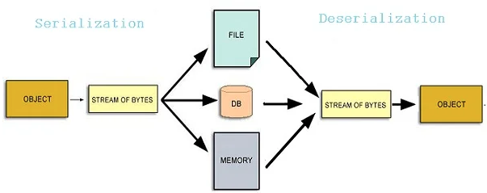
Serialization and Deserialization in Java
Serialization in Java allows us to convert an Object to stream that we can send over the network or save it as file or store in DB for later usage. Deserialization is the process of converting Object stream to actual Java Object to be used in our program.
Serialization in Java is a mechanism of writing the state of an object into a byte-stream. . It is mainly used in Hibernate, RMI, JPA, EJB and JMS technologies.
The reverse operation of serialization is called deserialization where byte-stream is converted into an object.
The serialization and deserialization process is platform-independent, it means you can serialize an object on one platform and deserialize it on a different platform.
For serializing the object, we call the writeObject() method of ObjectOutputStream class, and for deserialization we call the readObject() method of ObjectInputStream class.
We must have to implement the Serializable interface for serializing the object.
Advantages of Java Serialization:
  It is mainly used to travel object's
  state on the network

Slide 3
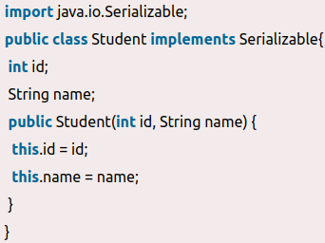
java.io.Serializable interface
Marker interface:
  It is an empty interface (no field or methods). Examples of marker interface are Serializable, Cloneable interface. All these interfaces are empty interfaces.
Serializable is a marker interface (has no data member and method). It is used to "mark" Java classes so that the objects of these classes may get a certain capability. The Cloneable is also a marker interface.
The Serializable interface must be implemented by the class whose object needs to be persisted.
Let's see the example given below:
  In the this example, Student class implements
  Serializable interface. Now its objects can be
  converted into stream. The main class
  implementation of is showed in the next code.
Example of marker interface:
  public interface Serializable
  {
  // nothing here
  }

Slide 4
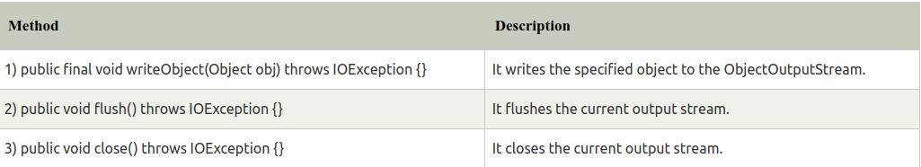
ObjectOutputStream class
The ObjectOutputStream class is used to write primitive data types, and Java objects to an OutputStream. Only objects that support the java.io.Serializable interface can be written to streams.
Constructor:
Important Methods:
ObjectInputStream class:
  An ObjectInputStream deserializes objects and primitive data written using an ObjectOutputStream.
Constructor:

Slide 5
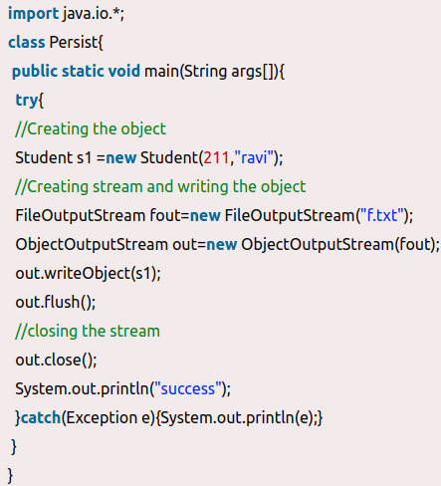
Example of Java Serialization
In this example, we are going to serialize the object of Student class from above code. The writeObject() method of ObjectOutputStream class provides the functionality to serialize the object. We are saving the state of the object in the file named f.txt.
Output: success

Slide 6
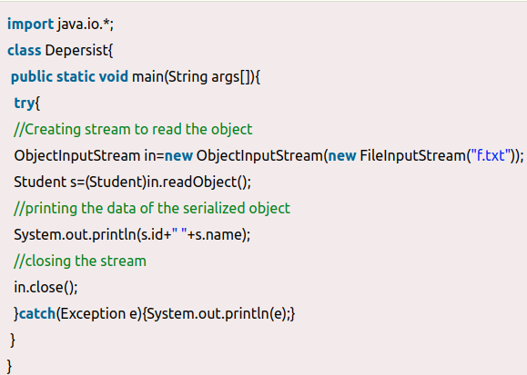
Example of Java Deserialization
Deserialization is the process of reconstructing the object from the serialized state. It is the reverse operation of serialization. Let's see an example where we are reading the data from a deserialized object.
Output: 211 ravi

Slide 7
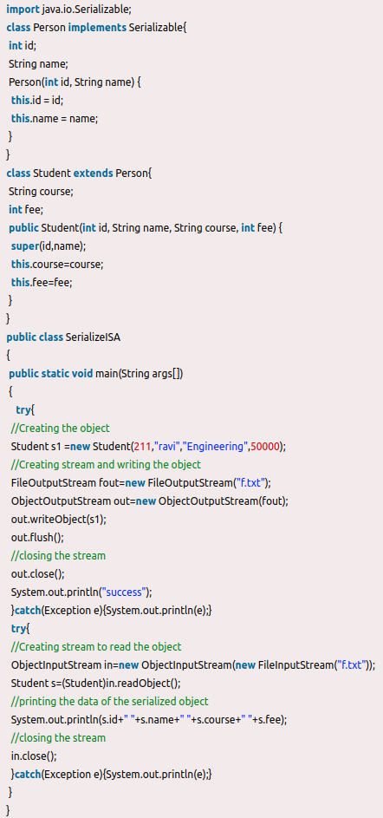
Java Serialization with Inheritance (IS-A Relationship)
If a class implements Serializable interface then all its sub classes will also be serializable. Let's see the example given below:
The SerializeISA class has serialized the Student
class object that extends the Person class which is
Serializable. Parent class properties are inherited to
subclasses so if parent class is Serializable, subclass
would also be.
Output:
success
211 ravi Engineering 50000

Slide 8
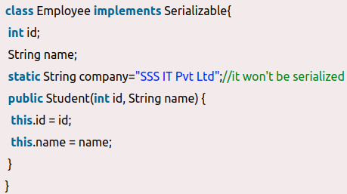
Java Serialization with the static data member
If there is any static data member in a class,it will not be serialized because static is the
part of class not object.

Slide 9
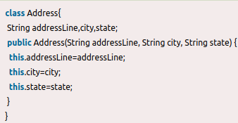
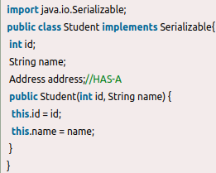
Java Serialization with Aggregation (HAS-A Relationship)
If a class has a reference to another class, all the references must be Serializable otherwise serialization process will not be performed. In such case, NotSerializableException is thrown at runtime.
Since Address is not Serializable, you cannot serialize the instance of the Student class.

Slide 10
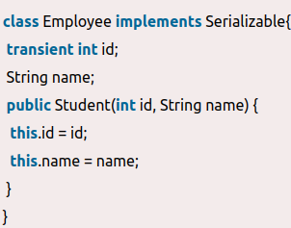
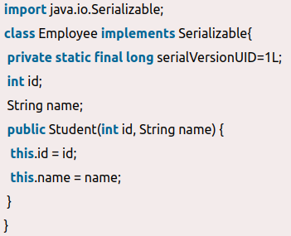
Java Transient Keyword
If you don't want to serialize any data member of a class, you can mark it as transient.
Now, id will not be serialized, so when you deserialize the
object after serialization, you will not get the value of id. It
will return default value always. In such case, it will return
0 because the data type of id is an integer.
SerialVersionUID:
  The serialization process at runtime associates an id
  with each Serializable class which is known as
  SerialVersionUID. It is used to verify the sender and
  receiver of the serialized object. The sender and
  receiver must have the same SerialVersionUID,
  otherwise, InvalidClassException will be thrown when
  deserialize the object. We can also declare our own
  SerialVersionUID in the Serializable class. To do so,
  need to create a field SerialVersionUID and assign
  a value to it. It must be of the long type with static
  and final. It is suggested to explicitly declare the
  serialVersionUID field in the class and have it private
  also. For example:

Slide 11
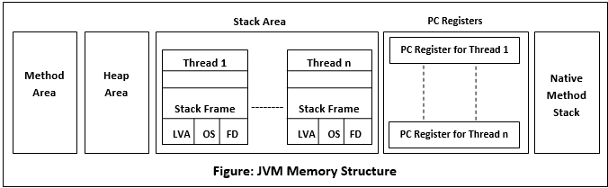
Memory Management in Java
In Java, memory management is the process of allocation and de-allocation of objects, called Memory management. Java does memory management automatically.
Java uses an automatic memory management system called a garbage collector. Thus, we are not required to implement memory management logic in an application. Java memory management divides into two major parts:
  JVM Memory Structure
  Working of the Garbage Collector
JVM Memory Structure
  JVM creates various run time data areas in a heap. These areas are used during the program execution. The memory areas are destroyed when JVM exits, whereas the data areas are destroyed when the thread exits.

Slide 12
Stack Area
Stack Area:
  Stack Memory in Java is used for static memory allocation and the execution of a thread. It contains primitive values that are specific to a method and references to objects referred from the method that are in a heap.
  Access to this memory is in Last-In-First-Out (LIFO) order. Whenever we call a new method, a new block is created on top of the stack which contains values specific to that method, like primitive variables and references to objects.
  When the method finishes execution, its corresponding stack frame is flushed, the flow goes back to the calling method, and space becomes available for the next method.
Key Features of Stack Memory:
  It grows and shrinks as new methods are called and returned, respectively.
  Variables inside the stack exist only as long as the method that created them is running.
  It's automatically allocated and deallocated when the method finishes execution.
  If this memory is full, Java throws java.lang.StackOverFlowError.
  Access to this memory is fast when compared to heap memory.
  This memory is threadsafe, as each thread operates in its own stack.
Native Method Stack:
  It is also known as C stack. It is a stack for native code written in a language other than Java. Java Native Interface (JNI) calls the native stack.
PC Registers:
  Each thread has a Program Counter (PC) register associated with it. PC register stores the return address. It also contains the address of the JVM instructions currently being executed.

Slide 13
Heap Area
Method/Class Area
  In the method area, all class level information like class name, immediate parent class name and methods are stored, including static variables. There is only one method area per JVM, and it is a shared resource.
Heap Area
  Heap space is used for the dynamic memory allocation of Java objects. New objects are always created in heap space, and the references to these objects are stored in stack memory. These objects have global access and we can access them from anywhere in the application.
  We can break this memory model down into smaller parts, called generations, which are:
    Young Generation – this is where all new objects are allocated and aged.
    Old or Tenured Generation – this is where long surviving objects are stored. When objects are stored in the Young Generation, a threshold for the object's age is set, and when that threshold is reached, the object is moved to the old generation.
    Permanent Generation – This memory segment contains metadata about the classes and methods in the program. Since these are long-lasting they are moved to the permanent section. However, these objects are also cleaned up if a particular class does not exist anymore. The string constant pool in Java is in the permanent generation.
Key Features of Java Heap Memory
  It's accessed via complex memory management techniques that include the Young, Old or Tenured, and Permanent Generation.
  If heap space is full, Java throws java.lang.OutOfMemoryError.
  Access to this memory is comparatively slower than stack memory
  This memory, in contrast to stack, isn't automatically deallocated. It needs Garbage Collector to free up unused objects so as to keep the efficiency of the memory usage.

Slide 14
How to make object eligible for garbage collection in Java?
An object is eligible to be garbage collected if its reference variable is lost from the program during execution.Sometimes they are also called unreachable objects.
What is reference of an object?
  The new operator dynamically allocates memory for an object and returns a reference to it. This reference is the address in memory of the object allocated by new. A reference is an address that indicates where an object’s variables are stored
    Box mybox = new Box(); //referencing to object
Role of an unreachable objects in java:
  In java, the memory allocated at runtime i.e. heap area can be made free by the process of garbage collection. Only the objects who have no longer reference to them are eligible for garbage collection in java.
Ways to make an object eligible for garbage collection:
  Please note that the object can not become a candidate for garbage collection until all references to it are discarded.
    Object created inside a method
    Reassigning the reference variable
    Nullifying the reference variable
    Anonymous object

Slide 15
How to call explicitly Garbage Collection in Java
Finalization in Java:
  As soon as the garbage collector clears the object, the compiler executes the finalize() method.
  This method generally contains actions which the JVM performs just before the object gets deleted.
  The Object class contains the finalize() method. Remember to override the finalize method in the class whose objects will be garbage collected.
Methods for calling the Garbage Collector in Java
  There are 2 ways to call the garbage collector in java.
    Can use the Runtime.getRuntime().gc() method- This class allows the program to interface with the Java Virtual machine. The “gc()” method allows us to call the garbage collector method.
    Can also use the System.gc() method which is common.

Slide 16
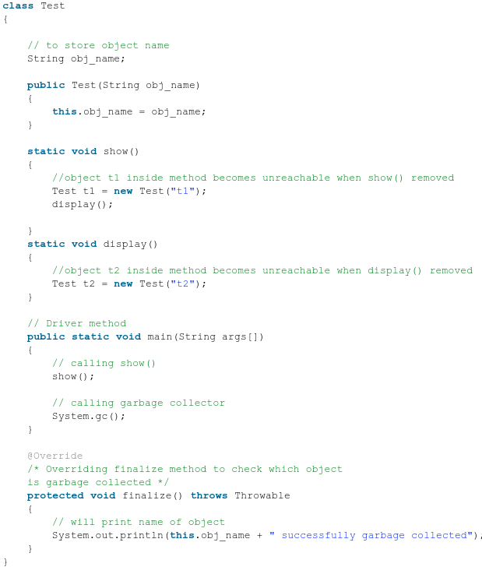
Object created inside a method
When a method is called it goes inside the stack frame. When the method is popped from the stack, all its members dies and if some objects were created inside it then these objects becomes unreachable or anonymous after method execution and thus becomes eligible for garbage collection
Note : If a method returns the object created
inside it and we store this object reference by
using a reference-type variable than it is no
longer eligible for garbage collection.
Output:
t2 successfully garbage collected
t1 successfully garbage collected

Slide 17
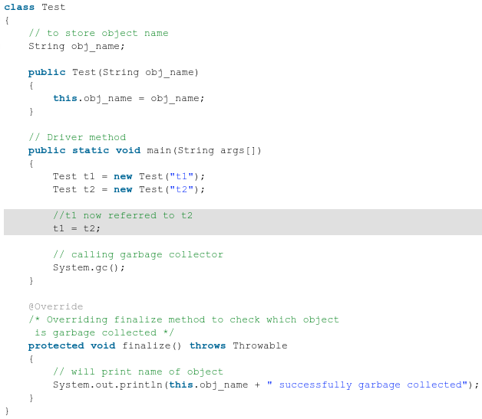
Reassigning the reference variable
When reference id of one object is referenced to reference id of some other object then the previous object has no any longer reference to it and becomes unreachable and thus becomes eligible for garbage collection.
Output:
t1 successfully garbage collected

Slide 18
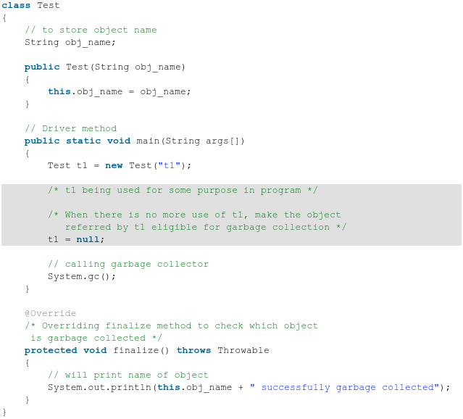
Nullifying the reference variable
When all the reference variables of an object are changed to NULL, it becomes unreachable and thus becomes eligible for garbage collection
Output:
t1 successfully garbage collected

Slide 19
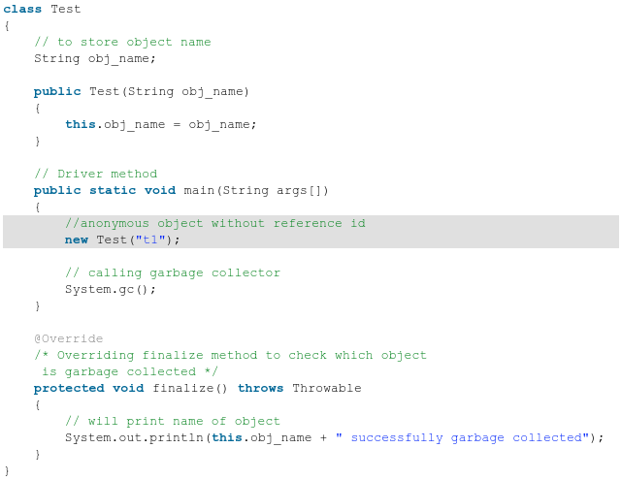
Anonymous object
The reference id of an anonymous object is not stored anywhere. Hence, it becomes unreachable
Output:
t1 successfully garbage collected

Slide 20
Working of Garbage Collector
Garbage Collector Overview:
  When a program executes in Java, it uses memory in different ways. The heap is a part of memory where objects live. It’s the only part of memory that involved in the garbage collection process. It is also known as garbage collectible heap.
  All the garbage collection makes sure that the heap has as much free space as possible. The function of the garbage collector is to find and delete the objects that cannot be reached.
Object Allocation:
  When an object allocates, the JVM checks the size of the object. It distinguishes between small and large objects. The small and large size depends on the JVM version, heap size, garbage collection strategy, and platform used. The size of an object is usually between 2 to 128 KB.

Slide 21
What does Java Garbage Collector?
JVM controls the garbage collector. JVM decides when to perform the garbage collection. We can also request to the JVM to run the garbage collector.
JVM runs the garbage collector if it senses that memory is running low. When Java program request for the garbage collector, the JVM usually grants the request in short order.
The point to understand is that "when an object becomes eligible for garbage collection?"
  Every Java program has more than one thread. Each thread has its execution stack. There is a thread to run in Java program that is a main() method.
  Now we can say that an object is eligible for garbage collection when no live thread can access it. The garbage collector considers that object as eligible for deletion. If a program has a reference variable that refers to an object, that reference variable available to live thread, this object is called reachable.
Here a question arises that "Can a Java application run out of memory?"
  The answer is yes. The garbage collection system attempts to objects from the memory when they are not in use. Though, if you are maintaining many live objects, garbage collection does not guarantee that there is enough memory. Only available memory will be managed effectively.

Slide 22
Mark and Sweep Algorithm
Java Garbage Collection Algorithms used to remove the unreachable objects, it always runs in the background. There are different types of Garbage Collection Algorithms in Java that run in the background, and among them, one is a Mark and Sweep algorithm.
Mark and Sweep Algorithm
  An algorithm for Java Garbage Collection should basically perform two functions. Firstly, it should locate and detect unreachable objects and secondly, it should free that the space from the memory heap so that it can be used by the programmer again.
The two phases of Java Garbage Collection Algorithm are
  Mark Phase
    When an object is created, its mark bit is set to 0(false). In the Mark phase, we set the marked bit for all the reachable objects to 1(true).
  Sweep Phase
    As the name suggests it “sweeps” the unreachable objects i.e. it clears the heap memory for all the unreachable objects. All those objects whose marked value is set to false are cleared from the heap memory, for all other objects (reachable objects) the marked bit is set to true.
The mark-and-sweep algorithm is called a tracing garbage collector because it traces out the entire collection of objects that are directly or indirectly accessible by the program.

Slide 23
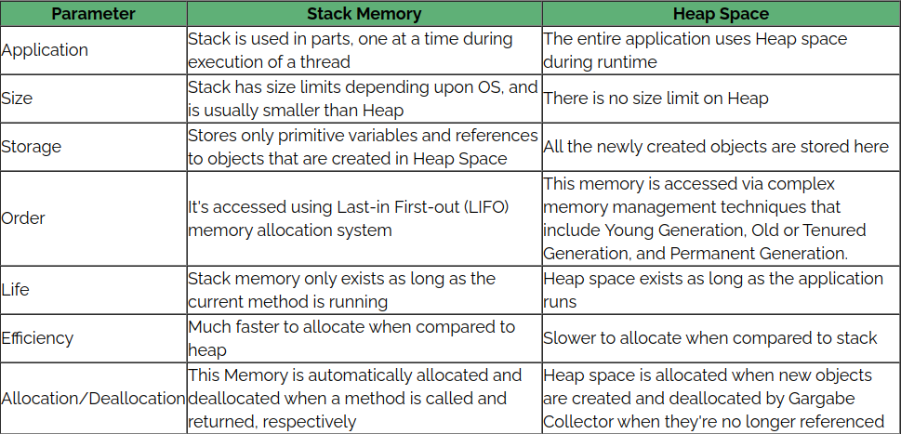
Differences between Stack and Heap memory
Let's quickly summarize the differences between the Stack Memory and the Heap Space:

Slide 24
Reference Types
There are four types of references: Strong, Weak, Soft, and Phantom reference. The difference among the types of references is that the objects on the heap they refer to are eligible for garbage collecting under the different criteria.
Strong reference: This is the default type of Reference Object. Any object which has an active strong reference are not eligible for garbage collection. The object is garbage collected only when the variable which was strongly referenced points to null.
    StringBuilder sb= new StringBuilder();
  Usage: default way of initialiation
Weak reference: If JVM detects an object with only weak references (i.e. no strong or soft references linked to any object), this object will be marked for garbage collection.
  These references are used in real time applications while establishing a DBConnection which might be cleaned up by Garbage Collector when the application using the database gets closed.
    WeakReference<StringBuilder> reference = new WeakReference<>(new StringBuilder());
  Usage: will make the ref null as soon as the ref is also made null
  Example is weakshashmap
Soft Reference: In Soft reference, even if the object is free for garbage collection then also its not garbage collected, until JVM is in need of memory badly. The objects gets cleared from the memory when JVM runs out of memory. To create such references java.lang.ref.SoftReference class is used.
    SoftReference<StringBuilder> reference = new SoftReference<>(new StringBuilder());
  softref ==> is used in cases when we need to keep the ref till the ast possible time
  Example is in memory DB / caching
Phantom Reference: It is defined in java.lang.ref.PhantomReference class. The object which has only phantom reference pointing them can be collected whenever garbage collector wants to collect.
    PhantomReference<StringBuilder> reference = new PhantomReference<>(new StringBuilder());
  Used in cases when we need to check the memory mgmt ,will be useful in cases of the memoy profiling

Slide 25
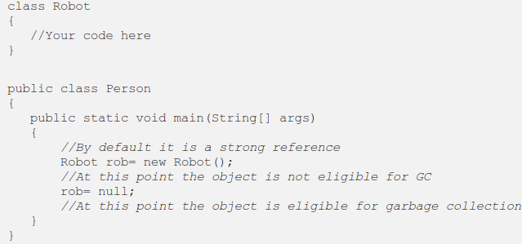
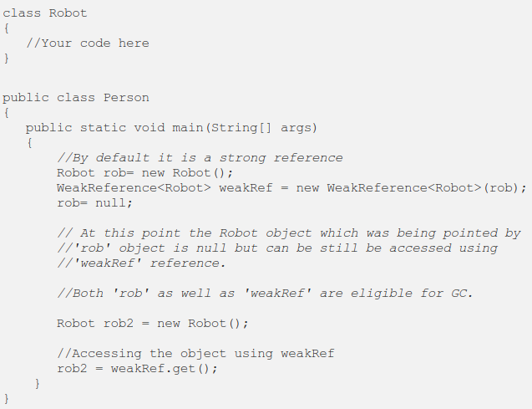
Example of Reference Types
Strong References:
  These references are the one which we
  usually use in our day to day programming.
Weak References:
  Weak references are the one which points
  out to Strong reference since we need to
  specify them explicitly while we write the
  code. Consider the below code snippet.

Slide 26
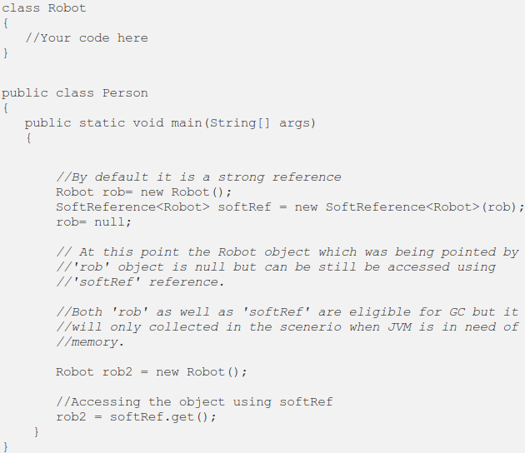
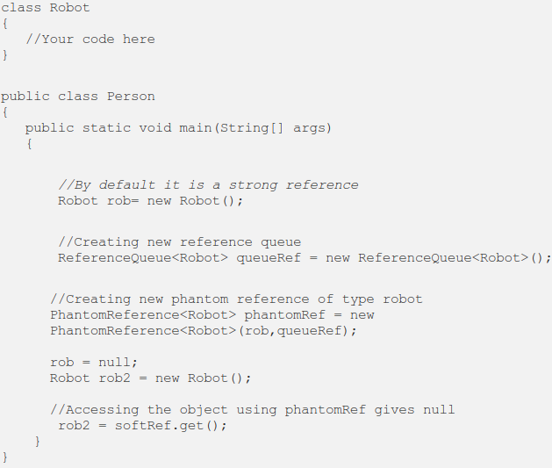
Example of Reference Types
Strong References:
  Soft references are similar to weak references
  except that they are only garbage collected
  when the JVM has an extreme shortage of
  memory(Unlike weak references which are
  immediately available for garbage collection).
Phantom References:
  Phantom references are the least used
  references in Java. They are always used along
  with reference queue and to keep a track of
  objects which have been finalized.
  Basically, phantom references are used when
  we want to load another large object only after
  the previous object has been garbage collected
  thereby avoiding out of memory error

Slide 27
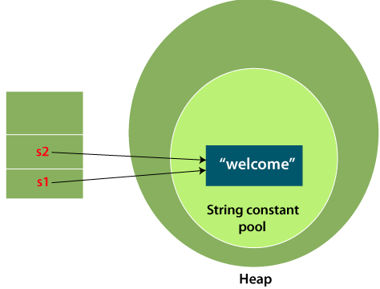
String
What is String in Java?
  Generally, String is a sequence of characters. But in Java, string is an object that represents a sequence of characters. The java.lang.String class is used to create a string object.
How to create a string object?
There are two ways to create String object:
  By string literal
  By new keyword
String Literal:
  Java String literal is created by using double
  quotes.
  For Example:
    String s="welcome";
Each time you create a string literal, the JVM
checks the "string constant pool" first. If the
string already exists in the pool, a reference
to the pooled instance is returned. If the string
doesn't exist in the pool, a new string instance
is created and placed in the pool. For example:

Slide 28
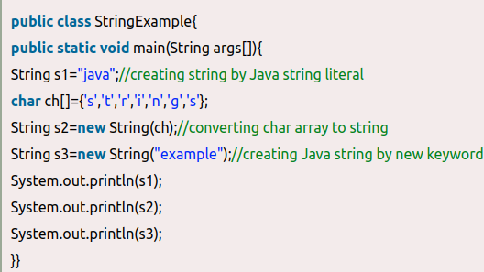
String
In the previous example, only one object will be created. Firstly, JVM will not find any string object with the value "Welcome" in string constant pool that is why it will create a new object. After that it will find the string with the value "Welcome" in the pool, it will not create a new object but will return the reference to the same instance.
Note: String objects are stored in a special memory area known as the "string constant pool".
Why Java uses the concept of String literal?
  To make Java more memory efficient (because no new objects are created if it exists already in the string constant pool).
By new keyword:
  String s=new String("Welcome");//creates
  two objects and one reference variable
In such case, JVM, will create a new string
object in normal (non-pool) heap memory,
and the literal "Welcome" will be placed in
the string constant pool. The variable s will
refer to the object in a heap (non-pool).

Slide 29
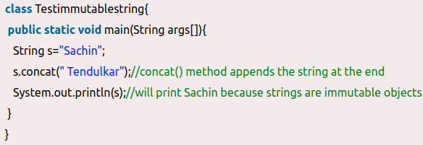
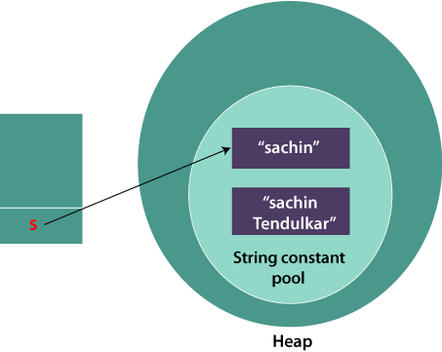
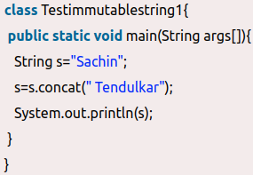
Immutable String in Java
String references are used to store various attributes like username, password, etc. In Java, String objects are immutable. Immutable simply means unmodifiable or unchangeable.
Once String object is created its data or state can't be changed but a new String object is created.
Let's try to understand the concept of immutability by the example given below:
Now it can be understood by the diagram.
Here Sachin is not changed but a new
object is created with Sachin Tendulkar.
That is why String is known as immutable.
As you can see in the above figure that two
objects are created but s reference variable
still refers to "Sachin" not to "Sachin Tendulkar".
But if we explicitly assign it to the reference
variable, it will refer to "Sachin Tendulkar" object.

Slide 30
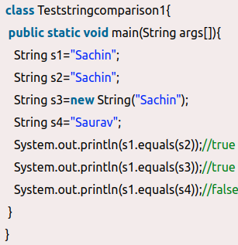
Java String compare
Why String objects are immutable in Java?
  As Java uses the concept of String literal. Suppose there are 5 reference variables, all refer to one object "Sachin". If one reference variable changes the value of the object, it will be affected by all the reference variables. That is why String objects are immutable in Java.
We can compare String in Java on the basis of content and reference.
It is used in content (by equals() method), reference matching (by == operator) etc.
By Using equals() Method:
  The String class equals() method compares
  the original content of the string. It compares
  values of string for equality. String class
  provides the following two methods
    public boolean equals(Object another)
    compares this string to the specified object.
    public boolean equalsIgnoreCase(String another)
    compares this string to another string, ignoring
    case.

Slide 31
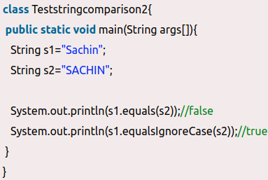
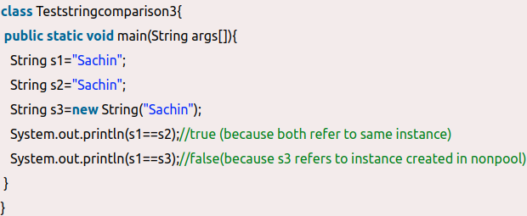
Java String compare
Example of equalIgnoreCase:
  the methods of String class are used. The
  equals() method returns true if String
  objects are matching and both strings are
  of same case. equalsIgnoreCase() returns
  true regardless of cases of strings.
By Using == operator:
  The == operator compares references not values.

Slide 32
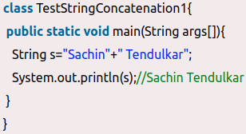
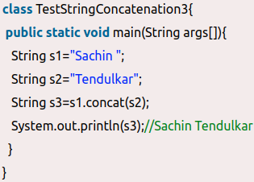
String Concatenation in Java
In Java, String concatenation forms a new String that is the combination of multiple strings. There are two ways to concatenate strings in Java:
  By + (String concatenation) operator
  By concat() method
String Concatenation by + operator:
  Java String concatenation operator (+)
  is used to add strings. For Example
String Concatenation by concat() method:
  The String concat() method concatenates the specified string to the end of current string. Syntax:
    public String concat(String another)
Let's see the example of String concat() method.
  The above Java program, concatenates two
  String objects s1 and s2 using concat() method
  and stores the result into s3 object.

Slide 33
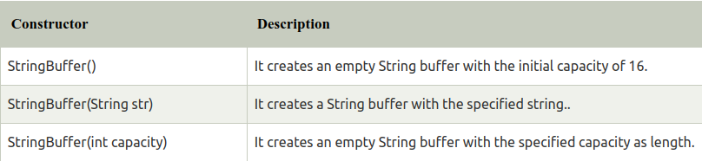
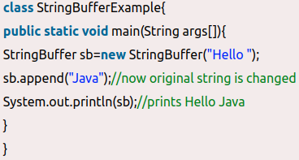
Java StringBuffer Class
Java StringBuffer class is used to create mutable (modifiable) String objects. The StringBuffer class in Java is the same as String class except it is mutable i.e. it can be changed.
Note: Java StringBuffer class is thread-safe i.e. multiple threads cannot access it simultaneously. So it is safe.
Important Constructors of StringBuffer Class
What is a mutable String?
  A String that can be modified or changed
  is known as mutable String. StringBuffer and
  StringBuilder classes are used for creating
  mutable strings.
StringBuffer Class append() Method:
  The append() method concatenates
  the given argument with this String.

Slide 34
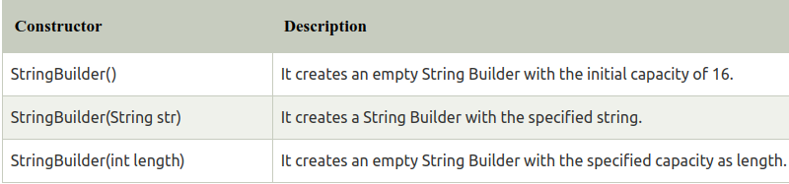
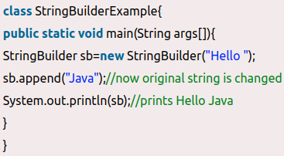
Java StringBuilder Class
Java StringBuilder class is used to create mutable (modifiable) String. The Java StringBuilder class is same as StringBuffer class except that it is non-synchronized.
Important Constructors of StringBuilder class
Java StringBuilder Example
  Let's see the examples of StringBuilder class.
StringBuilder append() method
  The StringBuilder append() method concatenates
  the given argument with this String.

Slide 35
String vs StringBuffer vs StringBuilder
String is immutable whereas StringBuffer and StringBuilder are mutable classes.
StringBuffer is thread-safe and synchronized whereas StringBuilder is not. That’s why StringBuilder is faster than StringBuffer.
String concatenation operator (+) internally uses StringBuffer or StringBuilder class.
For String manipulations in a non-multi threaded environment, we should use StringBuilder else use StringBuffer class.

Slide 36
Thank You

