Slide 1
MultiThreading in Java

Slide 2
Introduction
Multitasking: Executing several tasks simultaneously is the concept of multitasking.
Thread based multitasking
Executing several tasks simultaneously where each task is a separate independent part of the same program, is called Thread based multitasking.
And each independent part is called a "Thread".
This type of multitasking is best suitable for "programmatic level".
When compared with "C++", developing multithreading examples is very easy in java because java provides in-built support for multithreading through a rich
API (Thread, Runnable, ThreadGroup, ThreadLocal...etc).
In multithreading on 10% of the work the programmer is required to do and 90% of the work will be down by java API.
Process based multitasking
Executing several tasks simultaneously where each task is a separate independent process such type of multitasking is called process based multitasking.
Example:
While typing a java program in the editor we can able to listen mp3 audio songs at the same time we can download a file from the net all these tasks are independent of each other and executing simultaneously and hence it is Process based multitasking.
This type of multitasking is best suitable at "os level".

Slide 3
MultiThreading in Java
Multithreading is a Java feature that allows concurrent execution of two or more parts of a program for maximum utilization of CPU. Each part of such program is called a thread. So, threads are light-weight processes within a process.
Threads can be created by using two mechanisms :
Extending the Thread class
Implementing the Runnable Interface
class MultithreadingDemo extends Thread {
public void run()
{
try {
System.out.println("Thread " + Thread.currentThread().getId()
+ " is running");
}
catch (Exception e) {
System.out.println("Exception is caught");
}
}
}
public class Multithread {
public static void main(String[] args)
{
int n = 8; // Number of threads
for (int i = 0; i < n; i++) {
MultithreadingDemo object = new MultithreadingDemo();
object.start();
}
}
}
Thread 15 is running
Thread 14 is running
Thread 16 is running
Thread 12 is running
Thread 11 is running
Thread 13 is running
Thread 18 is running
Thread 17 is running

Slide 4
Cases
class Multithread extends Thread { //defining a Thread
public void run()
{
for (int i = 0; i < 10; i++) {
System.out.println("child Thread");
}
}
}
class ThreadDemo
{
public static void main(String[] args)
{
MyThread t=new MyThread(); //Instantiation of a Thread
t.start(); //starting of a Thread
for(int i=0;i<5;i++)
{
System.out.println("main thread");
}
}
}
Entire output produced by only main Thread.
Case 1: Thread Scheduler:
If multiple Threads are waiting to execute then which Thread will execute 1st is decided by "Thread Scheduler" which is part of JVM.
Which algorithm or behavior followed by Thread Scheduler we can't expect exactly it is the JVM vendor dependent hence in multithreading examples we can't expect exact execution order and exact output.
Case 2: Difference between t.start() and t.run() methods.
In the case of t.start() a new Thread will be created which is responsible for the execution of run() method.
But in the case of t.run() no new Thread will be created and run() method will be executed just like a normal method by the main Thread.
In the above program if we are replacing t.start() with t.run() the following is the output.
Output:
child thread
child thread
child thread
child thread
child thread
child thread
child thread
child thread
child thread
child thread
main thread
main thread
main thread
main thread

Slide 5
Cases
Case 3: importance of Thread class start() method.
For every Thread the required mandatory activities like registering the Thread with Thread Scheduler will takes care by Thread class start() method and programmer is responsible just to define the job of the Thread inside run() method.
Example:
start()
{
1. Register Thread with Thread Scheduler
2. All other mandatory low level activities.
3. Invoke or calling run() method.
}
We can conclude that without executing Thread class start() method there is no chance
of starting a new Thread in java. Due to this start() is considered as heart of multithreading.
Case 4: If we are not overriding run() method:
If we are not overriding run() method then Thread class run() method will be executed which has empty implementation and hence we won't get any output.
Example:
class MyThread extends Thread
{}
class ThreadDemo
{
public static void main(String[] args)
{
MyThread t=new MyThread();
t.start();
}
}
It is highly recommended to override run() method. Otherwise don't go for multithreading concept.

Slide 6
overriding of start() method:
If we override start() method then our start() method will be executed just like a normal method call and no new Thread will be started.
Example:
class MyThread extends Thread
{
public void start()
{
System.out.println("start method");
}
public void run()
{
System.out.println("run method");
}
}
class ThreadDemo
{
public static void main(String[] args)
{
MyThread t=new MyThread();
t.start();
System.out.println("main method");
}
}
Output:
start method
main method
Entire output produced by only main Thread.
Note : It is never recommended to override start() method.

Slide 7
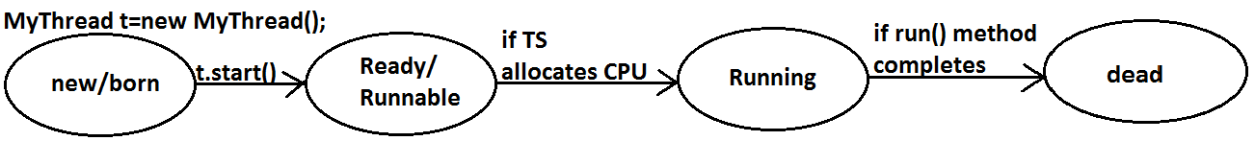
Thread Life Cycle
Once we created a Thread object then the Thread is said to be in new state or born state.
Once we call start() method then the Thread will be entered into Ready or Runnable state.
If Thread Scheduler allocates CPU then the Thread will be entered into running state.
Once run() method completes then the Thread will entered into dead state.
After starting a Thread we are not allowed to restart the same Thread once again otherwise we will get runtime exception saying "IllegalThreadStateException".
Example:
MyThread t=new MyThread();
t.start();//valid
;;;;;;;;
t.start();//we will get R.E saying: IllegalThreadStateException

Slide 8
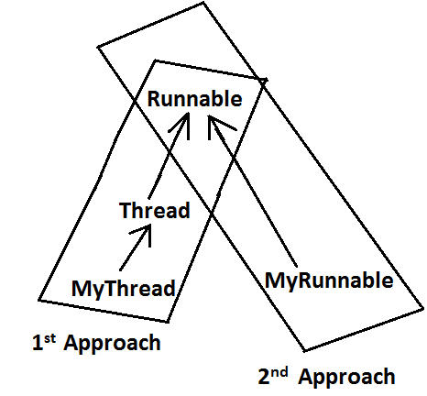
Defining Thread by Implementing Runnable Interface
class MyRunnable implements Runnable { //defining a Thread
public void run()
{
for (int i = 0; i < 10; i++) {
System.out.println("child Thread");
}
}
}
class ThreadDemo
{
public static void main(String[] args)
{
MyRunnable r = new MyRunnable();
Thread t = new Thread(r); //here r is a Target Runnable
t.start(); //starting of a Thread
for(int i=0;i<5;i++)
{
System.out.println("main thread");
}
}
}
We can't expect exact output but there are several possible outputs.
We can define a Thread even by implementing Runnable interface also.
Runnable interface present in java.lang.pkg and contains only one method run().

Slide 9
Cases
MyRunnable r = new MyRunnable();
Thread t1 = new Thread();
Thread t2 = new Thread(r);
Case 2: t1.run():
No new Thread will be created but Thread class run() method will be executed just like a normal method call.
Output:
main thread
main thread
main thread
main thread
main thread
Case 3: t2.start():
New Thread will be created which is responsible for the execution of MyRunnable run() method.
Output:
main thread
main thread
main thread
main thread
main thread
child Thread
child Thread
child Thread
child Thread
child Thread
Case 1: t1.start():
A new Thread will be created which is responsible for the execution of Thread class run()method.
Output:
main thread
main thread
main thread
main thread
main thread
Case 4: t2.run():
No new Thread will be created and MyRunnable run() method will be executed just like a normal method call.
Output:
child Thread
child Thread
child Thread
child Thread
child Thread
main thread
main thread
main thread
main thread
main thread
Case 5: r.start():
We will get compile time error saying start()method is not available in MyRunnable class.
Output:
Compile time error
cannot find symbol
Symbol: method start()
Location: class MyRunnable
Case 6: r.run():
No new Thread will be created and MyRunnable class run() method will be executed
just like a normal method call.

Slide 10
Thread Priorities
Every Thread in java has some priority it may be default priority generated by JVM (or) explicitly provided by the programmer.
The valid range of Thread priorities is 1 to 10[but not 0 to 10] where 1 is the least priority and 10 is highest priority.
Thread class defines the following constants to represent some standard priorities.
Thread. MIN_PRIORITY----------1
Thread. MAX_PRIORITY----------10
Thread. NORM_PRIORITY--------5
There are no constants like Thread.LOW_PRIORITY, Thread.HIGH_PRIORITY
Thread scheduler uses these priorities while allocating CPU.
The Thread which is having highest priority will get chance for 1st execution.
If 2 Threads having the same priority then we can't expect exact execution order it depends on Thread scheduler whose behavior is vendor dependent.
We can get and set the priority of a Thread by using the following methods.
public final int getPriority()
public final void setPriority(int newPriority);//the allowed values are 1 to 10
The allowed values are 1 to 10 otherwise we will get runtime exception saying "IllegalArgumentException".

Slide 11
Default Priority
class MyThread extends Thread
{
}
class ThreadPriorityDemo
{
public static void main(String[] args)
{
System.out.println(Thread.currentThread().getPriority()); //5
` Thread.currentThread().setPriority(9);
MyThread t=new MyThread();
System.out.println(t.getPriority()); //9
}
}
The default priority only for the main Thread is 5.
But for all the remaining Threads the default priority will be inheriting from parent to child.
That is whatever the priority parent has by default the same priority will be for the child also.

Slide 12
Methods to Prevent a Thread from Execution
We can prevent(stop) a Thread execution by using the following methods.
1. yield();
2. join();
3. sleep();

Slide 13
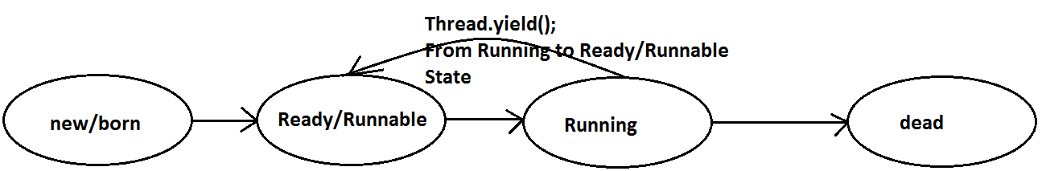
yield()
yield() method causes "to pause current executing Thread for giving the chance of remaining waiting Threads of same priority".
If all waiting Threads have the low priority or if there is no waiting Threads then the same Thread will be continued its execution.
If several waiting Threads with same priority available then we can't expect exact which Thread will get chance for execution.
The Thread which is yielded when it get chance once again for execution is depends on mercy of the Thread scheduler.
public static native void yield();
class MyThread extends Thread
{
public void run()
{
for(int i=0;i<5;i++)
{
Thread.yield();
System.out.println("child thread");
}
}
}
class ThreadYieldDemo
{
public static void main(String[] args)
{
MyThread t=new MyThread();
t.start();
for(int i=0;i<5;i++)
{
System.out.println("main thread");
}
}
}

Slide 14
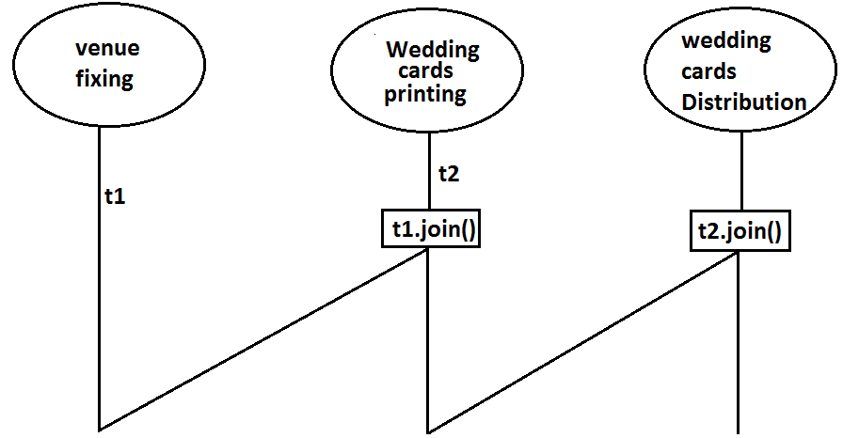
join()
If a Thread wants to wait until completing some other Thread then we should go for join() method.
Example: If a Thread t1 executes t2.join() then t1 should go for waiting state until completing t2
Every join() method throws InterruptedException, which is checked exception hence compulsory we should handle either by try catch or by throws keyword.
public final void join()throws InterruptedException
public final void join(long ms) throws InterruptedException
public final void join(long ms,int ns) throws InterruptedException

Slide 15
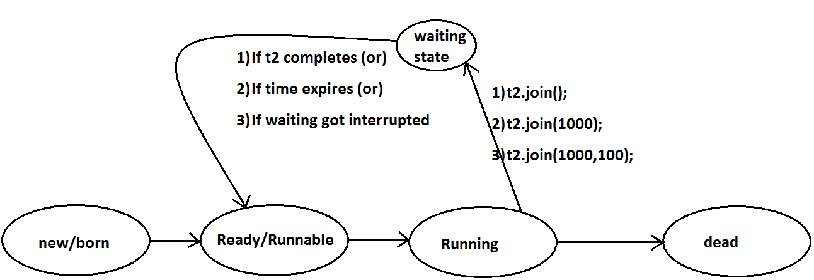
join()
class MyThread extends Thread
{
public void run()
{
for(int i=0;i<5;i++)
{
System.out.println("Sita Thread");
try
{
Thread.sleep(2000);
}
catch (InterruptedException e){}
}
}
}
class ThreadJoinDemo
{
public static void main(String[] args)throws InterruptedException
{
MyThread t=new MyThread();
t.start();
//t.join(); //--->1
for(int i=0;i<5;i++)
{
System.out.println("Rama Thread");
}
}
}
If we are commenting line 1 then both Threads will be executed simultaneously and we can't expect exact execution order.
If we are not commenting line 1 then main Thread will wait until completing child Thread in this the output is sita Thread 5 times followed by Rama Thread 5 times.

Slide 16
Waiting of child Thread until completing main Thread
class MyThread extends Thread
{
static Thread mt;
public void run()
{
try
{
mt.join();
}
catch (InterruptedException e){}
for(int i=0;i<5;i++)
{
System.out.println("Child Thread");
}
}
}
class ThreadJoinDemo
{
public static void main(String[] args)throws InterruptedException
{
MyThread.mt = Thread.currentThread();
MyThread t=new MyThread();
t.start();
for(int i=0;i<5;i++)
{
Thread.sleep(2000);
System.out.println("Main Thread");
}
}
}
If main thread calls join() on child thread object and child thread called join() on main thread object then both threads will wait for each other forever and the program will be hanged(like deadlock if a Thread class join() method on the same thread itself then the program will be hanged ).

Slide 18
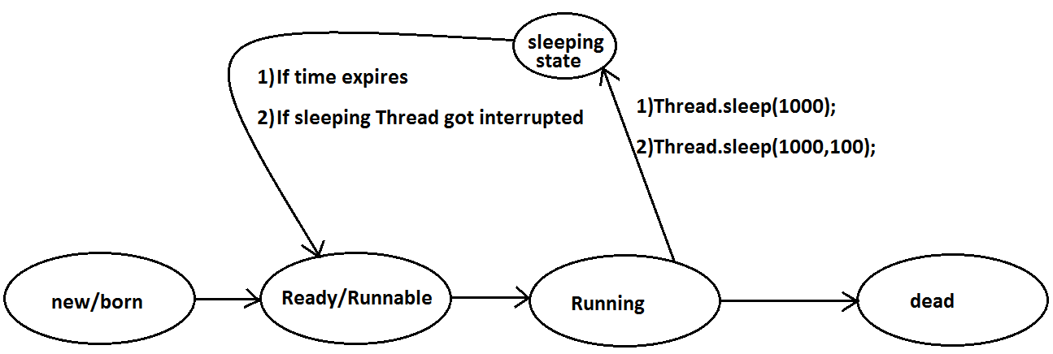
sleep()
If a Thread don't want to perform any operation for a particular amount of time then we should go for sleep() method.
public static native void sleep(long ms) throws InterruptedException
public static void sleep(long ms,int ns)throws InterruptedException
Example:
class ThreadJoinDemo
{
public static void main(String[] args)throws InterruptedException
{
System.out.println("M");
Thread.sleep(3000);
System.out.println("E");
Thread.sleep(3000);
System.out.println("G");
Thread.sleep(3000);
System.out.println("A");
}
}
Output:
M
E
G
A

Slide 19
Synchronization
If a Thread wants to execute any synchronized method on the given object 1st it has to get the lock of that object. Once a Thread got the lock of that object then it's allow to execute any synchronized method on that object. If the synchronized method execution completes then automatically Thread releases lock.
While a Thread executing any synchronized method the remaining Threads are not allowed execute any synchronized method on that object simultaneously. But remaining Threads are allowed to execute any non-synchronized method simultaneously. [lock concept is implemented based on object but not based on method].
Synchronized is the keyword applicable for methods and blocks but not for classes and variables.
If a method or block declared as the synchronized then at a time only one Thread is allow to execute that method or block on the given object.
The main advantage of synchronized keyword is we can resolve date inconsistency problems.
But the main disadvantage of synchronized keyword is it increases waiting time of the Thread and effects performance of the system.
Internally synchronization concept is implemented by using lock concept.
Every object in java has a unique lock. Whenever we are using synchronized keyword then only lock concept will come into the picture.

Slide 20
class Display
{
public synchronized void wish(String name)
{
for(int i=0;i<5;i++)
{
System.out.print("good morning:");
try
{
Thread.sleep(1000);
}
catch (InterruptedException e)
{}
System.out.println(name);
}
}
}
class MyThread extends Thread
{
Display d;
String name;
MyThread(Display d,String name)
{
this.d=d;
this.name=name;
}
public void run()
{
d.wish(name);
}
}
class SynchronizedDemo
{
public static void main(String[] args)
{
Display d1=new Display();
MyThread t1=new MyThread(d1,"dhoni");
MyThread t2=new MyThread(d1,"yuvaraj");
t1.start();
t2.start();
}
}
good morning:good morning:yuvaraj
good morning:dhoni
good morning:yuvaraj
good morning:dhoni
good morning:yuvaraj
good morning:dhoni
good morning:yuvaraj
good morning:dhoni
good morning:yuvaraj
dhoni
good morning:dhoni
good morning:dhoni
good morning:dhoni
good morning:dhoni
good morning:dhoni
good morning:yuvaraj
good morning:yuvaraj
good morning:yuvaraj
good morning:yuvaraj
good morning:yuvaraj

Slide 21
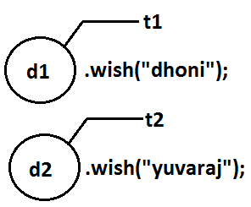
Cases
Display d1 = new Display();
Display d2 = new Display();
MyThread t1 = new MyThread(d1,"dhoni");
MyThread t2 = new MyThread(d2,"yuvaraj");
t1.start();
t2.start();
Even though we declared wish() method as synchronized but we will get irregular output in this case, because both Threads are operating on different objects.
Conclusion : If multiple threads are operating on multiple objects then there is no impact of Synchronization.
If multiple threads are operating on same java objects then synchronized concept is required(applicable).

Slide 22
Class Level lock
Every class in java has a unique lock. If a Thread wants to execute a static synchronized method then it required class level lock.
Once a Thread got class level lock then it is allow to execute any static synchronized method of that class.
While a Thread executing any static synchronized method the remaining Threads are not allow to execute any static synchronized method of that class simultaneously.
But remaining Threads are allowed to execute normal synchronized methods, normal static methods, and normal instance methods simultaneously.
Class level lock and object lock both are different and there is no relationship between these two.

Slide 23
Synchronized block
Example 1: To get lock of current object we can declare synchronized block as follows. If Thread got lock of current object then only it is allowed to execute this block.
Synchronized(this){}
Example 2: To get the lock of a particular object 'b' we have to declare a synchronized block as follows.
If thread got lock of 'b' object then only it is allowed to execute this block.
Synchronized(b){}
Example 3: To get class level lock we have to declare synchronized block as follows.
Synchronized(Display.class){}
If thread got class level lock of Display then only it allowed to execute this block.
Note:As the argument to the synchronized block we can pass either object reference or ".class file" and we can't pass primitive values as argument [because lock concept is
dependent only for objects and classes but not for primitives].
If very few lines of the code required synchronization then it's never recommended to declare entire method as synchronized we have to enclose those few lines of the code with in synchronized block.
The main advantage of synchronized block over synchronized method is it reduces waiting time of Thread and improves performance of the system.
Example:
Int x=b;
Synchronized(x){}
Output:
Compile time error.
Unexpected type.
Found: int
Required: reference

Slide 24
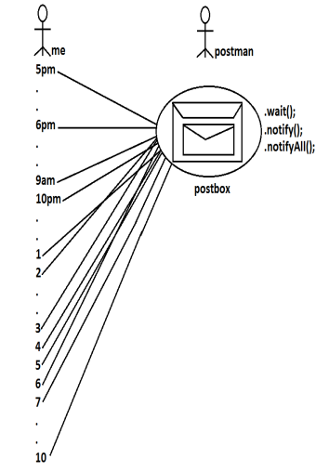
Inter Thread communication
Two Threads can communicate with each other by using wait(), notify() and notifyAll() methods.
The Thread which is required updation it has to call wait() method on the required object then immediately the Thread will entered into waiting state.
The Thread which is performing updation of object, it is responsible to give notification by calling notify() method.
After getting notification the waiting Thread will get those updations.

Slide 25
wait(), notify() and notifyAll() methods are available in Object class but not in Thread class because Thread can call these methods on any common object.
To call wait(), notify() and notifyAll() methods compulsory the current Thread should be owner of that object
i.e., current Thread should has lock of that object
i.e., current Thread should be in synchronized area. Hence we can call wait(), notify() and notifyAll() methods only from synchronized area otherwise we will get runtime exception saying IllegalMonitorStateException.
Example 1:
class ThreadA
{
public static void main(String[] args)throws InterruptedException
{
ThreadB b=new ThreadB();
b.start();
synchronized(b)
{
System.out.println("main Thread calling wait() method");//step-1
b.wait();
System.out.println("main Thread got notification call");//step-4
System.out.println(b.total);
}
}
}
class ThreadB extends Thread
{
int total=0;
public void run()
{
synchronized(this)
{
System.out.println("child thread starts calcuation");//step-2
for(int i=0;i<=100;i++)
{
total=total+i;
}
System.out.println("child thread giving notification call");//step-3
this.notify();
}
}
}

Slide 26
Once a Thread calls wait() method on the given object 1st it releases the lock of that object immediately and entered into waiting state.
Once a Thread calls notify() (or) notifyAll() methods it releases the lock of that object but may not immediately.
Except these (wait(),notify(),notifyAll()) methods there is no other place(method) where the lock release will be happen.
Example 1:
class ThreadA
{
public static void main(String[] args)throws InterruptedException
{
ThreadB b=new ThreadB();
b.start();
synchronized(b)
{
System.out.println("main Thread calling wait() method");//step-1
b.wait();
System.out.println("main Thread got notification call");//step-4
System.out.println(b.total);
}
}
}
class ThreadB extends Thread
{
int total=0;
public void run()
{
synchronized(this)
{
System.out.println("child thread starts calcuation");//step-2
for(int i=0;i<=100;i++)
{
total=total+i;
}
System.out.println("child thread giving notification call");//step-3
this.notify();
}
}
}

Slide 27
Method Is Thread Releases Lock?
yield() No
join() No
sleep() No
wait() Yes
notify() Yes
notifyAll() Yes
Once a Thread calls wait(), notify(), notifyAll() methods on any object then it releases the lock of that particular object but not all locks it has.
1. public final void wait()throws InterruptedException
2. public final native void wait(long ms)throws InterruptedException
3. public final void wait(long ms,int ns)throws InterruptedException
4. public final native void notify()
5. public final native void notifyAll()

Slide 28
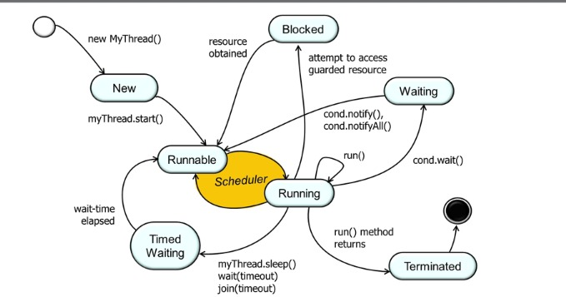
Example 1:
class ClassA
{
public static void main(String[] args)throws InterruptedException
{
ClassB b = new ClassB();
b.start();
synchronized(b)
{
System.out.println("main Thread calling wait() method");//step-1
b.wait();
System.out.println("main Thread got notification call");//step-4
System.out.println(b.total);
}
}
}
class ClassB extends Thread
{
int total=0;
public void run()
{
synchronized(this)
{
System.out.println("child thread starts calcuation");//step-2
for(int i=0;i<=100;i++)
{
total=total+i;
}
System.out.println("child thread giving notification call");//step-3
this.notify();
}
}
}
Output:
main Thread calling wait() method
child thread starts calculation
child thread giving notification call
main Thread got notification call
5050

Slide 29
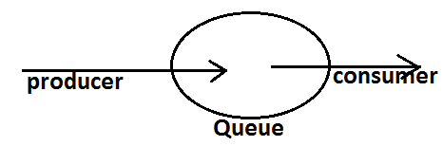
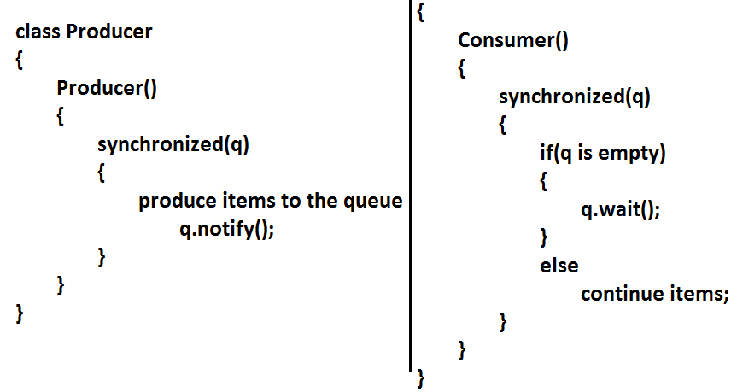
Example 2:
Producer consumer problem:
Producer(producer Thread) will produce the items to the queue and consumer(consumer thread) will consume the items from the queue. If the queue is empty then consumer has to call wait() method on the queue object then it will entered into waiting state.
After producing the items producer Thread call notify() method on the queue to give notification so that consumer Thread will get that notification and consumer items.

Slide 30
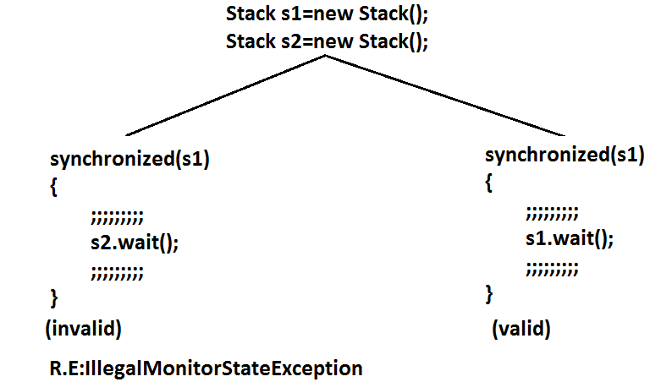
notify() vs notifyAll()
We can use notify() method to give notification for only one Thread.
If multiple Threads are waiting then only one Thread will get the chance and remaining Threads has to wait for further notification. But which Thread will be notify(inform) we can't expect exactly it depends on JVM.
We can use notifyAll() method to give the notification for all waiting Threads. All waiting Threads will be notified and will be executed one by one, because they are required lock
Note: On which object we are calling wait(), notify() and notifyAll() methods that corresponding object lock we have to get but not other object locks.

Slide 31

Deadlock
If 2 Threads are waiting for each other forever(without end) such type of situation(infinite waiting) is called dead lock.
There are no resolution techniques for deadlock but several prevention(avoidance) techniques are possible.
Synchronized keyword is the cause for deadlock hence whenever we are using synchronized keyword we have to take special care.

Slide 32
Example
class A
{
public synchronized void foo(B b)
{
System.out.println("Thread1 starts execution of foo()
method");
try
{
Thread.sleep(2000);
}
catch (InterruptedException e)
{}
System.out.println("Thread1 trying to call b.last()");
b.last();
}
public synchronized void last()
{
System.out.println("inside A, this is last()method");
}
}
class B
{
public synchronized void bar(A a)
{
System.out.println("Thread2 starts execution of bar() method");
try
{
Thread.sleep(2000);
}
catch (InterruptedException e)
{}
System.out.println("Thread2 trying to call a.last()");
a.last();
}
public synchronized void last()
{
System.out.println("inside B, this is last() method");
}
}
class DeadLock implements Runnable
{
A a=new A();
B b=new B();
DeadLock()
{
Thread t=new Thread(this);
t.start();
a.foo(b);//main thread
}
public void run()
{
b.bar(a);//child thread
}
public static void main(String[] args)
{
new DeadLock();//main thread
}
}
Output:
Thread1 starts execution of foo() method
Thread2 starts execution of bar() method
Thread2 trying to call a.last()
Thread1 trying to call b.last()
//here cursor always waiting.
Note : If we remove at least one synchronized keyword then we won't get DeadLOck.Hence synchronized keyword in the only reason for DeadLock due to this while using synchronized keyword we have to handling carefully.

Slide 33
Daemon Threads
We can check whether the Thread is daemon or not by using isDaemon() method of Thread class.
public final boolean isDaemon();
We can change daemon nature of a Thread by using setDaemon () method.
public final void setDaemon(boolean b);
But we can change daemon nature before starting Thread only. That is after starting the Thread if we are trying to change the daemon nature we will get R.E saying IllegalThreadStateException.
Default Nature : Main Thread is always non daemon and we can't change its daemon nature because it's already started at the beginning only.
Main Thread is always non daemon and for the remaining Threads daemon nature will be inheriting from parent to child that is if the parent is daemon child is also daemon and if the parent is non daemon then child is also non daemon.
Whenever the last non daemon Thread terminates automatically all daemon Threads will be terminated.
The Threads which are executing in the background are called daemon Threads.
The main objective of daemon Threads is to provide support for non-daemon Threads like main Thread.
Example:
Garbage collector
When ever the program runs with low memory the JVM will execute Garbage Collector to provide free memory. So that the main Thread can continue it's execution.

Slide 34
Example:
class MyThread extends Thread
{
}
class DaemonThreadDemo
{
public static void main(String[] args)
{
System.out.println(Thread.currentThread().isDaemon());
MyThread t=new MyThread();
System.out.println(t.isDaemon()); //- - - 1
t.start();
t.setDaemon(true);
System.out.println(t.isDaemon());
}
}
Output:
false
false
RE:IllegalThreadStateException
Example:
class MyThread extends Thread
{
public void run()
{
for(int i=0;i<10;i++)
{
System.out.println("lazy thread");
try
{
Thread.sleep(2000);
}
catch (InterruptedException e)
{}
}
}
}
class DaemonThreadDemo
{
public static void main(String[] args)
{
MyThread t=new MyThread();
t.setDaemon(true); //-->1
t.start();
System.out.println("end of main Thread");
}
}
Output:
End of main Thread
If we comment line 1 then both main & child Threads are non-Daemon , and hence both threads will be executed until there completion.
If we are not comment line 1 then main thread is non-Daemon and child thread is Daemon. Hence whenever main Thread terminates automatically child thread will be terminated.

Slide 35
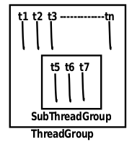
Thread Group
Based on the Functionality we can Group Threads into a Single Unit which is Nothing but ThreadGroup i.e. ThreadGroup Represents a Set of Threads.
In Addition a ThreadGroup can Also contains Other SubThreadGroups.
ThreadGroup Class Present in java.lang Package and it is the Direct Child Class of Object.
ThreadGroup provides a Convenient Way to Perform Common Operation for all Threads belongs to a Particular Group.
Example: Stop All Consumer Threads.
Suspend All Producer Threads.
Constructors:
ThreadGroup g = new ThreadGroup(String gname);
Creates a New ThreadGroup.
The Parent of this New Group is the ThreadGroup of Currently Running Thread.
ThreadGroup g = new ThreadGroup(ThreadGrouppg, String gname);
Creates a New ThreadGroup.
The Parent of this ThreadGroup is the specified ThreadGroup.

Slide 36
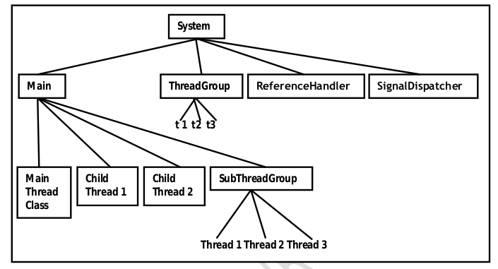
Note:
In Java Every Thread belongs to Some Group.
Every ThreadGroup is the Child Group of System Group either Directly OR Indirectly. Hence SystemGroup Acts as Root for all ThreadGroup’s in Java.
System ThreadGroup Represents System Level Threads Like ReferenceHandler, SignalDispatcher, Finalizer, AttachListener Etc.
classThreadGroupDemo {
public static void main(String[] args) {
System.out.println(Thread.currentThread().getThreadGroup().getName());
System.out.println(Thread.currentThread().getThreadGroup().getParent().getName());
ThreadGroup pg = new ThreadGroup("Parent Group");
System.out.println(pg.getParent().getName());
ThreadGroup cg = new ThreadGroup(pg, "Child Group");
System.out.println(cg.getParent().getName());
}
}
Output:
main
system
main
Parent Group

Slide 37
public class ThreadGroupDemo extends Thread {
public ThreadGroupDemo(String name, ThreadGroup tg) {
super(tg,name);
}
public void run() {
System.out.println("Running " + Thread.currentThread().getName());
}
public static void main(String[] args) {
ThreadGroup tg = new ThreadGroup("Group1");
ThreadGroup tg1 = new ThreadGroup(tg, "Group2");
ThreadGroupDemo t1 = new ThreadGroupDemo("Thread1", tg);
ThreadGroupDemo t2 = new ThreadGroupDemo("Thread2", tg);
ThreadGroupDemo t3 = new ThreadGroupDemo("Thread3", tg1);
t1.start();
t2.start();
t3.start();
System.out.println("Number of active threads: " + tg.activeCount());
System.out.println("Number of active thread groups: " + tg.activeGroupCount());
System.out.println("Maximum priority: " + tg.getMaxPriority());
System.out.println("Thread group name: " + tg.getName());
System.out.println("Child thread group name: "+ tg1.getName());
System.out.println(tg.parentOf(tg1));
System.out.println("Parent thread group: " + tg1.getParent());
tg.checkAccess();
System.out.println(tg.getName() + " has access");
tg1.checkAccess();
System.out.println(tg1.getName() + " has access");
System.out.println("List the information of thread group using the list method: ");
tg.list();
}
}

Slide 38
Thread Local
class CustomerThread extends Thread {
static Integer custID = 0;
private static ThreadLocal tl = new ThreadLocal() {
protected Integer initialValue() {
return ++custID;
}
};
CustomerThread(String name) {
super(name);
}
Public void run(){
System.out.println(Thread.currentThread().getName() +
“Executing with customer ID ”+ tl.get());
}
}
classThreadLocalDemo {
public static void main(String[] args) {
CustomerThread c1 = new CustomerThread(“Cust-1”);
CustomerThread c2 = new CustomerThread(“Cust-2”);
CustomerThread c3 = new CustomerThread(“Cust-3”);
CustomerThread c4 = new CustomerThread(“Cust-4”);
c1.start();
c2.start();
c3.start();
c4.start();
}
}
ThreadLocal provides ThreadLocal Variables.
ThreadLocal Class Maintains Values per Thread Basis.
Each ThreadLocal Object Maintains a Separate Value Like userID, transactionIDEtc for Each Thread that Accesses that Object.
Thread can access its local value, can manipulates its value and even can remove its value.
In every part of the code which is executed by the Thread we can access its local variables.
Examples:
Consider a Servlet which Calls Some Business Methods. we have a Requirement to generate a Unique transactionID for Each and Every Request and we have to Pass this transactionID to the Business Methods for Logging Purpose.
For this Requirement we can Use ThreadLocal to Maintain a Separate transactionID for Every Request and for Every Thread.

Slide 39
Thread Local (Continue)
classThreadLocalDemo {
public static void main(String[] args) {
ThreadLocal tl = new ThreadLocal();
System.out.println(tl.get()); //null
tl.set("Dhoni");
System.out.println(tl.get()); //Dhoni
tl.remove();
System.out.println(tl.get()); //null
}
}
A Thread can Access its Own Local Variables and can’t Access Other Threads Local Variables.
Once Thread Entered into Dead State All Local Variables are by Default Eligible for Garbage Collection.
//Overriding of intialValue()
classThreadLocalDemo {
public static void main(String[] args) {
ThreadLocal tl = new ThreadLocal() {
protected Object initialValue() {
return "abc";
}
};
System.out.println(tl.get()); //abc
tl.set("Dhoni");
System.out.println(tl.get()); //Dhoni
tl.remove();
System.out.println(tl.get()); //abc
}
}

Slide 40
Java.util.concurrent.locks package:
Problems with Traditional synchronized keyword
If a Thread releases the Lock then which waiting Thread will get that Lock we are not having any control on this.
We can’t specify maximum waiting time for a Thread to get Lock so that it will wait until getting Lock, which May effect performance of the system and causes deadlock.
We are not having any flexibility to try for Lock without waiting.
There is no API to list all waiting Threads for a Lock.
The synchronized keyword compulsory we have to Define within a method and it is not Possible to declare over multiple methods.
To overcome above problems SUN People introduced java.util.concurrent.locks Package in 1.5 Version.
It also provides several enhancements to the programmer to provide more control on concurrency.
Lock(I):
A Lock object is similar to implicit Lock acquired by a Thread to execute synchronized Method or synchronized block
Lock implementations provide more extensive operations than traditional implicit locks.
if (l.tryLock()) {
Perform Safe Operations
}
else {
Perform Alternative Operations
}

Slide 41
ReentrantLock
It implements Lock Interface and it is the direct child class of an Object.
Reentrant means a Thread can acquire same Lock multiple times without any issue.
Internally ReentrantLock increments Threads Personal Count whenever we call lock() and decrements counter whenever we call unlock() and Lock will be released whenever count Reaches ‘0’
import java.util.concurrent.locks.ReentrantLock;
class Test {
public static void main(String[] args) {
ReentrantLock l = new ReentrantLock();
l.lock();
l.lock();
System.out.println(l.isLocked()); //true
System.out.println(l.isHeldByCurrentThread()); //true
System.out.println(l.getQueueLength()); //0
l.unlock();
System.out.println(l.getHoldCount()); //1
System.out.println(l.isLocked()); //true
l.unlock();
System.out.println(l.isLocked()); //false
System.out.println(l.isFair()); //false
}
}
Constructor:
ReentrantLock rl = new ReentrantLock();
Creates an Instance of ReentrantLock.
ReentrantLock rl = new ReentrantLock(boolean fairness);
Creates an Instance of ReentrantLock with the Given Fairness Policy.

Slide 42
Examples
import java.util.concurrent.locks.ReentrantLock;
class Display {
ReentrantLock l = new ReentrantLock(true);
public void wish(String name) {
l.lock(); 1
for(int i=0; i<5; i++) {
System.out.println("Good Morning");
try {
Thread.sleep(2000);
}
catch(InterruptedException e) {}
System.out.println(name);
}
l.unlock(); 2
}
}
class MyThread extends Thread {
Display d;
String name;
MyThread(Display d, String name) {
this.d = d;
this.name = name;
}
public void run() {
d.wish(name);
}
}
lass ReentrantLockDemo {
public static void main(String[] args) {
Display d = new Display();
MyThread t1 = new MyThread(d, "Dhoni");
MyThread t2 = new MyThread(d, "Yuva Raj");
MyThread t3 = new MyThread(d, "Virat Kohli");
t1.start();
t2.start();
t3.start();
}
}
Good Morning
Dhoni
Good Morning
Dhoni
Good Morning
Dhoni
Good Morning
Dhoni
Good Morning
Dhoni
Good Morning
Yuva Raj
Good Morning
Yuva Raj
Good Morning
Yuva Raj
Good Morning
Yuva Raj
Good Morning
Yuva Raj
Good Morning
ViratKohli
Good Morning
ViratKohli
Good Morning
ViratKohli
Good Morning
ViratKohli
Good Morni

Slide 43
Parameters | Lock Framework | Synchronized
Across Methods | Yes, Locks can be implemented across the methods, you can invoke lock() in method1 and invoke unlock() in method2. | Not possible
try to acquire lock | yes, trylock(timeout) method is supported by Lock framework, which will get the lock on the resource if it is available, else it returns false and Thread won’t get blocked. | Not possible with synchronized
Fair lock management | Yes, Fair lock management is available in case of lock framework. It hands over the lock to long waiting thread. Even in fairness mode set to true, if trylock is coded, it is served first. | Not possible with synchronized
List of waiting threads | Yes, List of waiting threads can be seen using Lock framework | Not possible with synchronized
Release of lock in exceptions | Lock.lock(); myMethod();Lock.unlock(); unlock() cant be executed in this code if any exception being thrown from myMethod(). | Synchronized works clearly in this case. It releases the lock

Slide 44
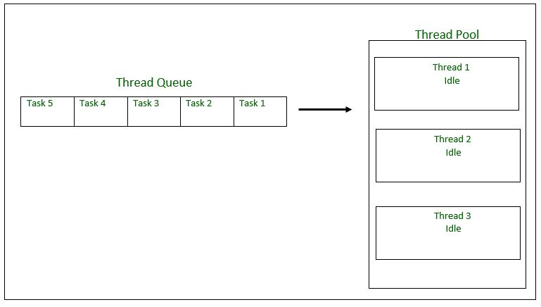
Thread Pool
A thread pool reuses previously created threads to execute current tasks and offers a solution to the problem of thread cycle overhead and resource thrashing.
Since the thread is already existing when the request arrives, the delay introduced by thread creation is eliminated, making the application more responsive.
Creating a New Thread for Every Job May Create Performance and Memory Problems.
To Overcome this we should go for Thread Pool Concept.
Thread Pool is a Pool of Already Created Threads Ready to do Our Job.
Java 1.5 Version Introduces Thread Pool Framework to Implement Thread Pools.
Thread Pool Framework is Also Known as Executor Framework.
We can Create a Thread Pool as follows
ExecutorService service = Executors.newFixedThreadPool(3);//Our Choice
We can Submit a Runnable Job by using submit().
service.submit(job);
We can ShutdownExecutiorService by using shutdown().
service.shutdown();
Steps to be followed
1. Create a task(Runnable Object) to execute
2. Create Executor Pool using Executors
3. Pass tasks to Executor Pool
4. Shutdown the Executor Pool

Slide 45
import java.util.concurrent.ExecutorService;
import java.util.concurrent.Executors;
class PrintJob implements Runnable {
String name;
PrintJob(String name) {
this.name = name;
}
public void run() {
SOP(name+"....Job Started By Thread:" +Thread.currentThread().getName());
try {
Thread.sleep(10000);
}
catch (InterruptedException e) {}
SOP(name+"....Job Completed By Thread:" +Thread.currentThread().getName());
}
}
class ExecutorDemo {
public static void main(String[] args) {
PrintJob[] jobs = {
newPrintJob("Task-1"),
newPrintJob("Task-2"),
newPrintJob("Task-3"),
newPrintJob("Task-4"),
newPrintJob("Task-5"),
newPrintJob("Task-6")
};
ExecutorService service = Executors.newFixedThreadPool(3);
for (PrintJob job : jobs) {
service.submit(job);
}
service.shutdown();
}
}
Output
Task-2....Job Started By Thread:pool-1-thread-2
Task-1....Job Started By Thread:pool-1-thread-1
Task-3....Job Started By Thread:pool-1-thread-3
Task-2....Job Completed By Thread:pool-1-thread-2
Task-1....Job Completed By Thread:pool-1-thread-1
Task-4....Job Started By Thread:pool-1-thread-2
Task-3....Job Completed By Thread:pool-1-thread-3
Task-5....Job Started By Thread:pool-1-thread-3
Task-6....Job Started By Thread:pool-1-thread-1
Task-4....Job Completed By Thread:pool-1-thread-2
Task-5....Job Completed By Thread:pool-1-thread-3
Task-6....Job Completed By Thread:pool-1-thread-1

Slide 46
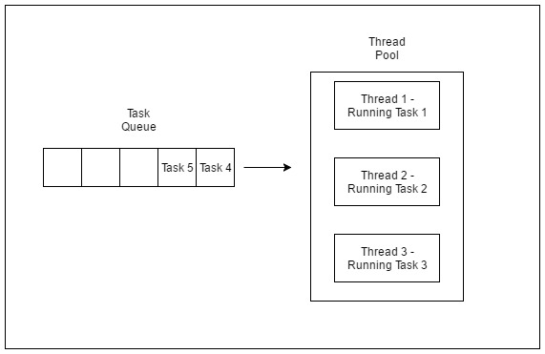
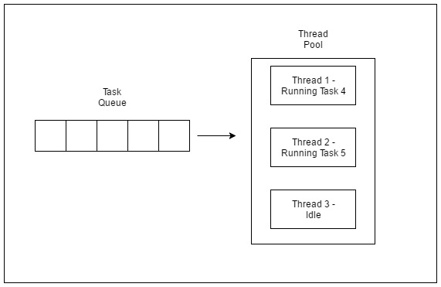
ThreadPool (Continue)

Slide 47
Callable and Future:
import java.util.concurrent.Callable;
import java.util.concurrent.ExecutorService;
import java.util.concurrent.Executors;
import java.util.concurrent.Future;
class MyCallable implements Callable {
int num;
MyCallable (int num) {
this.num = num;
}
public Object call() throws Exception {
int sum = 0;
for(int i=0; i<num; i++) {
sum = sum+i;
}
return sum;
}
}
class CallableFutureDemo {
public static void main(String args[]) throws Exception {
MyCallable[] jobs = {
new MyCallable(10),
new MyCallable(20),
new MyCallable(40),
new MyCallable(50),
new MyCallable(60)
};
ExecutorService service = Executors.newFixedThreadPool(3);
for (PrintJob job : jobs) {
Future r = service.submit(job);
System.out.println(r.get());
}
service.shutdown();
}
}
In the case of Runnable job Thread won’t Return anything.
If a Thread is required to return some result after execution then we should go for Callable.
Callable interface contains only one method public Object call() throws Exception.
If we submit a Callable Object to Executor then the Framework Returns an Object of Type java.util.concurrent.Future
The Future Object can be Used to Retrieve the Result from Callable Job.

Slide 48
Process Synchronization
Process Synchronization is a technique which is used to coordinate the process that use shared Data. There are two types of Processes in an Operating Systems:-
Independent Process – The process that does not affect or is affected by the other process while its execution then the process is called Independent Process. Example The process that does not share any shared variable, database, files, etc.
Cooperating Process – The process that affect or is affected by the other process while execution, is called a Cooperating Process. Example The process that share file, variable, database, etc are the Cooperating Process.
It is the condition where several processes tries to access the resources and modify the shared data concurrently and outcome of the process depends on the particular order of execution that leads to data inconsistency, this condition is called Race Condition.

Slide 49
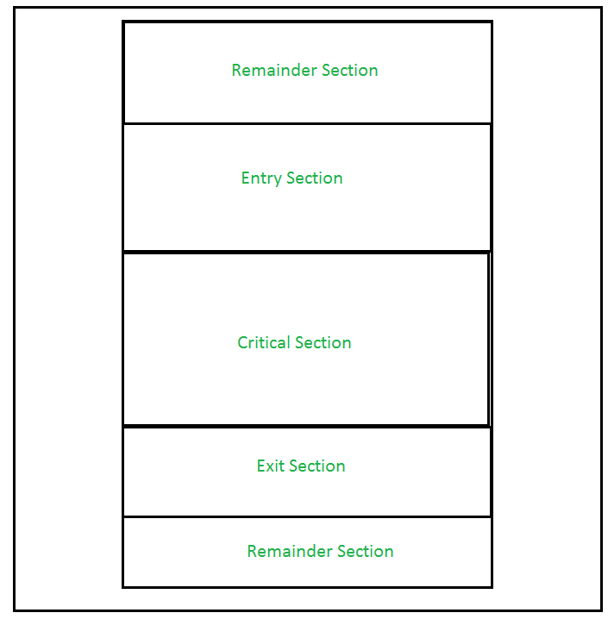
Process Synchronization (Continue)
This condition can be avoided using the technique called Synchronization or Process Synchronization, in which we allow only one process to enter and manipulates the shared data in Critical Section.

Slide 50
Critical Section Problems
Critical Section problems must satisfy these three requirements:
Mutual Exclusion – It states that no other process is allowed to execute in the critical section if a process is executing in critical section.
Progress – When no process is in the critical section, then any process from outside that request for execution can enter in the critical section without any delay. Only those process can enter that have requested and have finite time to enter the process.
Bounded Waiting – An upper bound must exist on the number of times a process enters so that other processes are allowed to enter their critical sections after a process has made a request to enter its critical section and before that request is granted.

Slide 51
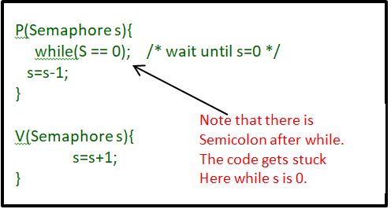
Semaphores in Process Synchronization
Semaphore is simply an integer variable that is shared between threads. This variable is used to solve the critical section problem and to achieve process synchronization in the multiprocessing environment.
Binary Semaphore – This is also known as mutex lock. It can have only two values – 0 and 1. Its value is initialized to 1. It is used to implement the solution of critical section problems with multiple processes.
Counting Semaphore – Its value can range over an unrestricted domain. It is used to control access to a resource that has multiple instances.

Slide 52
Thank you

