Slide 1
JAVA Reflections

Slide 2
Introduction
We will explore about Java reflection, which allows us to inspect and modify runtime attributes of classes, interfaces, fields and methods. This particularly comes in handy when we don't know their names at compile time.
Additionally, we can instantiate new objects, invoke methods and get or set field values using reflection.
Project setup:
  To use Java reflection, we don't need to include any special jars, any special configuration or Maven dependencies. The JDK ships with a group of classes that are bundled in the java.lang.reflect package specifically for this purpose.
  So, all we need to do is to make the following import into our code:
    import java.lang.reflect.*;
  To get access to the class, method and field information of an instance, we call the getClass method, which returns the runtime class representation of the object. The returned class object provides methods for accessing information about a class.

Slide 3

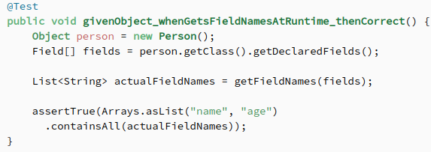
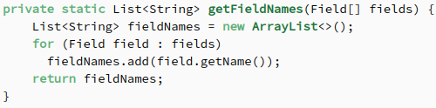
Simple Example of Java Reflection
We'll look at a very basic example that inspects the fields of a simple Java object at runtime.
Let's create a simple Person class with only name and age fields and no methods at all.
Here is the Person class:
We'll now use Java reflection to discover the names of all fields of this class.
To appreciate the power of reflection, let's construct a Person object and use Object as the reference type
This test shows us that we are able to
get an array of Field objects from our
person object, even if the reference to
the object is a parent type of that object.
In the above example, we were only
interested in the names of those fields.
But there is much more that can be done,
and we will see examples of this in the
next slides.
Notice how we use a helper method to
extract the actual field names.

Slide 4


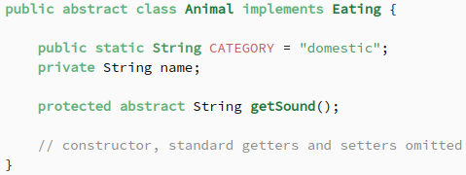
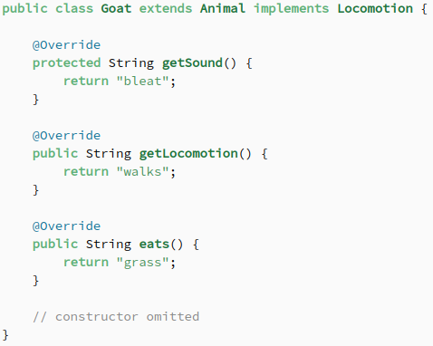
Inspecting Java Classes
We will explore the most fundamental component in the Java Reflection API. Java class objects, as we mentioned earlier, give us access to the internal details of any object.
We are going to examine internal details such as an object's class name, modifiers, fields, methods, implemented interfaces, etc.
To get a firm grip on the reflection API as applied to Java classes and have examples with variety, let's create an abstract Animal class that implements the Eating interface.
Here is the class Animal implementation
of the Eating interface.
Let's also create another interface called Locomotion
that describes how an animal moves.
We'll now create a concrete class called Goat
that extends Animal and implements Locomotion.
Since the superclass implements Eating, Goat
will have to implement that interface's methods
as well
From this point onwards, we will use Java reflection
to inspect aspects of Java objects that appear in the
classes and interfaces above.

Slide 5
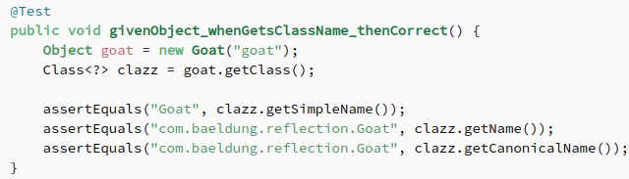
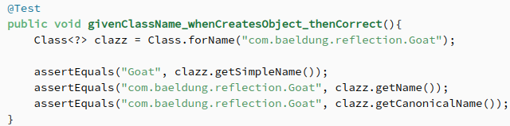
Class Names
Let's start by getting the name of an object from the Class
Note that the getSimpleName method of Class
returns the basic name of the object as it would
appear in its declaration. Then the other two
methods return the fully qualified class name
including the package declaration.
Let's also see how we can create an object of
the Goat class if we only know its fully qualified
class name
Notice that the name we pass to the static forName method should include the package information. Otherwise, we will get a ClassNotFoundException.

Slide 6
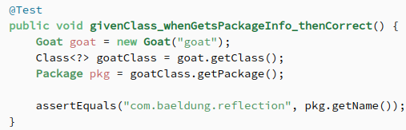
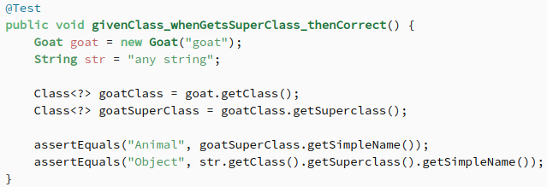
Package Information
By using Java reflection, we are also able to get information about the package of any class or object. This data is bundled inside
the Package class, which is returned by a call
to getPackage method on the class object.
Superclass:
  We are also able to obtain the superclass of any Java class by using Java reflection.
  Let's go ahead and determine the superclass of Goat.
  Additionally, we also show that java.lang.String class is a subclass of java.lang.Object class:

Slide 7
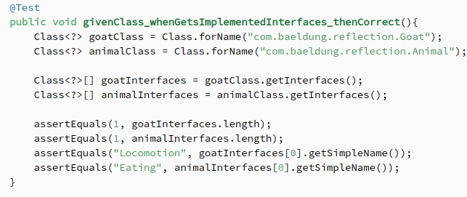
Implemented Interfaces
Using Java reflection, we are also able to get the list of interfaces implemented by a given class.
Let's retrieve the class types of the interfaces implemented by the Goat class and the Animal abstract class
Notice from the assertions that each class implements only a single interface. Inspecting the names of these interfaces, we find that Goat implements Locomotion and Animal implements Eating interface

Slide 8
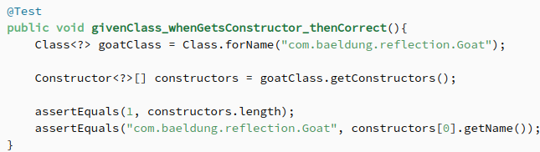
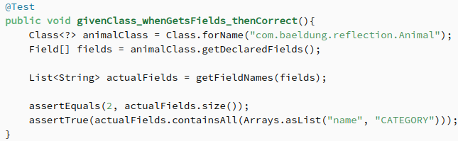
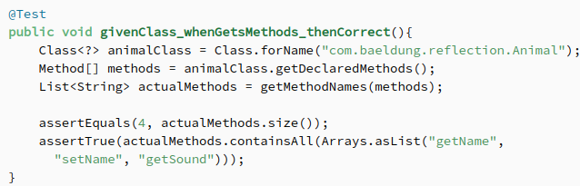
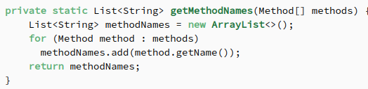
Constructors, Methods and Fields
With Java reflection, we are able to inspect the constructors of any object's class as well as methods and fields.
Let's see how to get the constructor
of the Goat class.
We can also inspect the fields of the
Animal class:
We can similarly inspect the
methods of the Animal class
Just like getFieldNames, we have added a helper method to retrieve method names from an array of Method objects:

Slide 9
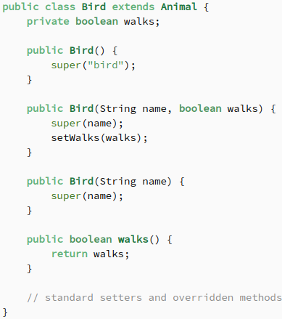
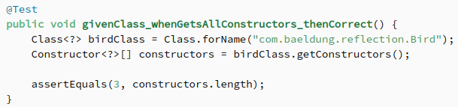
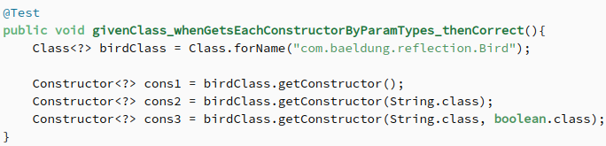
Inspecting Constructors
With Java reflection, we can inspect constructors of any class and even create class objects at runtime. This is made possible by the java.lang.reflect.Constructor class.
In this section, we will focus on how to retrieve specific constructors.
We will create a Bird subclass of Animal with three constructors.
Let's confirm by using reflection that this class has
three constructors
Next, we will retrieve each constructor for the Bird
class by passing the constructor's parameter class
types in declared order

Slide 10
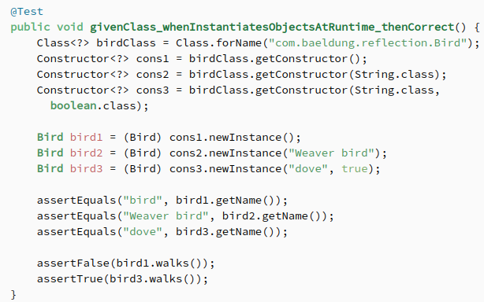
Instantiate objects
We instantiate class objects by calling
the newInstance method of Constructor
class and passing the required parameters
in declared order. We then cast the result
to the required type.
For bird1, we use the default constructor
that automatically sets the name to bird
from our Bird code, and we confirm that
with a test.
We then instantiate bird2 with only a name
and test as well.

Slide 11
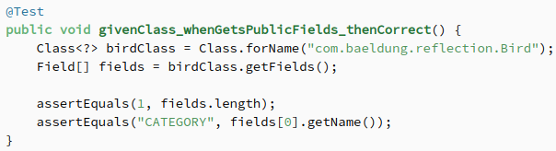
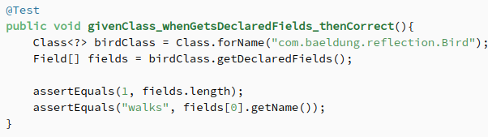
Inspecting Fields
We will show how to get and set their values at runtime.
There are two main methods used to inspect fields of a class at runtime: getFields() and getField(fieldName).
The getFields() method returns all accessible public fields of the class. It will return all the public fields in both the class and all superclasses.
For instance, when we call this method on the Bird class, we will only get the CATEGORY field of its superclass Animal, since Bird itself does not declare any public fields
However, we can inspect private fields
declared in the class by calling the
getDeclaredFields method

Slide 12
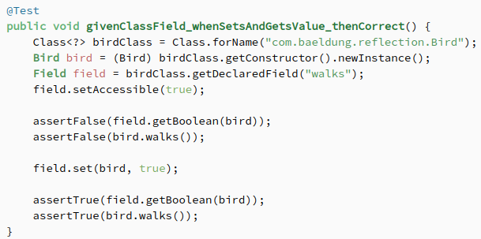
Inspecting Fields
Next, let's look at how to access field values and modify them.
To get the value of a field, let alone set it, we have to first set it's accessible by calling setAccessible method on the Field object and pass boolean true to it:

Slide 13
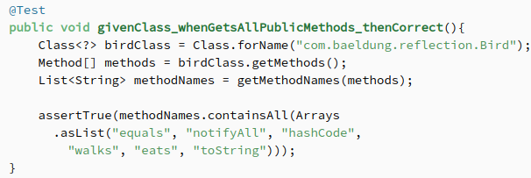
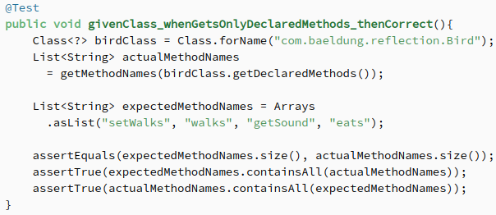
Inspecting Methods
With Java reflection, we can invoke methods at runtime and pass them their required parameters, just like we did for constructors. Similarly, we can also invoke overloaded methods by specifying parameter types of each.
Just like fields, there are two main methods that we use for retrieving class methods. The getMethods method returns an array of all public methods of the class and superclasses.
This means that with this method, we can get public methods of the java.lang.Object class such as toString, hashCode and notifyAll
To get all methods of the class we are
interested in, we have to use getDeclaredMethods
method

Slide 14
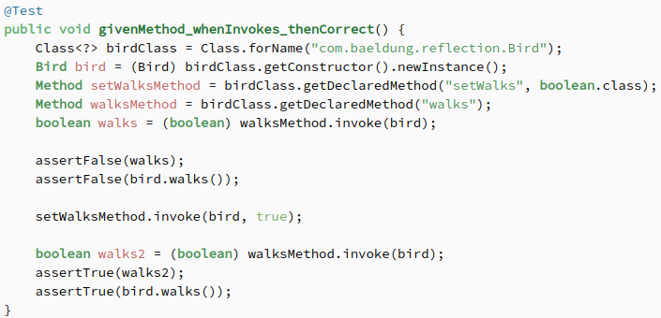
How to invoke a method
We will show how to invoke a method at runtime.
We know by default that the walks attribute of the Bird class is false.
We want to call its setWalks method and set it to true:

Slide 15
Thank You

