Slide 1
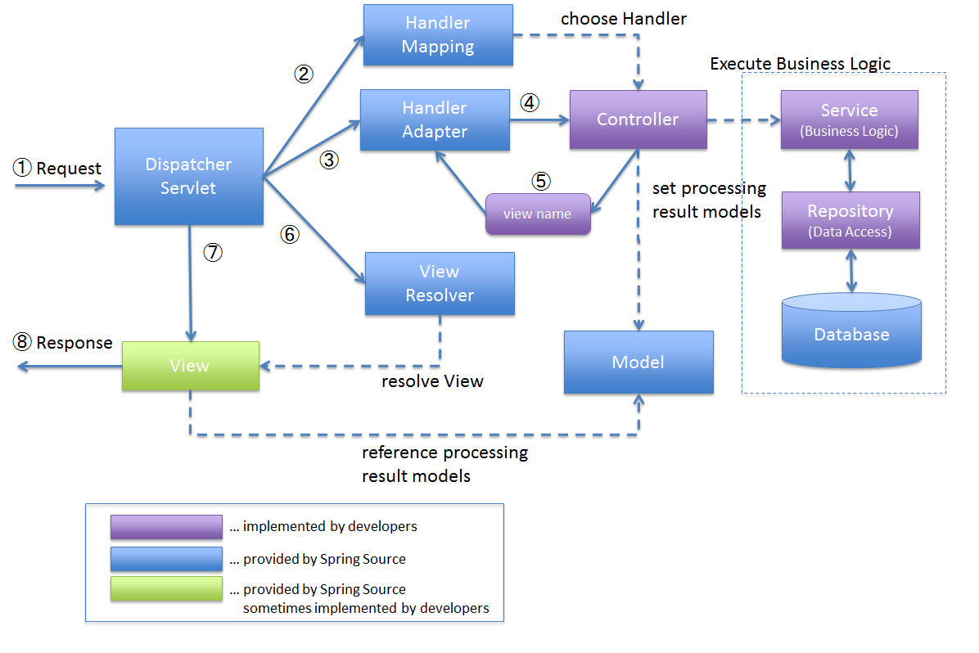
Spring MVC

Slide 2
Agenda
The purpose of spring mvc
What is Bean, Servlet?
Why Spring MVC?
What is Spring MVC?
Design patterns we use
Advantages of Spring MVC Framework
Spring MVC Architecture
Workflow of spring mvc
Spring MVC Components
Example Project

Slide 3
The Purpose of MVC Framework
MVC software framework helps us to separate the different aspects of the application (input logic, business logic, and GUI), while providing a loose coupling between these elements. Thus, the information (most reusable) logic belongs in the model, the GUI belongs in the view. Input logic belongs in the controller. This separation helps you manage complexity when you build an application because it enables you to focus on one aspect of the implementation at a time. MVC Framework is a good idea for a number of reasons, including:
Simultaneous development – Because MVC decouples the various components of an application, developers are able to work in parallel on different components without affecting or blocking one another.
Reusability – The same (or similar) view for one application can be refactored for another application with different data because the view is simply handling how the data is being displayed to the user. The separation of these main components model, view and controller help to create more reusable code that is easier to understand because each piece has a distinct purpose.
Improved scalability – if your application begins experiencing performance issues because database access is slow, you can upgrade the hardware running the database without other components being affected.
Low coupling — the very nature of the MVC framework is such that there is low coupling among models, views or controllers.
Better extendibility – as the components have a low dependency on each other, making changes to one (to fix bugs or change functionality) does not affect another.
It keeps the code readable and manageable.
Notes:
SEO (Search Engine Optimized) friendly URL using MVC. MVC is having Default route like “{controller}/{action}/{id}” where the “id” is normally a number which acts as a key for the record. But to ensure the URL to be SEO friendly we need to change the “id” to contain a name.

Slide 4
Spring Beans
In Spring, The objects that form the backbone of your application and that are managed by the Spring IoC container are called beans.
A bean is an object that is instantiated, assembled, and otherwise managed by a Spring IoC container.
Spring beans are defined in Spring configuration files (or, more recently, with annotations), instantiated by Spring containers, and then injected into applications.
It made the development of Web applications much easier than compared to classic Java frameworks and application programming interfaces (APIs), such as Java database connectivity (JDBC), JavaServer Pages(JSP), and Java Servlet.
Java Bean VS Spring Bean
Spring bean is managed by Spring IOC, Java Bean is not.
Java Bean is always serializable, Spring Bean doesn’t need to.
Java Bean must have a default no-arg constructor, Spring Bean doesn’t need to.
A Java object can be a JavaBean, a POJO and a Spring bean all at the same time.

Slide 5
Servlet:
The servlet is a Java class (used as an Controller) in a java Web Application. Its role is to manage the HTTP Request and generate an HTTP Response. The Servlet is using JavaBeans to get its information from the database for instance. The JavaBean is a simple java class used to represent the model of your application.
A servlet is used to extend the capabilities of servers that host applications accessed by means of a request-response programming model. Although servlets can respond to any type of request, they are commonly used to extend the applications hosted by web servers.
Servlets are based upon a low-level API for handling requests and responses. Web frameworks like Spring MVC are designed to make building web applications, which handle HTTP requests and responses, easier. Most Java web frameworks, including Spring MVC, use servlets behind the scenes.
You CAN use servlets to write a web application, but you'll have to handle all of the details manually. You'll get very little help with typical web stuff like validation, REST, request/response body for JSON, form binding, etc. You will end up writing lot of utility code to support your web application.
Web frameworks, on the other hand, are designed to make all of this stuff simple. With Spring MVC, you aren't bothered with manually handling the request and response even though you can still get access to them if you need to.
[Want to return JSON in Spring MVC? Just add a @ResponseBody annotation and Spring will append it.
Want RESTful URLs? Easy.
Input validation? Piece of cake.
Want to bind form data to an object? Simple. With servlets, you'd have to do all of this stuff manually.]

Slide 6
Why MVC?
The primary reason is for keeping the code readable and manageable.
In situations where more flexibility is needed, Spring MVC is ideal as it can be configured to your specific needs. In general, MVCs are used to offer the developer full HTML control, allow easy testing, generate SEO-friendly URL routing, and to integrate extensions into the framework. Furthermore, Spring MVC allows you to avoid writing utility code to support your web application as it makes handling HTTP requests and responses easier.
(If you have ever dealt with a large system of code that married the three of these together, you will have seen the typical copying of large chunks of redundant code that was not quite what was needed for the next task). These models are built in such a way that they are more generic making them more reusable than it was inline.
Notes:
SEO (Search Engine Optimized) friendly URL using MVC. MVC is having Default route like “{controller}/{action}/{id}” where the “id” is normally a number which acts as a key for the record. But to ensure the URL to be SEO friendly we need to change the “id” to contain a name.

Slide 7
What is Spring MVC?
One of the most popular Java frameworks for developing web applications is Spring. Almost every web application integrates with Spring Framework because it doesn’t require web server activation. With Spring MVC, this support is built-in. You are not bound to any container life cycle that you need to manipulate.
Spring MVC is a library within the Spring framework that simplifies handling HTTP requests and responses. It’s built on the Servlet API and is an essential component of the Spring Framework.
The MVC stands for Model-View-Controller, which is its core function, allowing separation of the business logic, presentation logic, and navigation logic. Use Spring MVC’s ready-made components to build fully functional Java web applications.
It follows the Model-View-Controller design pattern. Not just that, it also implements all the basic features of a core Spring Framework like Inversion of Control, Dependency Injection. Spring MVC provides a dignified solution to use MVC in Spring Framework by the help of DispatcherServlet. In this case, DispatcherServlet is a class that receives the incoming request and maps it to the right resource such as Controllers, Models, and Views.

Slide 8
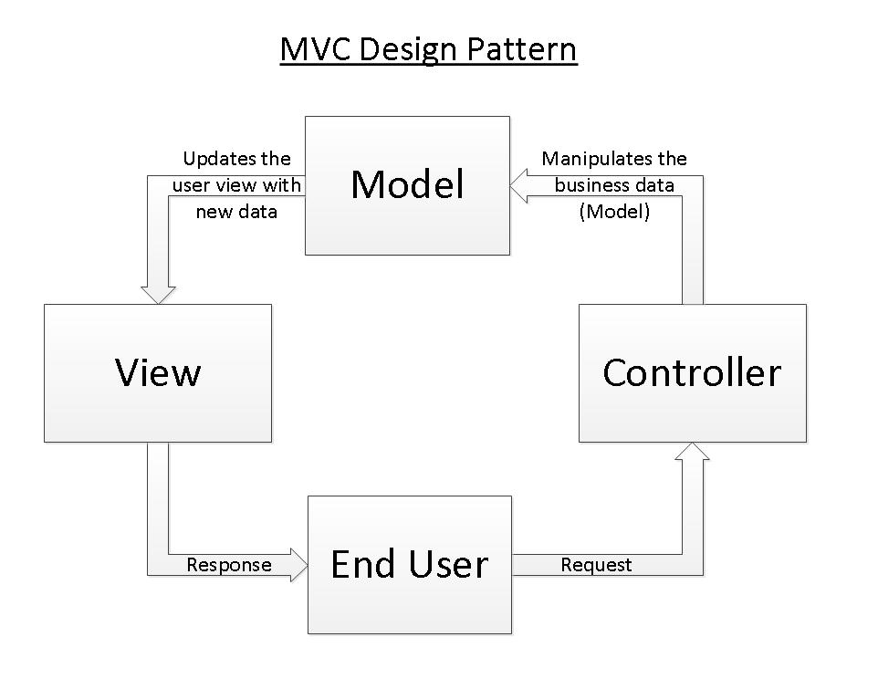
MVC
This design pattern helps us develop loosely coupled application by segregating various concerns into different layers. MVC design pattern enforces the application to be divided into three layers, Model, View and Controller.
Controller: ( Controllers are the traffic cops of the application, capable of passing data back and forth to the browser in MVC web applications.)
The controller receives user input then translates and validates the input and makes calls to model objects and the view to perform appropriate actions.
It is the part of the application that handles user interaction.
Typically controllers read data from a view, control user input, and send input data to the model.
It handles the input, typically user actions and may invoke changes on the model and view.
Model: (A model handles the data and business logic of the application. )
Responsible for managing the data of the application.
It responds to the request from the view and it also responds to instructions from the controller to update itself.
Lowest level pattern which is responsible for maintaining data.
Represents the application core (for instance a list of database records)
Also called the domain layer.
View: (A view handles the user interface elements. )
A view requests information from the model, that it needs to generate an output representation.
The view effectively provides the user interface element of the application.
It'll render data from the model into a form that is suitable for the user interface.
The view component deals with the UI logic and produces an HTML output for the browser.

Slide 9
Design patterns we use
Front Controller design pattern
This design pattern enforces a single point of entry for all the incoming requests. All the requests are handled by a single piece of code which can then further delegate the responsibility of processing the request to further application objects.
MVC design pattern
This design pattern helps us develop loosely coupled application by segregating various concerns into different layers. MVC design pattern enforces the application to be divided into three layers, Model, View and Controller.
Model: This represents the application data.
View: This represents the application’s user interface. View takes model as the input and renders it appropriately to the end user.
Controller: The controller is responsible for handling the request and generating the model and selecting the appropriate view for the request.

Slide 10
Advantages of MVC Design pattern
There are many advantages for using MVC pattern. Let’s state some of them here:
MVC allows rapid application development. If we simply define the Model layer in advance and pass this information to UI development team, they can start making the Views in paralles as Backend developers design the application Controllers and logic behind them resulting in faster development.
While changing a View mechanism, Controller layer doesn’t even have to know where the data goes. It only knows a logical view name and not even the HTML extension. So, it is very easy to switch to an Angular based view without affecting the Controller.
MVC pattern emphasis on the low coupling between different components of an application. So, the View layer have no dependency on service layer and only Controller depends on it, even that with the interfaces and not from concrete implementation.
Disadvantages:
The framework navigation can be complex because it introduces new layers of abstraction and requires users to adapt to the decomposition criteria of MVC.
Knowledge on multiple technologies becomes the norm. Developers using MVC need to be skilled in multiple technologies.

Slide 11
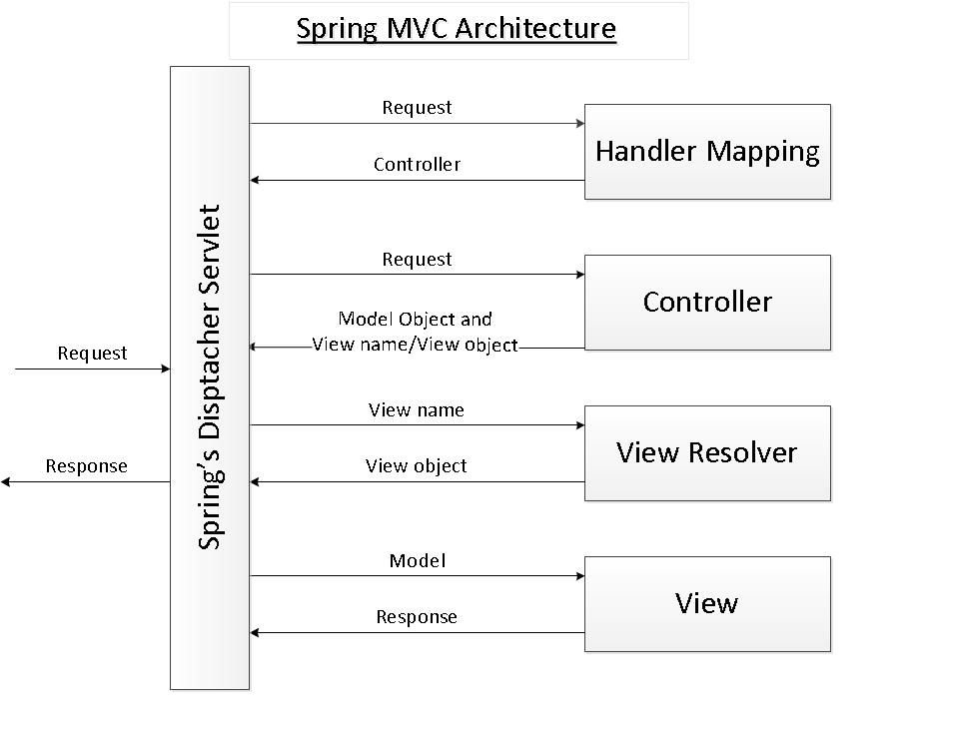
Spring MVC Architecture
Spring’s MVC module is based on front controller design pattern followed by MVC design pattern.
the Spring MVC framework is based on the Model - View - Controller (MVC) design pattern which separates the application’s logic into the three layers Mode, View and Controller. MVC is implemented in Spring by the following components:
Spring’s dispatcher servlet: acts as a front controller between the Spring application and its clients. The dispatcher servlet intercepts all requests coming to the application and consults the Handler Mapping for which controller to be invoked to handle the requests.
Handler Mapping: is responsible to find appropriate controllers that handle specific requests. The mapping between request URLs and controller classes is done via XML configuration or annotations.
Controller:is responsible to process the requests by calling other business/service classes. The output can be attached to model objects which will be sent to the view. To know which view will be rendered, the controller consults the View Resolver.
View Resolver: finds the physical view files from the logical names.
View:physical view files which can be JSP, HTML, XML, Velocity template, etc.

Slide 12
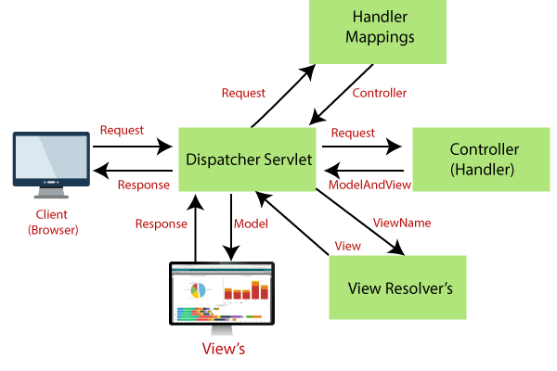
Workflow of spring mvc
All the incoming requests are handled by the single servlet named DispatcherServlet which acts as the front controller in Spring’s MVC module.
The DispatcherServlet then refers to the HandlerMapping to find a controller object which can handle the request.
DispatcherServlet then dispatches the request to the controller object so that it can actually perform the business logic to fulfil the user request. (Controller may delegate the responsibility to further application objects known as service objects).
The controller returns an encapsulated object containing the model object and the view object (or a logical name of the view).
In Spring’s MVC, this encapsulated object is represented by class ModelAndView. In case ModelAndView contains the logical name of the view, the DispatcherServlet refers the ViewResolver to find the actual View object based on the logical name.
DispatcherServlet then passes the model object to the view object which is then rendered to the end user.

Slide 13
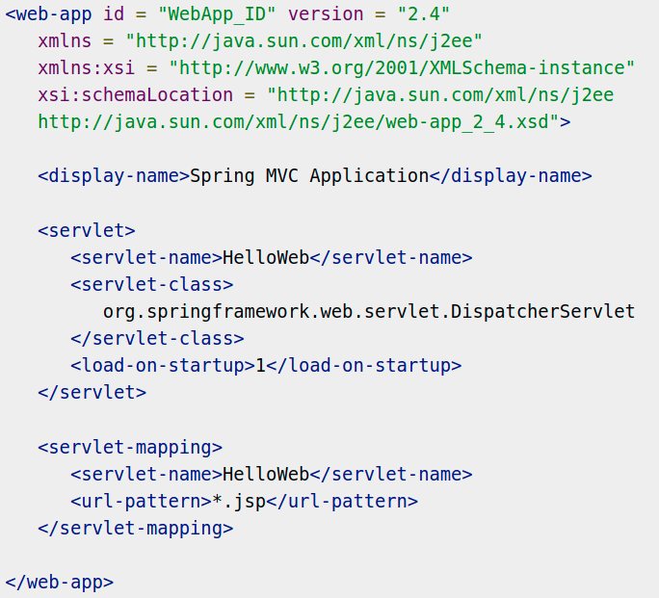
Dispatcher Servlet
DispatcherServlet acts as the front controller in the Spring’s MVC module. All the user requests are handled by this servlet. Since this is like any other servlet, it must be configured in the application’s web deployment descriptor file i.e. web.xml.
You need to map requests that you want the DispatcherServlet to handle, by using a URL mapping in the web.xml file.
The web.xml file will be kept in the WebContent/WEB-INF directory of your web application.
Upon initialization of HelloWeb DispatcherServlet, the framework will try to load the application context from a file named [servlet-name]-servlet.xml located in the application's WebContent/WEB-INF directory. In this case, our file will be HelloWebservlet.xml.
<servlet-mapping> tag indicates what URLs will be handled by which DispatcherServlet. Here all the HTTP requests ending with .jsp will be handled by the HelloWeb DispatcherServlet.

Slide 14
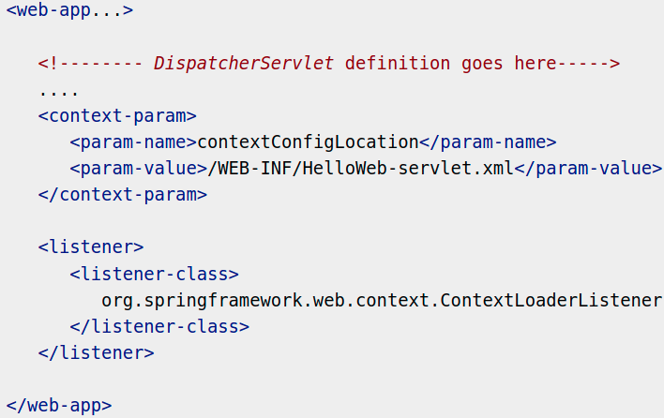
Web.xml configuration
If you do not want to go with default filename as [servlet-name]-servlet.xml and default location as WebContent/WEB-INF, you can customize this file name and location by adding the servlet listener ContextLoaderListener in your web.xml file as follows

Slide 15
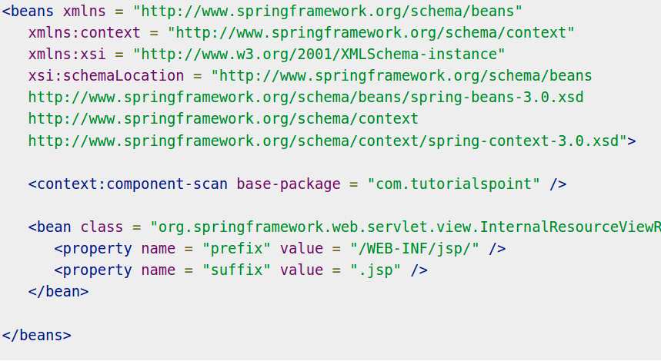
[servlet-name]-servlet.xml configuration
The [servlet-name]-servlet.xml file will be used to create the beans defined, overriding the definitions of any beans defined with the same name in the global scope.
The <context:component-scan...> tag will be use to activate Spring MVC annotation scanning capability which allows to make use of annotations like @Controller and @RequestMapping etc.
The InternalResourceViewResolver will have rules defined to resolve the view names. As per the above defined rule, a logical view named hello is delegated to a view implementation located at /WEB-INF/jsp/hello.jsp .
HelloWeb-servlet.xml file, placed in your web application's WebContent/WEB-INF directory

Slide 16
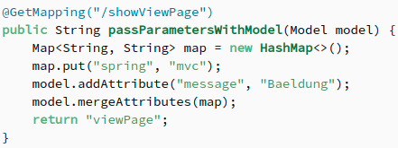
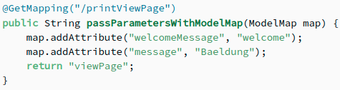
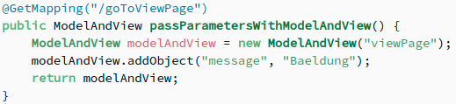
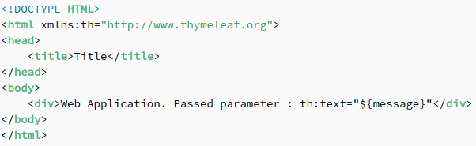
org.springframework.ui.Model, .ui.ModelMap and .web.servlet.ModelAndView provided by Spring MVC.
Model is an interface while ModelMap is a class.
ModelAndView is just a container for both a ModelMap and a view object. It allows a controller to return both as a single value.
The model can supply attributes used for rendering views.
To provide a view with usable data, we simply add this data to its Model object. Additionally, maps with attributes can be merged with Model instances:
ModelMap is also used to pass values to render a view.
The advantage of ModelMap is it gives us the ability to pass a collection of values and treat these values as if they were within a Map:
The final interface to pass values to a view is the ModelAndView.
This interface allows us to pass all the information required by Spring MVC in one return:
All the data, we place within these models, is used by a view – in general, a templated view to render the web page.

Slide 17
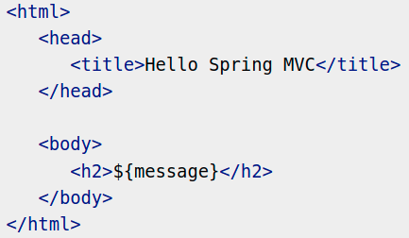
ModelAndView
Spring’s MVC module encapsulates the model object and the view object in a single entity which is represented by the object of class ModelAndView.
This object contains the model object and view object or the logical name of the view. The model object is the application data and the view is the object that renders the output to the user. The controller returns an object of ModelAndView to the dispatcher servlet for further processing.
Spring MVC supports many types of views for different presentation technologies. These include - JSPs, HTML, PDF, Excel worksheets, XML, Velocity templates, XSLT, JSON, Atom and RSS feeds, JasperReports, etc. But most commonly we use JSP templates written with JSTL.
${message} is the attribute which we have set up inside the Controller. You can have multiple attributes to be displayed inside your view.

Slide 18
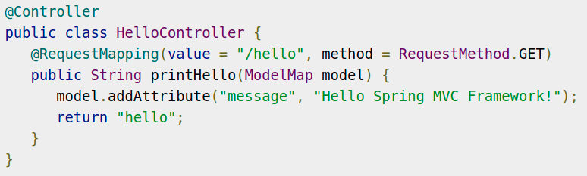
MVC Controller
The DispatcherServlet delegates the request to the controllers to execute the functionality specific to it.
The @Controller annotation indicates that a particular class serves the role of a controller.
The @RequestMapping annotation is used to map a URL to either an entire class or a particular handler method.Here, it indicates that all handling methods on this controller are relative to the /hello path.
The value attribute indicates the URL to which the handler method is mapped.
method attribute defines the service method to handle HTTP GET request.
You will define required business logic inside a service method. You can call another method inside this method as per requirement.
Based on the business logic defined, you will create a model within this method. You can use setter different model attributes and these attributes will be accessed by the view to present the final result. This example creates a model with its attribute "message".
A defined service method can return a String, which contains the name of the view to be used to render the model. This example returns "hello" as logical view name.

Slide 19

ViewResolver
In case ModelAndView object contains the logical name of the view then the DispatcherServlet needs resolving the view object based on its logical name. To resolve the view object, DispatcherServlet take the help of ViewResolver.
There are number of implementation of view resolver provided by Spring. All the view resolvers implement the interface org.springframework.web.servlet.ViewResolver.
InternalResourceViewResolver
It resolves the logical name of the view to an internal resource by prefixing the logical view name with the resource path and suffixing it with the extension.
If the logical name of the view returned by the controller in ModelAndView object is Welcome then the view which is shown to the user is /WEB-INF/jsp/Welcome.jsp

Slide 20
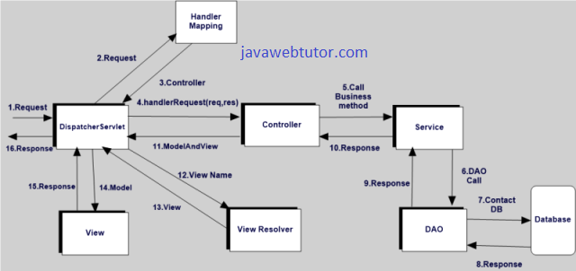
Spring MVC Flow
Notes:
Client(Browser) requests for a Resource in the web Application. The Spring front controller i.e, DispatcherServlet first receives the request.
DispatcherServlet consults the HandlerMapping to identify the particular controller for the given URL.
HandlerMapping identifies the controller for the given request and sends to the DispatcherServlet.
DispatcherServlet will call the handleRequest(request,response) method on Controller. A Controller is developed by writing a simple java class which implements Controller interface or extends its adapter class.
Controller will call the business method according to business requirement.
Service class will call the DAO class method for business data.
DAO interacts with DB to get data.
DAO returns same data to service.
Fetched data will be processed according to business requirement and return results to Controller.
The Controller returns the Model and View in the form of Object back to the Controller i.e, DispatcherServlet.
The front controller i.e, DispatcherServlet then tries to resolve the actual View which may be JSP,velocity or Free Marker by consulting the View Resolver Object.
ViewResolver selected view is rendred back to the DispatcherServlet.
DispatcherServletconsult the particular view with the model.
View executes and returns HTML output to the DispatcherServlet.
DispatcherServlet will sends the output to the Browser.

Slide 21
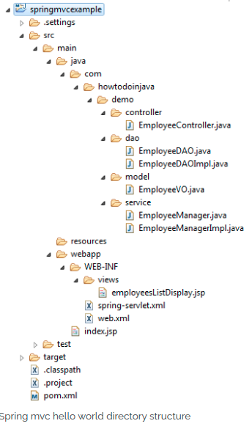
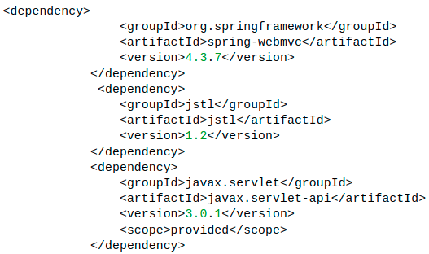
Example:
Dependencies within pom.xml: spring-web MVC jar would suffice for all container requirements to develop the MVC application, JSTL-jar is included for JSP

Slide 22
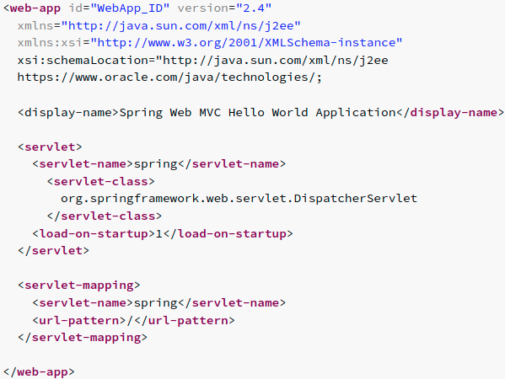
Web.xml
This minimum web.xml file declares one servlet (i.e. dispatcher servlet) to receive all kind of requests. Dispatcher servlet here acts as front controller.
All requests corresponding to the ‘/’ URL mapping would be handled by this dispatcher servlet.

Slide 23
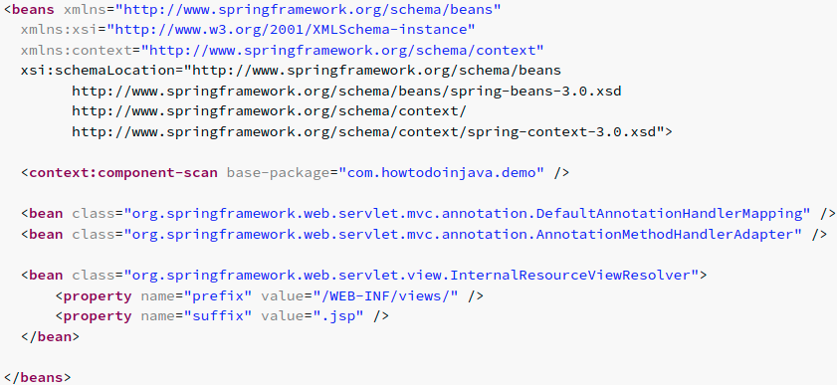
We are using annotated classes at request handler, service and dao layer so we have enabled annotation processing for all class files in base package “com.howtodoinjava.demo“.

Slide 24
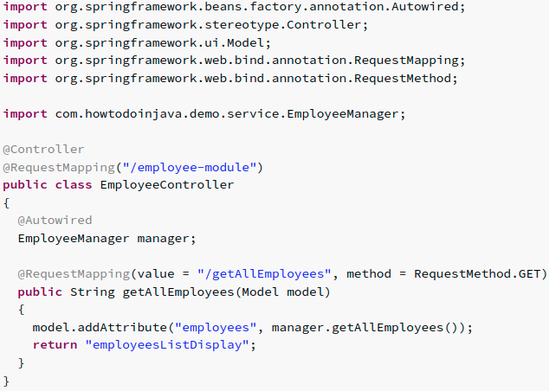
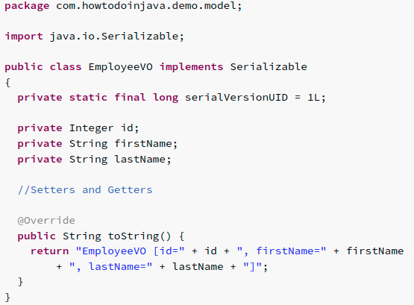
Annotation @RequestMapping at class level and method level determine the URL at which method will be invoked.
//controller class
This class act as model for MVC pattern.
employeesListDisplay.jsp is the jsp file

Slide 25
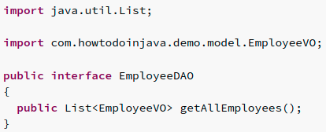
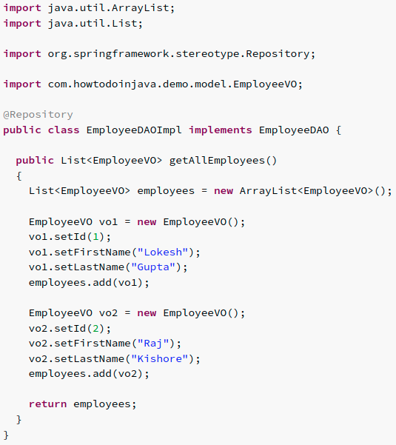
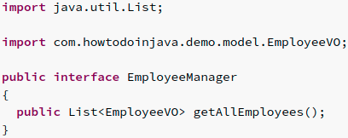
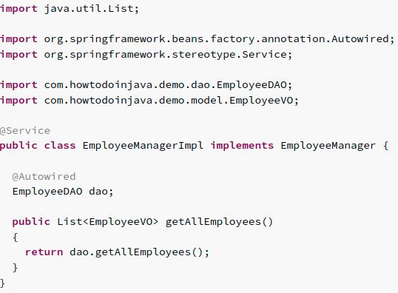
Responsible for interacting with underlying DB storage.
Responsible for interacting with DAO Layer.

Slide 26
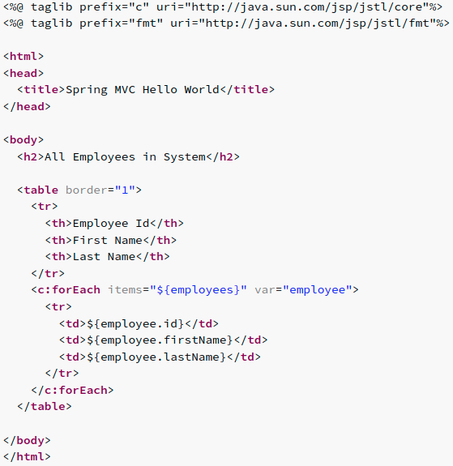
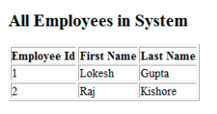
This jsp is used to display all the employees in system. It iterates the collection of employees in loop, and print their details in a table. This fits into view layer of MVC pattern.
employeesListDisplay.jsp
“http://localhost:8080/springmvcexample/employee-module/getAllEmployees“

Slide 27
Thank You

