Slide 1

8

Slide 2
Agenda
default method in Interfaces
static method in Interfaces
What and Why Functional programming
Functional Interfaces
Lambda Expressions
Java Stream API
Method Reference
forEach() method in Iterable interface
Optional Classes

Slide 3
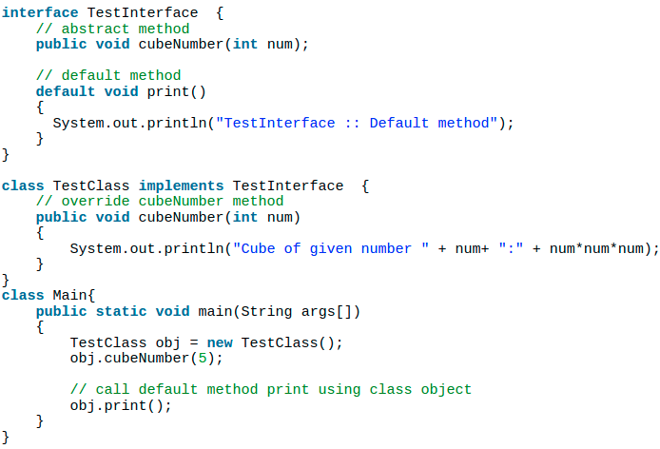
default methods in Interfaces
Before Java 8, interfaces were permitted to have only abstract methods and static and final variables. The abstract methods are by default public and need to be overridden by the class that implements an interface.
From Java 8, interfaces are enhanced to have a method with implementation. We can use default and static keyword to create interfaces with method implementation.
Like regular interface methods, default methods are implicitly public; there's no need to specify the public modifier.
Unlike regular interface methods, we declare them with the “default” keyword at the beginning of the method signature, and they provide an implementation.
We can override the default method as it is available to the class that implements the interface.
In the same way, we can invoke it using the implementation class object from the interface directly without overriding it.
When a class implements Interface, it is not mandatory to provide implementation for default methods of interface.

Slide 4
why is it required?
Default methods were introduced in Java 8 to have 'Backward Compatibility in case JDK modifies any interfaces.
In case a new abstract method is added to the interface, all classes implementing the interface will break and will have to implement the new method.
With default methods, there will not be any impact on the interface implementing classes.
default methods can be overridden if needed in the implementation. Also, it does not qualify as synchronized or final.
Java interface default methods will help us in removing base implementation classes, we can provide default implementation and the implementation classes can choose which one to override.

Slide 5
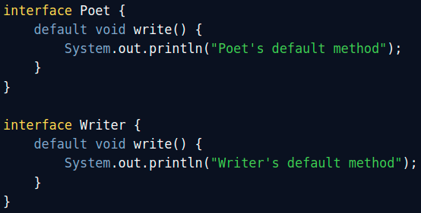
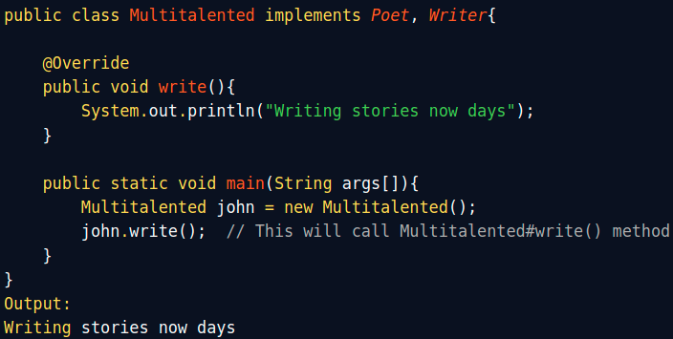
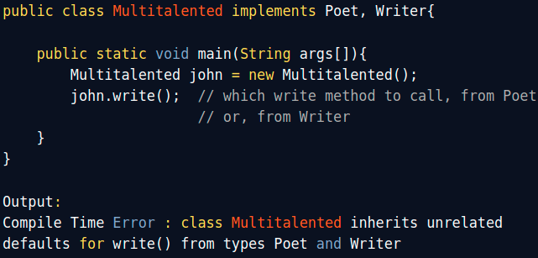
Default Methods And Multiple Inheritance
Example of Diamond Problem with Default Methods
How to avoid Diamond Problem With Default Methods in Java 8
In order to solve this error, you need to override the write() method in your implementation class i.e. class Multitalented here, this will remove the ambiguity, making the compiler happy enough to compile this class.
So until you don't create ambiguity by using default methods on interfaces, you are fine to use it. If it creates ambiguity, the compiler will alert you by throwing a compile-time error "inherits unrelated defaults".
This code will not compile in Java 8, because of ambiguity in calling the default method write() from a class, which extends both Poet and Writer interface.
At this point in time, the compiler doesn't know that which write() method should call because of ambiguity and that results in the compiler error.

Slide 6
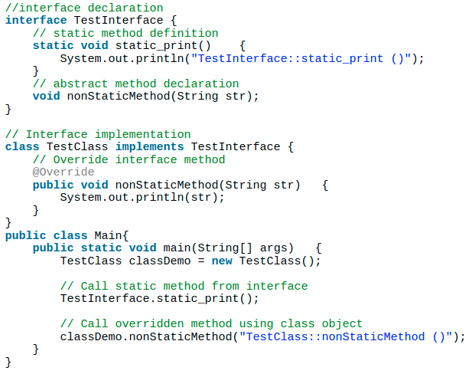

static methods in Interfaces
The following example demonstrates the use of the static method.
Java interface static method is similar to default method except that we can’t override them in the implementation classes. This feature helps us in avoiding undesired results incase of poor implementation in implementation classes.
Interface.StaticMethodName;
Note that the static method cannot be overridden by the class that implements the interface. Implementing class need not and can’t change the definition.
Java interface static method helps us in providing security by not allowing implementation classes to override them.
Java interface static methods are good for providing utility methods, for example null check, collection sorting etc.
output:

Slide 7
Introduction to Functional Programming
So far Java was supporting the imperative style of programming and object-oriented style of programming. The next big thing what java has been added is that Java has started supporting the functional style of programming with its Java 8 release.
What is Functional programming in java?
It is a declarative style of programming rather than imperative. The basic objective of this style of programming is to make code more concise, less complex, more predictable, and easier to test compared to the legacy style of coding. Functional programming deals with certain key concepts such as pure function, immutable state, assignment-less programming etc.
Why Functional Programming?
The biggest advantage of adopting functional programming in any language, including Java, is pure functions and immutable states. If we think in retrospect, most of the programming challenges are rooted in the side-effects and mutable state one way or the other. Simply getting rid of them makes our program easier to read, reason about, test, and maintain.
Declarative programming, as such, leads to very concise and readable programs. Functional programming, being a subset of declarative programming, offers several constructs like higher-order functions, function composition, and function chaining. Think of the benefits that Stream API has brought into Java 8 for handling data manipulations.
Imperative Programming | Declarative Programming
In this, programs specify how it is to be done. It simply describes the control flow of computation. Its main goal is to describe how to get it or accomplish it. | In this, programs specify what is to be done. It simply expresses the logic of computation. Its main goal is to describe the desired result without direct dictation on how to get it.
Notes:
Imperative style of programming?
It is a paradigm of software that uses statements that change a program’s state.
Imperative Programming Declarative Programming
In this, programs specify how it is to be done. In this, programs specify what is to be done.
It simply describes the control flow of computation. It simply expresses the logic of computation.
Its main goal is to describe how to get it or accomplish it. Its main goal is to describe the desired result without direct dictation on how to get it.
Its advantages include ease to learn and read, the notional model is simple to understand, etc. Its advantages include effective code, which can be applied by using ways, easy extension, high level of abstraction, etc.
Its type includes procedural programming, object-oriented programming, parallel processing approach. Its type includes logic programming and functional programming.
In this, the user is allowed to make decisions and commands to the compiler. In this, a compiler is allowed to make decisions.
It has many side effects and includes mutable variables as compared to declarative programming. It has no side effects and does not include any mutable variables as compared to imperative programming.
It gives full control to developers that are very important in low-level programming. It may automate repetitive flow along with simplifying code structure.
immutability offers thread safety, while continuous improvements to JVM performance often make it faster to create new objects instead of changing old objects.
Immutable objects lead to improved software reliability and better multithreaded performance.

Slide 8
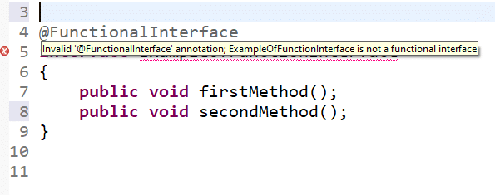
Functional Interface
A functional interface is an interface that has only one abstract method. It can contain any number of default and static methods but the abstract method it contains is exactly one. Additionally, a functional interface can have declarations of object class methods.
Functional Interface is known as “Single Abstract Method Interface” or “SAM Interface”.
The presence of a functional interface is indicated by using a @FunctionalInterface annotation.
It is not mandatory to use it, but it’s best practice to use it with functional interfaces to avoid addition of extra methods accidentally.
The major benefit of java 8 functional interfaces is that we can use lambda expressions to instantiate them and avoid using bulky anonymous class implementation.Java 8 Collections API has been rewritten and new Stream API is introduced that uses a lot of functional interfaces.
Java 8 has defined a lot of functional interfaces in java.util.function package. Some of the useful java 8 functional interfaces are Consumer, Supplier, Function and Predicate.
java.lang.Runnable is a great example of functional interface with single abstract method run().
In the functional interface, only one abstract method is allowed. If the programmer tries to add any other abstract method, then the compiler will show error as below.
//Syntax
@FunctionalInterface
public interface Foo {
String method();
}
//Example
package java.lang;
@FunctionalInterface
public interface Runnable {
void run();
}
Notes:
interface Foo { boolean equals(Object obj); }
// Not functional because equals is already an implicit member (Object class)
interface Comparator<T> {
boolean equals(Object obj);
int compare(T o1, T o2);
}
// Functional because Comparator has only one abstract non-Object method
interface Foo {
int m();
Object clone();
}
// Not functional because method Object.clone is not public
interface X { int m(Iterable<String> arg); }
interface Y { int m(Iterable<String> arg); }
interface Z extends X, Y {}
// Functional: two methods, but they have the same signature
interface X { Iterable m(Iterable<String> arg); }
interface Y { Iterable<String> m(Iterable arg); }
interface Z extends X, Y {}
// Functional: Y.m is a subsignature & return-type-substitutable
interface X { int m(Iterable<String> arg); }
interface Y { int m(Iterable<Integer> arg); }
interface Z extends X, Y {}
// Not functional: No method has a subsignature of all abstract methods
interface X { int m(Iterable<String> arg, Class c); }
interface Y { int m(Iterable arg, Class<?> c); }
interface Z extends X, Y {}
// Not functional: No method has a subsignature of all abstract methods
interface X { long m(); }
interface Y { int m(); }
interface Z extends X, Y {}
// Compiler error: no method is return type substitutable
interface Foo<T> { void m(T arg); }
interface Bar<T> { void m(T arg); }
interface FooBar<X, Y> extends Foo<X>, Bar<Y> {}
// Compiler error: different signatures, same erasure

Slide 9
Functional Interface- continued…
We can’t inherit any functional interface to another functional interface. Because it breaks the law of functional interface has exactly one abstract method.
It can extend other interfaces which do not have any abstract method and only have the
default, static, another class is overridden, and normal methods.
@FunctionalInterface
interface ExampleOfFunctionInterface
{
public void firstMethod();
}
@FunctionalInterface
interface ExampleOfAnotherFunctionInterface extends ExampleOfFunctionInterface
{
public void secondMethod();
}
The compiler will show the error “Invalid ‘@FunctionalInterface’ annotation; ExampleOfAnotherFunctionInterface is not a functional interface”
interface Parent {
default void parentMethod(){
System.out.println("Hello");
}
}
@FunctionalInterface
interface Child extends Parent {
public int childMethod();
}
Notes:
interface Foo { boolean equals(Object obj); }
// Not functional because equals is already an implicit member (Object class)
interface Comparator<T> {
boolean equals(Object obj);
int compare(T o1, T o2);
}
// Functional because Comparator has only one abstract non-Object method
interface Foo {
int m();
Object clone();
}
// Not functional because method Object.clone is not public
interface X { int m(Iterable<String> arg); }
interface Y { int m(Iterable<String> arg); }
interface Z extends X, Y {}
// Functional: two methods, but they have the same signature
interface X { Iterable m(Iterable<String> arg); }
interface Y { Iterable<String> m(Iterable arg); }
interface Z extends X, Y {}
// Functional: Y.m is a subsignature & return-type-substitutable
interface X { int m(Iterable<String> arg); }
interface Y { int m(Iterable<Integer> arg); }
interface Z extends X, Y {}
// Not functional: No method has a subsignature of all abstract methods
interface X { int m(Iterable<String> arg, Class c); }
interface Y { int m(Iterable arg, Class<?> c); }
interface Z extends X, Y {}
// Not functional: No method has a subsignature of all abstract methods
interface X { long m(); }
interface Y { int m(); }
interface Z extends X, Y {}
// Compiler error: no method is return type substitutable
interface Foo<T> { void m(T arg); }
interface Bar<T> { void m(T arg); }
interface FooBar<X, Y> extends Foo<X>, Bar<Y> {}
// Compiler error: different signatures, same erasure

Slide 10
Functional Interface- continued…
Instantiate Functional Interfaces With Lambda Expressions.
The compiler will allow us to use an inner class to instantiate a functional interface; however, this can lead to very verbose code. We should prefer to use lambda expressions.
Interface can declares an abstract method overriding one of the public method from java.lang.Object, that still can be considered as functional interface. The reason is any implementation class to this interface will have implementation for this abstract method either from super class (bare minimum java.lang.Object) class or defined by implementation class itself. In the example toString() method declared as abstract which will be implemented in its concrete implementation class or at last derived from java.lang.Object class.
The following program demonstrates the Functional Interface in Java:
package com.java8;
//declare a functional interface
@FunctionalInterface //annotation indicates it’s a functional interface
interface function_Interface{
void disp_msg(String msg); // abstract method
// Object class methods.
int hashCode();
String toString();
boolean equals(Object obj);
}
//implementation of Functional Interface
class FunctionalInterfaceExample implements function_Interface{
@Override
public void disp_msg(String msg){
System.out.println(msg);
}
}
class Main{
public static void main(String[] args) {
//create object of implementation class and call method
FunctionalInterfaceExample finte = new FunctionalInterfaceExample();
finte.disp_msg("Hello, World!!!");
}
}
//Output: Hello, World!!!
//Inner Class
Foo fooByIC = new Foo() {
@Override
public String method(String string) {
return string + " from Foo";
}
};
//Lambda Expression
Foo foo = parameter -> parameter + " from Foo";
foo.method(“Test string”);
Notes:
interface Foo { boolean equals(Object obj); }
// Not functional because equals is already an implicit member (Object class)
interface Comparator<T> {
boolean equals(Object obj);
int compare(T o1, T o2);
}
// Functional because Comparator has only one abstract non-Object method
interface Foo {
int m();
Object clone();
}
// Not functional because method Object.clone is not public
interface X { int m(Iterable<String> arg); }
interface Y { int m(Iterable<String> arg); }
interface Z extends X, Y {}
// Functional: two methods, but they have the same signature
interface X { Iterable m(Iterable<String> arg); }
interface Y { Iterable<String> m(Iterable arg); }
interface Z extends X, Y {}
// Functional: Y.m is a subsignature & return-type-substitutable
interface X { int m(Iterable<String> arg); }
interface Y { int m(Iterable<Integer> arg); }
interface Z extends X, Y {}
// Not functional: No method has a subsignature of all abstract methods
interface X { int m(Iterable<String> arg, Class c); }
interface Y { int m(Iterable arg, Class<?> c); }
interface Z extends X, Y {}
// Not functional: No method has a subsignature of all abstract methods
interface X { long m(); }
interface Y { int m(); }
interface Z extends X, Y {}
// Compiler error: no method is return type substitutable
interface Foo<T> { void m(T arg); }
interface Bar<T> { void m(T arg); }
interface FooBar<X, Y> extends Foo<X>, Bar<Y> {}
// Compiler error: different signatures, same erasure

Slide 11
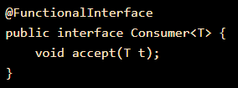
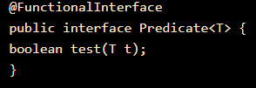
Functional Interface- continued…
Java SE 8 included four main kinds of functional interfaces which can be applied in multiple situations. These are:
Consumer: Accept one argument but do not return any values.
The Consumer interface is useful where an object needs to be consumed. It takes an object
as input and you can perform the operation on an object without returning any result. This
interface is used in a lambda expression and method reference where the user wants to
perform the operation without returning the object.
By using the Consumer interface the lambda expression provides optimized code. You can perform
any operation on the object without returning the values. In Java 8, Streams have forEach loop that
expects a Consumer as input so that it can perform the operation on it.
Consumer<Integer> consumer = (value) -> System.out.println(value);
Predicate: Accept One argument to perform a test and return a Boolean value.
This is a functional interface in Java that has a single abstract method test. The ‘test’ method
returns the boolean value after testing the specified argument.
predicate functional interface can also be implemented using Lambda expressions.
The example implementation of Predicate interface is given below
Predicate predicate = (value) -> value != null;
Notes:
interface Foo { boolean equals(Object obj); }
// Not functional because equals is already an implicit member (Object class)
interface Comparator<T> {
boolean equals(Object obj);
int compare(T o1, T o2);
}
// Functional because Comparator has only one abstract non-Object method
interface Foo {
int m();
Object clone();
}
// Not functional because method Object.clone is not public
interface X { int m(Iterable<String> arg); }
interface Y { int m(Iterable<String> arg); }
interface Z extends X, Y {}
// Functional: two methods, but they have the same signature
interface X { Iterable m(Iterable<String> arg); }
interface Y { Iterable<String> m(Iterable arg); }
interface Z extends X, Y {}
// Functional: Y.m is a subsignature & return-type-substitutable
interface X { int m(Iterable<String> arg); }
interface Y { int m(Iterable<Integer> arg); }
interface Z extends X, Y {}
// Not functional: No method has a subsignature of all abstract methods
interface X { int m(Iterable<String> arg, Class c); }
interface Y { int m(Iterable arg, Class<?> c); }
interface Z extends X, Y {}
// Not functional: No method has a subsignature of all abstract methods
interface X { long m(); }
interface Y { int m(); }
interface Z extends X, Y {}
// Compiler error: no method is return type substitutable
interface Foo<T> { void m(T arg); }
interface Bar<T> { void m(T arg); }
interface FooBar<X, Y> extends Foo<X>, Bar<Y> {}
// Compiler error: different signatures, same erasure

Slide 12
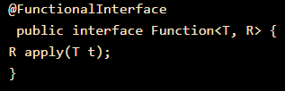
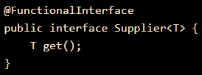
Functional Interface- continued…
Function: To transform arguments in returnable value.
A function is a type of functional interface in Java that has an abstract method apply()
which takes an argument of type T and returns a result of type R.
Supplier: Do not accept any arguments but return a value.
The Supplier functional interface is also a type of functional interface that does not take
any input or argument and yet returns a single output.
This type of functional interface is generally used in the lazy generation of values.
Supplier functional interfaces are also used for defining the logic for the generation of any sequence.
The major benefit is that we can pass a functional interface as an argument to another method and provide an implementation for these interfaces using lambda expressions.
Notes:
interface Foo { boolean equals(Object obj); }
// Not functional because equals is already an implicit member (Object class)
interface Comparator<T> {
boolean equals(Object obj);
int compare(T o1, T o2);
}
// Functional because Comparator has only one abstract non-Object method
interface Foo {
int m();
Object clone();
}
// Not functional because method Object.clone is not public
interface X { int m(Iterable<String> arg); }
interface Y { int m(Iterable<String> arg); }
interface Z extends X, Y {}
// Functional: two methods, but they have the same signature
interface X { Iterable m(Iterable<String> arg); }
interface Y { Iterable<String> m(Iterable arg); }
interface Z extends X, Y {}
// Functional: Y.m is a subsignature & return-type-substitutable
interface X { int m(Iterable<String> arg); }
interface Y { int m(Iterable<Integer> arg); }
interface Z extends X, Y {}
// Not functional: No method has a subsignature of all abstract methods
interface X { int m(Iterable<String> arg, Class c); }
interface Y { int m(Iterable arg, Class<?> c); }
interface Z extends X, Y {}
// Not functional: No method has a subsignature of all abstract methods
interface X { long m(); }
interface Y { int m(); }
interface Z extends X, Y {}
// Compiler error: no method is return type substitutable
interface Foo<T> { void m(T arg); }
interface Bar<T> { void m(T arg); }
interface FooBar<X, Y> extends Foo<X>, Bar<Y> {}
// Compiler error: different signatures, same erasure

Slide 13
Lambda Expressions
Java 8 Functional Interfaces and Lambda Expressions help us in writing smaller and cleaner code by removing a lot of boiler-plate code.
In general programming language, a Lambda expression (or function) is an anonymous function, i.e., a function without any name or identifier, and with a list of formal parameters and a body.
An arrow (->) is used to separate the list of parameters and the body.
Lambda Expression are the way through which we can visualize functional programming in the java object oriented world. Objects are the base of java programming language and we can never have a function without an Object, that’s why Java language provide support for using lambda expressions only with functional interfaces.
It will infer the return type, type, and several arguments from the signature of the abstract method of functional interface.

Slide 14
Lambda Expressions - Syntax
the basic structure/syntax of a lambda expression?
Lambda expression can be divided into three distinct parts as below:
1. List of Arguments/Params: (String name)
A list of params is passed in () round brackets. It can have zero or more params. Declaring the type of parameter is optional and can be inferred for the context.
2. Arrow Token: ->
Arrow token is known as the lambda arrow operator. It is used to separate the parameters from the body, or it points the list of arguments to the body.
3. Expression/Body:
{
System.out.println("Hello "+name);
return "Hello "+name;
}
A body can have expressions or statements. {} curly braces are only required when there is more than one line. In one statement, the return type is the same as the return type of the statement. In other cases, the return type is either inferred by the return keyword or void if nothing is returned.
Syntax:
(parameters) -> expression
(parameters) -> { statements; }
() -> expression
FunctionalInterface fi = (String name) -> {
System.out.println("Hello "+name);
return "Hello "+name;
}

Slide 15
// Interface definition
interface FunctionalIntrface {
String testMethod(String name);
}
// Method implementation using lambda and assign to variable.
FunctionalInterface fi = (String name) -> {
System.out.println("Hello "+name);
return "Hello "+name;
}
// Invoking method using function refference
String output = fi.testMethod(“Shashi”);

Slide 16
Lambda Expressions - best practices
some of the best practices:
A lambda expression can have zero, one or more parameters/arguments.
Callable<Integer> callMe = () -> 42;
Predicate<Integer> isOdd = n -> n % 2 != 0;
BinaryOperator<Integer> sum = (x, y) -> x + y;
Consumer<String> printer -> (String s) -> { System.out.println(s); };
The body of the lambda expressions can contain zero, one or more statements.
Runnable runner = () -> { System.out.println("Hello World!"); };
Lambda syntax only requires parentheses around more than one parameter, or when there is no parameter at all.
(x,y) -> {
System.out.println(x);
System.out.println(x);
return x+y;
}
Braces and return statements are optional in one-line lambda bodies. This means that they can be omitted for clarity and conciseness.
Callable<Integer> callMe = () -> 42;
Very often, lambda expressions just call methods which are already implemented elsewhere.
a -> a.toLowerCase();
Notes:
Target typing
Note that the name of a functional interface is not part of the lambda expression syntax. So what kind of object does a lambda expression represent? Its type is inferred from the surrounding context.
An implication of this approach is that the same lambda expression can have different types in different contexts:
Callable<String> c = () -> "done"; PrivilegedAction<String> a = () -> "done";
In the first case, the lambda expression () -> "done" represents an instance of Callable. In the second case, the same expression represents an instance of PrivilegedAction.
The compiler is responsible for inferring the type of each lambda expression. It uses the type expected in the context in which the expression appears; this type is called the target type. A lambda expression can only appear in a context that has a target type.
lambda expression is compatible with a target type T if all of the following conditions hold:
T is a functional interface type
The lambda expression has the same number of parameters as T's method, and those parameters' types are the same
Each expression returned by the lambda body is compatible with T's method's return type
Each exception thrown by the lambda body is allowed by T's method's throws clause
when there is just one parameter whose type is inferred (a very common case), the parentheses surrounding a single parameter name are optional:
FileFilter java = f -> f.getName().endsWith(".java"); button.addActionListener(e -> ui.dazzle(e.getModifiers()));

Slide 17
Lambda Expressions -Example...
create an immutable collection of a list of names with the following code:
final List<String> friends = Arrays.asList("Brian", "Nate", "Neal", "Raju", "Sara", "Scott");
Here’s the habitual, but not so desirable, way to iterate and print each of the elements.
for(int i = 0; i < friends.size(); i++) {
System.out.println(friends.get(i));
}
Java offers a construct that is a bit more civilized than the good old for loop.
for(String name : friends) {
System.out.println(name);
}
uses the Iterator interface and calls into its hasNext() and next() methods.
while (iterator.hasNext()) {
String friends= iterator.next();
System.out.println(friends);
}
Here, we use an internal iterator to enumerate the names. The Iterable interface has been enhanced with forEach(), which accepts a parameter of type Consumer. As the name indicates, an instance of Consumer will consume, through its accept() method, which is what’s given to it. Use the forEach() method with the anonymous inner class syntax.
friends.forEach(new Consumer<String>() {
public void accept(final String name) {
System.out.println(name);
}
);
This is where lambda expressions and the compiler magic come in. Let’s make one change, replacing the anonymous inner class with a lambda expression.
friends.forEach((final String name) -> System.out.println(name));
friends.forEach((name) -> System.out.println(name));
Notes:
https://javarevisited.blogspot.com/2014/02/10-example-of-lambda-expressions-in-java8.html#ixzz7V3jv1BxM
anonymous inner classes are imperfect for a number of reasons, primarily:
Bulky syntax
Confusion surrounding the meaning of names and this
Inflexible class-loading and instance-creation semantics
Inability to capture non-final local variables
Inability to abstract over control flow
http://cr.openjdk.java.net/~briangoetz/lambda/lambda-state-4.html

Slide 18
Lambda Expressions - Continued...
Avoid Blocks of Code in Lambda's Body
In an ideal situation, lambdas should be written in one line of code. With this approach, the lambda is a self-explanatory construction, which declares what action should be executed with what data (in the case of lambdas with parameters).
Avoid Specifying Parameter Types
A compiler, in most cases, is able to resolve the type of lambda parameters with the help of type inference. Consequently, adding a type to the parameters is optional and can be omitted.
Instead of:
Foo foo = parameter -> { String result = "Something " + parameter;
//many lines of code
return result;
};
Follow this:
Foo foo = parameter -> buildString(parameter);
private String buildString(String parameter) {
String result = "Something " + parameter;
//many lines of code
return result;
}
We can do this:
(a, b) -> a.toLowerCase() + b.toLowerCase();
Instead of this:
(String a, String b) -> a.toLowerCase() + b.toLowerCase();

Slide 19
Java Streams
A Stream, which represents a sequence of data objects & series of operations on that data is a data pipeline that is not related to Java I/O. Streams does not hold any data permanently. Rather, it adds support for functional-style operations on data pipelines.
The key interface is java.util.stream.Stream<T>. It accepts Functional Interfaces so that lambdas can be passed. Streams support a fluent interface or chaining.
We can use Java Stream API to implement internal iteration, that is better because java framework is in control of the iteration.
Internal iteration provides several features such as sequential and parallel execution, filtering based on the given criteria, mapping etc.
Most of the Java 8 Stream API method arguments are functional interfaces, so lambda expressions work very well with them.
stream maintains the same ordering of the elements as the ordering in the stream source.
//where we use streams,example:
List<Integer> list = Arrays.asList(2, 4, 1, 3, 7, 5, 9, 6, 8);
Optional<Integer> maxNumber = list.stream().max((i, j) -> i.compareTo(j));
System.out.println(maxNumber.get()); //9

Slide 20
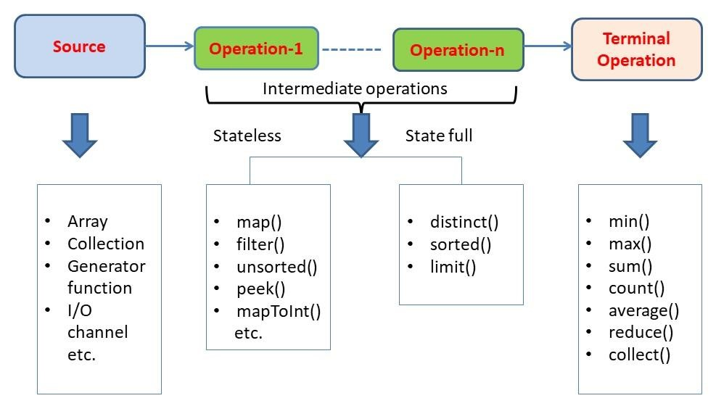
Main components of a Stream:
Components of the stream are:
A data source
Set of Intermediate Operations to process the data source
Single Terminal Operation that produces the result
Source
The stream can be created from the array, Set, List, Map or any Collection, any generator function like a random function generator, from a file or any IO channel, some computational pipeline.

Slide 21
Creating Streams
1. Stream.of(): creating a stream of a fixed number of integers.
Stream<Integer> stream = Stream.of(1,2,3,4,5,6,7,8,9);
stream.forEach(p -> System.out.println(p));
2. Stream.of(array): creating a stream from the array. The elements in the stream are taken from the array.
Stream<Integer> stream = Stream.of( new Integer[]{1,2,3,4,5,6,7,8,9} );
stream.forEach(p -> System.out.println(p));
3. List.stream(): creating a stream from the List. The elements in the stream are taken from the List.
List<Integer> list = new ArrayList<Integer>();
for(int i = 1; i< 10; i++){
list.add(i);
}
Stream<Integer> stream = list.stream();
stream.forEach(p -> System.out.println(p));
4. Stream.generate() or Stream.iterate(): creating a stream from generated elements. This will produce a stream of 20 random numbers. We have restricted the elements count using limit() function.
Stream<Integer> randomNumbers = Stream.generate(() -> (new Random()).nextInt(100));
randomNumbers.limit(20).forEach(System.out::println);
5. Stream of String chars or tokens
creating a stream from the characters of a given string. In the second part, we are creating the stream of tokens received from splitting from a string.
Stream<String> stream = Stream.of("A$B$C".split("\\$"));
stream.forEach(p -> System.out.println(p));

Slide 22
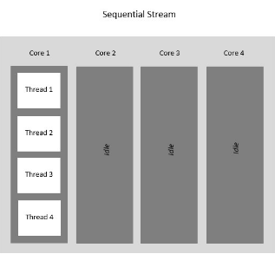
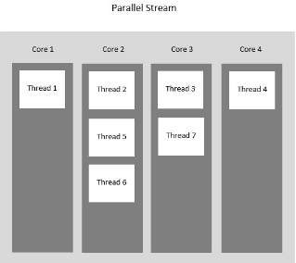
Parallel Streams
Java Parallel Streams is a feature of Java 8 and higher, meant for utilizing multiple cores of the processor.
Normally any java code has one stream of processing, where it is executed sequentially. Whereas by using parallel streams, we can divide the code into multiple streams that are executed in parallel on separate cores and the final result is the combination of the individual outcomes.
The order of execution, however, is not under our control.
Parallel Streams were introduced to increase the performance of a program, but opting for parallel streams isn’t always the best choice.
There are certain instances in which we need the code to be executed in a certain order and in these cases, we better use sequential streams to perform our task at the cost of performance.
The performance difference between the two kinds of streams is only of concern for large-scale programs or complex projects.
Using parallel() method on a stream
2. Using parallelStream() on a Collection
//parallel() method of the BaseStream interface
File fileName = new File("M:\\Documents\\Textfile.txt");
// Create a Stream of string type using the lines() method to read one line at a time from the text file
Stream<String> text = Files.lines(fileName.toPath());
text.parallel().forEach(System.out::println); text.close();
//Line 2
Line 3
Line 1
//parallelStream() method of the Collection interface
File fileName = new File("M:\\Documents\\Textfile.txt");
List<String> text
= Files.readAllLines(fileName.toPath());
// Creating parallel streams by creating a List using readAllLines() method
text.parallelStream().forEach(System.out::println);
text.close();
//Line 3
Line 1
Line 2

Slide 23
Stream Operations
Intermediate Operations:
These operations are used to pipeline other methods and to transform into the other streams. They don't produce results because these operation does not invoke until the terminal operation gets executed.
Typically transforms a stream into another stream.
Are lazy, i.e., not executed till a terminal operation is invoked.
Does internal iteration of all source elements.
Operations are applied as per the defined order.
Intermediate operations are mostly lambda functions.
Intermediate operations return the stream itself so you can chain multiple methods calls in a row.
filter(), map(), flatMap(), distinct(), sorted(), peek(), limit(), skip()
Stateless operations:
Operation’s which doesn’t require to maintain the state of the stream and has nothing to do with the other elements of the stream, Operations like map(), filter () mapToInt (), mapToDouble(), peek(), unsorted(), etc.
Stateless operations, such as filter and map, retain no state from previously seen element when processing a new element -- each element can be processed independently of operations on other elements.
Stateless operations allow for memory-efficient processing of streams. Operations like Stream.map and Stream.filter that do not require information on other items of the stream are considered to be stateless.
Every individual element can be processed without the need for sharing information between them for processing.
Each element is processed independently of others.
int count = Stream.of(1, 2, 3, 4, 5)
.filter(i -> i <4) // Intermediate Operation filter
.count(); // Terminal Operation count

Slide 24
Stateful operations:
Statefulness means the operation on each item depends on (some) other items of the stream.
Stateful operations may need to process the entire input before producing a result.
Operations in which elements can’t be processed individually and they are required to do some comparison with other elements, like distinct (), sorted (), limit (), etc.
This requires a state to be preserved. Statefulness operations may break with long, or infinite, streams. Operations like Stream.sorted require the entirety of the stream to be processed before any item is emitted which will break in a long enough stream of items.
// works - stateless stream
long BIG_ENOUGH_NUMBER = 999999999;
IntStream.iterate(0, i -> i + 1).limit(BIG_ENOUGH_NUMBER).forEach(System.out::println);
This will cause an out-of-memory due to statefulness of Stream.sorted:
// Out of memory - stateful stream
IntStream.iterate(0, i -> i + 1).limit(BIG_ENOUGH_NUMBER).sorted().forEach(System.out::println);
2. Terminal Operations:
A terminal operation in Java is a method applied to a stream as the final step.
Kick-starts the Stream pipeline.
used to collect the processed Stream data.
Terminal operations return a result of a certain type after processing all the stream elements.
toArray(), collect(), count(), reduce(), forEach(), forEachOrdered(), min(), max(), anyMatch(), allMatch(), noneMatch(), findAny(), findFirst()

Slide 25
3. Stream Collectors:
After performing the intermediate operations on elements in the stream, we can collect the processed elements again into a Collection using the stream Collector methods.
collect(Collectors.toList());
4. Short-circuit Operations:
It is often desired to break the operation whenever a matching element is encountered during iteration.
In external iteration, we will do with the if-else block.
In the internal iterations such as in streams, there are certain methods like Stream.anyMatch(), Stream.findFirst()
most common type of Terminal operations
collect() - Collects single result from all elements of the stream sequence.
reduce() - Produces a single result from all elements of the stream sequence
count() - Returns the number of elements on the stream.
min() - Returns the min element from the stream.
max() - Returns the max element from the stream.
Search/Query operations
anyMatch() , noneMatch() , allMatch() , ... - Short-circuiting operations.
Takes a Predicate as input for the match condition.
Stream processing will be stopped, as and when the result can be determined.
Iterative operations
forEach() - Useful to do something with each of the Stream elements. It accepts a consumer.
forEachOrdered() - It is helpful to maintain order in parallel streams.

Slide 26
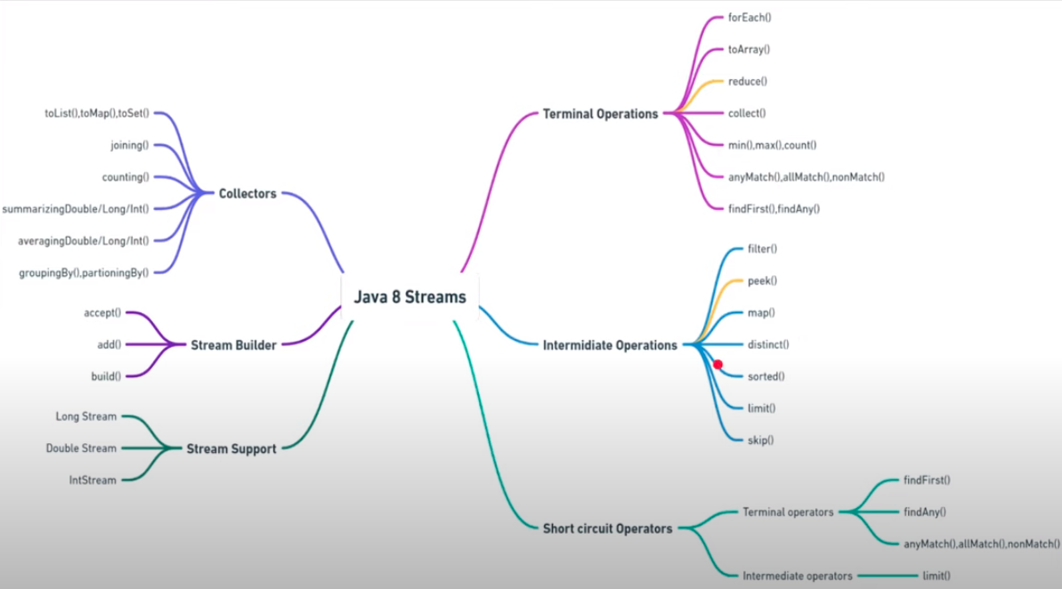
Notes:
Stream builder() returns a builder for a Stream.
IntStream.Builder build() builds the stream, transitioning this builder to the built state.
A stream builder has a lifecycle, which starts in a building phase, during which elements can be added, and then transitions to a built phase, after which elements may not be added. The built phase begins when the build() method is called, which creates an ordered stream whose elements are the elements that were added to the stream builder, in the order they were added.
DoubleStream.Builder add(double t) is used to insert an element into the element in the building phase of stream. It adds an element to the stream being built.
Exceptions: This method throws IllegalStateException: when the builder has already transitioned to the built state. It means that the stream has entered the built phase and now no it can’t be changed. Hence no more elements can be added into the stream.
Stream.Builder accept(T t) is used to insert an element into the element in the building phase of stream. It adds an element to the stream being built.
Exceptions: This method throws IllegalStateException: when the builder has already transitioned to the built state. It means that the stream has entered the built phase and now no it can’t be changed. Hence no more elements can be added into the stream.
DoubleStream builder() returns a builder for a DoubleStream.

Slide 27
List<String> fruits = Arrays.asList(“apple”, “mango”, “oranges”, “avacado”, “kiwi”);
Stream.map() :
The map is an intermediate operation that consumes a stream and produces a stream. It applies a given lambda expression or method reference to each element of the stream and converts it to a new stream.
Example: Convert each element of the list to uppercase.
List newList = fruits.stream().map( x->x.toUpperCase()).collect(Collectors.toList());
Stream.filter() :
The filter is an intermediate operation that consumes a stream and produces a stream. It applies a given lambda expression to each element of the stream and filters the input stream to the new stream.
Example: filter all elements that start with “A”.
List newList = fruits.stream().map( x->x.toUpperCase()).filter(x->x.startsWith(“A”)).collect(Collectors.toList());
Stream.reduce() :
Reduce is a terminal operation that consumes a stream, applies the lambda expression to each element and produces a single result and not a stream.
Example: Concatenate all fruits that start with “A”.
List newList = fruits.stream().map( x->x.toUpperCase()).filter(x->x.startsWith(“A”)).reduce(“”,(x,y)-> x+y);
Collectors
Java.util.stream.Collectors is a final utility class that contains various methods which are used with terminal operation Stream.collect() . It is generally used to convert the output stream after various operations are applied to some Collection using Collectors.toList() , Collectors.toSet() etc.
Example: Let’s count no fruits of each type.
Map<String, Long> map = fruits.stream().map(x->x.toUpperCase()).collect(Collectors.groupingBy(Function.identity(),Collectors.counting()));

Slide 28
class Demo{
public static void main(String args[]){
// create a list of integers
List<Integer> number = Arrays.asList(2,3,4,5);
// demonstration of map method
List<Integer> square = number.stream().map(x -> x*x). collect(Collectors.toList());
System.out.println(square);
// create a list of String
List<String> names = Arrays.asList("Reflection","Collection","Stream");
// demonstration of filter method
List<String> result = names.stream().filter(s->s.startsWith("S")).collect(Collectors.toList());
System.out.println(result);
// demonstration of sorted method
List<String> show = names.stream().sorted().collect(Collectors.toList());
System.out.println(show);
// create a list of integers
List<Integer> numbers = Arrays.asList(2,3,4,5,2);
// collect method returns a set
Set<Integer> squareSet = numbers.stream().map(x->x*x).collect(Collectors.toSet());
System.out.println(squareSet);
// demonstration of forEach method
number.stream().map(x->x*x).forEach(y->System.out.println(y));
// demonstration of reduce method
int even = number.stream().filter(x->x%2==0).reduce(0,(ans,i)-> ans+i);
System.out.println(even);
// creating a list of Strings
List<String> words = Arrays.asList("GFG", "Geeks", "for", "GeeksQuiz", "GeeksforGeeks");
Optional<String> longestString = words.stream().reduce((word1, word2)-> word1.length() > word2.length() ? word1 : word2);
// Displaying the longest String
longestString.ifPresent(System.out::println);
}
}
//Ouput
[4, 9, 16, 25]
[Stream]
[Collection, Reflection, Stream] [16, 4, 9, 25]
4
9
16
25
6
GeeksforGeeks

Slide 29
boolean | allMatch(Predicate<? super T> predicate) Returns whether all elements of this stream match the provided predicate.
boolean | anyMatch(Predicate<? super T> predicate) Returns whether any elements of this stream match the provided predicate.
void | forEach(Consumer<? super T> action) Performs an action for each element of this stream.
<R> Stream<R> | map(Function<? super T,? extends R> mapper) Returns a stream consisting of the results of applying the given function to the elements of this stream.
Stream<T> | distinct()
void | forEach(Consumer<? super T> action)
Optional<T> | min(Comparator<? super T> comparator)
<R,A> R | collect(Collector<? super T,A,R> collector)
Stream<T> | filter(Predicate<? super T> predicate)
Notes:
How are Collections different from Stream?
Collections are the source for the Stream. Java 8 collection API is enhanced with the default methods returning Stream<T> from the collections
Collections Streams
Data structure holds all the data elements No data is stored. Have the capacity to process an infinite number of elements on demand
External Iteration Internal Iteration
Can be processed any number of times Traversed only once
Elements are easy to access No direct way of accessing specific elements
Is a data store Is an API to process the data

Slide 30
Method References
The method reference is nothing but the simplified version of the lambda expression. Instead of providing an implementation body, a method reference refers to an existing available method.
Method reference can be used as a shorter and more readable alternative for a lambda expression that only calls an existing method.
There are four types of method references that are as follows:
Static Method Reference.
Instance Method Reference of a particular object.
Instance Method Reference of an arbitrary object of a particular type.
Constructor Reference.

Slide 31
1. Reference to a Static Method
Example of static method reference
(ContainingClass::methodName)
Ex: Making a call to static method isRealUser(User user)
boolean isReal = list.stream().anyMatch(u -> User.isRealUser(u));
Using Method reference
boolean isReal = list.stream().anyMatch(User::isRealUser);
import java.util.function.BiFunction;
class Arithmetic{
public static int add(int a, int b){
return a+b;
}
}
public class MethodReference3 {
public static void main(String[] args) {
/---- by using Lambda ----
//BiFunction<Integer, Integer, Integer> adder = (x,y) -> {
return Arithmetic.add(x,y); };
//---- by using method reference ----
BiFunction<Integer, Integer, Integer> adder = Arithmetic()::add;
int result = adder.apply(10, 20); //30
System.out.println(result);
}
}
//BiFunction.java
@FunctionalInterface
public interface BiFunction<T, U, R> {
R apply(T t, U u);
}

Slide 32
2. Reference to an Instance Method
(containingInstance::methodName)
Ex: calls method isLegalName(String string) of type User,
which validates an input parameter
User user = new User();
boolean isLegalName = list.stream().anyMatch(user::isLegalName);
Example of non-static method reference
import java.util.function.BiFunction;
class Arithmetic{
public int add(int a, int b){
return a+b;
}
}
public class InstanceMethodReference3 {
public static void main(String[] args) {
//BiFunction<Integer, Integer, Integer>adder = (x,y) -> {
return new Arithmetic().add(x,y); };
BiFunction<Integer, Integer, Integer>adder = new Arithmetic()::add;
int result = adder.apply(10, 20); //30
System.out.println(result);
}
}

Slide 33
3. Reference to a Constructor
(ClassName::new)
As constructor in Java is a special method, method reference could be applied to it too, with the help of new as a method name
Stream<User> stream = list.stream().map(User::new);
Example of constructor reference
interface Messageable{
Message getMessage(String msg);
}
class Message{
Message(String msg){
System.out.print(msg);
}
}
public class ConstructorReference {
public static void main(String[] args) {
Messageable hello = Message::new;
hello.getMessage("Hello");
}
}

Slide 34
4. Reference to an Instance Method of an Object of a Particular Type
(ContainingType::methodName)
long count = list.stream().filter(String::isEmpty).count();
public class GFG {
// Main driver method
public static void main(String[] args)
{
// Creating empty ArrayList of user defined type List of person
List<String> personList = new ArrayList<>();
// Adding elements to above object of List using add() method
personList.add("vicky");
personList.add("poonam");
personList.add("sachin");
// Method reference to String type
Collections.sort(personList, String::compareToIgnoreCase);
// Printing the elements(names) on console
personList.forEach(System.out::println);
}
}
Using Instance type method reference to sort with custom comparator

Slide 35
Kind | Syntax | Examples
Reference to a static method | ContainingClass::staticMethodName | Person::compareByAge MethodReferencesExamples::appendStrings
Reference to an instance method of a particular object | containingObject::instanceMethodName | myComparisonProvider::compareByName myApp::appendStrings2
Reference to an instance method of an arbitrary object of a particular type | ContainingType::methodName | String::compareToIgnoreCase String::concat
Reference to a constructor | ClassName::new | HashSet::new

Slide 36
forEach()
//Iterable.class
All the Collection Interfaces in Java (List, Set, Map etc) will be extending the Iterable interface as the super interface. In Java 8 a new method has been introduced for Iterating over collections in Java.
void forEach(Consumer<? super T> action)
We use forEach to iterate over a collection and perform a certain action on each element. The action to be performed is contained in a class that implements the Consumer interface and is passed to forEach as an argument.
Java 8 has introduced forEach method in java.lang.Iterable interface so that while writing code we focus on business logic.
forEach method has internal iteration.
The forEach() is a higher-order function that accepts a lambda expression or block of code to execute in the context of each element in the list.
package java.lang;
import java.util.Iterator;
import java.util.Objects;
import java.util.Spliterator;
import java.util.Spliterators;
import java.util.function.Consumer;
public interface Iterable<T> {
Iterator<T> iterator();
default void forEach(Consumer<? super T> action) {
Objects.requireNonNull(action);
Iterator var2 = this.iterator();
while(var2.hasNext()) {
T t = var2.next();
action.accept(t);
}
}
default Spliterator<T> spliterator() {
return Spliterators.spliteratorUnknownSize(this.iterator(), 0);
}
}
Notes:
1. An Iterable represents a collection that can be traversed. Implementing the Iterable interface allows an object to make use of the for-each loop. It does that by internally calling the iterator() method on the object. For example, the following code only works as a List interface extends the Collection interface, and the Collection interface extends the Iterable interface.
List<String> persons = new ArrayList<>(Arrays.asList("A", "B", "C"));
for (String person: persons) {
System.out.println(person);
}
Please note that we can also call the forEach() method on an iterable starting from Java 8, which performs the given action for each element of the Iterable. It is worth noting that the default implementation of forEach() also uses for-each internally.

Slide 37
forEach() - continued..
import java.util.ArrayList;
public class ForEachSamplecopy {
public static void main(String[] args) {
List<String> places = new ArrayList<>();
places.add("Delhi");
places.add("Bangalore");
places.add("Hyderabad");
//places.forEach(p -> System.out.println(p));
places.forEach(System.out::println);
}
}
//Output:
Delhi
Bangalore
Hyderabad
The forEach method takes java.util.function.Consumer object as an argument, so it helps in having our business logic at a separate location that we can reuse.
//Another way
The number of lines might increase but forEach method helps in having the logic for iteration and business logic at separate place resulting in higher separation of concern and cleaner code.
Consumer<String> printConsumer= new Consumer<String>() {
public void accept(String name) {
System.out.println(name);
}
};
names.forEach(printConsumer);
Notes:
3.1. Parallel Streams
Parallel streams allow us to execute the stream in multiple threads, and in such situations, the execution order is undefined. Java only requires all threads to finish before any terminal operation, such as Collectors.toList(), is called.
Let's look at an example where we first call forEach() directly on the collection, and second, on a parallel stream:
list.forEach(System.out::print);
System.out.print(" ");
list.parallelStream().forEach(System.out::print);
If we run the code several times, we see that list.forEach() processes the items in insertion order, while list.parallelStream().forEach() produces a different result at each run.
Here is one possible output:
ABCD CDBA
And this is another:
ABCD DBCA

Slide 38
Optional Class
It is a public final class and used to deal with NullPointerException in Java application. It provides methods which are used to check the presence of value for particular variable.
Java 8 Optional<T> class can help to handle situations where there is a possibility of getting the NPE. It works as a container for the object of type T. It can return a value of this object if this value is not a null. When the value inside this container is null, it allows doing some predefined actions instead of throwing NPE.
It can help in writing a neat code without using too many null checks. By using Optional, we can specify alternate values to return or alternate code to run. This makes the code more readable because the facts which were hidden are now visible to the developer.
Optional is a container object which may or may not contain a non-null value. You must import java.util package to use this class. If a value is present, isPresent() will return true and get() will return the value.
//Example
Optional<AppPackage> info = appPackageRepository.findById(appPackage.getAppPkgId());
if (!info.isPresent()) {
LOGGER.error("App package does not exist {}", appPackage.getAppPkgId());
throw new ApmException("App package does not exist");
}
appPackageRepository.save(appPackage);

Slide 39
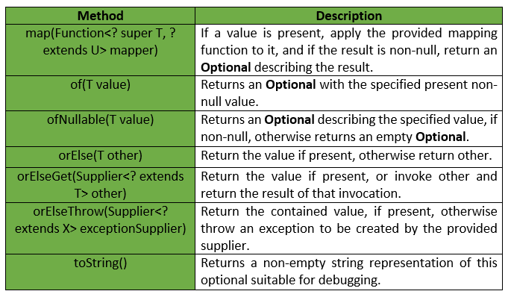
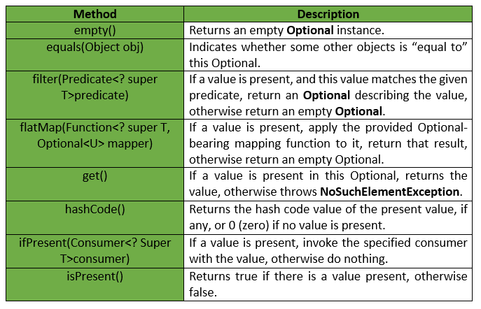
Optional Class
The following table shows the list of Concrete Methods provided by the Optional Class :

Slide 40
import java.util.Optional;
public class OptionalExample {
public static void main(String[] args) {
String[] str = new String[10];
str[5] = "JAVA OPTIONAL CLASS EXAMPLE"; // Setting value for 5th index
// It returns an empty instance of Optional class
Optional<String> empty = Optional.empty();
System.out.println(empty);
// It returns a non-empty Optional
Optional<String> value = Optional.of(str[5]);
// If value is present, it returns an Optional otherwise returns an empty Optional
System.out.println("Filtered value: "+value.filter((s)->s.equals("Abc")));
System.out.println("Filtered value: "+value.filter((s)->s.equals("JAVA OPTIONAL CLASS EXAMPLE")));
// It returns value of an Optional. if value is not present, it throws an NoSuchElementException
System.out.println("Getting value: "+value.get());
// It returns hashCode of the value
System.out.println("Getting hashCode: "+value.hashCode());
// It returns true if value is present, otherwise false
System.out.println("Is value present: "+value.isPresent());
// It returns non-empty Optional if value is present, otherwise returns an empty Optional
System.out.println("Nullable Optional: "+Optional.ofNullable(str[5]));
// It returns value if available, otherwise returns specified value,
System.out.println("orElse: "+value.orElse("Value is not present"));
System.out.println("orElse: "+empty.orElse("Value is not present"));
value.ifPresent(System.out::println); // printing value by using method reference
}
}
//Output:
Optional.empty
Filtered value: Optional.empty
Filtered value: Optional[JAVA OPTIONAL CLASS EXAMPLE]
Getting value: JAVA OPTIONAL CLASS EXAMPLE
Getting hashCode: -619947648
Is value present: true
Nullable Optional: Optional[JAVA OPTIONAL CLASS EXAMPLE]
orElse: JAVA OPTIONAL CLASS EXAMPLE
orElse: Value is not present
JAVA OPTIONAL CLASS EXAMPLE

Slide 41
//MobileService.java
package com.mkyong.without.optional;
public class MobileService {
public int getMobileScreenWidth(Mobile mobile){
if(mobile != null){
DisplayFeatures dfeatures = mobile.getDisplayFeatures();
if(dfeatures != null){
ScreenResolution resolution = dfeatures.getResolution();
if(resolution != null){
return resolution.getWidth();
}
}
}
return 0;
}
}
//MobileService.java
package com.mkyong.with.optional;
public class MobileService {
public Integer getMobileScreenWidth(Optional<Mobile> mobile){
return mobile.flatMap(Mobile::getDisplayFeatures)
.flatMap(DisplayFeatures::getResolution)
.map(ScreenResolution::getWidth)
.orElse(0);
}
}
Advantages of Java 8 Optional:
Null checks are not required.
No more NullPointerException at run-time.
We can develop clean and neat APIs.
No more Boiler plate code

Slide 42
How optional is different from normal null check?
For example let's say you have this stream of integers and you're doing a filtering:
int x = IntStream.of(1, -3, 5)
.filter(x -> x % 2 == 0)
.findFirst(); //hypothetical assuming that there's no Optional in the API // error
Concerning non-stream usages,
class Car {
RadioCar radioCar; //may be null or not
public Optional<RadioCar> getRadioCar() {
return Optional.ofNullable(radioCar); //Here you are clearly saying to the caller that the radio in the car is optional, it might be or not there.
}
}
There is nothing wrong with adding null checks where required. The new Optional class added in Java 8 is not to intended to replace every single null reference. Also to note, the improper use of Optional can introduce NullPointerException in your code.l
Optional<Integer> x = Stream.of(1, -3, 5)
.filter(a -> a % 2 == 0)
.findFirst();
System.out.println(x); //Optional.empty

Slide 43

Thanks

