Slide 1
EdgeGallery MEP

Slide 2
Agenda
ETSI MEP Revisit (Architecture)
MEP Component Design & Architecture
MEP Server (With Service Registry with Service Comb)
API Gateway (Kong)
MEP Auth
Mep Agent
DNS server
UPF Adapter
Network
Multi network support
vLB (MetalLB)
MEP Interface & External Interaction
MEP Flows
DNS & Traffic rule configuration Flow with Traffic Flow (MM5 + MP1+MP2)
Application Authentication (AK/SK based) Details
Example E2E Producer/Consumer Application Flow
Data Path Flow
Deployment & Code Repo Overview

Slide 3
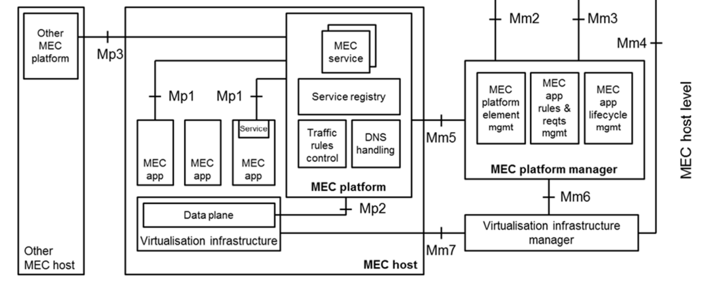
ETSI MEP Revisit (Architecture)
Components:
MEC host : The MEC host is an entity that contains the MEC platform and a virtualization infrastructure which provides compute, storage, and network resources for the MEC applications.
MEC Platform:
Hosting MEC services.
Offers an environment where the MEC applications can discover, advertise, consume and offer MEC services.
Receiving traffic rules from the MEC platform manager, applications, or services, and instructing the data plane accordingly.
Receiving DNS records from the MEC platform manager and configuring a DNS proxy/server accordingly.
Providing access to persistent storage and time of day information.
Service registry: Service registration and discovery.
Traffic rules control: Receive traffic rules from MEPM and configure/activate it to data plane.
DNS handling: Receive DNS rules from MEPM and configure/activate it to data plane.
MEC service: Service provided and consumed either by the MEC platform or a MEC application.
MEC App: User Applications running at edge.
Data plane: Routes the traffic among applications, services, DNS server/proxy, 3GPP network, local networks and external networks.
Interfaces:
MM5 Between MEPM and MEP, perform MEP platform configuration management, configure APP rules and other capabilities.
MM7 Between VIM and MEC host infrastructure.
MP1 Between APP and MEP, it provides APP service registration discovery, APP status notification subscription and other capabilities.
MP2 Between MEP and UPF, the configuration capability of the data plane is provided
MP3 Between MEP platforms, use for mobility (user context etc propagation)

Slide 4
Architecture

Slide 5
EdgeGallery MEP Architecture
Kong API Gateway
Integrated Open Source
MEP App2
MEP server
Load Balancer (MetalLB)
MEP services
Ingress Controller
MEP services
MEP services
Mp2
Handler
Mp1 Handler
MM5
Handler
MEP App2
Mep Auth
New Development
MEP App2
UPF Adapter
Service Comb
UPF Adapter
etcd
UPF Adapter
External
DNS Server
K8S Core DNS
secondary-ep-controller
Multus
Whereabouts
Future
boltDb
Calico
Infrastructure (k8s)

Slide 6
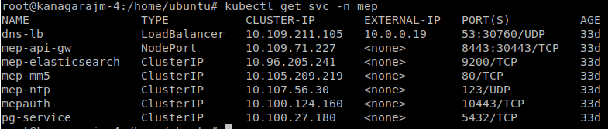
MEP Runtime Environment (Deployment)
MEP Pods
MEP-Server Pods
MEP services

Slide 7
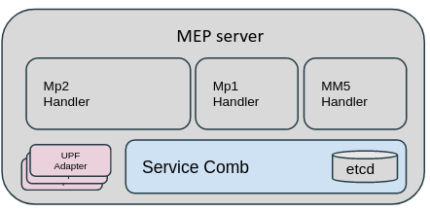
MEP Server - MP1 Handler
MP1 Handler
MEC service assistance:
authentication and authorization of producing and consuming MEC services;
a means for service producing MEC applications to register/deregister towards the MEC platform the MEC services they provide, and to update the MEC platform about changes of the MEC service availability;
a means to notify the changes of the MEC service availability to the relevant MEC application;
discovery of available MEC services;
Transport information:
This method is typically used by a service-producing application to discover transports provided by the MEC platform in the "transport information query" procedure
MEC application assistance:
MEC application start-up procedure;
MEC application graceful termination/stop;
Traffic routing:
traffic rules update, activation and deactivation;
DNS rules:
DNS rules activation and deactivation;
Timing:
providing access to time of day information;
Note: API Details and every API purpose is already discussed as part of ETSI MEC Session.

Slide 8
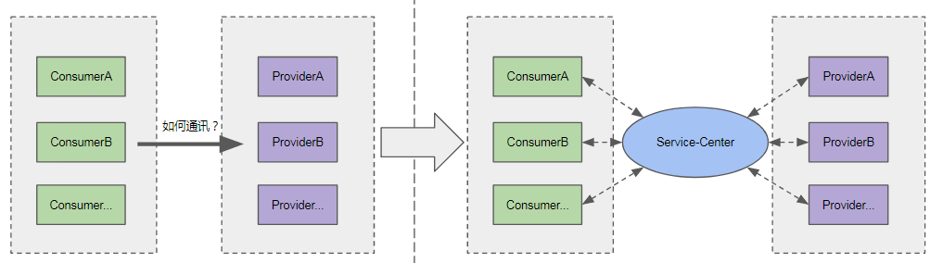
MEP Server (Service Assistance/Governance)
Requirements of Service Governance in SOA/microservice based architecture.
Decouple the provider and the consumer, the service consumer needn’t hardcode the provider address;
Service dynamic discovery and scalability, dynamic changes(up/down) of the instance of provider will be pushed to the consumer with the service-center;
You can monitor the quality of service operations(i.e. Application is up but service is ready/not ready) and
Why new Standard for Service Governance, why not K8s Service governance re-used?
ETSI defined MEC is not only meant for kubernetes based infrastructure. It intends to support other infra such as open stack based VMs, docker swarm.
Service registry
Service governance problem in SOA/microservice based architecture:
In image 1
Consumer does not know about provider endpoint (dynamic) details.(ks8 solve this)
If provider goes down or provider is up but functionality is down then consumer has know way to know it. (Notification towards consumer)
In image 2 service registry can solve this.
2. Also K8s in built service governance have following limitations
If container is down/crashed service entry will be still there with k8s. K8s can check health for container using liveness probe. If it fails it tries restarting it, but service will be always stays up along with cluster ip address. So if consumer access the service, the request will fail.
In k8s provider application instances can not ask k8s to keep service down when it is running but incapable of handling request. K8s is not aware of application functionality.
Service availability Notification mechanism: K8s does not maintain provider subscriber relationship. So there is no way it can notify about service deleted or down to subscribers.
This demands for a newer implementation of service governance fulfilling ETSI MEC standard for wider acceptance & application InterOperability.

Slide 9
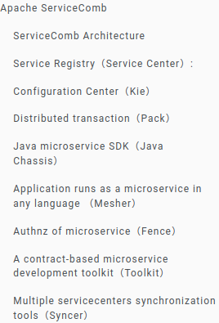
MEP Server (Service Registry with Service Comb)
MEP server offers ETSI MEC (MEC011) based service registry & service governance by using a service registry part “Service-Center” of open source “Service-Comb” and building a wrapper on top of it to support ETSI MEC specification.
What is service-comb:
Apache ServiceComb provides a complete open-source microservices solution/framework by integrating/using multiple other open-sources. It is committed to helping enterprises, users, and developers for faster microservice applications and deployment, also to achieve efficient management of microservice applications.
One of the components of service comb is service center which provides service registry and discovery solutions for microservices. MEP server handles ETSI standard service governance APIs and use service center at background to support it. Service center store producer consumer information, maintain relation, notification logics etc. on behalf of mep server.
MEP Service Governance
MEP Server
MP1 handler
Service Center
API Gateway
ETSI standard request
etcd
ETSI standard response
MP1 Handler: Wrapper for adaption to ETSI MEC specification
ServiceCenter: Service Governance framework developed for Kubernetes
ETCD: Key value store used by Service Center
TODO: https://servicecomb.apache.org/docs/introduction/

Slide 10
MEP Server - MM5 & MP2 Handler
DNS Server
AppRuleMgr
AppLCM
boltDb
FE (MEPM/MEP)
Type | API Example | Description
AppD Configurations | POST /mep/app_lcm/v1/applications/:appInstanceId/appd_configuration | Using this Mm5 interfaces MECM can create, query, update or delete the appd configurations which includes multiple dns and traffic rules associated to an application.
Platform Capability Query | GET /mep/mec_platform_config/v1/capabilities | Using this MM5 interface MECM can query current capabilities ( Producer services) and the list of consumer (Subscriber of the service availability notification) associated with the service.
App termination | DELETE /mep/mec_app_support/v1/applications/{appInstanceId}/AppInstanceTermination | Using this MM5 initiate the application termination via MEP. After the MEC platform receives a request to terminate or stop a MEC application instance, the MEC platform notifies the MEC application instance that it will be terminated or stopped soon incase if graceful termination/stop is subscribed.
Monitor Interface | /mep/service_govern/v1/kong_log /mep/service_govern/v1/subscribe_statistics | Using this MM5 interface MEP-FE enable/query log statistics for specific application, query subscription statistics etc.

Slide 11
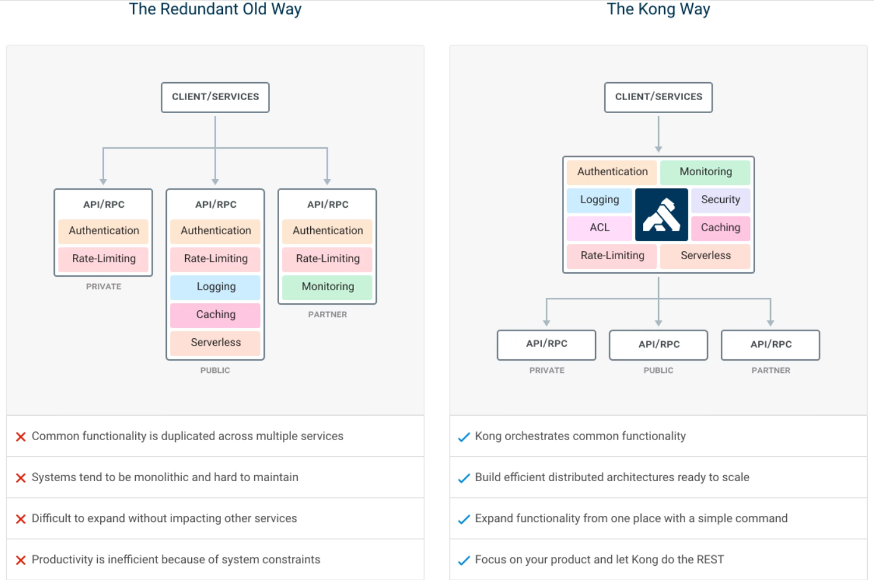
API Gateway (Kong)
Edgegallery use Kong for all types of communication, i.e. Between Applications to Application (provider & consumer) , Applications to MEP, MEPM to MEP.
What is an API Gateway?
An API gateway is an API management tool that sits between a client and a collection of backend services.
An API gateway acts as a reverse proxy to accept all application programming interface (API) calls, aggregate the various services required to fulfill them, and return the appropriate result.
Why you needs an API Gateway?
You want to protect your APIs from overuse and abuse, so you use an authentication service and rate limiting.
You want to understand how people use your APIs, so you’ve added analytics and monitoring tools.
If you have monetized APIs, you’ll want to connect to a billing system.
You may have adopted a microservices architecture, in which case a single request could require calls to dozens of distinct applications.
Over time you’ll add some new API services and retire others, but your clients will still want to find all your services in the same place.
API gateway such as kong bring all this common requirement of APIs under one hood.
https://github.com/Kong/kong

Slide 12
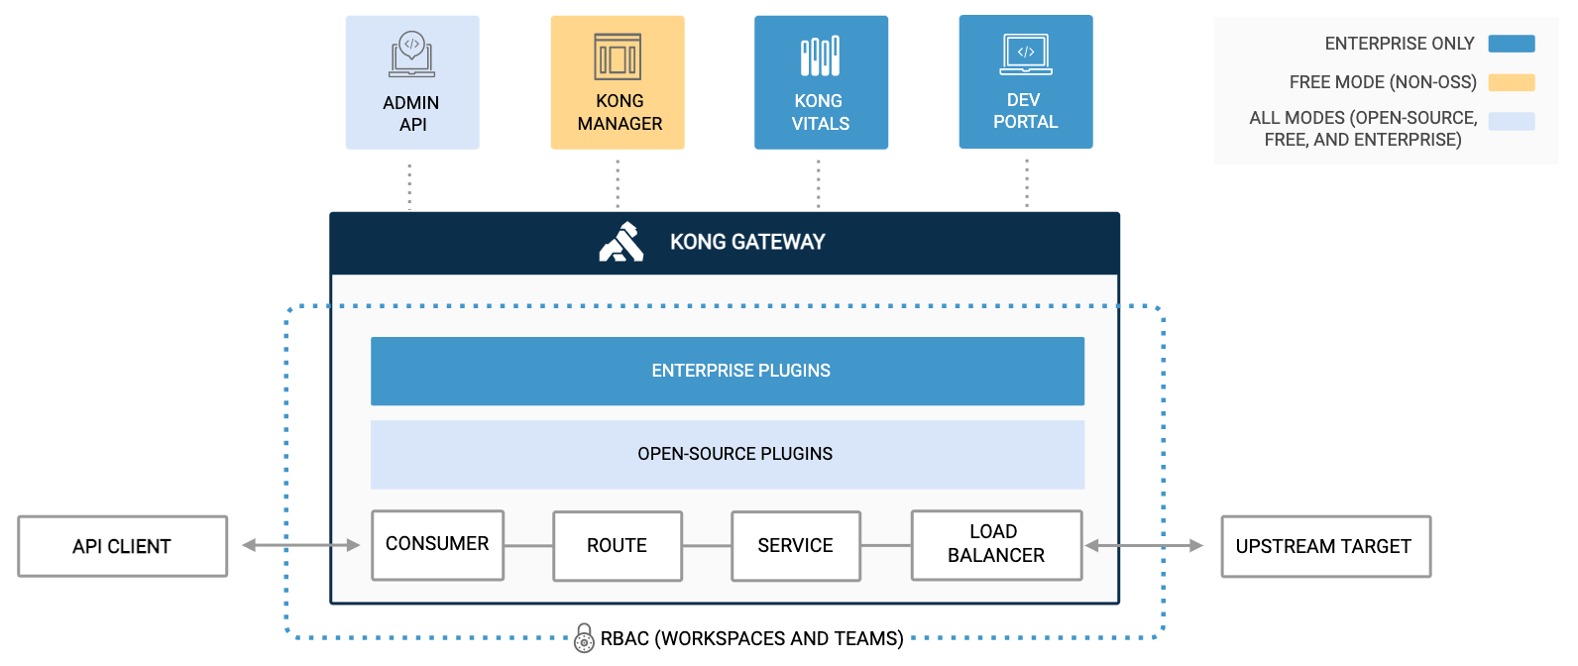
API Gateway (Kong)
A Service is an entity representing an external upstream API or microservice — for example, a data transformation microservice, a billing API, and so on. The main attribute of a Service is its URL, where the service listens for requests. You can specify the URL with a single string, or by specifying its protocol, host, port, and path individually.
Route: Before you can start making requests against the Service, you will need to add a Route to it. Routes determine how (and if) requests are sent to their Services after they reach Kong Gateway.
A consumer in kong is the application that is is using the API. Basically Consumers are associated to individuals using your Service, and can be used for tracking, access management, and more.
Kong provides different ways of load balancing requests to multiple services - a DNS-based method, round-robin method and a hash-based balancing method. This is optional feature and we don't use it in edgegallery.
Plugins provide advanced functionality and extend the use of the Kong Gateway, which allows you to add new features to your implementation. Several supported plugins are rate limiting, authentication etc.
curl -i -X POST http://<kong-admin-host>:8001/services \
--data name=example_service \
--data url='http://mockbin.org'
curl -i -X POST http://<admin-hostname>:8001/services/example_service/routes \
--data 'paths[]=/mock' \
--data name=mocking
curl -i -X POST \
--url http://localhost:8001/consumers/ \
--data "username=Jason"
curl -i -X POST \
--url http://localhost:8001/consumers/Jason/key-auth/ \
--data 'key=ENTER_KEY_HERE'

Slide 13
MEP Auth
APPLCM
Configure Ak,Sk, AppInstance
(For every Application Instance)
MEP-auth enables authentication functions for Applications. It provides two APIs:
Configure AK, SK & application instance: Invoked by APPLCM via KONG (extended MM5) to validate the token requesting application.
Get token: Invoked by application instance via KONG to obtain token
APP can provide the correct signature to MEP-auth based on the AK/SK signature algorithm to obtain a token, and then access MEP-server related interfaces using the token.
Note: Token based validation is performed by KONG using JWT Plugin. MEP-Auth just configures KONG plugin with required information for token validation
MEP-Auth INIT Flow
Add a consumer in kong along with public key for jwt token
Configuring service and route for MEP-auth itself.
Configuring service and route for MEP-server.
Configure and enable the kong plugin for MEP-auth and MEP-server.
The plugins that MEP-auth opened in the initialization kong process include:
JWT plugin Provides token verification capability for the corresponding interface.
Appid-header plugin Insert X-AppinstanceID header in interface request for MEP-server check. Check request token’s client ip is consistent with client ip of calling interface.
Rate Limiting Plugin Provides flow control capability for MEP-auth and MEP-server interfaces.
IP Restriction Plugin Provides client IP white list function support for MEP-auth.
response-transformer plugin Provides the server header capability in clear response.
Pre-function plugin providing modified interface request x_forwarded_for capability
MEP-Auth
Configures KONG
(Init Flow)
KONG
Get Token
(Producer/Consumer flow)
APP
APP
APP
MEP auth INIT flow
Kong API Gateway
MEP-Auth
Create consumer
Configure public key for jwt token verification.
Create Service for Mep server with path /mep/mec_service_mgmt and /mep/mec_app_support
Enable rate limiting, jwt authentication, app-id header etc plugins to the service.
Create Service for Mep/mep/token and /mep/appMng/v1
auth with path Enable rate limiting, transform plugins.

Slide 14
Kong config for MEP server and MEP auth
Client
Kong
MepAuth
2
Kong expose route /mep/mec_service_mgmt & /mep/mec_app_support
1
Create service name = “mepserver”, url = “https://mepserver:8088/”
Add route /mep/mec_service_mgmt, /mep/mec_app_support
Set Route option strip_path = False
On behalf of Mepserver MepAuth create service and route
3
4
Example Client Call https://{{KONG_HOST}}:{{KONG_PROXY_SSL}}/mep/mec_service_mgmt/v1/applications/5abe4782-2c70-4e47-9a4e-0ee3a1a0fd1f/services
Kong calls https://mepserver:8088/mep/mec_service_mgmt/v1/applications/5abe4782-2c70-4e47-9a4e-0ee3a1a0fd1f/services
Client
Kong
MepAuth
2
Kong expose route /mep/token & /mep/appMng/v1
1
Create service name = “mepauth”, url = “https://127.0.0.1:10443/”
Add route /mep/token, /mep/appMng/v1
Set Route option strip_path = False
3
4
Example Client Call https://{{KONG_HOST}}:{{KONG_PROXY_SSL}}/mep/token
Kong calls https://127.0.0.1:10443/mep/token

Slide 15
Kong config for Producer application from MEP server
Client
Kong
MepServer
2
Kong expose route /turn-service6621ddcb896811ec828f/
1
Create service name = “turn-service”, url = “https://turn-service.default:8089/”
Add route /turn-service6621ddcb896811ec828f/
Mep server add the route to api gateway during service registration flow on behalf of producer app.
Client
Kong
Producer APP
3
4
Example Client Call https://{{KONG_HOST}}:{{KONG_PROXY_SSL}}/turn-service6621ddcb896811ec828f/?service=turn&username=test
Kong calls https://turn-service.default:8089/?service=turn&username=test

Slide 16
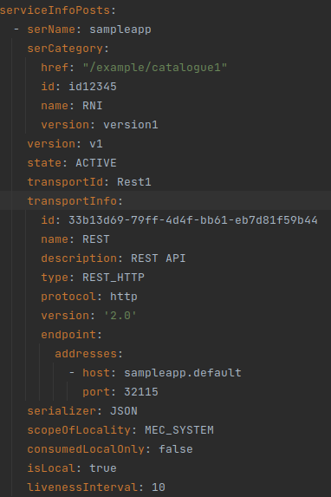
MEP Agent
MEP Agent is for rapid application integration to edgegallery. It does that by removing boiler plate code from application and giving that functionality on behalf of application. It runs as a sidecar along with the application. It helps in service discovery (for consumer apps) and service registration (for provider apps). Its written in go.
Currently it supports two APIs for Consumer Applications. - “GET /mep-agent/v1/token” is to get token from MEP auth which can be used later for further communication with other application etc, - “GET /mep-agent/v1/endpoint/:serName” for service discovery with service name as an filter.
Producer Application
Mep Agent
Get token
Mep
Consumer Application
/token
Mep Agent
Get token
Mep
Register service
Service discovery
Heartbeat
/endpoint
Scenario 1 - For producer app: 1. mep-agent read ak,sk, app instance ID from kubernetes environment variable.
2. Read service registration informations from config file
3. Get token using ak, sk and app instance id from MEP auth
4. Execute registration process by calling mep-server APIs
5. Send heartbeat messages for the registered services.
Scenario 2 - For Consumer app: 1. mep-agent read ak,sk, app instance ID from cfg file.
2. When consumer application need to do service discovery it calls /endpoint/:serName api. Mep-agent calls mep-server service discovery api to get the service information and pass it to app.
3. When consumer application needs a token it calls producer end point. Mep-agent call get token from mep-auth and returns the token to app.
A sample service registration information

Slide 17
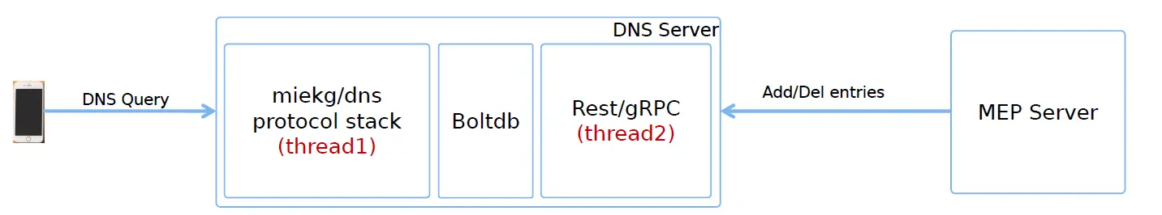
DNS server
The MEP platform provides the domain name resolution services to the applications deployed in the EdgeGallery MEC, which can be utilized by the device applications in UE. MEC platform receives the DNS configurations from the MEC management, which includes the FQDN(Fully Qualified Domain Name), IP address and related entries. MEC applications can later query or modify the state of these configurations.
The three major operations for DNS are:
DNS management operations.
Query configuration and Activation/Deactivation by the MEC applications.
DNS query by the device applications.
DNS server has three major modules.
Rest/gRPC(thread2) component is to handle add/delete, activate/deactivate of DNS entries. MEP server receives dns add/delete request from mepm over mm5 and it calls mp2 interfaces to configure them in DNS server.
Applications when ready to accept user traffic request MEP server about activate the DNS entries via mp1 app support interfaces to MEP server. Mep server in turn call mp2 interfaces towards DNS server to activate the DNS entry.
BoltDB is to store DNS entries. Its lightweight embedded key value store.
miekg/dns protocol stack(thread1) is to handle DNS query from client.

Slide 18
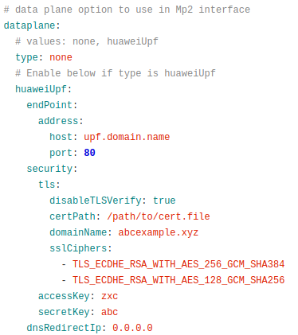
UPF adapter
MEP supports passing the DNS and traffic rules to the data-plane/UPF over the UPF standard interface. As the interface is not a standardized, there can be difference in implementation for different UPF provider. MEP Server has provided an interface file which a UPF provider has to implement as per their requirements and needs. Interface includes:
InitDataPlane: This interface will be called on startup of the mepserver to initialize the data-plane/upf. Operations like reading configurations, creating/initializing client, generating tokens etc can be performed in this.
AddTrafficRule: Will be triggered when mep server receives a traffic rule create request on Mm5 interface or a state change request on Mp1.
SetTrafficRule: Update a traffic rule instance, triggered on change in Mm5 or Mp1.
DeleteTrafficRule: Deletes a traffic rule instance, triggered on update or delete on Mm5 or update request in Mp1.
AddDNSRule: Creates a DNS rule in data-plane/upf. Triggered on create or modify request on Mm5 or state change request in Mp1.
SetDNSRule: Updates DNS rule on Mm5 modify request.
DeleteDNSRule: Deletes a DNS rule on update or delete request in Mm5 or state change in Mp1.
MEP uses Factory Pattern to find designated UPF adapter based on configuration file. func CreateDataPlane(config *config.MepServerConfig) dataplane.DataPlane {
if config.DataPlane.Type == meputil.DataPlaneNone {
return &none.NoneDataPlane{}
} else if config.DataPlane.Type == "abcUpf" {
return &abcupf.AbcDataPlane{}
}
return nil
UPF
UPF
https://github.com/EdgeGallery/mep

Slide 19
Architecture: Network

Slide 20
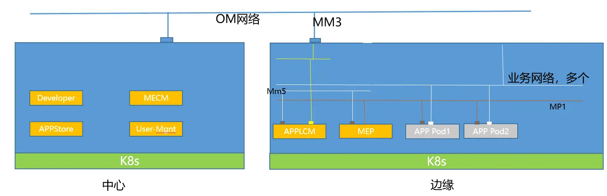
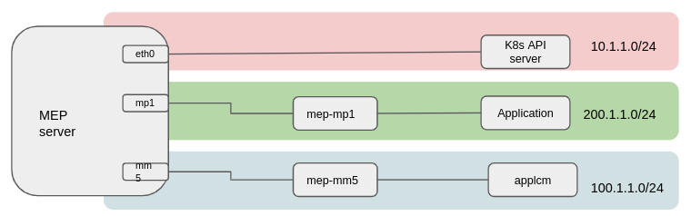
MEP Network Isolation support: Requirements
Requirements:
EdgeGallery deployment should support multiple network plane for various usecases
Enhance security by splitting various types of traffic, eg, mm5 traffic, mp1 traffic etc
Support traffic decoupling between multiple tenants.
Currently supported Use case. Separate Mp1, mm5 traffic.
APPLCM interacts with MEP through Mm5 plane
MEP and APP interact through MP1 plane
To realize above requirement Edgegallery use multiple projects:
Multus to support multiple interface in a pod.
Calico as the default CNI.
Macvlan CNI to support additional network creation.
A secondary-endpoint-controller to support service to be resolved over Pods secondary interface
Whereabouts (IP address management) to support ip address tracking for macvlan across multiple k8s node, since macvlan is host-local.

Slide 21
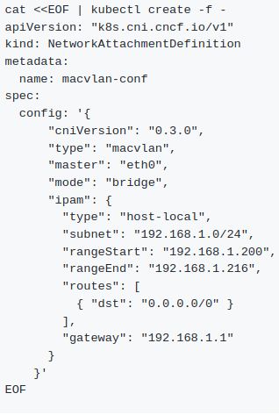
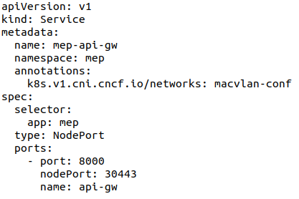
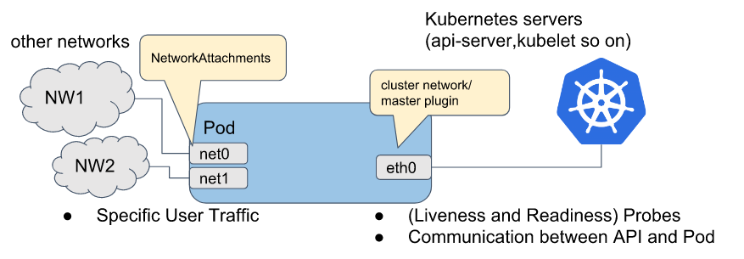
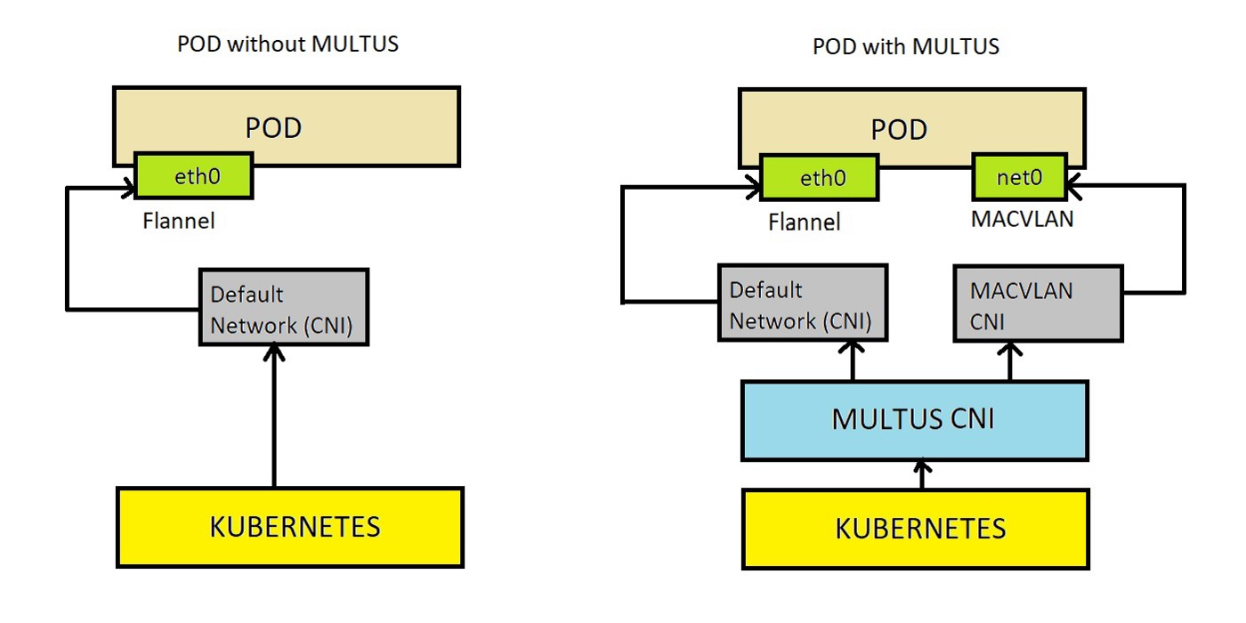
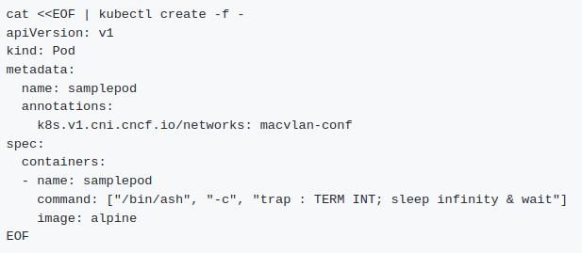
MEP Network Isolation support : How multus works
Create a network of specified network using NetworkAttachmentDefinition file. Specify cni type, network range etc.
Multus will ask CNI to create specified network in each node.
Create POD/deployment with annotations in metadata specifying list of comma separated network names.
Multus will invoke CNIs to create interfaces with specified network inside the pod.
Secondary-ep-controller make sure the service resolved on non default interface mentioned in annotation.
service
3
1
2

Slide 22
MEP Network Isolation support : Edgegallery
Vxlan2
net0(macvlan2)
MEP
APPLCM
APP
net0(macvlan2)
eth0
net0(macvlan1)
net0(macvlan)
eth0
eth0
Vxlan1
Default CNI (calico)
Worker Node 1
Worker Node 2
Network Isolation on multi node in edge gallery.
NOTE: Vxlan used for communication for macvlan interfaces across nodes.

Slide 23
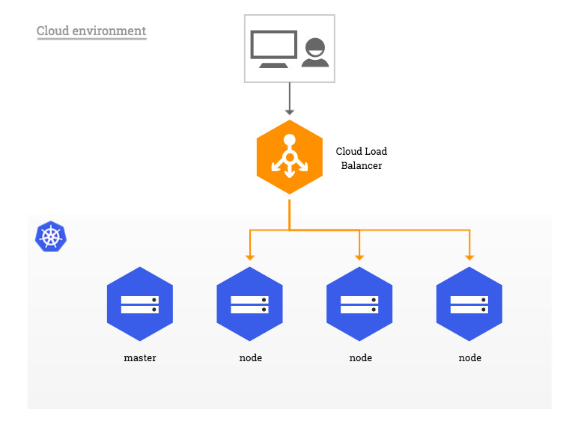
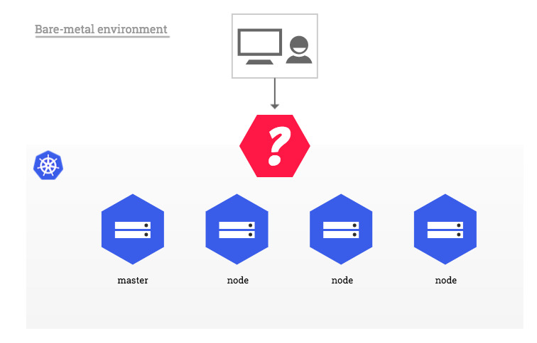
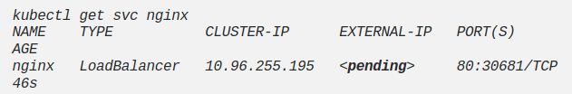
Kubernetes Load Balancer Service
Kubernetes Services:
In kubernetes pods are ephemeral and every time goes down, it get restarted by k8s with new address.
To overcome this dynamic nature of application endpoints, k8s provide service resource.
Service provide stable IP against selected Pods and clients can connect to this IP by service name.
K8s provide 4 service type to support different access scenarios to applications.
Cluster IP: Applications can be access within K8s Cluster
NodePort: Applications can be exposed to internet on a Port(30,000 to 32,767) each Node .
Load Balancer: Application can be exposed to internet on load balancer server which could be provided by cloud or Bare metal by MetalLB.
NodePort vs Load Balancer for service expose to internet:
NodePort:
It need to open firewall rules to allow access to ports 30,000 to 32,767,
Need to know the IPs of the individual worker nodes. If change happened to Node(deletion of Node) will cause change in endpoints for applications.
It provide Simple solution for development/debug env. but not recommended for Production.
Load Balancer:
Able to control the exact port it wants to use.
Exposed IP of Cloud provided load balancer will be stable irrespective of Cluster updates.
Idle solution for production workload.
If No cloud provider LB or metalLB available to cluster, then LB service will be always waiting for external IP.
Kubernetes Load balance options:
Cloud deployment(from Cloud providers) : In cloud deployment, through the cloud controller, Kubernetes will automatically provision and deprovision the required external IP and associated load balancer, and the nodes it will connect to in the cluster.
Bare metal deployment(metalLB) : In case of local cluster, to enable load balancer service which should get external IP from load balancer, MetalLB provide software based load balancer solution.
In case of Cloud, cloud external Load balancer to route client traffic to cluster
In case of bare metal, no external Load balancer to route client traffic to cluster
External IP is pending in case no external load balancer
Load balancer downside is it can get expensive, as every service will get its own load balancer and external IP, which cost on the public cloud.
Ingress is becoming the most commonly used, combined with the load balancer service; especially with MetalLB now available, as it minimizes the number of IPs being used while still allowing for every service to have its own name and/or URI routing.
Notes:
https://platform9.com/blog/understanding-kubernetes-loadbalancer-vs-nodeport-vs-ingress/

Slide 24
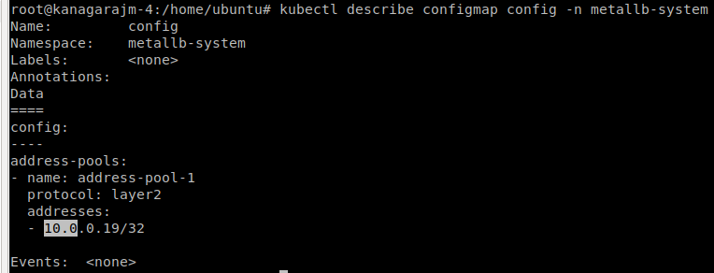
MEP Load Balancer(metalLB)
LoadBalancer IP:Port Assigned to App srv
LoadBalancer IP:Port assigned to DNS svc
Client
UPF DNS
In MEP, applications can be exposed to internet by either Node port or by Load balancer service type.
For load balancer service, it usages MetalLB which assign IP address from IP Pool. IP pool is created by providing IP range in metalLB configmap.
MetalLB based Load balancing service is used for applications and DNS:
DNS: MEP DNS need to be registered in external UPF DNS server. So it required a external IP assigned to DNS service. DNS service type is LB which get external IP(one of from IP pool) from metalLB. External DNS can connect with local DNS over this IP.
Application: application on MEP can exposed to internet by using load balancer service. MEtalLB will assign a IP to this application. External client can connect on external IP which will redirect to application.
On-prem cluster
LB IP 1
LB IP 2
MetalLB
App svc
DNS svc
App
DNS
MEP Platform
IP pools assigned to metalLB
External IP assigned by MetalLB to service type load Balancer

Slide 25
Interface & External Interaction

Slide 26
MEP Interface & External Interaction
MP2 is Data Plane specific and not defined by ETSI
MP3 is WIP
MM5 is again not defined yet.
Service Producers
Service Consumers
MP1
M P 1
MEC Hosts
Service Registry
AppLCM
MP3
Traffic Rule Handler
DNS Rule Handler
MM5
AppRuleMgr
Example: UPF
Extended External Data Plane
MP2
5G Integration for traffic influence
MP2
DNS
Virtualized Infrastructure
VIM
Internal Data Plane
Local DNS
MEC Host

Slide 27
Flows

Slide 28
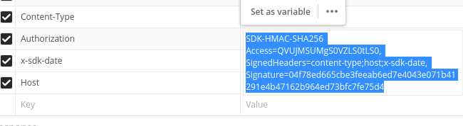
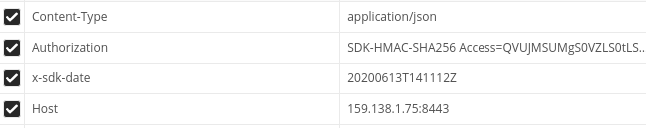
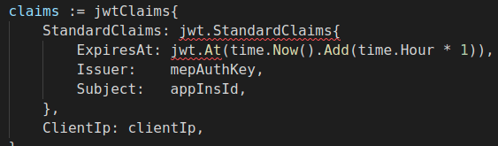
Ak/Sk/Token based authentication details
K8s secret for ak, sk and appInstanceId
VIM
App instantiate request
2
MEPM
Ak, SK and appInstId from k8s env.
App Instantiate:
Send AK, SK and app instance ID
2
Store AK, sk and app instance ID in DB for each App instantiation
App
(MepAgent)
Kong
Mep-Auth
AK and signature in token request
1
Mep auth init flow
Create consumer
Enable plugin for jwt authentication for the consumer.
Share public key of mep auth
Get MEP token by calling /mep/token
In Request header, add AK, and hash code(signature) as credentials for authentications
Hash code(signature) is generated using SK key with content type, date, host.
Create Service for Mep server with path /mep/mec_service_mgmt and /mep/mec_app_support
Enable rate limiting, jwt, app-id header etc plugins to the service.
Create Service for Mep auth with path /mep/token and /mep/appMng/v1
Enable rate limiting, transform plugins.
JWT token claim details
3
Based on AK, retrieve SK key from db
Get date, host, content type from request header and generate Hash code(Signature) using SK key.
Match generated hash code with signature come in request.
If match then Client is verified and token is generated.
Token is string of Expire time, issuer(Mep auth), subject(app ID), client IP.
MEP-Auth encrypt this token with its private key.
Return token
Return token
Get Token and decrypt using mep-auth public key
Verify issuer, app ID and client IP(with request IP)
If token verification pass, then apply other plugins like rate limit, appid-header, response-transformer etc.
If all plugin verify is ok, then route request to mep server.
4
MP1 interface related request with token
MEP-Server

Slide 29
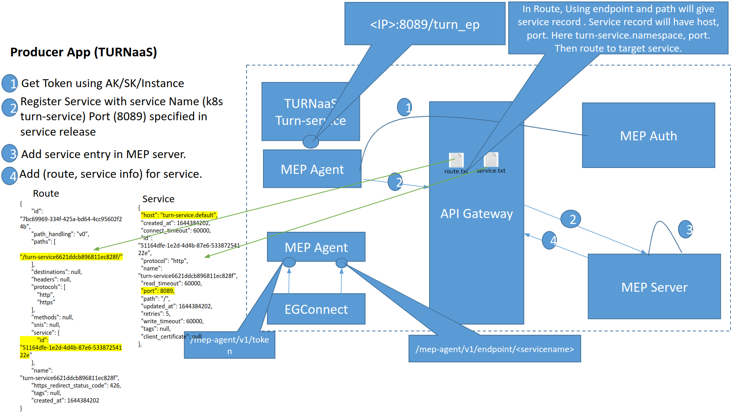
MEP Flows: Example E2E Producer/Consumer Application Flow

Slide 30
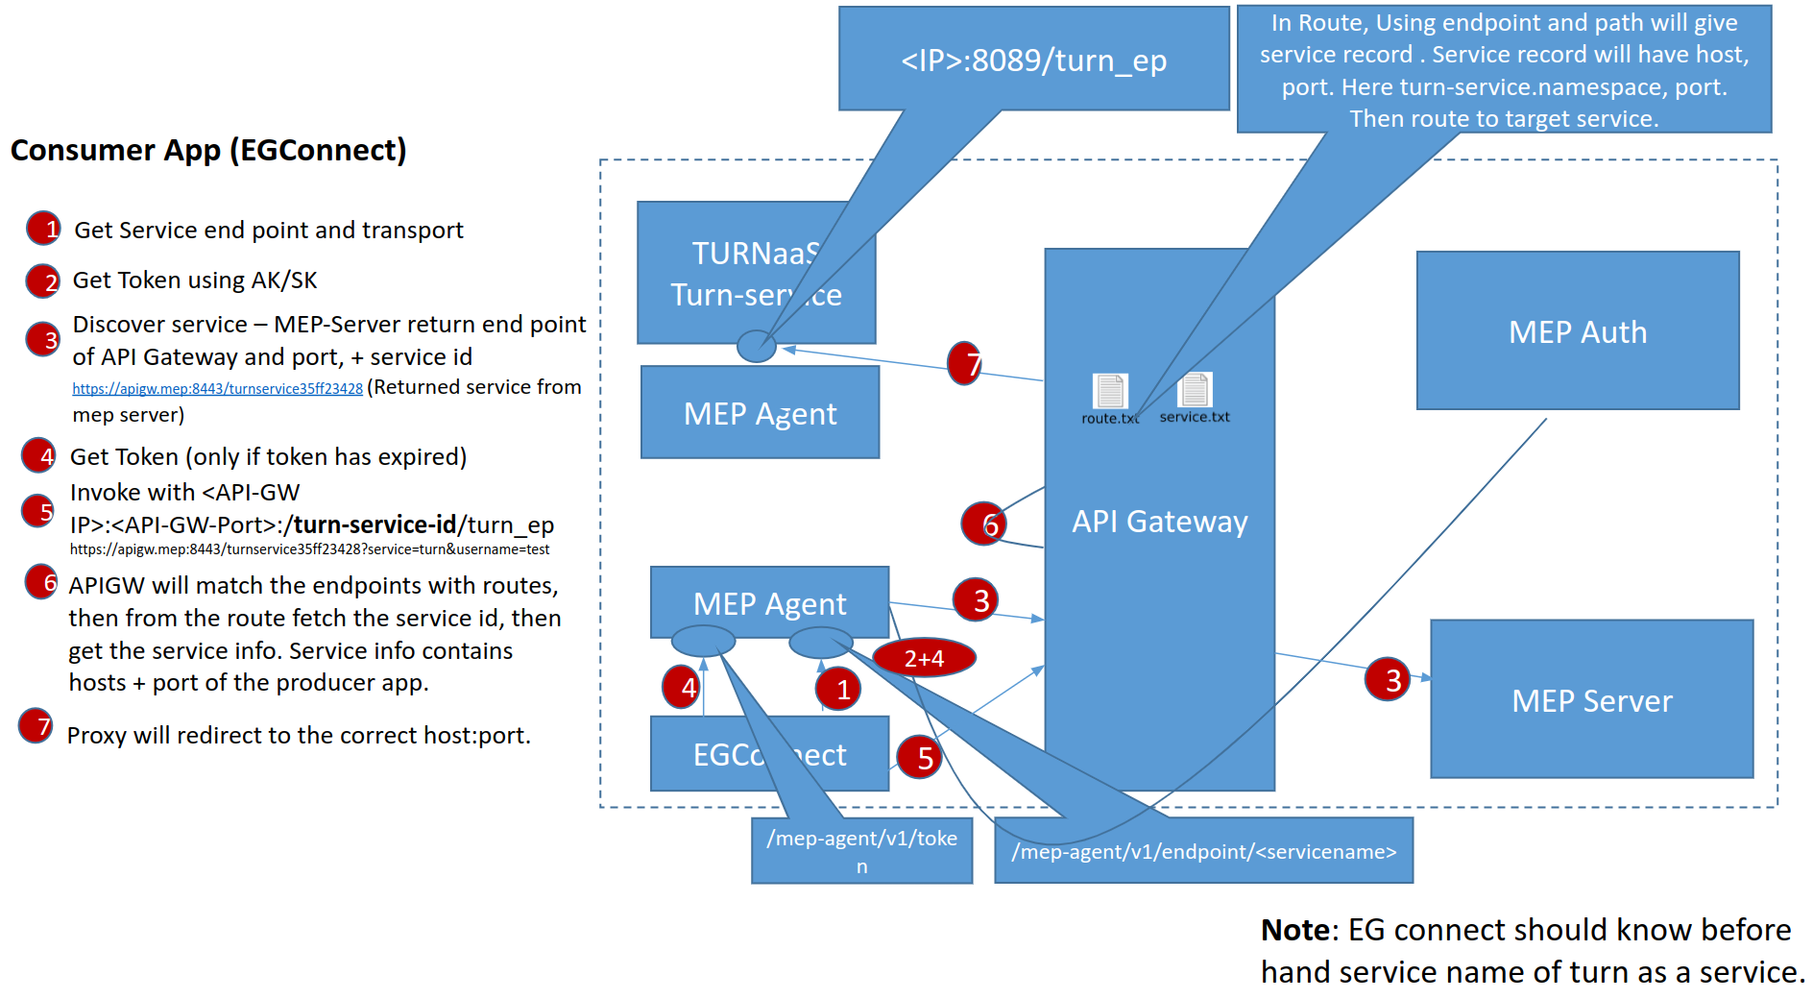
MEP Flows: Example E2E Producer/Consumer Application Flow

Slide 31
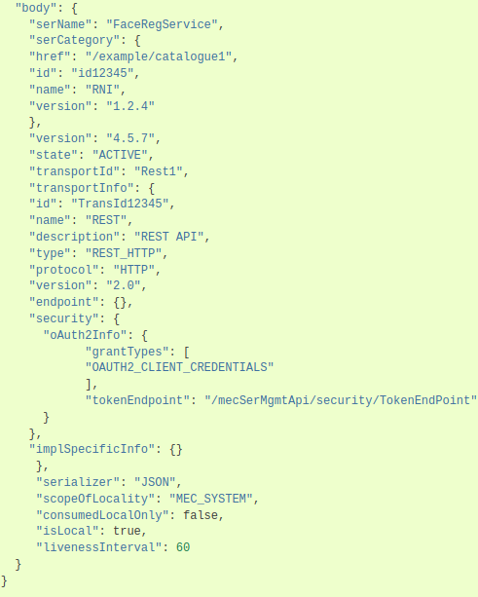
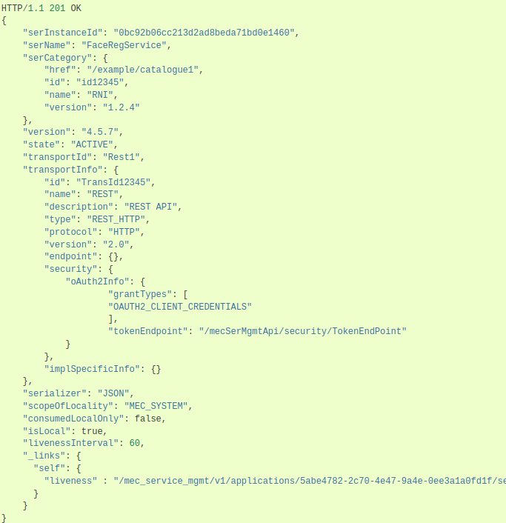
New Service Registration [ POST /mep/mec_service_mgmt/v1/applications/{appInstanceId}/services]
Response

Slide 32
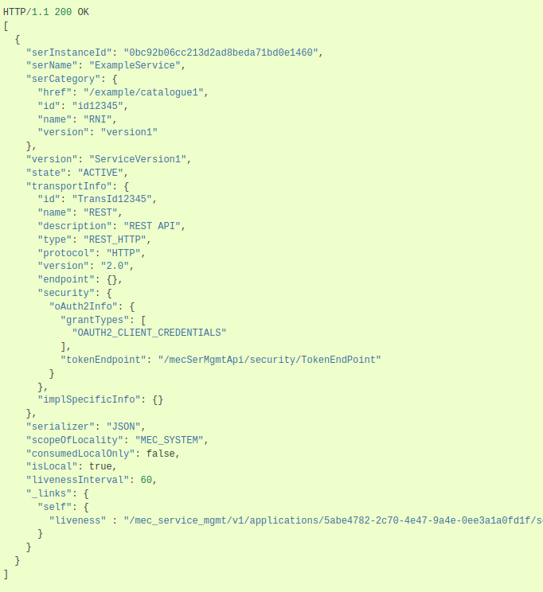
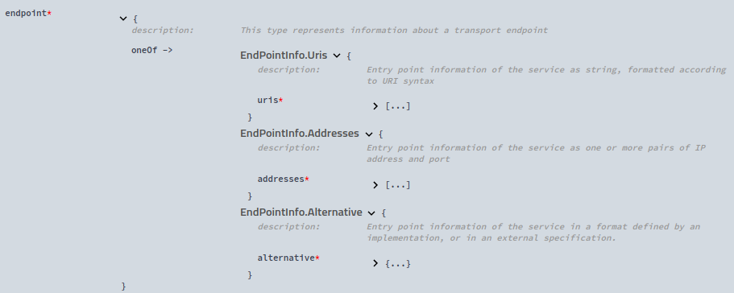
Service Discovery [ GET /mep/mec_service_mgmt/v1/services?serName]
Response
Endpoint contains the service endpoint.

Slide 33
MEP Flows: MP1 (Service Management API: Service Availability notification)
Producer APP
MEP server
Api Gw
Consumer App
Service Availability subscription [ POST /mep/mec_service_mgmt/v1/applications/{appInstanceId}/subscriptions]
Response (Contains service endpoint via api gw route)
New Service Registration [ POST /mep/mec_service_mgmt/v1/applications/{appInstanceId}/services]
Add Producer service endpoint as a route to APIGw
Response
SerAvailabilityNotification
Service Discovery [ GET /mep/mec_service_mgmt/v1/services/{serviceId}]
Response (Contains service endpoint via api gw route)
Calling service request to producer app

Slide 34
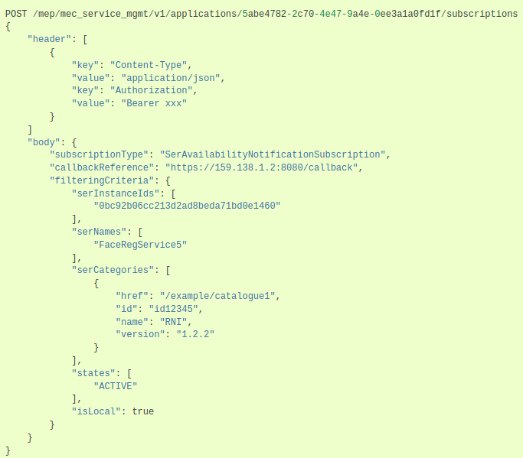
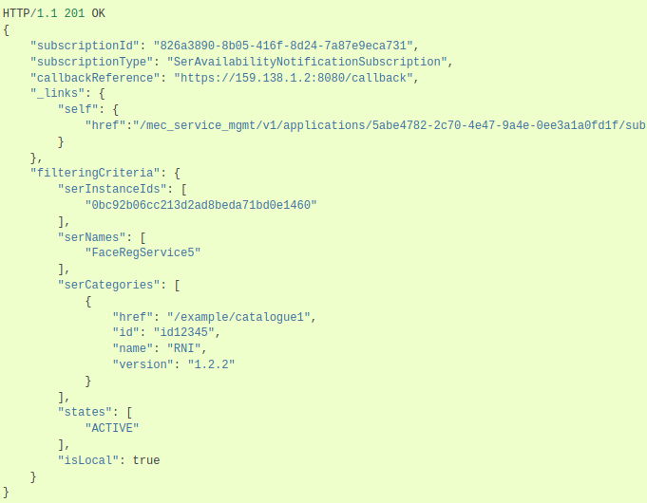
New Service Registration [ POST /mep/mec_service_mgmt/v1/applications/{appInstanceId}/subscriptions ]
Request
Response

Slide 35
MEP Flows: DNS & Traffic rule configuration Flow with Traffic Flow
For traffic steering traffic rules and DNS redirection rules has been send to external UPF. (Optional)
Service Consumers
Application activate the DNS and traffic rule.
App ruleMgr Send DNS & traffic rules to MEP
M P 1
4
Service Registry
1
3
Traffic Rule Handler
DNS Rule Handler
MM5
AppRuleMgr
Example: UPF
Extended External Data Plane
MP2
2
5G Integration for traffic influence
MP2
DNS rule handler send DNS rules to Local DNS.
DNS
Virtualized Infrastructure
NOTE Prerequisite: Application is instantiated.
Internal Data Plane
MEC Host
Local DNS

Slide 36
Client to Edge Connection: Data Path
2 Ways
Edge Aware client: Defined as part of 3GPP SA6 Standard
Edge Unaware Client: Via DNS
MM5 - DNS Rule
www.test.com: 1.1.1.1
NodePort Service with port = 32000
Node IP
1.1.1.1
1
DNS Standard Port = 53
Example: with NodePort to expose service
www.test.com -
1.1.1.1
Test App
Local DNS
5
Redirect to MEP DNS
Response = 1.1.1.1
2
UPF IP
2.2.2.2
MP2 - DNS Redirection www.test.com - redirect to Local DNS (dnsLb)
Mobile
4
3
Get IP for www.test.com
Response = 1.1.1.1
UPF
DNS - 2.2.2.2
Dstn: www.test.com:32000
DNS

Slide 37
ROADMAP and TODO
Edge Platform
Edge Autonomy/
User Self-Service
Container/VM
WASM
Application
AppLCM
Application Agent
AppRuleMgmt
API Gateway
Container/Virtual Machine and WASM (PoC) orchestration
Security/Audit/Load Balancing
Open Capability
Local Openness Capability
Data plane
Remote Capability
ETSI
Multiple network planes (Calico and Cilium)
AI (Kunpeng)
5G NW Capability
Profile (IOT...)
Hardware Capability
DN/TSN
SR-IOV/...
Network Programmable Interface
3rd party Capability Openness

Slide 38
Thanks

Slide 39
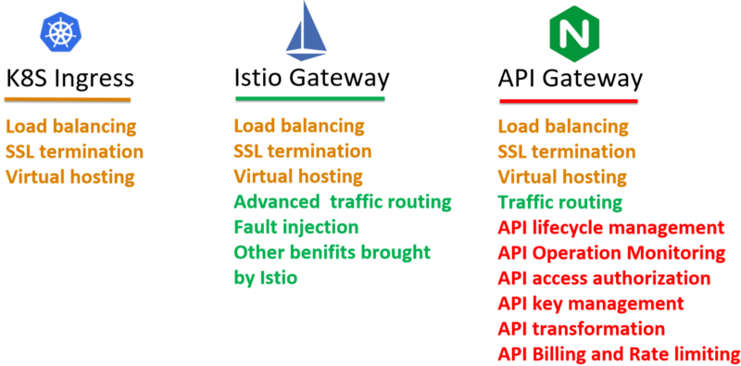
https://faun.pub/which-one-is-the-right-choice-for-the-ingress-gateway-of-your-service-mesh-21a280d4a29c

Slide 40
MEP Agent
MEP Agent is an adapter framework for rapid application integration. It runs as a sidecar along with the application. It helps in service discovery (for consumer apps) and service registration (for provider apps). Its written in go. Currently it supports two APIs for Applications. “GET /mep-agent/v1/token” is to get token from MEP auth which can be used later for further communication with other application etc, and “GET /mep-agent/v1/endpoint/:serName” for service discovery with service name as an filter.
APP
MEP Agent
MEP
Read AK, SK, App instance Id from config file
GET /mep-agent/v1/token
Read Service information to be registered from config file
/mep/mec_service_mgmt/v1/applications/${appInstanceId}/services
/liveness
/liveness
GET /mep-agent/v1/token
GET /mep-agent/v1/token
response
response
Producer app
/mep-agent/v1/endpoint/:serName
GET /mep/mec_service_mgmt/v1/services?serName
Consumer App
response
Response ( service endpoints)

Slide 41
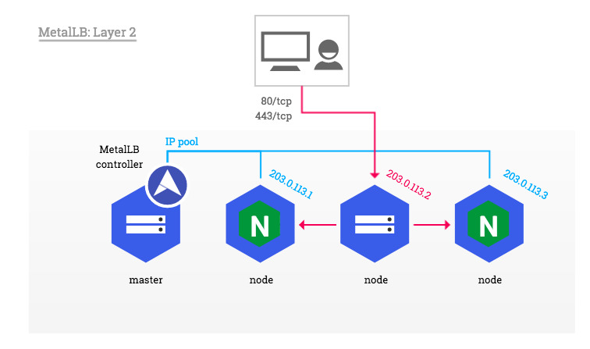
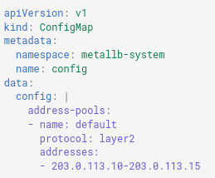

MetalLB
Kubernetes, by default does not offer an implementation of network load-balancer for bare metal cluster and hence LB service state always be pending.
MetalLB provides a network load-balancer implementation for Kubernetes clusters that do not run on a supported cloud provider, to enable Load Balancer Services within any cluster.
In case of cloud environment, the creation and allocation of external IP is the responsibility of the cloud provider. In case of local cluster environment, it is the responsibility of MetalLB.
MetalLB assigned the IP from the reserved pool of IP addresses which we allocate them via configmap. Once the external IP is assigned, it need to redirect traffic from external IP to the cluster and for that it uses protocol like ARP or BGP.
MetalLB has two features that work together to provide this service: address allocation, and external announcement.
Address allocation (controller pod): Responsible of IP assignment to k8s load balance services from IP pool.
External announcement(speaker pod): After MetalLB has assigned an external IP address to a service, it needs to make the network beyond the cluster aware that the IP “lives” in the cluster. MetalLB uses standard routing protocols to achieve this: ARP, NDP, or BGP.
IP address range to be used by MetalLB for laid balancer services.
Nginx ingress service with type LoadBalancer
Notes:
https://kubernetes.github.io/ingress-nginx/deploy/baremetal/
https://devopslearning.medium.com/metallb-load-balancer-for-bare-metal-kubernetes-43686aa0724f
https://metallb.universe.tf/concepts/

Slide 42
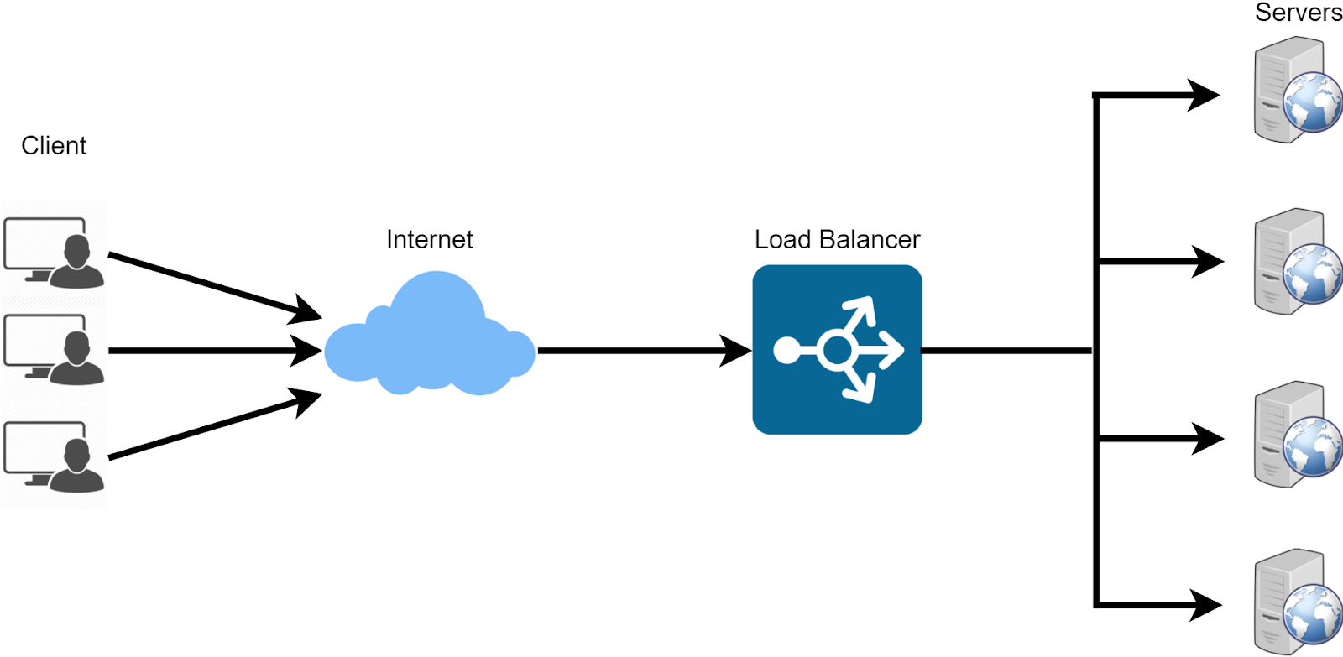
Load Balancer
Load balancing is the act of distributing network traffic across a group of servers. A load balancer is a server that performs this action.
A load balancer performs the following functions:
Distributes client requests or network load efficiently across multiple servers
Ensures high availability and reliability of service by sending requests only to servers that are online
Provides the flexibility to add or subtract servers as demand dictates.
Load balancing Algorithm:
Algorithm to determine how requests are distributed across the server pool.
Some of them are round robin, Least connection method, Least response time method, Least bandwidth method, Hashing methods etc.
Health Checks:
Regular Health checks for all backend servers
If Health check failed, server is automatically removed from the pool, and traffic will not be forwarded to it.
Notes:
https://medium.com/geekculture/load-balancing-da0bde7882f1
https://www.nginx.com/resources/glossary/load-balancing/

