Slide 1
ONAP E2E flow

Slide 2
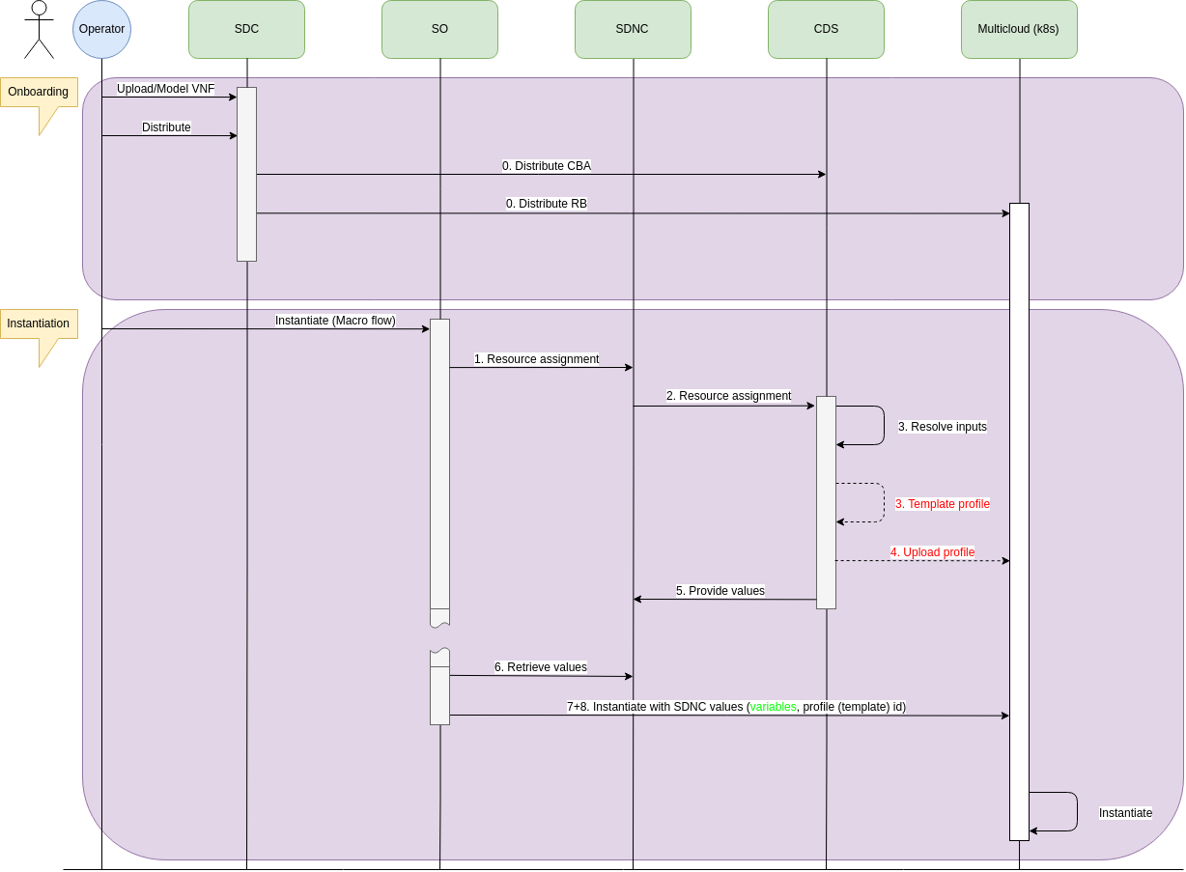
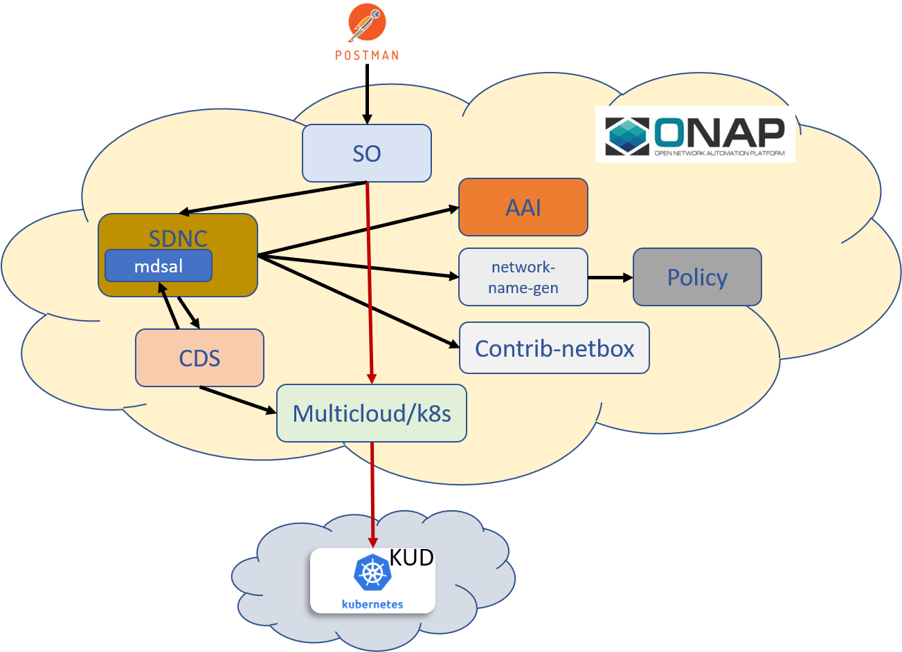
ONAP Specific Workflows
CNF Use Case - vFW CNF with CDS
vFW CNF CDS Use Case Runtime interactions.
vFW CNF CDS Use Case sequence flow (till instantiation)

Slide 3
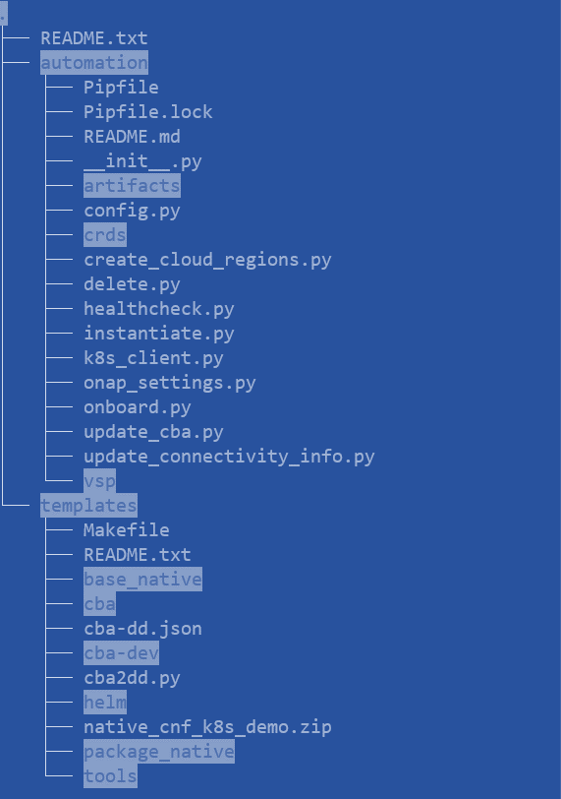
Automation for CNF Use Cases – from different sources
CDS CBA Structure:
Templates Folder
Build and Test CBA
Build VSP with make
Automation Folder
Step-by-step README
Create K8S Region
Onboard Service
Instantiate Service
Delete Service
Check Health of CNF
https://git.onap.org/demo/tree/heat/vFW_CNF_CDS/templates
https://git.onap.org/demo/tree/heat/vFW_CNF_CDS/automation
LFN Developer & Test Forum, 13-16 June 2022, Porto, Portugal

Slide 4
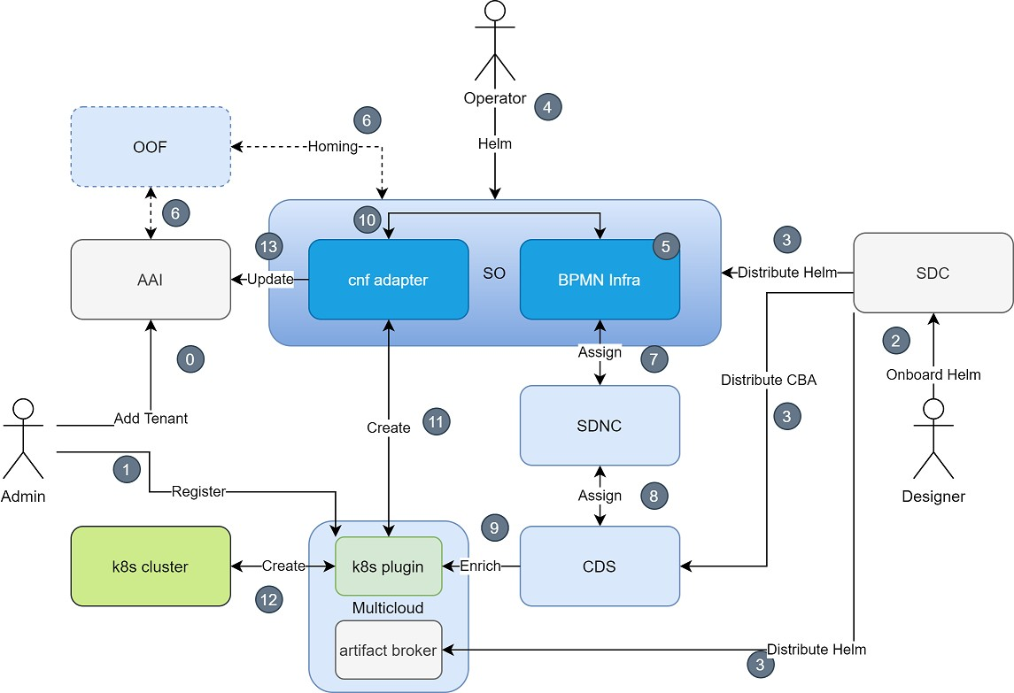
E2E Flow Details
Helm Onboarding
[SDC]
(without DCAE here)
Day 0/1 Customization
[CDS/MC]
Instantiation
[SO/MC]
Day 2 Configuration
[CDS/MC]
State Synchronization
[SO/AAI/MC]
Healthcheck
[SO/CDS/MC]
Upgrade
[SO/CDS/MC]
Multi-cluster deployment
[SO/MC]
VNF/PNF Integration
[ALL]
E2E Service Automation
[SDK]

Slide 5
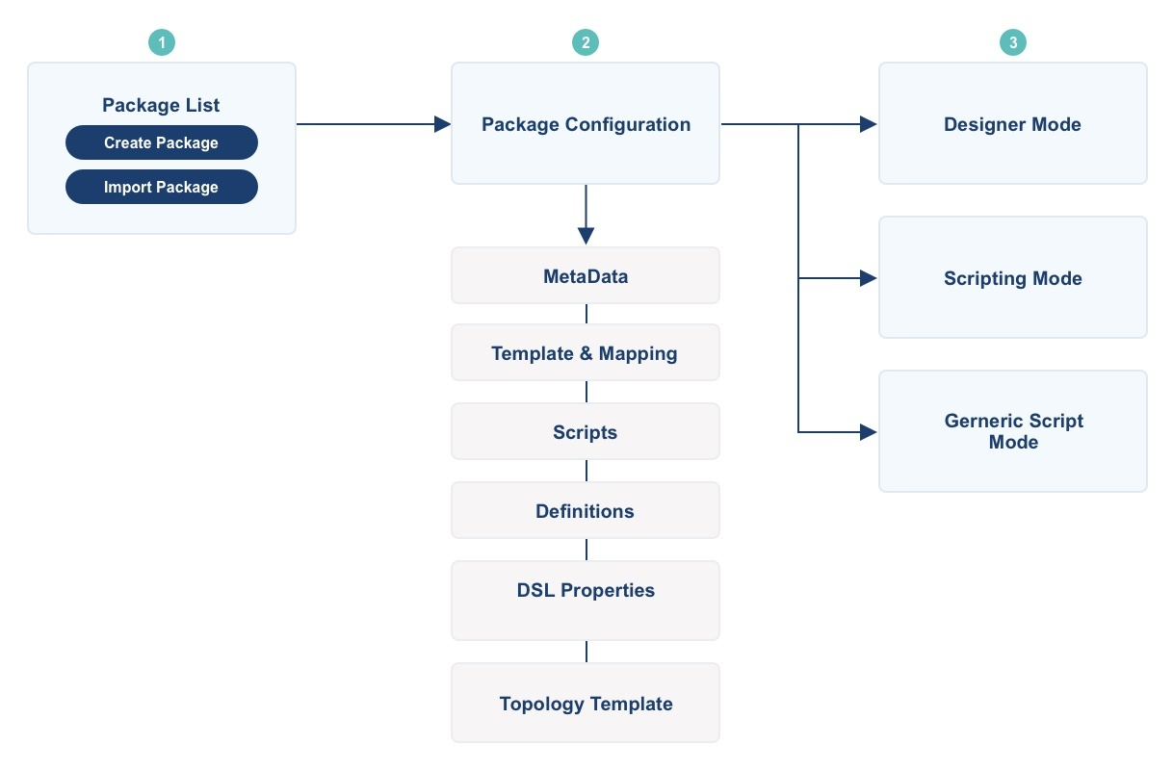
CDS Blueprint Design Steps
ccsdk-cds/components/model-catalog/definition-type/starter-type/node_type at master · onap/ccsdk-cds · GitHub
Step 1: Create required Data dictionaries
A data dictionary models the how a specific resource can be resolved.
A resource is a variable/parameter in the context of the service. It can be anything, but it should not be confused with SDC or Openstack resources.
A data dictionary can have multiple sources to handle resolution in different ways.
The main goal of data dictionary is to define re-usable entity that could be shared.
Step 2: Create CBA including following Steps
Create Package
Upload Artifact
Design Blueprint
Property | Description | Scope
updated-by | The creator | Mandatory
tags | Information related | Mandatory
sources | List of resource source instance | Mandatory
property | Defines type and description, as nested JSON | Mandatory
name | Data dictionary name | Mandatory
https://git.onap.org/demo/tree/heat/vFW_CNF_CDS

Slide 6
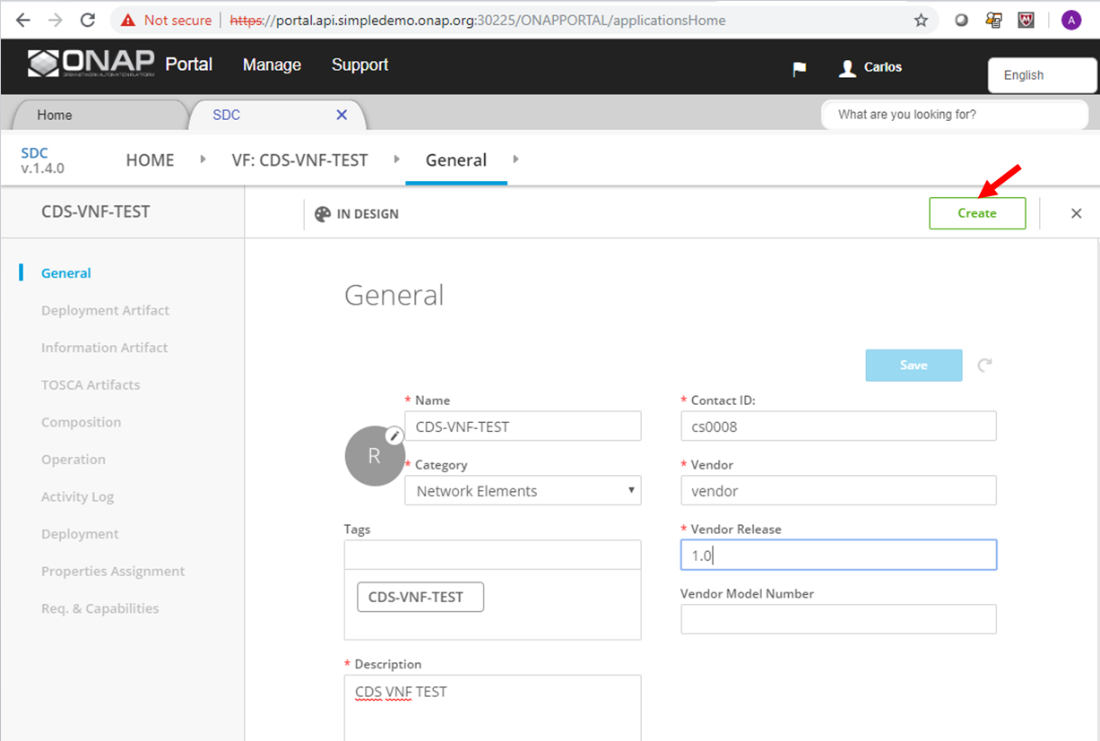
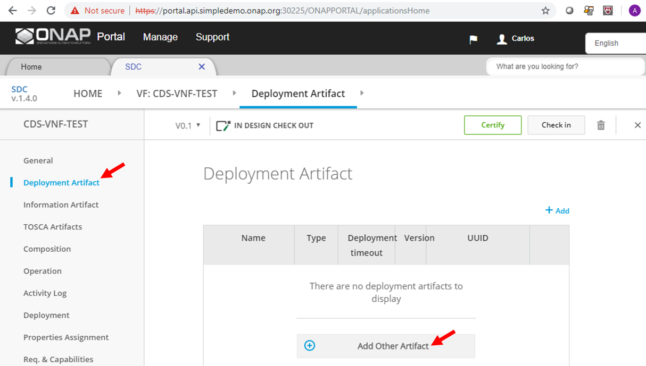
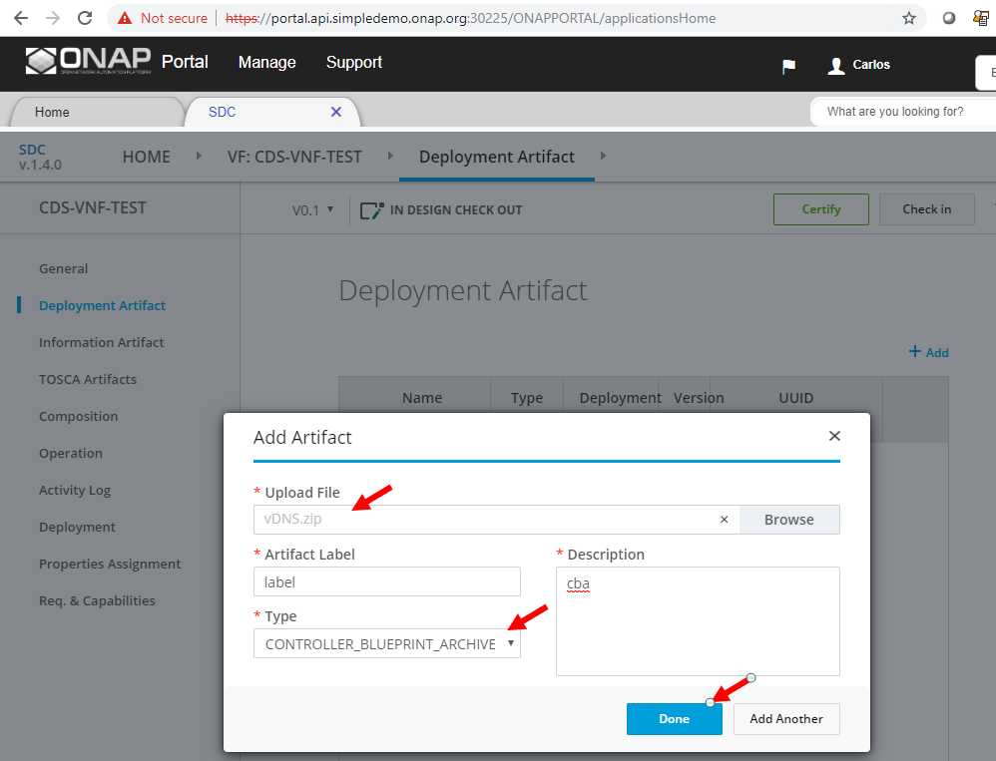
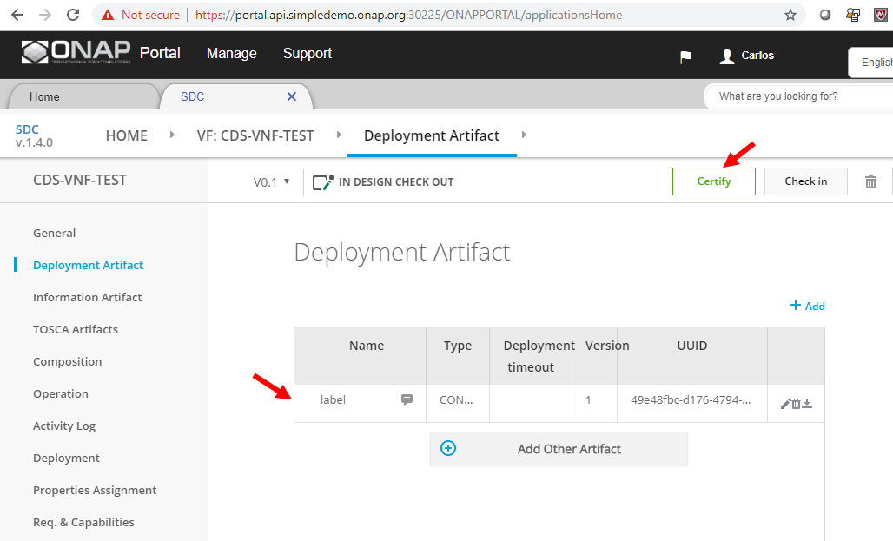
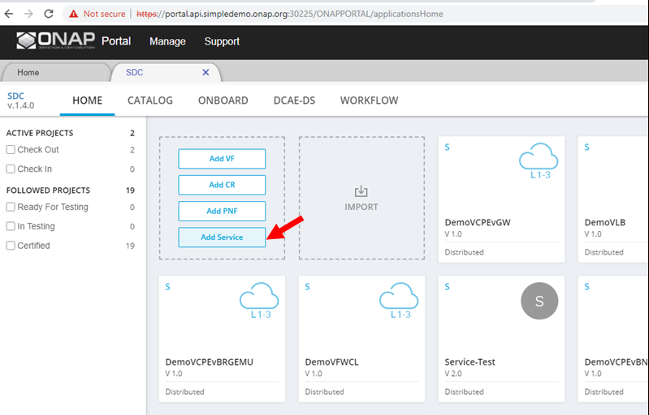
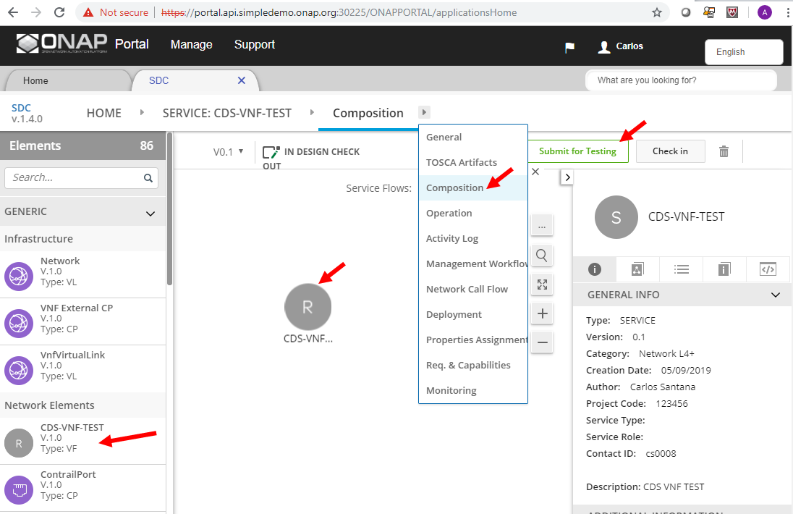
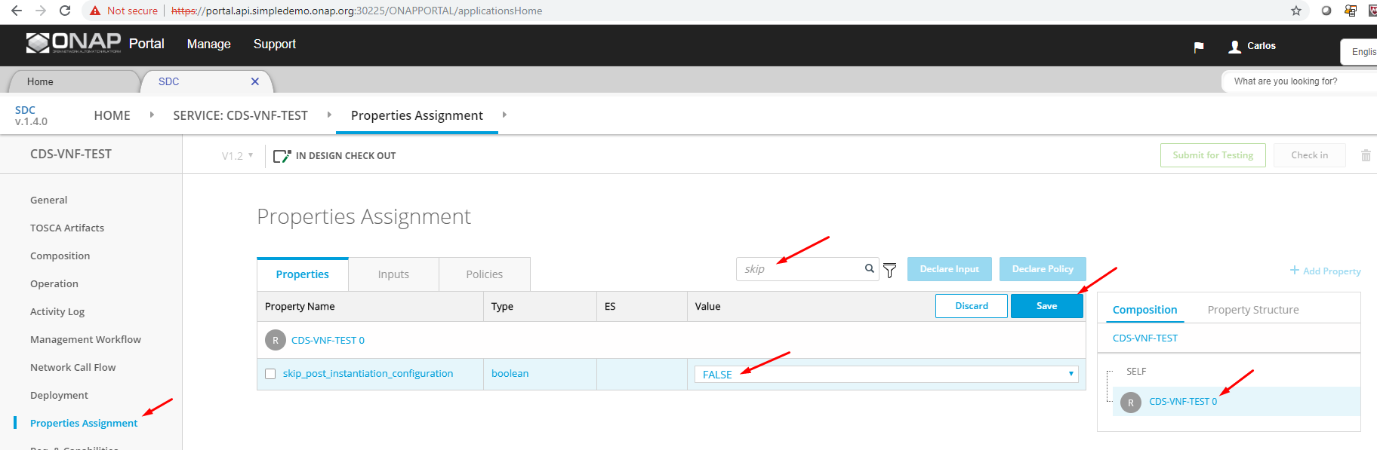
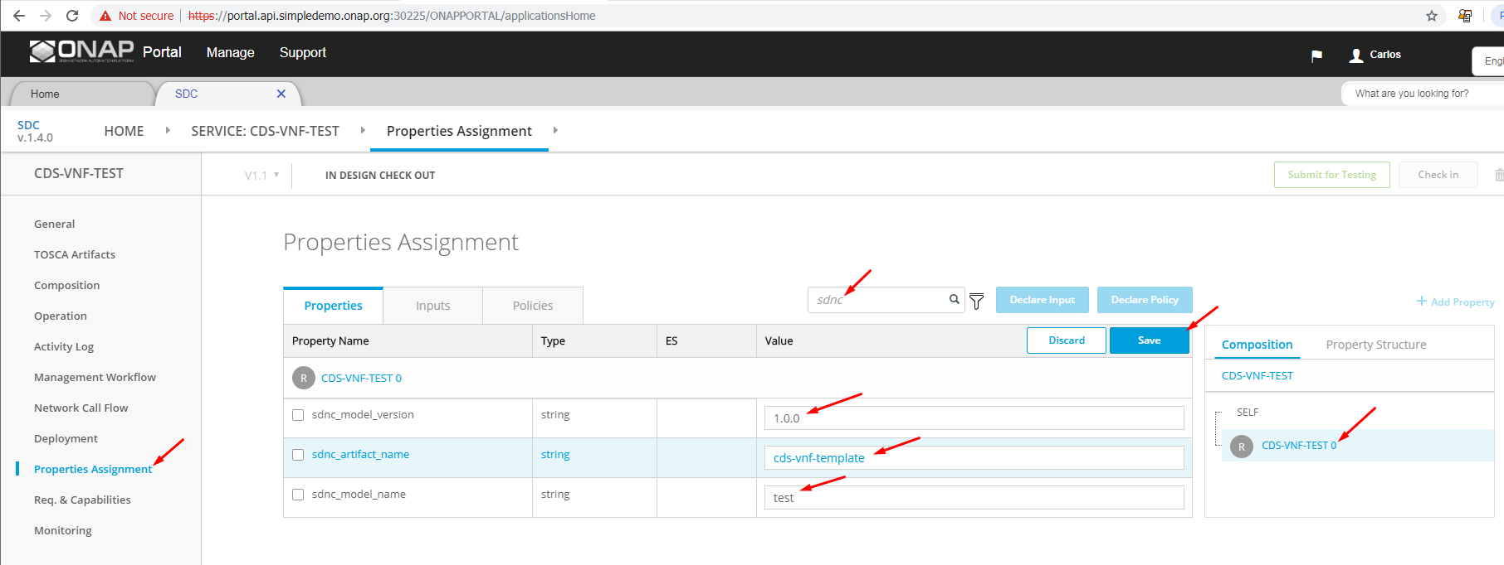
https://wiki.onap.org/display/DW/User+Guide#UserGuide-1737652736
CDS Distribution with SDC
Create the VF resource
Click on Deployment Artifact, then Add other arifacts, and select you CBA
Check the artifact is uploaded OK, and click on Certify.
Create a new service model, and add the newly created VF (including CBA artifact) to the new service model. Click on "Add Service"
Click on "Composition", and drag the VF we created from the palette on the left onto the canvas in the middle. Then, click on "Submit for Testing".
Click on Properties Assignments, then click on the service name, e.g. "CDS-VNF-TEST" from the right bar.
Type "sdnc" in the filter box, and add the sdnc_model_name, sdnc_model_version, and sdnc_artifact_version, and click "Save".
sdnc_model_name - This is the name of the blueprint (e.g. CBA name)
sdnc_model_version - This is the version of the blueprint
sdnc_artifact_name - This is the name of the VNF resource accumulator template
Type "skip" in the filter box, and set "skip post instantiation" to FALSE, then click "Save".
Login as Tester (jm0007/demo123456!) and accept the new service.
Login as Governor (gv0001/demo123456!) and approve for distribution.
Login as Operator (op0001/demo123456!) and click on "Distribute".

Slide 7
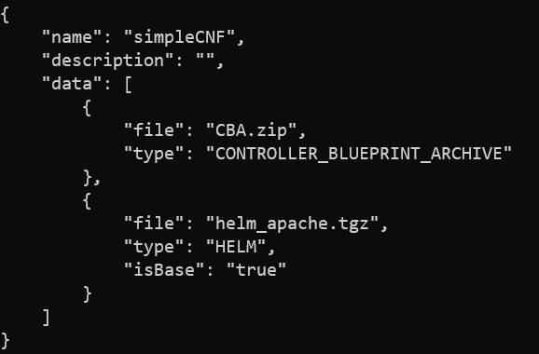
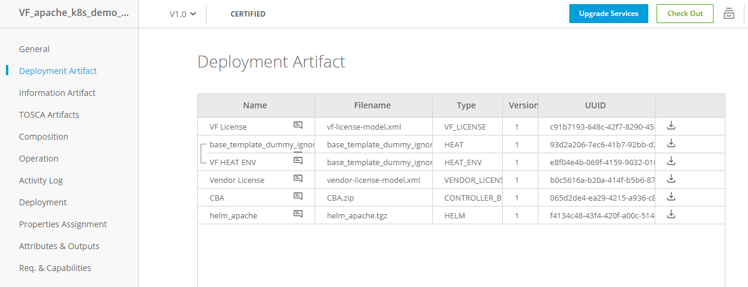
CNFO Onboarding
Standard Simple VSP Package (ZIP)
CBA is crucial and mandatory for CNFO
In the future may be replaced with ASD
We will see the complete package of a CBA in the coming slides

Slide 8
ONAP modeling concept (SDC)
Service
VF (1+)
PNF (0-1)
VFM (1+)
HELM
HELM
CSAR
HELM

Slide 9
CNF/PNF Coordination (1)
Service
VNF 1
PNF
2+
1*
VF Module 1
VF Module 2
service
Deploy.
service
Deploy.
configmap
pod
configmap
pod
PNF
3*
4*
* orchestration_flow_reference SO table allows to change it

Slide 10
CNF/PNF Coordination (3)
Service
VNF 1
VNF 2
VF Module 1
VF Module 2
VF Module 3
VF Module 4
service
Deploy.
service
Deploy.
service
Deploy.
service
Deploy.
configmap
pod
configmap
pod
configmap
pod
configmap
pod
Config Deploy¹
Post/Pre- Deploy Hook²
We can coordinate deployment on CBA¹ or Helm² level
CBA [Config Deploy] – CNF Status Check
Helm [Hook] – Readiness or liveness checks

Slide 11
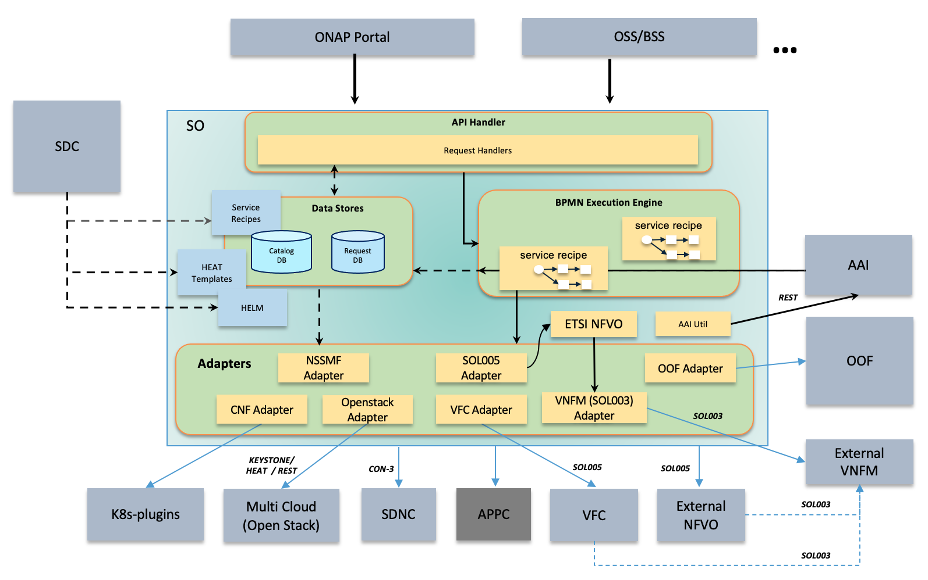
Understand SO
https://github.com/onap/so

Slide 12
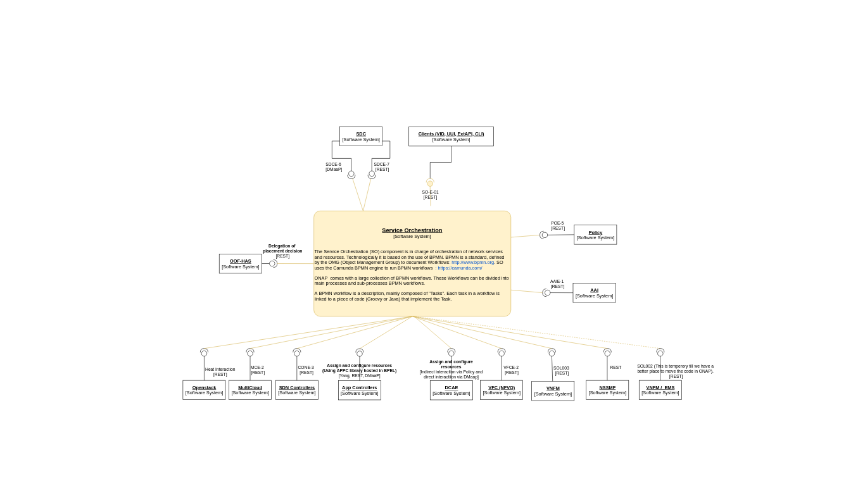
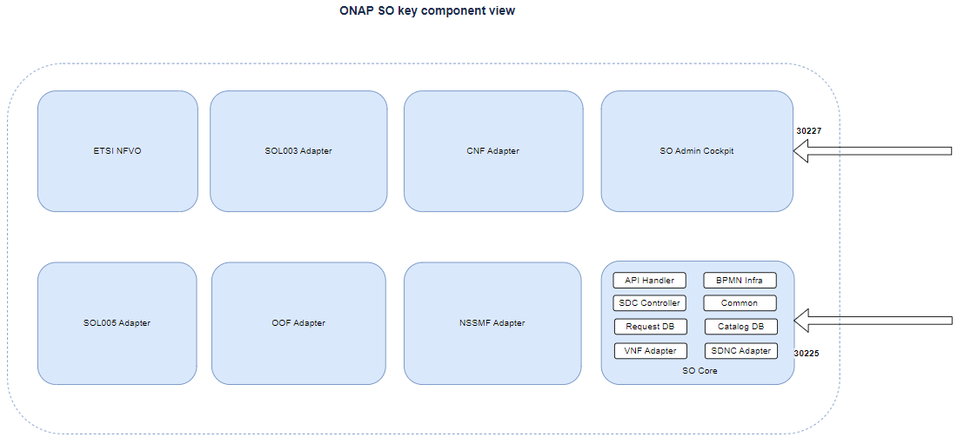
Understand SO cont
https://wiki.onap.org/display/DW/ARC+Service+Orchestrator+Component+Description+-+London-R12

Slide 13
Key Flows in SO
Alacarte
Service Instances
Macro
API HANDLER
E2E Service instance
Onap3Gpp Service instance

Slide 14
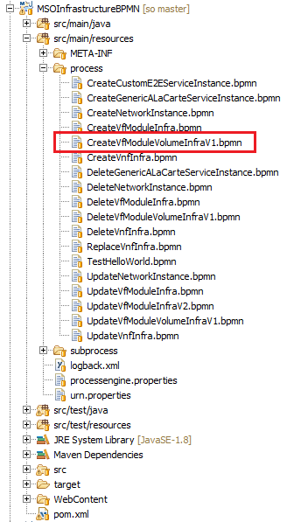
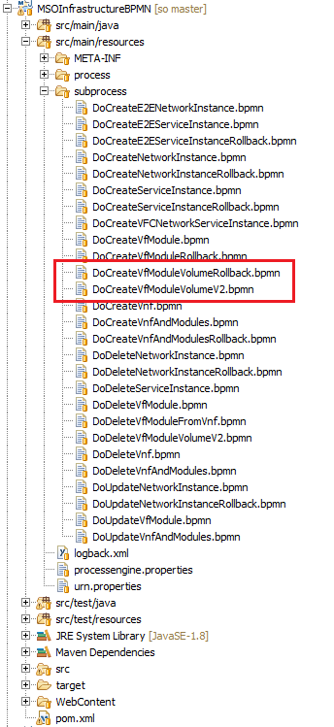
Key Flows in SO
a unique requestid is generated corresponding to every request, and is checked whether that particular requestid exists in request db
Checks whether the service already exists in catalogdb http://catalog-db-adapter:8082/service/{modelNameVersionId} (GET).
Checks the service recipe table with the modelNameVersionId and the action to be performed http://catalog-db-adapter:8082/serviceRecipe/search/findFirstByServiceModelUUIDAndAction?serviceModelUUID={modelNameVersionId}&action=createInstance
https://docs.onap.org/projects/onap-so/en/latest/developer_info/BPMN_Project_Structure.html
https://github.com/onap/so/tree/master/bpmn/so-bpmn-infrastructure-flows/src/main/resources/process

Slide 15
Macro Flow – PNF PNP as an Example
orchestration_flow_reference table in the SO catalog table
Sequence in Service-Macro-Create flow
AssignServiceInstanceBB
CreateNetworkCollectionBB
AssignNetworkBB
AssignVnfBB
AssignVolumeGroupBB
AssignVfModuleBB
AssignPnfBB
WaitForPnfReadyBB
ControllerExecutionBB (action: configAssign, scope: pnf)
ControllerExecutionBB (action: configDeploy, scope: pnf)
ActivatePnfBB
ConfigAssignVnfBB
CreateNetworkBB
ActivateNetworkBB
CreateVolumeGroupBB
ActivateVolumeGroupBB
CreateVfModuleBB
ActivateVfModuleBB
ConfigDeployVnfBB
ActivateVnfBB
ActivateNetworkCollectionBB
ActivateServiceInstanceBB
https://github.com/onap/so/tree/master/bpmn/so-bpmn-building-blocks/src/main/resources/subprocess/BuildingBlock
https://docs.onap.org/projects/onap-so/en/latest/developer_info/pnf_pnp_workflow_migration_to_BB/Building_Block_based_PNF_PnP_flows.html

Slide 16
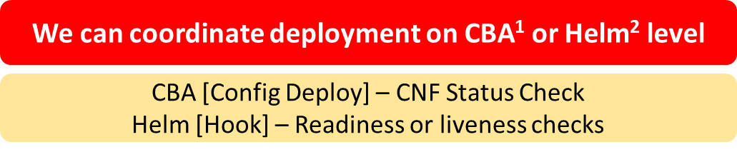
CNF Instantiation (macro mode)
CDS
CDS
CDS
Assign Service Instance
Assign VNF Instance
Assign VF module Instance
Config Assign VNF
Create VF module
Retrieve Helm overrides + Profiling
Prepare post deploy config
Deploy Helm package & Synch AAI
Execute post deploy config
Activate VF module
Config Deploy VNF
Activate VNF
Activate Service Instance
CDS
optional

Slide 17
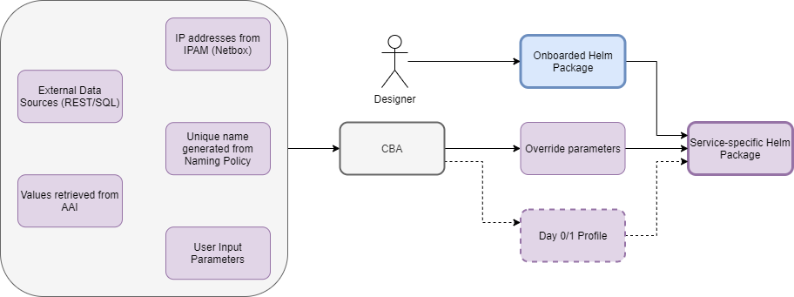
Helm Package Day 0/1 + Day2
1
HELM
2
6
3
4
5
K8s Cluster Resources
Config Assign
7
Day 2 Configuration Template
Config Deploy
Day 2 Configuration
Instance
8
Day 2 Configuration Parameters
9
17

Slide 18
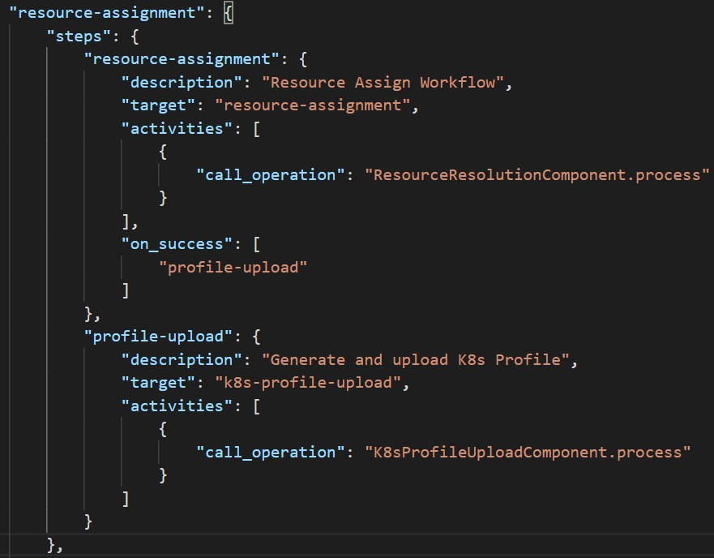
CNF Day 0 – Helm Enrichment
CNF instance based
Modifies Helm package from VSP
K8s Profile Creation & Upload
Native mechanisms in CDS
Customizable by CBA
Modification of Helm values
Customization of labels
Selection of k8s namespace
Modification of Helm templates
Provisioning of new Helm templates
New k8s-resource types to

Slide 19
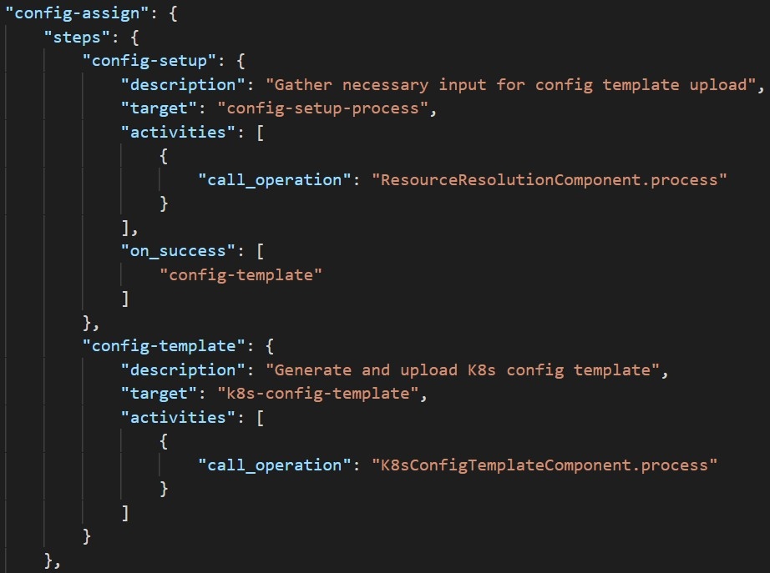
CNF Day 2 – Config Preparation
CNF instance based
Config Template (CFT)
Helm package
Build or modified by CDS
We can use VSP Helm as a template
CFT preparation may be a part of
Config-Assign in CDS
Native mechanisms in CDS
Customizable by CBA
Config Setup merges data
CBA
AAI i.e. vf-modules info
MDSAL – i.e. resolved Day 0
K8s – i.e. k8s resource status info
Kotlin, Python, REST
Complex JSON

Slide 20
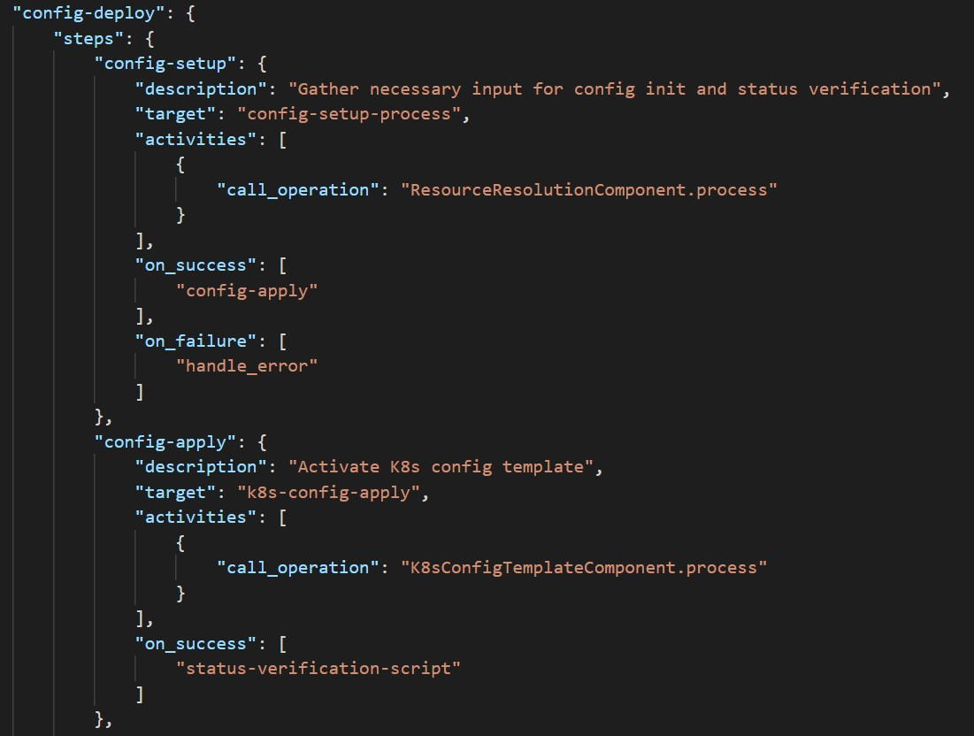
CNF Day 2 – Config Creation
CNF instance based
Config Instance (CFI)
Instantiates CFT
Provides overrides for CFT
CFI creation is part of Config-
Deploy in CDS
Creates new k8s resources
Modifies k8s resources of existing CNF instance
Native mechanisms in CDS
Customizable by CBA
In vFW CNF Use Case followed by simple Status Check
Checks Pod Status until „Running”
Fails after 30 retries

Slide 21
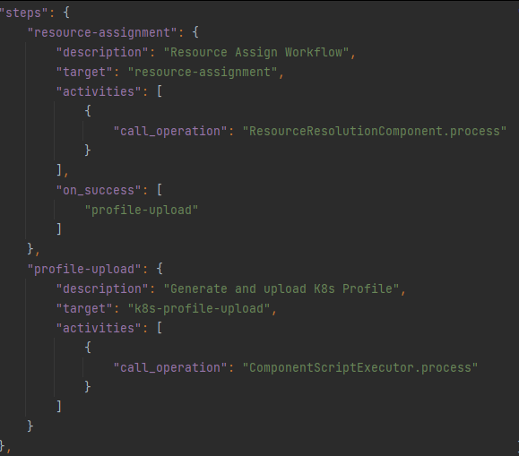
Resource Assignment (CNF/PNF)
Resource Assignment:
First of the ways to enrich Helm package
Resolves overrides for Helm instantiation
It is supplemented by profiling
We use it to gather inputs and prepare for profiling
Result is stored in MDSAL and can be easily used during Day2 operations
ResourceResolutionComponent used

Slide 22
Resource Assignment (CNF/PNF)
Profiling mechanism allows to also parametrize complex overrides values
values.yaml file is taken from the profile
original helm chart is not modified
There are two types of profiles
static – predefined in CBA
dynamic – generated and templated during instantiation
CBA may have many profils with predefined overrides.
K8sProfileUploadComponent is used

Slide 23
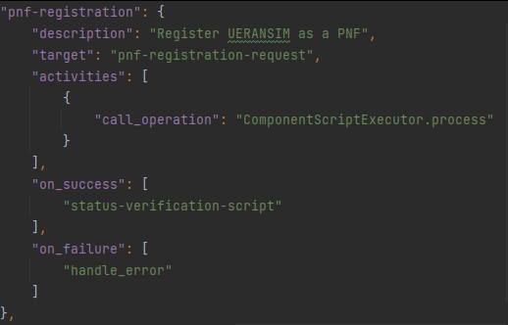
Config Deploy: PNF Registration
Service model is composed of PNF and CNF
PNF is simulated by UERANSIM solution
In order to register PNF in ONAP PNF Plug and Play procedure is used
This step sends PNF registration event to PRH component of DCAE
CNF Core instantiation waits until PNF Registration finishes

Slide 24
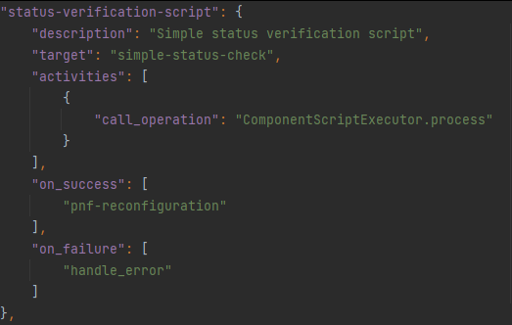
Config Deploy: Status Verification
Procedure verifies if CNF is up and running
All k8s resources created must have „Running” state to continue
Script calls k8sPlugin Status API
Instance status verification checks value of ready flag:
False means deployment in progress
True means deployment is finished
ComponentScriptExecutor operation used

Slide 25
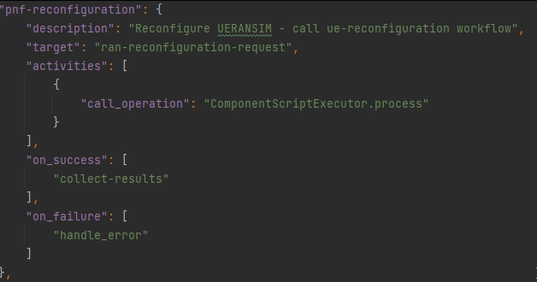
Config Deploy: PNF Reconfiguration
Aim at configuration of PNF base on the configuration resolved from the CNF
Request sent towards UERANSIM component contains parameters required during subscription, eg:
PLMN ID
UE ID
ComponentScriptExecutor operation used

Slide 26
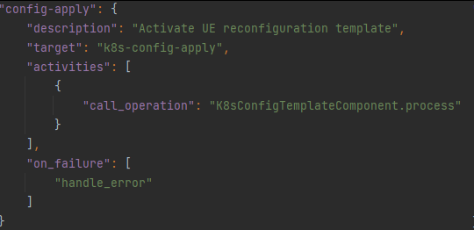
Resource Reconfiguration: Config Apply
K8sPlugin instantiates the configuration uploaded during config-upload step
As a result:
new gnb pod is created with modified parameters
The old instance is deleted
K8sConfigValuesComponent component is utilized

Slide 27
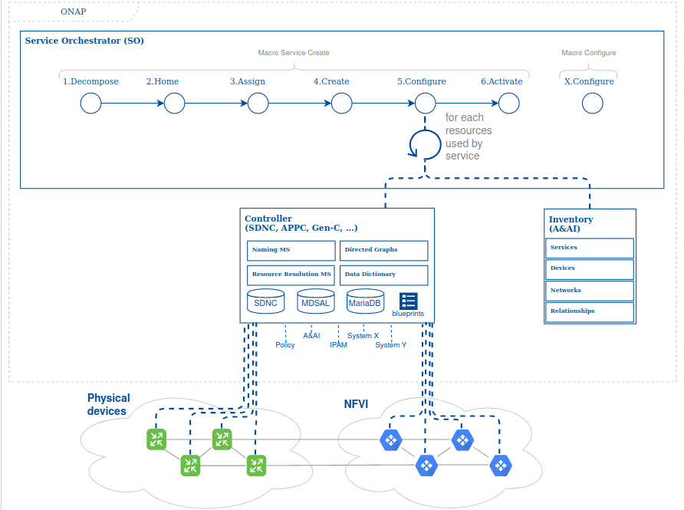
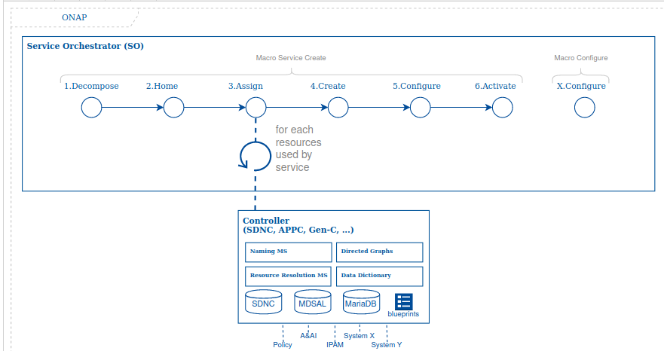
ONAP Specific Workflows
VNF/VF-Module - Instantiation & Post Instantiation
https://wiki.onap.org/display/DW/SO+Building+blocks
https://wiki.onap.org/display/DW/User+Guide#Designtime--1690278344
https://wiki.onap.org/pages/viewpage.action?pageId=36966186
https://wiki.onap.org/pages/viewpage.action?pageId=64006314#E2ERunTime-2095048582
The following workflows are contracts established between SO, SDNC and CDS to cover the instantiation and the post-instantiation use cases.
User -> SO (Macro Service Create)
SO -> AssignBB (service, vnf, vf-module)
->CDS (resource-assignment workflow)
SO -> ConfigAssignBB - day0 config assign
-> CDS (config-assign workflow)
SO -> CreateBB (VF-Module)
-> OpenStack adapter / Multi-Cloud
SO -> ConfigDeployBB - day0 config push
-> CDS (config-deploy workflow)
The third step is to perform assignment. Assignment will be performed per the orchestration plan - and will start from the service-level, then iterating through the various resources contained within the service. Assignment can involve different systems.
For example: for a 'management_ip' property on a specific VNF component, representing the management interface address, the system may have to reach out to an IPAM system, pulling information from a specific subnet (either rules-based, leveraging a database such as the controller data store, or provided through input).
The ONAP Controller Design Studio (CDS) initiative implements an exhaustive framework to tackle this (through data dictionary, controller blueprints or other means as it evolves).
These assigned values will be stored in the service context, inside the controller's data store (MDSAL). These can be leveraged at any time afterwards - this replaces the legacy preload function.
Assignment for
Instantiation & Post Instantiation configuration
Instantiation
Post Instantiation Configuration
The fifth function is the configuration of the device - essentially applying service configuration or application type configuration to the device so it can become operational.
This is done involving the right controllers, and again leverages the service & resource context stored in the controller data store, the directed graphs and/or Controller Design Studio blueprints artifacts (which can include DGs, code, etc.). It will then transformed all the assigned values into configuration payload for the device, using the right protocol (Netconf/Restconf or just Rest APIs), and when triggered through CDS Blueprints will use Velocity templating for transformation/mapping. This applies to PNFs or VNFs - it is purely network device configuration. If any aspect of the configuration needs to be represented in the inventory, it will perform such updates.

Slide 28
AAI model: k8s resource object
Attribute | Type | Mandatory
id | UUID | Yes (PK)
name | String | Yes
group | String | Yes
version | String | Yes
kind | String | Yes
labels | List of strings | No
namespace | String | Yes
selflink | URI | Yes
K8s resource is basic AAI entity
to model resources created in
K8s cluster.
It plays similar role as vserver
resource for standard VNFs.
Self-link allows to access full
and actual details of the
k8s resource

Slide 29
AAI model: relations
1
cloud-region
1
Belongs To
service-instance
1..
1
1
1..
Belongs To
1
tenant
1
Composed Of
Located In
Depends On
1
*
volume-group
*
1..
Depends On
*
generic-vnf
1..
1
Belongs To
1
Uses
1..
1
Uses
k8s-resource
Belongs To
*
vf-module
1..
1
1..
Belongs To
Hosted On
https://wiki.onap.org/display/DW/Simplified+K8S+Resource+Model+-+IM

Slide 30
Instantiation of the Helm Chart – Istanbul
SO
AAI
SDNC
CDS
SO: CNF Adapter
K8s Plugin
K8s cluster
Create Service
Assign Service, Assign VNF
Create vf-module
Assign vf-module
Assign vf-module
Assign result
Build RB Profile
vf-module assigned
Assign vf-module
RB Profile
[Helm enrichment]
vf-module assigned
Update vf-module
vnf Config-Assign
Config Template
Create vf-module in K8s
Create RB Instance
Install K8s Resources
K8s Resources Status
Big Bang!
k8s-resource
vnf Config-Deploy
Config Instance

Slide 31
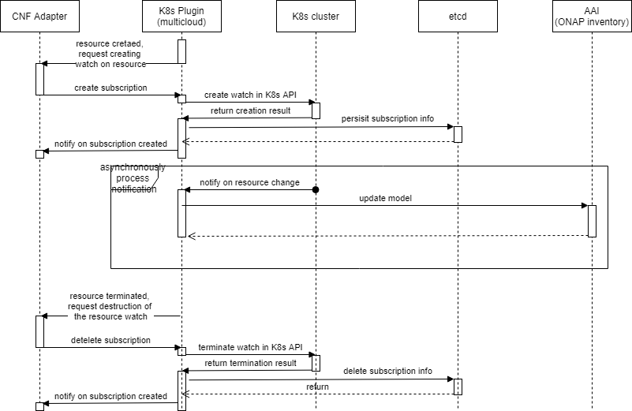
CNF AAI Update - Jakarta
SO: CNF Adapter
K8s Plugin
K8s cluster
K8s Plugin (etcd)
AAI
CNF Adapter creates status notification subscription
K8s Notifies on Resource’s change
K8sPlugin Sends Subscription Notification
CNF Adapter Determines type of change
Create new k8s-resource
Deletes k8s-resource
Update K8s resource version

Slide 32
Thank You

