Slide 2
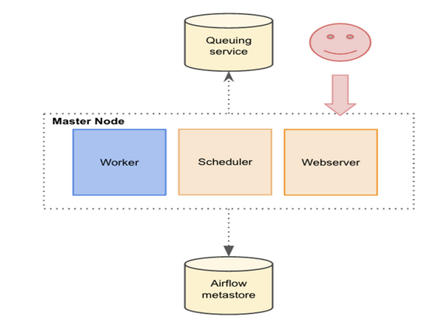
Apache Airflow
Apache Airflow Architecture:
WebUI: the portal for users to view the related status of the DAGs.
Metadata DB: the metastore of Airflow for storing various metadata including job status, task instance status, etc.
Scheduler: a multi-process which parses the DAG bag, creates a DAG object and triggers executor to execute those dependency met tasks.
Executor: A message queuing process that orchestrates worker processes to execute tasks.
Airflow worker: retrieve the commands from the queues, execute them and update the metadata.
Written in Python
Nice UI
Programmatic pipeline construction
Can run complex pipelines

Slide 3
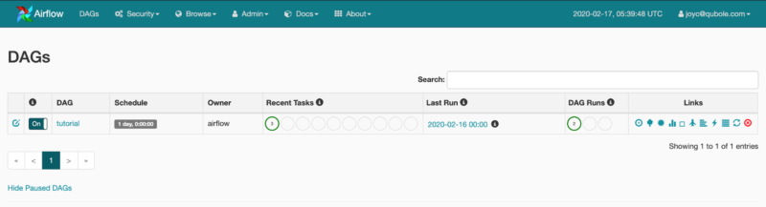
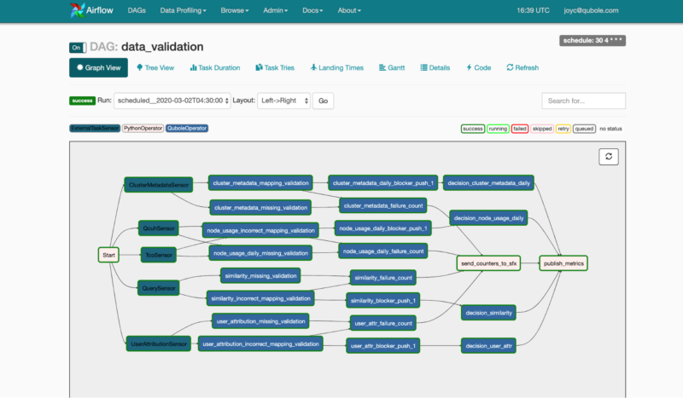
Monitoring DAGs
The Airflow Web Server homepage provides a brief overview of the statues of the DAGs and their recent runs.
Visualizing DAGs: The UI also has a section for visualizing the DAG flow, a tree view to represent all the recent runs and the status of each task for these runs.

Slide 4
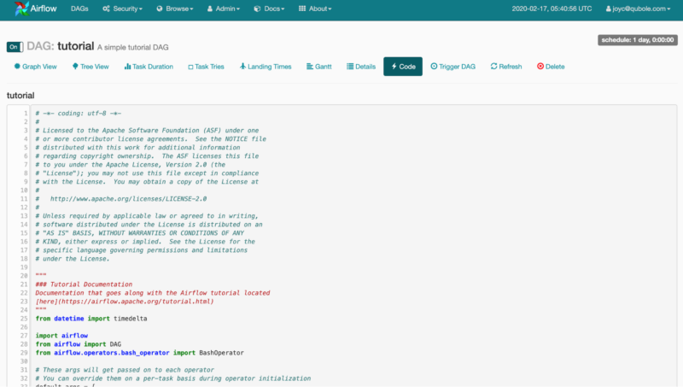
Viewing DAG Code from Airflow UI

Slide 5
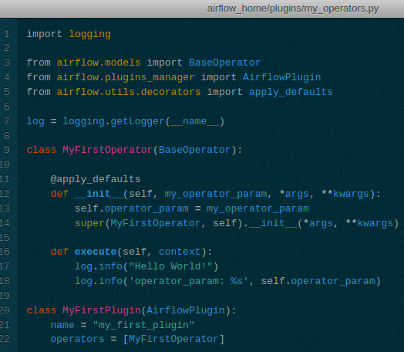
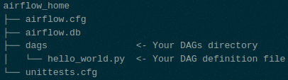
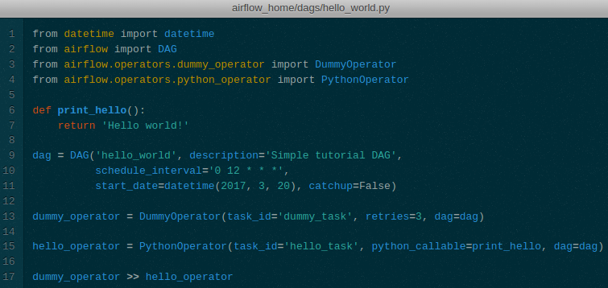
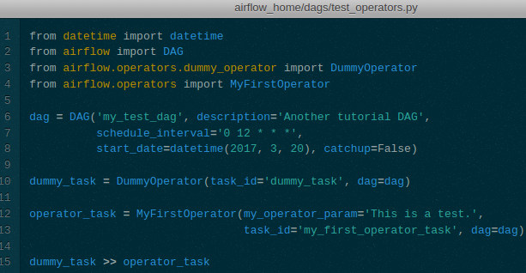
workflows with Apache Airflow
Airflow DAG example:
Add the following code to dags/hello_world.py
This file creates a simple DAG with just two operators, the DummyOperator, which does nothing and a PythonOperator which calls the print_hello function when its task is executed.

Slide 6
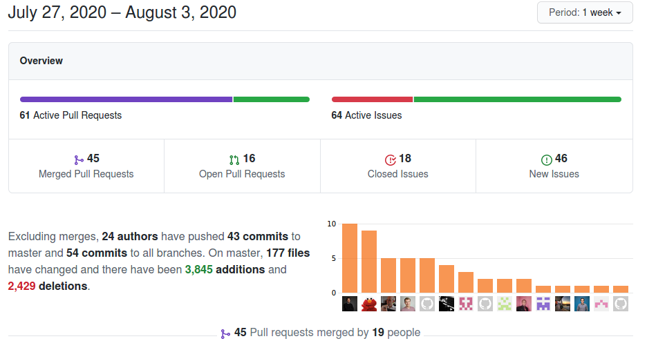
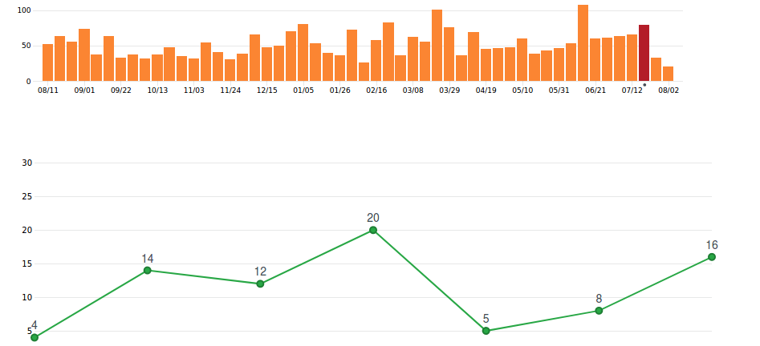
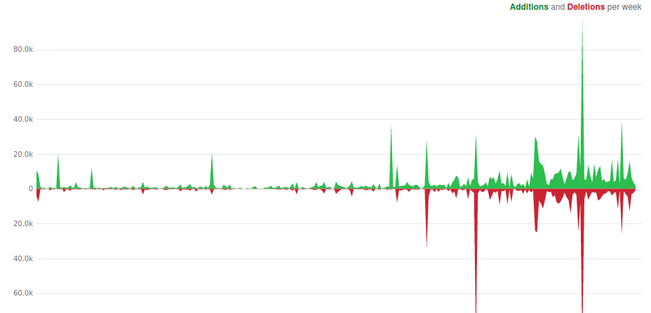
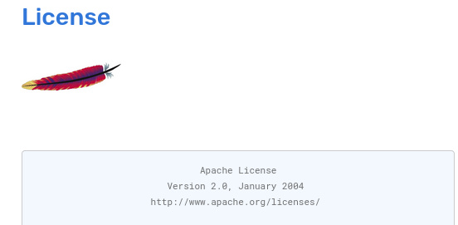
Pulse
Commits
Code frequency

Slide 7
Camunda

Slide 8
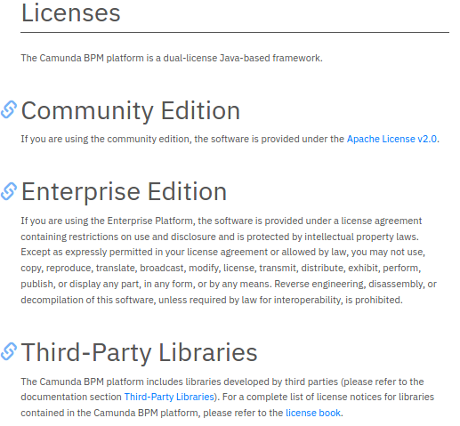
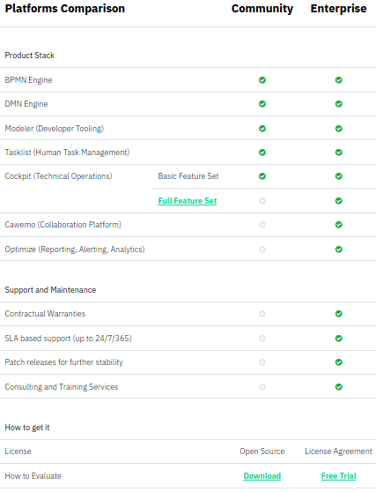
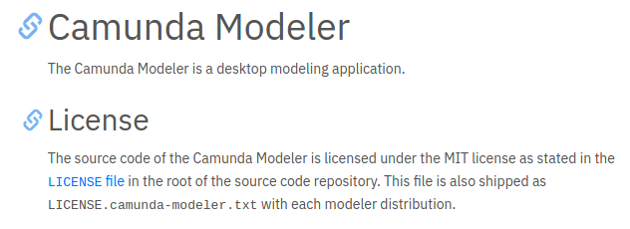
https://camunda.com/enterprise/
When a new version of the CE is released (every 6 months) the engine is identical to the EE version. But between releases of the CE the EE gets a series of patch releases which the CE version will not get.

Slide 9
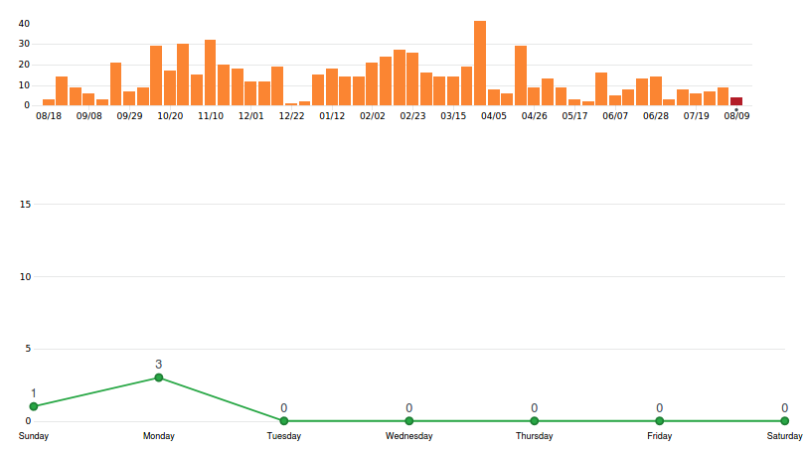
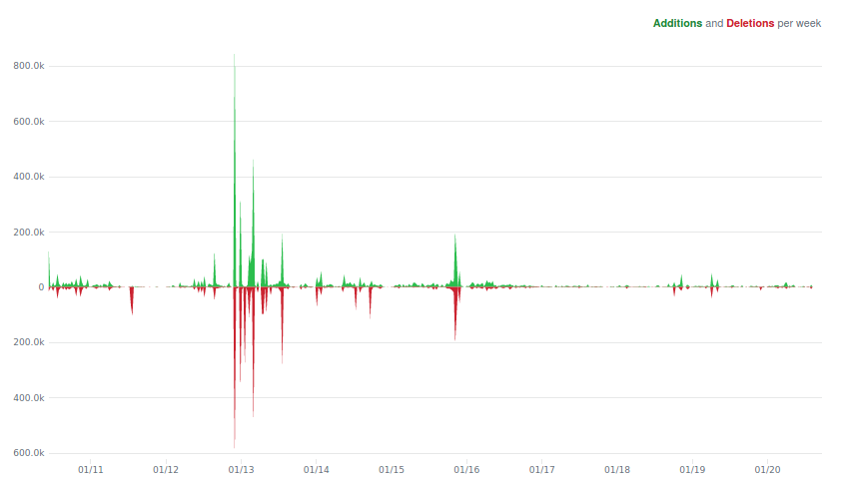
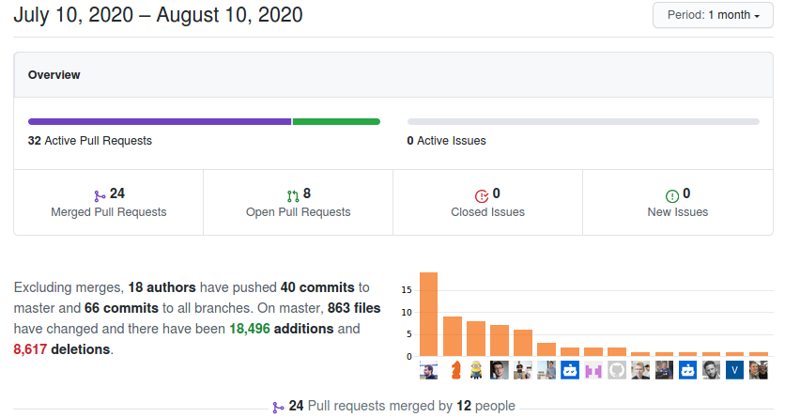
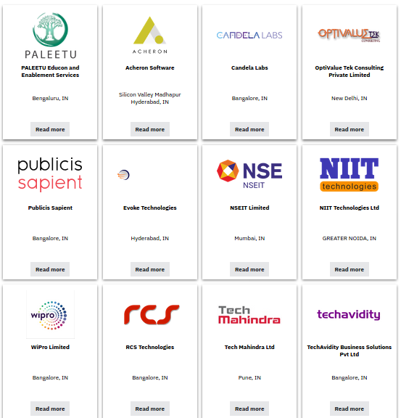
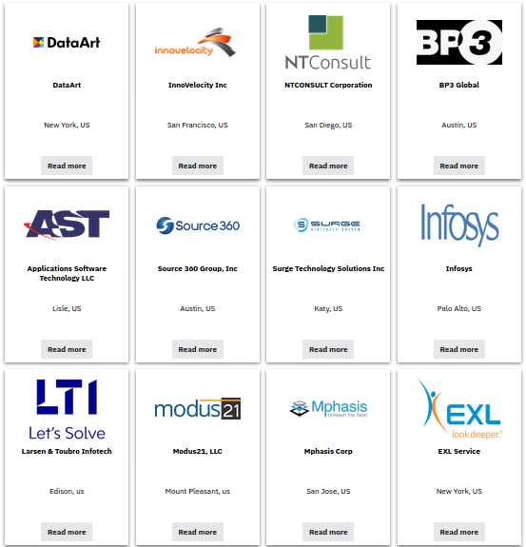
Code Commits
Code Frequency
Partners
Pulse

Slide 10
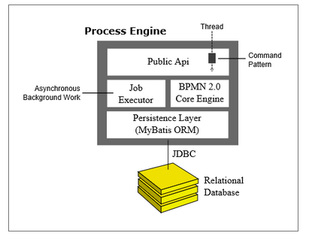
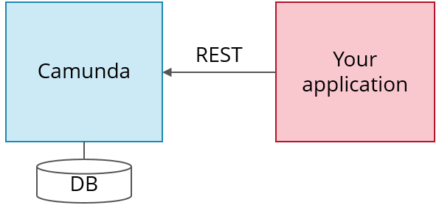
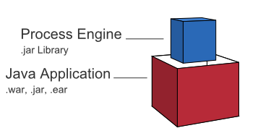
Architecture Overview
Camunda is written in Java and needs a Java Virtual Machine (JVM) to run. Camunda provides a REST API which allows you to code in whatever language you like and just talk REST with Camunda
Workflows in Camunda are defined in BPMN which is basically an XML file. It can be graphically modeled using the Camunda Modeler.

Slide 11
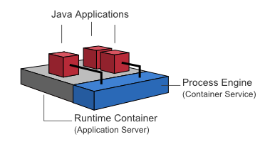
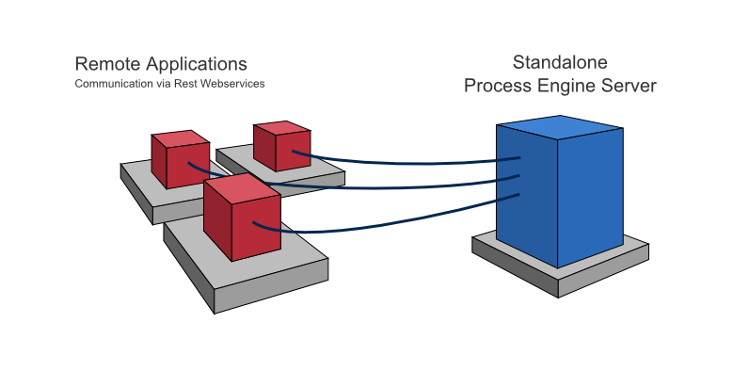
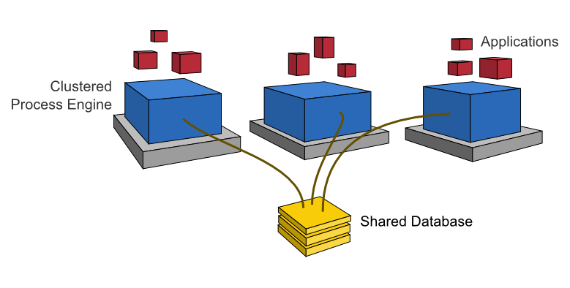
Camunda BPM Platform Architecture
Embedded Process Engine
Shared, Container-Managed Process Engine
Standalone (Remote) Process Engine Server
Clustering Model

Slide 12
Embedded Process Engine: The process engine is added as an application library to a custom application. This way, the process engine can easily be started and stopped with the application lifecycle. It is possible to run multiple embedded process engines on top of a shared database.
Shared, Container-Managed Process Engine: The process engine is started inside the runtime container (Servlet Container, Application Server, …). The process engine is provided as a container service and can be shared by all applications.
Standalone (Remote) Process Engine Server: The process engine is provided as a network service. Different applications running on the network can interact with the process engine through a remote communication channel. The easiest way to make the process engine accessible remotely is to use the built-in REST API. Different communication channels such as SOAP Webservices or JMS are possible but need to be implemented by users.
Clustering Model: In order to provide scale-up or fail-over capabilities, the process engine can be distributed to different nodes in a cluster. Each process engine instance must then connect to a shared database.

Slide 13
ONAP BPMN Project Deployment Strategy
Single Application with Embedded Process Engine
Deployment in SO is currently limited to a single process application: MSOInfrastructureBPMN. The WAR file for this application contains everything needed to execute the infrastructure process flows, including:
BPMN process flows, java classes, groovy scripts, and resource files from MSOInfrastructureBPMN itself.
BPMN process flows, java classes, groovy scripts, and resource files from other SO projects, like MSOCommonBPMN and MSOCoreBPMN.
An embedded Camunda Process Engine to execute the flows.
The process application exposes a REST endpoint to the API Handler(s) for receiving flow execution requests.
Development is required in SO to be able to support one a more versatile deployment strategy, probably one of the following:
Shared Process Engine
The Camunda Process Engine is created and manged as a Wildfly module. This single engine is shared by all process applications.
Multiple Applications, each with an Embedded Process Engine
More than one application could be deployed, each having its own embedded process engine.
https://wiki.onap.org/display/DW/BPMN+Project+Deployment+Strategy

Slide 14
https://camunda.com/best-practices/deciding-about-your-stack/

Slide 15
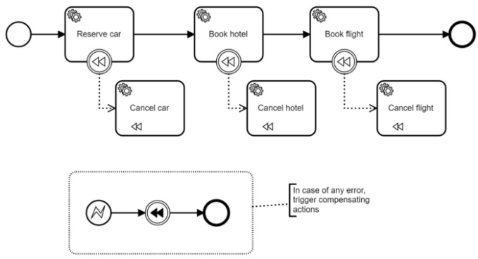
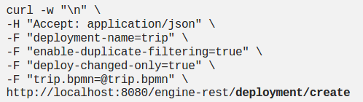
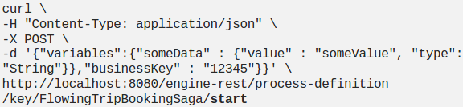
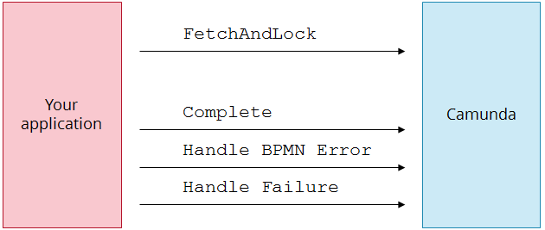
Deploy a process model
you can leverage the REST API to deploy the process model.Assume you saved it with the name trip.bpmn and started Camunda via Docker to have it available on localhost:8080
Now, the next interesting question is: How does Camunda call services like the car reservation? Camunda can not only call services right away (Push-Principle) using some built-in connectors, but also put work items into a kind of built-in queue. Then a worker can fetch work items via REST, do the work and let Camunda know of the completion (Pull-Principle).
you can start new workflow instances via REST API and hand over data you want to have as workflow instance variables

Slide 16
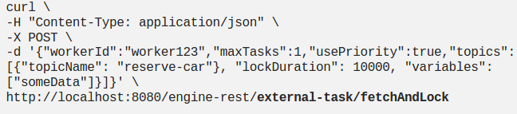
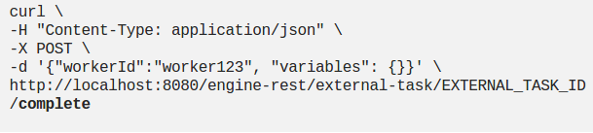
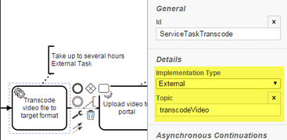
So first you fetch tasks and lock them for you (as other workers might fetch at the same time to scale your system)
And tell Camunda the worker has completed its work (note that you have to enter the external task id you retrieved in the first request)
https://camunda.com/blog/2015/11/external-tasks/
https://blog.bernd-ruecker.com/use-camunda-without-touching-java-and-get-an-easy-to-use-rest-based-orchestration-and-workflow-7bdf25ac198e

Slide 17
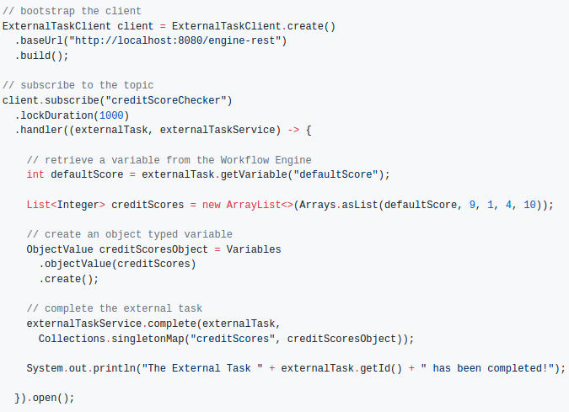
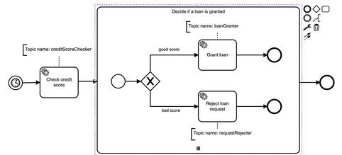
https://github.com/camunda/camunda-external-task-client-java/tree/master/examples/loan-granting

Slide 18
APIs
https://docs.camunda.org/manual/7.8/reference/rest/history/process-instance/get-process-instance-query/

Slide 19
https://github.com/camunda/camunda-external-task-client-java/tree/master/examples/loan-granting
https://camunda.com/best-practices/deciding-about-your-stack/
https://wiki.onap.org/display/DW/BPMN+Project+Deployment+Strategy
https://github.com/camunda/camunda-bpm-examples/tree/master/deployment/spring-boot
https://forum.camunda.org/t/execute-same-workflow-in-parallel/15499/6
https://docs.camunda.org/manual/latest/reference/rest/deployment/post-deployment/
https://dzone.com/articles/running-spring-boot-application-with-embedded-camu
https://docs.camunda.org/manual/7.3/api-references/rest/#history-get-historic-details

Slide 20
Argo CD

Slide 21
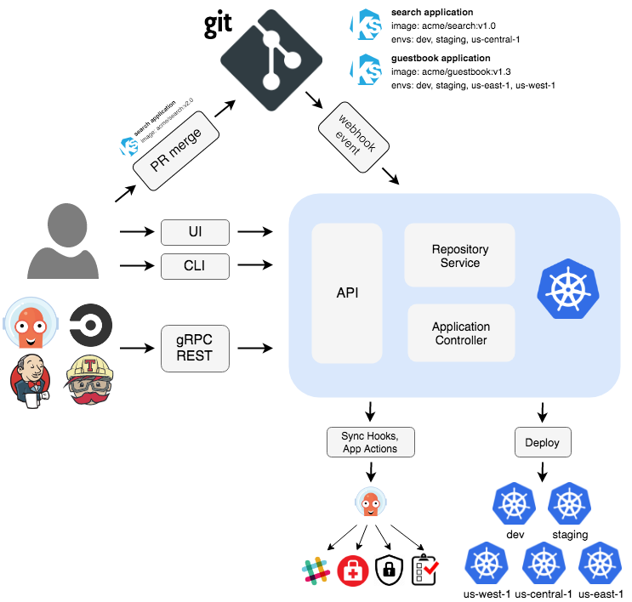
Argo CD is implemented as a kubernetes controller which continuously monitors running applications and compares the current, live state against the desired target state
Argo is an open source project that provides container-native workflows for Kubernetes. Each step in an Argo workflow is defined as a container.
Argo is implemented as a Kubernetes CRD (Custom Resource Definition). As a result, Argo workflows can be managed using kubectl and natively integrates with other Kubernetes services such as volumes, secrets, and RBAC
The new Argo software is light-weight and installs in under a minute, and provides complete workflow features including parameter substitution, artifacts, fixtures, loops and recursive workflows.
.

Slide 22
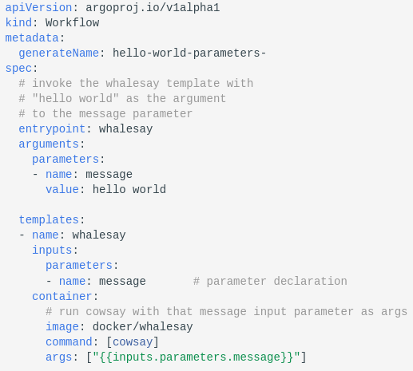
complex workflow spec with parameters
The whalesay template takes an input parameter named message that is passed as the args to the cowsay command.
argo submit arguments-parameters.yaml -p message="goodbye world"

Slide 23
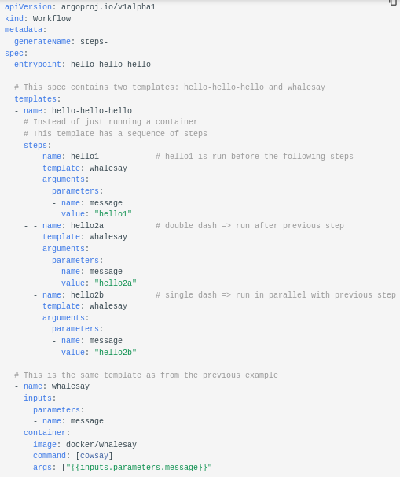
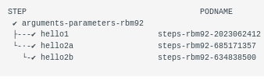
create multi-step workflows,
Result:

Slide 24
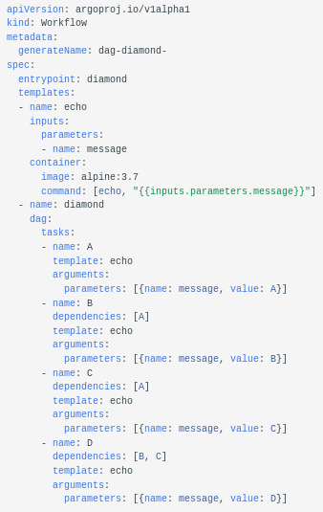
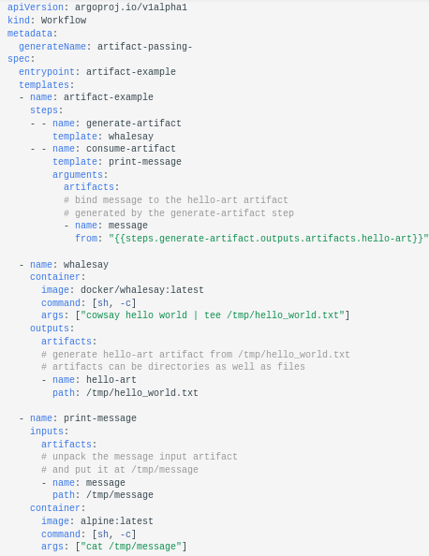
define the workflow as a directed-acyclic graph (DAG) by specifying the dependencies of each task.
workflow spec consists of two steps that run in sequence.
The first step named generate-artifact will generate an artifact using the whalesay template that will be consumed by the second step named print-message that then consumes the generated artifact.
This can allow for complex workflows to be split into manageable pieces.

Slide 25
https://argoproj.github.io/argo/examples/
https://tanzu.vmware.com/developer/guides/ci-cd/argocd-gs/

Slide 26
TekTon

Slide 27
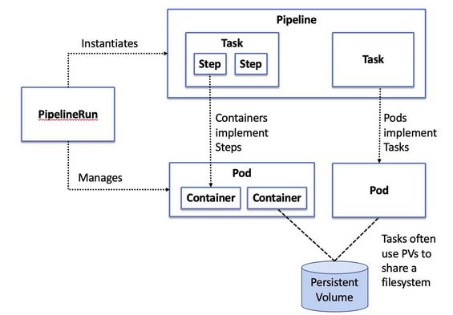
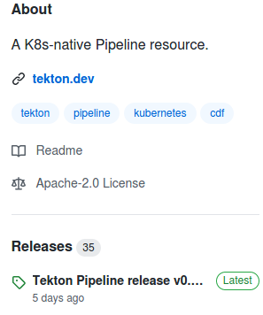
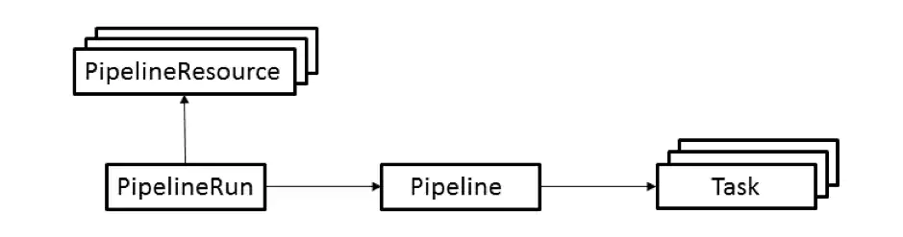
TekTon
Tekton is a powerful yet flexible Kubernetes-native open-source framework for creating continuous integration and delivery (CI/CD) systems. It lets you build, test, and deploy across multiple cloud providers or on-premises systems by abstracting away the underlying implementation details.Tekton Pipelines expose the ability to define and execute build tasks, inputs and outputs in the form of simple values or complex objects like Docker images, and to combine these resources in pipelines.
Task: Defines a set of build steps, such as compiling code, running tests, and building and deploying images.
Pipeline: Defines the set of tasks that compose a pipeline.
PipelineResource: Defines an object that is an input (such as a Git repository) or an output (such as a Docker image) of the pipeline.
PipelineRun: Defines the execution of a pipeline. This resource references the Pipeline to run and which PipelineResource(s) to use as input and output.

Slide 28
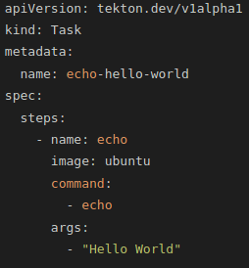
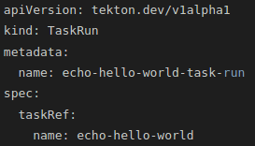
https://github.com/tektoncd/pipeline/blob/master/examples/v1alpha1/pipelineruns/pipelinerun-with-params.yaml

Slide 29
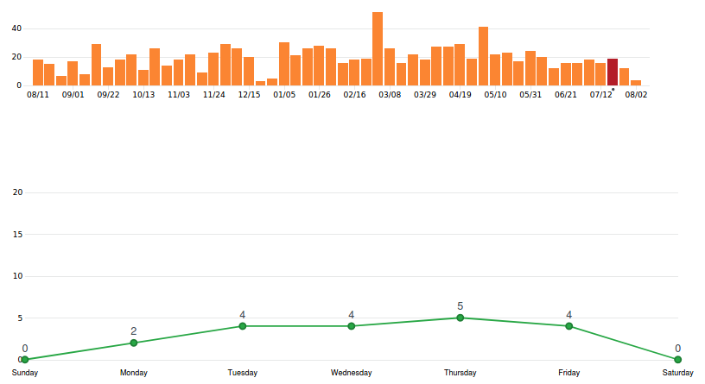
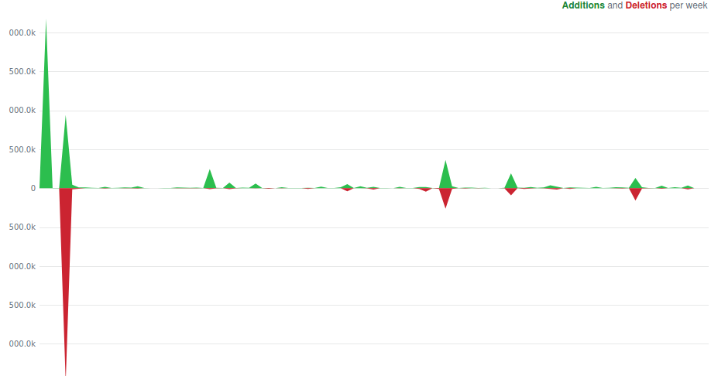
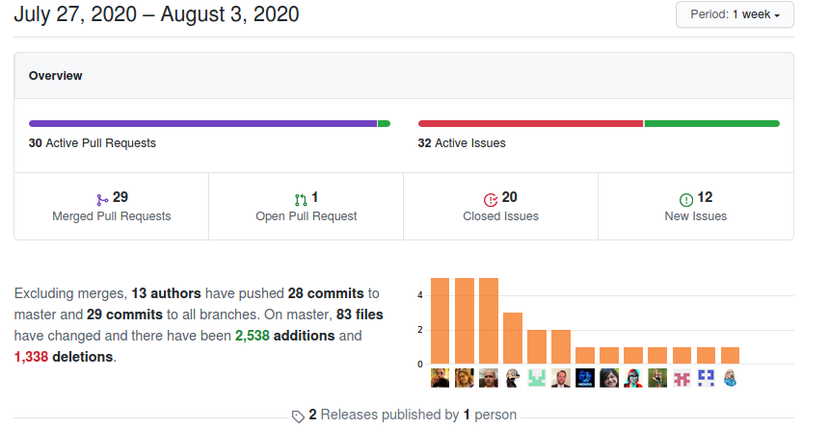
Code commit
Code frequency
Pulse

Slide 30
https://cloudnativetoolkit.dev/guides/continuous-integration-tekton/
https://cp4apps.cloudnative101.dev/web/1.0.0/tekton-create-pipeline.html

Slide 31
ZEEBEE

Slide 32
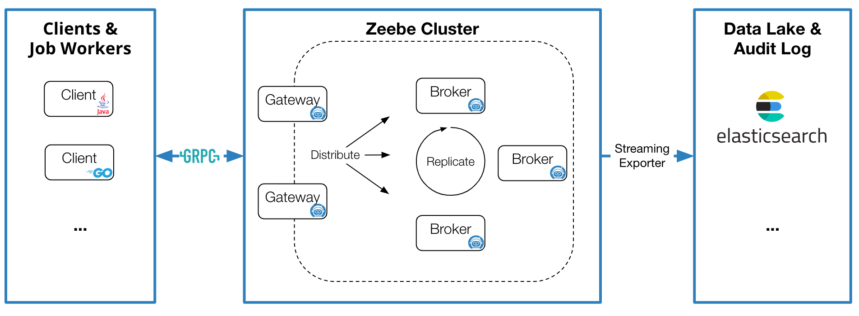
Architecture
Broker
The Zeebe broker is the distributed workflow engine that keeps state of active workflow instances.
Client
Clients are libraries that you embed in an application (e.g. a microservice that executes your business logic) to connect to a Zeebe cluster. Clients have two primary uses:
Carrying out business logic (starting workflow instances, publishing messages, working on tasks)
Handling operational issues (updating workflow instance variables, resolving incidents)

Slide 33


Exporter
The exporter system provides an event stream of state changes within Zeebe. This data has many potential uses, including but not limited to:
Monitoring the current state of running workflow instances
Analysis of historic workflow data for auditing, business intelligence, etc
Tracking incidents created by Zeebe

Slide 34
Licensing for Software and Documentation
Zeebe Broker (incl. Gateway)
The Zeebe Broker including the Gateway are licensed under the Zeebe Community License 1.0.
Proprietary licenses are also available from Camunda Services GmbH.
APIs and Protocols
The Gateway Protocol is licensed under the Zeebe Community License 1.0. See also: “Clarification on gRPC Code Generation”.
The Exporter API is licensed under the Apache License v2.0.
Clients
Official Zeebe Clients: Apache License v2.0.
Third party / community clients: Licenses will vary.

Slide 35
Flowable

Slide 36

Architecture
Flowable is an open-source workflow engine written in Java that can execute business processes described in BPMN 2.0.It is an actively maintained fork of Activiti (software).
a compact and highly efficient workflow and Business Process Management (BPM) platform for developers, system admins and business users.
a lightning fast, tried and tested BPMN 2 process engine written in Java. It is Apache 2.0 licensed open source, with a committed community.
can run embedded in a Java application, or as a service on a server, a cluster, and in the cloud. It integrates perfectly with Spring. With a rich Java and REST API, it is the ideal engine for orchestrating human or system activities.
License
Flowable is distributed under the Apache V2 license (http://www.apache.org/licenses/LICENSE-2.0.html).
There is also a Flowable Modeler web based UI application which is available under the Apache 2 License

Slide 37




