Slide 1
Age & Gender identification using Bone structure
C.Vishnu Teja
CS21B1025
B.M.Saish
CS21B1084
Introduction to Biometrics

Slide 2
Table of Contents
Introduction
Methodology of the Project
Data collection
Challenges Faced
Pre- Processing
Xception Model
Results/ Future scope
References

Slide 3
Introduction
The Bone Age Estimator project focuses on using biometric data to determine the age of an individual based on the analysis of bone development, primarily through imaging techniques such as X-rays.
As a foundation, the collection of personal information such as age, sex, and ethnicity can be utilized for broader demographic predictions.
By this we can make biometric systems more reliable and accurate by integrating this data with other biometrics

Slide 4
Methodology of the Project
Initiate Project: Begin the project by defining goals, scope, and resources.
Data Collection: Gather high-quality X-ray images and relevant patient data including demographic information.
Data Preprocessing: Clean the data, handle missing values, and standardize the format for further analysis.
Model Building: Develop machine learning models using annotated datasets and suitable algorithms.
Model Testing: Test the models on separate validation datasets to evaluate their performance.
Results Evaluation: Evaluate the model's accuracy and effectiveness in estimating bone age.
Model Fine-tuning: Fine-tune the model based on evaluation results and feedback.

Slide 5
Data Collection
We required a data set of internal Bone structure of palm X-ray images with labels
1.Age
2.Sex
There are many hosted data sets online but their demography was not labelled
For which we contacted authors of research paper:Biometric Information Recognition UsingArtificial Intelligence Algorithms:A Performance Comparison

Slide 6
Challenges Faced
The data set provided is of small size,as a resut the model is getting over fitted,so to overcome this we have used techniques like
1.Data Augmentation
2.Adding Data
3.simplifying the model
While adding more data there was an issue with the labels for which we have trained a model to predict the labels.

Slide 7
Pre-Processing
We applied specific filters to enhance the images so that all features were easy to see. This preprocessing step aimed to standardize the dataset, making it easier to accurately extract features and analyze the images.
By improving image quality, these preprocessing techniques set the stage for strong identification and classification in the hand bone structure biometrics project.
Filters used:
1.LOG
2.Gaussian Gradient
3.Sobel
4.Canny Edge Detector

Slide 8
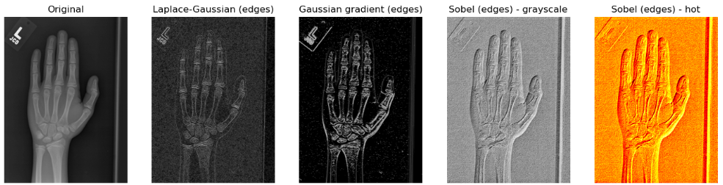
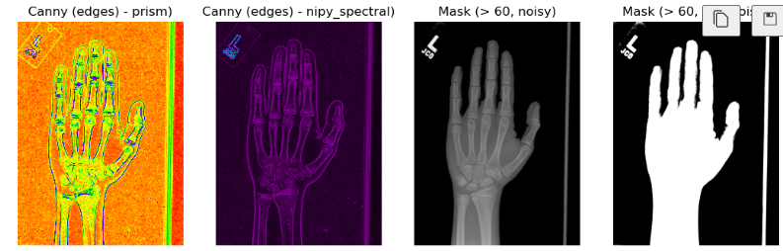

Slide 9
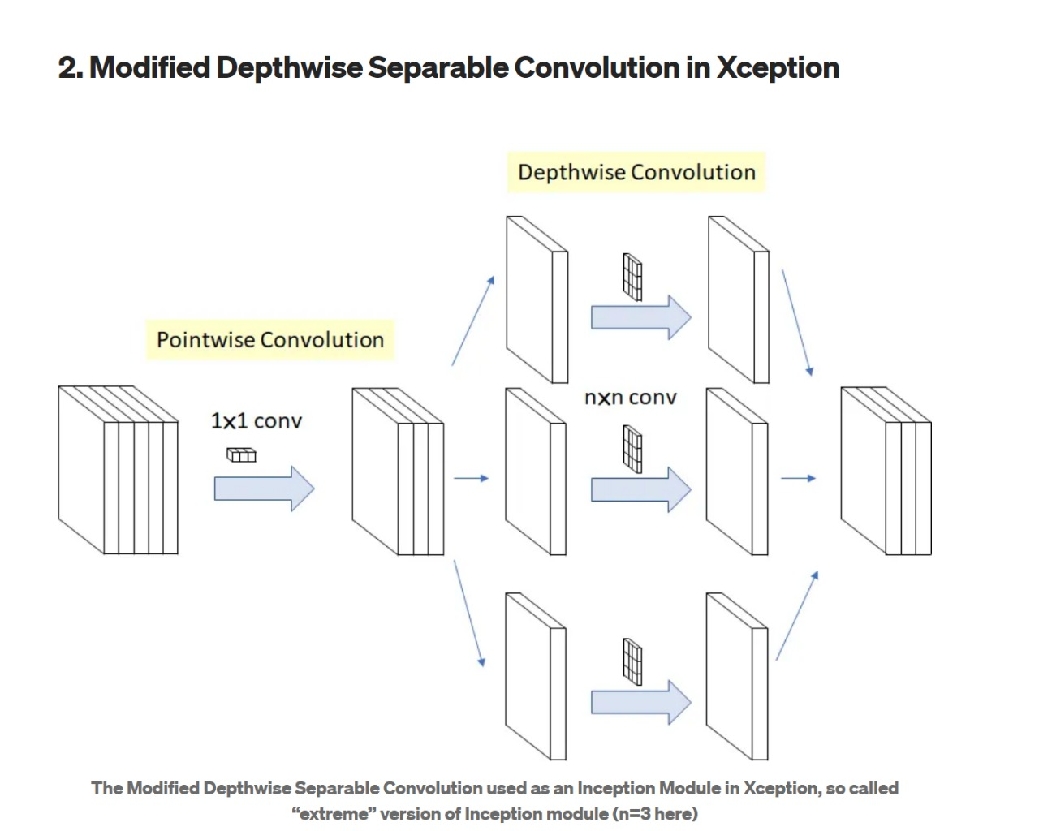
Xception Model
Xception by Google, stands for Extreme version of Inception
With a modified depthwise separable convolution, it is even better than Inception-v3
Xception Vs Inception
Two minor differences:
1.The order of operations
2.The Presence/Absence of
Non-Linearity

Slide 10
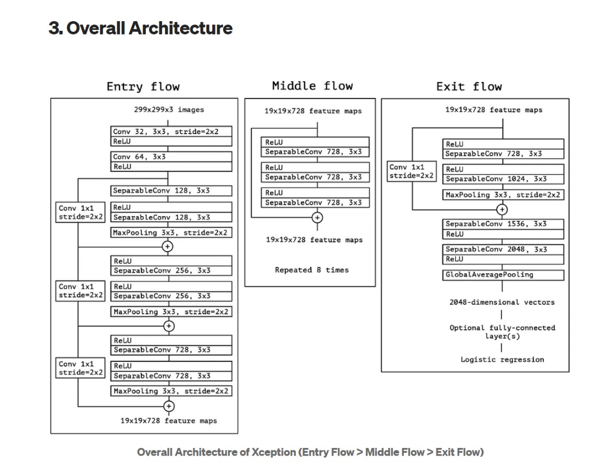

Slide 11
Results & Future Scope
We have tested our model on test data set of 200 x-ray images and the metric used to quantify the accuracy of our model is MSE and the value of error is 4.62(as we are predicting the age we used MSE.)
Recently we got a data set having labels of demography using this as a foundation we can predict
1.Age
2.Ethnicity
3.Sex
4.Demography
5.Height/Weight
6.Medical Conditions

Slide 12
References
Greulich WW, Pyle SI. Radiograph atlas of skeletal development of the hand and wrist. 2nd ed. California: Stanford University Press;1959. [Google Scholar]
Tanner JM, Whitehouse RH, Cameron N, Marshall WA, Healy MJ, Goldstein H. Assessment of skeletal maturity and prediction of adult height (TW2 method). London: Academic Press;1983. [Google Scholar]
Ashizawa K, Asami T, Anzo M, Matsuo N, Matsuoka H, Murata M, et al.. Standard RUS skeletal maturation of Tokyo children. Ann Hum Biol 1996;23: 457–69. doi: 10.1080/03014469600004682 [PubMed] [CrossRef] [Google Scholar]

Slide 13
Thank You Any Questions?

