Slide 1

SMART INDIA HACKATHON 2026
Problem Statement ID – SIH26187
Problem Statement Title- AI-Based Intelligent Video Analytics Platform for Border Surveillance using Existing CCTV Infrastructure
Theme- Blockchain & Cybersecurity
PS Category- Software
Team ID- (as allotted on SIH portal)
Team Name - Paridrishti

Slide 2
IBVAP: Adaptive, Reliability-Aware Video Intelligence for Border CCTV
Paridrishti
Problems Addressed
• Border surveillance requires continuous monitoring of vast and difficult terrains, making manual observation resource-intensive.
• Traditional CCTV monitoring causes delayed threat detection, missed events, and human error.
• Existing systems lack integrated real-time detection, tracking, identity verification, and vehicle recognition.
Proposed Solution
▪ We propose a software-first, real-time AI-powered CCTV analytics platform for intelligent border surveillance.
▪ Uses IP/RTSP CCTV cameras and video feeds, avoiding dedicated smart-camera hardware.
▪ AI modules enable:
1. Human & Vehicle Detection and Tracking
2. Virtual Fence Intrusion Detection, Face Verification & ANPR
▪ A centralized dashboard provides live analytics and real-time alerts for faster operator response, with GPS coordinates assigned to each camera for precise location tracking and incident identification.
Innovation and Uniqueness
• Adaptive Reliability-Aware AI Analytics
• Detects visual degradation including low light, blur, and fog-like conditions
• Generates a condition-based reliability score for surveillance results
• Adapts alert confirmation logic to reduce false and unreliable alerts

Slide 3
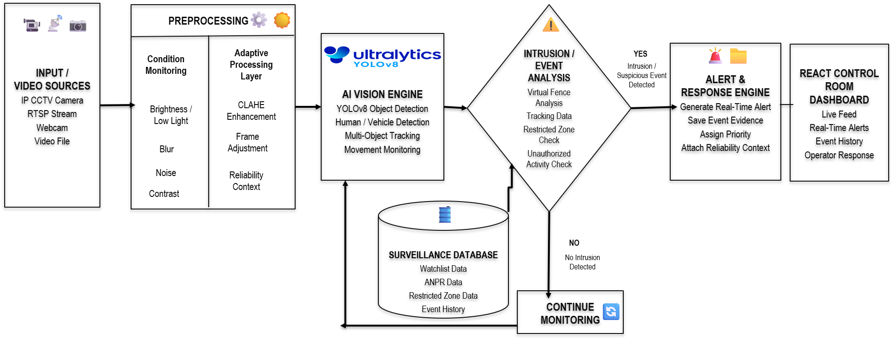
TECHNICAL APPROACH
Paridrishti
Technologies to be Used
AI / Computer Vision
• YOLOv8 – Object Detection
• ByteTrack – Multi-Object Tracking
• DeepFace – Face Verification
• EasyOCR – ANPR
Video Processing
• OpenCV – Frame Processing
• FFmpeg – RTSP / Video Streaming
• CLAHE – Low-Light Enhancement
Software Stack
• Python + FastAPI – Backend & APIs
• React + Vite – Control-Room Dashboard
• WebSocket – Real-Time Updates
Data & Deployment
• SQLite / PostgreSQL – Data Storage
• Docker Compose – Deployment

Slide 4
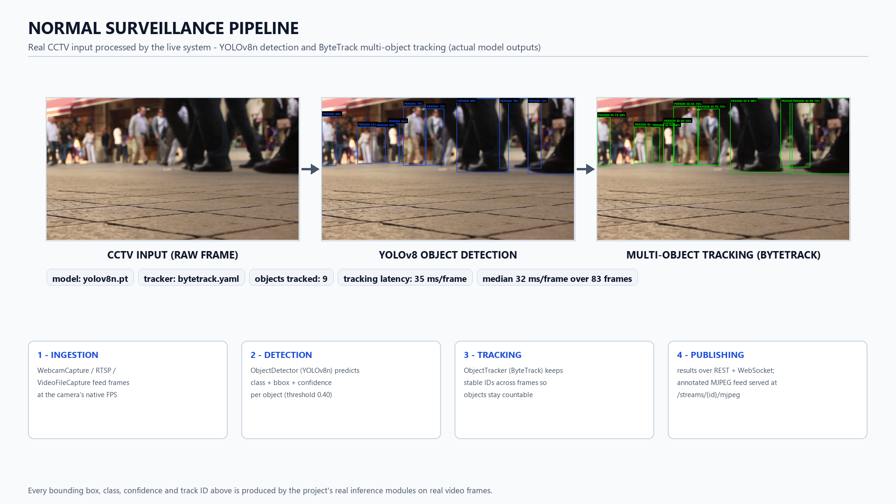
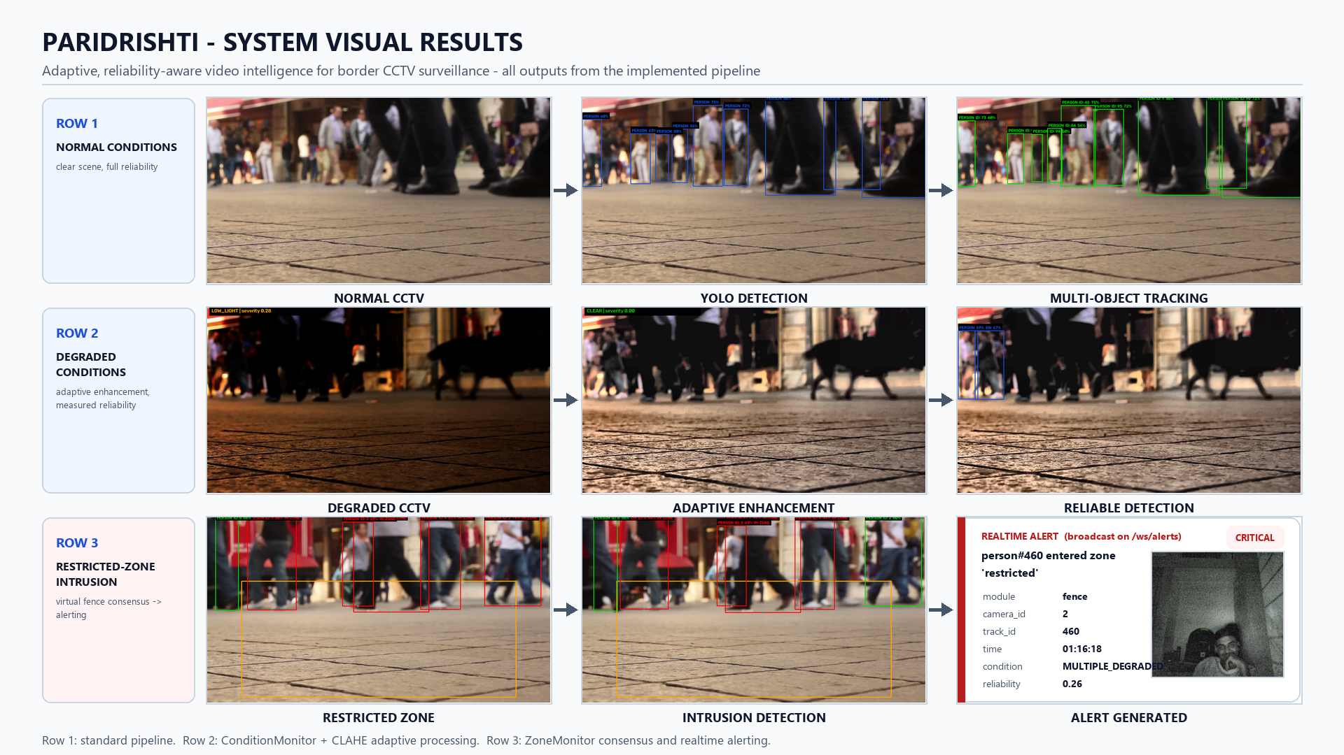
FEASIBILITY AND VIABILITY
Paridrishti
Feasibility of Project
○ Technically feasible – Runs on standard computing hardware using modular AI models for detection, tracking, face verification, and ANPR.
○ Economically viable – Leverages existing IP/RTSP CCTV infrastructure, reducing the need for dedicated smart-camera hardware.
○ Scalable – Multiple camera feeds and analytics modules can be deployed and expanded based on surveillance requirements.
○ Practical – Provides real-time alerts and a centralized dashboard, enabling operators to respond faster to potential threats.
Challenges Faced and Their Solutions
Reliable AI Surveillance Under Degraded Conditions
○ Low-light scenes – CLAHE-based enhancement improves visibility before AI analysis.
○ Blur, noise and low contrast – A condition-monitoring module detects degradation and adjusts the reliability context.
○ False intrusion alerts – Persistent object tracking and configurable multi-frame fence confirmation improve alert reliability and reduce false intrusion alerts.
○ RTSP interruptions / inference delays – Automatic stream reconnection, frame buffering, and configurable frame sampling maintain continuous operation.
○ Privacy and watchlist concerns – Future deployment can incorporate access control, encryption, audit logging, and retention policies.
coordinates
(28.7041° N, 77.1025° E)

Slide 5
IMPACT AND BENEFITS
Paridrishti
Potential Impact & Benefits
• Border Security Forces & Operators – Faster identification of intrusion candidates and suspicious movement through real-time AI-assisted monitoring.
• Security Agencies & Command Centres – Centralized live feeds, alerts, tracking information, and reliability context for faster decision-making.
• Critical Infrastructure & Restricted Facilities – Virtual-fence monitoring helps protect sensitive zones, checkpoints, transport corridors, and perimeter areas.
❖ Operational Impact
• Converts passive CCTV feeds into real-time event-driven surveillance.
• Reduces manual monitoring through prioritized alerts and automated tracking, while enabling coordinate-based identification of intrusion locations.
❖ Economic Impact
• Reuses RTSP/IP CCTV infrastructure, reducing dependency on complete hardware replacement.
• Modular architecture enables gradual and scalable deployment based on operational requirements.
❖ Technical Impact
• Combines detection, tracking, face-watchlist verification, ANPR, and intrusion monitoring in one platform.
• Reliability-aware analytics provide operators with context about degraded visual conditions and alert confidence.

Slide 6
RESEARCH AND REFERENCES
Paridrishti
• Fu, S., Zhao, Q., Liu, H., Tao, Q., & Liu, D. (2025). Low-light object detection via adaptive enhancement and dynamic feature fusion. Alexandria Engineering Journal, 126, 60–69.
https://doi.org/10.1016/j.aej.2025.04.047
• Zhang, Y., Sun, P., Jiang, Y., Yu, D., Weng, F., Yuan, Z., Luo, P., Liu, W., & Wang, X. (2022). ByteTrack: Multi-Object Tracking by Associating Every Detection Box. European Conference on Computer Vision (ECCV).
https://www.ecva.net/papers/eccv_2022/papers_ECCV/html/315_ECCV_2022_paper.php
• Wojke, N., Bewley, A., & Paulus, D. (2017). Simple Online and Realtime Tracking with a Deep Association Metric. IEEE International Conference on Image Processing (ICIP), 3645–3649.
https://doi.org/10.1109/ICIP.2017.8296962
• Zuiderveld, K. (1994). Contrast Limited Adaptive Histogram Equalization. In Graphics Gems IV, pp. 474–485. Academic Press.
https://doi.org/10.1016/B978-0-12-336156-1.50061-6
• Singh, S., Kumari, R., Pallavi, P., et al. (2026). A systematic review of deep learning methods for low-light image enhancement and object detection. Discover Applied Sciences, 8, 241.
https://doi.org/10.1007/s42452-025-08051-5
• Qu, J., Liu, R. W., Gao, Y., Guo, Y., Zhu, F., & Wang, F. (2023). Double Domain Guided Real-Time Low-Light Image Enhancement for Ultra-High-Definition Transportation Surveillance.
https://arxiv.org/abs/2309.08382

