Slide 1

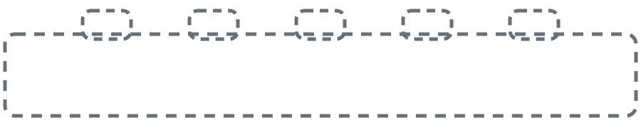
OPENING
BEYOND
Better
Models
Why coding agents advanced first - and what knowledge work is still missing.
THE MISSING FOUNDATION
Notes:
Open with the puzzle: the same class of models can modify large codebases, yet routine business workflows still feel dangerous. Today is about the environment around the model.
TRANSITION: Ask: Why did agents become coders first?FULL SPEAKER NOTES
Let me begin with a strange observation about AI agents. We now have models that can read, reason, write, use tools, and interact with software. In theory, that should make them useful across finance, sales, hiring, support, operations, and almost every other form of knowledge work.
But the clearest success story has been software engineering. Coding agents can inspect repositories, modify multiple files, run commands, test their own changes, and continue iterating. Outside coding, the same models often feel much less dependable.
So the question for today is not simply how intelligent the models are. The more interesting question is why useful agentic autonomy emerged in coding first. The argument I will walk through is that coding had a hidden advantage. The models improved, but they entered an environment that had already been prepared for them over decades.

Slide 2
THE PUZZLE
Where agentic work took off first
SOFTWARE ENGINEERING
49.7%
0
10
20
30
40
50
% OF TOOL CALLS
Notes:
Agentic use is disproportionately concentrated in software engineering. Treat the 49.7% chart as the speaker's framing, not as independently verified market data.
TRANSITION: Reveal that everything else is far behind.

Slide 3
THE PUZZLE
Where agentic work took off first
SOFTWARE ENGINEERING
49.7%
CUSTOMER SUPPORT
2.2%
BACK-OFFICE
9.1%
GAMING
2.1%
OTHER
7.1%
DOCUMENTS
1.9%
MARKETING
4.4%
EDUCATION
1.8%
SALES & CRM
4.3%
E-COMMERCE
1.3%
FINANCE
4.0%
HEALTHCARE
1.1%
DATA & BI
3.5%
LEGAL
0.9%
RESEARCH
2.8%
LOGISTICS
0.8%
CYBERSECURITY
2.4%
Notes:
The interesting question is not whether models improved. It is why useful autonomy concentrated in one domain.
TRANSITION: Move from the adoption pattern to the change in coding itself.

Slide 4
FROM AUTOCOMPLETE TO AUTONOMY
handler.ts - editor
1 import { db } from "./db"
2 import { limit } from "./limit"
3
4 export async function handler(req) {
5 const ip = req.headers.get("x-real-ip")
6 await limit(ip)
7 const user = await db.find(id)
8 return Response.json(user)
9 }
6 await limit(ip)
7 const user = await db.find(id)
8 return Response.json(user)
9 }
TAB
2023
Notes:
A few years ago AI coding mostly meant line-level autocomplete. The dim code is the suggestion. Press once: TAB blinks while the accepted version brightens and fades in a continuous loop.
TRANSITION: Advance once to the 2026 comparison; it loads automatically.FULL SPEAKER NOTES
A few years ago, AI in programming mostly meant autocomplete. The developer remained in control of every step: type a few characters, accept a suggestion, correct it, and continue.
Today the unit of delegation is much larger. We can ask an agent to investigate a bug, implement a feature, refactor a subsystem, write tests, run those tests, and repair the failures. The human has moved upward from typing every line toward defining intent, reviewing decisions, and approving outcomes.
Karpathy described a noticeable inflection around December 2025: generated changes became larger, more coherent, and more likely to work without line-by-line correction. But state this carefully. Coding is not completely autonomous. It has reached useful bounded autonomy in many workflows. Humans still own architecture, security, taste, requirements, and final responsibility. Karpathy calls this an autonomy slider, not a binary switch.

Slide 5
FROM AUTOCOMPLETE TO AUTONOMY
AGENT TASK
handler.ts - editor
Add Redis-backed rate limiting to the public API, with tests.
const user = await db.find(id)
return Response.json(user)
READ src/server/router.ts
PLAN add token-bucket middleware
EDIT src/server/middleware.ts +18 -2
TEST 24 passed
REVIEW no regressions
2023
2026
Notes:
Today we delegate larger tasks: inspect, edit, test, and repair. Karpathy calls this an autonomy slider. Humans still own architecture, judgment, and responsibility.
TRANSITION: Ask what coding had besides better models.

Slide 6
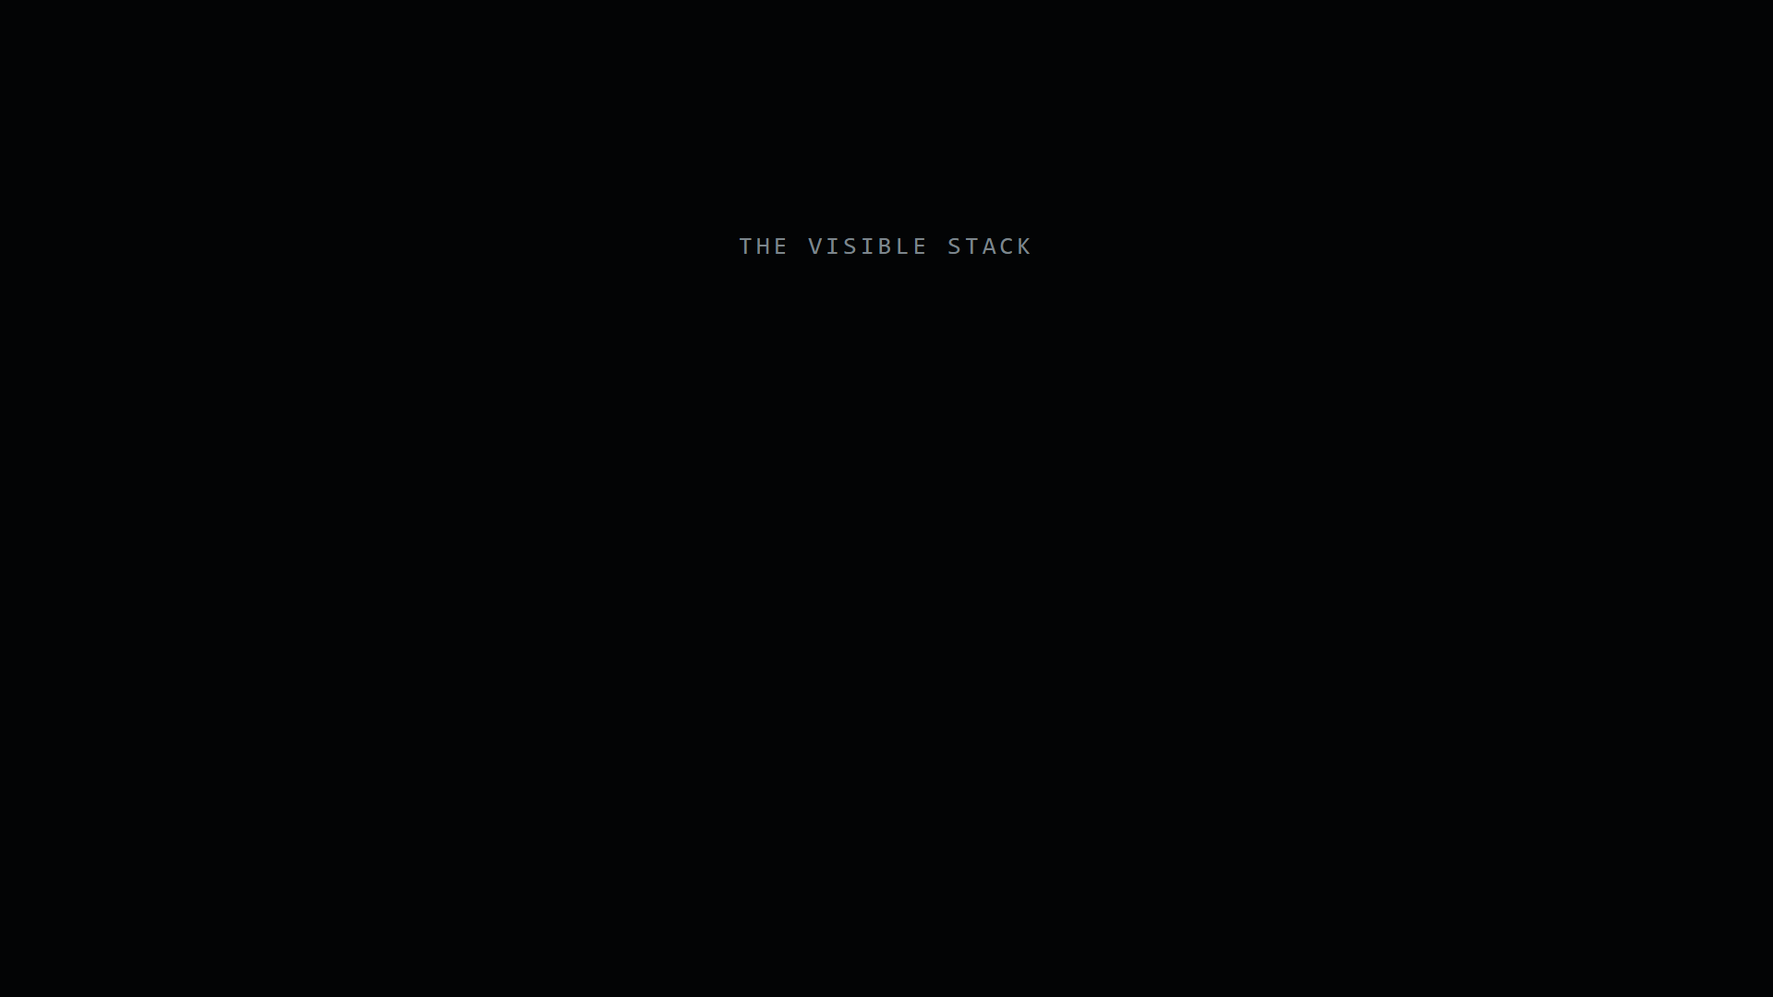
THE SCAFFOLDING CODE ALREADY HAD
Notes:
Explain the visible stack: frontier models, a coding harness, and modern coding agents. The model improvement is real, but it is not the whole system.
PRESENTER ACTION: Click the video once to play the animation. After it completes, continue speaking on the settled frame.

Slide 7
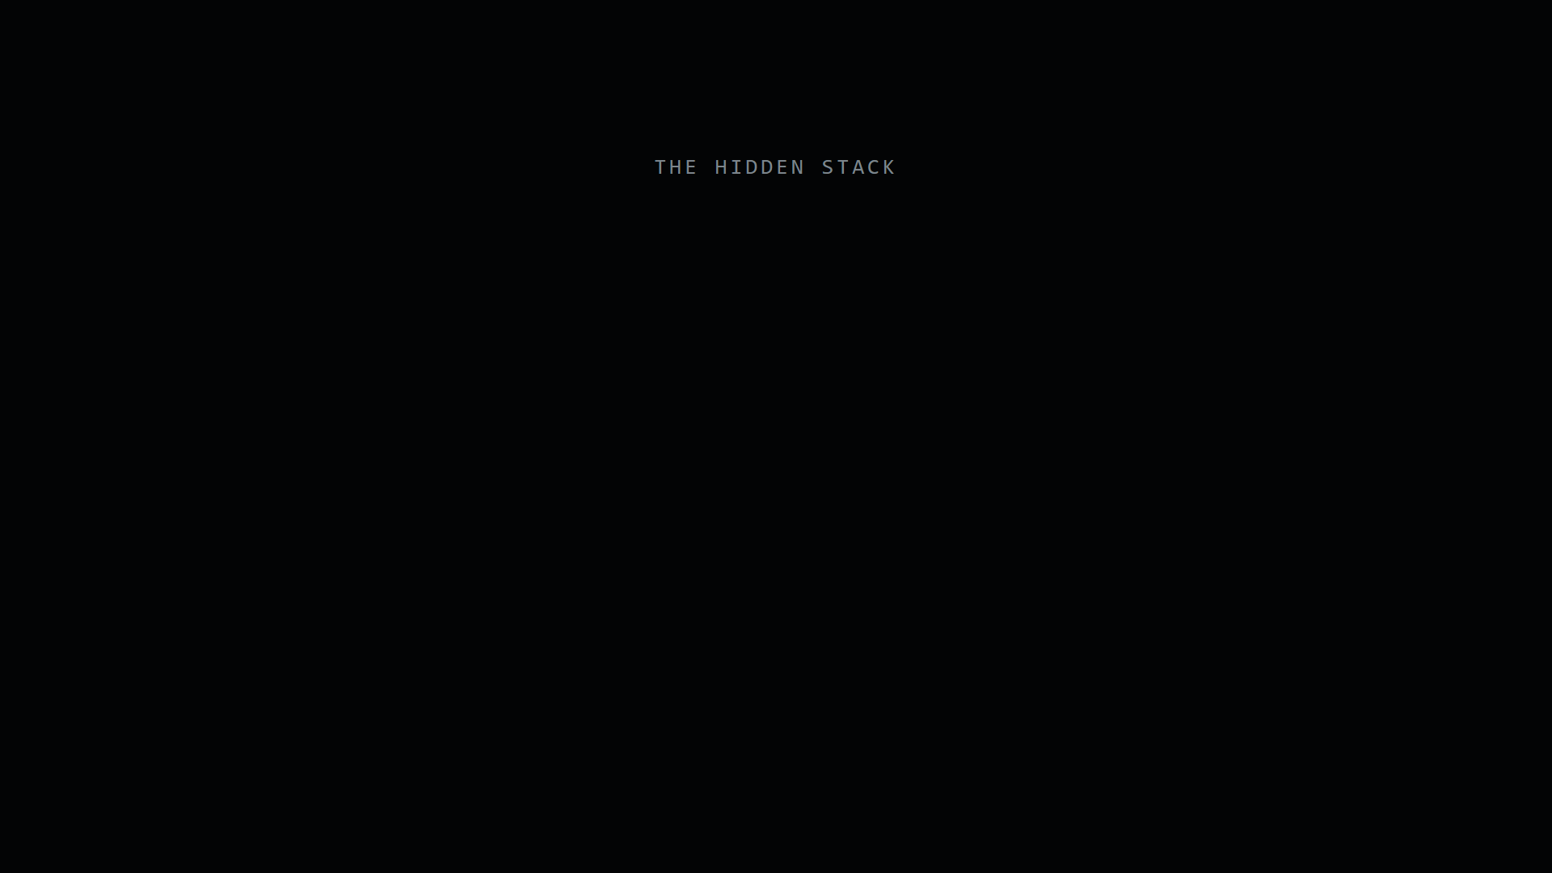
THE SCAFFOLDING CODE ALREADY HAD
Notes:
Reveal the infrastructure beneath coding agents: repository, history, tests, CI, review, linting, permissions, and rollback. These systems were built for human teams but happen to be ideal for autonomous contributors.
PRESENTER ACTION: Click the video once to play the animation. After it completes, continue speaking on the settled frame.FULL SPEAKER NOTES
A coding agent rarely enters an empty environment. We give it a repository containing the current system. It can inspect commit history, make a branch, produce a diff, run tests, invoke a compiler, follow type checks and linters, open a pull request, trigger CI, and revert a change if necessary.
Those systems were created for human software teams, not for AI. But they solve exactly the problems autonomous contributors create: how to share context, observe changes, coordinate work, check quality, restrict access, and recover from mistakes.
Karpathy made this point directly in October 2025: we already have a lot of infrastructure for handling code and text. He used slides as the counterexample. If an agent changes code, we know how to show a diff. If it changes a presentation visually, where is the equivalent diff?
Microsoft Research and GitHub Next later gave the idea a broader formulation. They argue that repositories may become a primary unit of knowledge work: not merely storage, but shared workspace, source of truth, institutional memory, validation environment, and governance system.

Slide 8
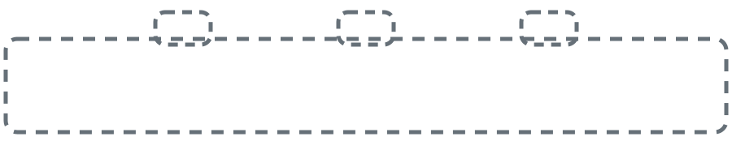
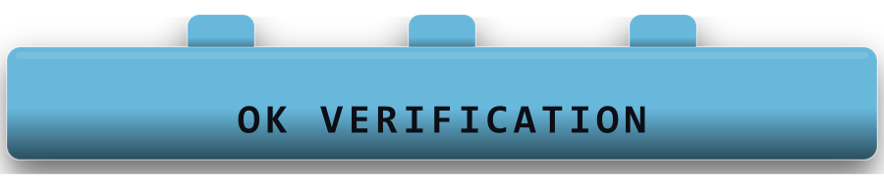
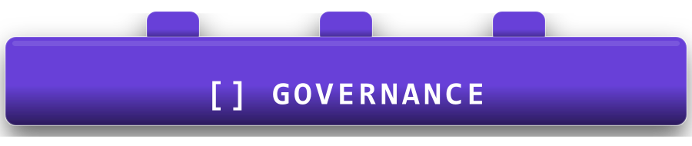



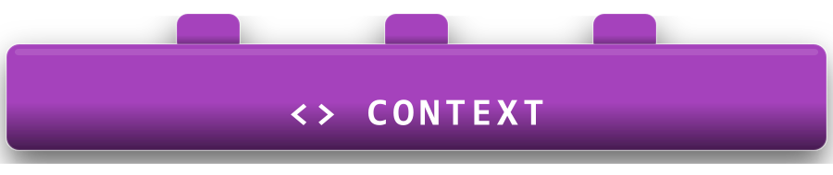
THE MISSING BRIDGE
Knowledge
work
Coding
Six empty sockets
Knowledge work did not inherit the same operating environment.
Notes:
Introduce the six missing primitives in the same order as the video: centralization, history, context, verification, governance, and reversibility.
TRANSITION: Promote Centralization from the bridge.

Slide 9
PRIMITIVE 1
A coding agent starts near the source of truth.
A knowledge-work agent starts by searching for it.
Notes:
Centralization is not necessarily one giant database. It is one governed way for the agent to find, authenticate, retrieve, and relate the truth.
TRANSITION: Show one customer deal fragmented across five tools.FULL SPEAKER NOTES
The first primitive is centralization. A coding agent usually begins close to the source of truth. The repository tells it what the system is. Infrastructure files explain how it runs. Documentation and tests indicate expected behavior. The agent can search one connected workspace before acting.
Compare that with a sales agent trying to understand one customer deal. The customer record may be in Salesforce. The proposal may be in Notion or Drive. Email history is in Gmail. Internal discussion is in Slack. Previous support problems are in Zendesk.
No individual application contains the complete truth. Each has its own data model, identity, permissions, and history. Before the agent performs the task, it must discover where the information lives, authenticate, retrieve it, resolve contradictions, and combine everything into one working context.
A human employee does this almost invisibly because they carry an organizational map in their head. The infrastructure requirement is one governed way for the agent to discover applications, use approved connections, retrieve state, and understand record relationships. This does not require copying every datum into one database. It requires giving the agent a coherent center.

Slide 10
CENTRALIZATION
CRM
NOTES
SUPPORT
Opportunity: $250K
Stage: negotiate
Discovery notes
Owner: Alice
Ticket #1284
SSO failing
ONE
CUSTOMER
EMAIL
CHAT
Next steps after
Tuesday call
#deal-acme
Latest context
Notes:
One deal is scattered across CRM, notes, support, email, and internal chat. Before the real task, the agent must reconstruct the context a human already carries mentally.
TRANSITION: Turn the fragmented cards into a governed center.

Slide 11
CENTRALIZATION
CRM
SUPPORT
deal state
GOVERNED CONTEXT LAYER
open incidents
Identity
Approved connections
Cross-application retrieval
Record relationships
NOTES
EMAIL
discovery notes
customer thread
Notes:
The repository article takes a source-centric approach. Composio proposes an integration and control layer over existing apps. Different architectures, same need: give the agent a coherent center.
TRANSITION: Once work passes through a center, it can create history.

Slide 12
ROADMAP
Knowledge
work
Coding
Find the work
Remember the work
Notes:
Centralization creates the path through which a durable record can be built.
TRANSITION: Move the History block into the chapter-marker position.

Slide 13
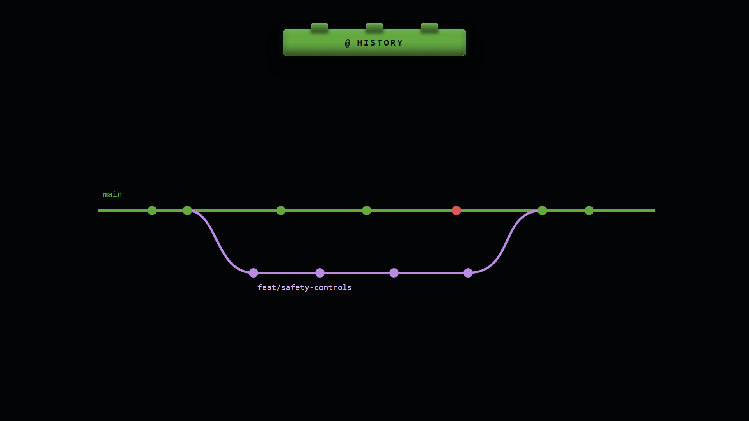
HISTORY
Notes:
Git gives both agent and human a record of what changed, why an approach failed, and where to recover. The highlight visits every commit on main and then every commit on the feature branch before repeating.
PRESENTER ACTION: The animation starts automatically and loops until you leave the slide.FULL SPEAKER NOTES
The second primitive is history. In software, history is not optional. Version control records every change. We can inspect what changed, who changed it, when it changed, and often why it changed.
That history helps the agent find an earlier implementation, understand why a change was reverted, compare successful approaches, and avoid repeating a known failure. It also helps the human. We do not have to trust an agent saying it completed the task. We can inspect the diff, commits, tests, and review discussion.
Knowledge work does have history inside individual tools, but it is fragmented. The CRM may show the current value without explaining the conversation that produced it. A successful email exists in a sent folder, but the reasoning behind it is not captured. A support escalation may cross tickets, chat, calls, and private notes.
A centralized action record changes this. Every tool call can be logged: what the agent read, changed, skipped, failed, and finally completed. The agent gains memory, while the organization gains accountability. Autonomy can then increase based on evidence rather than hope.

Slide 14
HISTORY
CRM
NOTES
CHAT
What led to this deal state?
Where is the escalation playbook?
Who approved the exception?
history in another system
history in another system
history in another system
EMAIL
SUPPORT
ISSUES
Find the winning renewal email
When did ticket #4218 begin?
Why was EU billing delayed?
history in another system
0 exact matches
history in another system
Notes:
Business apps have histories, but not one coherent history of the work. The agent often starts each session without knowing what was tried or why it failed.
TRANSITION: Show the unified record of work.

Slide 15
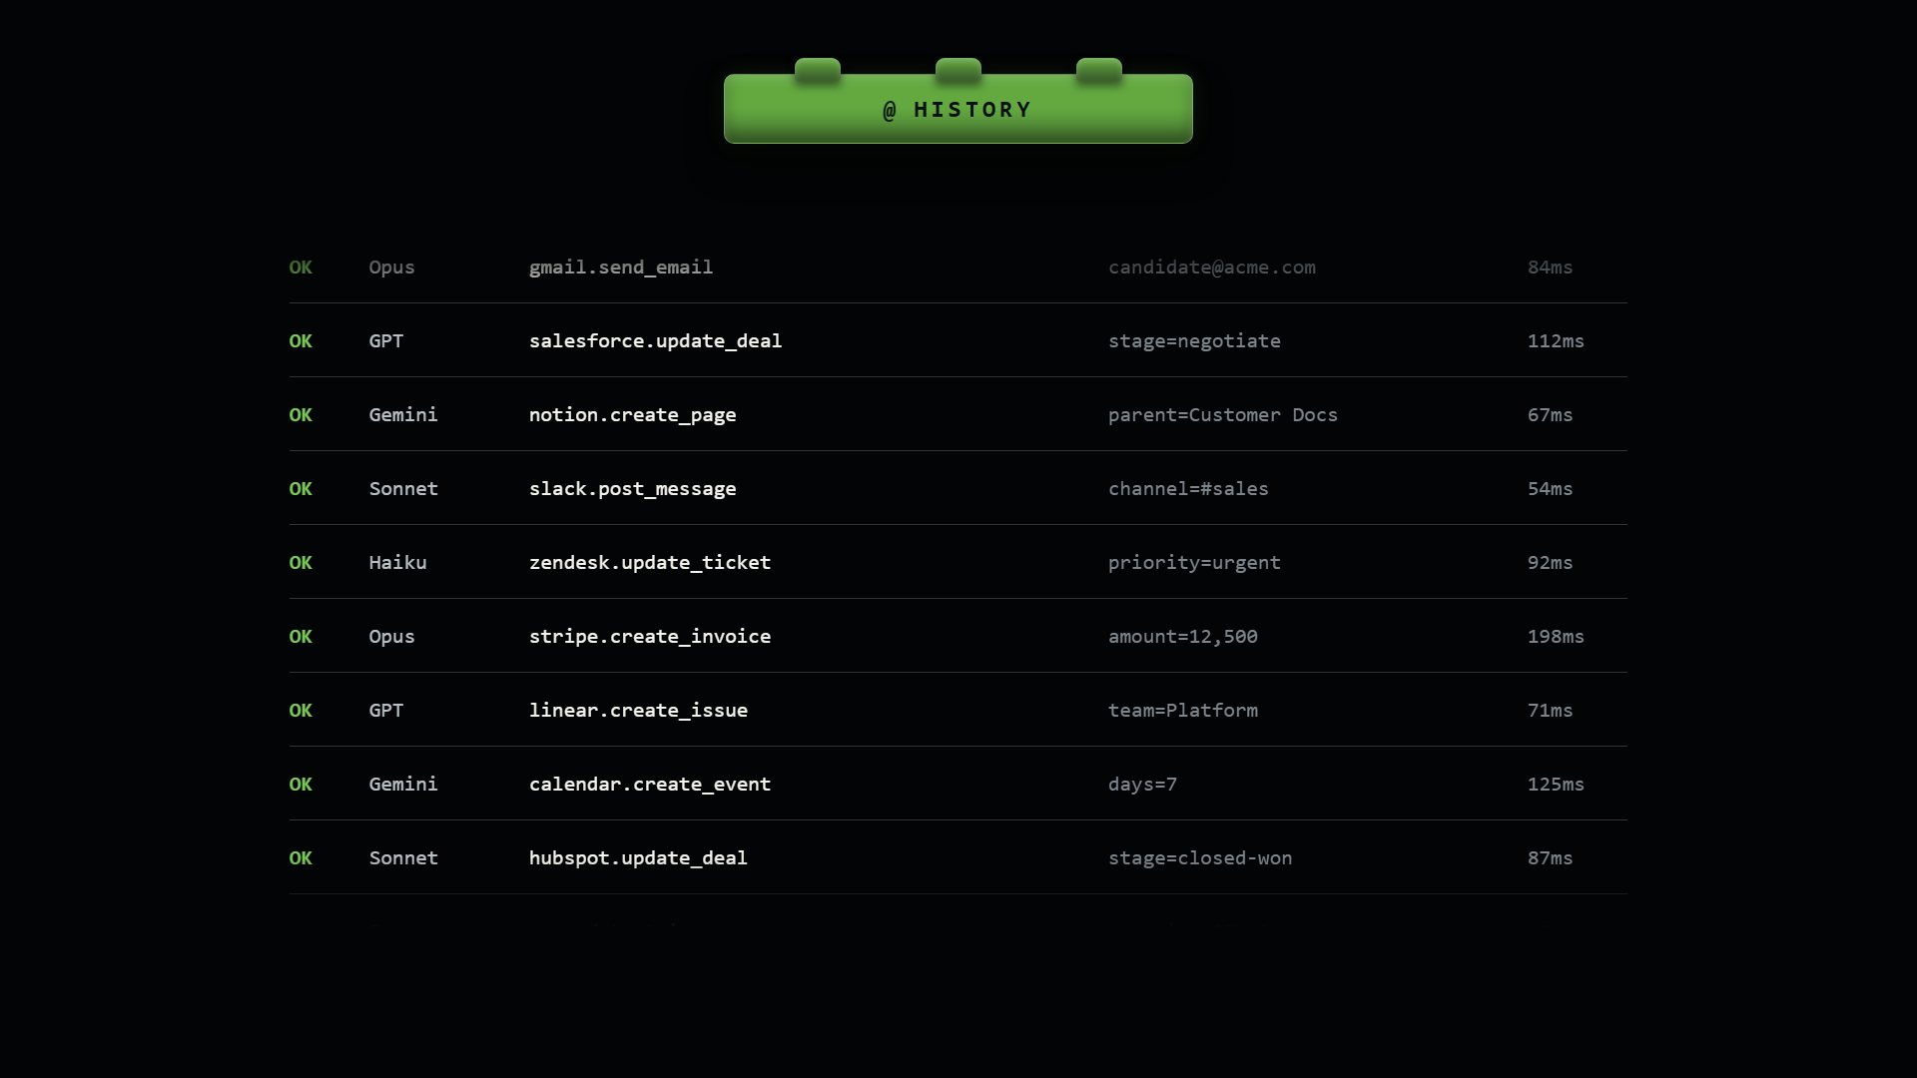
HISTORY
Notes:
A shared action record logs what the agent touched, skipped, changed, and failed. This creates memory for the agent and trust for the human.
PRESENTER ACTION: Click the video once to play the animation. After it completes, continue speaking on the settled frame.

Slide 16
ROADMAP
Knowledge
work
Coding
Notes:
As history accumulates, recurring patterns become organizational context and reusable skills.
TRANSITION: Promote Context.

Slide 17
CONTEXT
THE MAP
THE STYLE
apps/web
apps/admin
@Authorized()
@Audited("customer.read")
@RateLimited("standard")
Tone: direct, warm, concise
Exceptions: escalate above $25K
Preferred format: summary first
api
auth
billing
db
Architecture tells the agent how work flows.
Style tells it what good looks like here.
Notes:
Context has two layers: the organizational map and the local style. A senior employee knows both. An agent needs them made explicit or recoverable.
TRANSITION: Show context being used against real evidence.FULL SPEAKER NOTES
The third primitive is context, and the video separates it into two kinds.
The first is the map: how the organization works. Which systems are authoritative? How does data move? Which team owns the decision? When should an issue be escalated? A senior employee builds this map over months or years.
The second is the style: what good work looks like here. It includes tone, preferred formats, exceptions, risk tolerance, and personal preferences. In code, an agent can infer some of this from files, tests, type rules, naming patterns, and review history.
Consider an agent writing a customer brief. Before the first sentence, it may need product usage, analytics, contract details, previous commitments, support history, and examples of how the company communicates. No single application contains the answer.
When actions and outcomes are recorded over time, an organization can distill reusable playbooks at three levels: how a tool works, how this company performs a process, and how a person prefers the result. This is why a16z says company-specific context and process knowledge are becoming the durable advantage.

Slide 18

CONTEXT
Notes:
A customer brief is only reliable when the agent can connect every claim to product usage, CRM state, provisioning data, and company standards. The evidence can confirm, contradict, or reveal an omission.
PRESENTER ACTION: Click the video once to play the animation. After it completes, continue speaking on the settled frame.

Slide 19
CONTEXT
EVENT LOG / EVERY ACTION
TOOL DEFAULT
TEAM PLAYBOOK
-> mail.send
chat.postMessage
thread_ts: optional
Default: reply at thread root
Renewal email
Reference the account ID.
CC the account executive.
Escalate pricing exceptions.
OK chat.post
OK crm.update
-> support.escalate
OK invoice.create
OK issue.resolve
MY RULES
async first.
Notes -> team chat.
-> calendar.create
Notes:
Recorded behavior can become context at three levels: how the tool works, how the company works, and how this person prefers to work. a16z calls company-specific context the durable moat.
TRANSITION: Context makes output plausible; verification checks whether it is right.

Slide 20
ROADMAP
Knowledge
work
Coding
Notes:
The lower row is now complete. Verification begins the upper row of controls.
TRANSITION: Promote Verification.

Slide 21
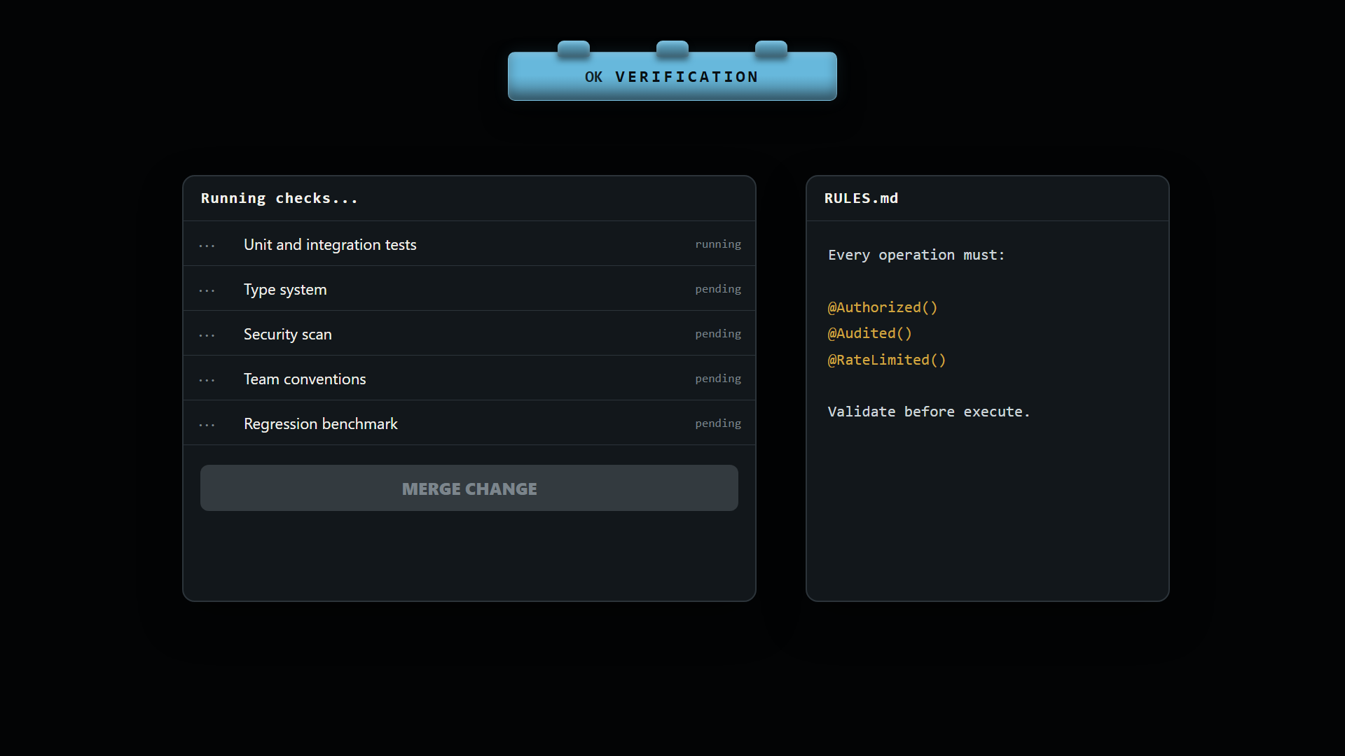
VERIFICATION
Notes:
Unit tests, integration tests, types, compilers, linters, and CI create a feedback loop the agent can run by itself. Karpathy argues that models improve fastest where success can be verified.
PRESENTER ACTION: Click the video once to play the animation. After it completes, continue speaking on the settled frame.FULL SPEAKER NOTES
The fourth primitive is verification. Coding agents have an unusual advantage: much of their work can check itself. Unit tests catch local errors. Integration tests catch interactions. The type system rejects incompatible values. The compiler may refuse to build. Linters check conventions. CI repeats these checks consistently.
This connects with Karpathy's verifiability thesis: traditional software automates what we can specify exactly, while learning systems improve fastest where outcomes can be verified and rewarded. Coding provides dense feedback. Programs run or crash. Tests pass or fail. Diffs can be inspected. Benchmarks can be measured.
But knowledge work exposes a deeper problem. An outreach agent can find valid addresses and successfully send messages while making a professionally wrong decision. Technical checks answer whether the operation executed, but not necessarily whether it should have happened.
There are two levels of verification: execution correctness and business correctness. The response is to compare proposed work against historical examples and policies, cross-check claims against authoritative data, and let the agent act in a sandbox before effects reach the real world. The goal is generate, check, revise, and only then execute.

Slide 22
VERIFICATION
OUTREACH AGENT
Did it work?
Yes.
Should it have happened?
No.
Send a personalized email to every candidate in hiring_list.csv.
247 candidates loaded.
All emails sent.
Notes:
The outreach agent mechanically completed the task. Every address could be valid and every send successful, while the overall decision remained wrong. This separates execution correctness from business correctness.
TRANSITION: Show the blast radius.

Slide 23
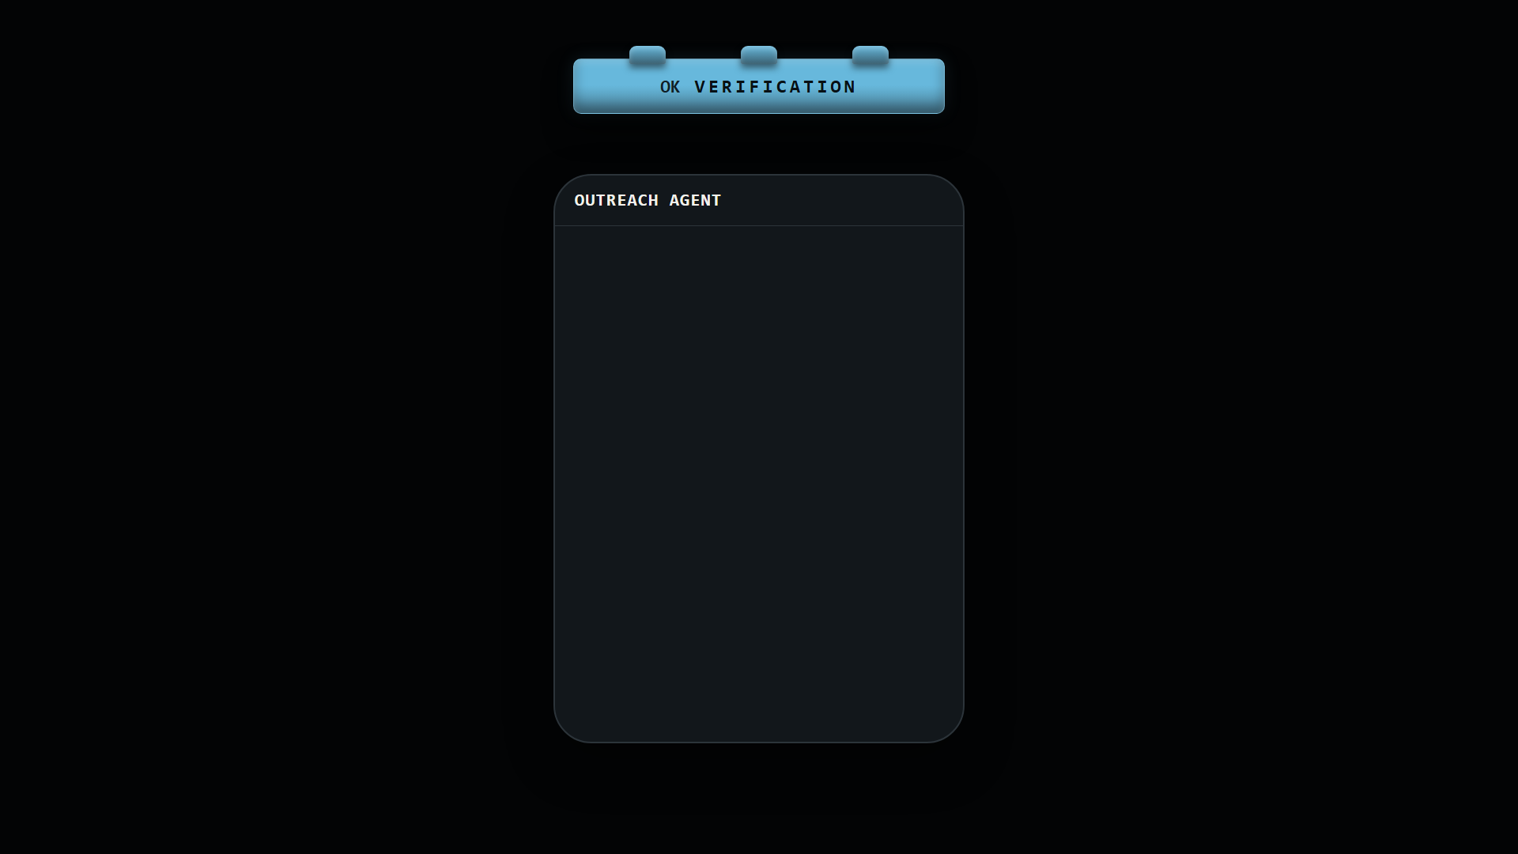
VERIFICATION
Notes:
The notification flood makes the blast radius visible. Emphasize that technical checks answer "did the operation succeed?" but not necessarily "was this appropriate?"
PRESENTER ACTION: Click the video once to play the animation. After it completes, continue speaking on the settled frame.

Slide 24
VERIFICATION
GOODNESS CHECKS
SANDBOX / NO REAL SENDS
Tone match vs. approved emails
FAILED
# working copy
for candidate in hiring:
sandbox.mail.send(
to=candidate.email,
body=draft.render(candidate),
preview=True
)
23 flagged: tone mismatch
Personalization evidence
PASSED
CTA and length
PASSED
Company style guide
PASSED
Spam and formality
PASSED
SEND TO 247 CANDIDATES - BLOCKED
Notes:
The remedy is to test before the action is real: compare against approved examples, run deterministic rules, simulate the tool call, and block production when a meaningful check fails.
TRANSITION: Verification controls quality. Governance controls authority.

Slide 25
ROADMAP
Knowledge
work
Coding
Notes:
Verification is installed. Governance is the next wall.
TRANSITION: Promote Governance.

Slide 26
GOVERNANCE
MERGING IS BLOCKED
CODEOWNERS
PRODUCTION / PROTECTED
All checks passed
6 success
/billing @finance
/auth @security
/infra @sre
/workflows @security
Required reviewer
@sre
Deployment branch
main only
Secrets
after approval
Allowed actors
humans only
Code-owner review
0 of 1
Branch protection
main
MERGE PULL REQUEST
Notes:
In code, governance is layered: branches isolate, PRs review, code owners route sensitive changes, and production environments require stronger permission. Quote: "The problems that version control and code review were designed to solve - untrusted contributors, destructive changes, coordination failures - are precisely the problems that arise when AI agents become contributors."
TRANSITION: Contrast an enforceable wall with a prompt instruction.FULL SPEAKER NOTES
The fifth primitive is governance. Software engineering does not rely on every contributor remembering every rule. It enforces boundaries through the environment.
An agent may make changes on its own branch but remain unable to merge into main. A pull request can require human approval. Code owners can be required for sensitive files. An agent may deploy to preview but not production. Stronger controls appear where the blast radius is larger.
This is good governance because it does not stop all automation. It gives freedom inside a safe area and creates stronger gates as consequences become more serious.
The key distinction is between an instruction and a wall. Ask-before-deleting inside a prompt is still probabilistic guidance. It can be misunderstood, displaced, compacted, or forgotten. A permission boundary exists outside the model and cannot be argued with.
Use two layers. Deterministic access controls which systems and operations the agent can reach. Externally enforced policy controls behavior within that access, such as deletion limits, allowed email domains, and approval thresholds. Together they turn please behave into this is what the system permits.

Slide 27
GOVERNANCE
200 conversations moved to Trash
EMAIL AGENT
INBOX
PINNED RULE
confirm before any destructive action
Inbox 2,231
Starred
Drafts
Sent
Trash 200
Agent: clear everything old
A prompt can be forgotten.
A permission boundary cannot.
STOP THE AGENT
Agent: keep looping until the inbox is clear
Notes:
The talk recounts a reported incident where an email agent continued deleting after a stop instruction. The lesson is structural: a prompt lives inside model context. A wall lives outside it.
TRANSITION: Show the two layers of enforceable governance.

Slide 28
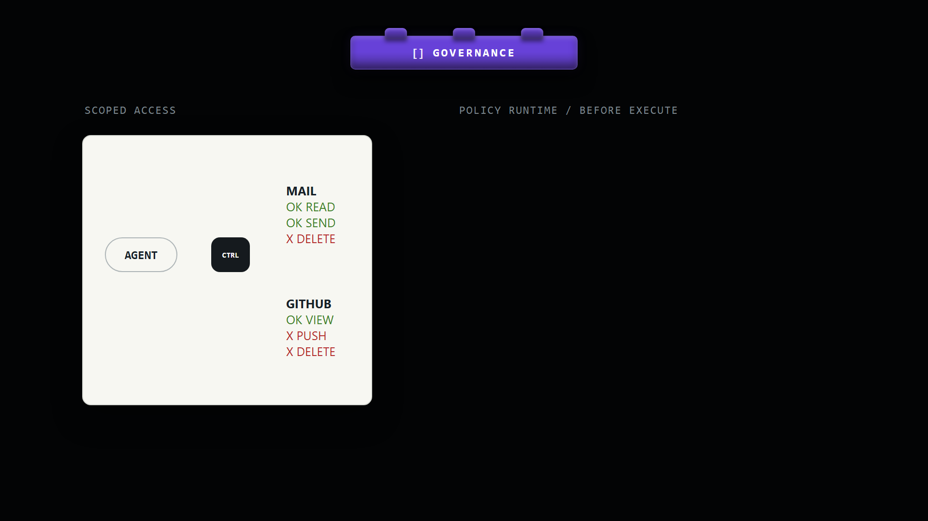
GOVERNANCE
Notes:
Explain two layers. Scoped access defines what the agent can reach. The external policy runtime defines what it can do with that access. Natural-language policy should compile to or be backed by deterministic enforcement for high-risk actions.
PRESENTER ACTION: Click the video once to play the animation. After it completes, continue speaking on the settled frame.

Slide 29
ROADMAP
Knowledge
work
Coding
Notes:
Five primitives are installed. Reversibility completes the bridge.
TRANSITION: Promote Reversibility.

Slide 30
REVERSIBILITY
BAD CHANGE
prod errors: 12%
revert commit a31bc62
main
feat/safety-controls
RESTORED / ERRORS 0.1%
Notes:
Code is forgiving because history and revert provide a pathway back. A production incident is serious, but it is not necessarily permanent.
TRANSITION: Contrast code with irreversible real-world actions.FULL SPEAKER NOTES
The sixth primitive is reversibility. Software teams tolerate experimentation partly because most versioned changes can be undone. If a commit causes a problem, we can revert it. If we do not know which change introduced the problem, we can inspect or bisect history. Production failure is still serious, but there is normally a pathway back.
Knowledge work is different because many actions cross into the real world. We cannot truly unsend an email after someone reads it. We cannot always reverse a wire. A hard-deleted record may be unrecoverable. Even if data is restored technically, reputational or legal consequences may remain.
This changes when trust must be established. In code, we can sometimes act, inspect, and revert afterward. For an irreversible action, verification and approval must move before execution.
There are three useful categories. Naturally reversible actions should expose undo. Actions with compensating operations should record enough state to compensate safely. Truly irreversible actions require preview, simulation, limits, or explicit approval before production execution. Different timing, same goal: a mistake should not be allowed to stick.

Slide 31
REVERSIBILITY
PAYMENT AGENT
Pinned rule:
confirm before any external action
PAYMENT NETWORK
Agent: preparing $50,000 vendor wire
You: hold on - wrong recipient
Agent: wire authorized
You: STOP STOP STOP
WIRE AUTHORIZED
$50,000.00
EXTERNAL LLC
After execution, "stop" is not undo.
Notes:
Many business actions cross into the real world: sent email, money movement, hard deletes, legal or reputational consequences. Failure can be permanent.
TRANSITION: Move verification before execution.

Slide 32
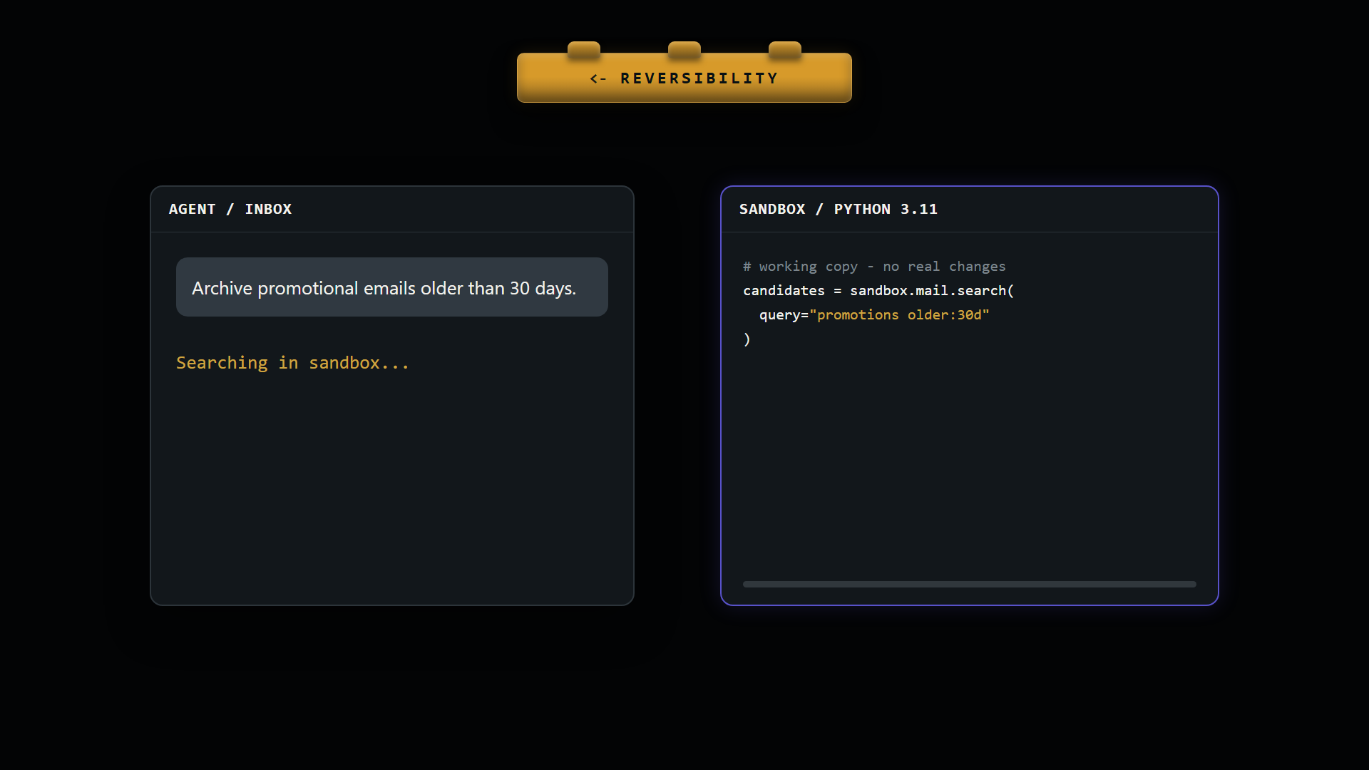
REVERSIBILITY
Notes:
Use three categories: truly reversible actions get undo; partially reversible actions get compensating operations; irreversible actions require preview, simulation, limits, and approval before execution.
PRESENTER ACTION: Click the video once to play the animation. After it completes, continue speaking on the settled frame.

Slide 33
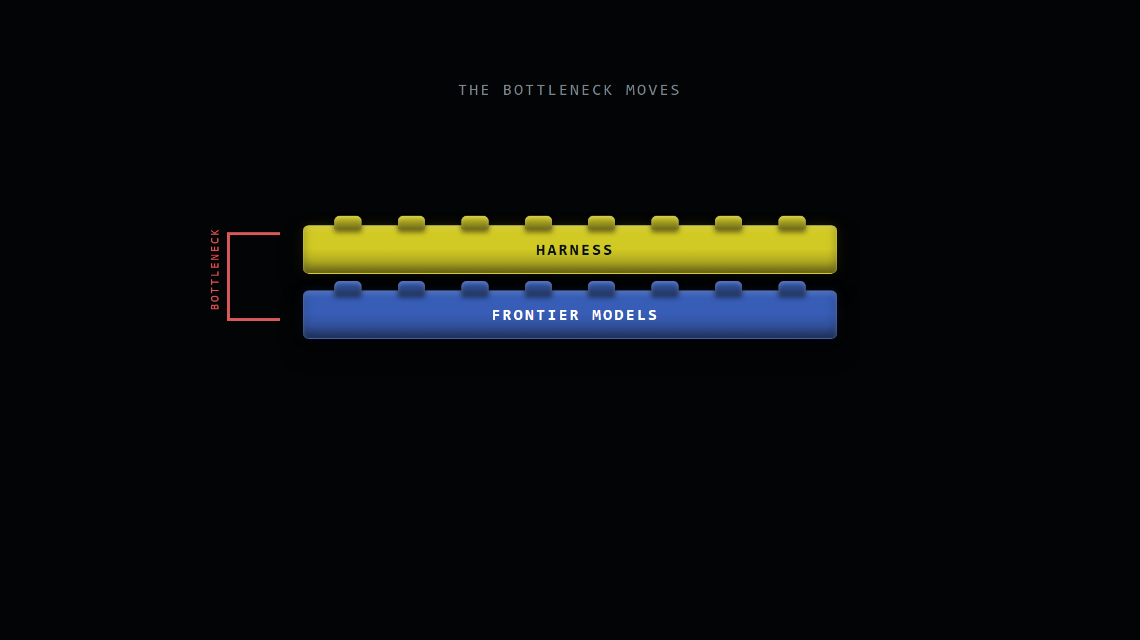
THE BOTTLENECK MOVES
Notes:
Models had to cross a capability threshold. Now the production bottleneck increasingly sits in context, permissions, verification, escalation, error handling, and recovery.
PRESENTER ACTION: Click the video once to play the animation. After it completes, continue speaking on the settled frame.FULL SPEAKER NOTES
For several years, model capability was the obvious bottleneck. Models struggled to plan, use tools, understand screens, or sustain longer tasks. Model improvements still matter, but a16z's August 2026 research suggests that computer use crossed a practical threshold for narrow production workflows.
Their cited OSWorld-Verified frontier score rose from about 42 percent in early 2025 to 85 percent by June 2026. But this statistic also reveals the problem. An 85 percent success rate means 15 failures in every 100 tasks. Business processes do not grade on a curve. If a workflow contains many dependent steps, one failed step can invalidate the outcome.
a16z found production agents work best on standardized repeatable processes with clear rules and observable evidence of success. Enterprise buyers increasingly evaluate everything around the model: context, permissions, validation, escalation, error handling, security, auditability, and return on investment.
The defensible conclusion is not that models are solved. It is that once the model crosses a minimum capability threshold, the deciding bottleneck shifts upward into system design.

Slide 34
THE BOTTLENECK MOVES
85%
best reported OSWorld-Verified score
15
failures in every 100 tasks
Reliability is not one model score.
It is the complete operating environment.
Notes:
a16z reports frontier computer-use performance rising from about 42% to 85%, above its cited human score. But 85% still means 15 failures per 100 tasks. A multi-step business process may fail if any step fails.
TRANSITION: Show independent convergence across research, practice, and production.

Slide 35
INDEPENDENT SUPPORT
Three independent signals
EXPERT PERSPECTIVE
Repositories become a governance substrate
Researchers from Microsoft Research and GitHub Next argue that history, review, permissions, and revert map directly to agent governance.
PRACTITIONER
Coding had pre-built infrastructure and feedback
Karpathy points to text, IDEs, diffs, tests, and agent-native interfaces as structural advantages.
PRODUCTION
The differentiator moves above the model
a16z buyers increasingly evaluate context, validation, escalation, security, error handling, and ROI.
Notes:
This is not only a founder's product narrative. Researchers provide an expert governance model, Karpathy explains the capability mechanics, and a16z provides directional production evidence. The SIGPLAN source is a perspective article, not a peer-reviewed paper or an official Microsoft/GitHub institutional statement.
TRANSITION: Return to the completed bridge and close.

Slide 36
CLOSE
Models made agents capable.
Knowledge
work
Coding
Infrastructure makes them governable.
The next opportunity is to bring that environment to every form of knowledge work.
Notes:
Close slowly. Coding agents inherited an environment designed for observable, reviewable, reversible contribution. Knowledge-work autonomy depends on deliberately rebuilding those conditions.
TRANSITION: End. Do not add another idea after the final sentence.FULL SPEAKER NOTES
Let me close with one thought. Coding agents did not succeed in isolation. They inherited decades of engineering around repositories, diffs, tests, review, permissions, and rollback.
As agents move into sales, support, finance, hiring, and operations, the challenge is not merely connecting them to more tools. It is recreating the conditions that make autonomous contribution observable, verifiable, governable, and recoverable.
Microsoft and GitHub researchers describe the repository as a governance substrate. Karpathy describes verifiable loops and agent-native interfaces. a16z observes production value moving toward context and orchestration. The Composio talk brings these ideas together as six missing primitives.
Models made agents capable. Software-engineering infrastructure made them governable. The next opportunity is to bring that environment to every form of knowledge work.

Slide 37
REFERENCES
Sources & citations
All supporting links previously shown in slide footers are collected here.
PRIMARY TALK
Karan Vaidya, "From Coding to Knowledge Work Agents," Composio / Frontier Models, 2026.
https://frontiermodels.cc/video/from-coding-to-knowledge-work-agents-karan-vaidya-composio/
REPOSITORIES & GOVERNANCE
Peli de Halleux, Don Syme, and Ben Zorn, ACM SIGPLAN Blog, May 15, 2026.
https://blog.sigplan.org/2026/05/15/the-transformation-of-documents-repositories-are-the-new-unit-of-knowledge-work/
WHY CODING WENT FIRST
Andrej Karpathy, Dwarkesh interview, October 17, 2025.
https://www.dwarkesh.com/p/andrej-karpathy
VERIFIABILITY
Andrej Karpathy, "Sequoia Ascent 2026 Summary," April 30, 2026.
https://karpathy.bearblog.dev/sequoia-ascent-2026/
PRODUCTION EVIDENCE
Fabrizio Serafini, Seema Amble, and Eric Zhou, a16z, August 10, 2026.
https://a16z.com/can-agents-use-a-computer-yet-weve-got-the-data/
BENCHMARK
OSWorld and OSWorld-Verified project and leaderboard.
https://os-world.github.io/
Notes:
Reference appendix. All URLs are clickable and consolidate the citations removed from the presentation footers.
TRANSITION: End.

