Slide 1


Python Project
Fitness Calculator

Slide 2
Team Members:
N Sai Sharan(TL) - 11703746
V Karthik - 11703739

Slide 3
INTRODUCTION:
The Project which is allocated to us is
“Design a GUI for Fitness Calculator using python.“
Comprises of different GUI interfaces
Database(SQLite)

Slide 4
Roles
and
Responsibilities

Slide 5
N Sai Sharan
Made Major part of backend coding.
Database
Technical Work.
Team Leader
Interface Designing

Slide 6
V Karthik
Front end.
Synopsis
PPT
Report

Slide 7
Screenshots of
Output

Slide 8
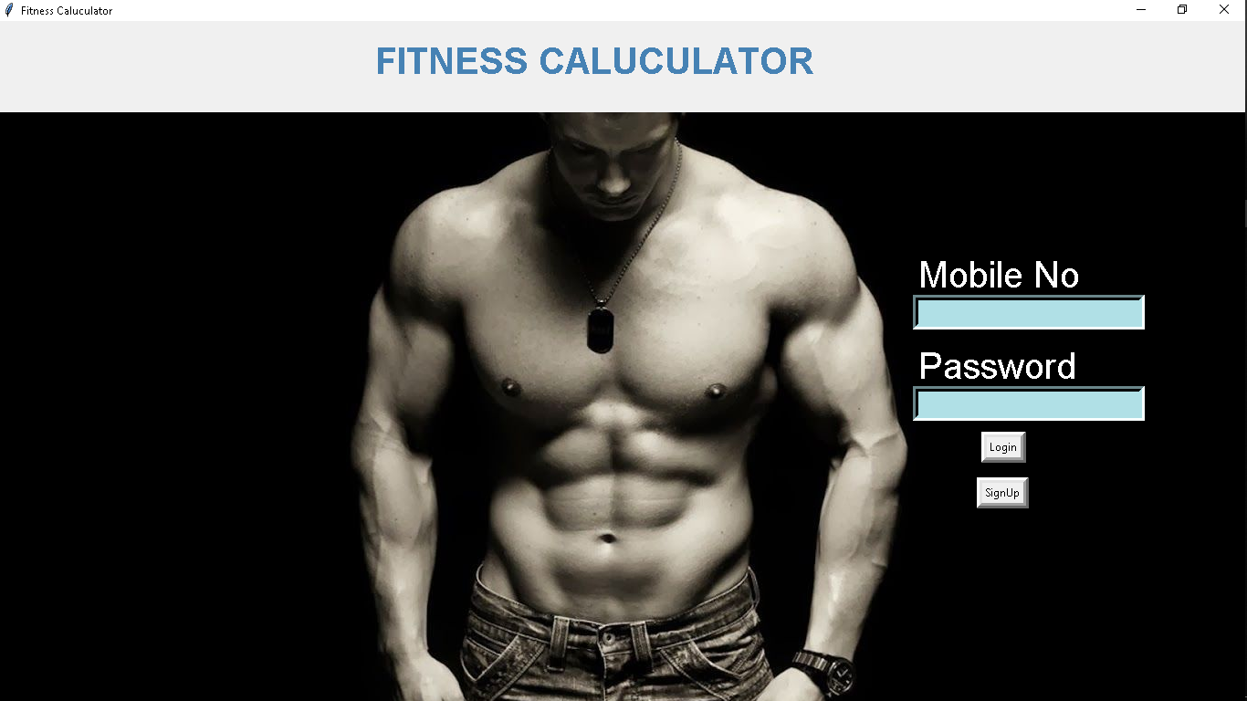
Login Page

Slide 9
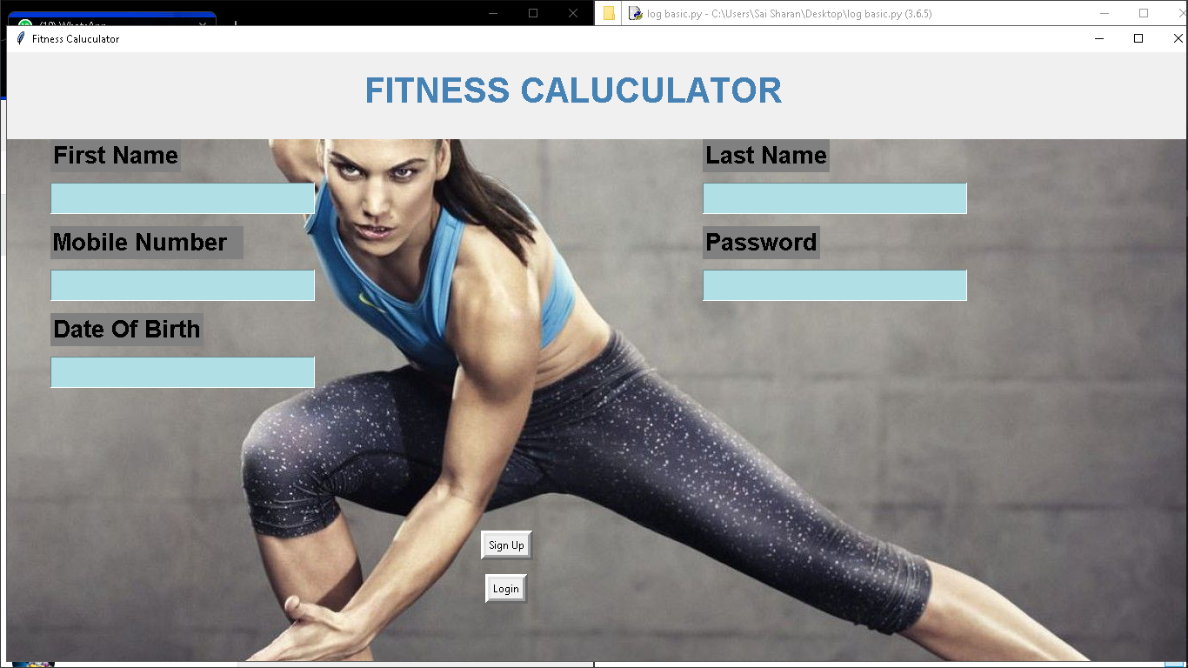
Sign In:

Slide 10
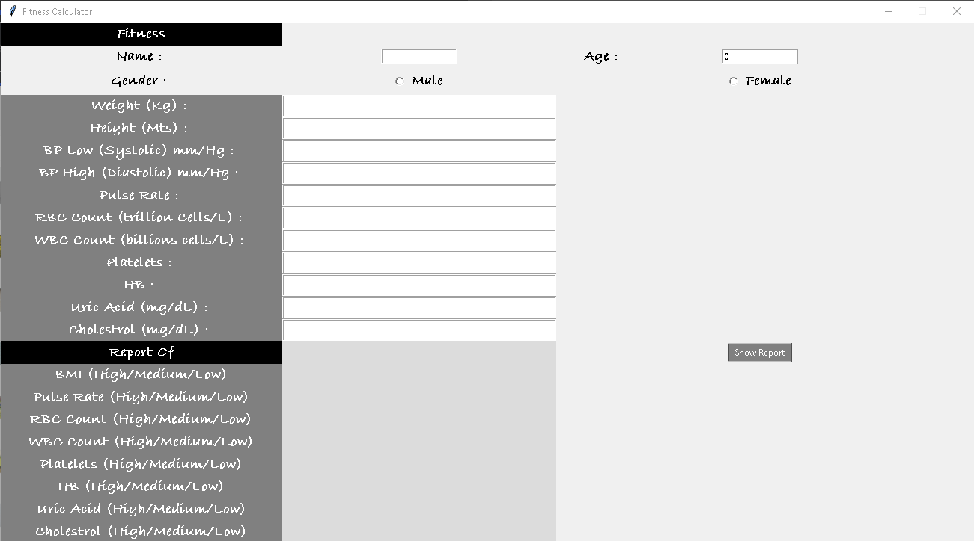
Filling Details and Displaying Report

Slide 11
Advantages
For checking Our Health Status
Easy to use
User comfortable
Free of cost
One user can save many people information

Slide 12
Disadvantages
No Forget password
Cant see the past info of user

Slide 13
Future SCOPES
Forget password
Can see the past info of user.
Showing the info of doctor for respective disease or problem of patient.

Slide 14
conclusion
For checking Our Health Status we can use this .Easy to use user comfortable. Free of cost because every person cant affordable to pay money. One user can save many people information

Slide 15
REFERENCES
WWW.PYTHON.ORG
WWW.W3SCHOOLS.COM
WWW.TUTORIALPOINT.COM
WWW.GEEKSFORGEEKS.COM

Slide 16
Thank You

