Slide 1
PROJECT TITLE: Kronos – Interactive voice assistant for desktop
PIP104 University Project-II
Final Review
Batch Number: 26
Under the Supervision of,
Ms. B.Parkavi
Assistant Professor
School of Computer Science & Engineering
Presidency University
Roll Number | Student Name
1.20201CDV0025 2.20201CDV0013 3.20201CDV0010 4.20201CDV0018 5.20201CDV0019 | Rohit Jayaraj D.Sai Shashank Mohammed Rinshad Arun Philip Sigeon Chaithra N

Slide 2
Introduction
Kronos is a python based personal assistant that can be used to do daily tasks on the system using voice commands. It simplifies the interface between the user and the system.
PROBLEM:
Currently, there are existing voice assistants for MacOS (Siri) and Android. The voice assistant for Windows called Cortana failed to achieve success. There are many manual tasks that are recurrent and tedious that can easily be automated.
SOLUTION:
We aim to develop a voice assistant that can run on multiple operating systems and make everyday tasks simple.

Slide 3
Literature Review
Natural Language Processing (NLP): The literature emphasizes the pivotal role of Natural Language Processing (NLP) in enhancing voice assistants' accuracy and comprehension. Python’s several NLP libraries have been used significantly.
Python Libraries for Voice Recognition: Python libraries like SpeechRecognition and PyAudio play a crucial role in efficient audio input capture and processing, contributing to the development of robust voice recognition systems (Clark, 2016).

Slide 4
Literature Review
Integration with Text-to-Speech (TTS) Engines: The literature highlights the significance of Text-to-Speech (TTS) engines, such as pyttsx3 and gTTS in Python, for enhancing user experience by converting text into natural-sounding speech (Johnson, 2020).
Cloud-Based Services and Multimodal Interaction: Recent developments explore the integration of Python-based voice assistants with cloud platforms (AWS, Google Cloud), offloading computational demands and enhancing scalability (Gupta et al., 2021). Additionally, Python's adaptability supports multimodal interaction, combining voice commands with gestures and traditional inputs for improved accessibility (Chen et al., 2022).

Slide 5
Research Gaps Identified
NLP Advancements: Despite progress in voice recognition, there's a research gap in NLP for voice assistants. Improvements are needed for better understanding of diverse linguistic patterns, especially for complex queries and idiomatic expressions.
Privacy and Security Concerns: A critical gap exists in voice assistant research regarding privacy and security. Focus must be given on developing robust solutions, including secure communication protocols and privacy-preserving mechanisms, to address data privacy and security vulnerabilities.
Interoperability Challenges: Interoperability and cross-platform compatibility are significant gaps in voice assistant research. Solutions are often platform-specific, causing fragmentation in user experience.

Slide 6
Proposed Methodology
Requirements Analysis: Define Kronos's functionalities, features, and target platforms based on user expectations.
Data Collection and Preparation: Gather diverse datasets for training machine learning models, annotating and preprocessing data to align with Kronos's use cases.
Speech Recognition Implementation: Integrate state-of-the-art algorithms for accurate conversion of spoken language to text, exploring noise reduction techniques for adaptability in different environments.
Adaptability to Platforms: Develop Kronos to seamlessly integrate with various platforms, including smart speakers, TVs, desktops, and smartphones, providing a consistent user experience across different devices.

Slide 7
Objectives
Improved Interaction with the System: Develop an advanced voice assistant that allows users to perform various tasks with ease.
Language Understanding: Implement sophisticated natural language processing (NLP) algorithms to enhance the system's comprehension of user commands.
Accessing the Internet for Information: Enable Kronos to retrieve and provide information from the internet, expanding its capabilities beyond local system tasks.
User Interface Enhancement with Flutter : Integrate Flutter to enhance the user interface, ensuring an intuitive and visually appealing design.

Slide 8
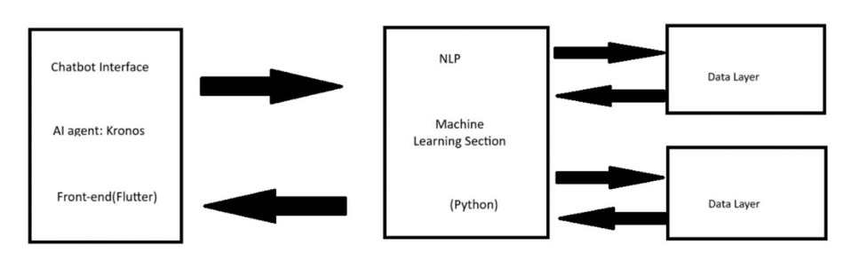
System Design and Implementation

Slide 9
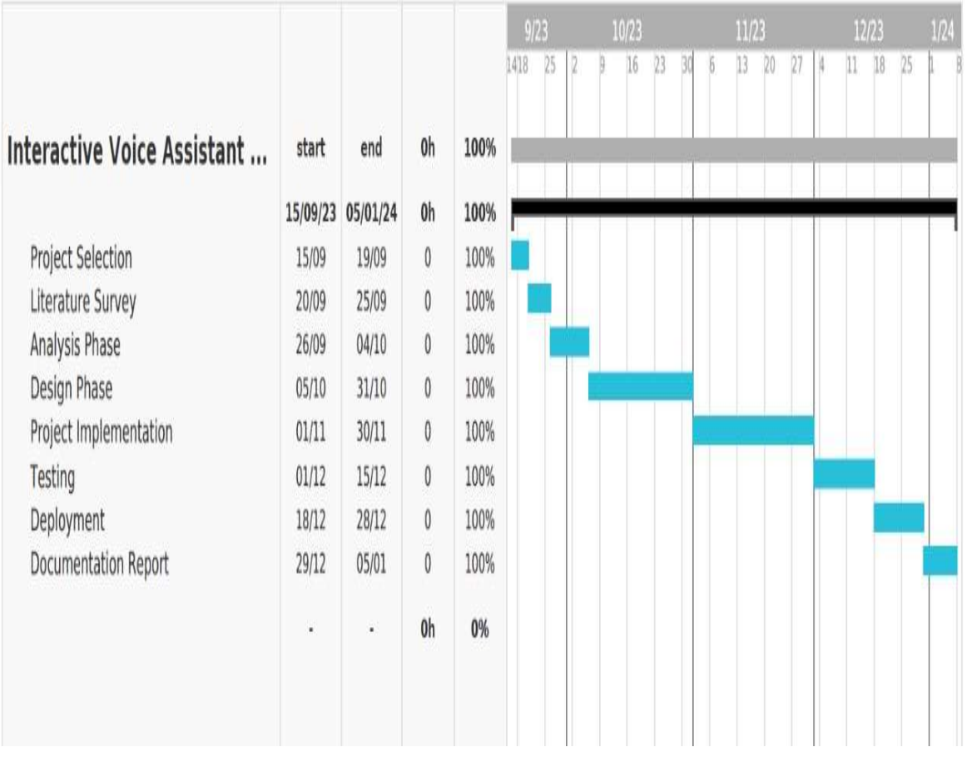
Timeline of the Project

Slide 10
Outcomes / Results Obtained
Voice Recognition and Interaction: Utilizes the `speech_recognition` library for voice recognition, allowing users to interact with the assistant through spoken commands.
Text-to-Speech (TTS) Engine: Implements the `pyttsx3` library for text-to-speech conversion, providing audible responses to user queries.
Functionality: Performs various tasks such as summarizing information from Wikipedia, opening web browsers, searching Google, playing music, sending emails, providing the current time, telling jokes, accessing news headlines, and more.
Task Automation: Automates tasks like opening PowerPoint, emptying the recycle bin, taking photos with the camera, writing and displaying notes, and managing system operations (shutdown, restart, hibernate, log off)

Slide 11
Conclusion
Python and Flutter Significance: The project showcases the importance of Python and Flutter's capabilities in cross-platform development, emphasizing their potential for creating versatile and engaging applications.
Human-Computer Interaction Evolution: The project acknowledges the evolving landscape of human-computer interaction, driven by ongoing developments in machine learning and artificial intelligence.
Digital Environment Harmony: We anticipate the contribution of these advancements to the creation of a cohesive and harmonious digital environment, where voice assistants play a key role in facilitating immersive interactions and user engagement.

Slide 12
References
J. Weizenbaum, "ELIZA-a computer program for the study of natural language communication between man and machine," Commumications of the ACM, vol. 9, no. I, pp. 36-45, 1966.
K. M. Colby, Artificial Paranoia: A Computer Simulation of Paranoid Process, Pergamon Press. Oxford, UK, 1975
R. Dale, "The return of the chatbots," Natural Language Engineering, vol. 22, no. 5, pp. 811-817, 2016
Mittal, A. Agrawal, A. Chouksey, R. Shriwas, and S. Agrawal, "A comparative study of chatbots and humans," Situations, vol. 2. p. 2, 2016. 5) D. A. Ferrucci, "Introduction to "this is watson"," IBM Journal of Research and Development, vol. 56, no. 3.4, pp. I-15, 2012.

Slide 13
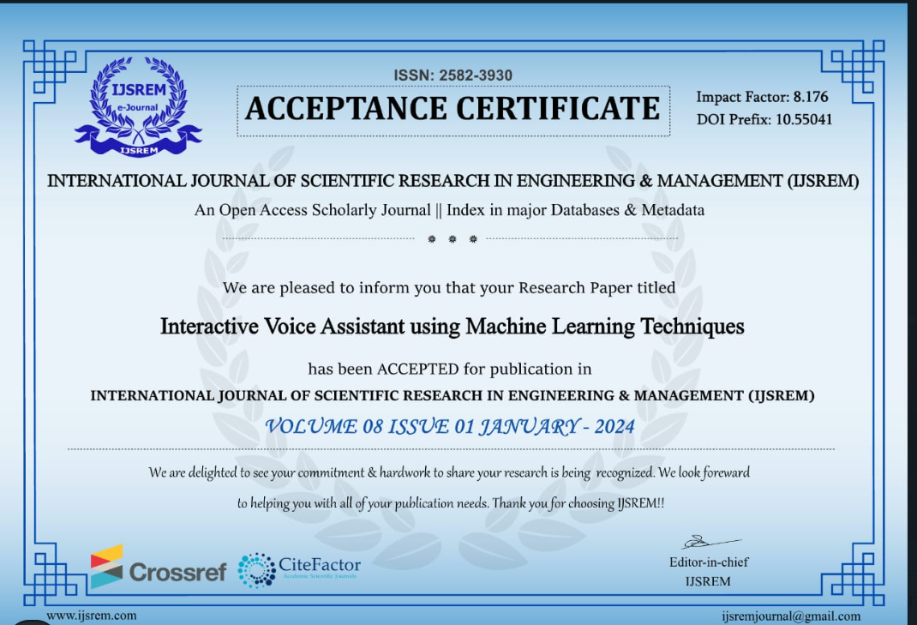
Publication Details
Research Paper ID : IJSREM28022
Published site : https://ijsrem.com/submit-research-paper-online/

Slide 14
Thank You

